Slide 1
Weekly report
11612126 李可明

Slide 2

Paper review
毕设
Code of upper bound and lower bound
kSPR:
“we say that a record dominates another if it is no less preferable in all dimensions and better in at least one. ”
kSPR:

Slide 3
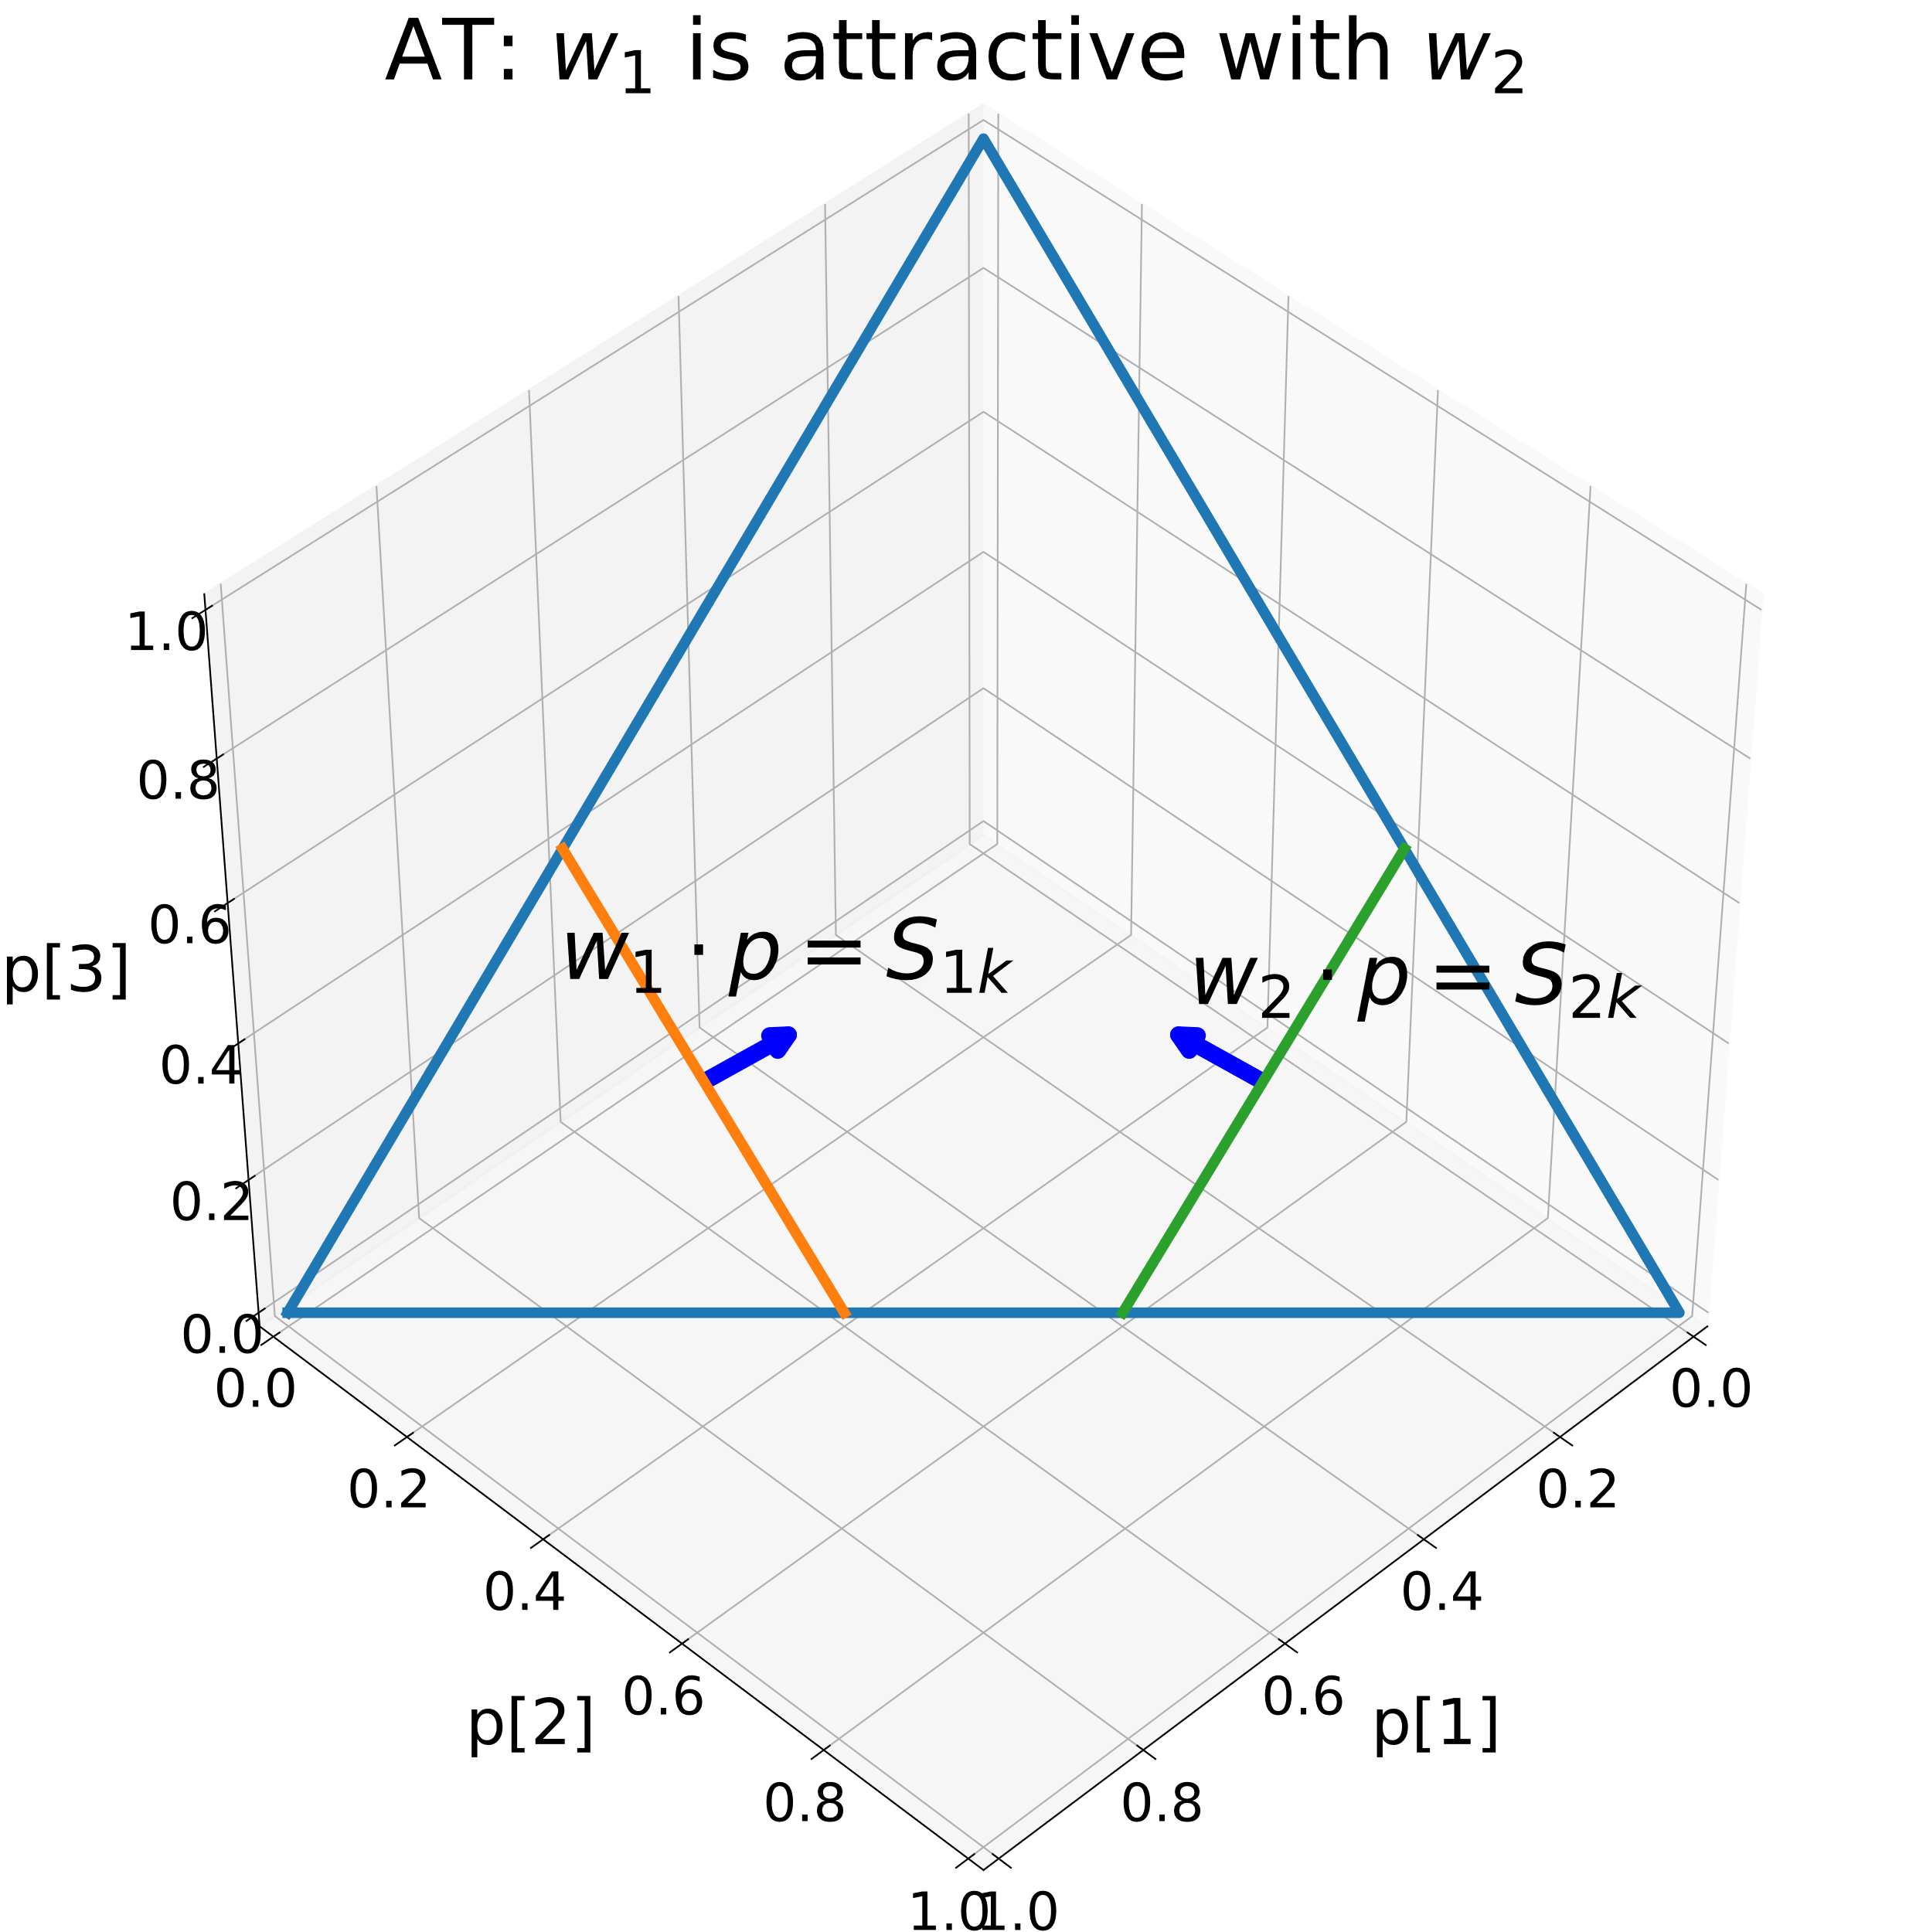
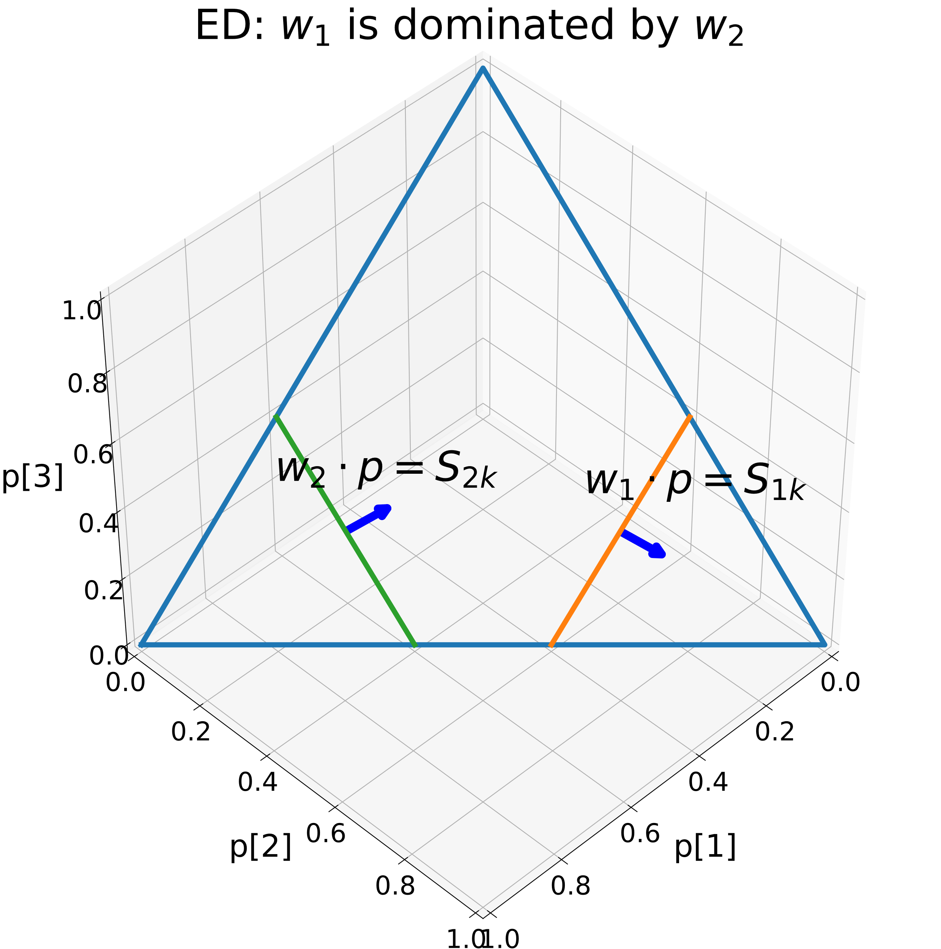
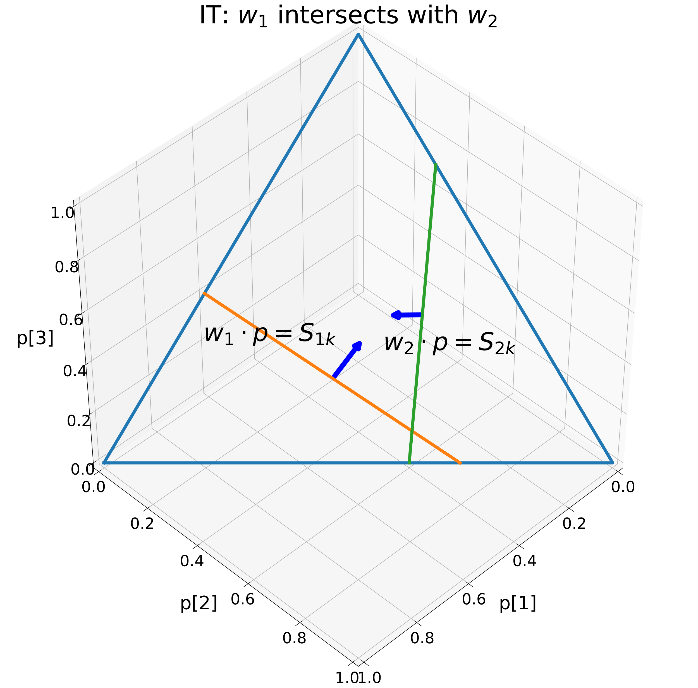
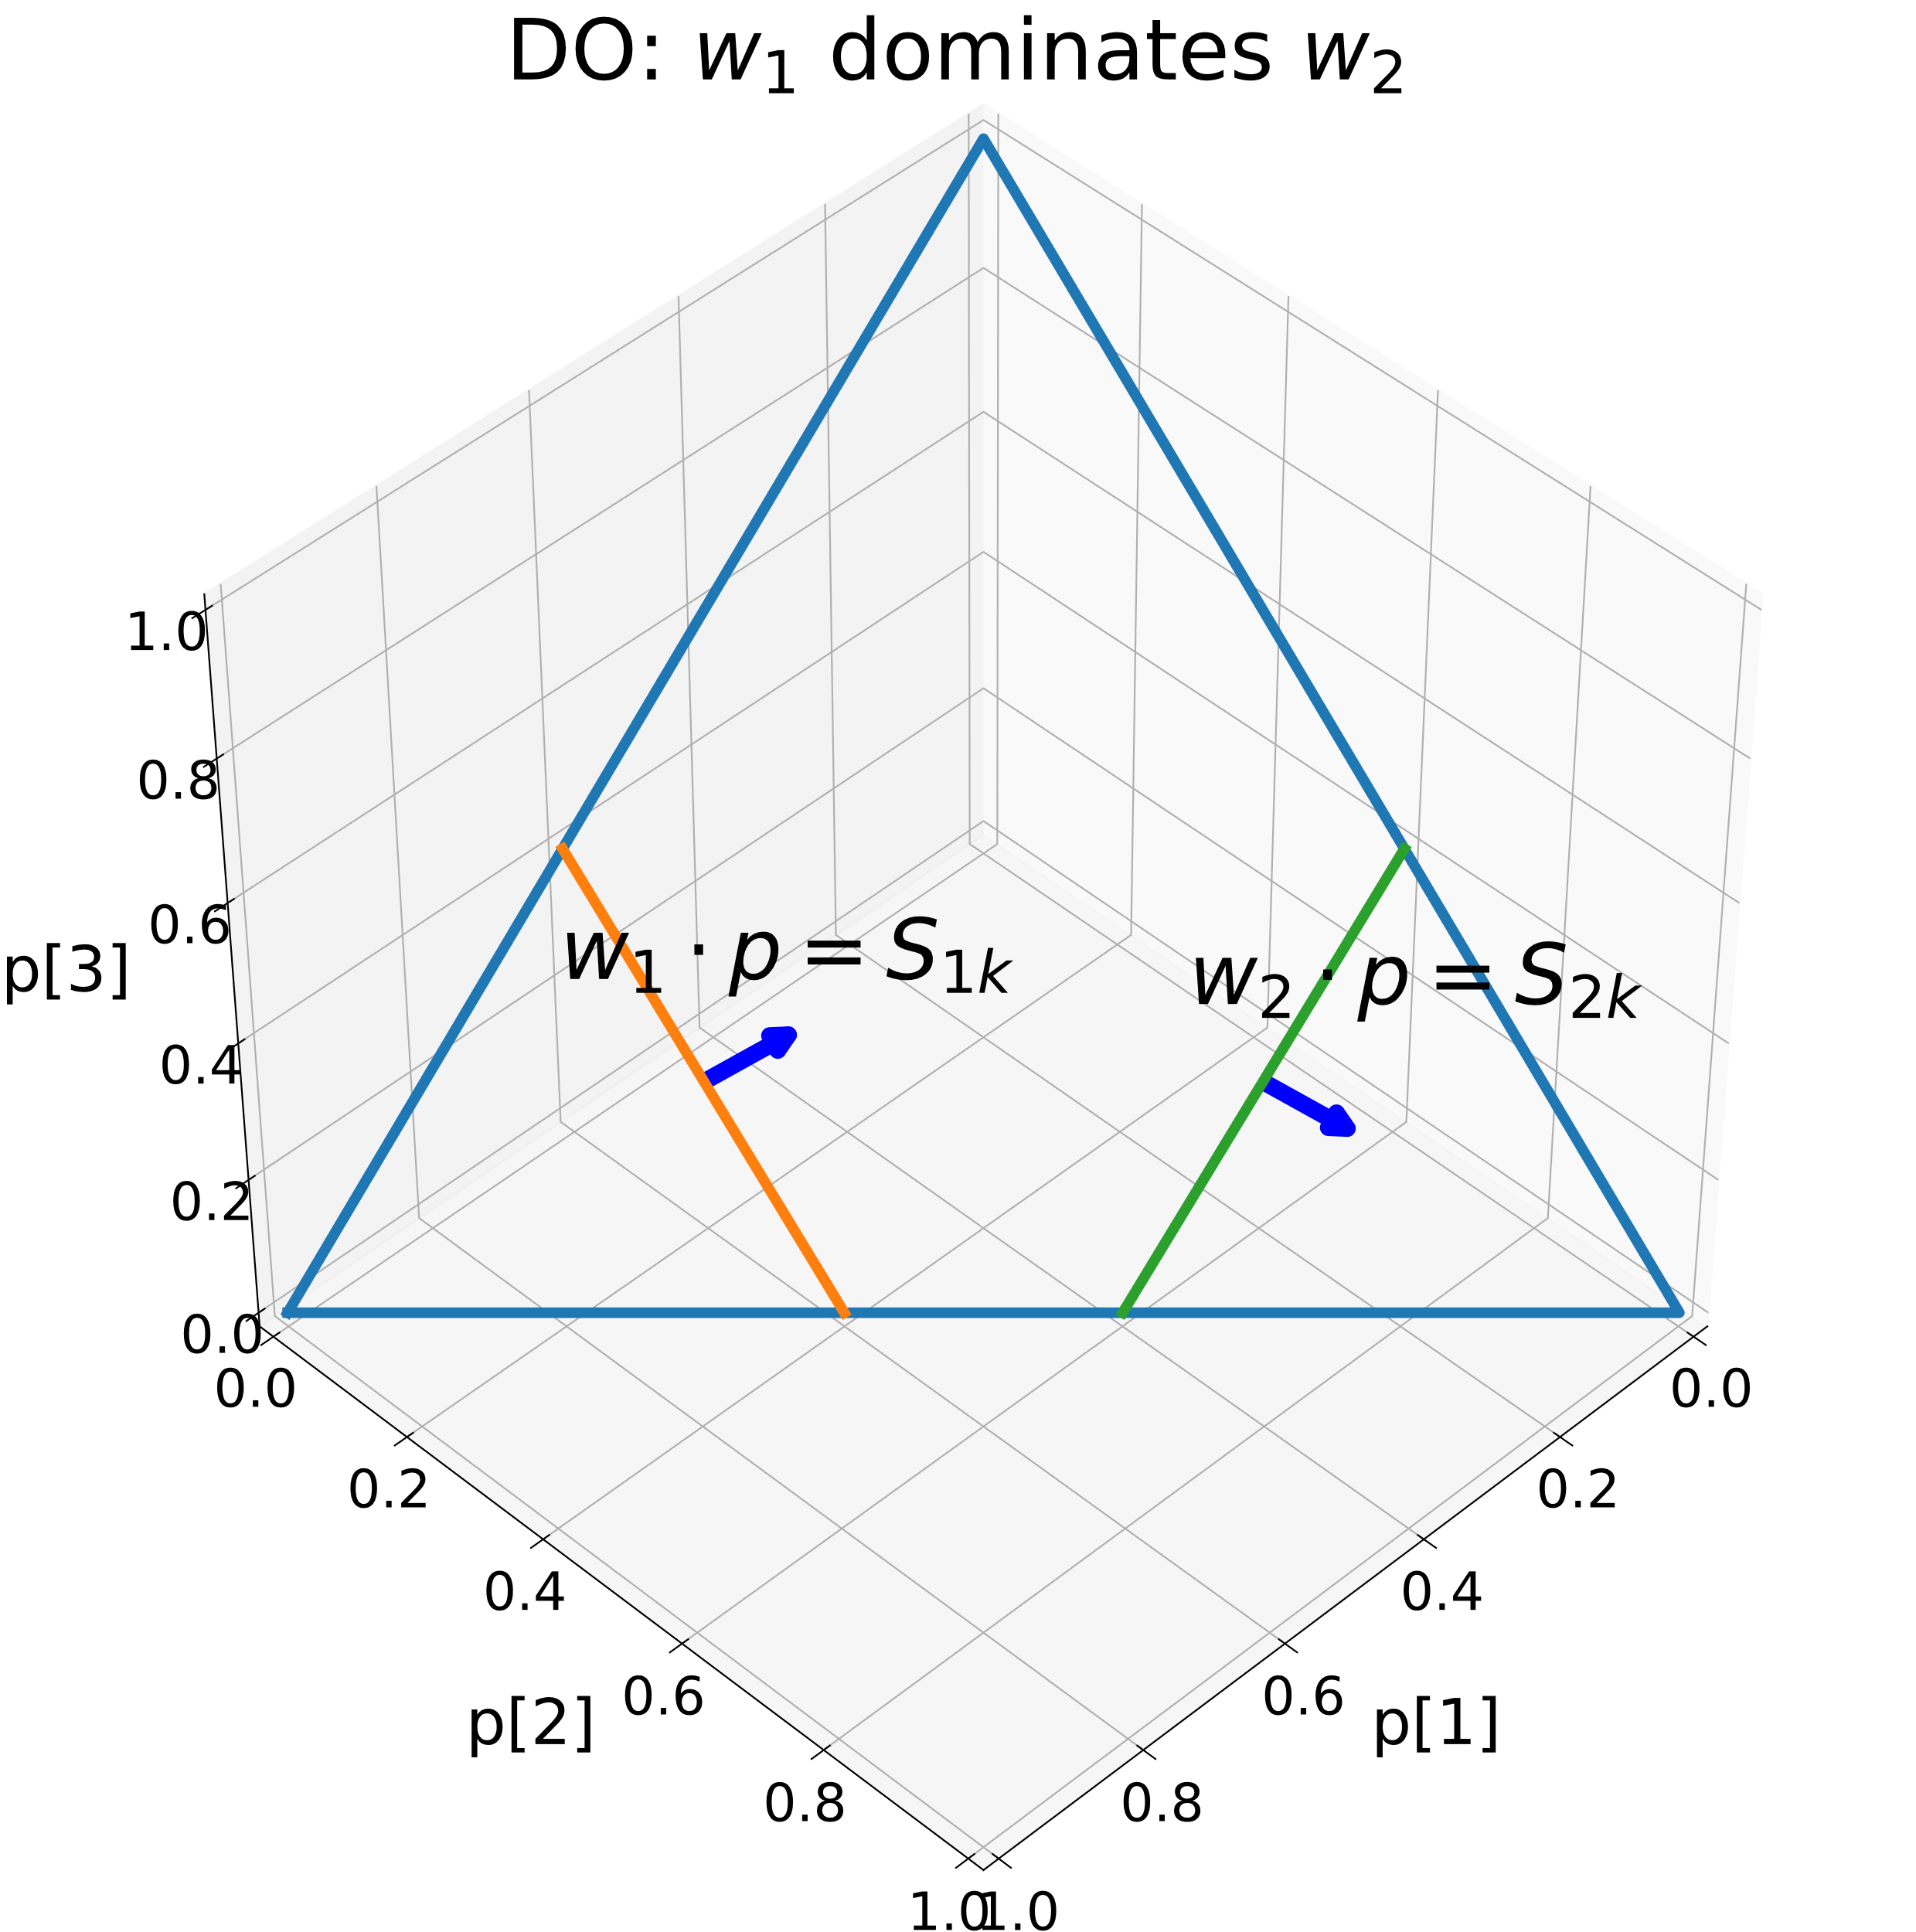
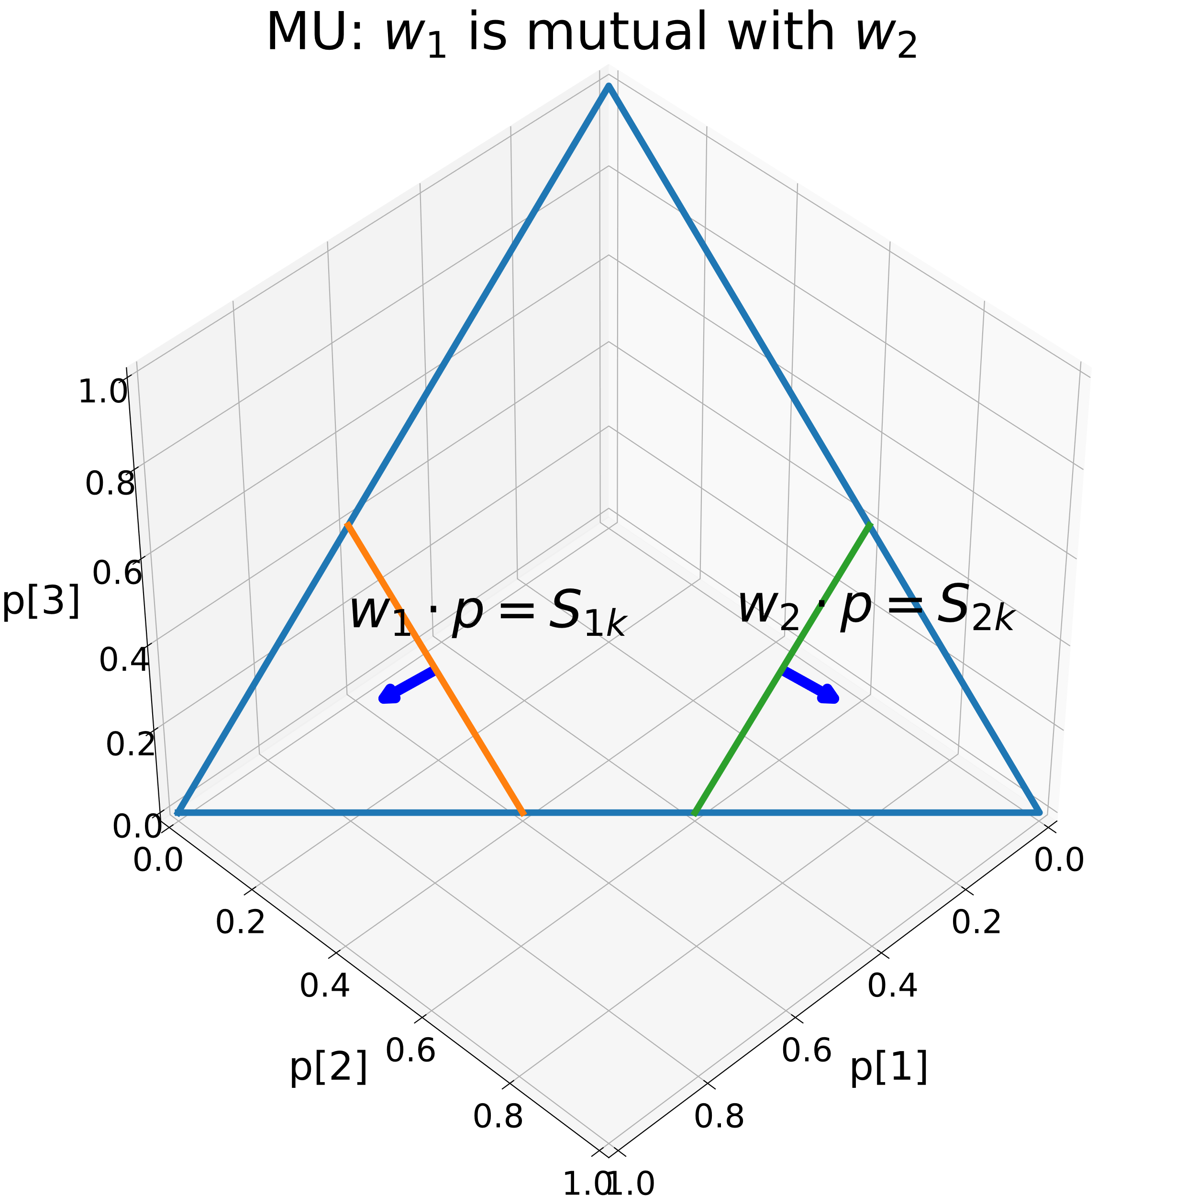
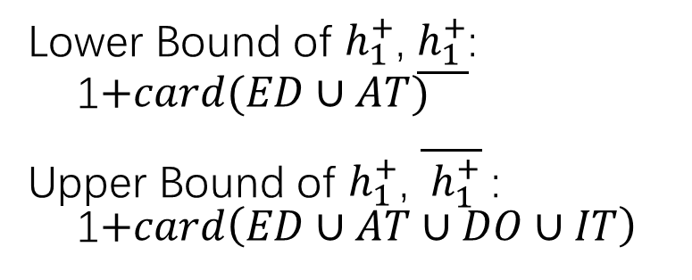
Lower Bound of $h_{1}^{+}$, $\underline{h_{1}^{+}}$:
1$+card(ED∪AT)$
Upper Bound of $h_{1}^{+}$, $\overline{ h_{1}^{+}}$:
1$+card\left(ED∪AT∪DO∪IT\right)$

Slide 4
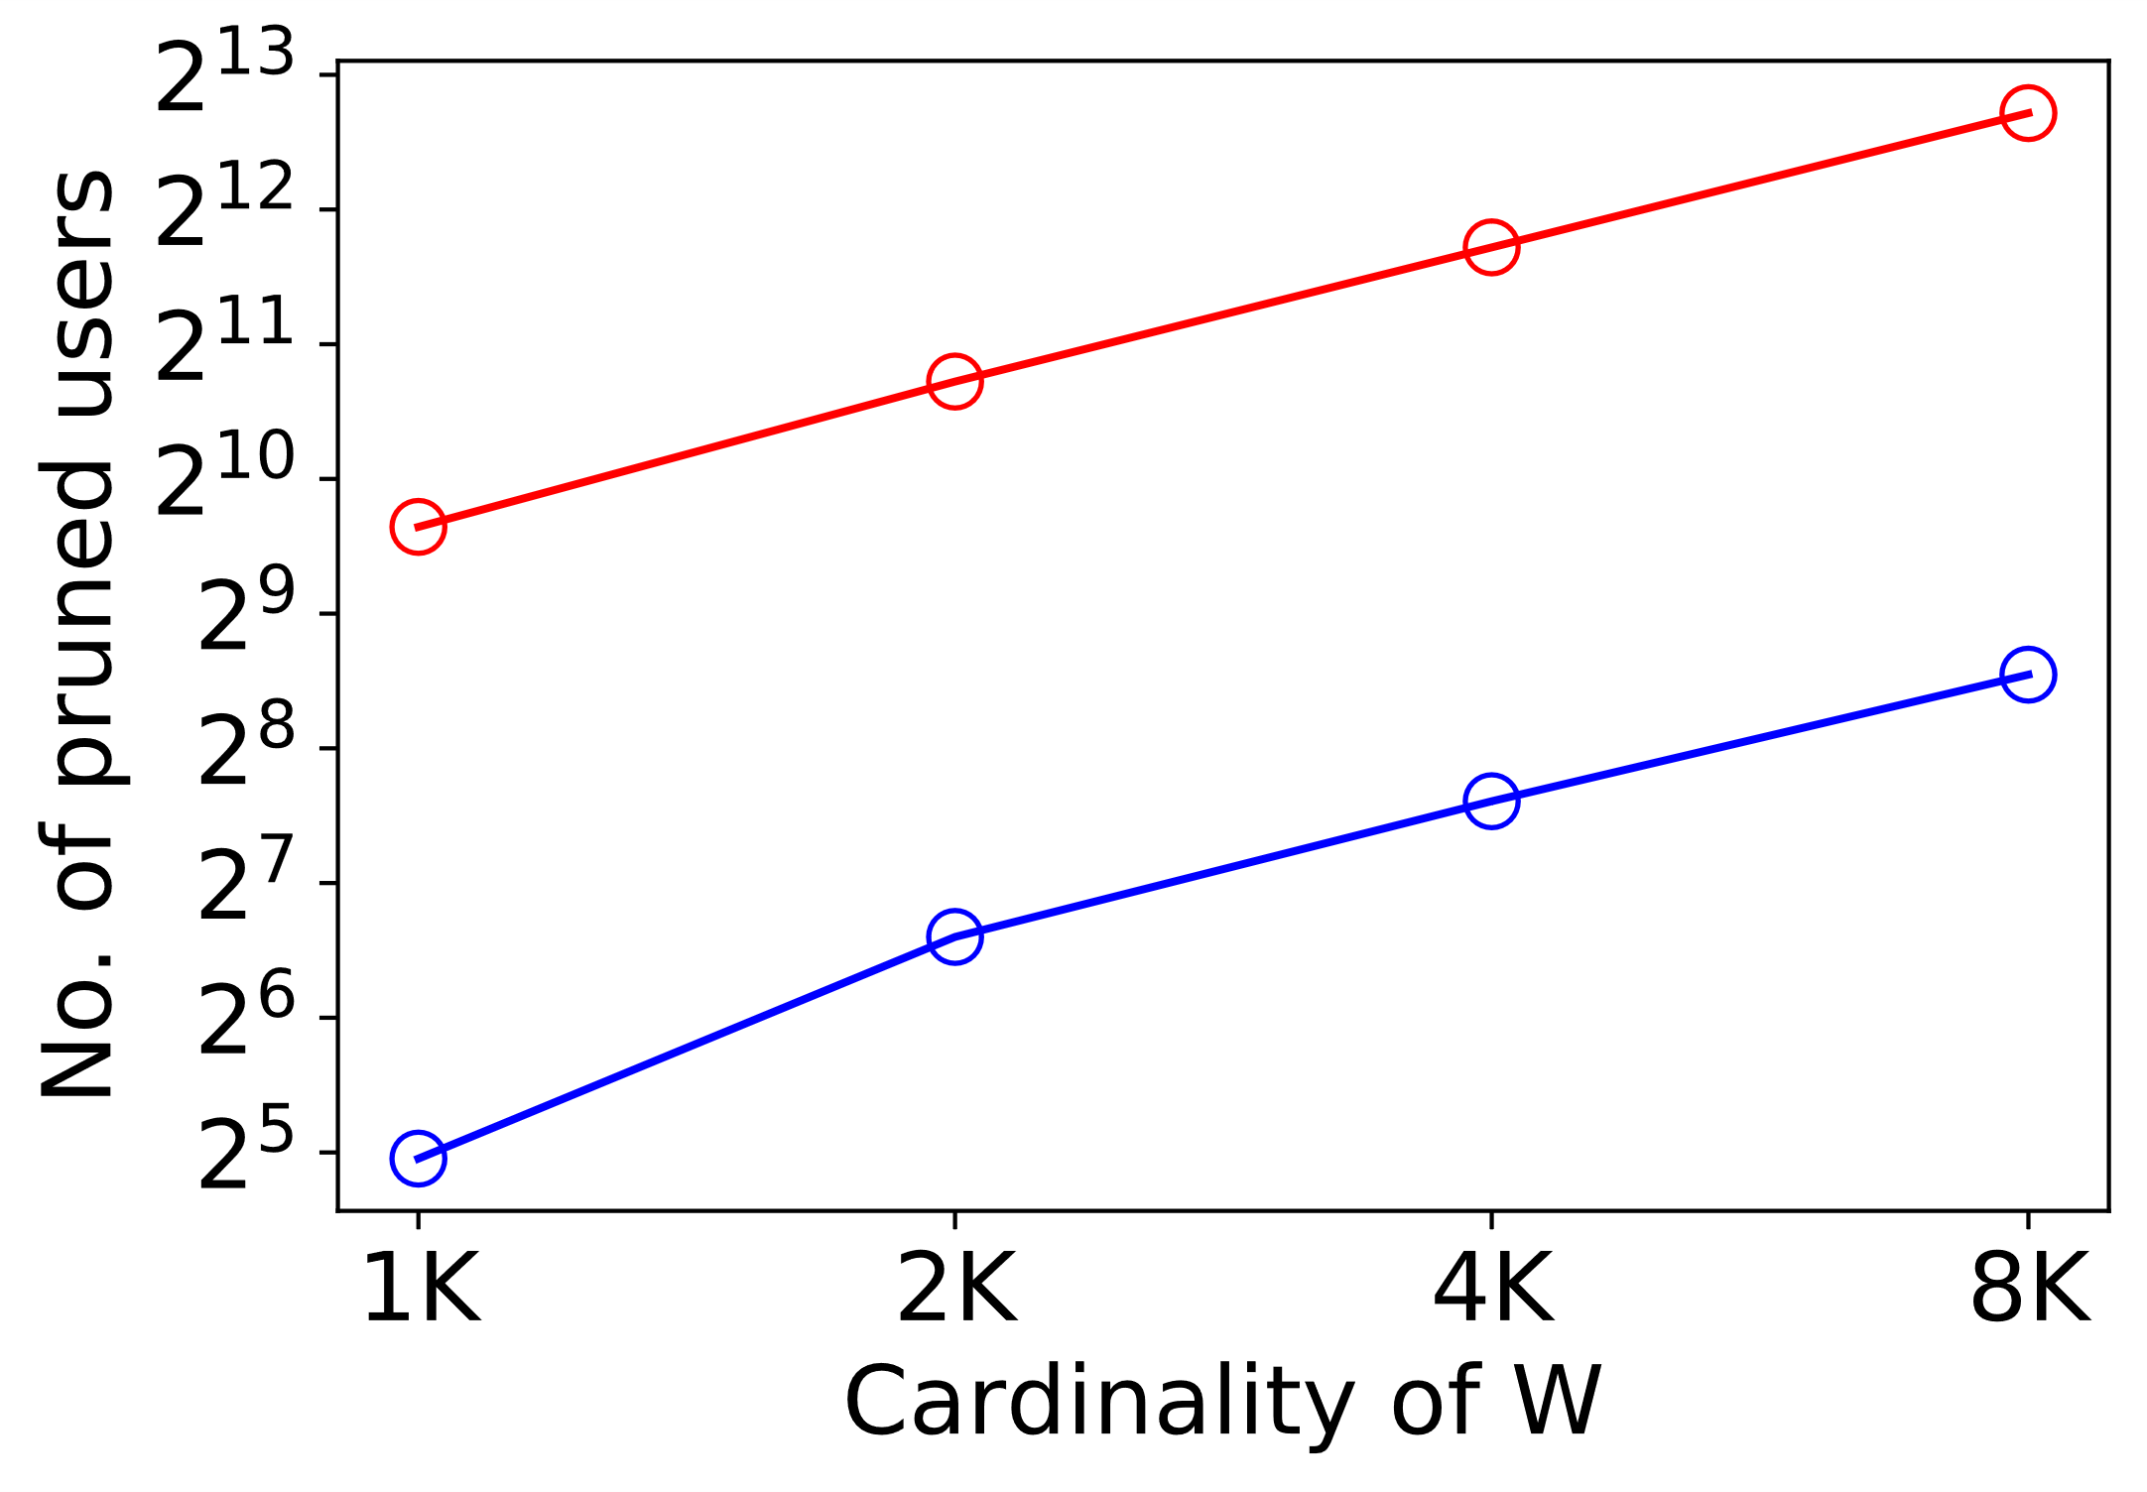
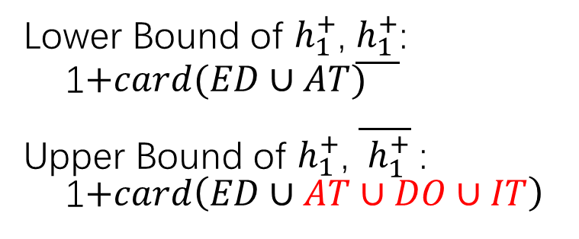
Lower Bound of $h_{1}^{+}$, $\underline{h_{1}^{+}}$:
1$+card(ED∪AT)$
Upper Bound of $h_{1}^{+}$, $\overline{ h_{1}^{+}}$:
1$+card\left(ED∪AT∪DO∪IT\right)$

Slide 5
TODO
kSPR
More stringent upper bounds and lower bounds
Code of 2

