Slide 1
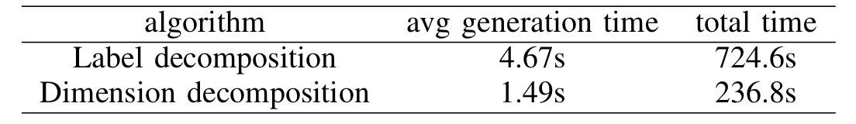
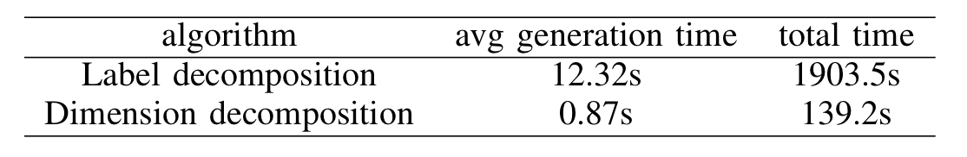
Decomposition algorithm
Label decomposition: each subpopulation size is 30, run 150 generations.
Dimensional decomposition: each subpopulation size is 100, run 150 generations.
Glass_table
wine_change_table

Slide 2
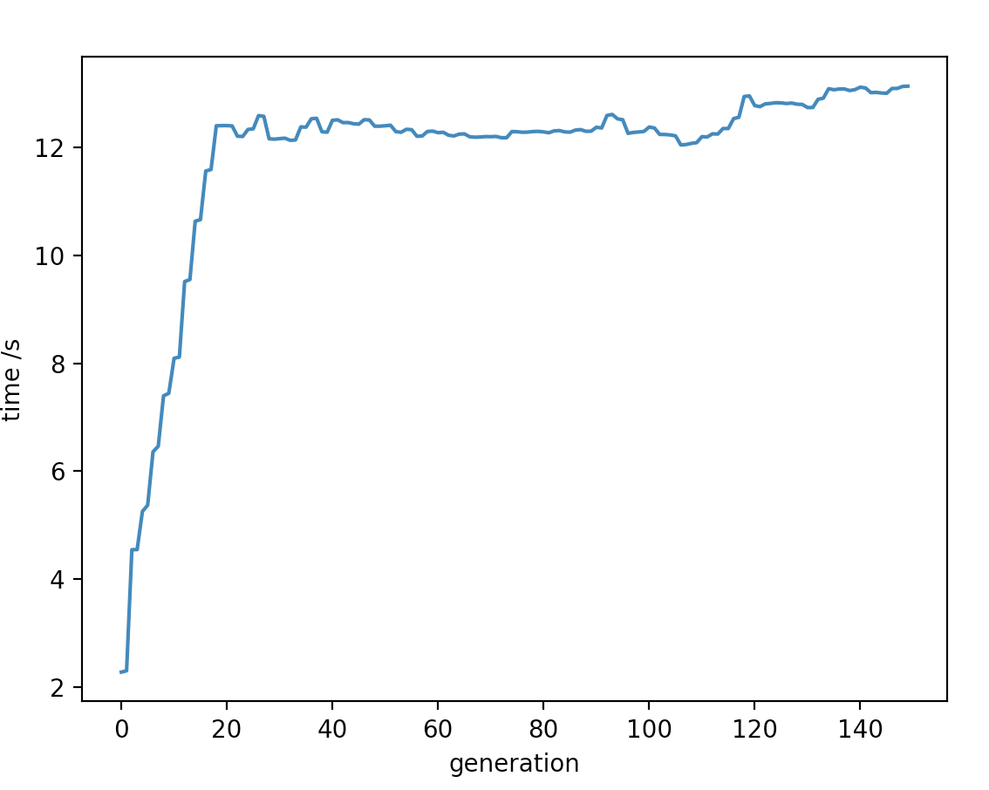
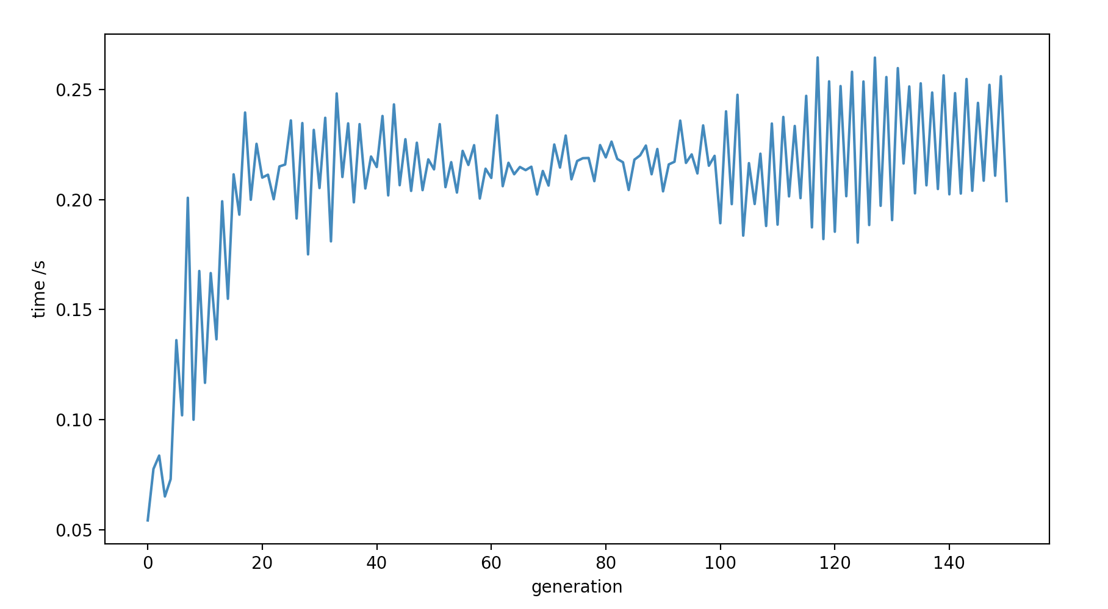
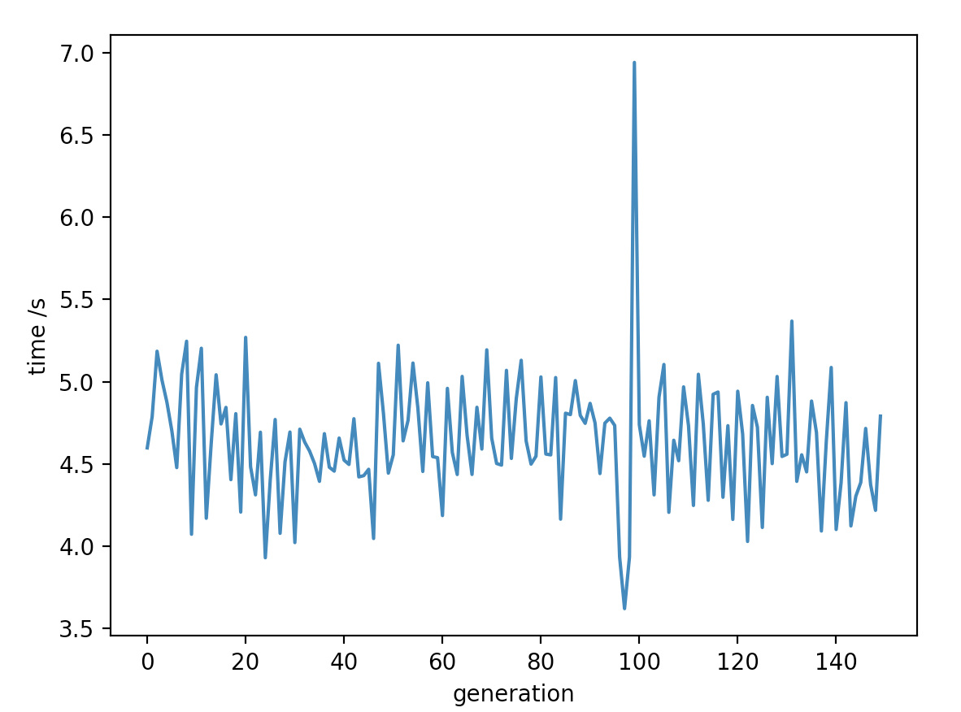
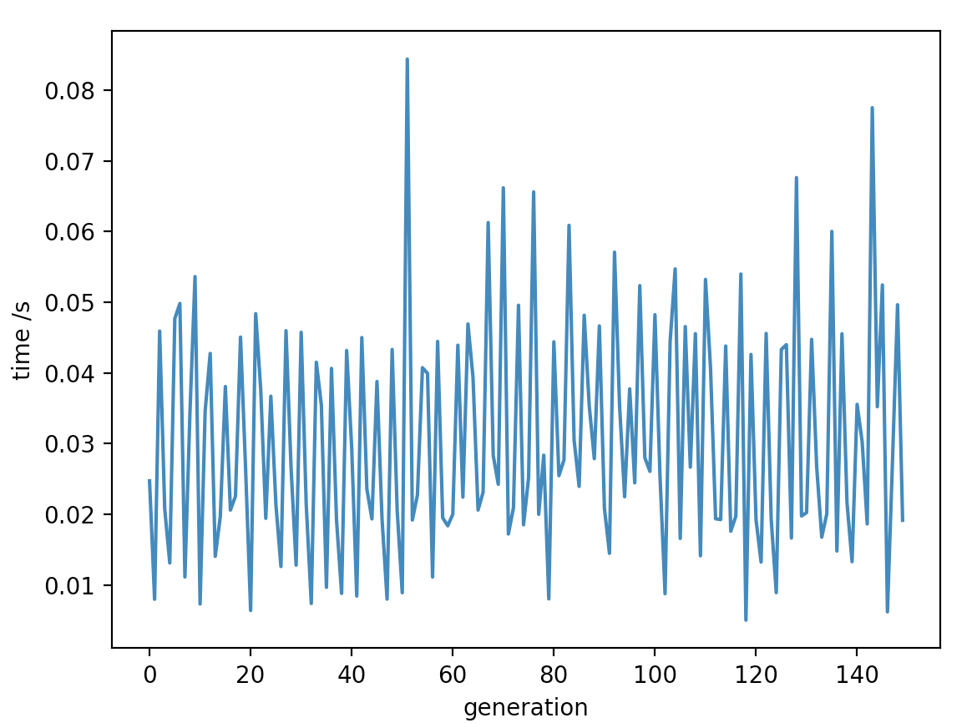
Label Decomposition
wine_change_generation_time
wine_change_communication_time
Glass_generation_time
Glass_communication_time

Slide 3
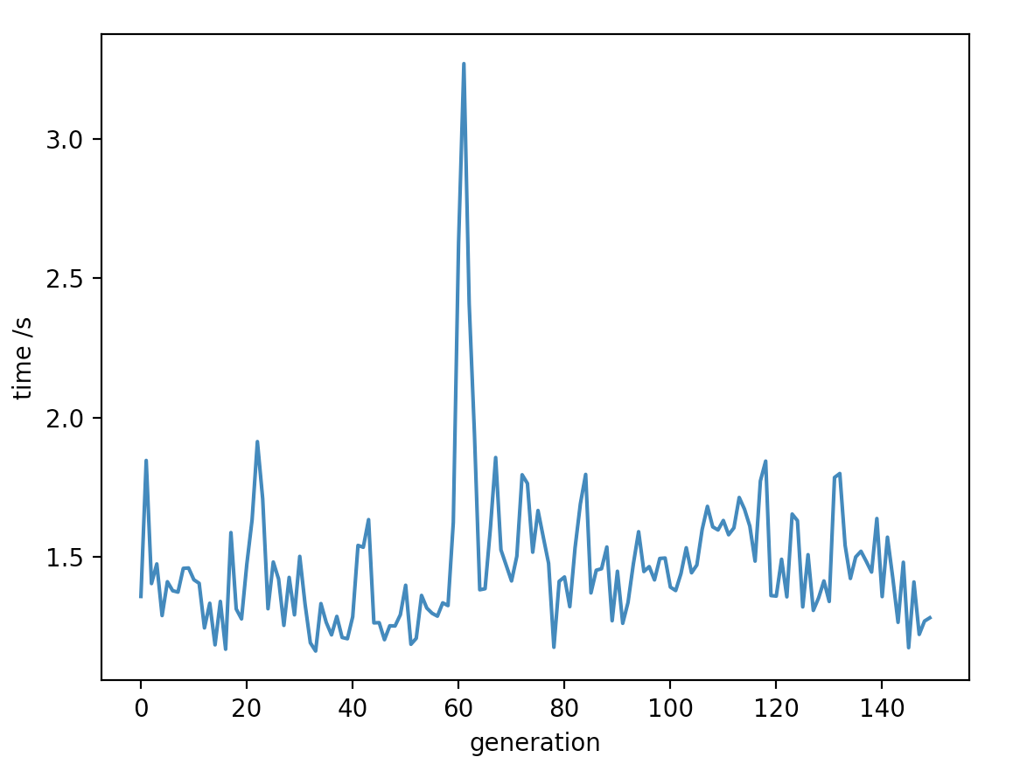
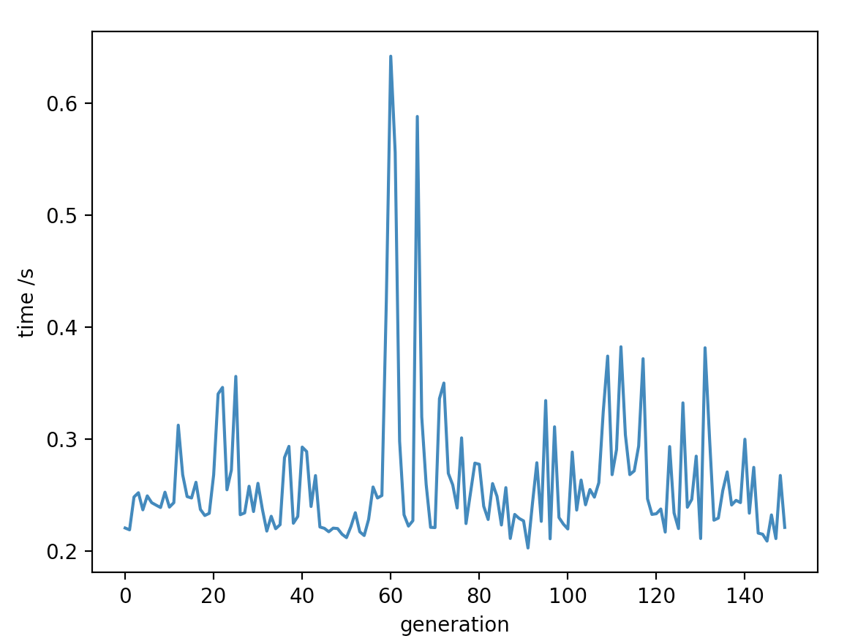
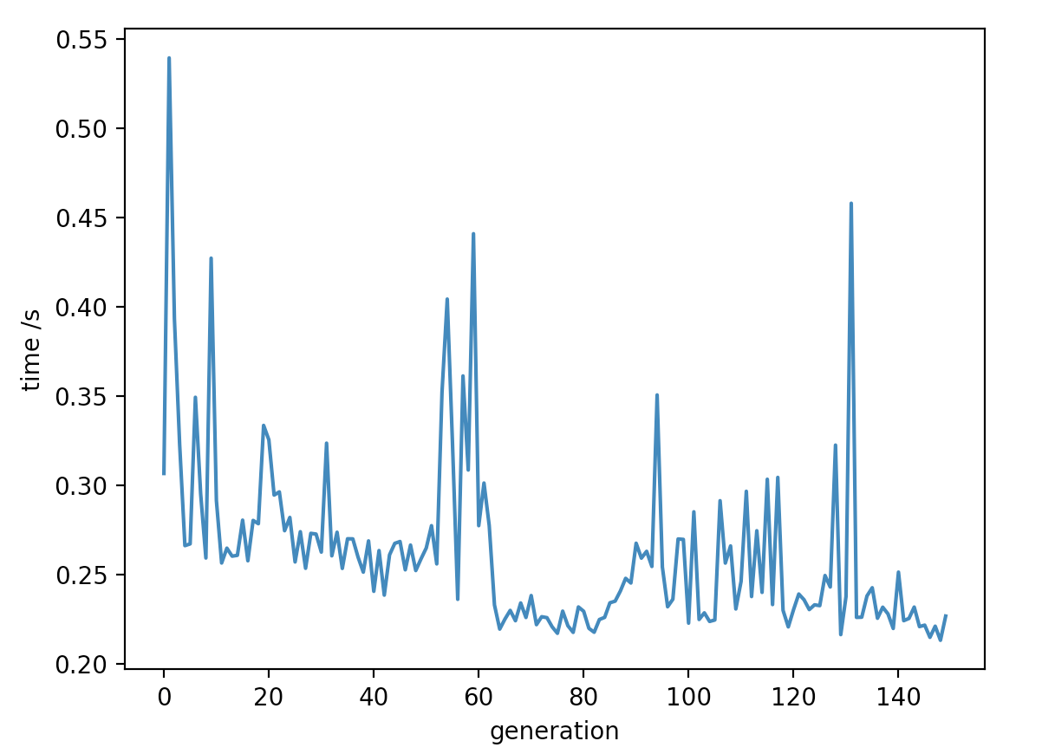
Dimension Decomposition
wine_change_generation_time
wine_change_communication_time
Glass_generation_time
Glass_communication_time

Slide 4
Analysis of experimental results and hypothesis
Analysis
1. label decomposition cost more time than dimension decomposition
2. Compared to the wine_change dataset and the glass dataset, the label decomposition takes less time and the dimension decomposition takes more time.
hypothesis
For label decomposition, the algorithm run faster in the multi-label dataset than in the small-label dataset when those datasets size and dimension are equal.

