Slide 1
AUTOMATIC LENS SMEAR
DETECTION
MADE BY –
JAIMEET PATEL
PRERNA KAPOOR
SOUHAM BISWAS

Slide 2
Introduction
Lens smear and other image artifacts are usually introduced in images in presence of occluding agents such as dirt, smudges,etc.
Usually such artifacts are difficult to detect as it’s visibility is prominent only in few images.
The project involves detecting the artifacts in image dataset. In several scenarios, it is impossible to clear the camera screen such as underwater cameras or if the images are already captured.

Slide 3
PHYSICS BEHIND DETECTING
SMEARS:
In our case, smears are barely seen in dataset of images, as mostly it is camouflaged by clouds or incase where the car is moving through the tunnel.
With our visual observation, we concluded that smears are visible only when the car is in transition from tunnel to open road.
The main reason for visibility of smear in this case is as the exposure of camera lens if perfect enough to get the focused image in which the smear are visible because of having darker background (tunnel).

Slide 4
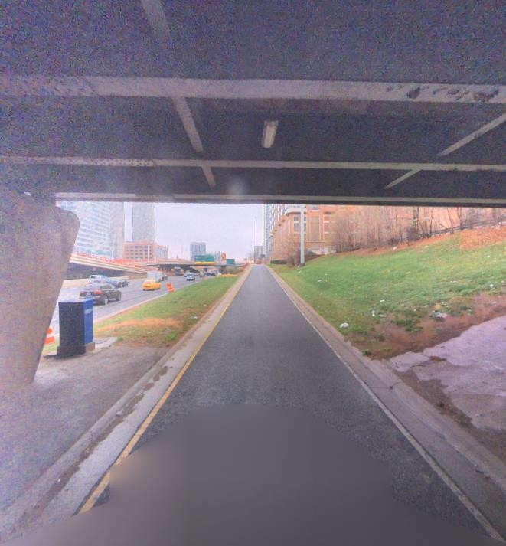
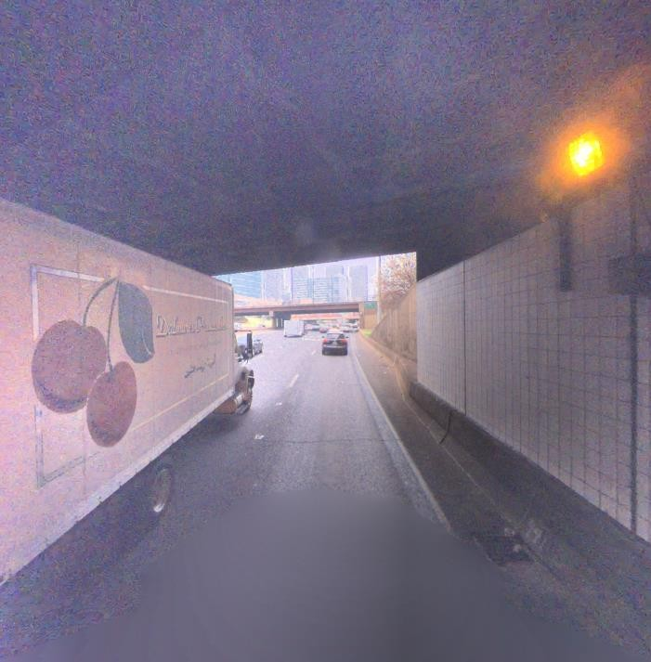
Smear Visibility while leaving Tunnel
m

Slide 5
METHOD:
Usually while dealing with images, it is important to filter out the data which can lead us to important features(eg: smears).
As per our theory, smears apper in the image while the care is in transition from tunnel to open road.
We detected a line with (theata = -30 to +30) which is assumed to be a tunnel transition.
To particularly pick the images, we set condition which checks the upper portion to be drk and the bottem part to be brighter based on the mean value.
After creating new database, we will use our main algorithm to detect the smears.

Slide 6
Algorithm:
Stack all images in 3D format.
Find min and max pixels at each location over all the images for each channel.
Subtract minimum pixel map from the maximum pixel map to get the attenuation map.
Convert RGB attenuation map to grayscale.
From the grayscale image we obtain the histogram of the image, with 40 bins.
From the histogram obtained ,we find out threshold such that only the smears are highlighted.
Method to find Threshold: We find the point in histogram where the fraction of increase in the count of pixels within 2 adjacent bins is the highest; this gives us the threshold.
After binarizing the image using this threshold, we isolate the smears by imposing specific contour area/ perimeter constraints(Binarizing is immediately followed by contour detection )

Slide 7
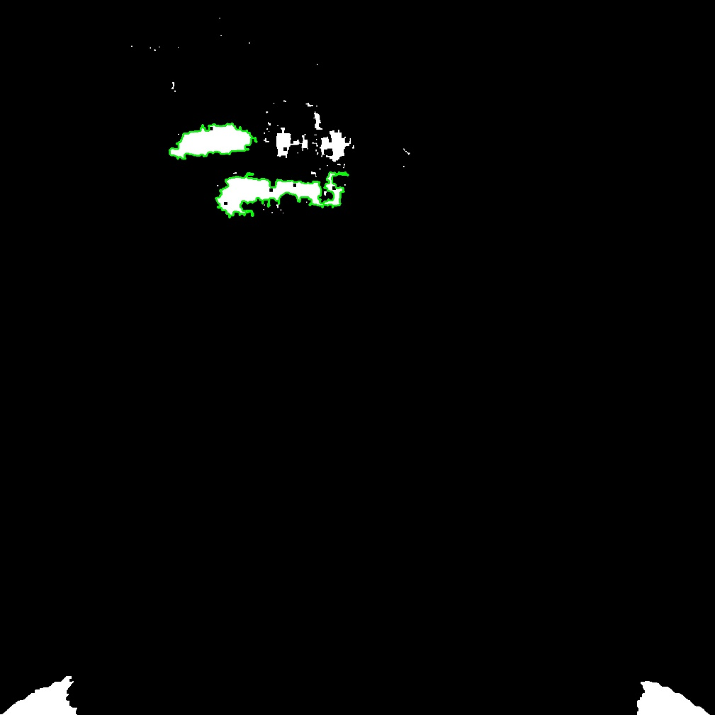
Results of camera 1 (Smear Contours Highlighted)

Slide 8
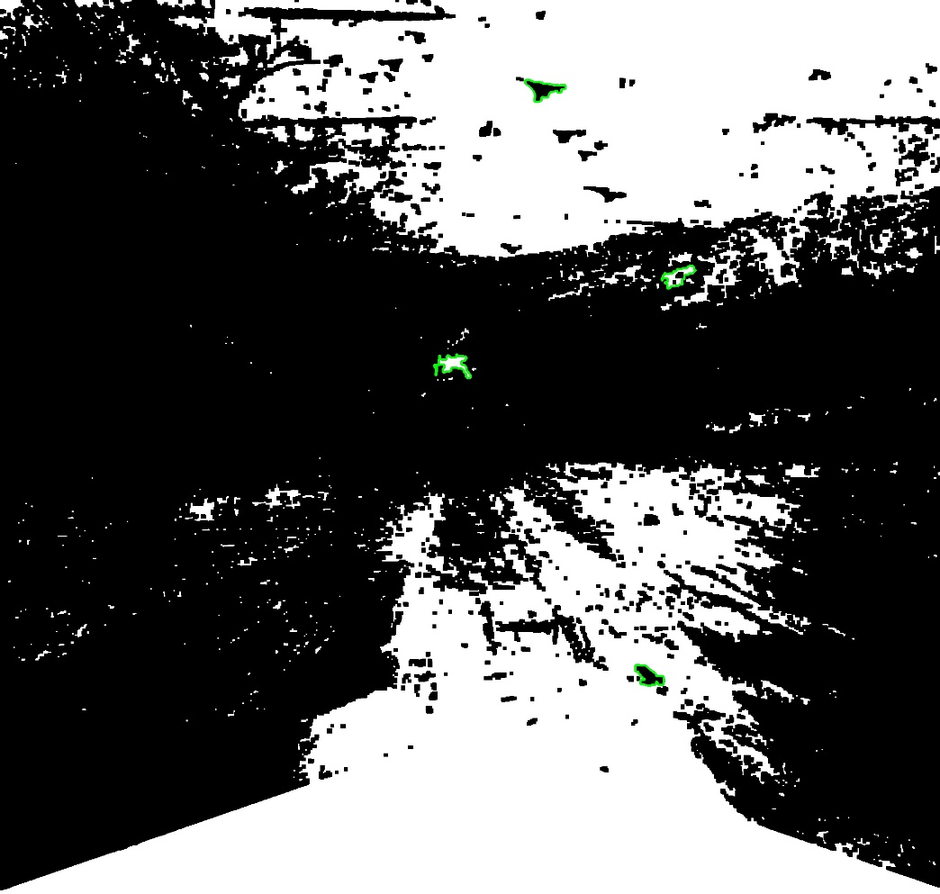
Results of camera 2 (Smear Contours Highlighted)

Slide 9
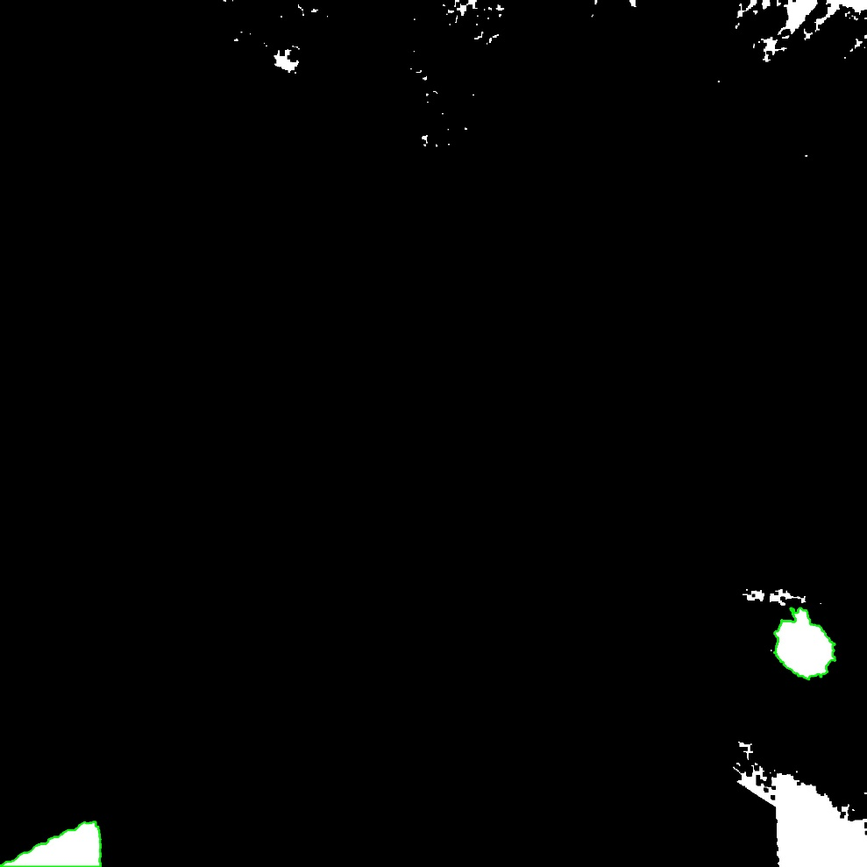
Results of camera 3 (Smear Contours Highlighted)

Slide 10
ANOTHER APPROACH
Smear are present in all images , but may not be visible with naked eyes in all cases.
The region of lens which has smear will have its effect
throughout the database and hence it will have less variance.
After stacking all the images and creating 3D matrix.We can mean measure the variance of each pixel and cluster each of the pixel and detect the smear.
Only, drawback in this method is that it will also detect the masked content of an image.

Slide 11
REFERENCES:
[1] - -"Removing Image Artifacts Due to Dirty Camera Lenses and Thin Occluders," J. Gu, R. Ramamoorthi, P.N. Belhumeur and S.K. Nayar.
Digital Image Processing, by Rafael C. Gonzalez.
Open CV Documentation.

