Slide 1
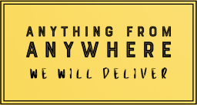
Goods Delivery System
Sujay Sunil Ghodke (001090197)

Slide 2
Real Problem
Different apps for delivery of each type of goods
Difficult to keep track of all orders
Lack of platform for local shops selling non-consumables

Slide 3
Proposed Solution
Single stop for all types of products from local stores
Connecting platforms, delivery companies with stores
Buy anything, sell anything

Slide 4
Customer - Choose store and place new orders or cancel eligible orders
Store - Add/update/delete items from inventory - Receive orders and mark them ready - Purchase items to stock up inventory - Manage store finances
Delivery - Pick customer placed orders for delivery - Mark them completed once delivered
Platform - Manage platform finances - Approve/reject store money requests
Approach

Slide 5
Design
Customer
Network
Store
Platform
Delivery
Store Manager
Inventory
Purchase
Store-Finance
Platform Manager
Platform-Finance
Delivery Manager
Delivery Company

Slide 6
Enterprises
Customer
Store
Platform
Delivery

Slide 7
Organizations
Store Manager
Inventory
Purchase
Store Finance
Platform Manager
Platform Finance
Delivery Manager
Delivery Company
Customer

Slide 8
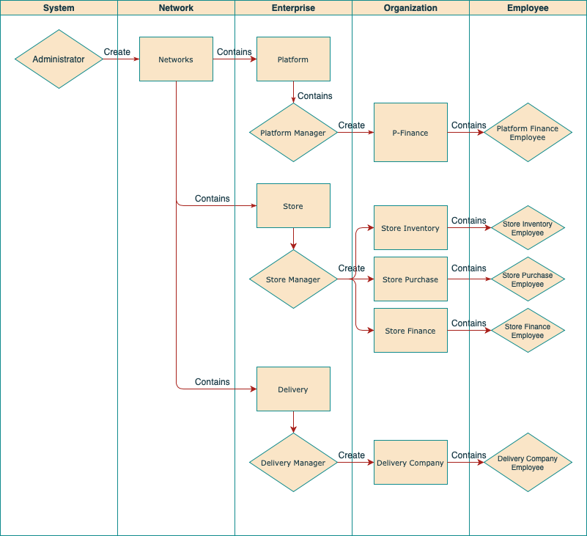
Workflow
1. Manage Employees

Slide 9
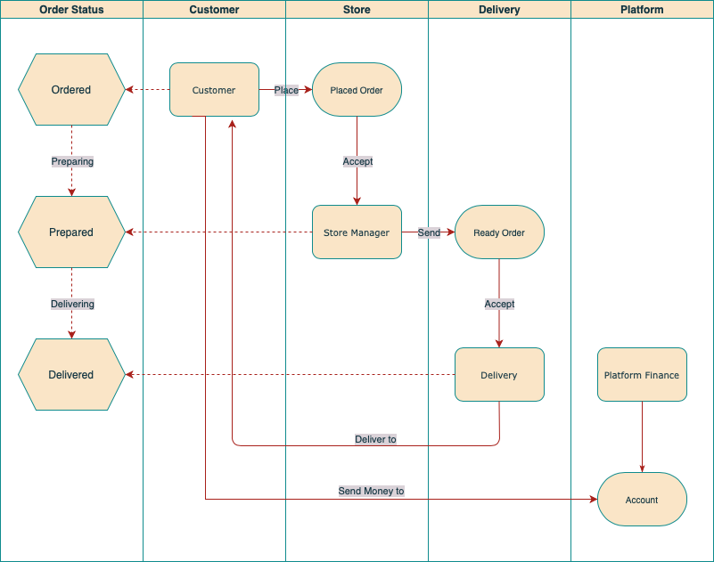
Workflow
2. Place Order

Slide 10
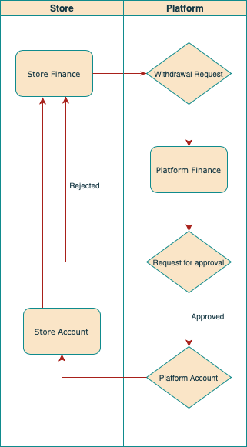
Workflow
3. Withdraw Profit

Slide 11
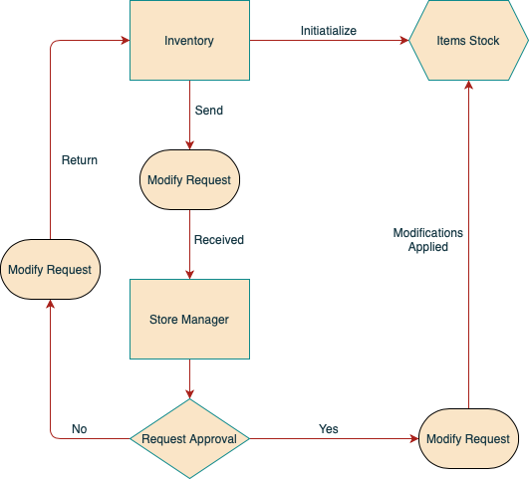
Workflow
4. Inventory Items Management

Slide 12
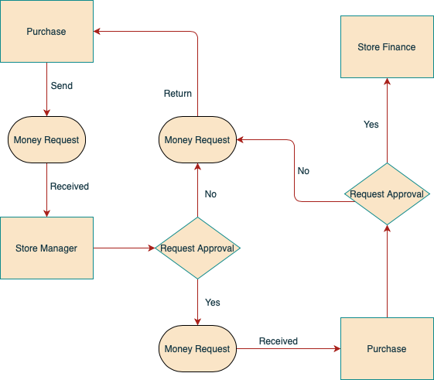
Workflow
5. Purchase for stocking up

Slide 13
Use Case Scenario
Network: Austin
Stores: HEB, BestBuy
Platform: ADunzo
Delivery: ATXDelivery
Network: Boston
Stores: Wollaston, Trek
Platform: BDunzo
Delivery: BOSDelivery

Slide 14
Thank You!

