Slide 1

Learning React.js by example
Joel Nylund @jnylund
Jeff Schuman @jschuman72
@SolutionStreet
Notes:
Introduce us,
Joel Nylund – Managing Partner
Jeff Schuman – SR Software Developer
Mention my blog article--- if this peaks your interest,

Slide 2
Agenda
JavaScript Revolution
React.js
Example App
Walk through the code
Adding npm & webpack
Adding es6
Adding a flux implementation (redux)
Review
Notes:
Introduction to react to give you the flavor of what is is like and why it is used…. If you come out of this confused…that is normal…
19 seconds

Slide 3
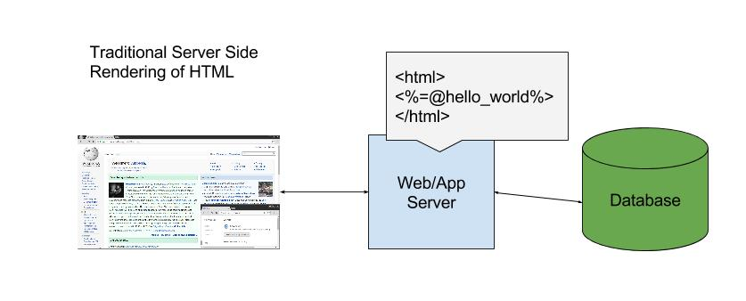

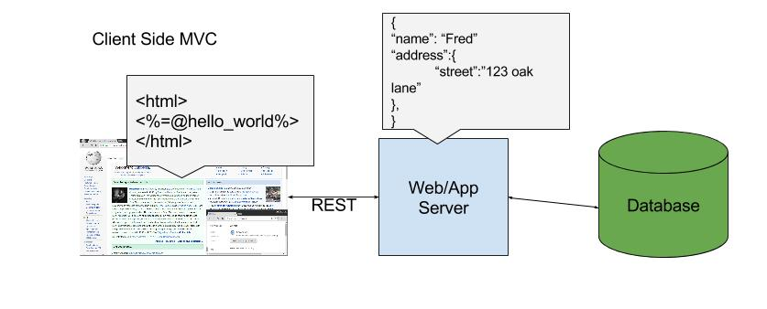

JavaScript Revolution
Notes:
If you would have asked me 8 years ago, was javascript the future….I would have laughed…
Migration from server side rendering to client side rendering.
Thin client vs fat client….history repeats itself…..
So what do we get from all this???? Maybe better single page apps? Maybe using the language the browser speaks? But the main thing is simpler state management on the client……..(more on next page).
Downside – anyone can have my client code (although maybe I can minify)….more layers…confusion…
37 seconds

Slide 4
React.js
A JavaScript library for building user interfaces
Just the UI
Lots of people use React as the V in MVC. Since React makes no assumptions about the rest of your technology stack, it's easy to try it out on a small feature in an existing project.
Virtual Dom
React abstracts away the DOM from you, giving a simpler programming model and better performance. React can also render on the server using Node, and it can power native apps using React Native.
Data Flow
React implements one-way reactive data flow which reduces boilerplate and is easier to reason about than traditional data binding.
https://facebook.github.io/react/
Notes:
Invented by facebook, reason is their developers were having trouble keeping things like the notification counts in sync, (add one, remove one…etc)
Key “aha” is don’t worry about your view and how to update it , when where if, just layout your components and react will take care of the rendering efficiently (virtual dom)
41 seconds

Slide 5
Business Case
Unfuddle is a great Project/Code Management Tool
It has 100 ways to get reports on Tickets
It has 1 way to get reports on Activities
We want to get reports of activities worked on by developers during an iteration, so we need ways to filter by:
Date Start & Date Stop
Activity Type
User
Sometimes specific sub activity types (closed or resolved)
Notes:
Explain breakdown of components
Explain how you would do this in jquery, then talk at a high level of how you would do it in react.
52 seconds

Slide 6
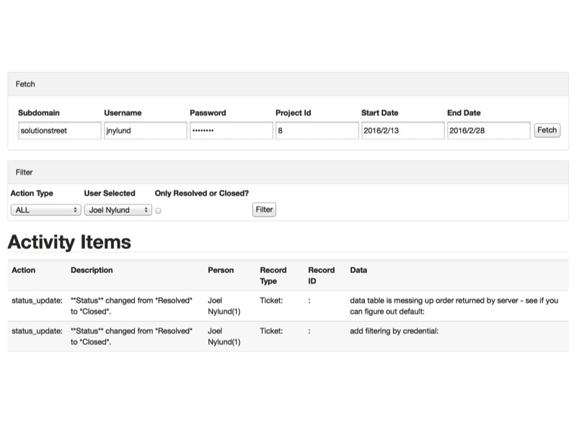
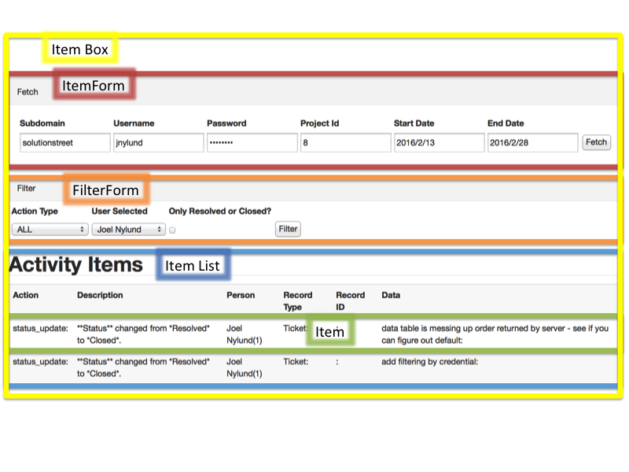
Example App
Notes:
Go through the UI, each piece
Now show components…..thinking in React…this is how we think of things as components made up of other components…
ItemBox contains all the other components, outer most component
Item is the smallest component, made up of a few pieces of data, to render an item, you just need to know it is a row and each cell is a string….
54 seconds

Slide 7
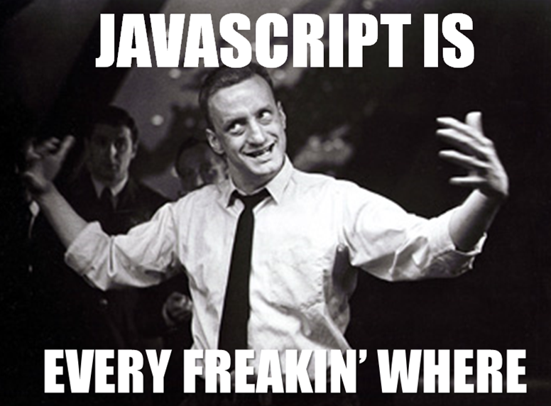
Code Walkthrough
Demo of basic code
Notes:
Go to index.html file and point out content div where everything is going to end up
Go to unfuddleactivity.js and go to bottom, talk quickly about jsx ----- jsx is html like xml where components can be elements --- and how we render to the div
Show picture again (talk about item) and then Go to line 3, and look at Item, talk about it being the smallest component and how it is rendered from state that is set by other components (ItemList), all it is is a few string fields
Go to line 49 and talk about ItemList and how it gets props, don’t have time to talk about how everything works, focus is on how things are rendered
Go to line 418 ItemBox sets its state and then passes it as props to the ItemList to rerender.
- Go to line 308 – load items
Go to line 361 – set state (setting state is the mechanism on which you force a rerendering of a component. Because of the virtual dom it doesn’t have to be expensive…
7 minutes + 4 secs
Components/Properties/State

Slide 8

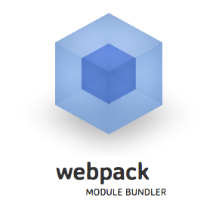
Adding NPM & Webpack
NPM - is the package manager for JavaScript. Find, share, and reuse packages of code from hundreds of thousands of developers — and assemble them in powerful new ways.
react
babel
jquery
bundle.js
Item.jsx
ItemBox.jsx
ItemList.jsx
Webpack - webpack takes modules with dependencies and generates static assets representing those modules.
Notes:
2 minutes

Slide 9
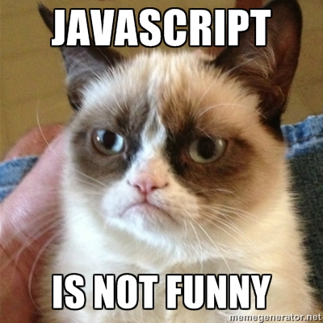
Code Walkthrough (of NPM & Wepack code)
Demo of npm code
Notes:
Talk about each component and how they are now in their own file
Also show how they each depend on what they need
Also show index.html file now has no libraries included
Components/Properties/State

Slide 10
Adding es6
Different ways to the way you define React.js components
// Old Way:
var Item = React.createClass({
removeRecord: function(e){
this.props.handleItemRemove(this);
},
render: function() {
-------------------------------------------------------------------------------------------------------
// New Way
class Item extends React.component {
render() {
https://babeljs.io/blog/2015/06/07/react-on-es6-plus
Notes:
51 seconds

Slide 11
Flux/Redux
When you get into complex React.js applications managing data becomes more important.
The most important things for you to understand in this introduction are:
Flux – Data flow architecture designed by Facebook
There are many implementations of Flux, some conform the spec better than others.
Redux seems to be gaining popularity right right now.. It doesn’t completely conform to the spec, but is very simple and easy to learn.
Flux is NOT MVC, it is different, read more here - https://medium.com/hacking-and-gonzo/flux-vs-mvc-design-patterns-57b28c0f71b7#.h1ouvy70v

Slide 12

Review
Overview of React
Sample Application
Components, State & Properties
NPM & Webpack, ES6
Flux/Redux
Questions?
Blog article here - http://www.solutionstreet.com/blog/learning-react-js-by-example/#.VyNYVddT7ug
We are Hiring!
Enter our Raffle

