Slide 1
Content Aware Photo Enhancement
George Hoersting
george.hoersting@us.sogeti.com
Link to README.html

Slide 2
Topics:
Content Aware Seam Removal
Content Aware Automatic Photo Enhancement

Slide 3
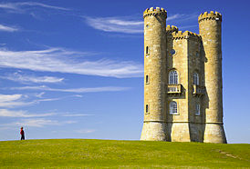
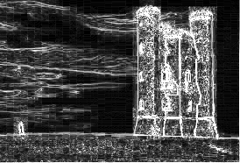

Content Aware – Seam Removal
Image
Compute Energy of image
Image Energy
=

Slide 4
Content Aware – Seam Removal
Image
Compute Energy of image
Image Energy
=

Slide 5
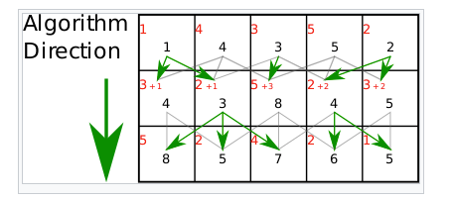



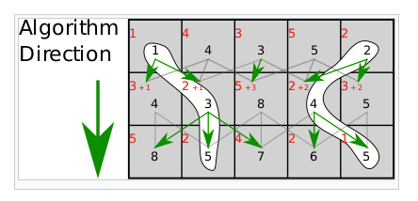

Content Aware – Seam Removal
Horizontal Seam
Identify Minimal Seams
Vertical Seam
Optimal Seam
Find Optimal Seam
Cumulative Energy Matrix

Slide 6
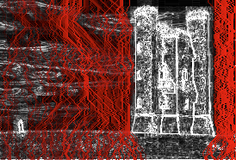
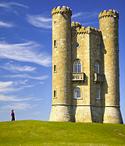
Content Aware – Seam Removal
Minimal Vertical Seams
Image With Seams Removed

Slide 7
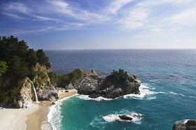
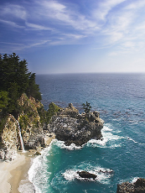
Content Aware – Seam Removal
Dynamic removal of Vertical Seams.
Description:
The Vertical Seams Here are dynamically removed
In order to remove the lowest energy seam each iteration
Until a target width is hit.
Input Image
Output Image
Link to Jupyter Notebook

Slide 8
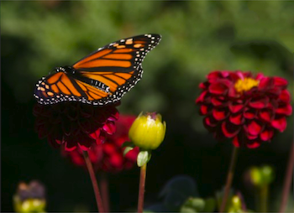
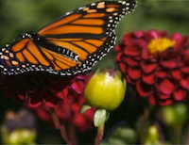
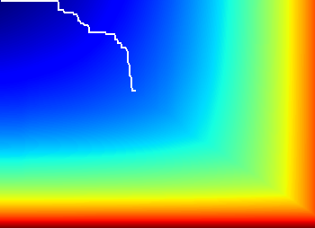

Retargeting With Optimal Seams Order
Output Image
Transport Map(100,150)
Description:
In order to remove vertical seems in the most optimal order, a transport map is created then the bit map stores whether a cell came from left or above and traces back the minimal path . Giving instructions for which order to remove seams (vertical or horizontal) in order to preserve the energy of the image. So the above image had 100 horizontal and 150 vertical seams removed.
Input Image
Transport Map Algorithm
Link to Jupyter Notebook

Slide 9
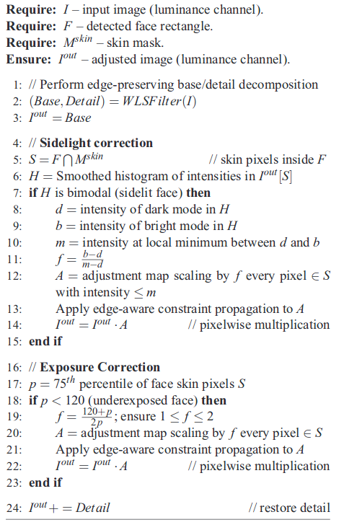
Content-Aware Automatic Photo Enhancement – Psuedo Code
Intent:
replicating the section 4 found here http://www.cs.huji.ac.il/labs/cglab/projects/cape/cape-cgf-2012.pdf
To detect skin and fix under exposed skin and side lit faces.
High Level Process:
Sidelight:
Enhance luminance
Use this to detect faces with viola-jones
Determine what pixels are skin
Weighted least squares filter to base and detail
Check for bi modality in skin face pixels
If bimodal scale by f if less than m
Apply edge aware constraint propagation
Proceed to exposure
Exposure:
Get p (75 percentile for pixels based on luminance)
If p less than 120 scale by f
Apply edge aware constraint propagation

Slide 10
Pipeline
Identifies skin pixels
Input image
Aindane**
[7]
getskin
Getskin2**
[5]
CaFacePhotoEnhance
This is the primary function called on an image
This enhances the luminance to improve skin and facial detection
Tao & Asari[2]
Improves skin pixel identification
L normalized (0,1) from
LAB channel as input
Detail
Ellipse bound
hsvSkin
adjacentSkin
WSL filter
[8]
Detect Faces
[6]
Images Split into base and detail operations to improve luminace are carried out on base.
viola jones facial detector
Used to detect skin
Base
Skin patch
This is just the rectangular region of the base that has been identified as a face and the pixels are skin

Slide 11
This is a higher level overview of the pipeline. Smaller functions have been omitted.
Corrects underexposed faces by applying tone map
Detail
Skin Patch
Sidelight Correct
Exposure Correct
Corrects side lit faces by applying tone map
Corrects side lit faces by applying tone map
This is the primary function called on an image
Detail Combined
With corrections
EACP**
[9]
isbimodal
smoothehist
EACP**
[9]
Checks for bimodal distribution large enough to apply tonemap
Return Image
Applies edge aware constraint propagation when combining tone mapped portion back with input.
Smoothes histogram of luminance values
Computational Photography @ GT

Slide 12
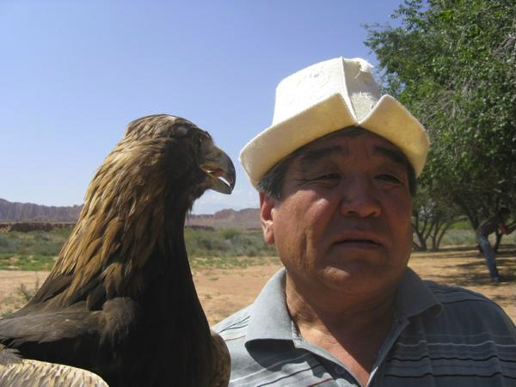
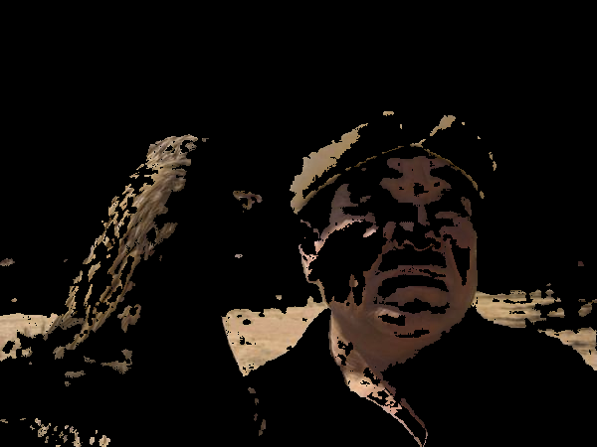
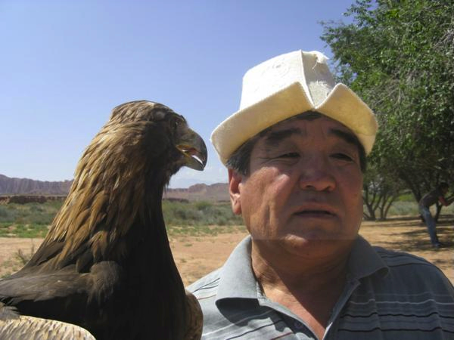
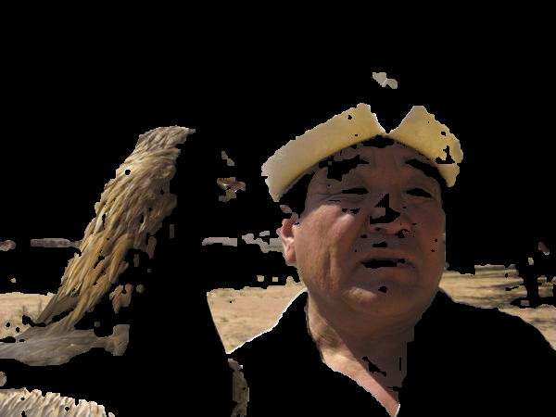
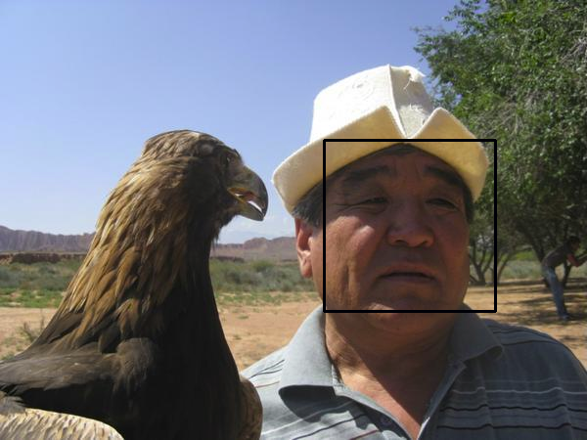
Face 1
Input
Skin pixels
Improved Skin pixels
Face Boundary
Output

Slide 13
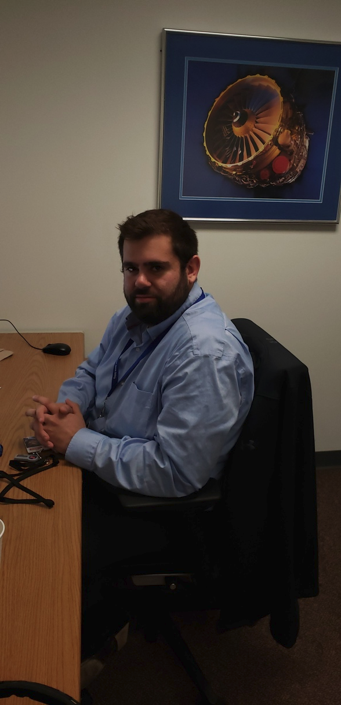
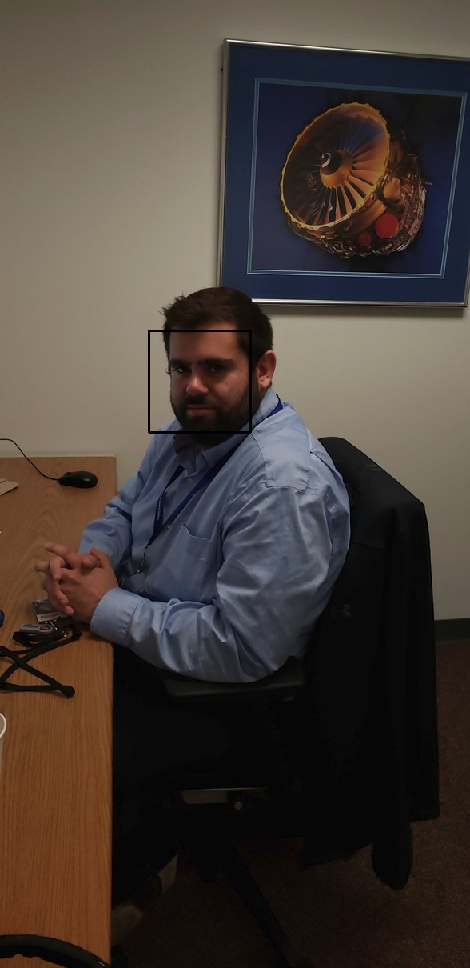
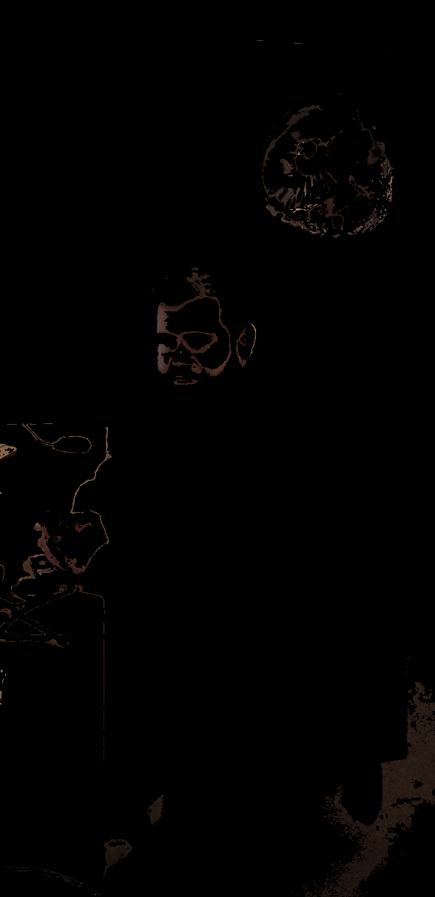
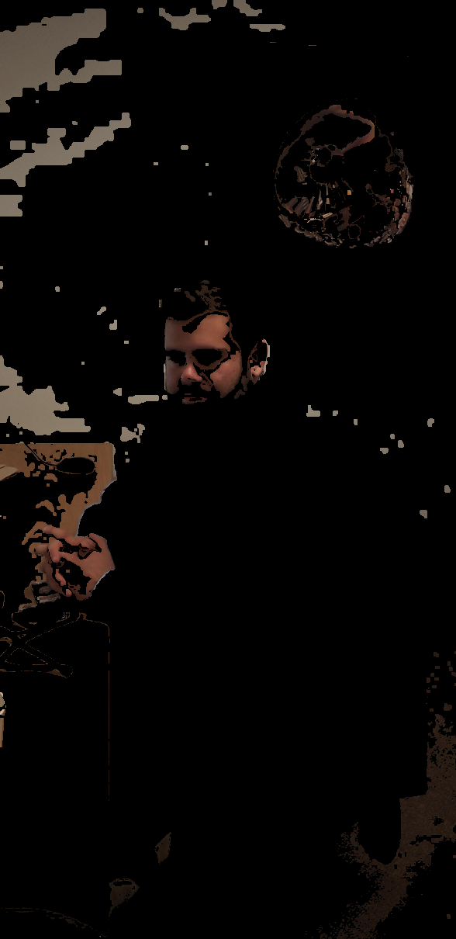
Content Aware Face Enhancement
Input
Face Boundary
Skin
Improved Skin

Slide 14
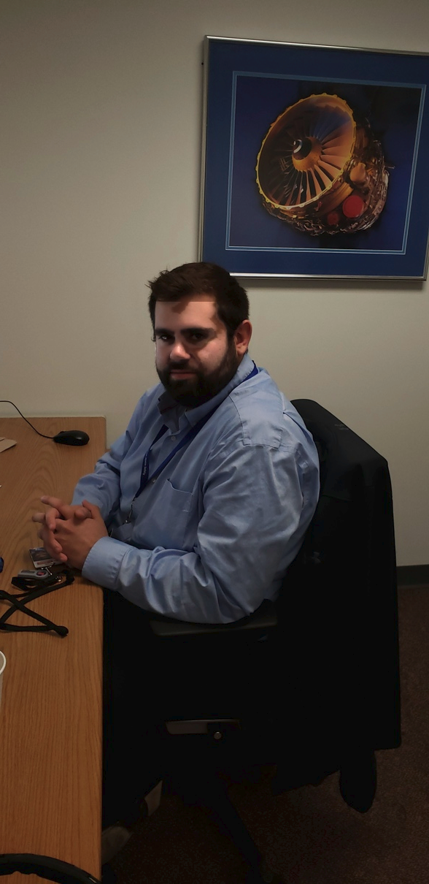

Face 2
Portions that are never identified as skin in the first place cannot have the correct tone map applied.
Leading to artifacts in the application of the algorithm.
Skin Patch
Input
Output

Slide 15
Questions ?

Slide 16
Resources
[1] Main Paper (CAPE) http://www.cs.huji.ac.il/labs/cglab/projects/cape/
[2] Li Tao; Vijayan K. Asari
J. of Electronic Imaging, 14(4), 043006 (2005). https://doi.org/10.1117/1.2136903
[3]Weighted Least Sqaures filter http://evasion.imag.fr/Enseignement/cours/2009/ProjetImage/multiscale/multiscale.pdf
[4] Edge Aware Constraint Propagation http://www.cse.huji.ac.il/~danix/itm/itm.pdf
[5] getskin2 source https://github.com/CHEREF-Mehdi/SkinDetection/blob/master/SkinDetection.py
[6] viola jones face detector https://opencv-python-tutroals.readthedocs.io/en/latest/py_tutorials/py_objdetect/py_face_detection/py_face_detection.html
[7] aindaine.py https://github.com/shiruilu/CAPE/blob/master/aindane/aindane.py
[8] WLS filter https://github.com/shiruilu/CAPE/blob/master/wls_filter/wls_filter.py
[9] Edge Aware Contraint Propogation https://github.com/shiruilu/CAPE/blob/master/face_skin/eacp.py
[10] Author supplemental test images http://www.cs.huji.ac.il/labs/cglab/projects/cape/Supp/supp_main.html
[11] Seam Carving http://www.faculty.idc.ac.il/arik/SCWeb/imret/index.html
[12] Seam Carving sample images https://en.wikipedia.org/wiki/Seam_carving

