Slide 1
MAT344 Combinatorics Graph Theory
Session 1

Slide 2
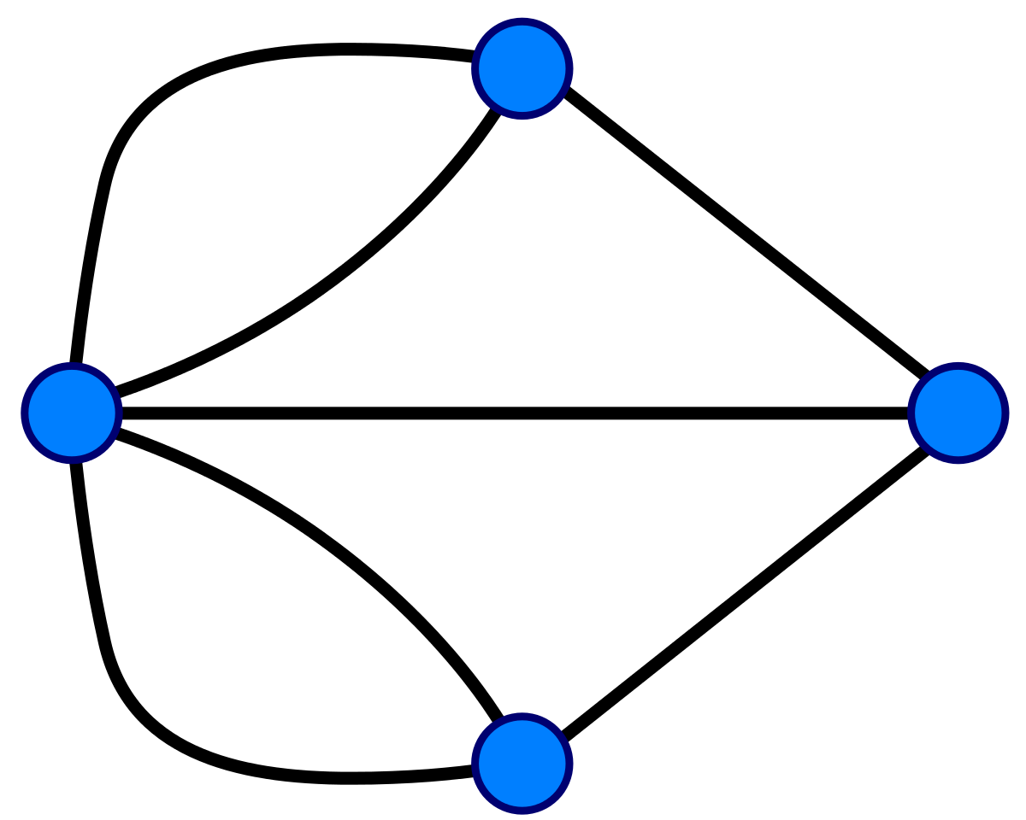
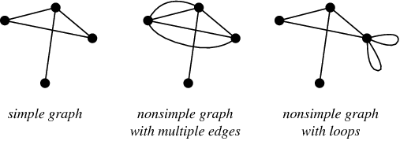
Definitions
Graph: A diagram made up from Vertices and Edges that connect some pairs of Vertices.[1]
Vertices
An Edge: A line that connects a pair of vertices.
Degree of a Vertex: The number of Edges connected to that vertex
Loops: Edges that start and end in the same vertex.[1]
Simple Graph: If a graph G has no loops, and has no multiple edges between the same pair of vertices, then we will say that G is a simple graph.[1]

Slide 3
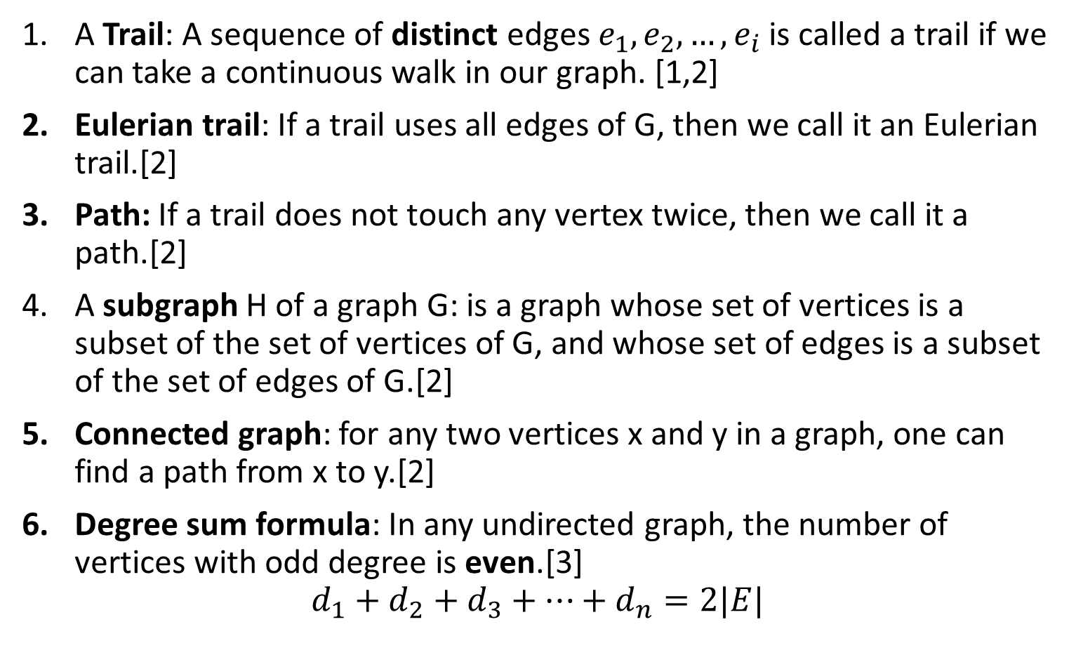
Definitions
A Trail: A sequence of distinct edges $e_{1},e_{2},…,e_{i}$is called a trail if we can take a continuous walk in our graph. [1,2]
Eulerian trail: If a trail uses all edges of G, then we call it an Eulerian trail.[2]
Path: If a trail does not touch any vertex twice, then we call it a path.[2]
A subgraph H of a graph G: is a graph whose set of vertices is a subset of the set of vertices of G, and whose set of edges is a subset of the set of edges of G.[2]
Connected graph: for any two vertices x and y in a graph, one can find a path from x to y.[2]
Degree sum formula: In any undirected graph, the number of vertices with odd degree is even.[3]
$$d_{1}+d_{2}+d_{3}+…+d_{n}=2|E|$$

Slide 4
1. Prove that in any simple graph there are two vertices with the same degree.
Proof by contradiction:
Assume, that given a simple graph of n vertices, there does not exist any 2 vertices with the same degrees, i.e. degrees are distinct for distinct vertices.
The set of possible distinct degrees for n vertices is {0, 1, 2, …, n-1}, which is of size n.
Since we have n vertices and want them to have distinct degrees, we have to use all of the possible distinct degrees.
Considering our graph; now we have a vertex with degree 0 and a vertex with degree n-1, which is impossible as the first one is connected to no other vertex and the latter is connected to every other vertex. Contradiction.

Slide 5
2. Ten players participate in a chess tournament. Eleven games have been played so far. Prove that at least one player has played at least three games.
Loops are not allowed, as no player plays against him/her self.
Proof by contradiction.
Assume, that it is possible that 11 games have been played and each player has played at most 2 games.
Each player is a vertex, and the number of games they have played is the degree of that vertex.
Players who have played a game against each other are connected by an edge.
By our assumption the degree of each player is at most 2:
d1 <=2
d2<=2
d3<=2
d10<=2

Slide 6
2. Ten players participate in a chess tournament. Eleven games have been played so far. Prove that at least one player has played at least three games.
d1 <=2
d2<=2
d3<=2
.
.
.
d10<=2
Then: d1+d2+d3+...+d10<=20=2x10, then |E| <=10
By the degree sum formula,
the sum of the total number of degrees = 2 x total number of edges.
This implies that the maximum number of edges, i.e. games, is 10, which is a contradiction.
Therefore; there has to be at least one player who has played at least 3 games.

Slide 7
Let G be a simple regular graph on n vertices such that every vertex has degree 2. Prove that G is the union of disjoint cycles.
Note: A graph is said to be simple if it has no loops and every pair of vertices has at most one edge between them. A simple graph is said to be regular if every vertex has the same degree
Pick a random vertex v1 from G, and let v1 be connected to v2 and vk since the degree of all vertices is 2, G is 2-regular. Now, starting from v1 keep going in a direction, to find all the vertices of the current cycle, since at some point there is no new vertex to go to, since the degree of the current vertex is 2, we have to go back to one of the vertices that we have already visited. Let that vertex be vi, the only possibility for vi is the initial vertex since it has degree 2 and we have only used one of its edges so far, otherwise if we go to some other vertex that we have visited than the initial one then the degree of that vertex will exceed 2, as we have already used both of its edges. Since all the vertices have degree 2, then the resulting walk is either, v1 -> v2 -> … -> vk -> v1, or v1 -> vk -> vk-1 -> … -> v2 -> v1. Both of which are the vertices of a connected 2-regular subgraph, cycle.

Slide 8
Let G be a simple regular graph on n vertices such that every vertex has degree 2. Prove that G is the union of disjoint cycles.
Now, take out the cycle that we found, i.e. v1-v2-...vk-v1, from graph G.
Repeat the process in 1 and 2 to find and remove another cycle.
Stop when there are no more vertices left in G to pick.
Following the steps above, we can find all the disjoint cycles of the graph G.

Slide 9
Miklós Bóna. A Walk Through Combinatorics:An Introduction to Enumeration and Graph Theory (p. 206). World Scientific Publishing Company. Kindle Edition.
Miklós Bóna. A Walk Through Combinatorics:An Introduction to Enumeration and Graph Theory (p. 207). World Scientific Publishing Company. Kindle Edition.
Miklós Bóna. A Walk Through Combinatorics:An Introduction to Enumeration and Graph Theory (p. 209). World Scientific Publishing Company. Kindle Edition.

