Slide 1
MAT344 Combinatorics
Graph Theory
Session 2

Slide 2
1. Let G be a simple regular graph on n vertices such that every vertex has degree Prove that G is the union of disjoint cycles.
Note:
  A graph is said to be simple if it has no loops and every pair of vertices has at most one edge between them.
  A simple graph is said to be regular if every vertex has the same degree
Pick a random vertex v1 from G, and let v1 be connected to v2 and vk since the degree of all vertices is 2, G is 2-regular. Now, starting from v1 keep going in a direction, to find all the vertices of the current cycle, since at some point there is no new vertex to go to, since the degree of the current vertex is 2, we have to go back to one of the vertices that we have already visited. Let that vertex be vi, the only possibility for vi is the initial vertex since it has degree 2 and we have only used one of its edges so far, otherwise if we go to some other vertex that we have visited than the initial one then the degree of that vertex will exceed 2, as we have already used both of its edges. Since all the vertices have degree 2, then the resulting walk is either, v1 -> v2 -> … -> vk -> v1, or v1 -> vk -> vk-1 -> … -> v2 -> v1. Both of which are the vertices of a connected 2-regular subgraph, cycle.

Slide 3
1. Let G be a simple regular graph on n vertices such that every vertex has degree Prove that G is the union of disjoint cycles.
Now, take out the cycle that we found, i.e. v1-v2-...vk-v1, from graph G.
Repeat the process in 1 and 2 to find and remove another cycle.
Stop when there are no more vertices left in G to pick.
Repeat the steps above, we can find all the disjoint cycles of the graph G.

Slide 4
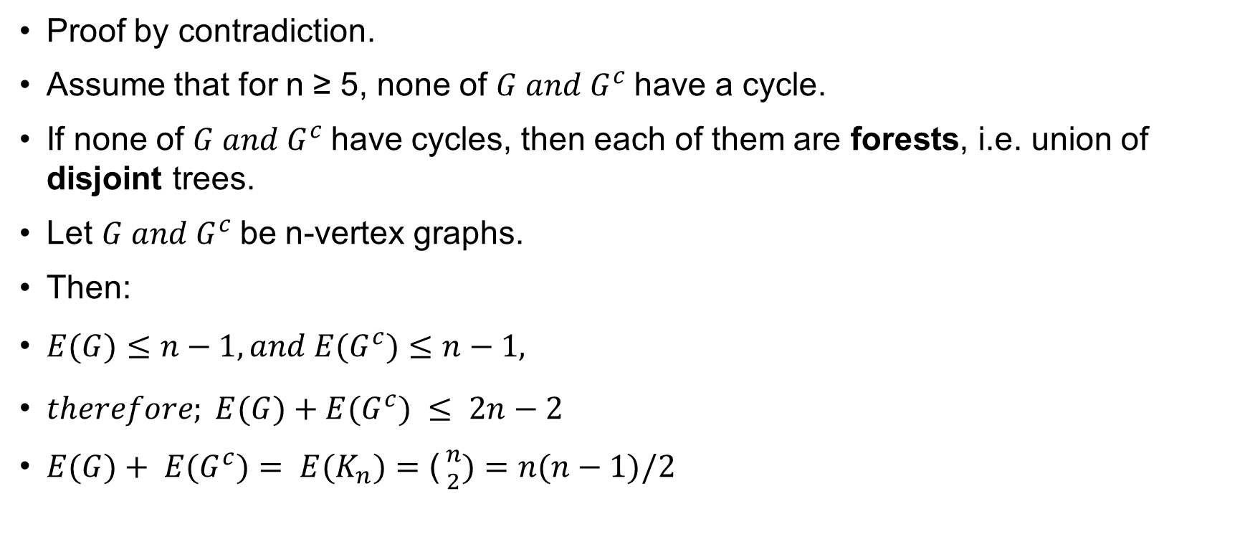
2. Let G be a simple graph on n vertices. We define the complement graph G of G to be the graph on the same vertex set of G in which the vertices x and y are connected by an edge in G if and only if x and y are not connected by an edge in G. Prove that for n ≥ 5, either G or G complement has a cycle.
Proof by contradiction.
Assume that for n ≥ 5, none of $G and G^{c}$have a cycle.
If none of $G and G^{c}$have cycles, then each of them are forests, i.e. union of disjoint trees.
Let $G and G^{c}$be n-vertex graphs.
Then:
$E(G)≤n−1, and E(G^{c})≤n−1,$
$therefore; E(G)+E(G^{c}) ≤ 2n−2$
$E(G)+ E(G^{c})= E(K_{n})=\text{(}{n \atop 2})=n(n−1)/2$

Slide 5
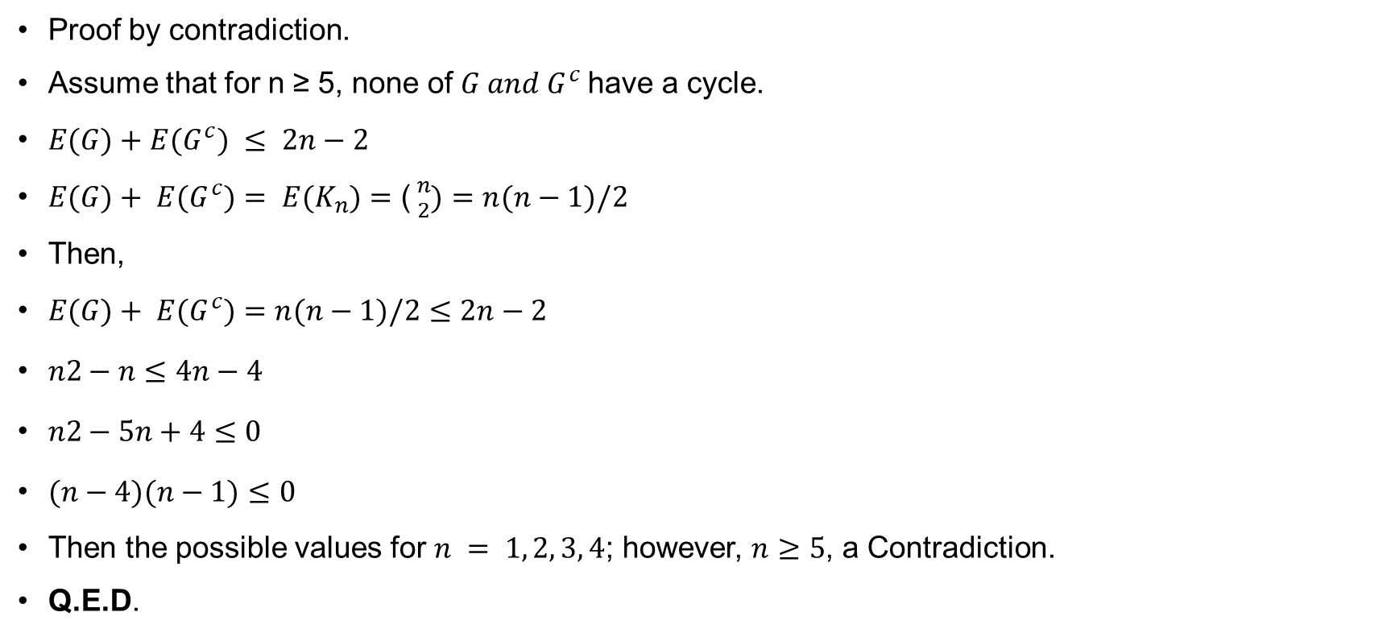
Let G be a simple graph on n vertices. We define the complement graph G of G to be the graph on the same vertex set of G in which the vertices x and y are connected by an edge in G if and only if x and y are not connected by an edge in G. Prove that for n ≥ 5, either G or G complement has a cycle.
Proof by contradiction.
Assume that for n ≥ 5, none of $G and G^{c}$have a cycle.
$E(G)+E(G^{c}) ≤ 2n−2$
$E(G)+ E(G^{c})= E(K_{n})=\text{(}{n \atop 2})=n(n−1)/2$
Then,
$E(G)+ E(G^{c})=n(n−1)/2≤2n−2$
$n2−n≤4n−4$
$n2−5n+4≤0$
$(n−4)(n−1)≤0$
Then the possible values for $n = 1, 2, 3, 4$; however, $n≥5$, a Contradiction.
Q.E.D.

Slide 6
3. Let G be a connected bipartite graph. Let v and w be two vertices of G.
Let P1 and P2 be any (not necessarily vertex or edge disjoint) paths from v to w. Prove that the lengths (the number of edges) of P1 and P2 are either both even or both odd.
Proof by contradiction:
Assume one is even and one is odd, then walking from v to w using p1 and coming back from w to v using p2, will make an odd cycle, which is a contradiction, since a bipartite graph has no odd cycle.
Q.E.D.

Slide 7
4. Is there a bipartite graph G with 9 vertices v1, v2, . . ., v9 such that their degrees are 3, 3, 3, 3, 3, 5, 6, 6, and 6, respectively?
Note:
  The total number of edges =sum of degrees/2 =38/2 = 19
Since G is a bipartite graph, and it has 9 vertices, let’s consider different cases that G can exist:
LHS = 1 RHS = 8 then, the maximum number of edges is 8, a contradiction
LHS = 2 RHS = 7 then, the maximum number of edges is 14, a contradiction
LHS = 3 RHS = 6 then, the maximum number of edges is 18, a contradiction
LHS = 4 RHS = 5 then, the maximum number of edges is 20; However, there cannot exist a vertex of degree 6, a contradiction
Therefore; none of the cases will satisfy the conditions for G; Therefore, G does not exist.
Q.E.D.

Slide 8
Miklós Bóna. A Walk Through Combinatorics:An Introduction to Enumeration and Graph Theory (p. 206). World Scientific Publishing Company. Kindle Edition.
Miklós Bóna. A Walk Through Combinatorics:An Introduction to Enumeration and Graph Theory (p. 207). World Scientific Publishing Company. Kindle Edition.
Miklós Bóna. A Walk Through Combinatorics:An Introduction to Enumeration and Graph Theory (p. 209). World Scientific Publishing Company. Kindle Edition.

