Slide 1
MAT102 Welcome
Arash Gholami
Tutorial 1
Email: arash.gholami@mail.utoronto.ca
LinkedIn

Slide 2
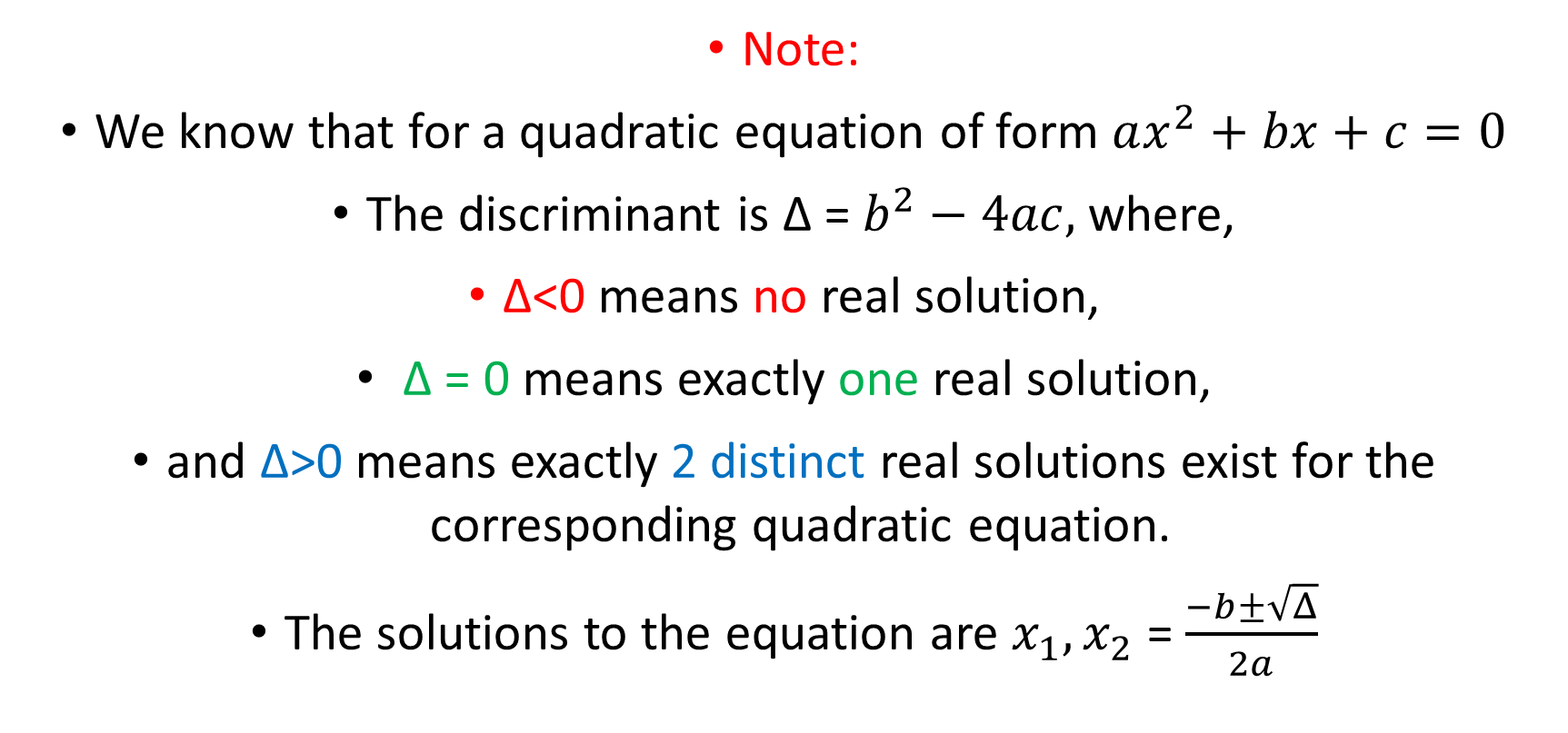
Example 0.1
Note:
We know that for a quadratic equation of form $ax^{2}+bx+c=0$
The discriminant is ∆ = $b^{2}−4ac,$ where,
∆<0 means no real solution,
∆ = 0 means exactly one real solution,
and ∆>0 means exactly 2 distinct real solutions exist for the corresponding quadratic equation.
The solutions to the equation are $x_{1},x_{2}$ = $\frac{−b±\sqrt{Δ}}{2a}$

Slide 3

Example 0.2
$initialy, if x>0>y,$
$then −\frac{1}{x}<0,$
$whilst −\frac{1}{y}>0$
$therefore −\frac{1}{x}>\frac{1}{y}is false$

Slide 4
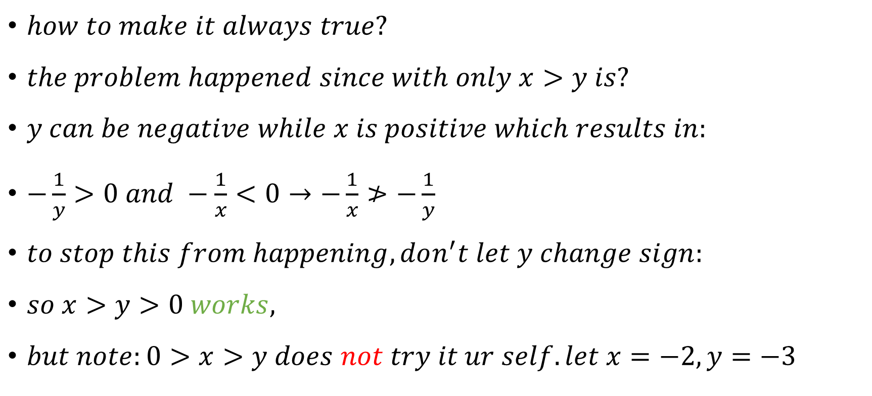
Example 0.2 cont’d
$how to make it always true?$
$the problem happened since with only x>y is?$
$y can be negative while x is positive which results in:$
$−\frac{1}{y}>0 and −\frac{1}{x}<0→−\frac{1}{x}≯−\frac{1}{y}$
$to stop this from happening, don^{′}t let y change sign:$
$so x>y>0 works,$
$but note:0>x>y does not try it ur self. let x=−2, y=−3$

Slide 5
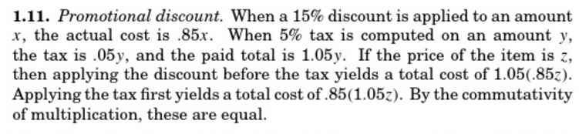

Example 0.3
$does it matter?$
$NO$

Slide 6


Example 0.4
$since δ>0, r,s=\frac{−b±\sqrt{δ}}{2a}$
$r.s=\frac{−b−\sqrt{δ}}{2a}$. $\frac{−b+\sqrt{δ}}{2a}$
$r.s=\frac{b^{2}−δ}{4a^{2}}$
$r.s=\frac{b^{2}−b^{2}+4ac}{4a^{2}}$
$r.s=\frac{4ac}{4a^{2}}=\frac{c}{a}$
$$(x−y).(x+y)=x^{2}−y^{2}$$
$$δ=b^{2}−4ac$$

Slide 7

Example 0.4
$since δ>0, r,s=\frac{−b±\sqrt{δ}}{2a}$
$r+s=\frac{−b−\sqrt{δ}}{2a}+$ $\frac{−b+\sqrt{δ}}{2a}$
$=\frac{−b−\sqrt{δ}−b+\sqrt{δ}}{2a}=\frac{−2b}{2a}$
$=−\frac{b}{a}$

Slide 8

Example 0.5
Determine the set of real solutions to $\frac{x}{ x + 1} ≤ 1:$
$\frac{x}{x+1}≤1$
$\frac{x}{x+1}−1≤0$
$\frac{x−x−1}{x+1}≤0$
$\frac{−1}{x+1}≤0$
$\frac{1}{x+1}≥0$
$this can never equal 0, and is only positive when x+1 is positive$
$However x+1≠ 0, so x+1>0, then x>−1$
Subtract 1 from both sides
Bring -1 in the fraction
Multiply by -1

Slide 9
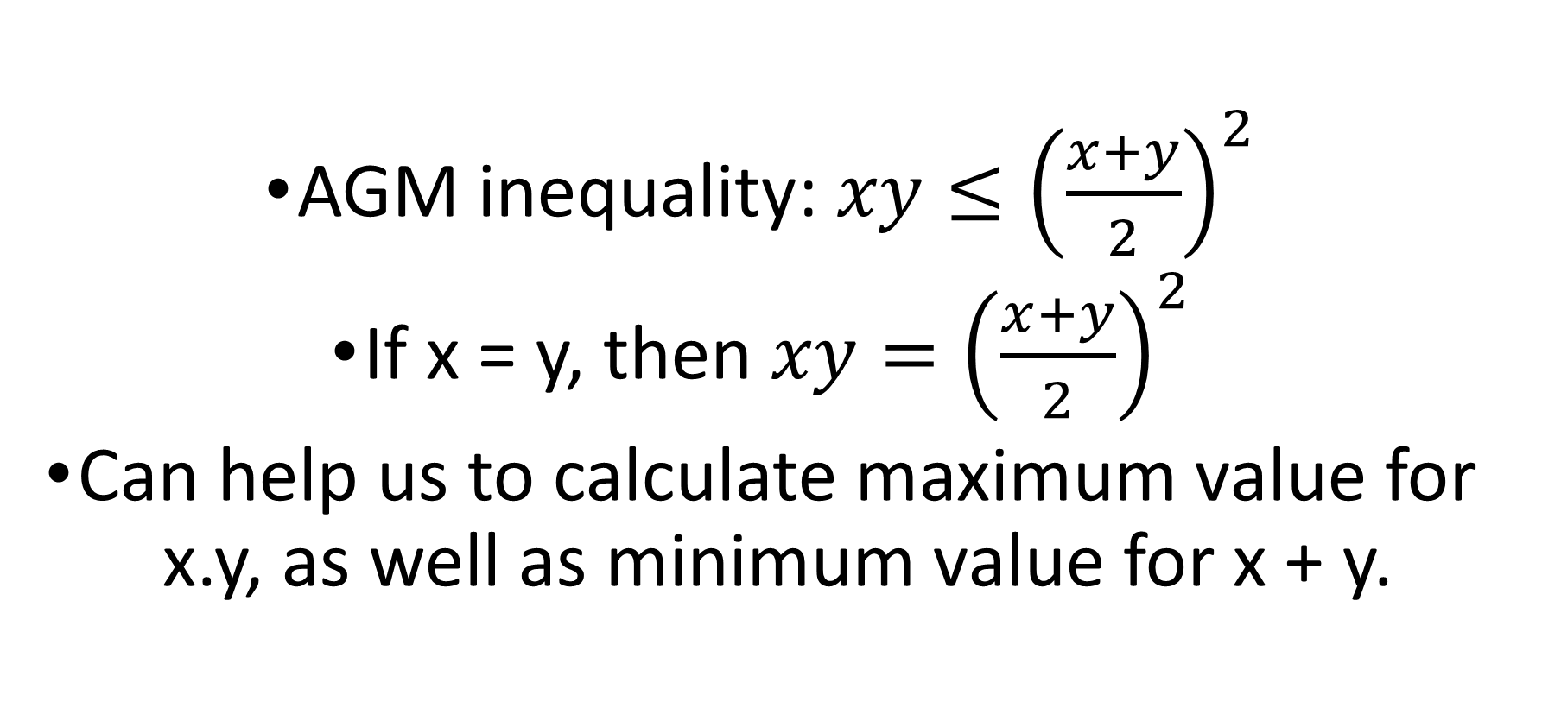
Example 1
AGM inequality: $xy≤{\left(\frac{x+y}{2}\right)}^{2}$
If x = y, then $xy={\left(\frac{x+y}{2}\right)}^{2}$
Can help us to calculate maximum value for x.y, as well as minimum value for x + y.

Slide 10
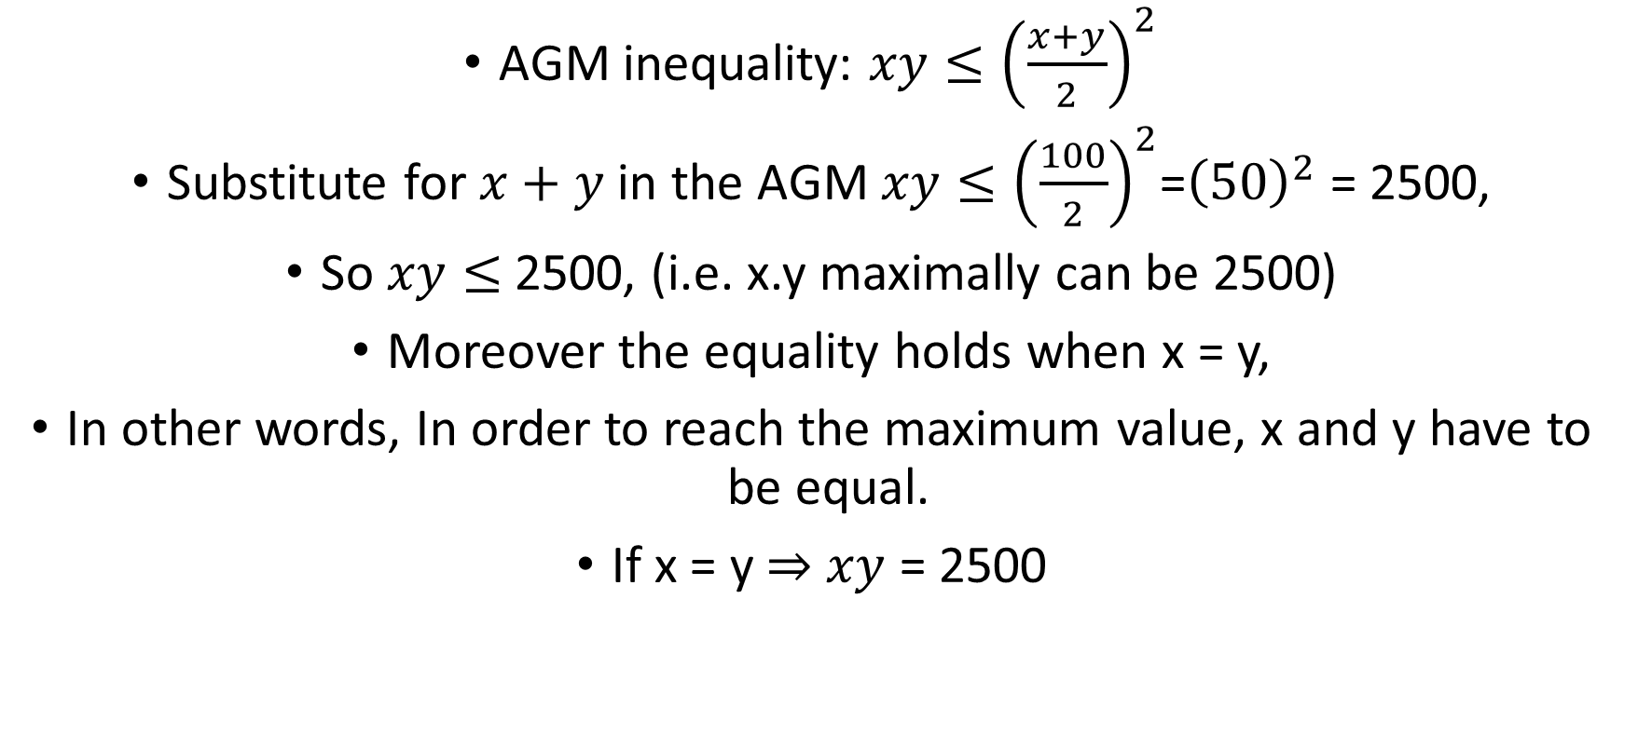
Example 1 cont’d
AGM inequality: $xy≤{\left(\frac{x+y}{2}\right)}^{2}$
Substitute for $x+y$in the AGM $xy≤{\left(\frac{100}{2}\right)}^{2}$=${\left(50\right)}^{2}$ = 2500,
So $xy≤$2500, (i.e. x.y maximally can be 2500)
Moreover the equality holds when x = y,
In other words, In order to reach the maximum value, x and y have to be equal.
If x = y $⇒$ $xy$ = 2500

Slide 11

Example 2
Given that $xy$ = 3600, calculate the minimum value for x + y?
AGM inequality: $xy≤{\left(\frac{x+y}{2}\right)}^{2}$
Substitute for $xy$ in the AGM,
$3600≤{\left(\frac{x+y}{2}\right)}^{2}$
$⇒$ $\sqrt{3600}≤\frac{x+y}{2}$
$⇒$ $60≤\frac{x+y}{2}$
$⇒$ $120≤x+y$

Slide 12
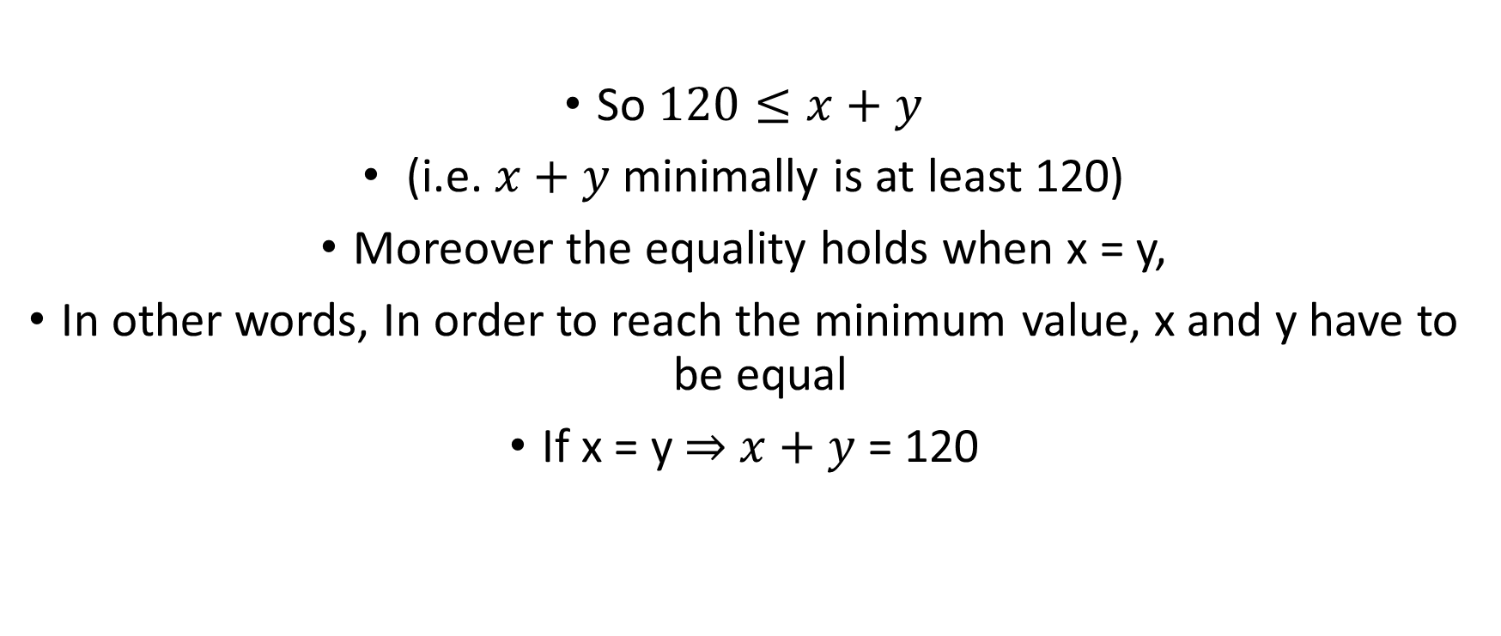
Example 2 cont’d
Given that $xy$ = 3600, calculate the minimum value for x + y?
So $120≤x+y$
(i.e. $x+y$ minimally is at least 120)
Moreover the equality holds when x = y,
In other words, In order to reach the minimum value, x and y have to be equal
If x = y $⇒$ $x+y$ = 120

Slide 13
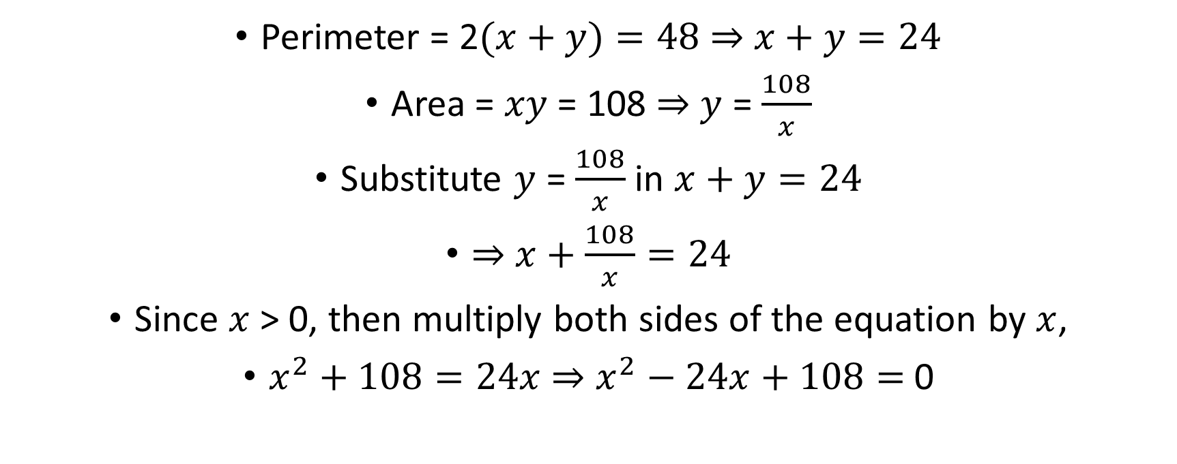
Example 3
Perimeter = 2$(x+y)=48$ $⇒$ $x+y=24$
Area = $xy$ = 108 $⇒$ $y$ = $\frac{108}{x}$
Substitute $y$ = $\frac{108}{x}$ in $x+y=24$
$⇒$ $x+\frac{108}{x}=24$
Since $x$ > 0, then multiply both sides of the equation by $x$,
$x^{2}+108=24x$ $⇒$ $x^{2}−24x+108=$ 0

Slide 14
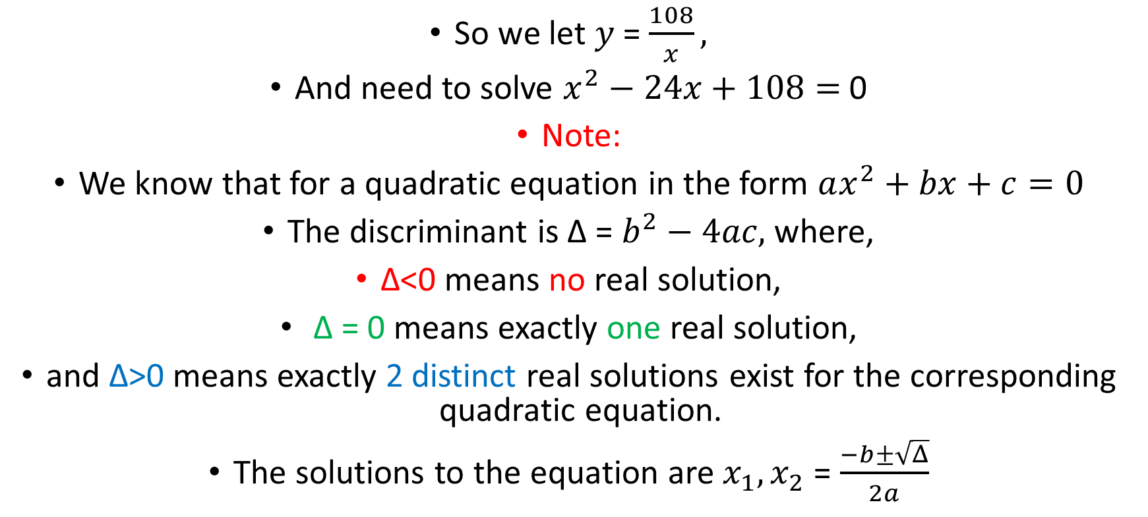
Example 3 cont’d
So we let $y$ = $\frac{108}{x},$
And need to solve $x^{2}−24x+108=$ 0
Note:
We know that for a quadratic equation in the form $ax^{2}+bx+c=0$
The discriminant is ∆ = $b^{2}−4ac,$ where,
∆<0 means no real solution,
∆ = 0 means exactly one real solution,
and ∆>0 means exactly 2 distinct real solutions exist for the corresponding quadratic equation.
The solutions to the equation are $x_{1},x_{2}$ = $\frac{−b±\sqrt{Δ}}{2a}$

Slide 15
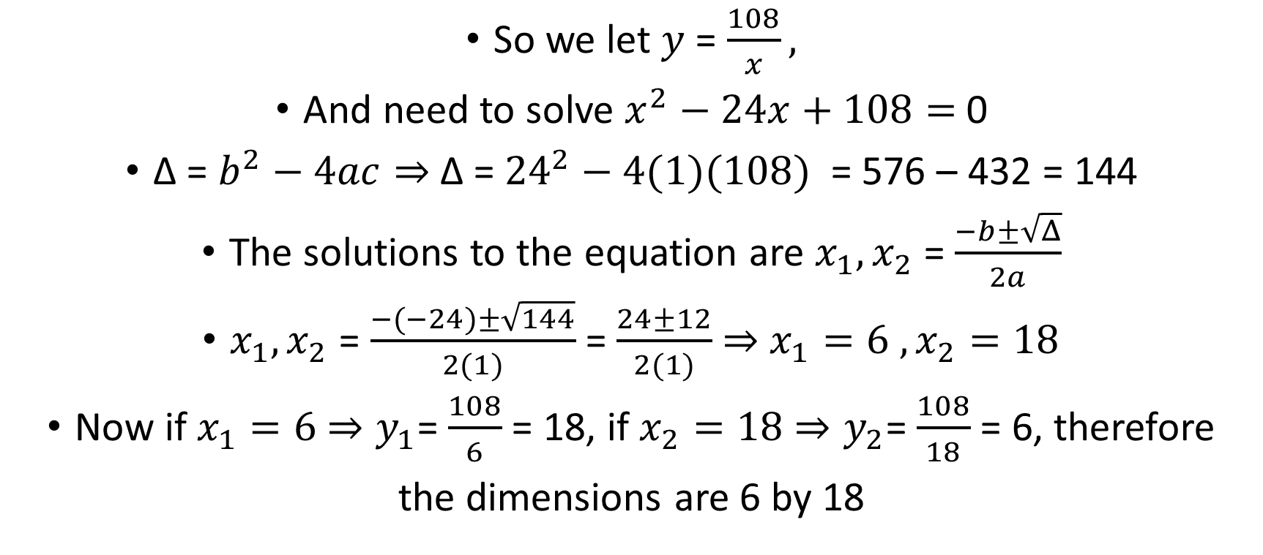
Example 3 cont’d
So we let $y$ = $\frac{108}{x},$
And need to solve $x^{2}−24x+108=$ 0
∆ = $b^{2}−4ac⇒$ ∆ = ${24}^{2}−4(1)(108)$ = 576 – 432 = 144
The solutions to the equation are $x_{1},x_{2}$ = $\frac{−b±\sqrt{Δ}}{2a}$
$x_{1},x_{2}$ = $\frac{−(−24)±\sqrt{144}}{2(1)}$ = $\frac{24±12}{2(1)}$ $⇒$ $x_{1}=6 ,x_{2}=18$
Now if $x_{1}=6$ $⇒y_{1}$= $\frac{108}{6}$ = 18, if $x_{2}=18$ $⇒y_{2}$= $\frac{108}{18}$ = 6, therefore
the dimensions are 6 by 18

Slide 16
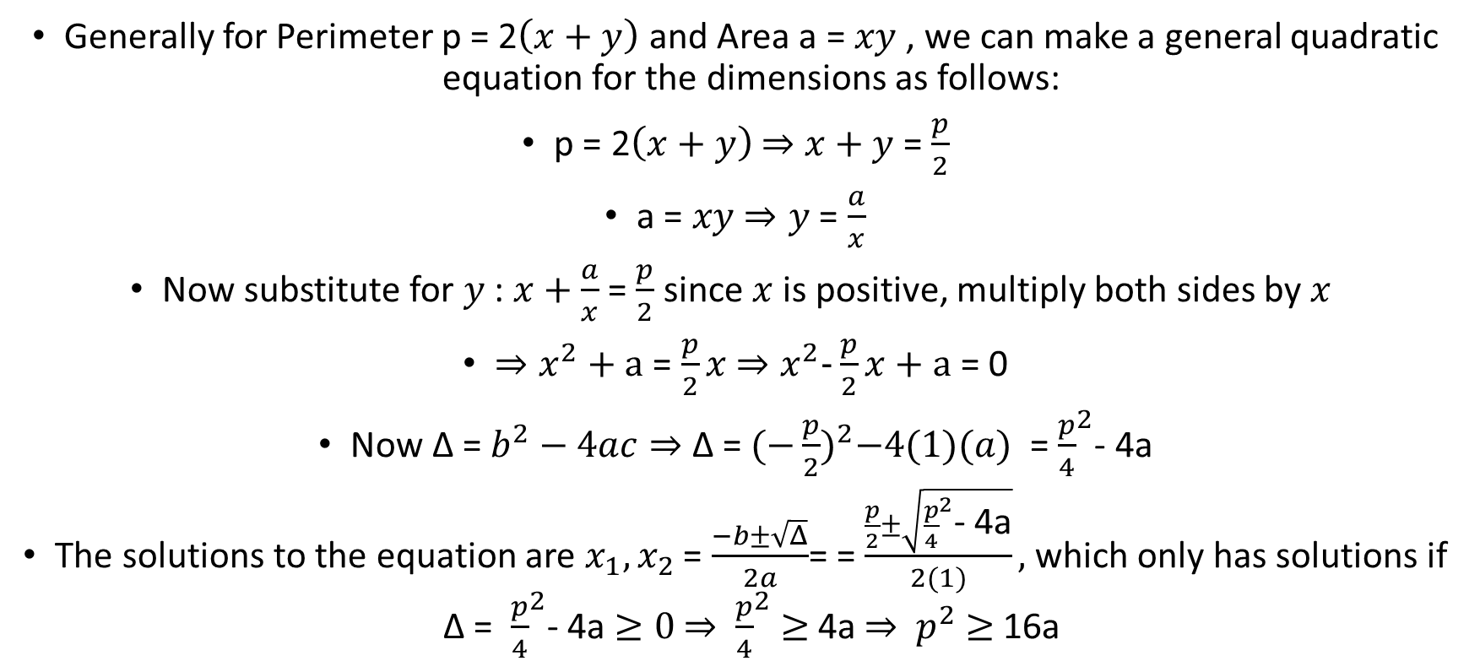
Example 3 cont’d
Generally for Perimeter p = 2$\left(x+y\right)$ and Area a = $xy$ , we can make a general quadratic equation for the dimensions as follows:
p = 2$\left(x+y\right)$ $⇒$ $x+y$ = $\frac{p}{2}$
a = $xy$ $⇒y$ = $\frac{a}{x}$
Now substitute for $y$: $x+\frac{a}{x}$ = $\frac{p}{2}$ since $x$ is positive, multiply both sides by $x$
$⇒x^{2}+a$ = $\frac{p}{2}x$ $⇒x^{2}\text{−}\frac{p}{2}x+a$ = 0
Now ∆ = $b^{2}−4ac⇒$ ∆ = ${(\text{−}\frac{p}{2})}^{2}−4(1)(a)$ = ${\frac{p}{4}}^{2}$- 4a
The solutions to the equation are $x_{1},x_{2}$ = $\frac{−b±\sqrt{Δ}}{2a}$= = $\frac{\frac{p}{2}±\sqrt{{\frac{p}{4}}^{2}\text{− 4}\text{a}}}{2(1)},$which only has solutions if ∆ = ${\frac{p}{4}}^{2}$- 4a $≥0$ $⇒$ ${\frac{p}{4}}^{2}$ $≥$ 4a $⇒$ $p^{2}$ $≥$ 16a

Slide 17
Example 3 cont’d
Home exercise :
Given the carpet with perimeter 48 feet, what is the maximum area that the carpet can have?
Given the carpet with area 108 feet, what is the minimum perimeter that the carpet has?

Slide 18

Example 4
AGM inequality: $xy≤{\left(\frac{x+y}{2}\right)}^{2}$
Let $x=x$, and let $y=$ $c−x$
$x\left(c−x\right)≤{\left(\frac{x+c−x}{2}\right)}^{2}={\left(\frac{c}{2}\right)}^{2}={\frac{c}{4}}^{2}$
The left side reaches the maximum value of ${\frac{c}{4}}^{2}$ if and only if $x=y=\left(c−x\right)$
$⇒x=\left(c−x\right) ⇒$ $2x=c$ $⇒$ $x=\frac{c}{2}$

Slide 19
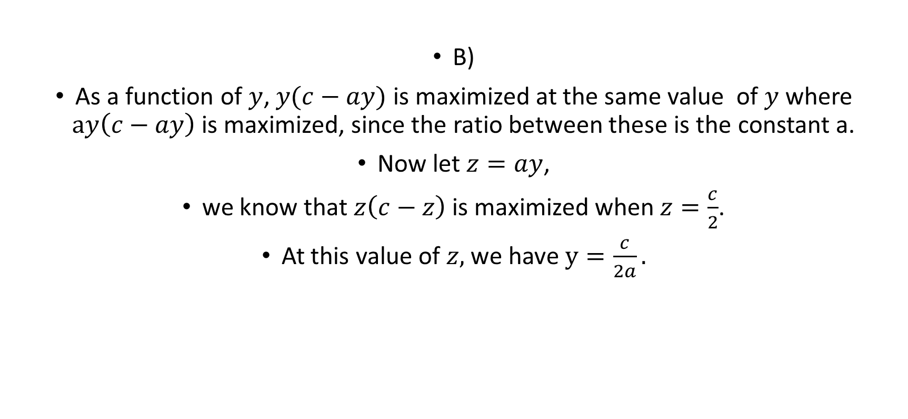
Example 4 cont’d
B)
As a function of $y$, $y(c−ay)$ is maximized at the same value of $y$ where $ay\left(c−ay\right)$ is maximized, since the ratio between these is the constant a.
Now let $z=ay$,
we know that $z\left(c−z\right)$ is maximized when $z=\frac{c}{2}$.
At this value of $z,$we have $y=\frac{c}{2a}.$

Slide 20
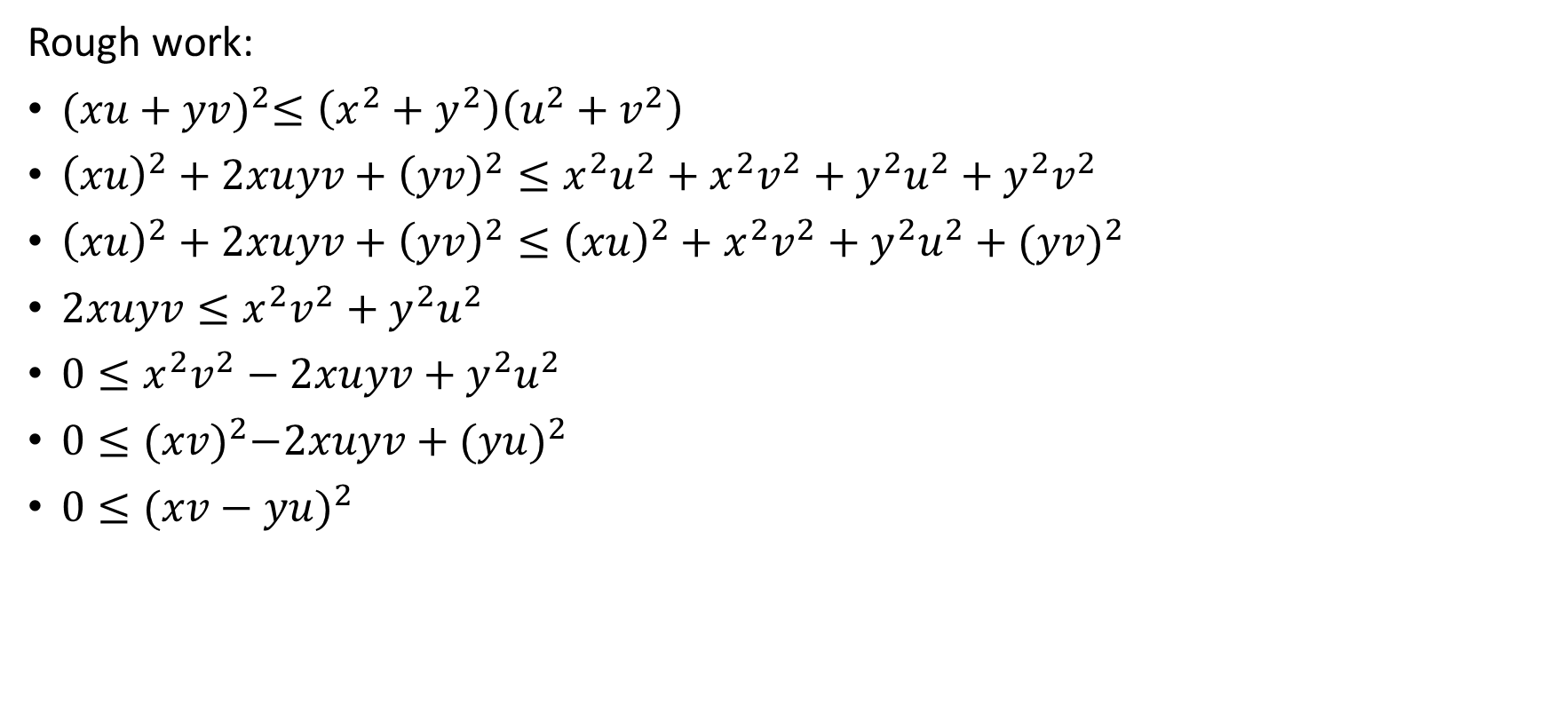

Example 5
Rough work:
${(xu+yv)}^{2}≤\left(x^{2}+y^{2}\right)\left(u^{2}+v^{2}\right)$
${\left(xu\right)}^{2}+2xuyv+{\left(yv\right)}^{2}≤x^{2}u^{2}+x^{2}v^{2}+y^{2}u^{2}+y^{2}v^{2}$
${\left(xu\right)}^{2}+2xuyv+{\left(yv\right)}^{2}≤{\left(xu\right)}^{2}+x^{2}v^{2}+y^{2}u^{2}+({yv)}^{2}$
$2xuyv≤x^{2}v^{2}+y^{2}u^{2}$
$0≤x^{2}v^{2}−2xuyv+y^{2}u^{2}$
$0≤{(xv)}^{2}−2xuyv+{(yu)}^{2}$
${0≤(xv−yu)}^{2}$
$${−(\left(xu\right)}^{2}+{\left(yv\right)}^{2})$$
Which is True

Slide 21
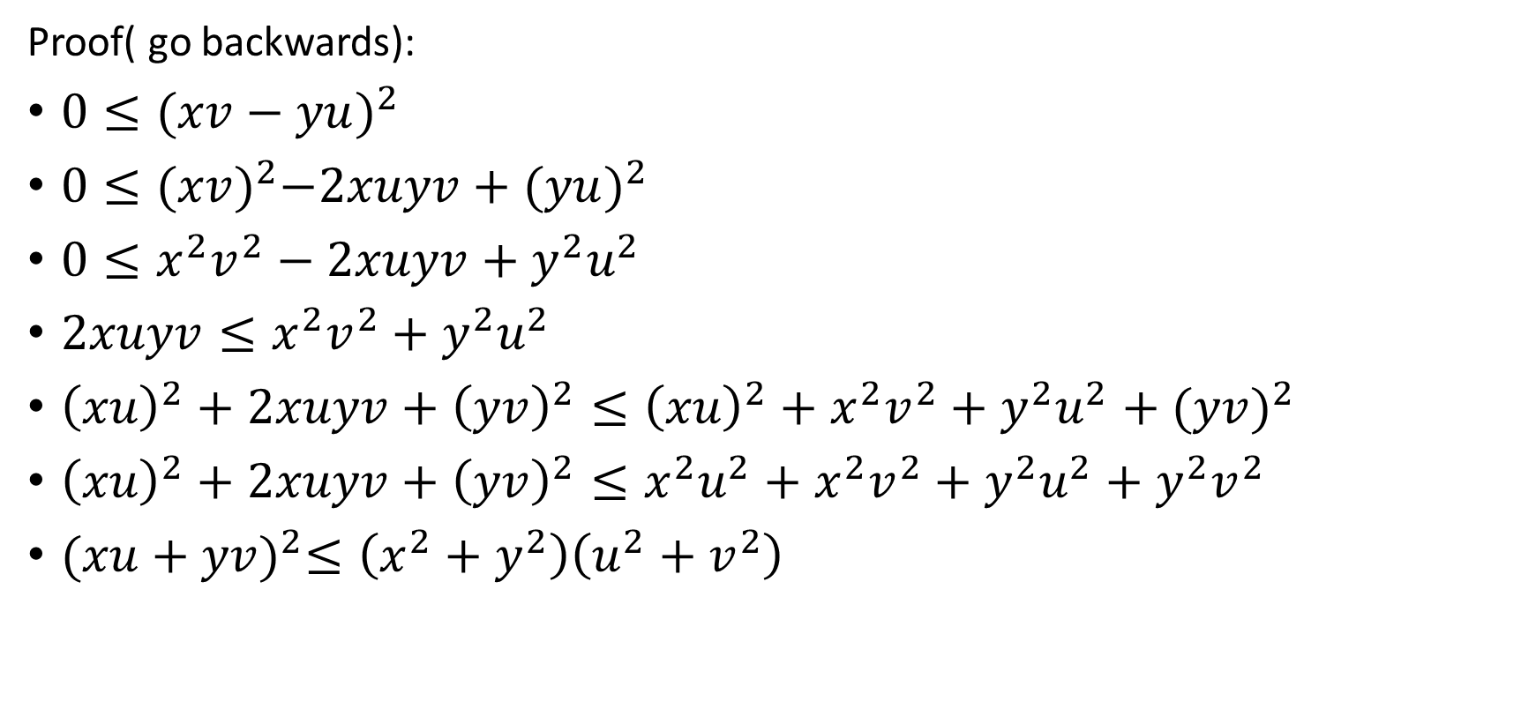
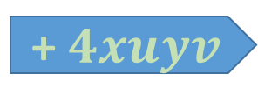

Example 5 cont’d
Proof( go backwards):
${0≤(xv−yu)}^{2}$
$0≤{(xv)}^{2}−2xuyv+{(yu)}^{2}$
$0≤x^{2}v^{2}−2xuyv+y^{2}u^{2}$
$2xuyv≤x^{2}v^{2}+y^{2}u^{2}$
${\left(xu\right)}^{2}+2xuyv+{\left(yv\right)}^{2}≤{\left(xu\right)}^{2}+x^{2}v^{2}+y^{2}u^{2}+({yv)}^{2}$
${\left(xu\right)}^{2}+2xuyv+{\left(yv\right)}^{2}≤x^{2}u^{2}+x^{2}v^{2}+y^{2}u^{2}+y^{2}v^{2}$
${(xu+yv)}^{2}≤\left(x^{2}+y^{2}\right)\left(u^{2}+v^{2}\right)$
Which is True
expand
+ $4xuyv$
$${+(\left(xu\right)}^{2}+{\left(yv\right)}^{2})$$

Slide 22


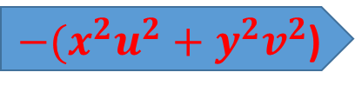
Example 5 cont’d
Part b)
${(xu+yv)}^{2}=\left(x^{2}+y^{2}\right)\left(u^{2}+v^{2}\right)$
$x^{2}u^{2}+2xuyv+y^{2}v^{2}=x^{2}u^{2}+x^{2}v^{2}+y^{2}u^{2}+y^{2}v^{2}$
$2xuyv=x^{2}v^{2}+y^{2}u^{2}$
$0=x^{2}v^{2}−2xuyv+y^{2}u^{2}$
$0={(xv−yu)}^{2}$
Therefore the equality holds when $xv=yu$
expand
${−(x}^{2}u^{2}+y^{2}v^{2}$)
$$−4xuyv$$

Slide 23
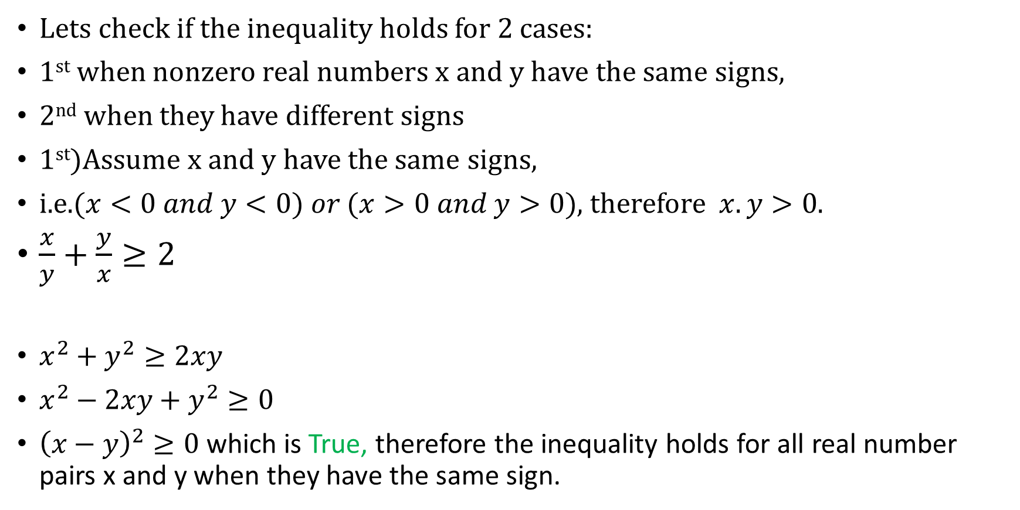
Example 6
Lets check if the inequality holds for 2 cases:
1st when nonzero real numbers x and y have the same signs,
2nd when they have different signs
1st)Assume x and y have the same signs,
i.e.$(x<0 and y<0) or (x>0 and y>0)$, therefore $x.y>0$.
$\frac{x}{y}+\frac{y}{x}≥2$
$x^{2}+y^{2}≥2xy$
$x^{2}−2xy+y^{2}≥0$
${\left(x−y\right)}^{2}≥0$ which is True, therefore the inequality holds for all real number pairs x and y when they have the same sign.
Multiply by xy
$$Note:since xy>0→the order of inequality doesn^{′}t change$$

Slide 24
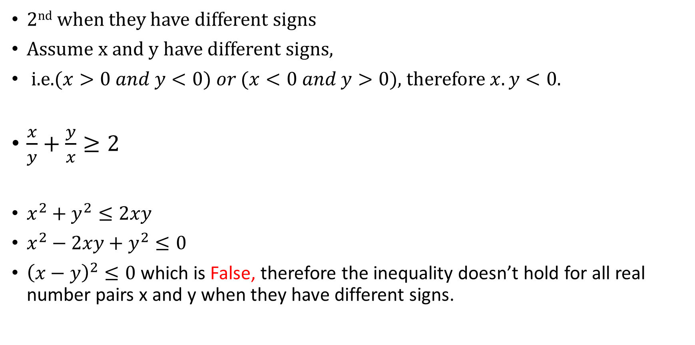
Example 6 cont’d
2nd when they have different signs
Assume x and y have different signs,
i.e.$(x>0 and y<0) or (x<0 and y>0)$, therefore $x.y<0$.
$\frac{x}{y}+\frac{y}{x}≥2$
$x^{2}+y^{2}≤2xy$
$x^{2}−2xy+y^{2}≤0$
${\left(x−y\right)}^{2}≤0$ which is False, therefore the inequality doesn’t hold for all real number pairs x and y when they have different signs.
Multiply by xy
$$Note:since xy<0→the order of inequality does change$$

Slide 25
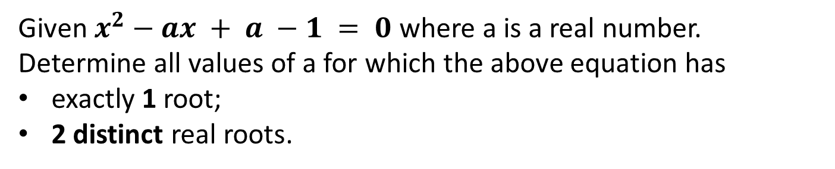
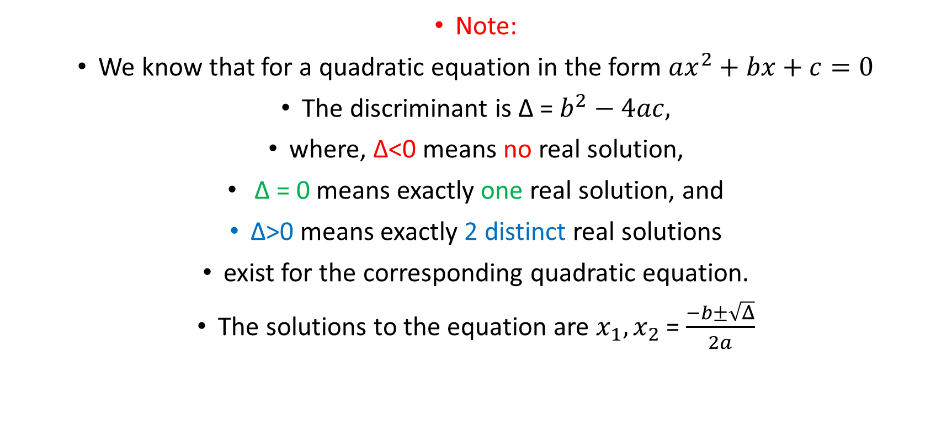
Example 7
Given $x^{2}−ax + a −1 = 0$ where a is a real number.
Determine all values of a for which the above equation has
exactly 1 root;
2 distinct real roots.
Note:
We know that for a quadratic equation in the form $ax^{2}+bx+c=0$
The discriminant is ∆ = $b^{2}−4ac,$
where, ∆<0 means no real solution,
∆ = 0 means exactly one real solution, and
∆>0 means exactly 2 distinct real solutions
exist for the corresponding quadratic equation.
The solutions to the equation are $x_{1},x_{2}$ = $\frac{−b±\sqrt{Δ}}{2a}$

Slide 26
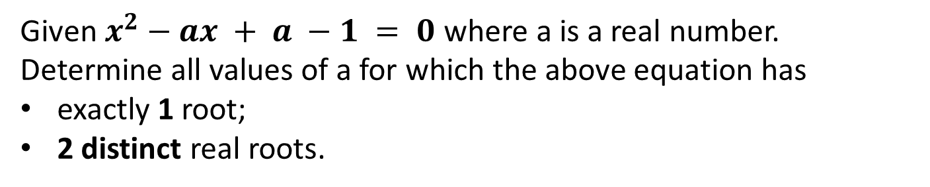
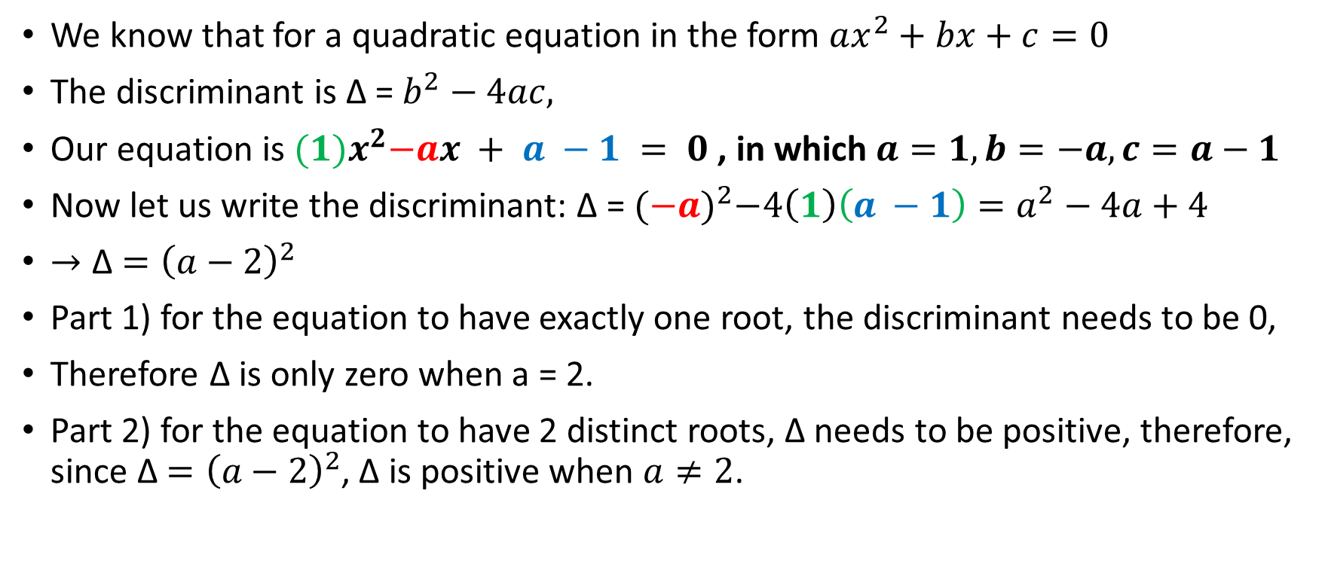
Example 7 cont’d
Given $x^{2}−ax + a −1 = 0$ where a is a real number.
Determine all values of a for which the above equation has
exactly 1 root;
2 distinct real roots.
We know that for a quadratic equation in the form $ax^{2}+bx+c=0$
The discriminant is ∆ = $b^{2}−4ac,$
Our equation is ${(1)x}^{2}−ax + a −1 = 0$ , in which $a=1, b=−a, c=a−1$
Now let us write the discriminant: ∆ = ${(−a)}^{2}−4\left(1\right)\left(a −1\right)=a^{2}−4a+4$
$→\text{∆}$ $={\left(a−2\right)}^{2}$
Part 1) for the equation to have exactly one root, the discriminant needs to be 0,
Therefore ∆ is only zero when a = 2.
Part 2) for the equation to have 2 distinct roots, ∆ needs to be positive, therefore, since $\text{∆}$ $={\left(a−2\right)}^{2}$, ∆ is positive when $a≠2$.

Slide 27
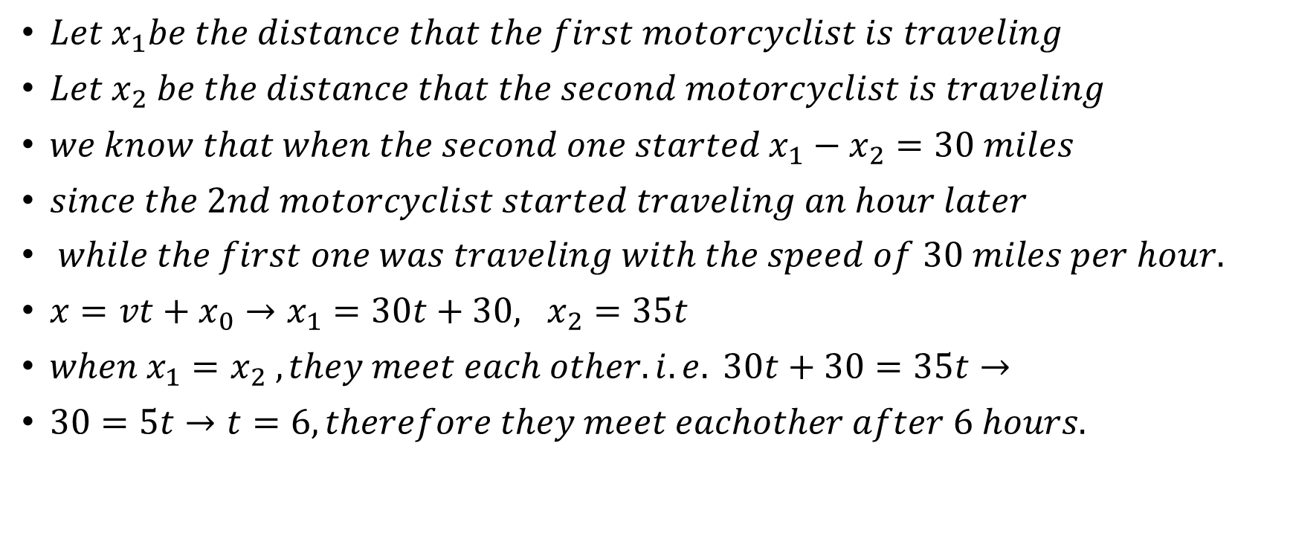
Example 8
A motorcyclist, traveling 30 miles per hour, leaves Westford heading toward Eastford. One hour later another motorcyclist, traveling 35 miles per hour, also leaves Westford heading toward Eastford.
When do the two motorcyclists meet?
$Let x_{1}be the distance that the first motorcyclist is traveling$
$Let x_{2} be the distance that the second motorcyclist is traveling$
$we know that when the second one started x_{1}−x_{2}=30 miles$
$since the 2nd motorcyclist started traveling an hour later$
$while the first one was traveling with the speed of 30 miles per hour.$
$x=vt+x_{0}→x_{1}=30t+30, x_{2}=35t$
$when{ x}_{1}=x_{2} ,they meet each other. i.e. 30t+30=35t→$
$30=5t→t=6, therefore they meet eachother after 6 hours.$

Slide 28



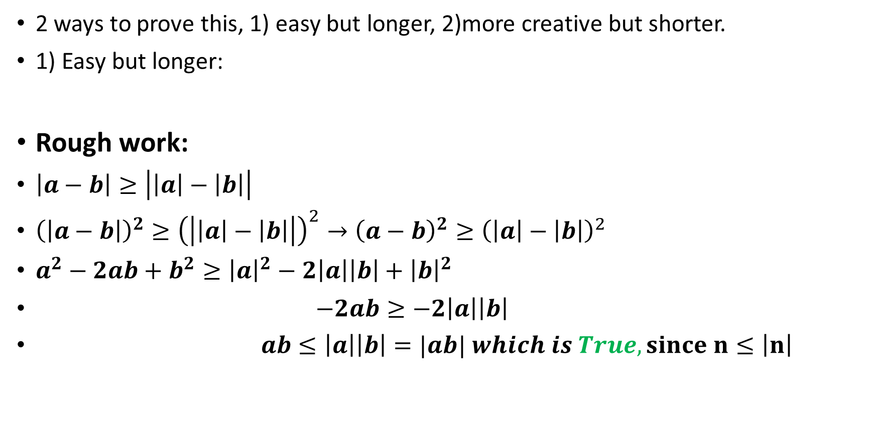



Example 9
Prove that for all real a and b we have
$$\left|a−b\right|≥\left|\left|a\right|−\left|b\right|\right|.$$
2 ways to prove this, 1) easy but longer, 2)more creative but shorter.
1) Easy but longer:
Rough work:
$\left|a−b\right|≥\left|\left|a\right|−\left|b\right|\right|$
${\left(\left|a−b\right|\right)}^{2}≥{\left(\left|\left|a\right|−\left|b\right|\right|\right)}^{2}→{\left(a−b\right)}^{2}≥{\left(\left|a\right|−\left|b\right|\right)}^{2}$
$a^{2}−2ab+b^{2}≥{\left|a\right|}^{2}−2\left|a\right|\left|b\right|+{\left|b\right|}^{2}$
$−2ab≥−2\left|a\right|\left|b\right|$
$ab≤\left|a\right|\left|b\right|=|ab| which is True, since n≤\left|n\right|$
$$square both sides$$
$$Note:a^{2}={\left|a\right|}^{2}$$
$$expand$$
$$Note:a^{2}={\left|a\right|}^{2}, b^{2}={\left|b\right|}^{2}$$
$$subtract a^{2} and b^{2}$$
$$devide by −2$$

Slide 29



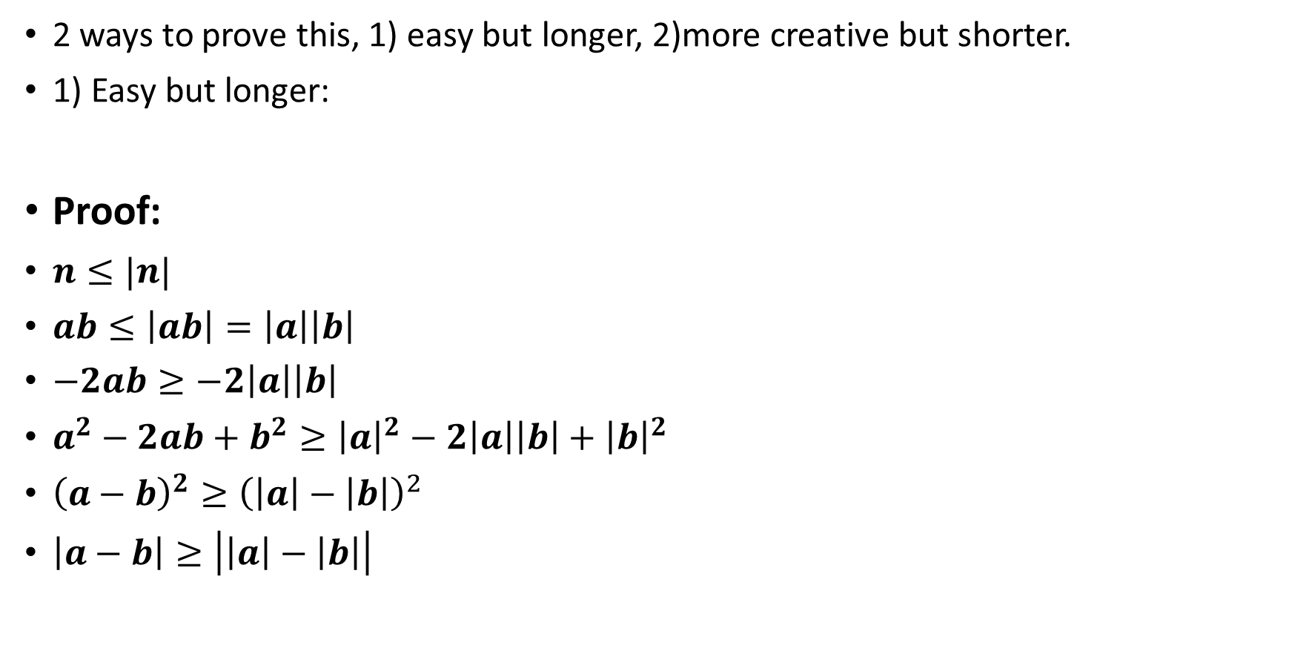



Example 9 cont’d
Prove that for all real a and b we have
$$\left|a−b\right|≥\left|\left|a\right|−\left|b\right|\right|.$$
2 ways to prove this, 1) easy but longer, 2)more creative but shorter.
1) Easy but longer:
Proof:
$n≤|n|$
$ab≤\left|ab\right|=\left|a\right|\left|b\right|$
$−2ab≥−2\left|a\right|\left|b\right|$
$a^{2}−2ab+b^{2}≥{\left|a\right|}^{2}−2\left|a\right|\left|b\right|+{\left|b\right|}^{2}$
${\left(a−b\right)}^{2}≥{\left(\left|a\right|−\left|b\right|\right)}^{2}$
$\left|a−b\right|≥\left|\left|a\right|−\left|b\right|\right|$
$$multipy by −2$$
$$add a^{2} and b^{2}$$
$$Note:a^{2}={\left|a\right|}^{2}, b^{2}={\left|b\right|}^{2}$$
$$rewrite$$
$$square root both sides$$
$$Note:\sqrt{a^{2}}=|a|$$

Slide 30
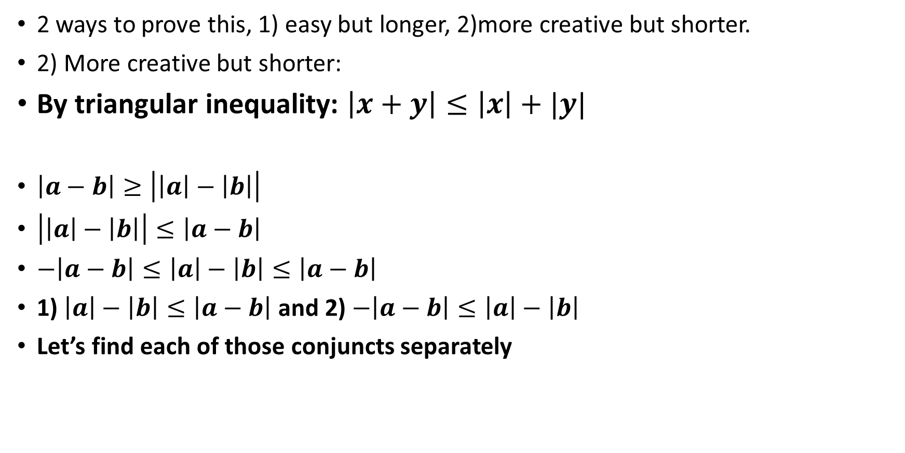
Example 9 cont’d
Prove that for all real a and b we have
$$\left|a−b\right|≥\left|\left|a\right|−\left|b\right|\right|.$$
2 ways to prove this, 1) easy but longer, 2)more creative but shorter.
2) More creative but shorter:
By triangular inequality: $\left|x+y\right|≤\left|x\right|+|y|$
$\left|a−b\right|≥\left|\left|a\right|−\left|b\right|\right|$
$\left|\left|a\right|−\left|b\right|\right|≤\left|a−b\right|$
$−\left|a−b\right|≤\left|a\right|−\left|b\right|≤\left|a−b\right|$
1) $\left|a\right|−\left|b\right|≤\left|a−b\right|$ and 2) $−\left|a−b\right|≤\left|a\right|−\left|b\right|$
Let’s find each of those conjuncts separately

Slide 31
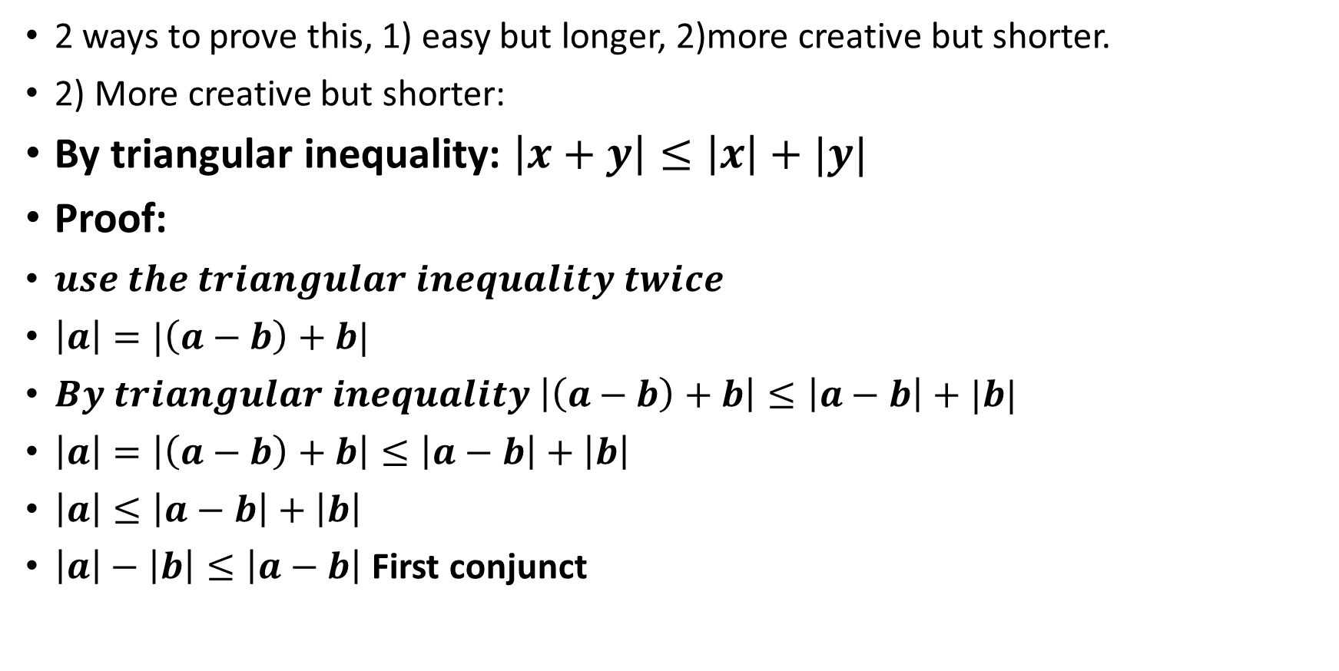
Example 9 cont’d
Prove that for all real a and b we have
$$\left|a−b\right|≥\left|\left|a\right|−\left|b\right|\right|.$$
2 ways to prove this, 1) easy but longer, 2)more creative but shorter.
2) More creative but shorter:
By triangular inequality: $\left|x+y\right|≤\left|x\right|+|y|$
Proof:
$use the triangular inequality twice$
$\left|a\right|=|\left(a−b\right)+b|$
$By triangular inequality \left|\left(a−b\right)+b\right|≤\left|a−b\right|+|b|$
$\left|a\right|=\left|\left(a−b\right)+b\right|≤\left|a−b\right|+\left|b\right|$
$\left|a\right|≤\left|a−b\right|+\left|b\right|$
$\left|a\right|−\left|b\right|≤\left|a−b\right|$ First conjunct

Slide 32
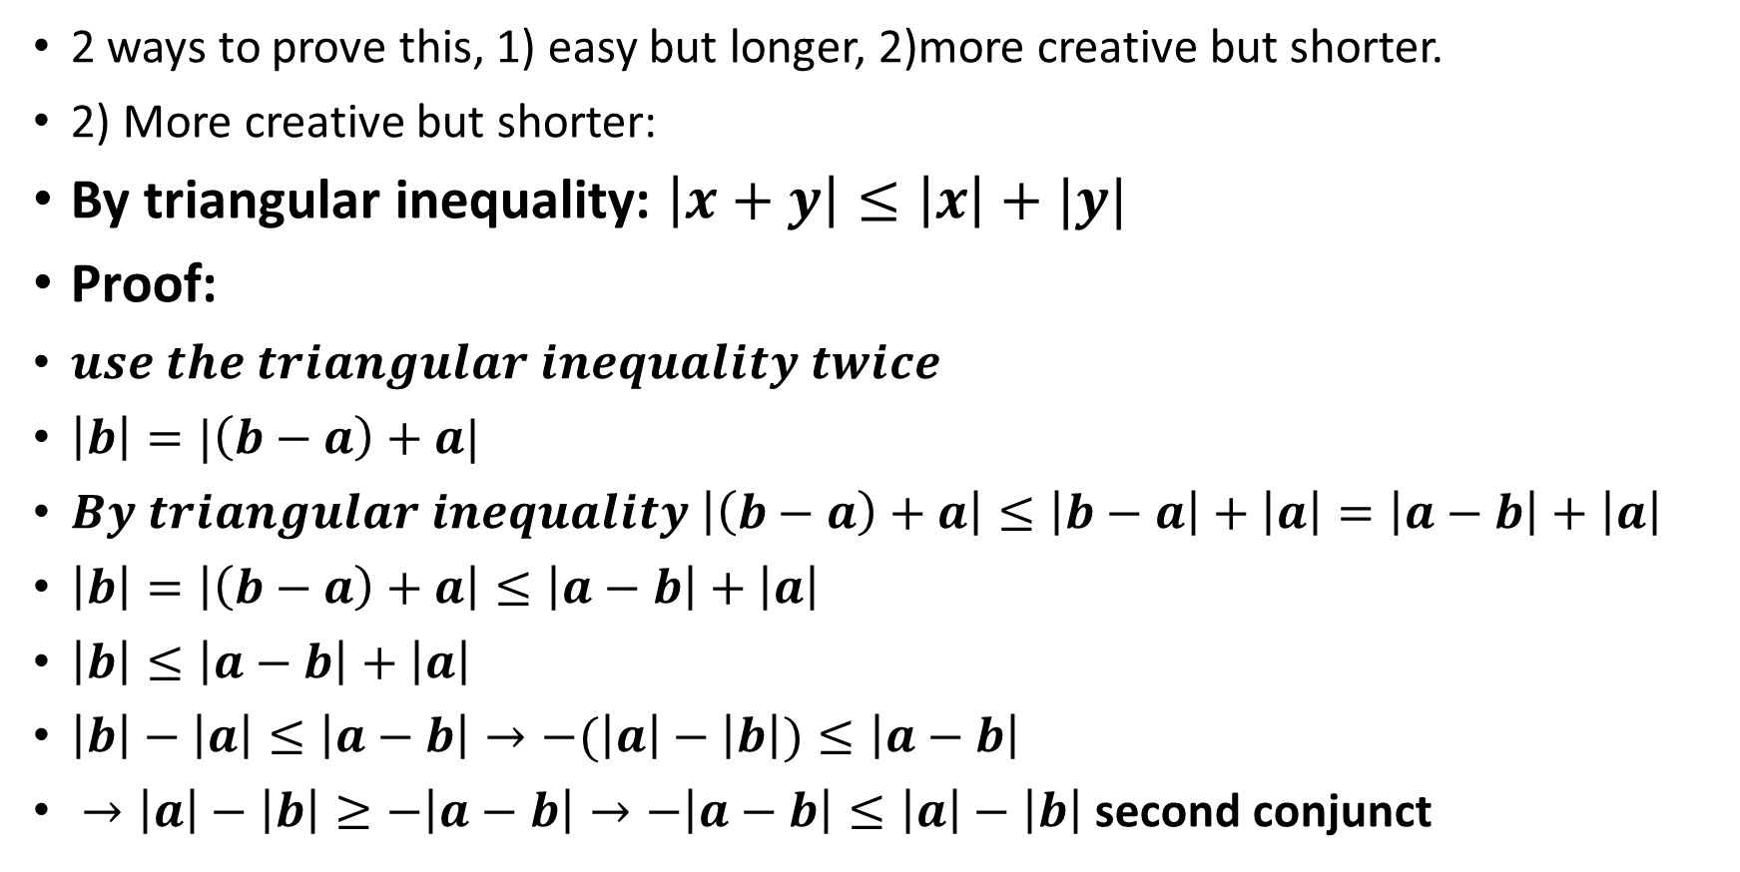

Example 9 cont’d
Prove that for all real a and b we have
$$\left|a−b\right|≥\left|\left|a\right|−\left|b\right|\right|.$$
2 ways to prove this, 1) easy but longer, 2)more creative but shorter.
2) More creative but shorter:
By triangular inequality: $\left|x+y\right|≤\left|x\right|+|y|$
Proof:
$use the triangular inequality twice$
$\left|b\right|=|\left(b−a\right)+a|$
$By triangular inequality \left|\left(b−a\right)+a\right|≤\left|b−a\right|+\left|a\right|=\left|a−b\right|+\left|a\right|$
$\left|b\right|=\left|\left(b−a\right)+a\right|≤\left|a−b\right|+\left|a\right|$
$\left|b\right|≤\left|a−b\right|+\left|a\right|$
$\left|b\right|−\left|a\right|≤\left|a−b\right|→−(\left|a\right|−\left|b\right|)≤\left|a−b\right|$
$→\left|a\right|−\left|b\right|≥−\left|a−b\right|→−\left|a−b\right|≤\left|a\right|−\left|b\right|$second conjunct
$$multipy by −1$$

Slide 33
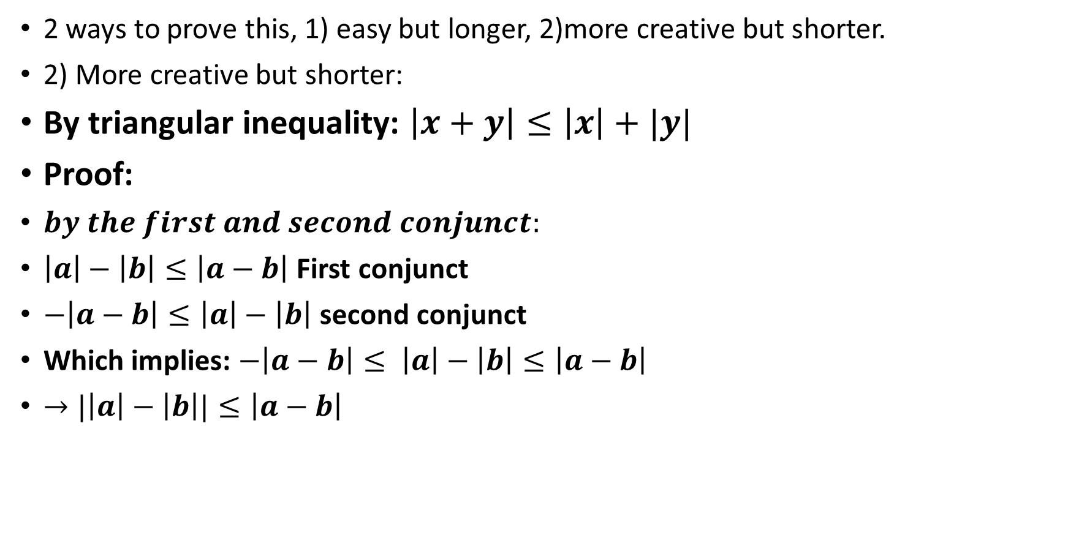

Example 9 cont’d
Prove that for all real a and b we have
$$\left|a−b\right|≥\left|\left|a\right|−\left|b\right|\right|.$$
2 ways to prove this, 1) easy but longer, 2)more creative but shorter.
2) More creative but shorter:
By triangular inequality: $\left|x+y\right|≤\left|x\right|+|y|$
Proof:
$by the first and second conjunct:$
$\left|a\right|−\left|b\right|≤\left|a−b\right|$ First conjunct
$−\left|a−b\right|≤\left|a\right|−\left|b\right|$second conjunct
Which implies: $−\left|a−b\right|≤ \left|a\right|−\left|b\right|≤\left|a−b\right|$
$→|\left|a\right|−\left|b\right||≤\left|a−b\right|$
$$Note:\left|x\right|<2⇔−2<x<2$$

Slide 34








Example 10
Show that for any positive a and b the following inequality holds true:
$$\sqrt{\frac{a^{2}}{b}}+\sqrt{\frac{b^{2}}{a}}≥\sqrt{a}+\sqrt{b}$$
Rough work:
$\sqrt{\frac{a^{2}}{b}}+\sqrt{\frac{b^{2}}{a}}≥\sqrt{a}+\sqrt{b} {\left(\sqrt{\frac{a^{2}}{b}}+\sqrt{\frac{b^{2}}{a}}\right)}^{2}≥{\left(\sqrt{a}+\sqrt{b}\right)}^{2},$
$\frac{a^{2}}{b}+2\sqrt{a}\sqrt{b}+\frac{b^{2}}{a}≥a+2\sqrt{a}\sqrt{b}+b,$
$\frac{a^{2}}{b}+\frac{b^{2}}{a}≥a+b,$
$\frac{a^{2}}{b}−a+\frac{b^{2}}{a}−b≥0,$
$a^{3}−a^{2}b+b^{3}−b^{2}a≥0,$
$a^{2}\left(a−b\right)−b^{2}(a−b)≥0,$
${(a}^{2}−b^{2})\left(a−b\right)≥0 (a−b)(a+b)(a−b)≥0,$
${\left(a−b\right)}^{2}(a+b)≥0,$
Square both sides
$$−2\sqrt{a}\sqrt{b}$$
$$−(a+b)$$
$$multiply by ab, since ab>0$$
$$the sign of inequality doesn^{′}t change.$$
$$factor an a^{2}and a b^{2}$$
$$factor (a−b)$$
$$expand$$
$$which is True since both factors are positive$$

Slide 35


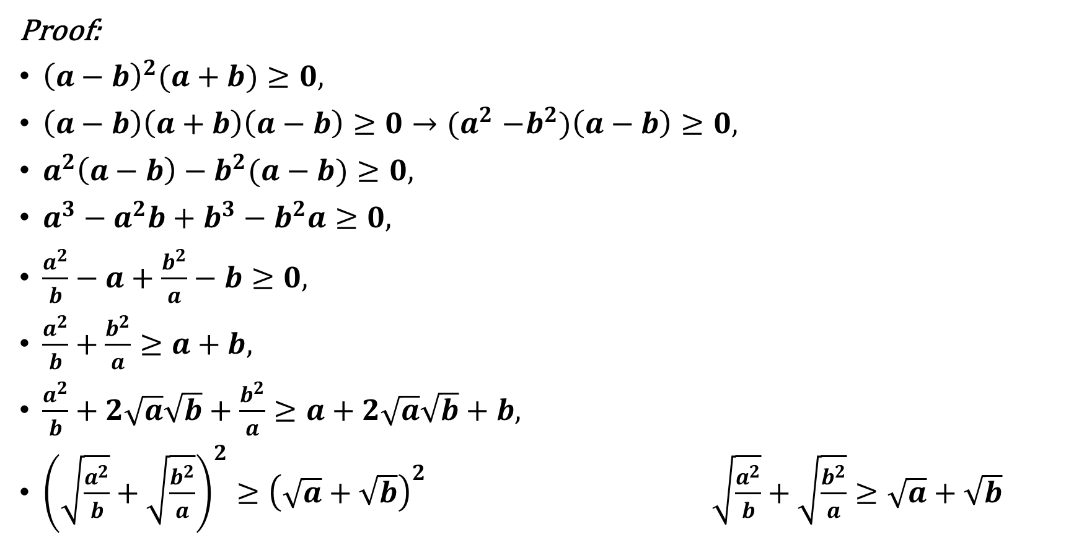




Example 10
Show that for any positive a and b the following inequality holds true:
$$\sqrt{\frac{a^{2}}{b}}+\sqrt{\frac{b^{2}}{a}}≥\sqrt{a}+\sqrt{b}$$
Proof:
${\left(a−b\right)}^{2}(a+b)≥0,$
$\left(a−b\right)\left(a+b\right)\left(a−b\right)≥0{→(a}^{2}−b^{2})\left(a−b\right)≥0,$
$a^{2}\left(a−b\right)−b^{2}(a−b)≥0,$
$a^{3}−a^{2}b+b^{3}−b^{2}a≥0,$
$\frac{a^{2}}{b}−a+\frac{b^{2}}{a}−b≥0,$
$\frac{a^{2}}{b}+\frac{b^{2}}{a}≥a+b,$
$\frac{a^{2}}{b}+2\sqrt{a}\sqrt{b}+\frac{b^{2}}{a}≥a+2\sqrt{a}\sqrt{b}+b,$
${\left(\sqrt{\frac{a^{2}}{b}}+\sqrt{\frac{b^{2}}{a}}\right)}^{2}≥{\left(\sqrt{a}+\sqrt{b}\right)}^{2} \sqrt{\frac{a^{2}}{b}}+\sqrt{\frac{b^{2}}{a}}≥\sqrt{a}+\sqrt{b}$
$$True since both factors are positive$$
$$expand$$
$$expand$$
$$expand$$
$$devide by ab, since ab>0$$
$$the sign of inequality doesn^{′}t change.$$
$$+(a+b)$$
$$+2\sqrt{a}\sqrt{b}$$
factor
square root

Slide 36
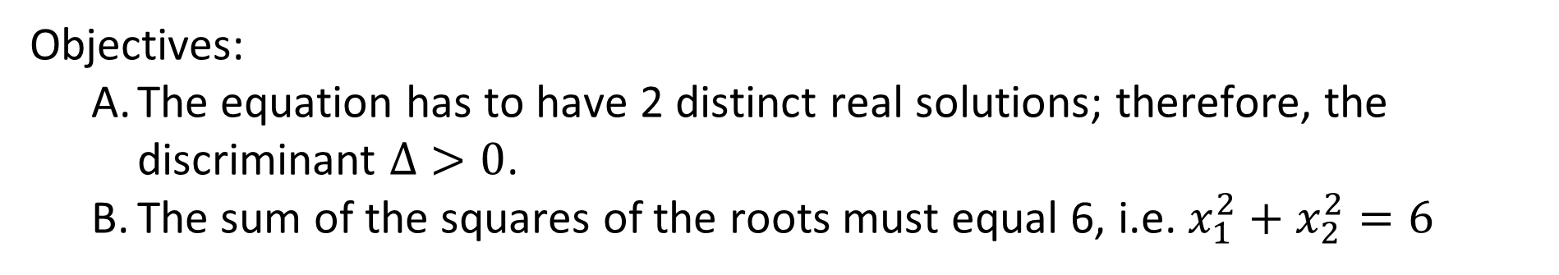

Example 11
For what values of the parameter a, is the sum of squares of two distinct solutions of the equation $x^{2} −4ax + 5a = 0$equal to 6?
Objectives:
The equation has to have 2 distinct real solutions; therefore, the discriminant $Δ>0$.
The sum of the squares of the roots must equal 6, i.e. $x_{1}^{2}+x_{2}^{2}=6$

Slide 37

Example 11 cont’d
For what values of the parameter a, is the sum of squares of two distinct solutions of the equation $x^{2} −4ax + 5a = 0$equal to 6?
The equation has to have 2 distinct real solutions; therefore, the discriminant $Δ>0$. $Δ=b^{2}−4ac$
$Δ={\left(−4a\right)}^{2}−4\left(5a\right)$
$= 16a^{2}− 20a$
$=16a^{2} − 20a >0$
$⇒4a^{2} −5a>0$
$⇒a(4a−5)>0$
$⇒a<0 or a >5/4$

Slide 38
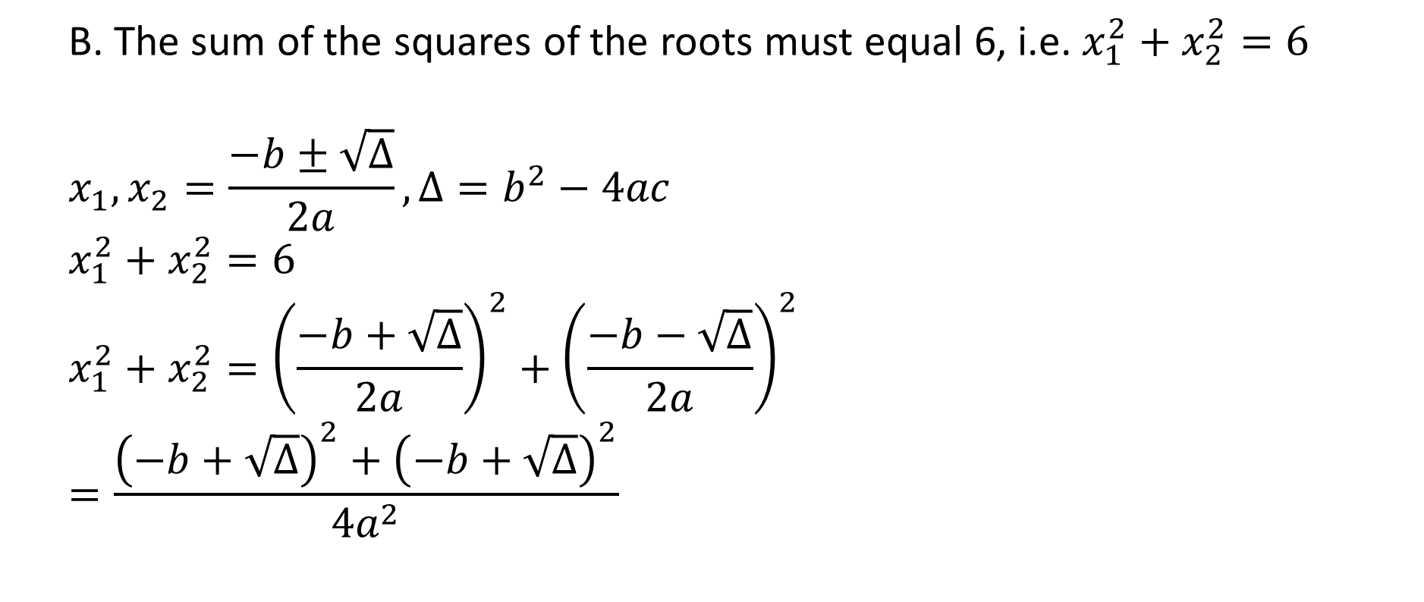
Example 11 cont’d
For what values of the parameter a, is the sum of squares of two distinct solutions of the equation $x^{2} −4ax + 5a = 0$equal to 6?
B. The sum of the squares of the roots must equal 6, i.e. $x_{1}^{2}+x_{2}^{2}=6$
$$x_{1},x_{2}=\frac{−b±\sqrt{Δ}}{2a}, Δ=b^{2}−4ac$$
$$x_{1}^{2}+x_{2}^{2}=6$$
$${x_{1}^{2}+x_{2}^{2}=\left(\frac{−b+\sqrt{Δ}}{2a}\right)}^{2}+{\left(\frac{−b−\sqrt{Δ}}{2a}\right)}^{2}$$
$$=\frac{{\left(−b+\sqrt{Δ}\right)}^{2}+{\left(−b+\sqrt{Δ}\right)}^{2}}{4a^{2}}$$

Slide 39
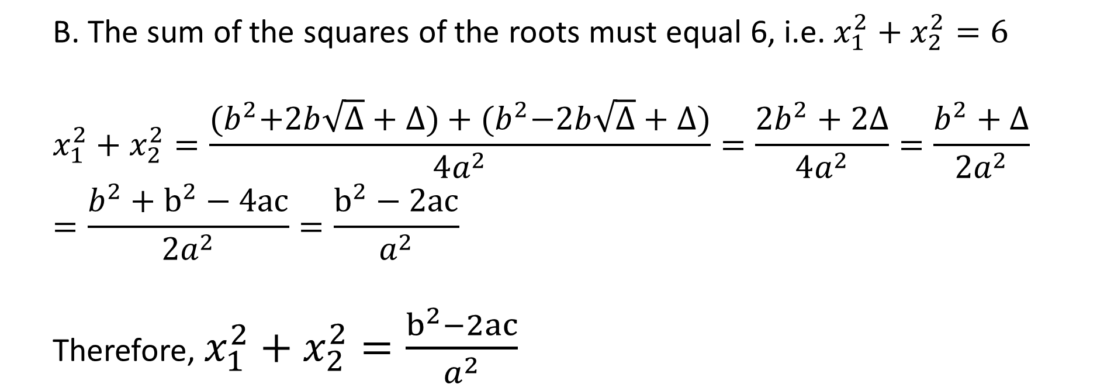
Example 11 cont’d
For what values of the parameter a, is the sum of squares of two distinct solutions of the equation $x^{2} −4ax + 5a = 0$equal to 6?
B. The sum of the squares of the roots must equal 6, i.e. $x_{1}^{2}+x_{2}^{2}=6$
$$x_{1}^{2}+x_{2}^{2}=\frac{{(b}^{2}+2b\sqrt{Δ}+Δ)+{(b}^{2}−2b\sqrt{Δ}+Δ)}{4a^{2}}=\frac{{2b}^{2}+2Δ}{4a^{2}}=\frac{b^{2}+Δ}{2a^{2}}$$
$$=\frac{b^{2}+b^{2}−4ac}{2a^{2}}=\frac{b^{2}−2ac}{a^{2}}$$
Therefore, $x_{1}^{2}+x_{2}^{2}=\frac{b^{2}−2ac}{a^{2}}$

Slide 40
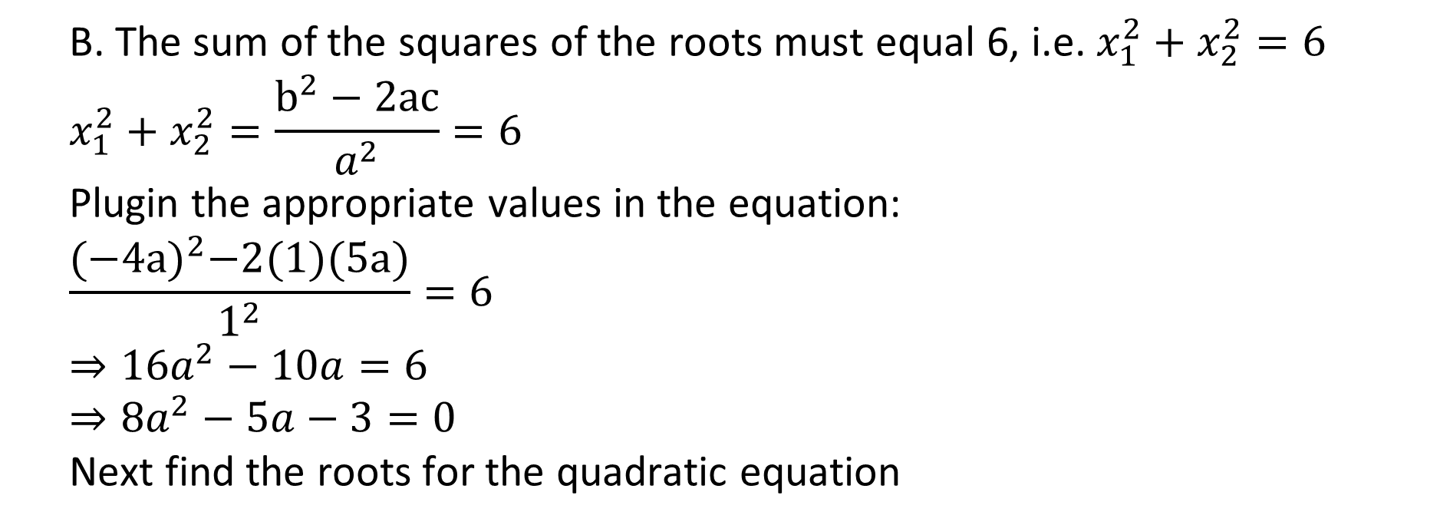
Example 11 cont’d
For what values of the parameter a, is the sum of squares of two distinct solutions of the equation $x^{2} −4ax + 5a = 0$equal to 6?
B. The sum of the squares of the roots must equal 6, i.e. $x_{1}^{2}+x_{2}^{2}=6$
$$x_{1}^{2}+x_{2}^{2}=\frac{b^{2}−2ac}{a^{2}}=6$$
Plugin the appropriate values in the equation:
$$\frac{{(−4a)}^{2}−2(1)(5a)}{1^{2}}=6$$
$$⇒16a^{2}−10a=6$$
$$⇒8a^{2}−5a−3=0$$
Next find the roots for the quadratic equation

Slide 41
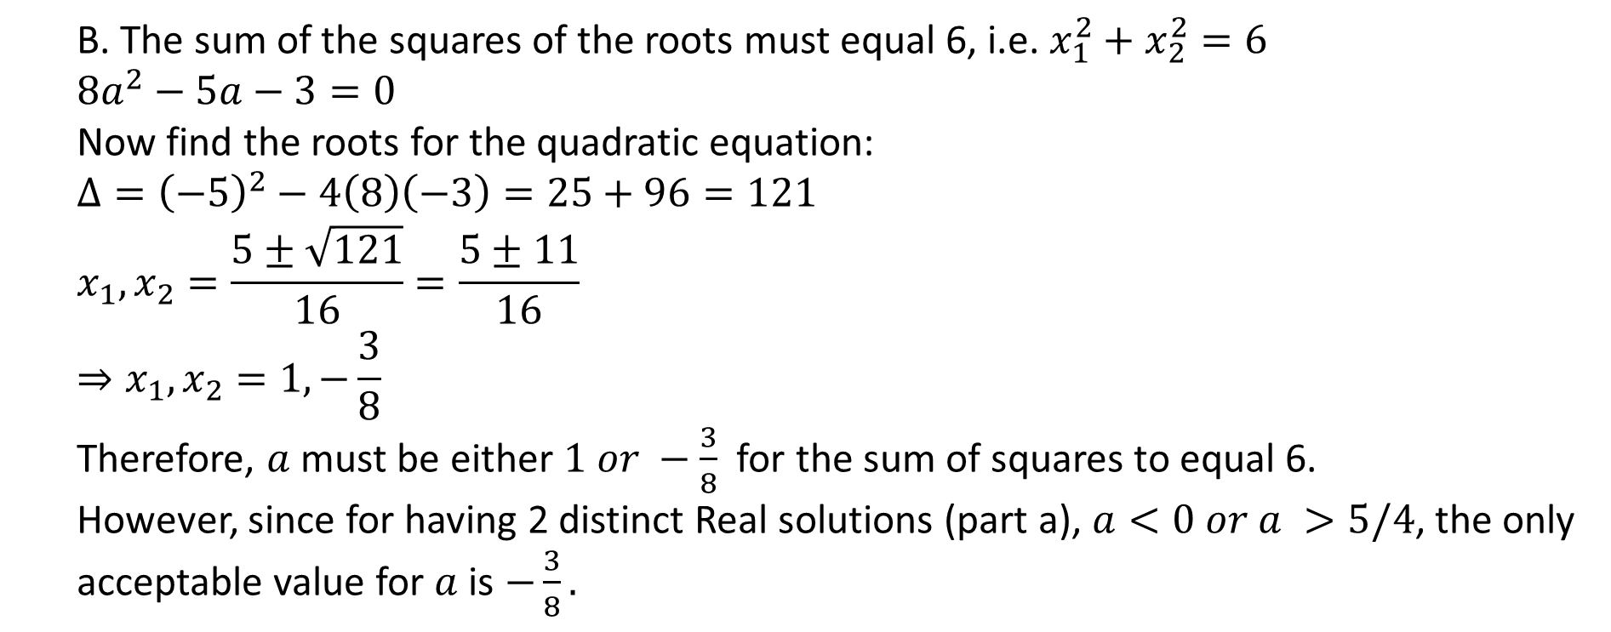
Example 11 cont’d
For what values of the parameter a, is the sum of squares of two distinct solutions of the equation $x^{2} −4ax + 5a = 0$equal to 6?
B. The sum of the squares of the roots must equal 6, i.e. $x_{1}^{2}+x_{2}^{2}=6$
$$8a^{2}−5a−3=0$$
Now find the roots for the quadratic equation:
$$Δ={\left(−5\right)}^{2}−4\left(8\right)\left(−3\right)=25+96=121$$
$$x_{1},x_{2}=\frac{5±\sqrt{121}}{16}=\frac{5±11}{16}$$
$$⇒x_{1},x_{2}=1, −\frac{3}{8}$$
Therefore, $a$ must be either $1 or −\frac{3}{8}$ for the sum of squares to equal 6.
However, since for having 2 distinct Real solutions (part a), $a<0 or a >5/4$, the only acceptable value for $a$ is $−\frac{3}{8}.$

Slide 42
Citations:
Book
Mathematical Thinking: Problem-solving and Proofs
D'Angelo, J.P.
West, D.B.
9780130144126
https://books.google.ca/books?id=fL6nQgAACAAJ
2000
Prentice Hall

