Slide 1

M$Δ$T1100110 of course in base 2
Arash Gholami
Tutorial 2
Email: arash.gholami@mail.utoronto.ca
LinkedIn

Slide 2
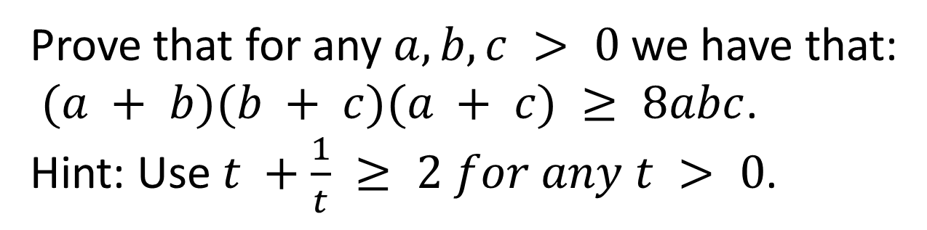
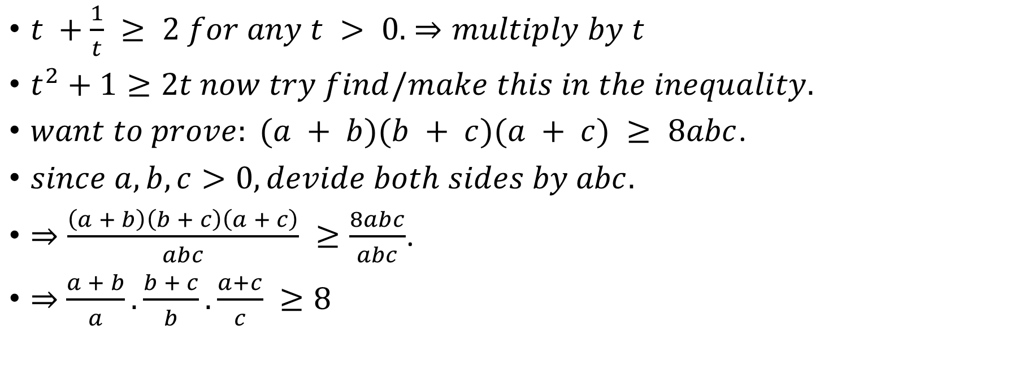
Example 0.1
Prove that for any $a, b, c > 0$we have that:
$(a + b)(b + c)(a + c) ≥ 8abc$.
Hint: Use $t +\frac{1}{t} ≥ 2 for any t > 0$.
$t +\frac{1}{t} ≥ 2 for any t > 0.$ $⇒multiply by t$
$t^{2}+1≥2t now try find/make this in the inequality.$
$want to prove: (a + b)(b + c)(a + c) ≥ 8abc$.
$since a,b,c>0, devide both sides by abc.$
$⇒\frac{\left(a + b\right)\left(b + c\right)\left(a + c\right)}{abc} ≥\frac{8abc}{abc}$.
$⇒$ $\frac{a + b}{a}.\frac{b + c}{b}.\frac{a+c}{c} ≥8$

Slide 3

Example 0.1
Prove that for any $a, b, c > 0$we have that:
$(a + b)(b + c)(a + c) ≥ 8abc$.
Hint: Use $t +\frac{1}{t} ≥ 2 for any t > 0$.
$⇒$ $\frac{a + b}{a}.\frac{b + c}{b}.\frac{a+c}{c} ≥8$
$(1+\frac{b}{a}).(1+\frac{c}{b}).\left(1+\frac{a}{c}\right) ≥8$
$t^{2}+1≥2t$
Now let:
$t_{1}^{2}=\frac{b}{a}⇒t_{1}=\sqrt{\frac{b}{a}} ,t_{2}^{2}=\frac{c}{b}⇒t_{2}=\sqrt{\frac{c}{b}}, t_{3}^{2}=\frac{a}{c}⇒t_{3}=\sqrt{\frac{a}{c}}$

Slide 4
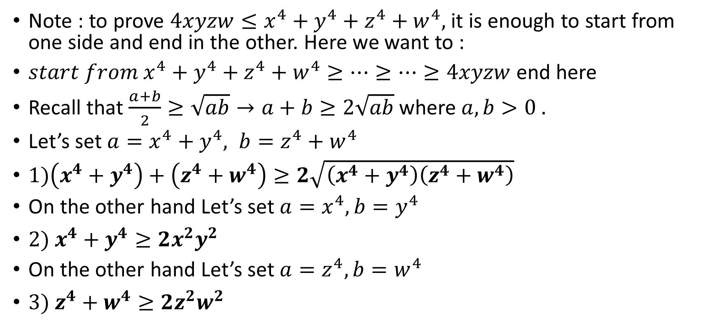
Example 1
Note : to prove $4xyzw≤x^{4}+{y^{4}+z}^{4}+w^{4},$ it is enough to start from one side and end in the other. Here we want to :
${start from x}^{4}+{y^{4}+z}^{4}+w^{4}≥…≥…≥4xyzw$ end here
Recall that $\frac{a+b}{2}≥\sqrt{ab}→a+b≥2\sqrt{ab}$ where $a, b>0 .$
Let’s set $a=x^{4}+y^{4}, b=z^{4}+w^{4}$
$1)\left(x^{4}+y^{4}\right)+\left(z^{4}+w^{4}\right)≥2\sqrt{\left(x^{4}+y^{4}\right)\left(z^{4}+w^{4}\right)}$
On the other hand Let’s set $a=x^{4}, b=y^{4}$
$2) x^{4}+y^{4}≥2x^{2}y^{2}$
On the other hand Let’s set $a=z^{4}, b=w^{4}$
$3) z^{4}+w^{4}≥2z^{2}w^{2}$

Slide 5
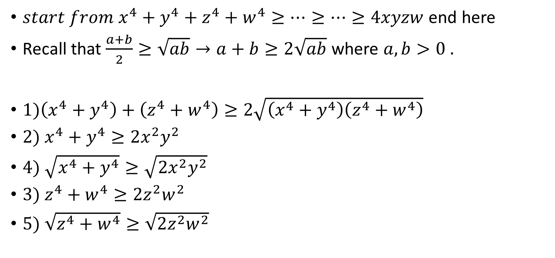
Example 1 cont’d
${start from x}^{4}+{y^{4}+z}^{4}+w^{4}≥…≥…≥4xyzw$ end here
Recall that $\frac{a+b}{2}≥\sqrt{ab}→a+b≥2\sqrt{ab}$ where $a, b>0 .$
$1)\left(x^{4}+y^{4}\right)+\left(z^{4}+w^{4}\right)≥2\sqrt{\left(x^{4}+y^{4}\right)\left(z^{4}+w^{4}\right)}$
$2) x^{4}+y^{4}≥2x^{2}y^{2}$
$4) \sqrt{x^{4}+y^{4}}≥\sqrt{2x^{2}y^{2}}$
$3) z^{4}+w^{4}≥2z^{2}w^{2}$
$5) \sqrt{z^{4}+w^{4}}≥\sqrt{2z^{2}w^{2}}$
Make this part out of inequality number 2 and 3
Since both sides are positive we can square root both sides
Since both sides are positive we can square root both sides

Slide 6

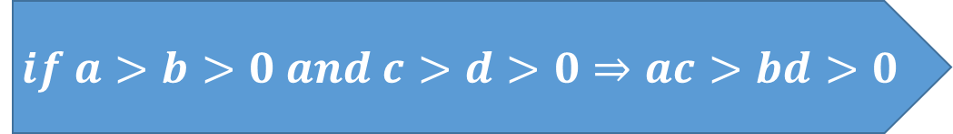
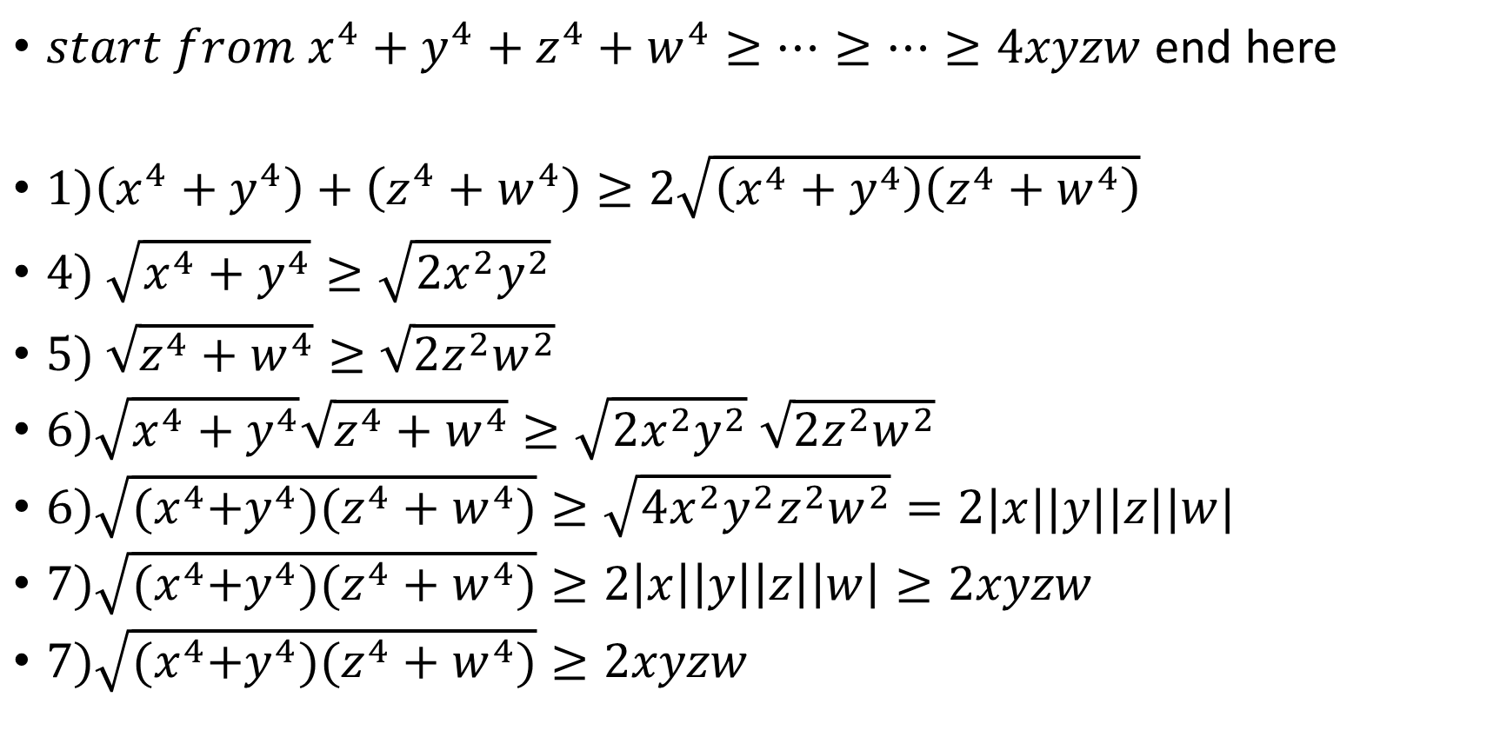
Example 1 cont’d
${start from x}^{4}+{y^{4}+z}^{4}+w^{4}≥…≥…≥4xyzw$ end here
$1)\left(x^{4}+y^{4}\right)+\left(z^{4}+w^{4}\right)≥2\sqrt{\left(x^{4}+y^{4}\right)\left(z^{4}+w^{4}\right)}$
$4) \sqrt{x^{4}+y^{4}}≥\sqrt{2x^{2}y^{2}}$
$5) \sqrt{z^{4}+w^{4}}≥\sqrt{2z^{2}w^{2}}$
$6)\sqrt{x^{4}+y^{4}}\sqrt{z^{4}+w^{4}}≥\sqrt{2x^{2}y^{2}}$ $\sqrt{2z^{2}w^{2}}$
$6)\sqrt{{(x}^{4}+y^{4})(z^{4}+w^{4})}≥\sqrt{4x^{2}y^{2}z^{2}w^{2}}=2|x||y||z||w|$
$7)\sqrt{{(x}^{4}+y^{4})(z^{4}+w^{4})}≥2\left|x\right|\left|y\right|\left|z\right|\left|w\right|≥2xyzw$
$7)\sqrt{{(x}^{4}+y^{4})(z^{4}+w^{4})}≥2xyzw$
Make this part out of inequality number 2 and 3
$$if a>b>0 and c>d>0⇒ac>bd>0$$
$$\left|x\right|\left|y\right|≥xy$$

Slide 7
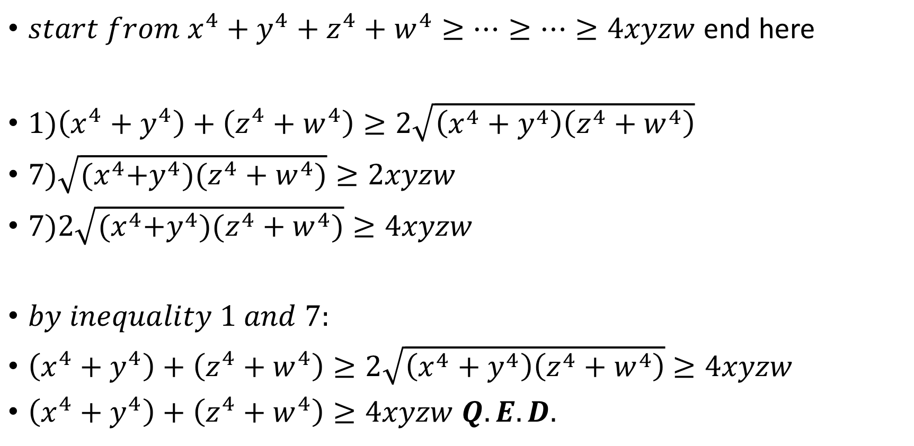

Example 1 cont’d
${start from x}^{4}+{y^{4}+z}^{4}+w^{4}≥…≥…≥4xyzw$ end here
$1)\left(x^{4}+y^{4}\right)+\left(z^{4}+w^{4}\right)≥2\sqrt{\left(x^{4}+y^{4}\right)\left(z^{4}+w^{4}\right)}$
$7)\sqrt{{(x}^{4}+y^{4})(z^{4}+w^{4})}≥2xyzw$
$7)2\sqrt{{(x}^{4}+y^{4})(z^{4}+w^{4})}≥4xyzw$
$by inequality 1 and 7:$
$\left(x^{4}+y^{4}\right)+\left(z^{4}+w^{4}\right)≥2\sqrt{\left(x^{4}+y^{4}\right)\left(z^{4}+w^{4}\right)}$ $≥4xyzw$
$\left(x^{4}+y^{4}\right)+\left(z^{4}+w^{4}\right)≥4xyzw Q.E.D.$
$$just multiply both sides by 2$$

Slide 8
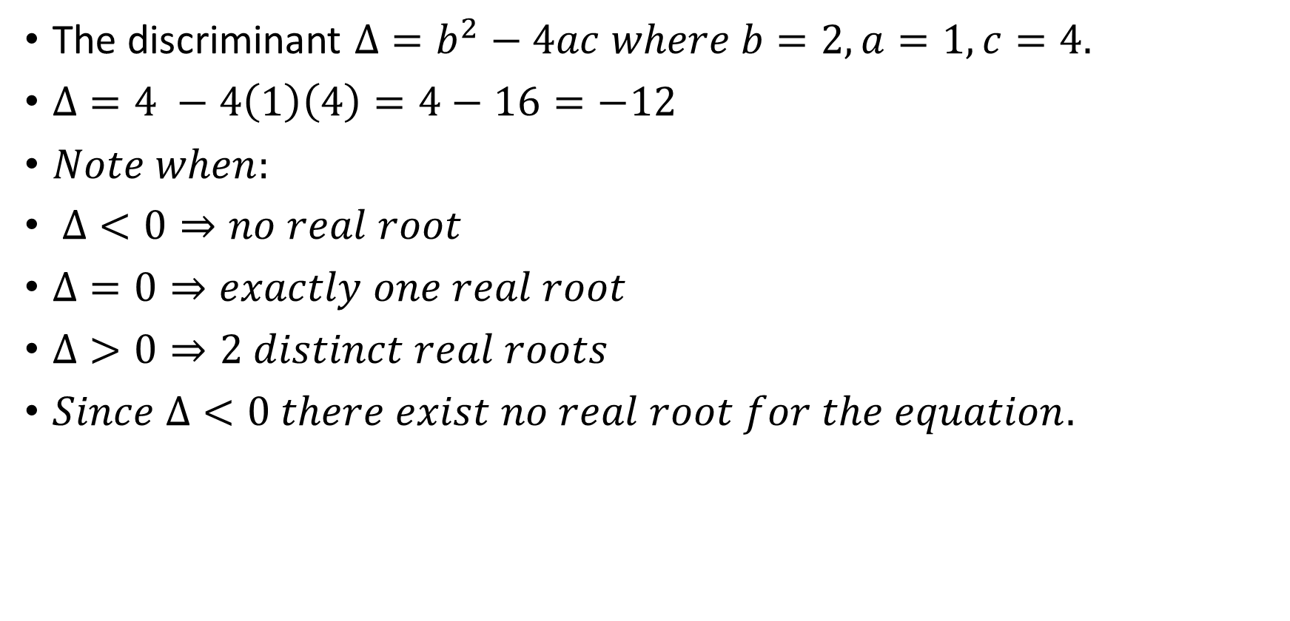
Example 2
1. (a) Find all real solutions of the equation $x^{2}+2x+4=0$if there are any.
The discriminant $Δ=b^{2}−4ac where b=2, a=1, c=4.$
$Δ=4 −4\left(1\right)\left(4\right)=4−16=−12$
$Note when:$
$Δ<0⇒no real root$
$Δ=0⇒exactly one real root$
$Δ>0⇒2 distinct real roots$
$Since Δ<0 there exist no real root for the equation.$

Slide 9
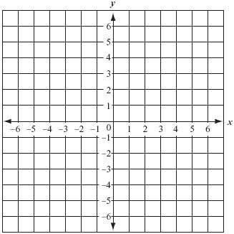
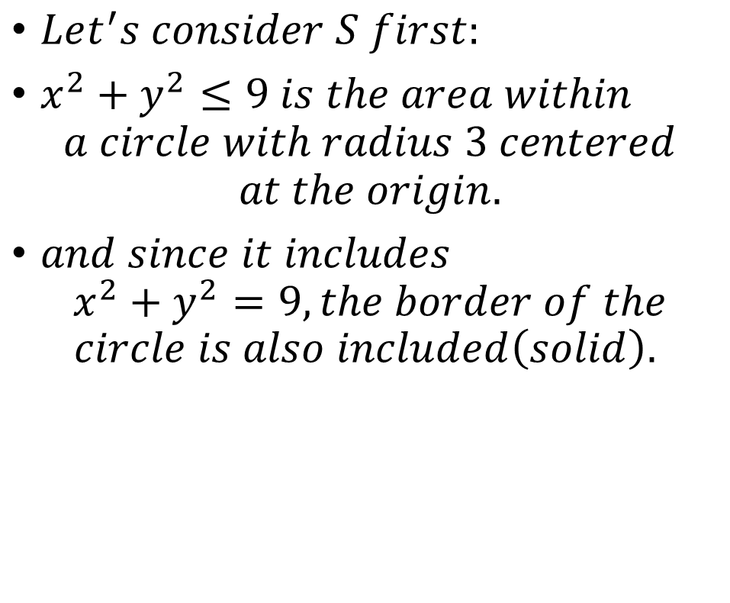
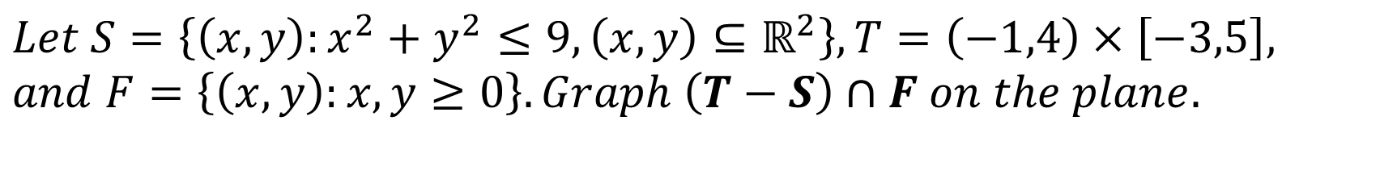
Example 3
$$Let S=\left\{\left(x,y\right):x^{2}+y^{2}≤9, \left(x,y\right)⊆ℝ^{2}\right\}, T=\left(−1,4\right)×\left[−3,5\right],$$
$$and F=\left\{\left(x,y\right):x,y≥0\right\}. Graph \left(T−S\right)∩F on the plane.$$
$Let^{′}s consider S first:$
$x^{2}+y^{2}≤9 is the area within$
$$a circle with radius 3 centered$$
$$at the origin.$$
$and since it includes$
$$x^{2}+y^{2}=9, the border of the$$
$$circle is also included\left(solid\right).$$

Slide 10
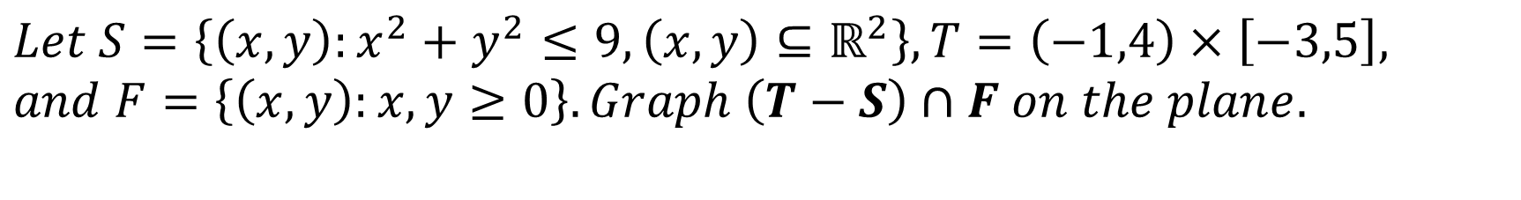
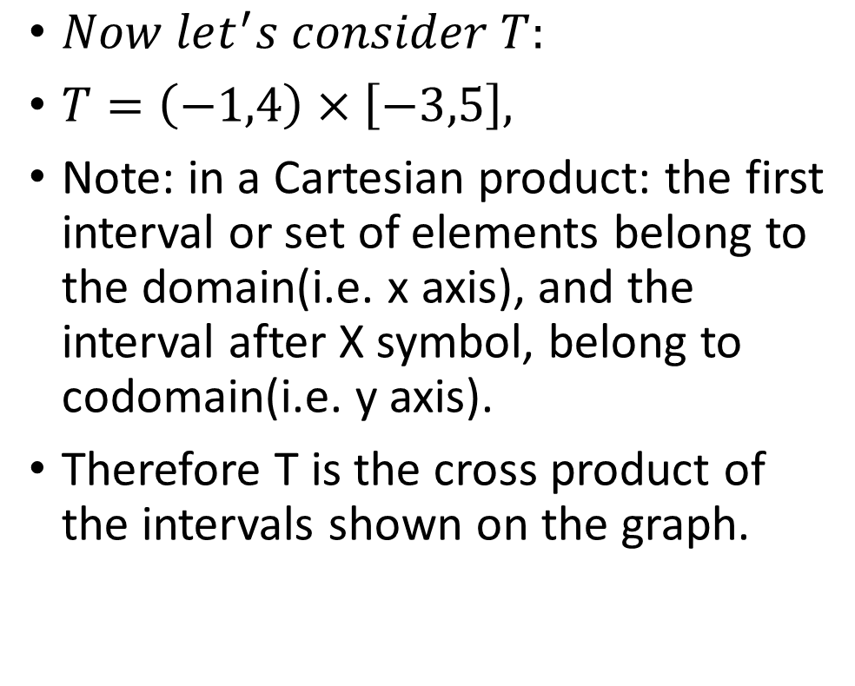
Example 3 cont’d
$$Let S=\left\{\left(x,y\right):x^{2}+y^{2}≤9, \left(x,y\right)⊆ℝ^{2}\right\}, T=\left(−1,4\right)×\left[−3,5\right],$$
$$and F=\left\{\left(x,y\right):x,y≥0\right\}. Graph \left(T−S\right)∩F on the plane.$$
$Now let^{′}s consider T:$
$T=\left(−1,4\right)×\left[−3,5\right],$
Note: in a Cartesian product: the first interval or set of elements belong to the domain(i.e. x axis), and the interval after X symbol, belong to codomain(i.e. y axis).
Therefore T is the cross product of the intervals shown on the graph.

Slide 11
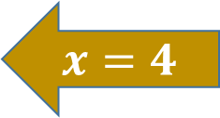

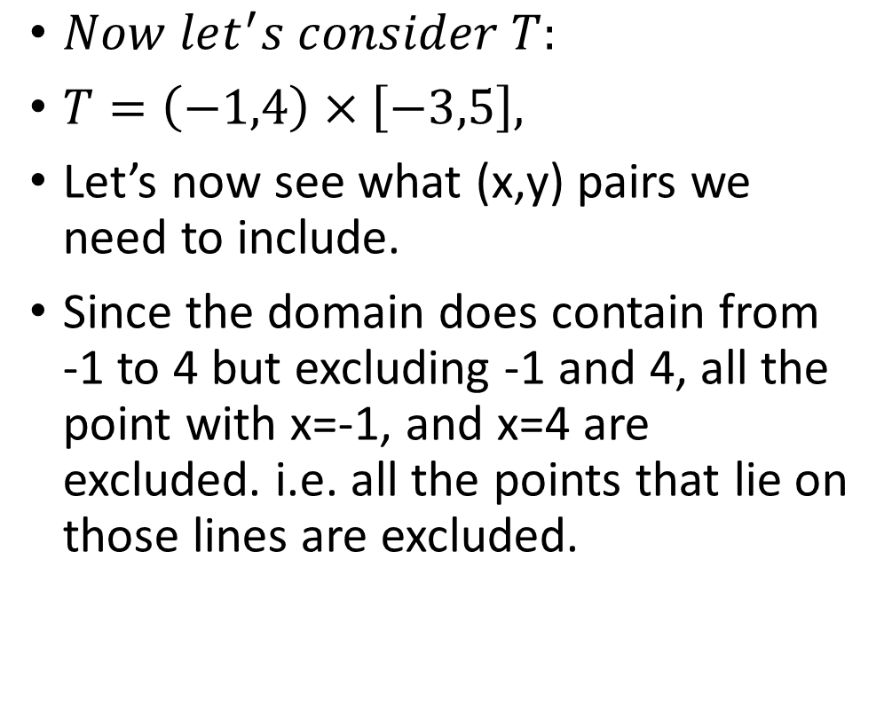
Example 3 cont’d
$$Let S=\left\{\left(x,y\right):x^{2}+y^{2}≤9, \left(x,y\right)⊆ℝ^{2}\right\}, T=\left(−1,4\right)×\left[−3,5\right],$$
$$and F=\left\{\left(x,y\right):x,y≥0\right\}. Graph \left(T−S\right)∩F on the plane.$$
$Now let^{′}s consider T:$
$T=\left(−1,4\right)×\left[−3,5\right],$
Let’s now see what (x,y) pairs we need to include.
Since the domain does contain from -1 to 4 but excluding -1 and 4, all the point with x=-1, and x=4 are excluded. i.e. all the points that lie on those lines are excluded.
$$x=−1$$
$$x=4$$

Slide 12
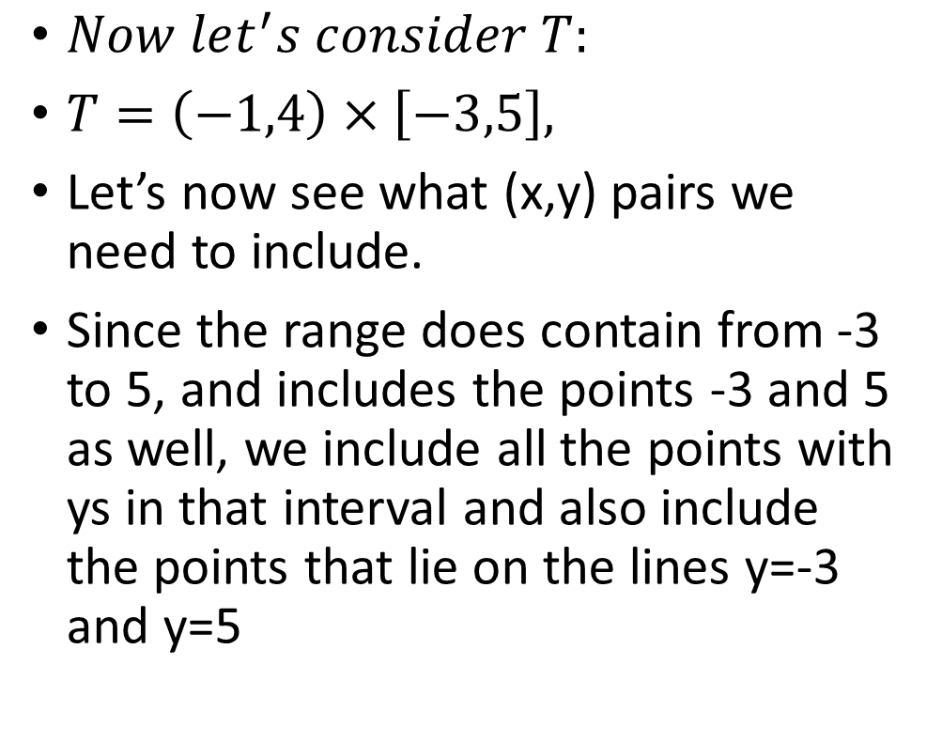




Example 3 cont’d
$$Let S=\left\{\left(x,y\right):x^{2}+y^{2}≤9, \left(x,y\right)⊆ℝ^{2}\right\}, T=\left(−1,4\right)×\left[−3,5\right],$$
$$and F=\left\{\left(x,y\right):x,y≥0\right\}. Graph \left(T−S\right)∩F on the plane.$$
$$x=−1$$
$$x=4$$
$Now let^{′}s consider T:$
$T=\left(−1,4\right)×\left[−3,5\right],$
Let’s now see what (x,y) pairs we need to include.
Since the range does contain from -3 to 5, and includes the points -3 and 5 as well, we include all the points with ys in that interval and also include the points that lie on the lines y=-3 and y=5
$$y=5$$
$$y=−3$$

Slide 13
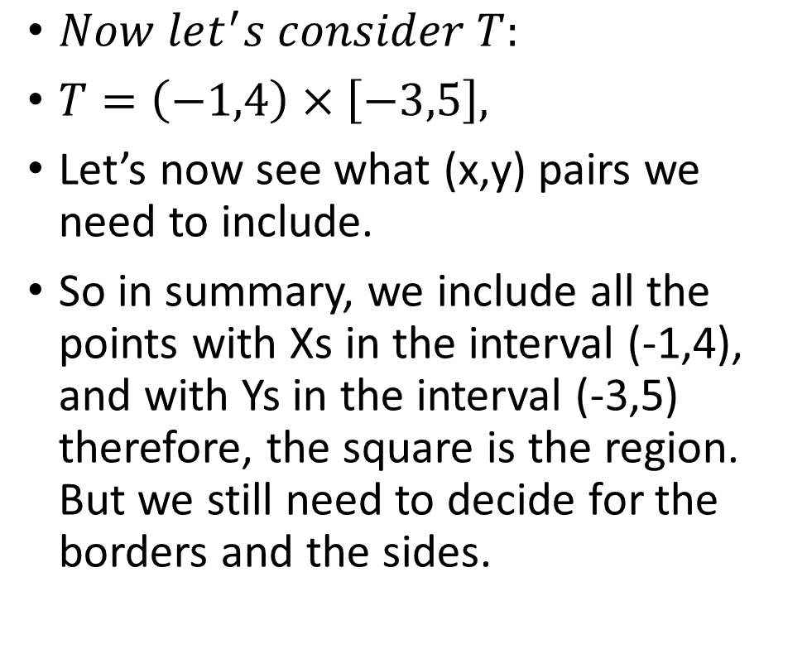
Example 3 cont’d
$$Let S=\left\{\left(x,y\right):x^{2}+y^{2}≤9, \left(x,y\right)⊆ℝ^{2}\right\}, T=\left(−1,4\right)×\left[−3,5\right],$$
$$and F=\left\{\left(x,y\right):x,y≥0\right\}. Graph \left(T−S\right)∩F on the plane.$$
$$x=−1$$
$$x=4$$
$Now let^{′}s consider T:$
$T=\left(−1,4\right)×\left[−3,5\right],$
Let’s now see what (x,y) pairs we need to include.
So in summary, we include all the points with Xs in the interval (-1,4), and with Ys in the interval (-3,5) therefore, the square is the region. But we still need to decide for the borders and the sides.
$$y=5$$
$$y=−3$$

Slide 14

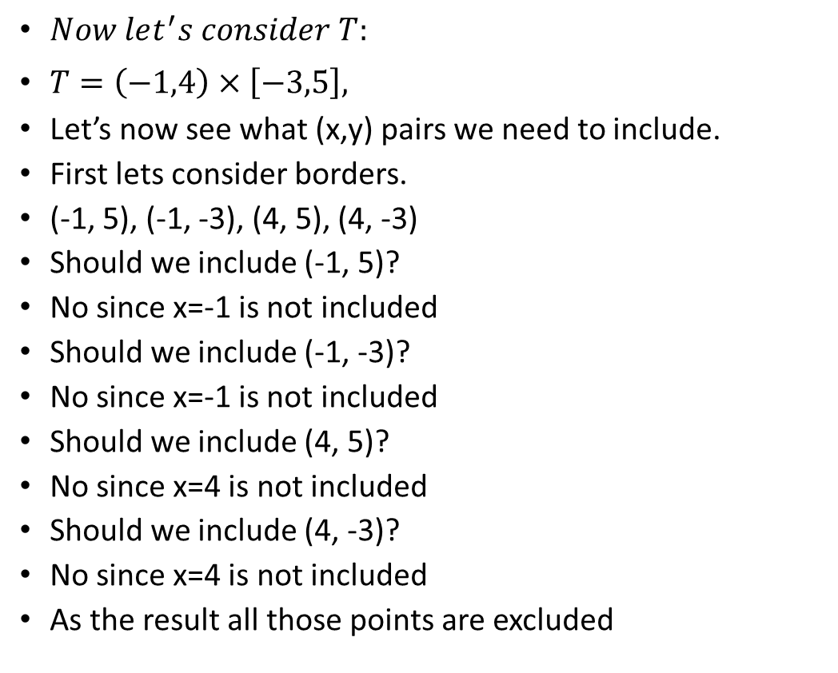
Example 3 cont’d
$$Let S=\left\{\left(x,y\right):x^{2}+y^{2}≤9, \left(x,y\right)⊆ℝ^{2}\right\}, T=\left(−1,4\right)×\left[−3,5\right],$$
$$and F=\left\{\left(x,y\right):x,y≥0\right\}. Graph \left(T−S\right)∩F on the plane.$$
$Now let^{′}s consider T:$
$T=\left(−1,4\right)×\left[−3,5\right],$
Let’s now see what (x,y) pairs we need to include.
First lets consider borders.
(-1, 5), (-1, -3), (4, 5), (4, -3)
Should we include (-1, 5)?
No since x=-1 is not included
Should we include (-1, -3)?
No since x=-1 is not included
Should we include (4, 5)?
No since x=4 is not included
Should we include (4, -3)?
No since x=4 is not included
As the result all those points are excluded
$$x=−1$$
$$x=4$$
$$y=5$$
$$y=−3$$

Slide 15
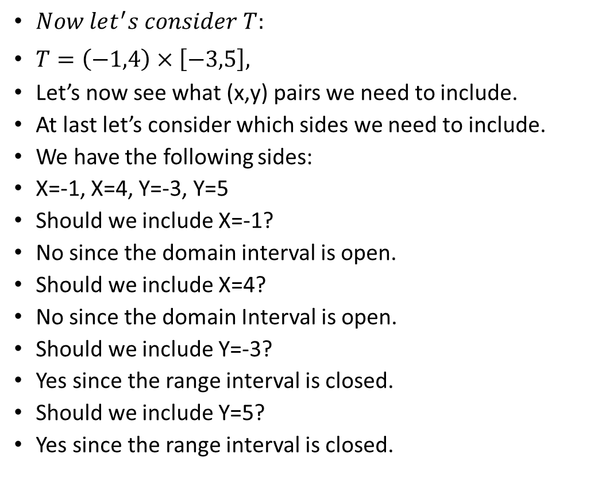
Example 3 cont’d
$$Let S=\left\{\left(x,y\right):x^{2}+y^{2}≤9, \left(x,y\right)⊆ℝ^{2}\right\}, T=\left(−1,4\right)×\left[−3,5\right],$$
$$and F=\left\{\left(x,y\right):x,y≥0\right\}. Graph \left(T−S\right)∩F on the plane.$$
$Now let^{′}s consider T:$
$T=\left(−1,4\right)×\left[−3,5\right],$
Let’s now see what (x,y) pairs we need to include.
At last let’s consider which sides we need to include.
We have the following sides:
X=-1, X=4, Y=-3, Y=5
Should we include X=-1?
No since the domain interval is open.
Should we include X=4?
No since the domain Interval is open.
Should we include Y=-3?
Yes since the range interval is closed.
Should we include Y=5?
Yes since the range interval is closed.
$$x=−1$$
$$x=4$$
$$y=5$$
$$y=−3$$

Slide 16

Example 3 cont’d
$$Let S=\left\{\left(x,y\right):x^{2}+y^{2}≤9, \left(x,y\right)⊆ℝ^{2}\right\}, T=\left(−1,4\right)×\left[−3,5\right],$$
$$and F=\left\{\left(x,y\right):x,y≥0\right\}. Graph \left(T−S\right)∩F on the plane.$$
$Now let^{′}s consider T:$
$T=\left(−1,4\right)×\left[−3,5\right],$
So the region for T is as follows.

Slide 17

Example 3 cont’d
$$Let S=\left\{\left(x,y\right):x^{2}+y^{2}≤9, \left(x,y\right)⊆ℝ^{2}\right\}, T=\left(−1,4\right)×\left[−3,5\right],$$
$$and F=\left\{\left(x,y\right):x,y≥0\right\}. Graph \left(T−S\right)∩F on the plane.$$
$Now let^{′}s consider F:$
$F=\left\{\left(x,y\right):x,y≥0\right\}$.
It is basically all the points with nonnegative Xs and nonnegative Ys

Slide 18
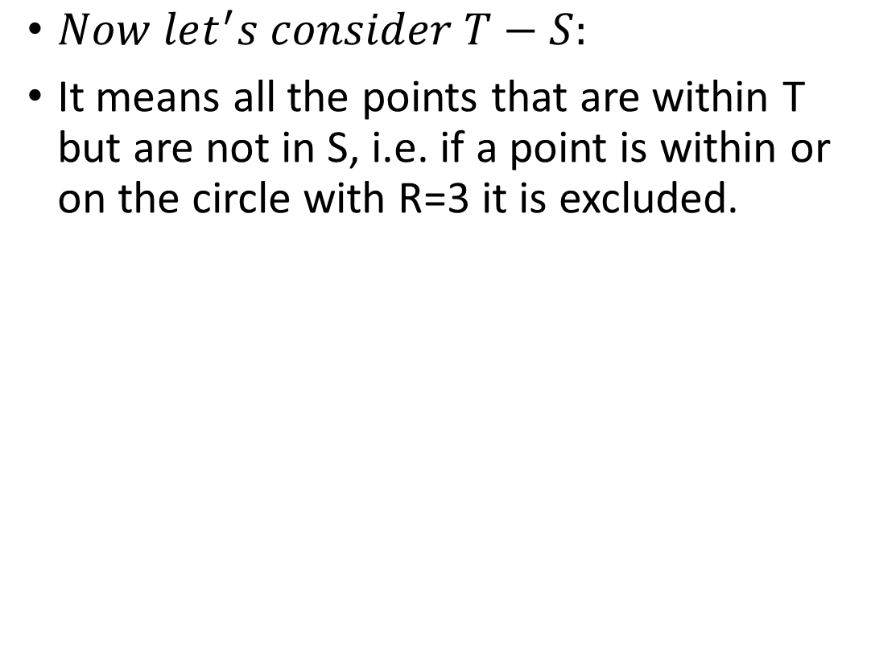
Example 3 cont’d
$$Let S=\left\{\left(x,y\right):x^{2}+y^{2}≤9, \left(x,y\right)⊆ℝ^{2}\right\}, T=\left(−1,4\right)×\left[−3,5\right],$$
$$and F=\left\{\left(x,y\right):x,y≥0\right\}. Graph \left(T−S\right)∩F on the plane.$$
$Now let^{′}s consider T−S:$
It means all the points that are within T but are not in S, i.e. if a point is within or on the circle with R=3 it is excluded.

Slide 19
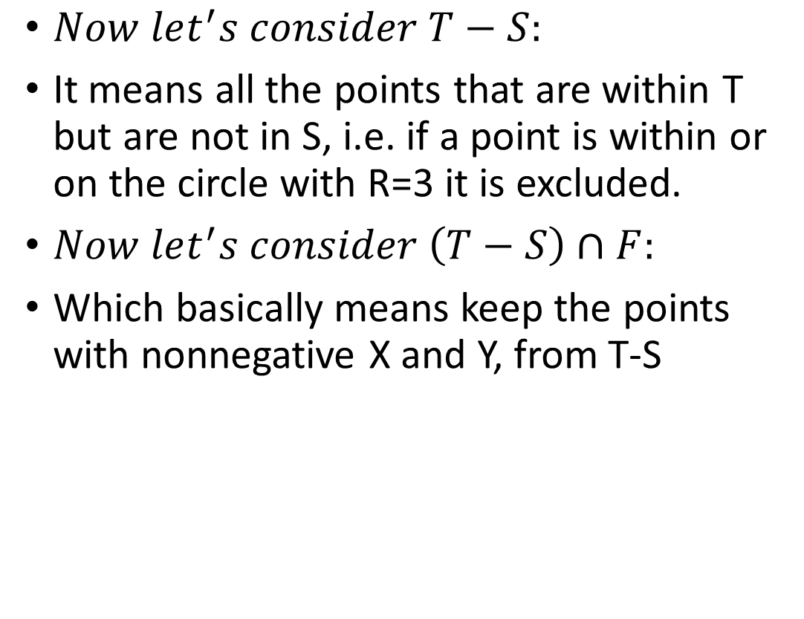
Example 3 cont’d
$$Let S=\left\{\left(x,y\right):x^{2}+y^{2}≤9, \left(x,y\right)⊆ℝ^{2}\right\}, T=\left(−1,4\right)×\left[−3,5\right],$$
$$and F=\left\{\left(x,y\right):x,y≥0\right\}. Graph \left(T−S\right)∩F on the plane.$$
$Now let^{′}s consider T−S:$
It means all the points that are within T but are not in S, i.e. if a point is within or on the circle with R=3 it is excluded.
$Now let^{′}s consider \left(T−S\right)∩F:$
Which basically means keep the points with nonnegative X and Y, from T-S

Slide 20


Example 3 cont’d
$$Let S=\left\{\left(x,y\right):x^{2}+y^{2}≤9, \left(x,y\right)⊆ℝ^{2}\right\}, T=\left(−1,4\right)×\left[−3,5\right],$$
$$and F=\left\{\left(x,y\right):x,y≥0\right\}. Graph \left(T−S\right)∩F on the plane.$$
$Now let^{′}s consider \left(T−S\right)∩F:$
Which basically means keep the points with nonnegative X and Y, from T-S

Slide 21
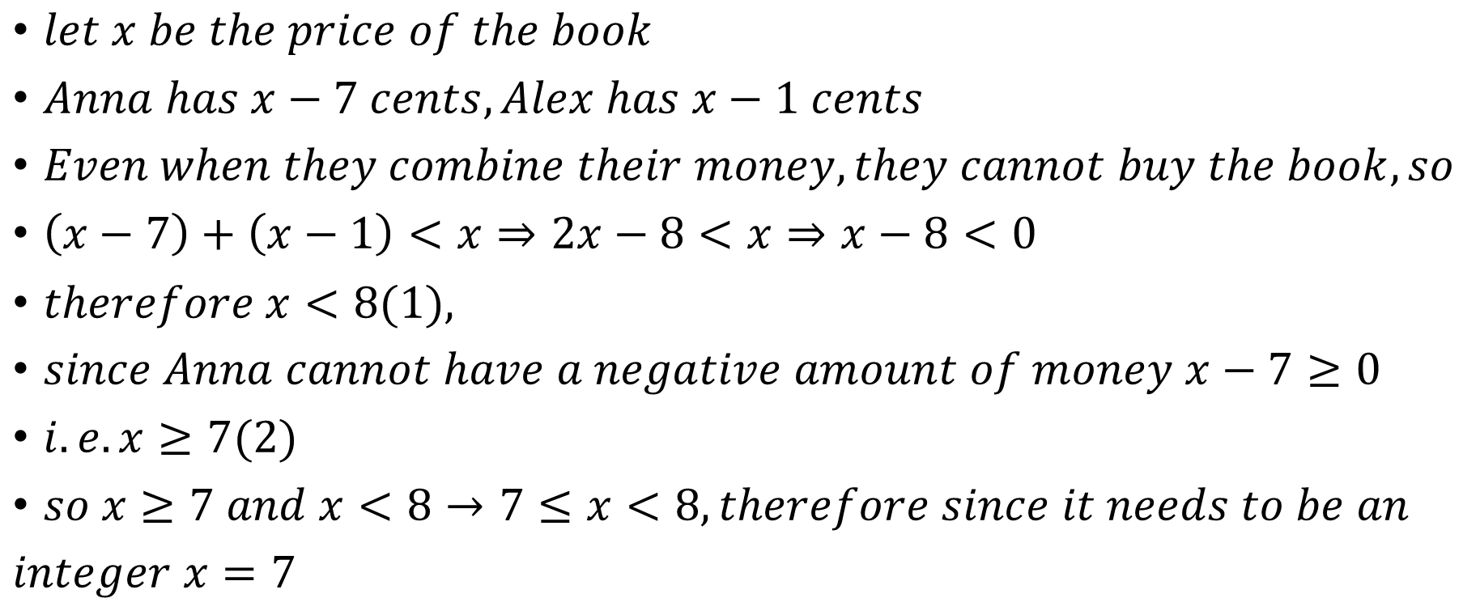
Example 4
Anna was seven cents short of the price of an alphabet book, and Alex was one cent short. They combined their money to buy one book to share, but even then they didn't have enough. How much did the book cost?
$let x be the price of the book$
$Anna has x−7 cents, Alex has x−1 cents$
$Even when they combine their money, they cannot buy the book,so$
$\left(x−7\right)+\left(x−1\right)<x⇒2x−8<x⇒x−8<0$
$therefore x<8(1),$
$since Anna cannot have a negative amount of money x−7≥0$
$i.e. x≥7(2)$
$so x≥7 and x<8→7≤x<8, therefore since it needs to be an$
$integer x=7$

Slide 22
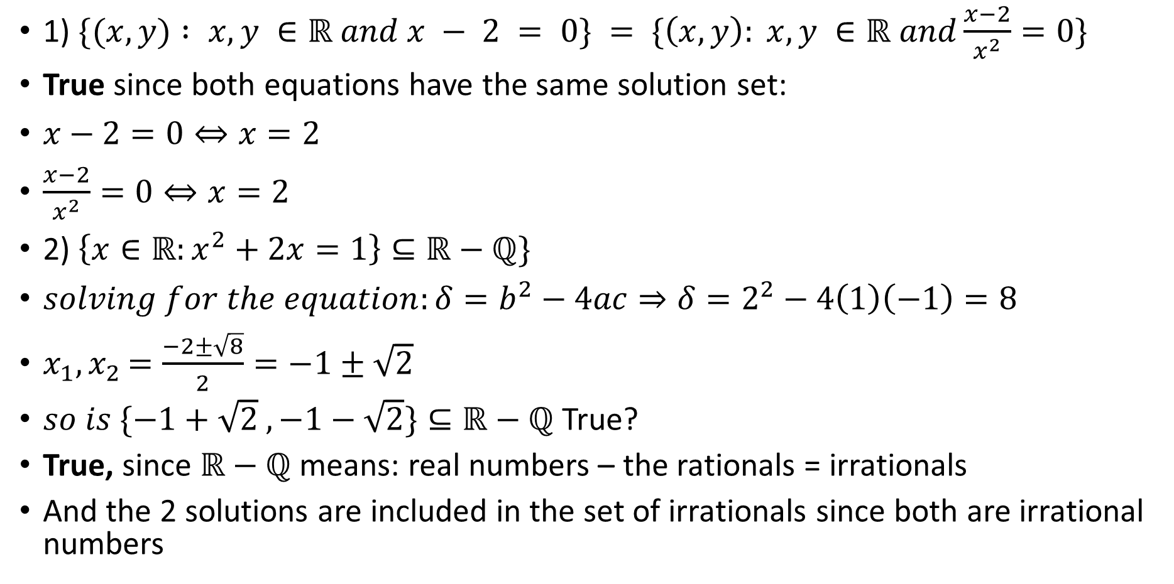
Example 5
For each statement, decide whether it is TRUE or FALSE. Justify your answer briefly.
1) $\{(x,y) : x,y ∈ℝ and x − 2 = 0\} = \{\left(x,y\right): x,y ∈ℝ and\frac{x−2}{x^{2}}=0\}$
True since both equations have the same solution set:
$x−2=0⇔x=2$
$\frac{x−2}{x^{2}}=0⇔x=2$
2) $\left\{x∈ℝ:x^{2}+2x=1\right\}⊆ℝ−ℚ\}$
$solving for the equation:δ=b^{2}−4ac⇒δ=2^{2}−4\left(1\right)\left(−1\right)=8$
$x_{1}{,x}_{2}=\frac{−2±\sqrt{8}}{2}=−1±\sqrt{2}$
$so is \{−1+\sqrt{2} ,−1−\sqrt{2}\}⊆ℝ−ℚ$ True?
True, since $ℝ−ℚ$ means: real numbers – the rationals = irrationals
And the 2 solutions are included in the set of irrationals since both are irrational numbers
Note both solutions are irrational numbers

Slide 23
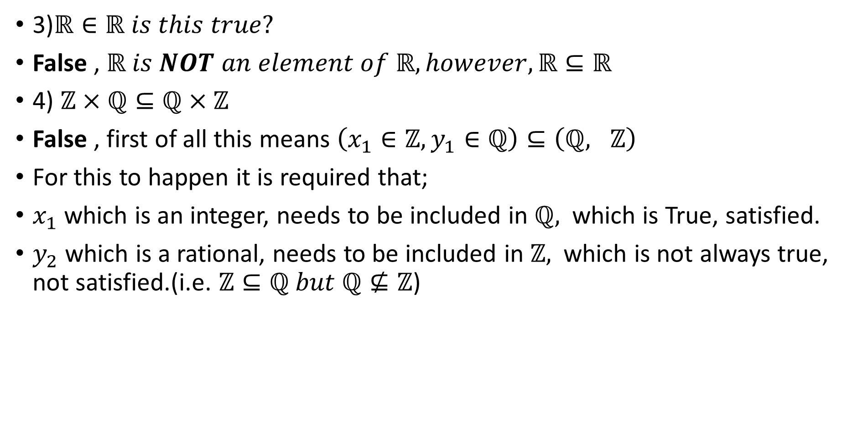
Example 5 cont’d
For each statement, decide whether it is TRUE or FALSE. Justify your answer briefly.
3)$ℝ∈ℝ is this true?$
False , $ℝ is NOT an element of ℝ, however, ℝ⊆ℝ$
4) $ℤ×ℚ⊆ℚ×ℤ$
False , first of all this means $\left(x_{1}∈ℤ, y_{1}∈ℚ\right)⊆\left(ℚ, ℤ\right)$
For this to happen it is required that;
$x_{1}$ which is an integer, needs to be included in $ℚ,$ which is True, satisfied.
$y_{2}$ which is a rational, needs to be included in $ℤ,$ which is not always true, not satisfied.(i.e. $ℤ⊆ℚ but ℚ⊈ℤ$)

Slide 24
Citations:
Book
Mathematical Thinking: Problem-solving and Proofs
D'Angelo, J.P.
West, D.B.
9780130144126
https://books.google.ca/books?id=fL6nQgAACAAJ
2000
Prentice Hall

