Slide 1

M$Δ$T1100110 of course in base 2
Arash Gholami
Tutorial 3
Email: arash.gholami@mail.utoronto.ca
LinkedIn

Slide 2


Example 1
$$a) let^{′}s consider A⊆A∪B$$
$$A∪B means the elements that are either in A or in B$$
universe
universe
A
B
A
B
$$A∪B$$

Slide 3



Example 1 cont’d
universe
$a) let^{′}s consider A⊆A∪B$
$A∪B means the elements that are$
$$either in A or in B$$
$A⊆A∪B means:$
$A is included in the A∪B,$
A
B
$$∪$$
universe
A
B
U
$$∪$$

Slide 4




Example 1 cont’d
$$a) let^{′}s now consider A∩B⊆A$$
$A∩B means the elements that are$
$$both in A and B$$
$$A∩B$$
universe
universe
A
B
A
B
$$A∩B$$
$$A∩$$
$$B$$

Slide 5
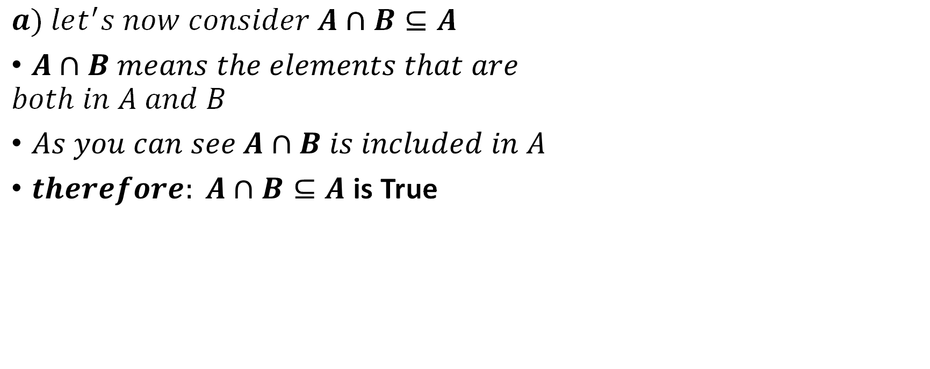


Example 1 cont’d
$$a) let^{′}s now consider A∩B⊆A$$
$A∩B means the elements that are$
$$both in A and B$$
$As you can see A∩B is included in A$
$therefore: A∩B⊆A$ is True
$$A∩B$$
universe
A
B
$$A∩$$
$$B$$

Slide 6
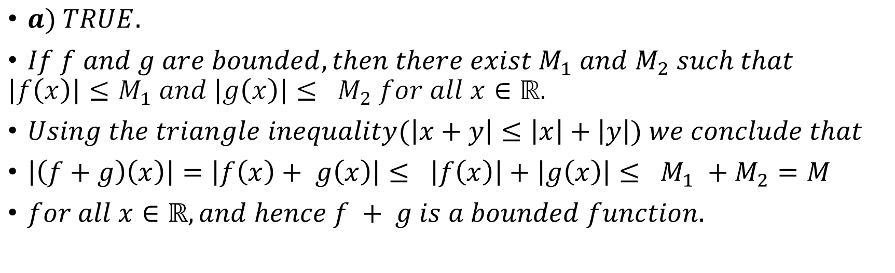
Example 2
$a) TRUE.$
$If f and g are bounded, then there exist M_{1} and M_{2} such that$
$$\left|f\left(x\right)\right|≤M_{1} and \left|g\left(x\right)\right|≤ M_{2} for all x∈ℝ.$$
$Using the triangle inequality(\left|x+y\right|≤\left|x\right|+\left|y\right|) we conclude that$
$\left|\left(f+g\right)\left(x\right)\right|=\left|f\left(x\right)+ g\left(x\right)\right|≤ \left|f\left(x\right)\right|+\left|g\left(x\right)\right|≤ M_{1} +M_{2}=M$
$for all x∈ℝ, and hence f + g is a bounded function.$

Slide 7
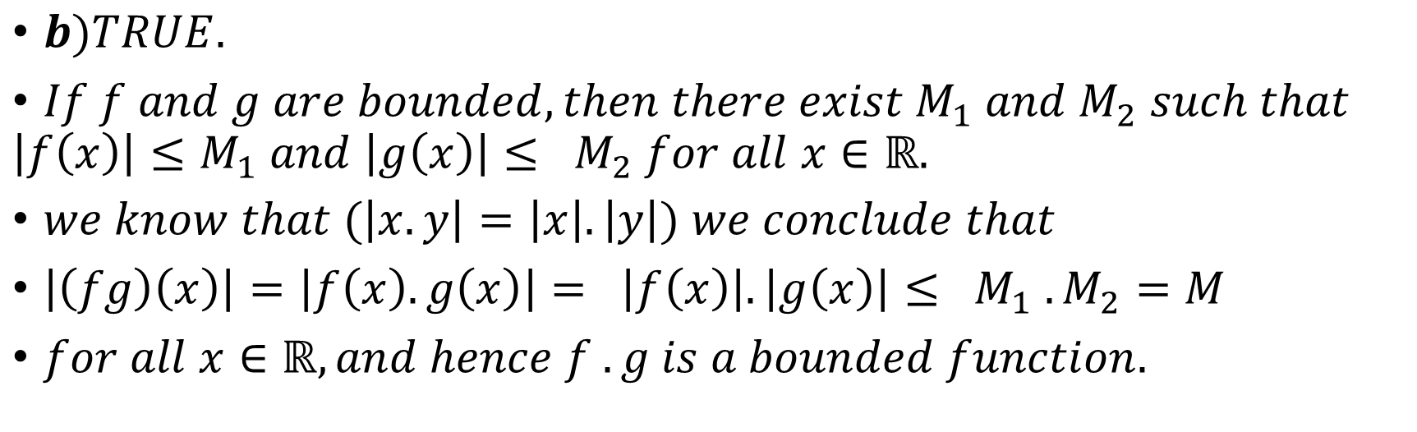
Example 2 cont’d
$b)TRUE.$
$If f and g are bounded, then there exist M_{1} and M_{2} such that$
$$\left|f\left(x\right)\right|≤M_{1} and \left|g\left(x\right)\right|≤ M_{2} for all x∈ℝ.$$
$we know that (\left|x.y\right|=\left|x\right|.\left|y\right|) we conclude that$
$\left|\left(fg\right)\left(x\right)\right|=\left|f\left(x\right). g\left(x\right)\right|= \left|f\left(x\right)\right|.\left|g\left(x\right)\right|≤ M_{1} .M_{2}=M$
$for all x∈ℝ, and hence f . g is a bounded function.$

Slide 8
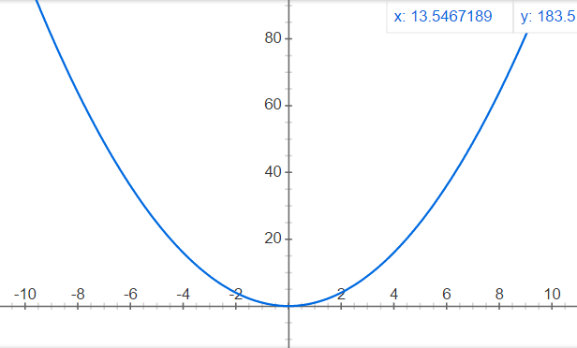
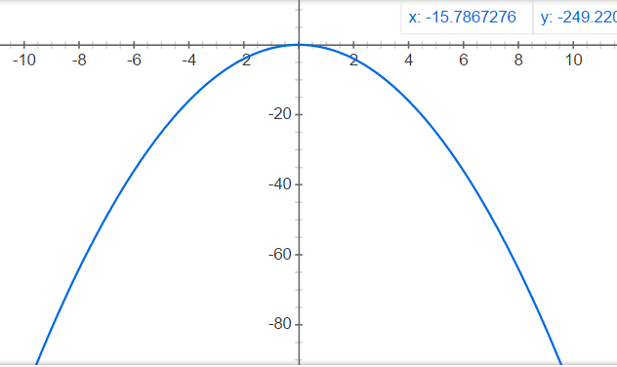

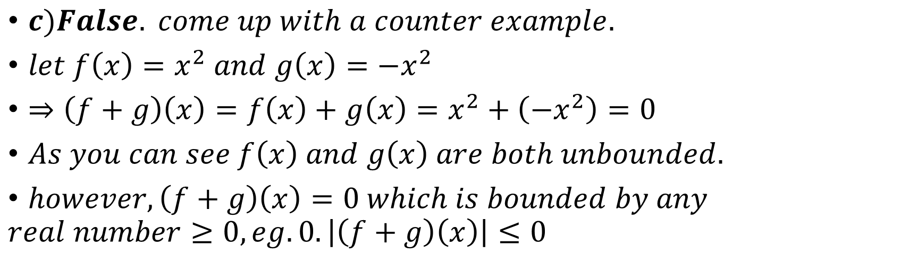

Example 2 cont’d
$$y=x^{2}$$
$c)False. come up with a counter example.$
$let f\left(x\right)=x^{2} and g\left(x\right)=−x^{2}$
$⇒\left(f+g\right)\left(x\right)=f\left(x\right)+g\left(x\right)=x^{2}+\left(−x^{2}\right)=0$
$As you can see f\left(x\right) and g\left(x\right) are both unbounded.$
$however, \left(f+g\right)\left(x\right)=0 which is bounded by any$
$$real number≥0, eg. 0. \left|\left(f+g\right)\left(x\right)\right|≤0$$
$$y=−x^{2}$$

Slide 9
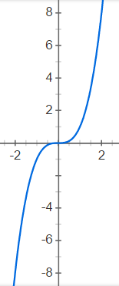
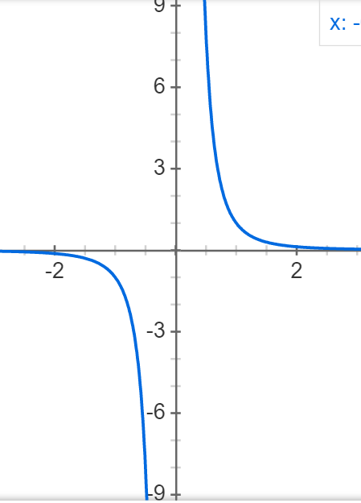
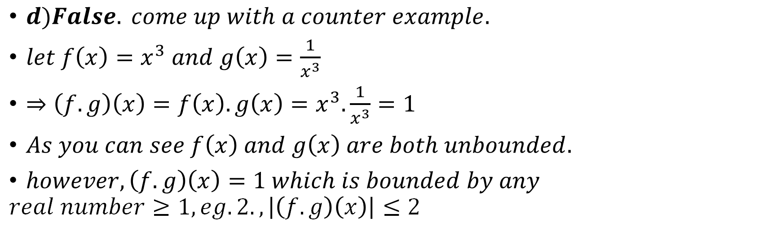


Example 2 cont’d
$$y=x^{3}$$
$$y=\frac{1}{x^{3}}$$
$d)False. come up with a counter example.$
$let f\left(x\right)=x^{3} and g\left(x\right)=\frac{1}{x^{3}}$
$⇒\left(f.g\right)\left(x\right)=f\left(x\right).g\left(x\right)=x^{3}.\frac{1}{x^{3}}=1$
$As you can see f\left(x\right) and g\left(x\right) are both unbounded.$
$however, \left(f.g\right)\left(x\right)=1 which is bounded by any$
$$real number≥1, eg. 2., \left|\left(f.g\right)\left(x\right)\right|≤2$$

Slide 10
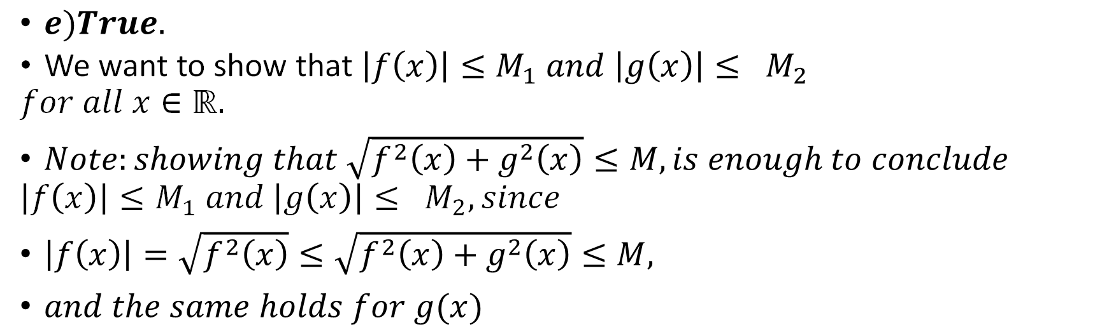
Example 2 cont’d
$e)True.$
We want to show that $\left|f\left(x\right)\right|≤M_{1} and \left|g\left(x\right)\right|≤ M_{2}$
$$for all x∈ℝ.$$
$Note:showing that \sqrt{f^{2}\left(x\right)+g^{2}\left(x\right)}≤M, is enough to conclude$
$$\left|f\left(x\right)\right|≤M_{1} and \left|g\left(x\right)\right|≤ M_{2}, since$$
$\left|f\left(x\right)\right|=\sqrt{f^{2}\left(x\right)}≤\sqrt{f^{2}\left(x\right)+g^{2}\left(x\right)}≤M,$
$and the same holds for g(x)$

Slide 11

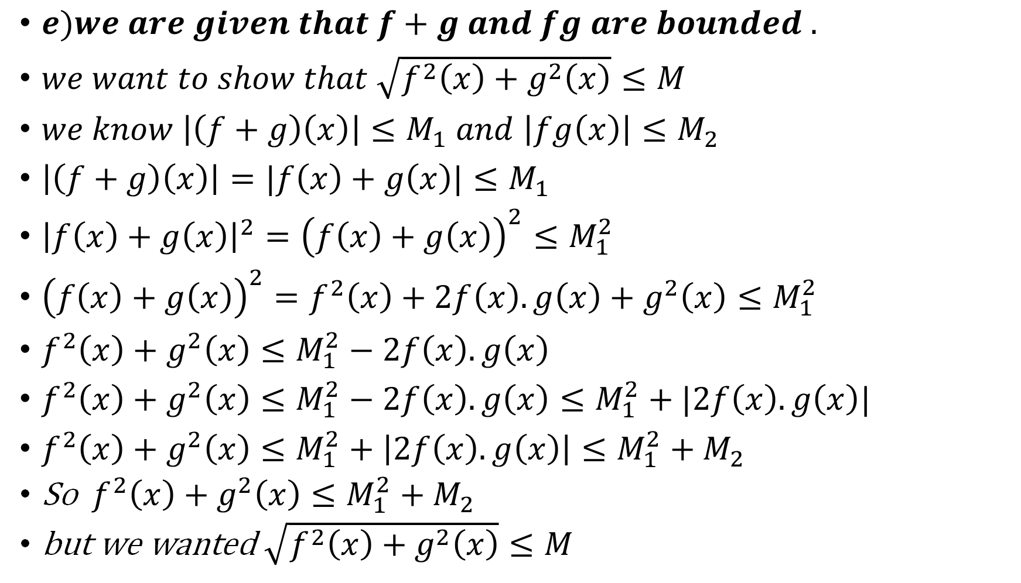


Example 2 cont’d
$e)we are given that f+g and fg are bounded .$
$we want to show that \sqrt{f^{2}\left(x\right)+g^{2}\left(x\right)}≤M$
$we know \left|\left(f+g\right)\left(x\right)\right|≤M_{1} and \left|fg\left(x\right)\right|≤M_{2}$
$\left|\left(f+g\right)\left(x\right)\right|=|f\left(x\right)+g\left(x\right)|≤M_{1}$
${\left|f\left(x\right)+g\left(x\right)\right|}^{2}={\left(f\left(x\right)+g\left(x\right)\right)}^{2}≤M_{1}^{2}$
${\left(f\left(x\right)+g\left(x\right)\right)}^{2}=f^{2}\left(x\right)+2f\left(x\right).g\left(x\right)+g^{2}\left(x\right)≤M_{1}^{2}$
$f^{2}\left(x\right)+g^{2}\left(x\right)≤M_{1}^{2}−2f\left(x\right).g\left(x\right)$
$f^{2}\left(x\right)+g^{2}\left(x\right)≤M_{1}^{2}−2f\left(x\right).g\left(x\right)≤M_{1}^{2}+|2f\left(x\right).g\left(x\right)|$
$f^{2}\left(x\right)+g^{2}\left(x\right)≤M_{1}^{2}+\left|2f\left(x\right).g\left(x\right)\right|≤M_{1}^{2}+M_{2}$
So ${ f}^{2}\left(x\right)+g^{2}\left(x\right)≤M_{1}^{2}+M_{2}$
but we wanted $\sqrt{f^{2}\left(x\right)+g^{2}\left(x\right)}≤M$
Square both sides
expand
$$−2f\left(x\right).g\left(x\right)$$
$$a≤|a|$$
$$|fg\left(x\right)|≤M_{2}$$

Slide 12

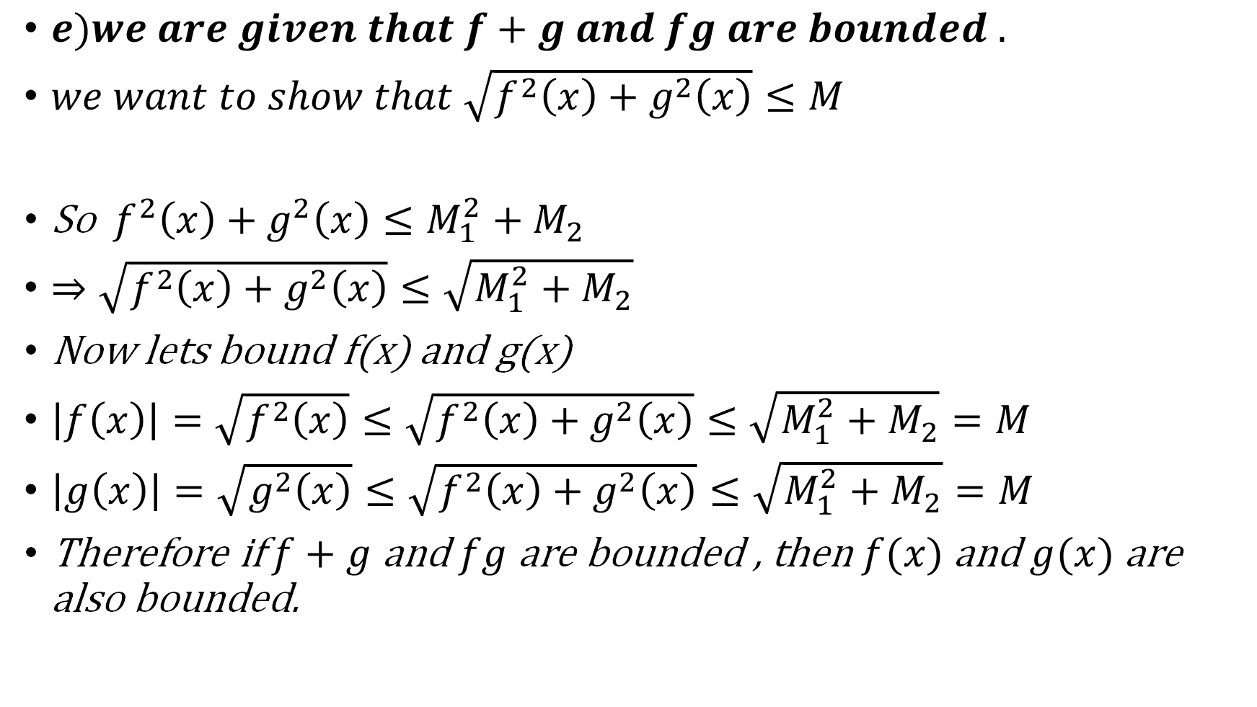
Example 2 cont’d
$e)we are given that f+g and fg are bounded .$
$we want to show that \sqrt{f^{2}\left(x\right)+g^{2}\left(x\right)}≤M$
So ${ f}^{2}\left(x\right)+g^{2}\left(x\right)≤M_{1}^{2}+M_{2}$
$⇒\sqrt{f^{2}\left(x\right)+g^{2}\left(x\right)}≤\sqrt{M_{1}^{2}+M_{2}}$
Now lets bound f(x) and g(x)
$\left|f\left(x\right)\right|=\sqrt{f^{2}\left(x\right)}≤\sqrt{f^{2}\left(x\right)+g^{2}\left(x\right)}≤\sqrt{M_{1}^{2}+M_{2}}=M$
$\left|g\left(x\right)\right|=\sqrt{g^{2}\left(x\right)}≤\sqrt{f^{2}\left(x\right)+g^{2}\left(x\right)}≤\sqrt{M_{1}^{2}+M_{2}}=M$
Therefore if $f+g$ and $fg$ are bounded , then $f(x)$ and $g(x)$ are also bounded.
$$square root$$

Slide 13


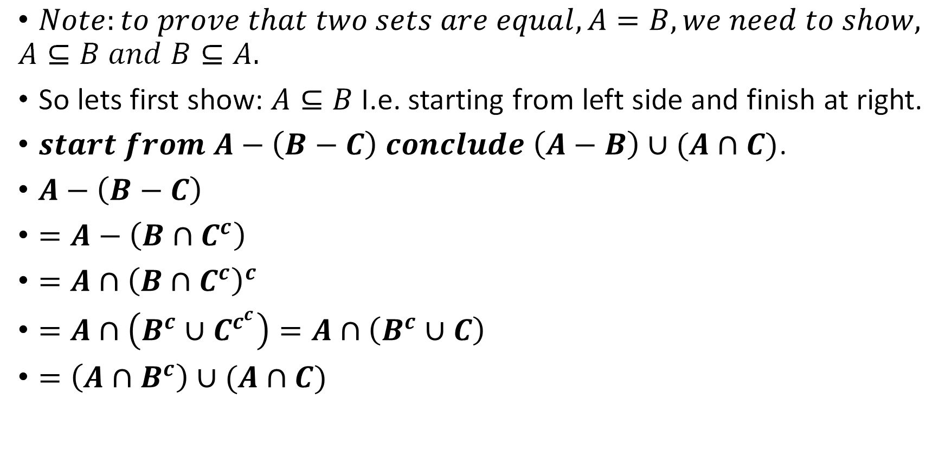



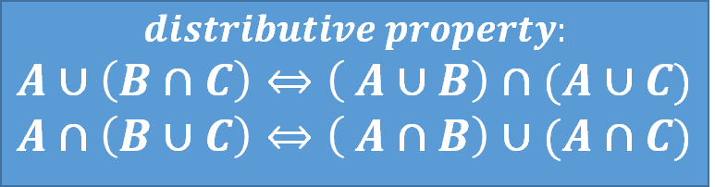
Example 3
Show that for any three sets $A, B, C$we have: $A−\left(B−C\right)=\left(A−B\right)∪(A∩C)$. Write a formal solution, and draw the appropriate Venn diagram.
$Note:to prove that two sets are equal, A=B, we need to show,$
$$A⊆B and B⊆A.$$
So lets first show: $A⊆B$I.e. starting from left side and finish at right.
$start from A−\left(B−C\right) conclude \left(A−B\right)∪(A∩C)$.
$A−\left(B−C\right)$
$=A−\left(B∩C^{c}\right)$
$=A∩{\left(B∩C^{c}\right)}^{c}$
$=A∩\left(B^{c}∪C^{c^{c}}\right)=A∩\left(B^{c}∪C\right)$
$=\left(A∩B^{c}\right)∪(A∩C)$
$$A−B=A∩B^{c}$$
$$demorgan^{′}s laws:$$
$${\left(A∩B\right)}^{c}=A^{c}∪B^{c}$$
$${\left(A∪B\right)}^{c}=A^{c}∩B^{c}$$
$$A−B=A∩B^{c}$$
$$by demorgan^{′}s law$$
$$by \text{Distributive} \text{property}$$
$$distributive property:$$
$$A∪\left(B∩C\right)⇔\left( A∪B\right)∩(A∪C)$$
$$A∩\left(B∪C\right)⇔\left( A∩B\right)∪(A∩C)$$

Slide 14
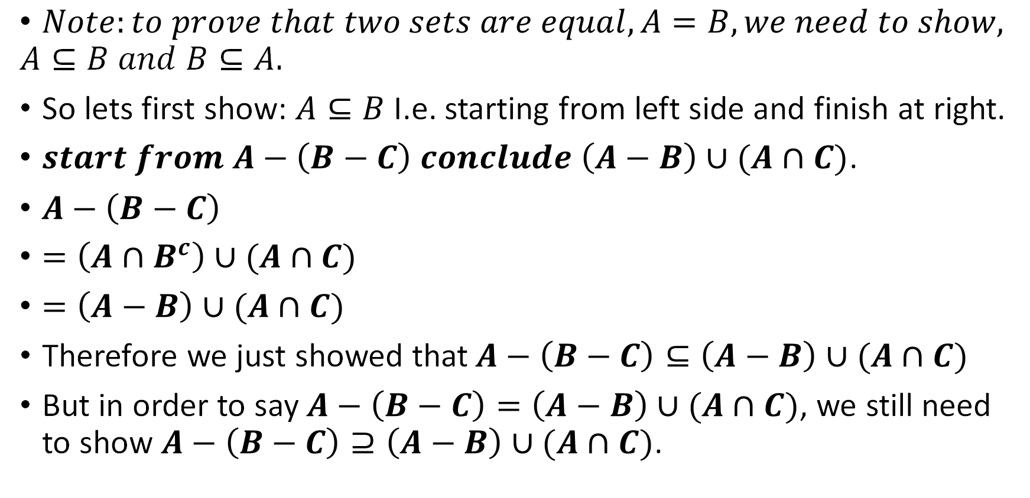

Example 3 cont’d
Show that for any three sets $A, B, C$we have: $A−\left(B−C\right)=\left(A−B\right)∪(A∩C)$. Write a formal solution, and draw the appropriate Venn diagram.
$Note:to prove that two sets are equal, A=B, we need to show,$
$$A⊆B and B⊆A.$$
So lets first show: $A⊆B$I.e. starting from left side and finish at right.
$start from A−\left(B−C\right) conclude \left(A−B\right)∪(A∩C)$.
$A−\left(B−C\right)$
$=\left(A∩B^{c}\right)∪(A∩C)$
$=\left(A−B\right)∪(A∩C)$
Therefore we just showed that$A−\left(B−C\right)⊆\left(A−B\right)∪(A∩C)$
But in order to say $A−\left(B−C\right)=\left(A−B\right)∪(A∩C)$, we still need to show $A−\left(B−C\right)⊇\left(A−B\right)∪(A∩C)$.
$$A−B=A∩B^{c}$$

Slide 15


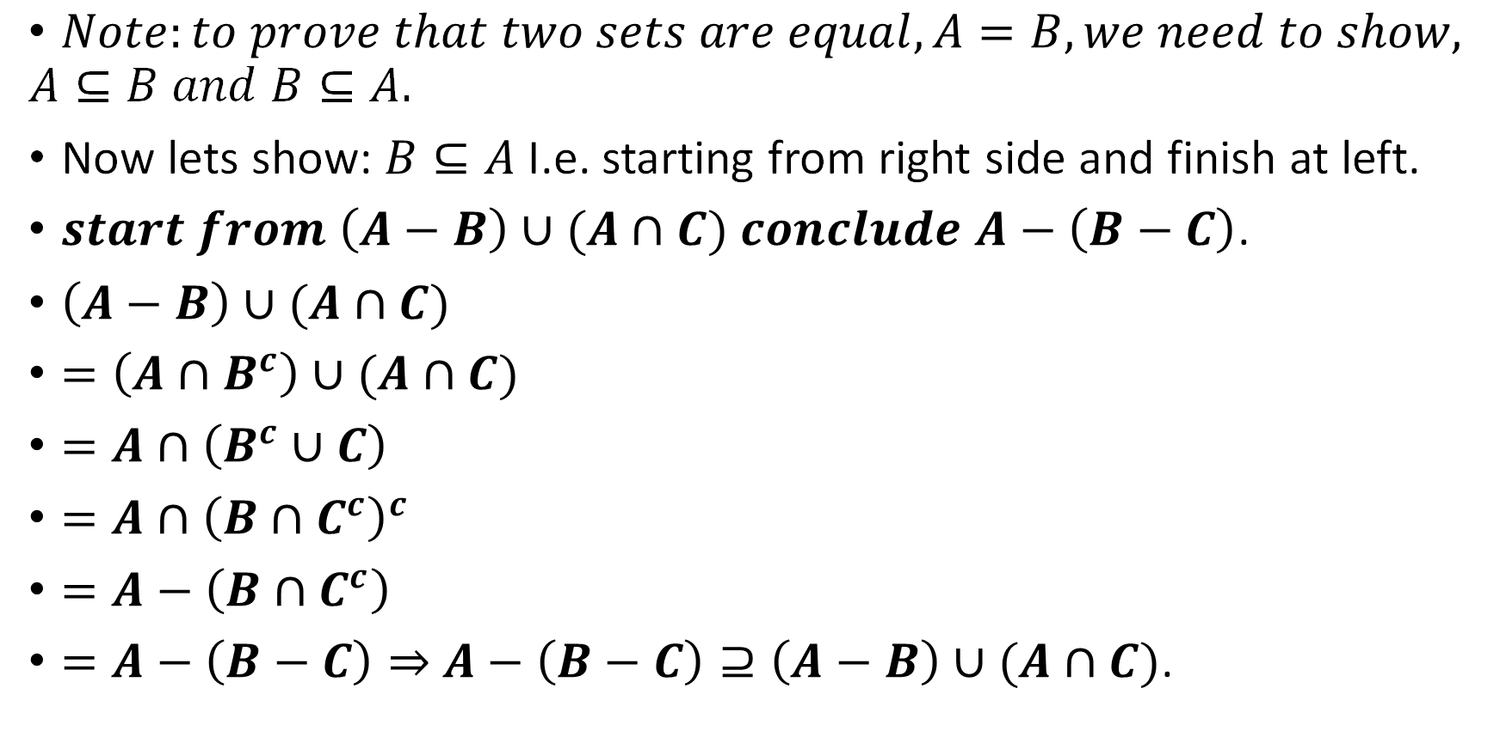
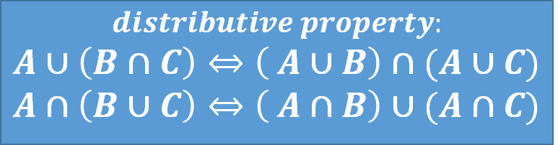




Example 3 cont’d
Show that for any three sets $A, B, C$we have: $A−\left(B−C\right)=\left(A−B\right)∪(A∩C)$. Write a formal solution, and draw the appropriate Venn diagram.
$Note:to prove that two sets are equal, A=B, we need to show,$
$$A⊆B and B⊆A.$$
Now lets show: $B⊆A$I.e. starting from right side and finish at left.
$start from \left(A−B\right)∪(A∩C) conclude$ $A−\left(B−C\right)$.
$\left(A−B\right)∪(A∩C)$
$=\left(A∩B^{c}\right)∪(A∩C)$
$=A∩\left(B^{c}∪C\right)$
$=A∩{\left(B∩C^{c}\right)}^{c}$
$=A−\left(B∩C^{c}\right)$
$=A−\left(B−C\right)⇒$ $A−\left(B−C\right)⊇\left(A−B\right)∪(A∩C)$.
$$A−B=A∩B^{c}$$
$$distributive property:$$
$$A∪\left(B∩C\right)⇔\left( A∪B\right)∩(A∪C)$$
$$A∩\left(B∪C\right)⇔\left( A∩B\right)∪(A∩C)$$
$$by \text{Distributive} \text{law}$$
$$by demorgan^{′}s law$$
$$demorgan^{′}s laws:$$
$${\left(A∩B\right)}^{c}=A^{c}∪B^{c}$$
$${\left(A∪B\right)}^{c}=A^{c}∩B^{c}$$
$$A−B=A∩B^{c}$$
$$A−B=A∩B^{c}$$

Slide 16
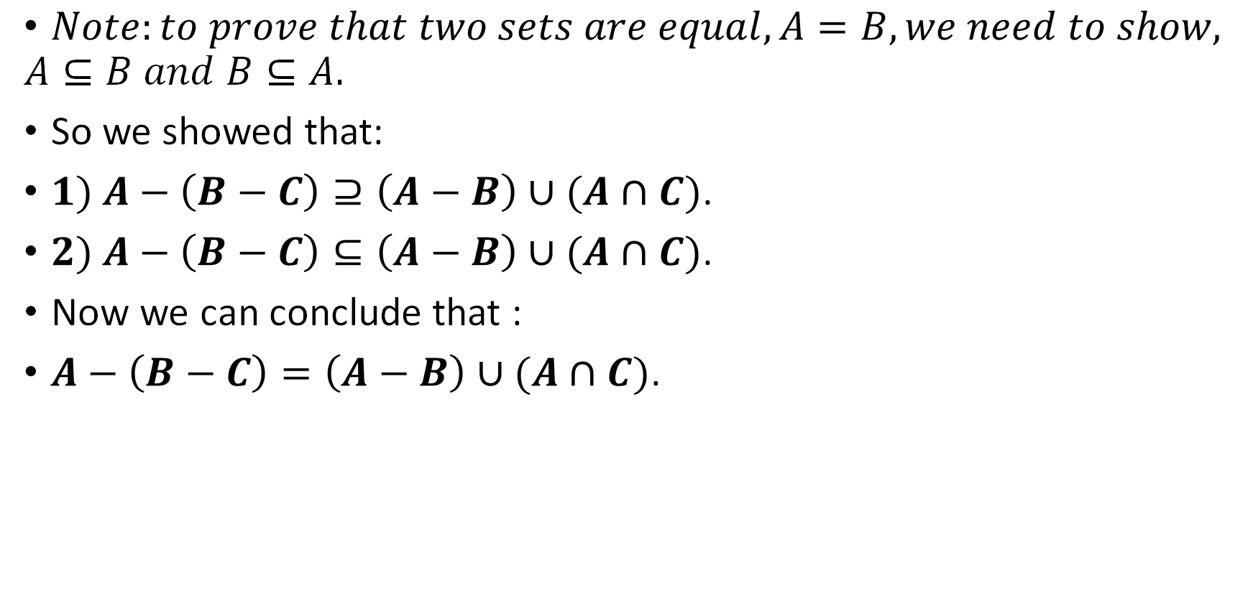
Example 3 cont’d
Show that for any three sets $A, B, C$we have: $A−\left(B−C\right)=\left(A−B\right)∪(A∩C)$. Write a formal solution, and draw the appropriate Venn diagram.
$Note:to prove that two sets are equal, A=B, we need to show,$
$$A⊆B and B⊆A.$$
So we showed that:
$1) A−\left(B−C\right)⊇\left(A−B\right)∪(A∩C)$.
$2) A−\left(B−C\right)⊆\left(A−B\right)∪(A∩C)$.
Now we can conclude that :
$A−\left(B−C\right)=\left(A−B\right)∪(A∩C)$.

Slide 17

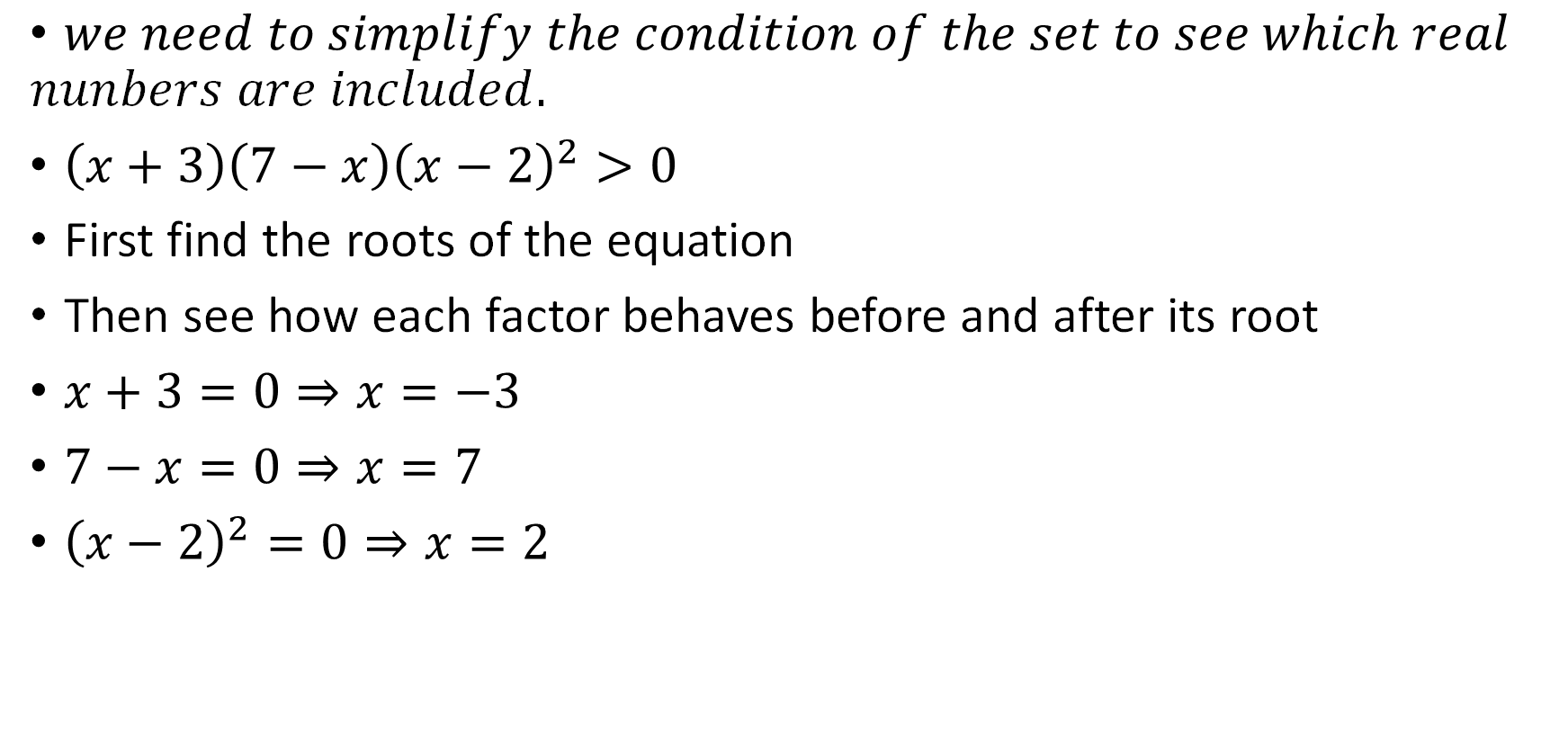
Example 4
Express the set $\left\{x∈ℝ \right|\left(x+3\right)\left(7−x\right){\left(x−2\right)}^{2}>0\}$ as a union of intervals. Explain your answer briefly.
$we need to simplify the condition of the set to see which real$
$$nunbers are included.$$
$\left(x+3\right)\left(7−x\right){\left(x−2\right)}^{2}>0$
First find the roots of the equation
Then see how each factor behaves before and after its root
$x+3=0⇒x=−3$
$7−x=0⇒x=7$
${\left(x−2\right)}^{2}=0⇒x=2$
Use a table to see how the equation behaves on different intervals

Slide 18


Example 4 cont’d
Express the set $\left\{x∈ℝ \right|\left(x+3\right)\left(7−x\right){\left(x−2\right)}^{2}>0\}$ as a union of intervals. Explain your answer briefly.
$we need to simplify the condition of the set to see which real$
$$nunbers are included.$$
E=$\left(x+3\right)\left(7−x\right){\left(x−2\right)}^{2}>0$
Then see how each factor behaves before and after its root
$x+3=0⇒x=−3$
$7−x=0⇒x=7$
${\left(x−2\right)}^{2}=0⇒x=2$
Use a table to see how the equation behaves on different intervals
 | $$(∞, −3)$$ | $$(−3, 2)$$ | $$(2, 7)$$ | $$(7, ∞)$$
$$x+3$$
$$7−x$$
$${\left(x−2\right)}^{2}$$
E

Slide 19

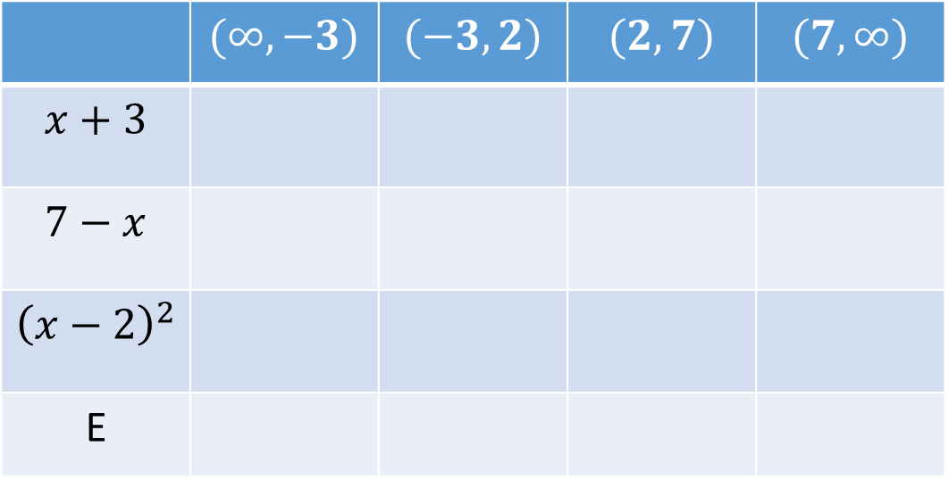

Example 4 cont’d
Express the set $\left\{x∈ℝ \right|\left(x+3\right)\left(7−x\right){\left(x−2\right)}^{2}>0\}$ as a union of intervals. Explain your answer briefly.
$we need to simplify the condition of the set to see which real$
$$nunbers are included.$$
E=${\left(x+3\right)\left(7−x\right)\left(x−2\right)}^{2}>0$
Then see how each factor behaves before and after its root
$x+3<0 when x<−3$
$x+3>0 when x>−3$
$7−x<0 when x>7$
$7−x>0 when x<7$
${\left(x−2\right)}^{2}>0 when x<2$
${\left(x−2\right)}^{2}>0 when x>2$
Use a table to see how the equation behaves on different intervals
 | $$(∞, −3)$$ | $$(−3, 2)$$ | $$(2, 7)$$ | $$(7, ∞)$$
$$x+3$$
$$7−x$$
$${\left(x−2\right)}^{2}$$
E

Slide 20

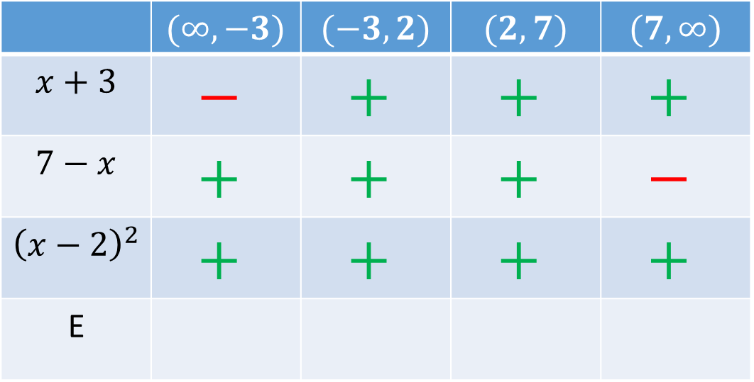
Example 4 cont’d
Express the set $\left\{x∈ℝ \right|\left(x+3\right)\left(7−x\right){\left(x−2\right)}^{2}>0\}$ as a union of intervals. Explain your answer briefly.
$we need to simplify the condition of the set to see which real$
$$nunbers are included.$$
E=${\left(x+3\right)\left(7−x\right)\left(x−2\right)}^{2}>0$
Then see how each factor behaves before and after its root
$Note now that:$
$+.+=+$
$−.+=−$
$+.−=−$
$−.−=+$
Use a table to see how the equation behaves on different intervals
 | $$(∞, −3)$$ | $$(−3, 2)$$ | $$(2, 7)$$ | $$(7, ∞)$$
$$x+3$$ | $$−$$ | $$+$$ | $$+$$ | $$+$$
$$7−x$$ | $$+$$ | $$+$$ | $$+$$ | $$−$$
$${\left(x−2\right)}^{2}$$ | $$+$$ | $$+$$ | $$+$$ | $$+$$
E

Slide 21

Example 4 cont’d
Express the set $\left\{x∈ℝ \right|\left(x+3\right)\left(7−x\right){\left(x−2\right)}^{2}>0\}$ as a union of intervals. Explain your answer briefly.
$we need to simplify the condition of the set to see which real$
$$nunbers are included.$$
E=${\left(x+3\right)\left(7−x\right)\left(x−2\right)}^{2}>0$
Then see how each factor behaves before and after its root
$Note now that:$
$1st column:−.+.+=−$
$2ndcolumn:+.+.+=+$
$3rd column:+.+.+=+$
$4th column:+.−.+=−$
Use a table to see how the equation behaves on different intervals
 | $$(∞, −3)$$ | $$(−3, 2)$$ | $$(2, 7)$$ | $$(7, ∞)$$
$$x+3$$ | $$−$$ | $$+$$ | $$+$$ | $$+$$
$$7−x$$ | $$+$$ | $$+$$ | $$+$$ | $$−$$
$${\left(x−2\right)}^{2}$$ | $$+$$ | $$+$$ | $$+$$ | $$+$$
E

Slide 22

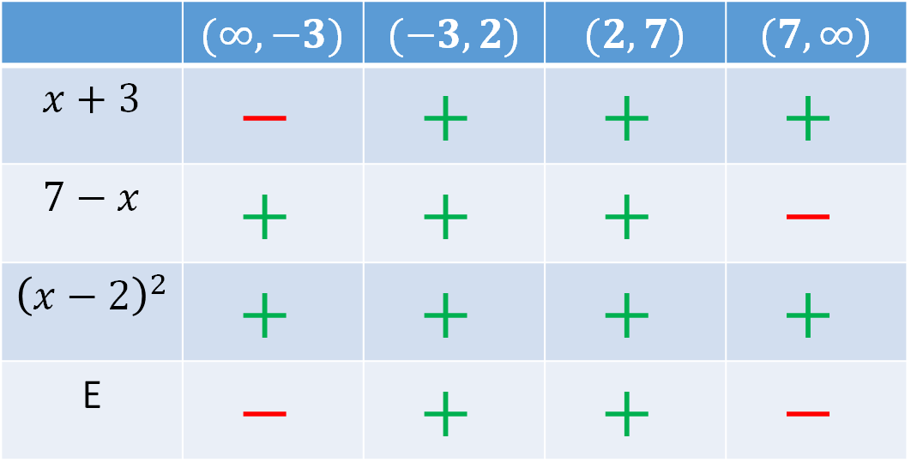
Example 4 cont’d
Express the set $\left\{x∈ℝ \right|\left(x+3\right)\left(7−x\right){\left(x−2\right)}^{2}>0\}$ as a union of intervals. Explain your answer briefly.
$we need to simplify the condition of the set to see which real$
$$nunbers are included.$$
E=${\left(x+3\right)\left(7−x\right)\left(x−2\right)}^{2}>0$
Then see how each factor behaves before and after its root
$Note now that:$
$since we want E>0:$
$x∈\left(−3,2\right)∪\left(2,7\right)$
Note since at 2, E=0,
we exclude 2.
Use a table to see how the equation behaves on different intervals
 | $$(∞, −3)$$ | $$(−3, 2)$$ | $$(2, 7)$$ | $$(7, ∞)$$
$$x+3$$ | $$−$$ | $$+$$ | $$+$$ | $$+$$
$$7−x$$ | $$+$$ | $$+$$ | $$+$$ | $$−$$
$${\left(x−2\right)}^{2}$$ | $$+$$ | $$+$$ | $$+$$ | $$+$$
E | $$−$$ | $$+$$ | $$+$$ | $$−$$

Slide 23

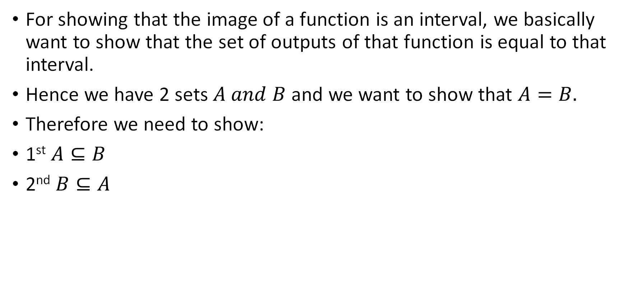
Example 5 cont’d
Consider the function $f:\left(0, ∞\right)→ℝ$given by $f\left(x\right)=\frac{4x}{x+1}$. Prove that the image of $f$ is the interval $(0, 4)$.
For showing that the image of a function is an interval, we basically want to show that the set of outputs of that function is equal to that interval.
Hence we have 2 sets $A and B$ and we want to show that $A=B.$
Therefore we need to show:
1st $A⊆B$
2nd $B⊆A$

Slide 24

Example 5 cont’d
Consider the function $f:\left(0, ∞\right)→ℝ$given by $f\left(x\right)=\frac{4x}{x+1}$. Prove that the image of $f$ is the interval $(0, 4)$.
We want to show $f\left(\left(0, ∞\right)\right)=\left(0, 4\right).$
We need to show:
1st $f\left(\left(0, ∞\right)\right)⊆\left(0, 4\right).$
2nd $f\left(\left(0, ∞\right)\right)⊇\left(0, 4\right).$

Slide 25
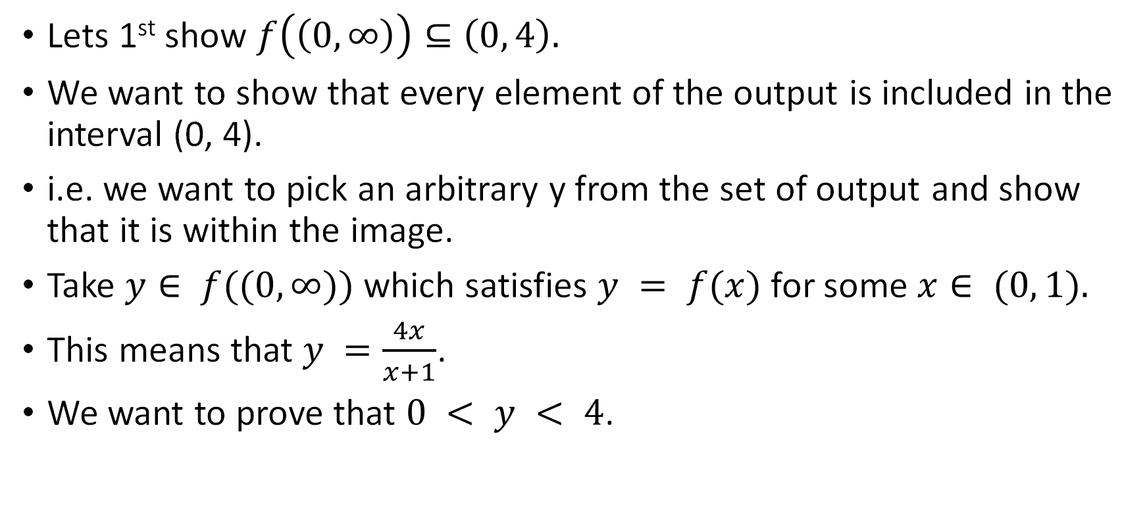
Example 5 cont’d
Consider the function $f:\left(0, ∞\right)→ℝ$given by $f\left(x\right)=\frac{4x}{x+1}$. Prove that the image of $f$ is the interval $(0, 4)$.
Lets 1st show $f\left(\left(0, ∞\right)\right)⊆\left(0, 4\right).$
We want to show that every element of the output is included in the interval (0, 4).
i.e. we want to pick an arbitrary y from the set of output and show that it is within the image.
Take $y∈ f((0,∞))$which satisfies $y = f(x)$for some $x∈ (0, 1).$
This means that $y =\frac{4x}{x+1}$.
We want to prove that $0 < y < 4$.

Slide 26
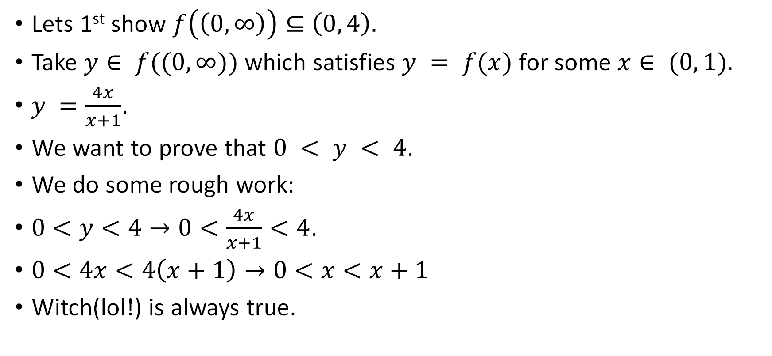

Example 5 cont’d
Consider the function $f:\left(0, ∞\right)→ℝ$given by $f\left(x\right)=\frac{4x}{x+1}$. Prove that the image of $f$ is the interval $(0, 4)$.
Lets 1st show $f\left(\left(0, ∞\right)\right)⊆\left(0, 4\right).$
Take $y∈ f((0,∞))$which satisfies $y = f(x)$for some $x∈ (0, 1).$
$y =\frac{4x}{x+1}$.
We want to prove that $0 < y < 4$.
We do some rough work:
$0<y<4→0<\frac{4x}{x+1}<4$.
$0<4x<4\left(x+1\right)→0<x<x+1$
Witch(lol!) is always true.
$$Since x+1>0, multiply by it$$

Slide 27
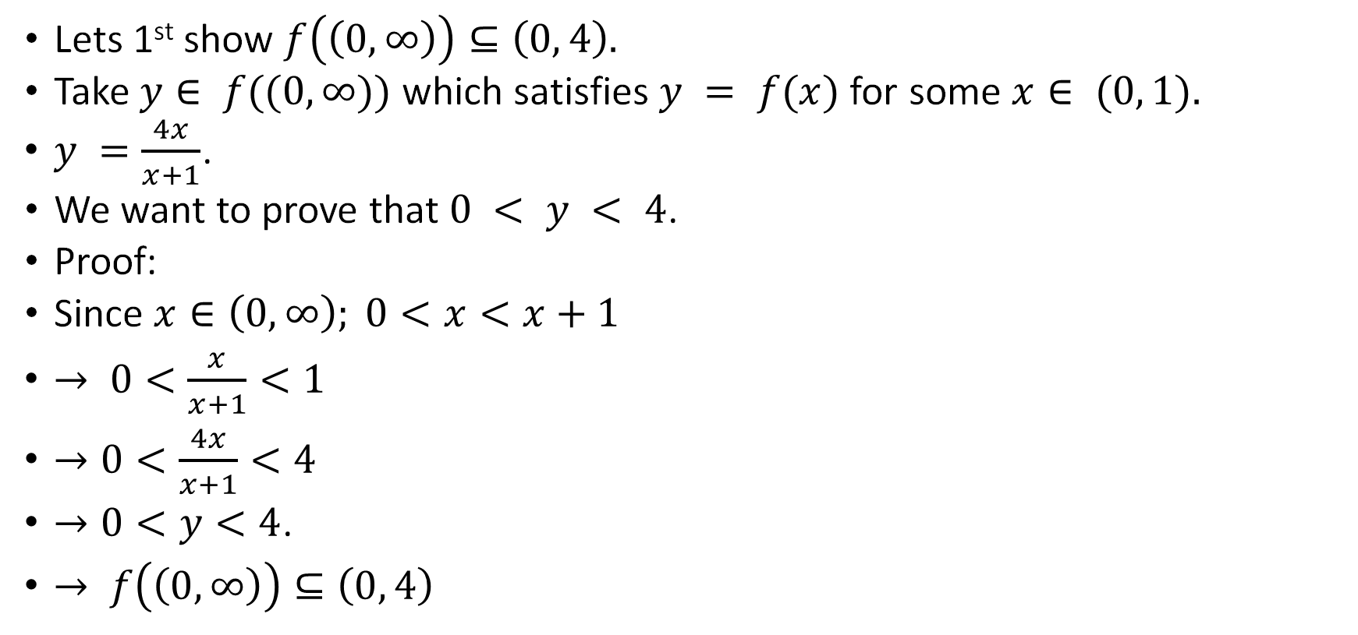


Example 5 cont’d
Consider the function $f:\left(0, ∞\right)→ℝ$given by $f\left(x\right)=\frac{4x}{x+1}$. Prove that the image of $f$ is the interval $(0, 4)$.
Lets 1st show $f\left(\left(0, ∞\right)\right)⊆\left(0, 4\right).$
Take $y∈ f((0,∞))$which satisfies $y = f(x)$for some $x∈ (0, 1).$
$y =\frac{4x}{x+1}$.
We want to prove that $0 < y < 4$.
Proof:
Since $x∈\left(0,∞\right); 0<x<x+1$
$→ 0<\frac{x}{x+1}<1$
$→0<\frac{4x}{x+1}<4$
$→0<y<4$.
$→ f\left(\left(0, ∞\right)\right)⊆\left(0, 4\right)$
$$Since x+1>0, devide by it$$
$$mul by 4$$

Slide 28
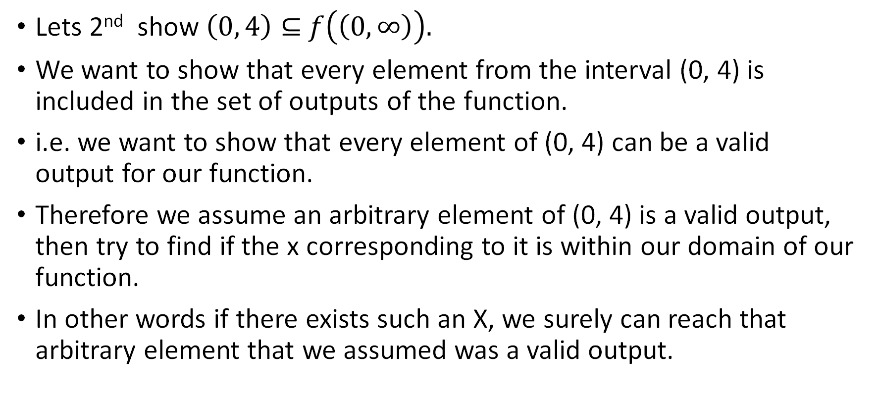
Example 5 cont’d
Consider the function $f:\left(0, ∞\right)→ℝ$given by $f\left(x\right)=\frac{4x}{x+1}$. Prove that the image of $f$ is the interval $(0, 4)$.
Lets 2nd show $\left(0, 4\right)⊆$ $f\left(\left(0, ∞\right)\right).$
We want to show that every element from the interval (0, 4) is included in the set of outputs of the function.
i.e. we want to show that every element of (0, 4) can be a valid output for our function.
Therefore we assume an arbitrary element of (0, 4) is a valid output, then try to find if the x corresponding to it is within our domain of our function.
In other words if there exists such an X, we surely can reach that arbitrary element that we assumed was a valid output.

Slide 29
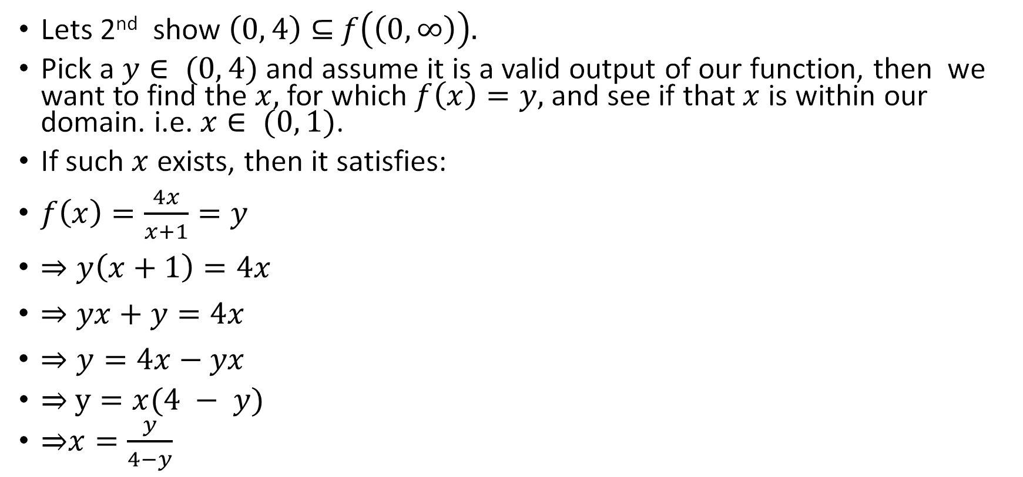

Example 5 cont’d
Consider the function $f:\left(0, ∞\right)→ℝ$given by $f\left(x\right)=\frac{4x}{x+1}$. Prove that the image of $f$ is the interval $(0, 4)$.
Lets 2nd show $\left(0, 4\right)⊆$ $f\left(\left(0, ∞\right)\right).$
Pick a $y∈ (0, 4)$ and assume it is a valid output of our function, then we want to find the $x,$for which $f\left(x\right)=y,$ and see if that $x$ is within our domain. i.e. $x∈ (0, 1)$.
If such $x$ exists, then it satisfies:
$f\left(x\right)=\frac{4x}{x+1}=y$
$⇒y\left(x+1\right)=4x$
$⇒yx+y=4x$
$⇒y=4x−yx$
⇒ $y=x(4 − y)$
⇒$x=\frac{y}{4−y}$
basically solve for $x$ and see if it is valid for the function

Slide 30
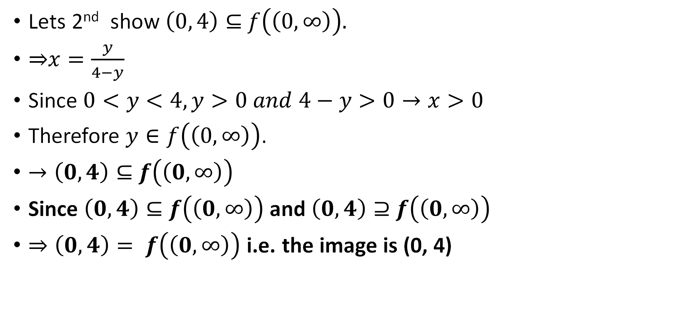
Example 5 cont’d
Consider the function $f:\left(0, ∞\right)→ℝ$given by $f\left(x\right)=\frac{4x}{x+1}$. Prove that the image of $f$ is the interval $(0, 4)$.
Lets 2nd show $\left(0, 4\right)⊆$ $f\left(\left(0, ∞\right)\right).$
⇒$x=\frac{y}{4−y}$
Since $0<y<4, y>0 and 4−y>0→x>0$
Therefore $y∈f\left(\left(0, ∞\right)\right)$.
$→\left(0, 4\right)⊆$ $f\left(\left(0, ∞\right)\right)$
Since $\left(0, 4\right)⊆$ $f\left(\left(0, ∞\right)\right)$ and $\left(0, 4\right)⊇$ $f\left(\left(0, ∞\right)\right)$
$⇒\left(0, 4\right)= f\left(\left(0, ∞\right)\right)$ i.e. the image is (0, 4)

Slide 31
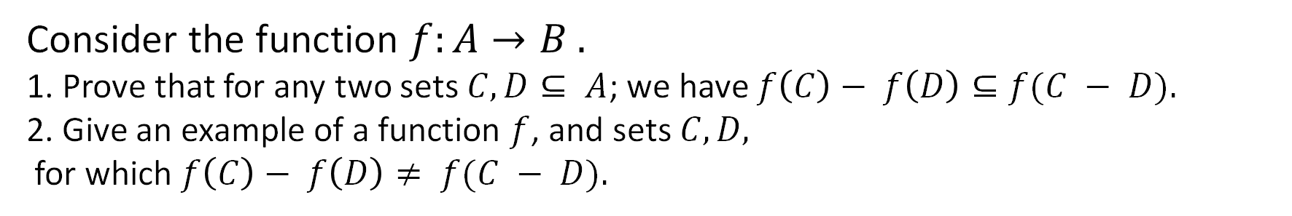
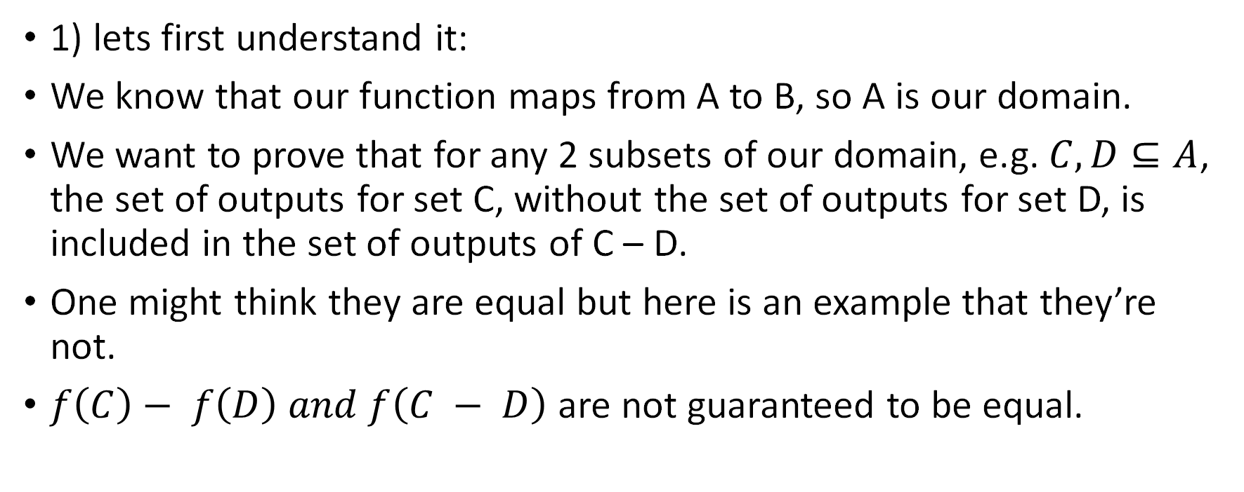
Example 6
Consider the function $f:A→B .$
1. Prove that for any two sets $C,D⊆ A$; we have $f\left(C\right)− f\left(D\right)⊆f(C − D).$
2. Give an example of a function $f$, and sets $C,D,$
for which $f\left(C\right)− f\left(D\right)≠ f(C − D).$
1) lets first understand it:
We know that our function maps from A to B, so A is our domain.
We want to prove that for any 2 subsets of our domain, e.g. $C, D⊆A$, the set of outputs for set C, without the set of outputs for set D, is included in the set of outputs of C – D.
One might think they are equal but here is an example that they’re not.
$f\left(C\right)− f\left(D\right) and f\left(C − D\right)$ are not guaranteed to be equal.

Slide 32
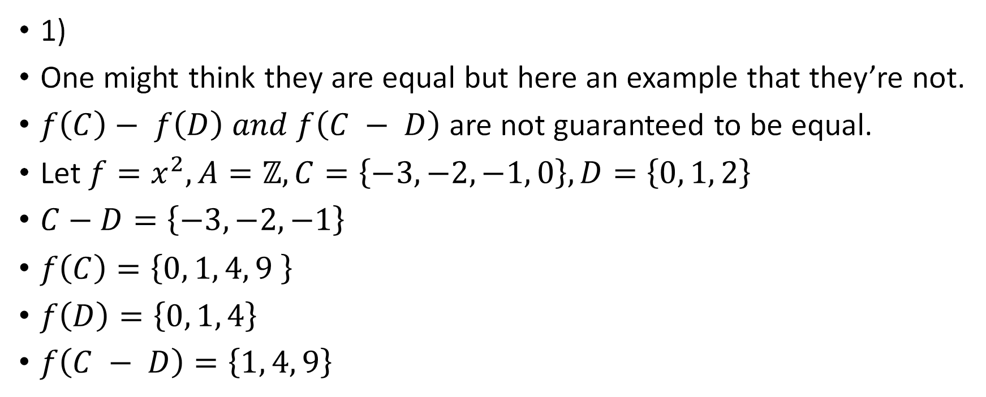
Example 6 cont’d
Consider the function $f:A→B .$
1. Prove that for any two sets $C,D⊆ A$; we have $f\left(C\right)− f\left(D\right)⊆f(C − D).$
2. Give an example of a function $f$, and sets $C,D,$
for which $f\left(C\right)− f\left(D\right)≠ f(C − D).$
1)
One might think they are equal but here an example that they’re not.
$f\left(C\right)− f\left(D\right) and f\left(C − D\right)$ are not guaranteed to be equal.
Let $f=x^{2}, A=ℤ, C=\left\{−3, −2, −1, 0\right\}, D=\left\{0, 1, 2\right\}$
$C−D=\left\{−3, −2, −1\right\}$
$f\left(C\right)=\left\{0, 1, 4, 9 \right\}$
$f\left(D\right)=\left\{0, 1, 4\right\}$
$f\left(C − D\right)=\left\{1, 4, 9\right\}$

Slide 33
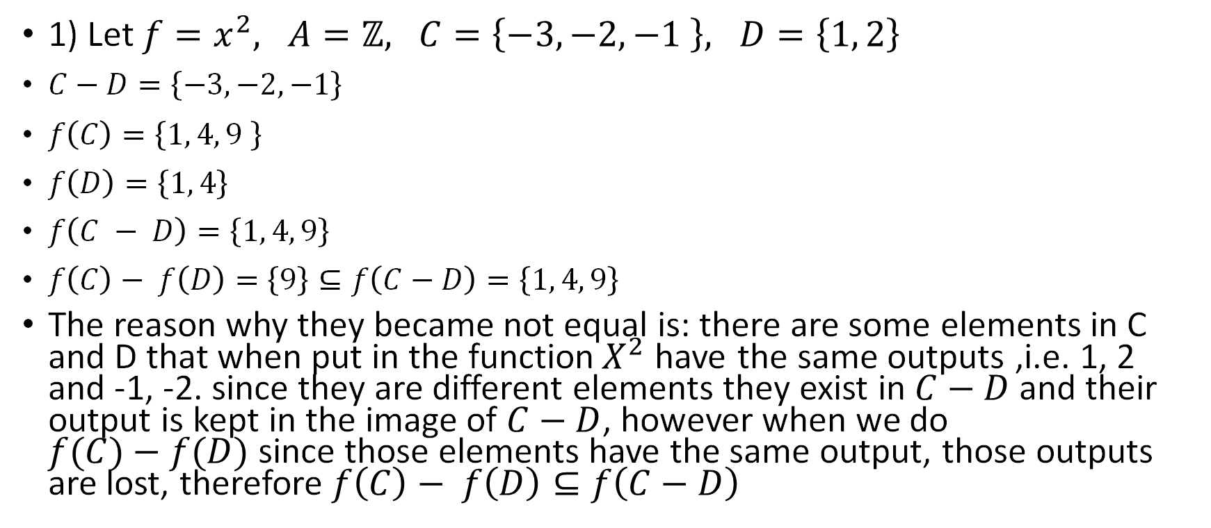
Example 6 cont’d
Consider the function $f:A→B .$
1. Prove that for any two sets $C,D⊆ A$; we have $f\left(C\right)− f\left(D\right)⊆f(C − D).$
2. Give an example of a function $f$, and sets $C,D,$
for which $f\left(C\right)− f\left(D\right)≠ f(C − D).$
1) Let $f=x^{2}, A=ℤ, C=\left\{−3, −2, −1 \right\}, D=\left\{1, 2\right\}$
$C−D=\left\{−3, −2, −1\right\}$
$f\left(C\right)=\left\{1, 4, 9 \right\}$
$f\left(D\right)=\left\{1, 4\right\}$
$f\left(C − D\right)=\left\{1, 4, 9\right\}$
$f\left(C\right)− f\left(D\right)=\left\{9\right\}⊆f\left(C−D\right)=\left\{1, 4, 9\right\}$
The reason why they became not equal is: there are some elements in C and D that when put in the function$X^{2}$have the same outputs ,i.e. 1, 2 and -1, -2. since they are different elements they exist in $C−D$ and their output is kept in the image of $C−D$, however when we do $f(C)−f(D)$since those elements have the same output, those outputs are lost, therefore $f\left(C\right)− f\left(D\right)⊆f\left(C−D\right)$

Slide 34
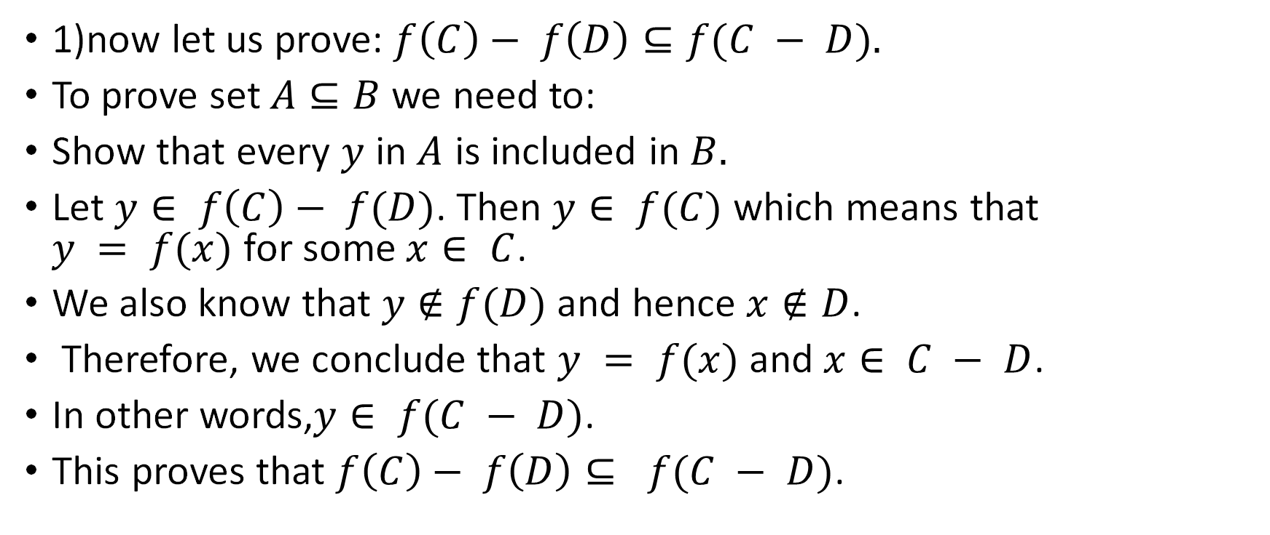
Example 6 cont’d
Consider the function $f:A→B .$
1. Prove that for any two sets $C,D⊆ A$; we have $f\left(C\right)− f\left(D\right)⊆f(C − D).$
2. Give an example of a function $f$, and sets $C,D,$
for which $f\left(C\right)− f\left(D\right)≠ f(C − D).$
1)now let us prove: $f\left(C\right)− f\left(D\right)⊆f(C − D).$
To prove set $A⊆B$ we need to:
Show that every $y$ in $A$ is included in $B.$
Let $y∈ f\left(C\right)− f(D)$. Then $y∈ f(C)$which means that $y = f(x)$for some $x∈ C$.
We also know that $y∉f(D)$ and hence $x∉D$.
Therefore, we conclude that $y = f(x)$and $x∈ C − D$.
In other words,$y∈ f(C − D)$.
This proves that $f\left(C\right)− f\left(D\right)⊆ f(C − D)$.

Slide 35
Citations:
Book
Mathematical Thinking: Problem-solving and Proofs
D'Angelo, J.P.
West, D.B.
9780130144126
https://books.google.ca/books?id=fL6nQgAACAAJ
2000
Prentice Hall

