Slide 1

M$Δ$T1100110 of course in base 2
Arash Gholami
Tutorial 4
Email: arash.gholami@mail.utoronto.ca
LinkedIn

Slide 2
Example 1
It’s a good idea to always do multiplication table first since we might need it to fill in the addition table
1st 0 times every other element is 0.
. | 0 | 1 | X
0 | 0 | 0 | 0
1 | 0
X | 0

Slide 3

Example 1 cont’d
2nd 1 times every element is that element since 1 is the multiplicative identity.
$X.1=X$
$1.1=1$
. | 0 | 1 | X
0 | 0 | 0 | 0
1 | 0 | 1 | X
X | 0 | X

Slide 4
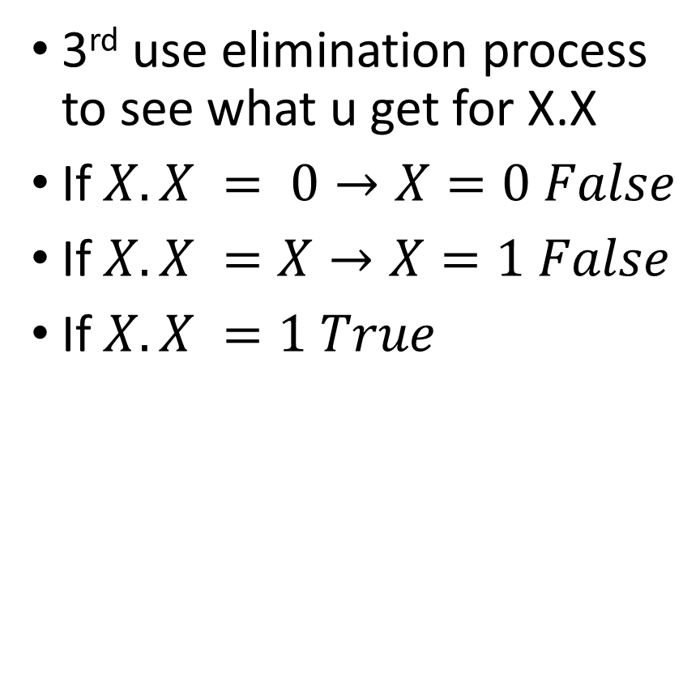
Example 1 cont’d
3rd use elimination process to see what u get for X.X
If $X.X = 0→X=0 False$
If $X.X =X→X=1 False$
If $X.X =1 True$
. | 0 | 1 | X
0 | 0 | 0 | 0
1 | 0 | 1 | X
X | 0 | X | 1

Slide 5
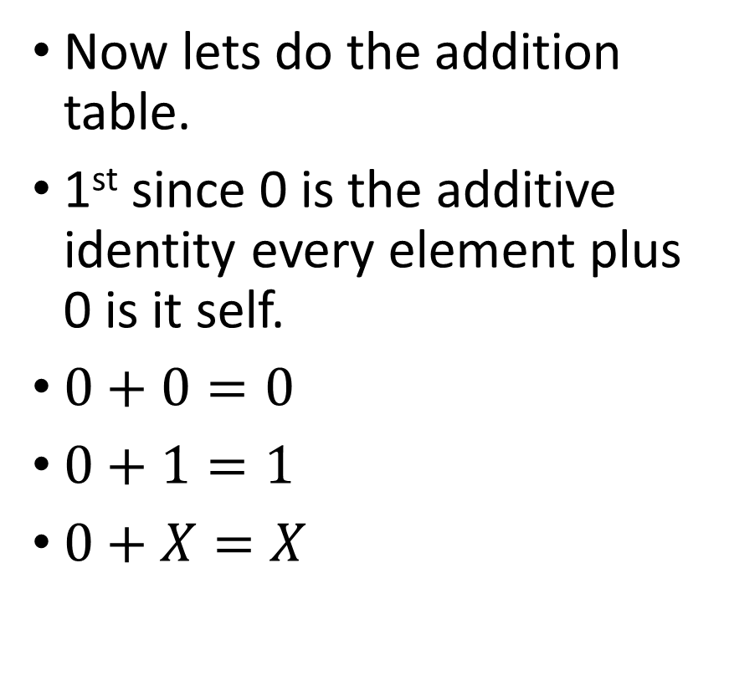
Example 1 cont’d
Now lets do the addition table.
1st since 0 is the additive identity every element plus 0 is it self.
$0+0=0$
$0+1=1$
$0+X=X$
+ | 0 | 1 | X
0 | 0 | 1 | X
1 | 1
X | X

Slide 6
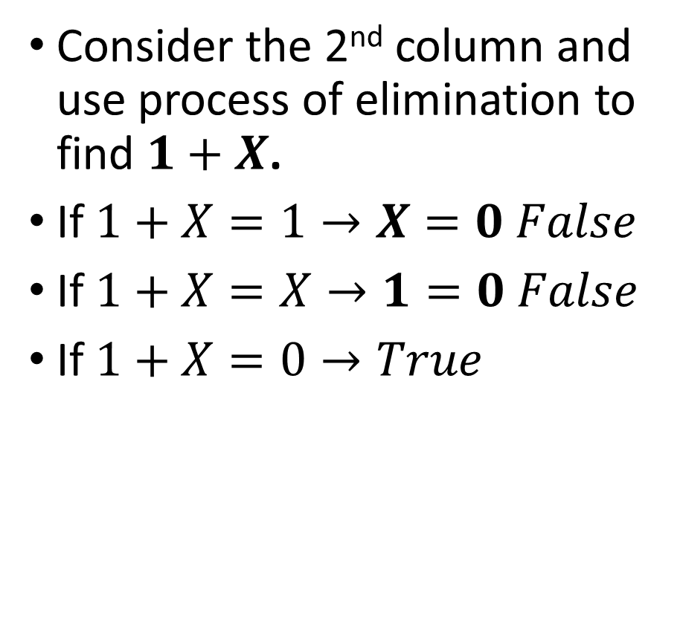
Example 1 cont’d
Consider the 2nd column and use process of elimination to find $1+X$.
If $1+X=1→X=0 False$
If $1+X=X→1=0 False$
If $1+X=0→True$
+ | 0 | 1 | X
0 | 0 | 1 | X
1 | 1 |  | 0
X | X | 0

Slide 7
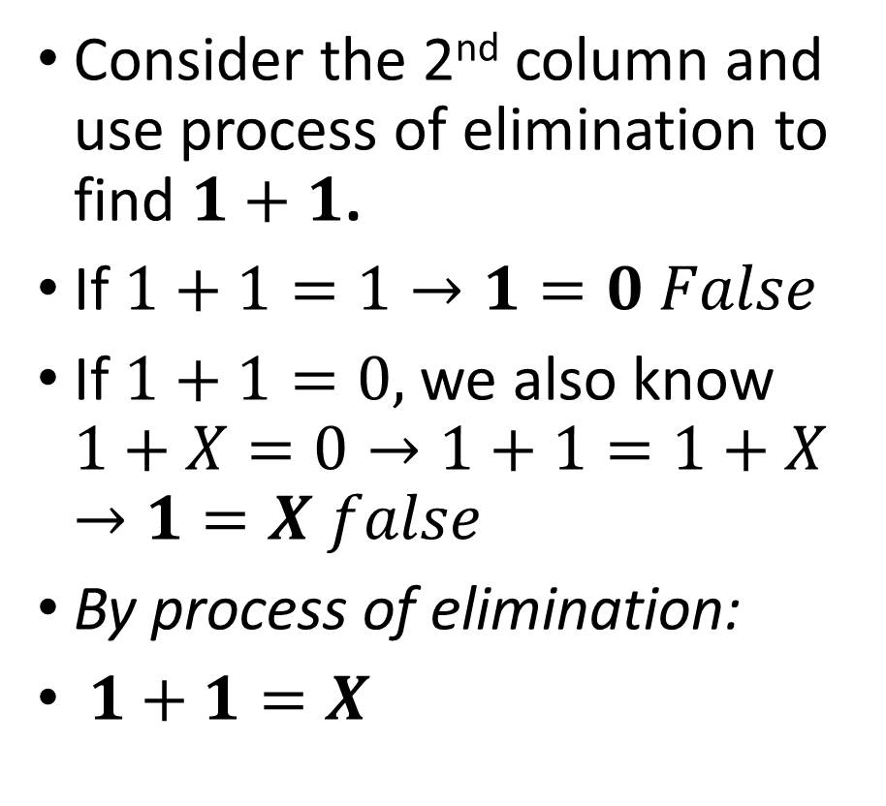
Example 1 cont’d
Consider the 2nd column and use process of elimination to find $1+1$.
If $1+1=1→1=0 False$
If $1+1=0,$we also know $1+X=0→1+1=1+X$ $→1=X false$
By process of elimination:
$1+1=X$
+ | 0 | 1 | X
0 | 0 | 1 | X
1 | 1 | X | 0
X | X | 0

Slide 8
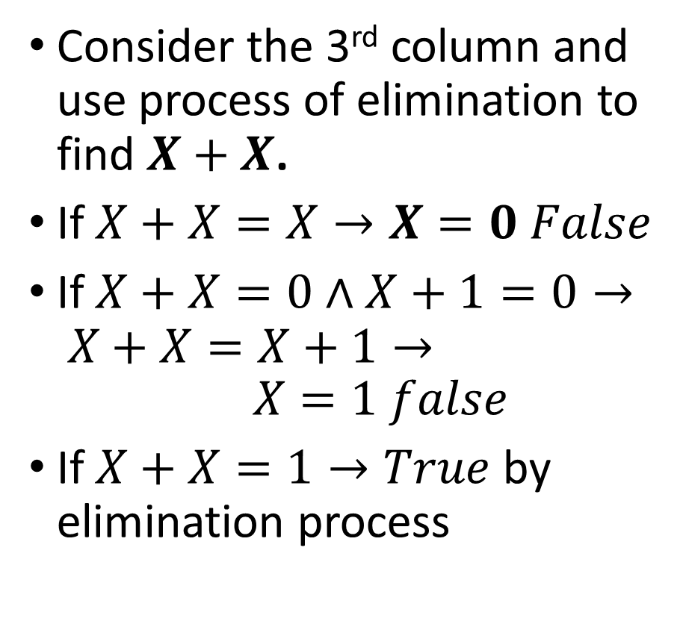
Example 1 cont’d
Consider the 3rd column and use process of elimination to find $X+X$.
If $X+X=X→X=0 False$
If $X+X=0$ $∧X+1=0→ X+X=X+1→ X=1 false$
If $X+X=1→True$ by elimination process
+ | 0 | 1 | X
0 | 0 | 1 | X
1 | 1 | X | 0
X | X | 0 | 1

Slide 9
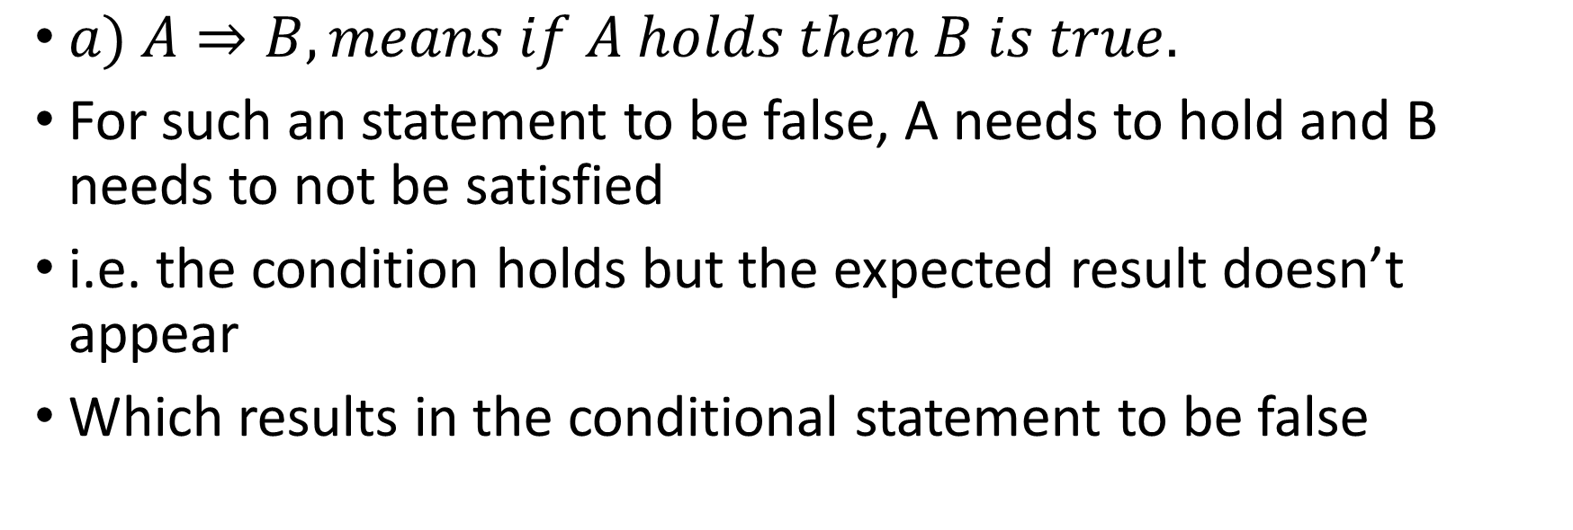
Example 2
$a) A⇒B, means if A holds then B is true.$
For such an statement to be false, A needs to hold and B needs to not be satisfied
i.e. the condition holds but the expected result doesn’t appear
Which results in the conditional statement to be false

Slide 10
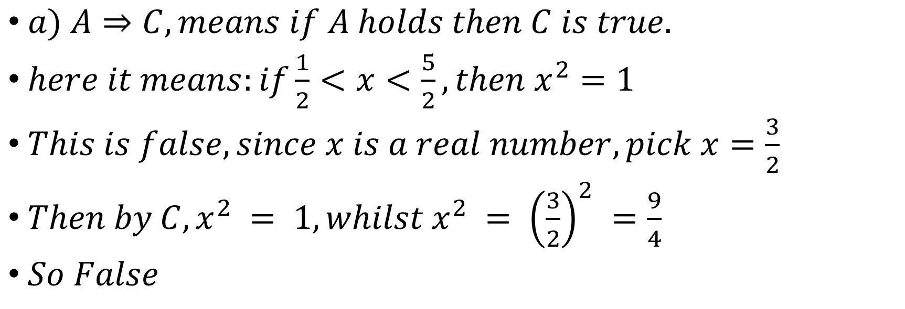
Example 2 cont’d
$a) A⇒C, means if A holds then C is true.$
$here it means:if\frac{1}{2}<x<\frac{5}{2}, then x^{2}=1$
$This is false, since x is a real number, pick x=\frac{3}{2}$
$Then by C, x^{2} = 1, whilst x^{2} = {\left(\frac{3}{2}\right)}^{2} =\frac{9}{4}$
$So False$

Slide 11

Example 2 cont’d
$b)B⇒C means, if x∈ℤ, then x^{2}=1$
$False just pick x to be some integer other than 1 and −1$
$If x = 2, then x^{2} = 4 not 1, a contradiction$

Slide 12
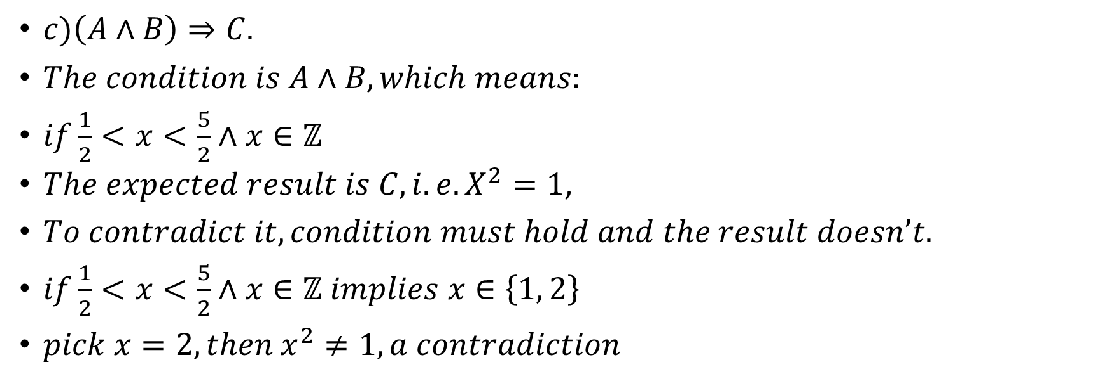
Example 2 cont’d
$c)\left(A∧B\right)⇒C.$
$The condition is A∧B, which means:$
$if\frac{1}{2}<x<\frac{5}{2}∧x∈ℤ$
$The expected result is C, i.e. X^{2}=1$,
$To contradict it, condition must hold and the result doesn’t.$
$if\frac{1}{2}<x<\frac{5}{2}∧x∈ℤ implies x∈\left\{1, 2\right\}$
$pick x=2, then x^{2}≠1, a contradiction$

Slide 13
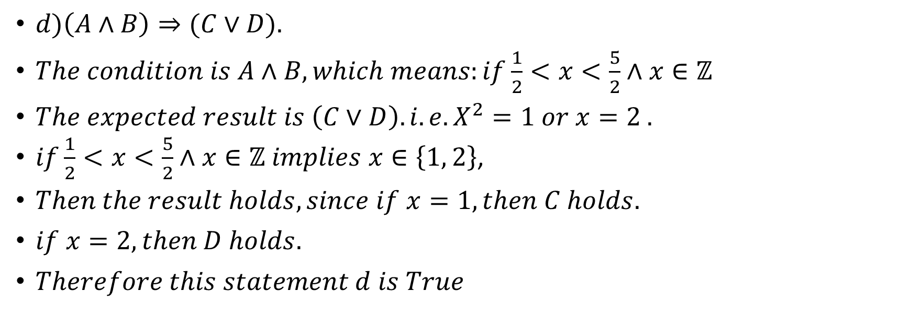
Example 2 cont’d
$d)\left(A∧B\right)⇒(C∨D).$
$The condition is A∧B, which means:if\frac{1}{2}<x<\frac{5}{2}∧x∈ℤ$
$The expected result is \left(C∨D\right).i.e. X^{2}=1 or x=2 .$
$if\frac{1}{2}<x<\frac{5}{2}∧x∈ℤ implies x∈\left\{1, 2\right\}$,
$Then the result holds, since if x=1, then C holds.$
$if x=2, then D holds.$
$Therefore this statement d is True$

Slide 14
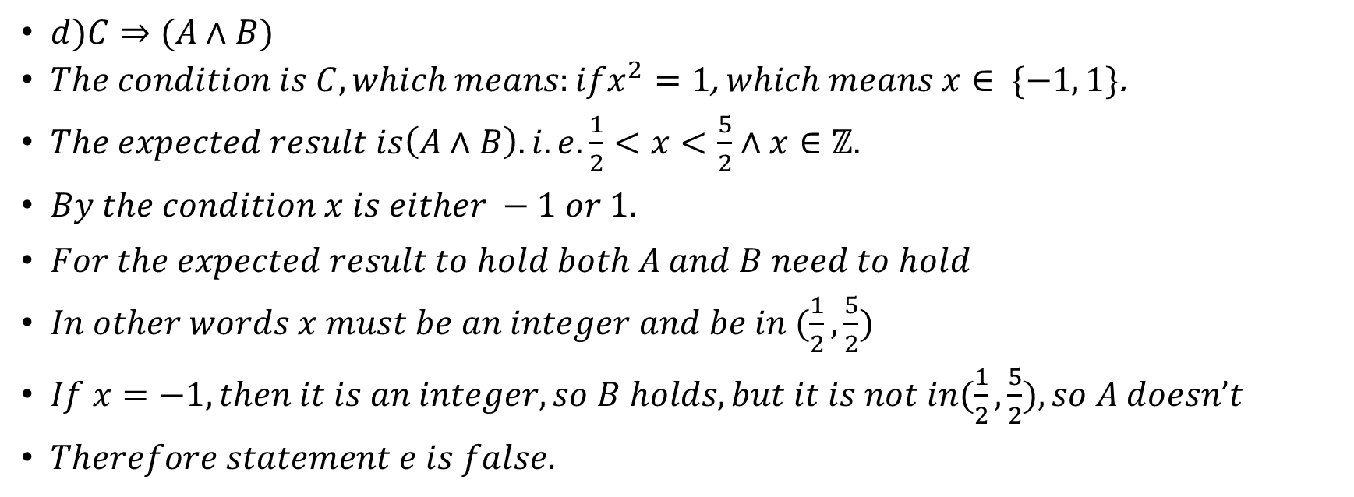
Example 2 cont’d
$d)C⇒(A∧B)$
$The condition is C, which means:ifx^{2}=1$, $which means x∈ \{−1, 1\}$.
$The expected result is\left(A∧B\right). i.e.\frac{1}{2}<x<\frac{5}{2}∧x∈ℤ.$
$By the condition x is either −1 or 1.$
$For the expected result to hold both A and B need to hold$
$In other words x must be an integer and be in (\frac{1}{2},\frac{5}{2})$
$If x=−1, then it is an integer, so B holds, but it is not in(\frac{1}{2},\frac{5}{2}), so A doesn’t$
$Therefore statement e is false.$

Slide 15
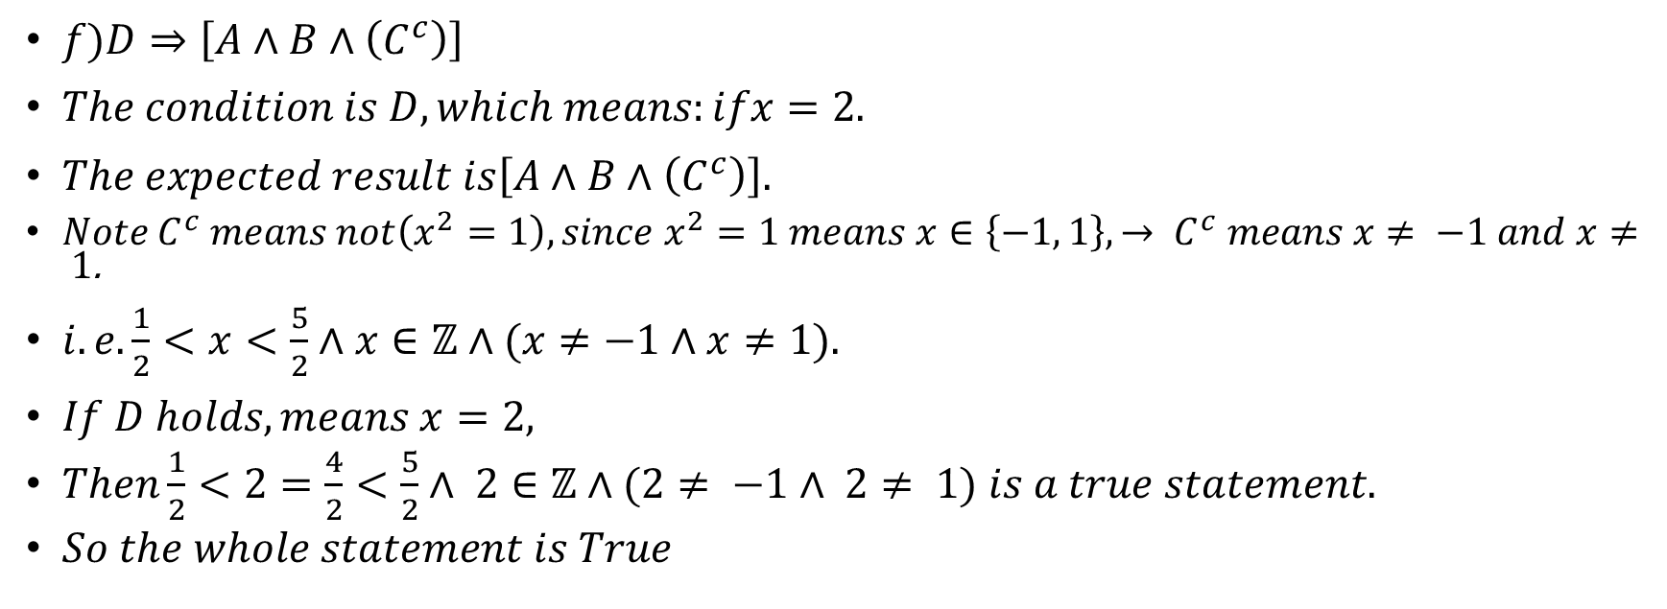
Example 2 cont’d
$f)D⇒\left[A∧B∧\left(C^{c}\right)\right]$
$The condition is D, which means:ifx=2.$
$The expected result is\left[A∧B∧\left(C^{c}\right)\right].$
$Note C^{c} means not\left(x^{2}=1\right), since x^{2}=1 means x∈\left\{−1, 1\right\}, → C^{c} means x≠ −1 and x≠ 1$.
$i.e.\frac{1}{2}<x<\frac{5}{2}∧x∈ℤ∧(x≠−1∧x≠1).$
$If D holds, means x=2,$
$Then\frac{1}{2}<2=\frac{4}{2}<\frac{5}{2}∧ 2∈ℤ∧(2≠ −1∧ 2≠ 1)$ $is a true statement.$
$So the whole statement is True$

Slide 16
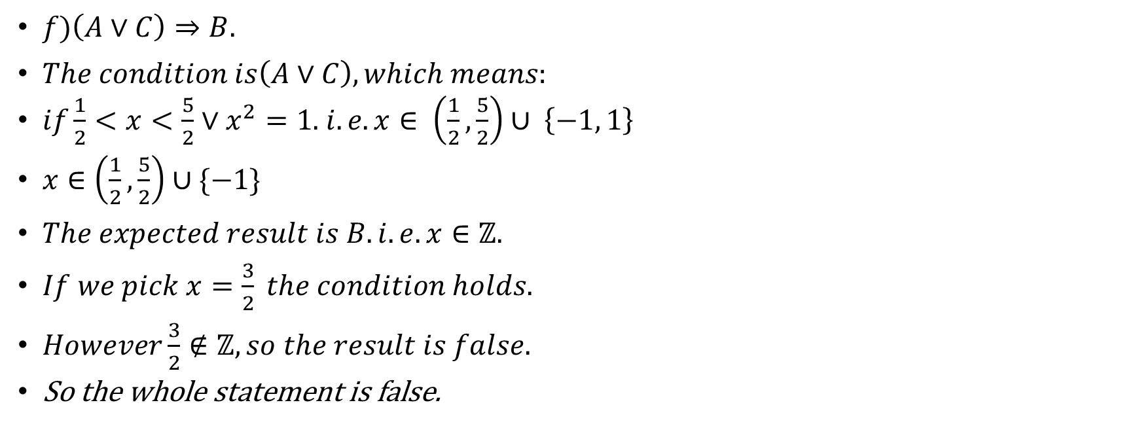
Example 2 cont’d
$f)\left(A∨C\right)⇒B.$
$The condition is\left(A∨C\right), which means:$
$if\frac{1}{2}<x<\frac{5}{2}∨x^{2}=1.$ $i.e. x∈ \left(\frac{1}{2},\frac{5}{2}\right)∪ \left\{−1, 1\right\}$
$x∈\left(\frac{1}{2},\frac{5}{2}\right)∪\{−1\}$
$The expected result is B. i.e. x∈ℤ.$
$If we pick x=\frac{3}{2} the condition holds.$
$However\frac{3}{2}∉ℤ, so the result is false.$
So the whole statement is false.

Slide 17
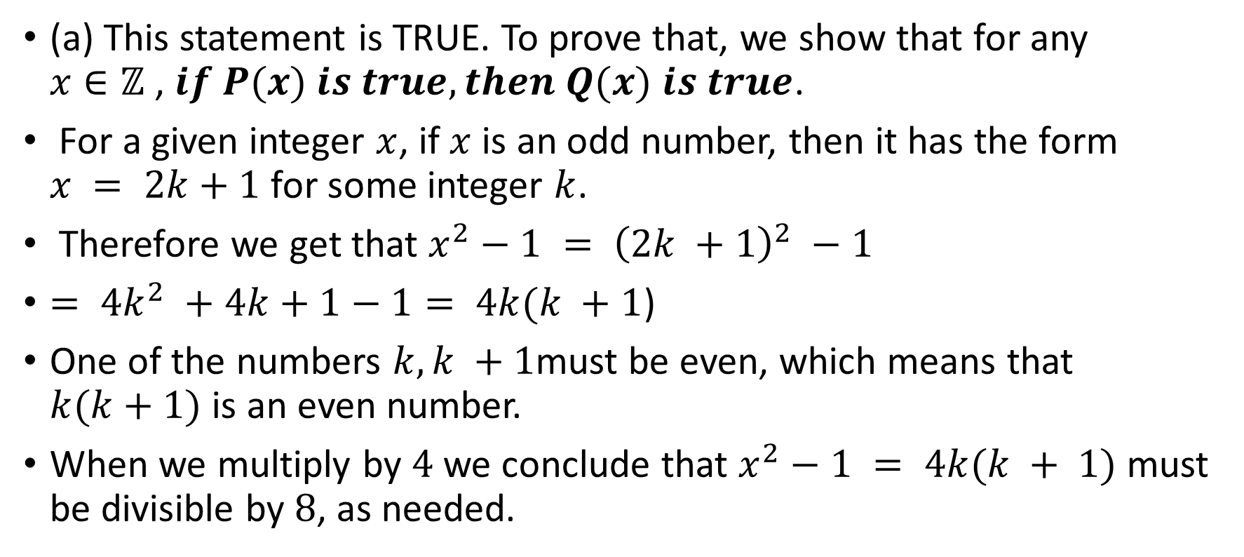
Example 3
(a) This statement is TRUE. To prove that, we show that for any $x∈ℤ$, $if P(x) is true, then Q(x)$ $is true$.
For a given integer $x$, if $x$ is an odd number, then it has the form $x = 2k+1$for some integer $k$.
Therefore we get that $x^{2}−1 = {\left(2k +1\right)}^{2} −1$
$= 4k^{2} +4k+1−1= 4k(k +1$)
One of the numbers $k, k +1$must be even, which means that $k(k+1)$ is an even number.
When we multiply by $4$ we conclude that $x^{2}−1 = 4k(k + 1)$ must be divisible by $8$, as needed.

Slide 18
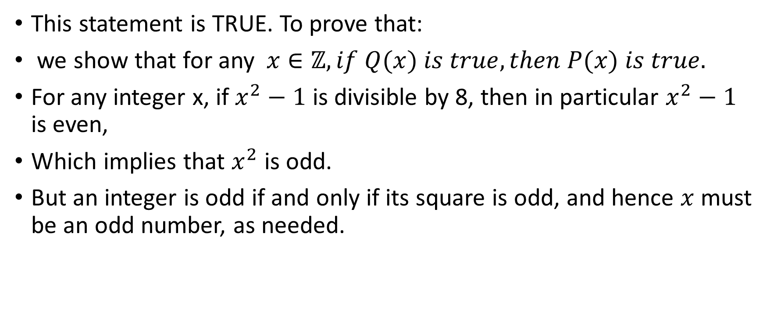
Example 3 cont’d
This statement is TRUE. To prove that:
we show that for any $x∈ℤ, if Q(x) is true, then P(x) is true.$
For any integer x, if $x^{2}−1$ is divisible by 8, then in particular $x^{2}−1$ is even,
Which implies that $x^{2}$ is odd.
But an integer is odd if and only if its square is odd, and hence $x$ must be an odd number, as needed.

Slide 19
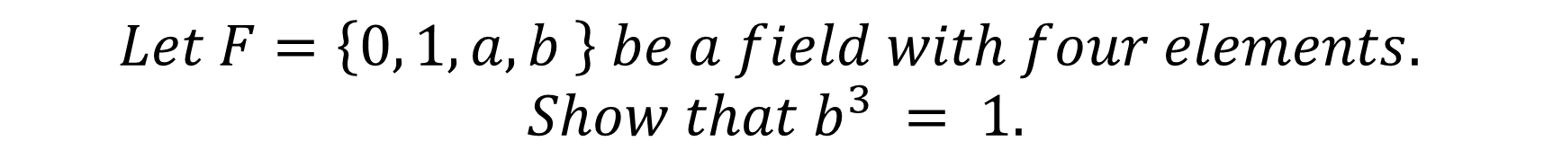
Example 4
$$Let F=\left\{0, 1, a, b \right\} be a field with four elements.$$
$$Show that b^{3} = 1.$$
We need to always do multiplication table first since we need it to fill in the addition table
1st 0 times every other element is 0.
. | 0 | 1 | a | b
0 | 0 | 0 | 0 | 0
1 | 0
a | 0
b | 0

Slide 20
Example 4 cont’d
$$Let F=\left\{0, 1, a, b \right\} be a field with four elements.$$
$$Show that b^{3} = 1.$$
2nd every element times 1 is itself, since 1 is the multiplicative identity.
. | 0 | 1 | a | b
0 | 0 | 0 | 0 | 0
1 | 0 | 1 | a | b
a | 0 | a
b | 0 | b

Slide 21
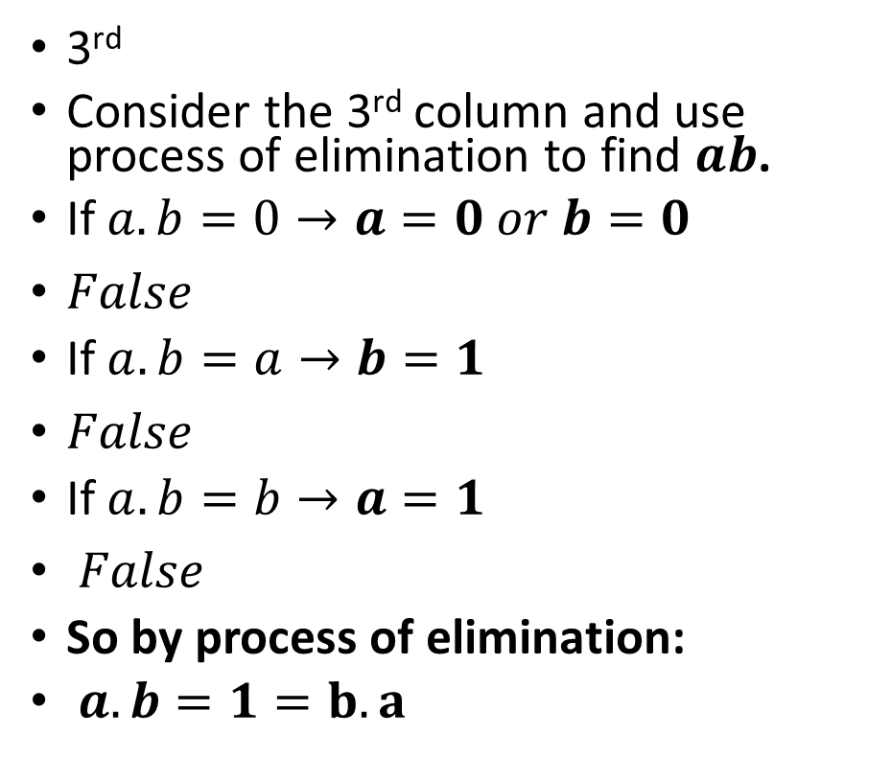
Example 4 cont’d
$$Let F=\left\{0, 1, a, b \right\} be a field with four elements.$$
$$Show that b^{3} = 1.$$
3rd
Consider the 3rd column and use process of elimination to find $ab$.
If $a.b=0→a=0 or b=0$
$False$
If$a.b=a→b=1$
$False$
If$a.b=b→a=1$
$False$
So by process of elimination:
$a.b=1=b.a$
. | 0 | 1 | a | b
0 | 0 | 0 | 0 | 0
1 | 0 | 1 | a | b
a | 0 | a |  | 1
b | 0 | b | 1

Slide 22
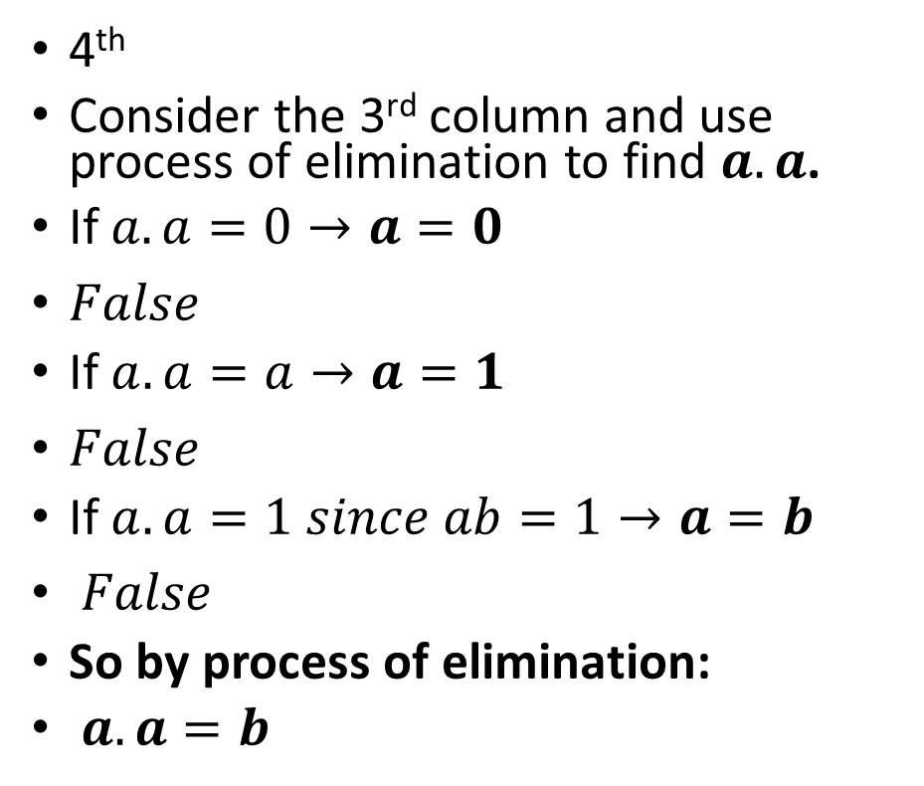
Example 4 cont’d
$$Let F=\left\{0, 1, a, b \right\} be a field with four elements.$$
$$Show that b^{3} = 1.$$
4th
Consider the 3rd column and use process of elimination to find $a.a$.
If $a.a=0→a=0$
$False$
If$a.a=a→a=1$
$False$
If$a.a=1 since ab=1→a=b$
$False$
So by process of elimination:
$a.a=b$
. | 0 | 1 | a | b
0 | 0 | 0 | 0 | 0
1 | 0 | 1 | a | b
a | 0 | a | b | 1
b | 0 | b | 1

Slide 23
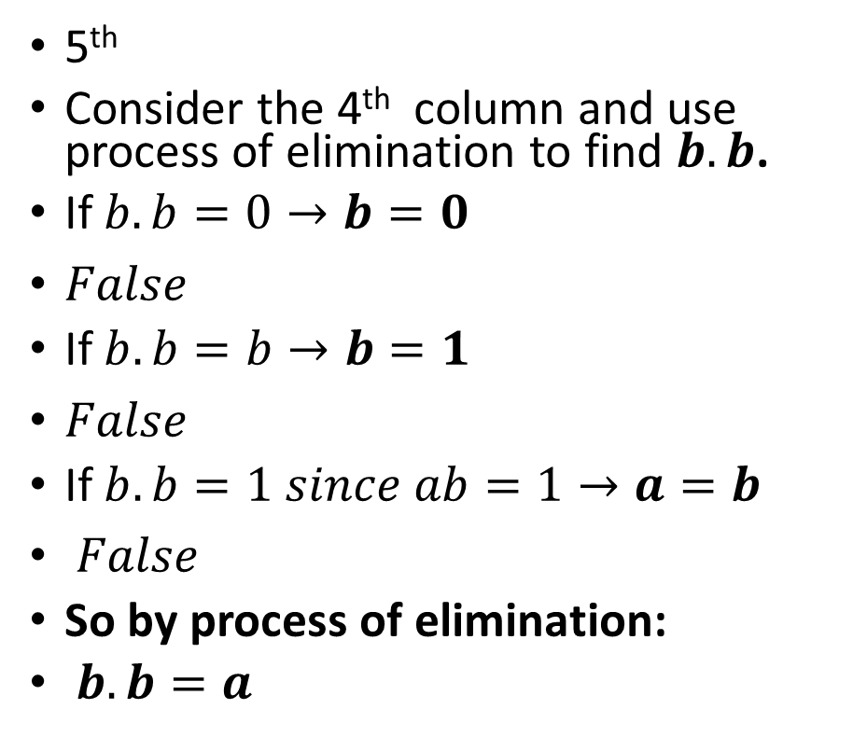
Example 4 cont’d
$$Let F=\left\{0, 1, a, b \right\} be a field with four elements.$$
$$Show that b^{3} = 1.$$
5th
Consider the 4th column and use process of elimination to find $b.b$.
If $b.b=0→b=0$
$False$
If$b.b=b→b=1$
$False$
If$b.b=1 since ab=1→a=b$
$False$
So by process of elimination:
$b.b=a$
. | 0 | 1 | a | b
0 | 0 | 0 | 0 | 0
1 | 0 | 1 | a | b
a | 0 | a | b | 1
b | 0 | b | 1 | a

Slide 24


Example 4 cont’d
$$Let F=\left\{0, 1, a, b \right\} be a field with four elements.$$
$$Show that b^{3} = 1.$$
Now lets calculate $b^{3}$.
$b^{3} = b.b.b$
$=\left(b.b\right).b$
$=a.b$
$=1$
. | 0 | 1 | a | b
0 | 0 | 0 | 0 | 0
1 | 0 | 1 | a | b
a | 0 | a | b | 1
b | 0 | b | 1 | a
$$b.b=a$$

Slide 25
Citations:
Book
Mathematical Thinking: Problem-solving and Proofs
D'Angelo, J.P.
West, D.B.
9780130144126
https://books.google.ca/books?id=fL6nQgAACAAJ
2000
Prentice Hall

