Slide 1
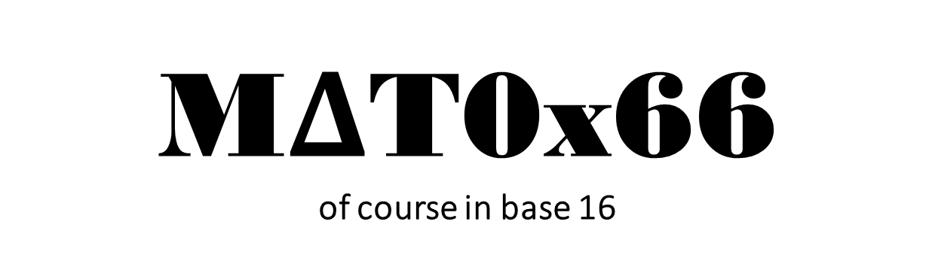
M$Δ$T0x66 of course in base 16
Arash Gholami
Email: arash.gholami@mail.utoronto.ca
Tutorial 6
LinkedIn
Credits to Larry Zhang

Slide 2
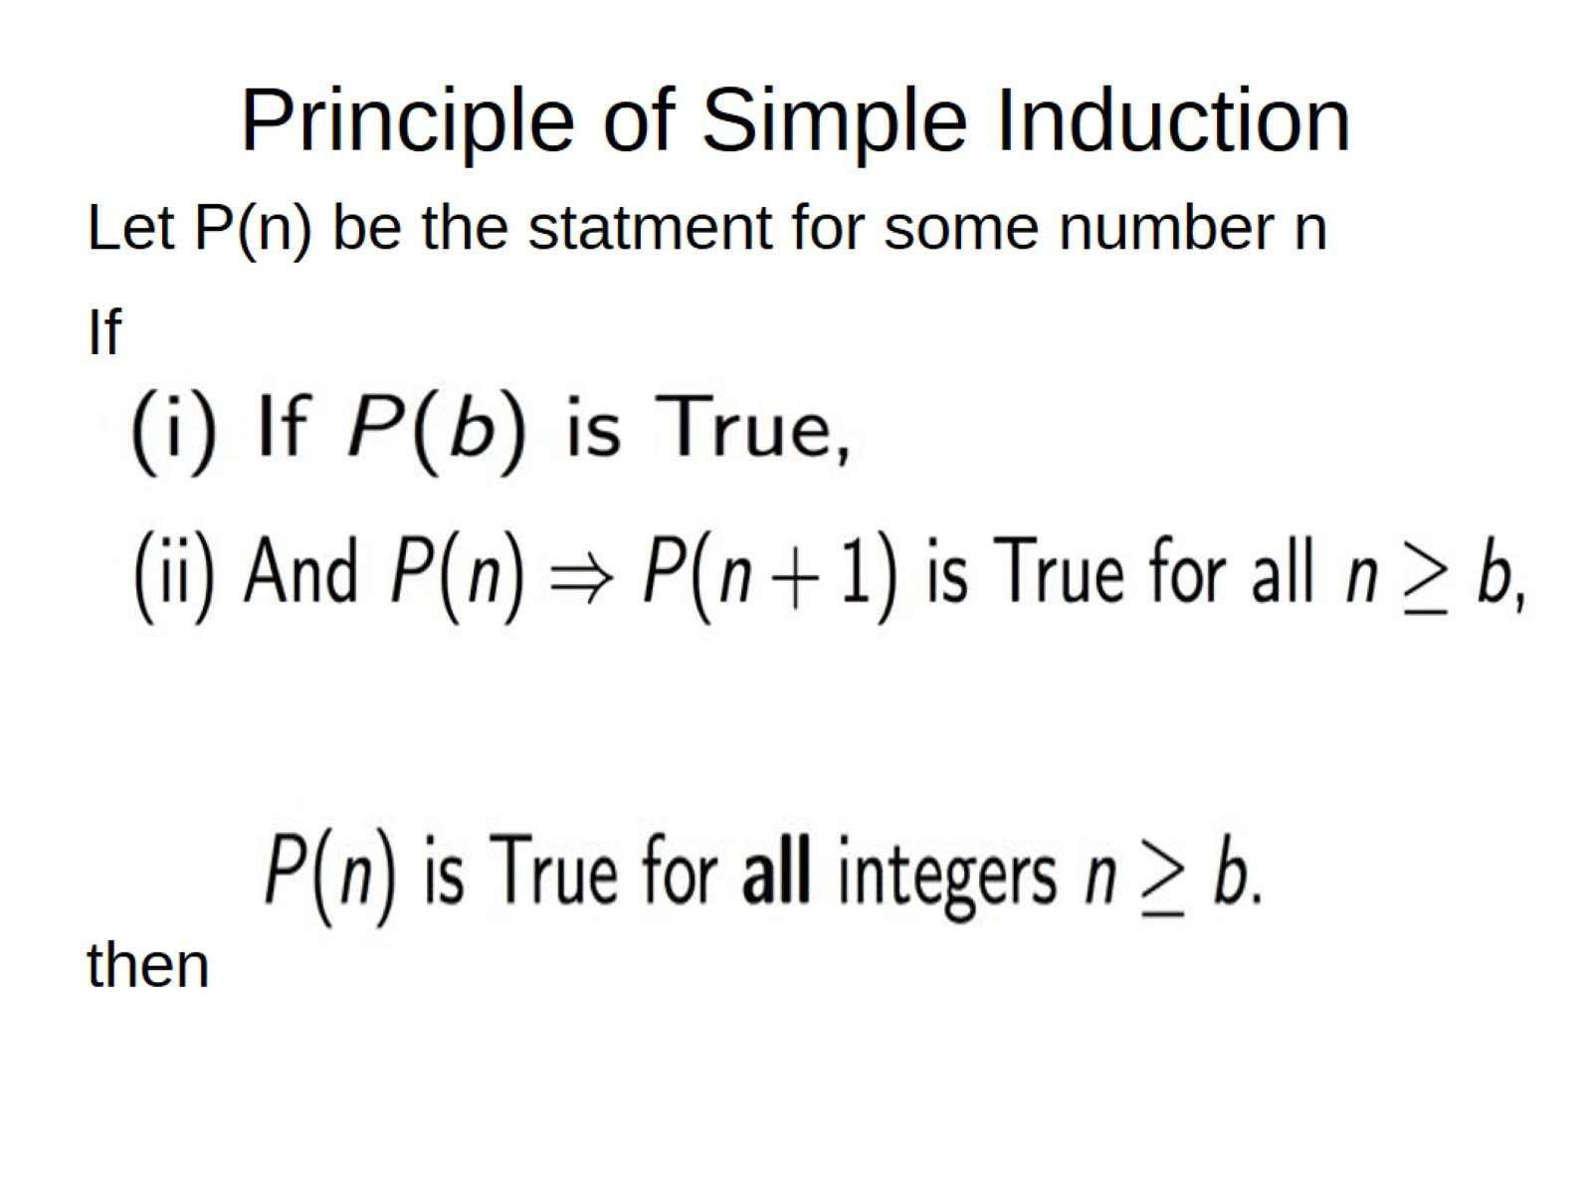
Principle of Simple Induction

Slide 3
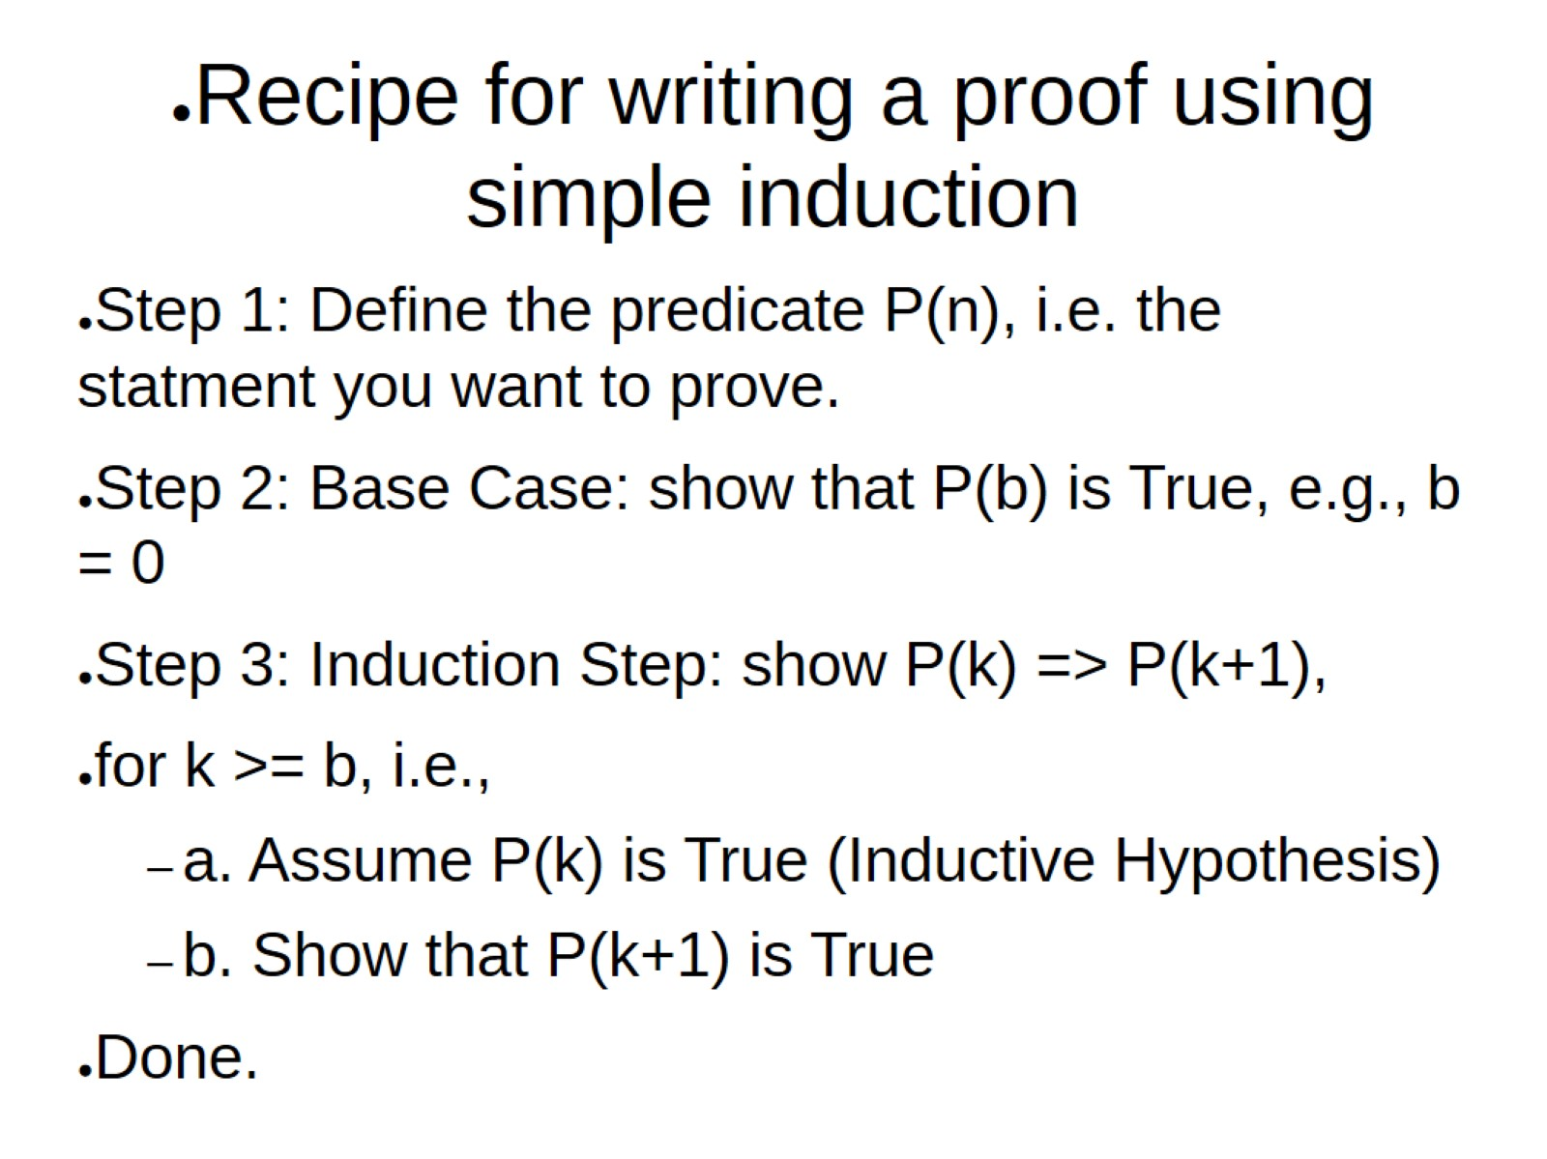
Recipe for writing a proof using simple induction

Slide 4
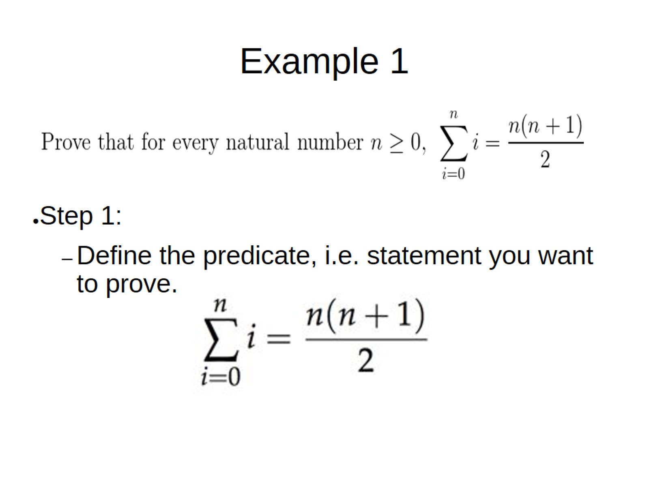
Example 1

Slide 5
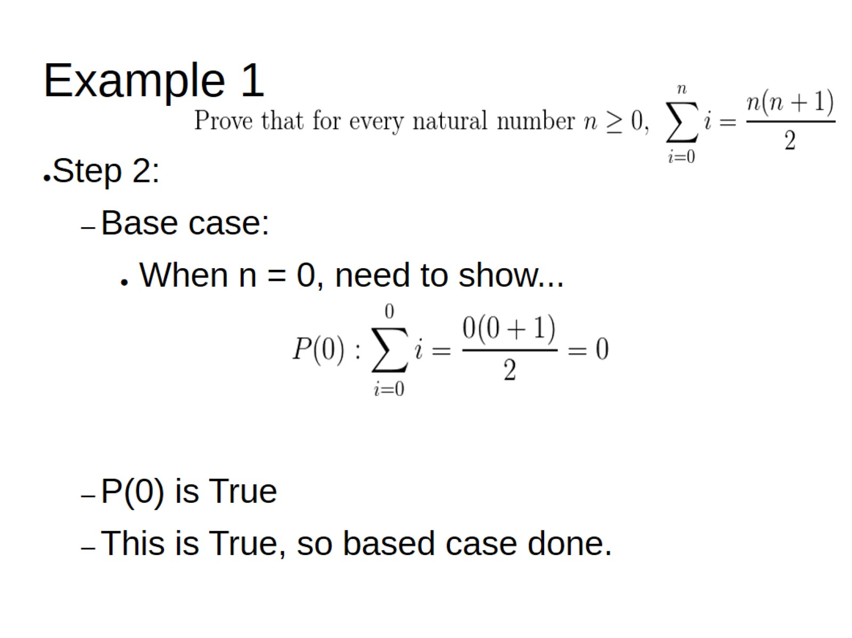
Example 1

Slide 6
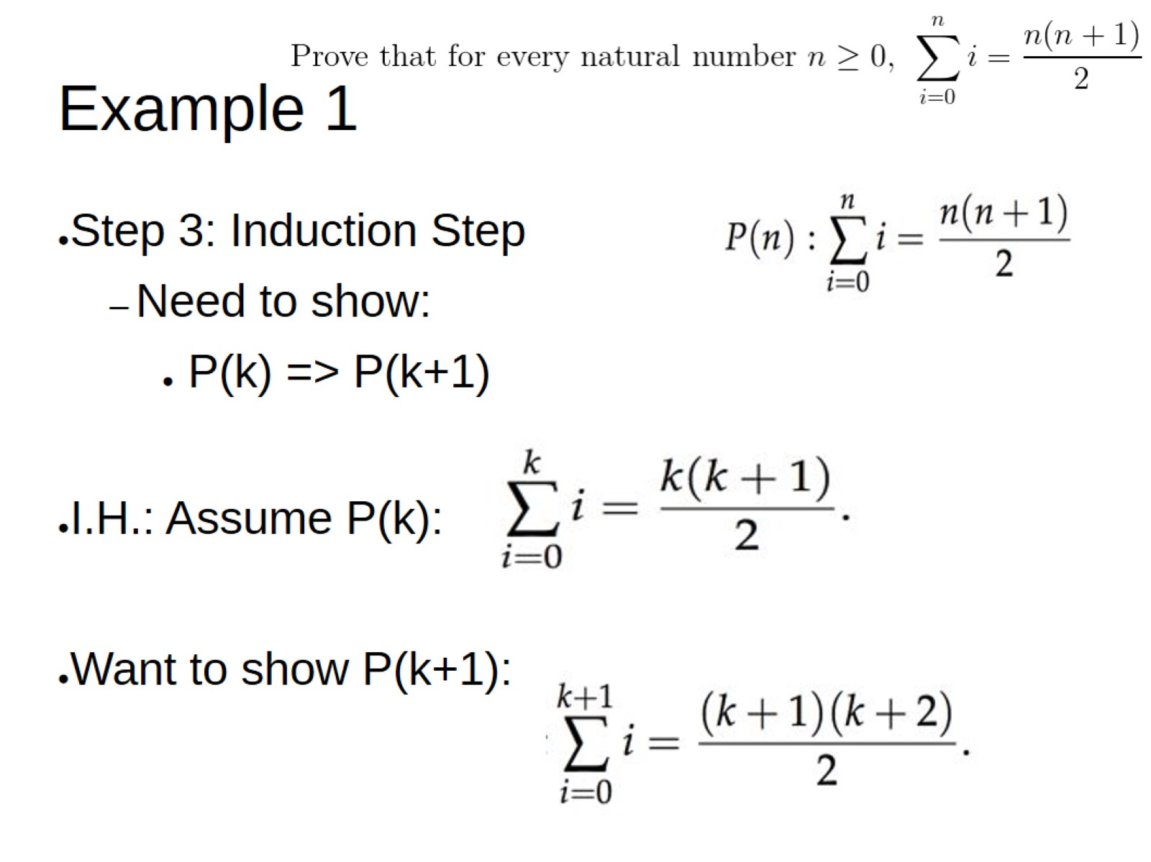
Example 1

Slide 7
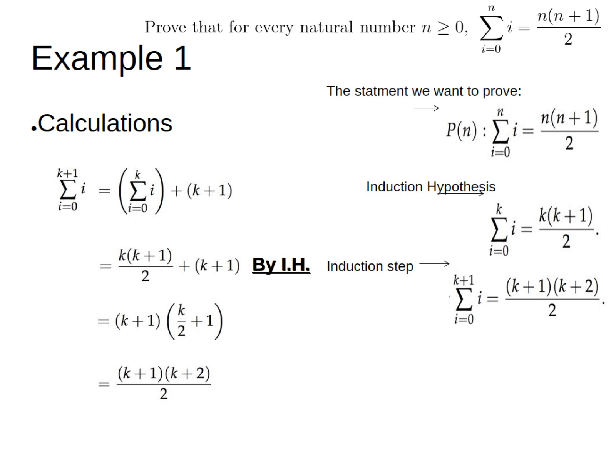
Example 1

Slide 8
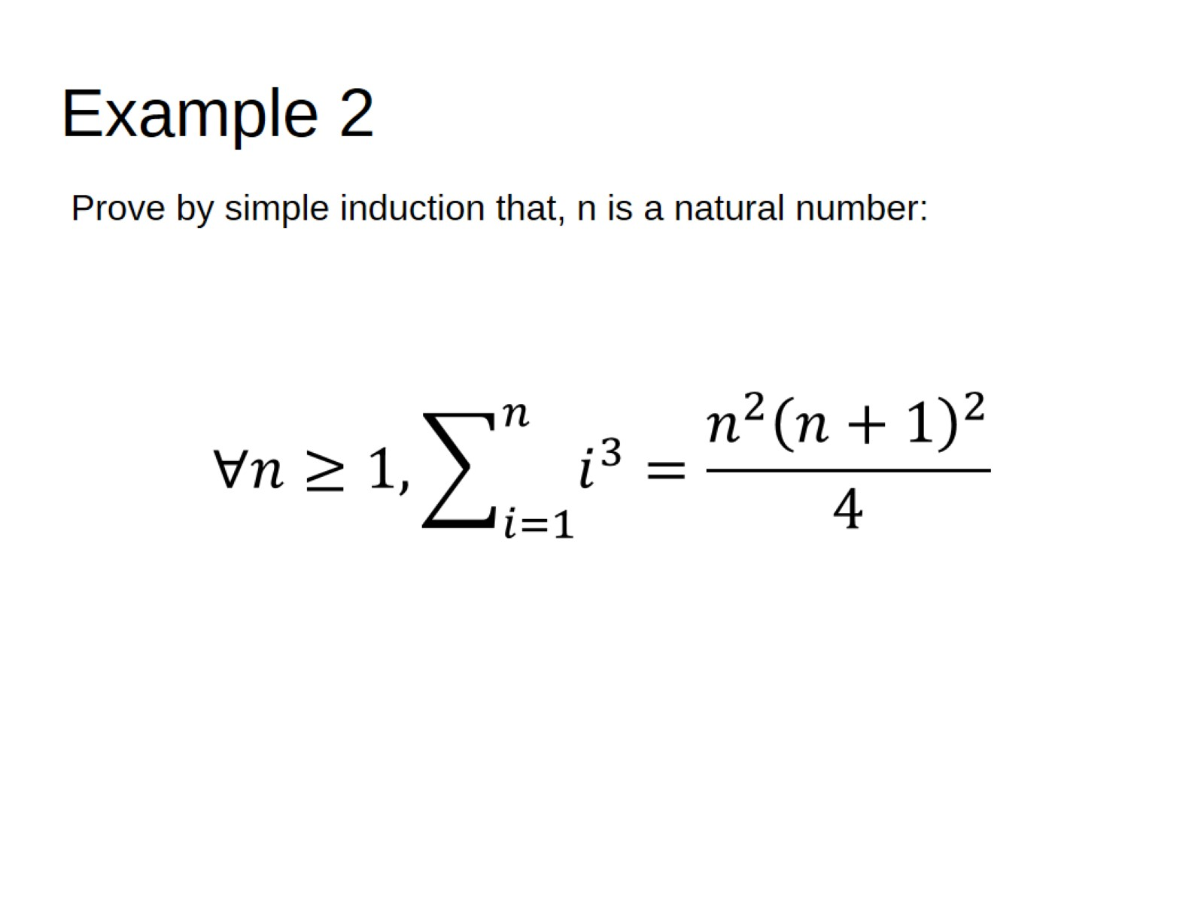
Example 2

Slide 9
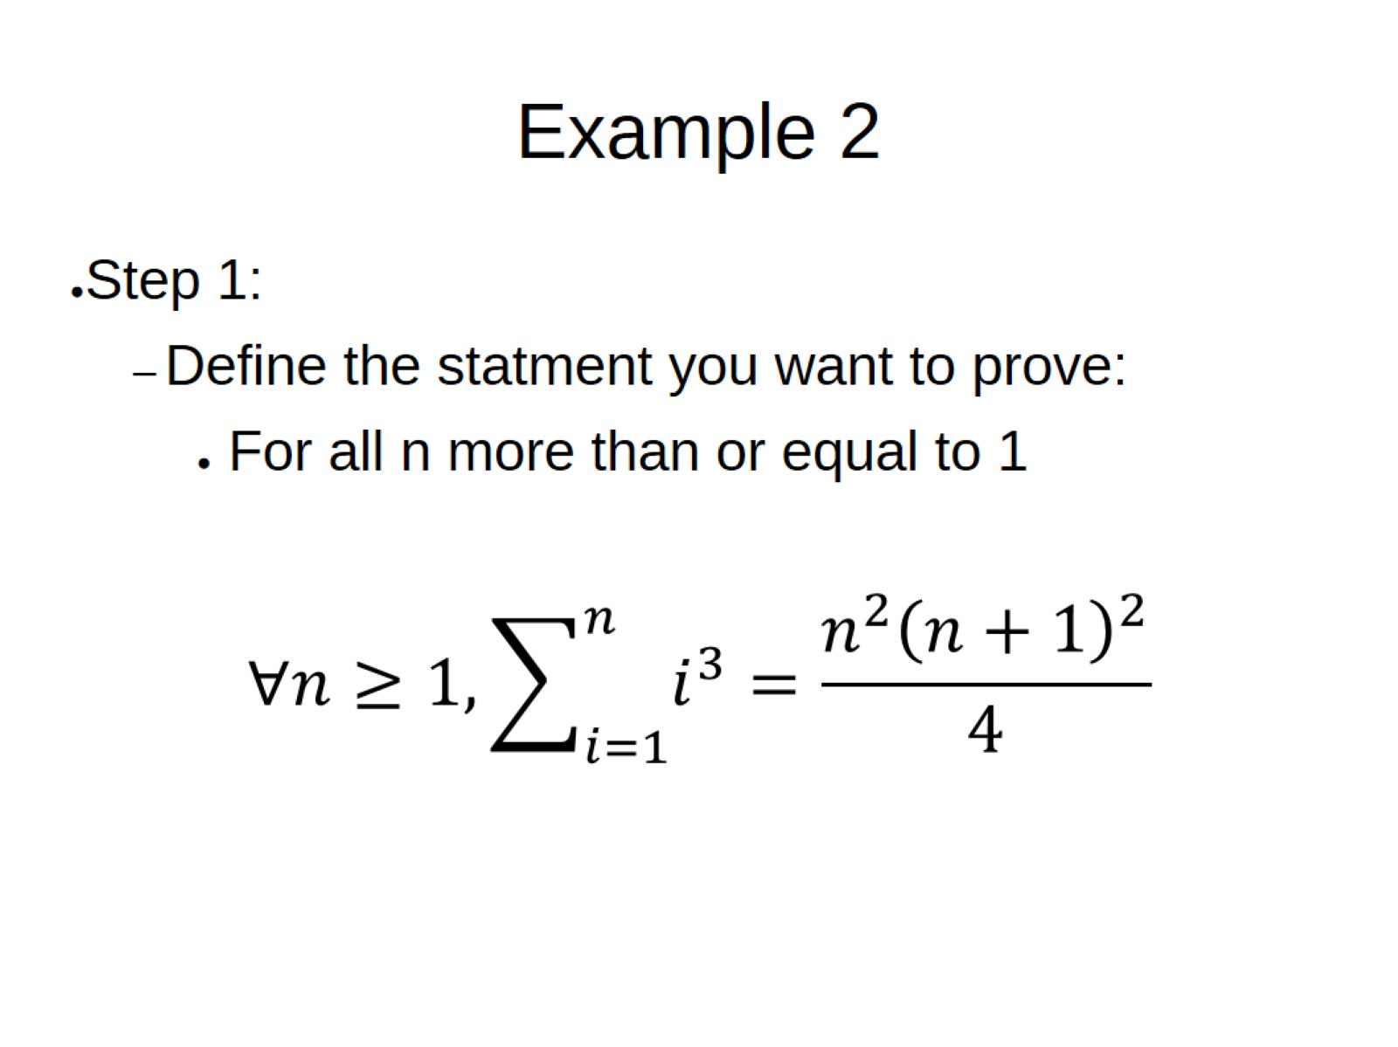
Example 2

Slide 10
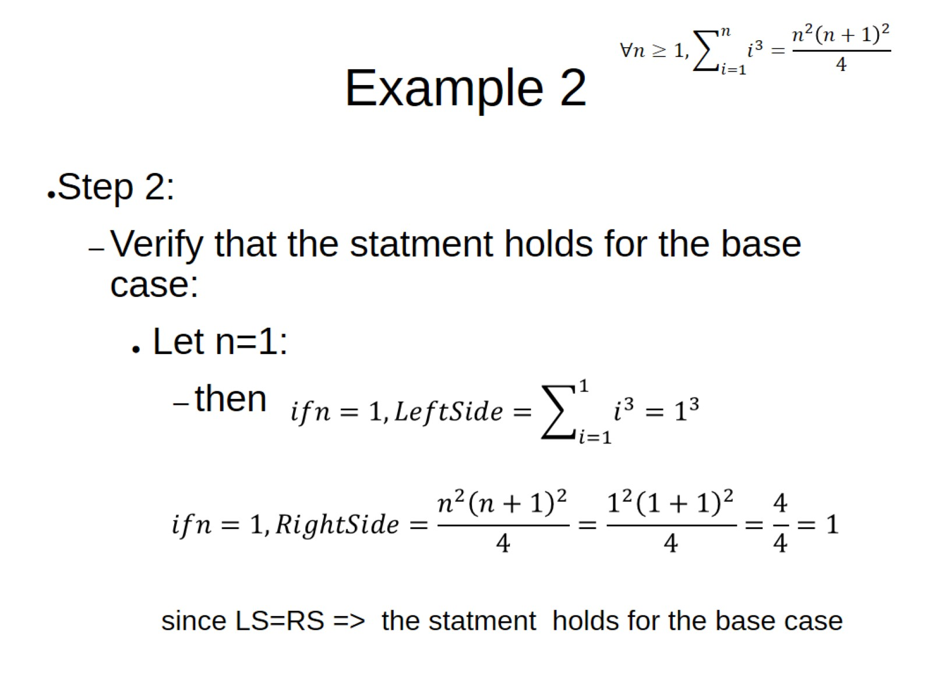
Example 2

Slide 11
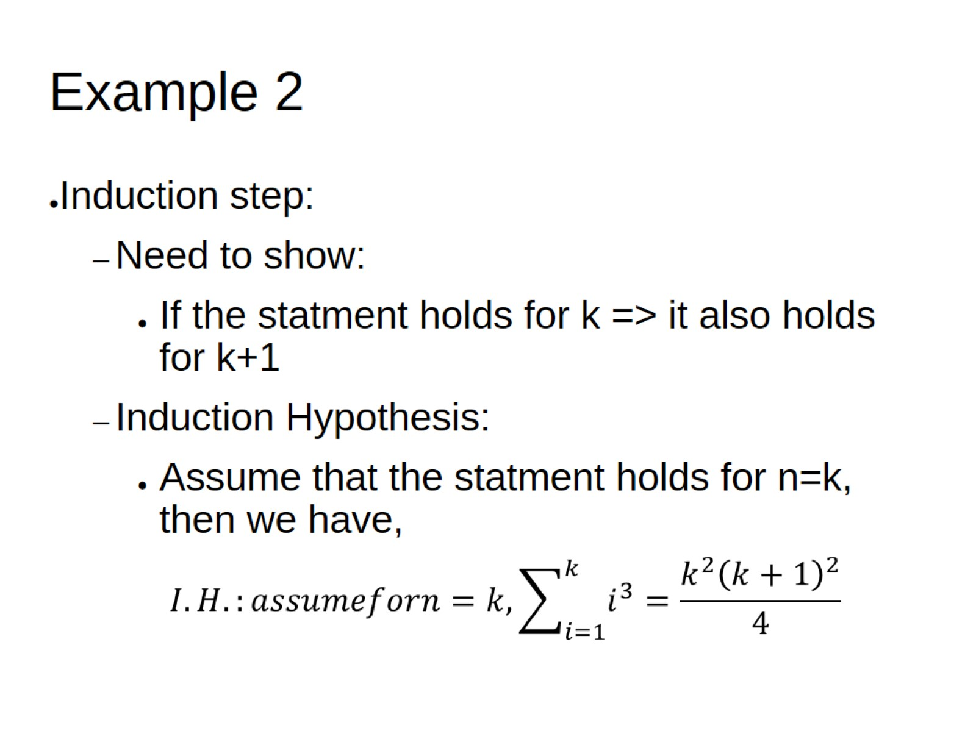
Example 2

Slide 12
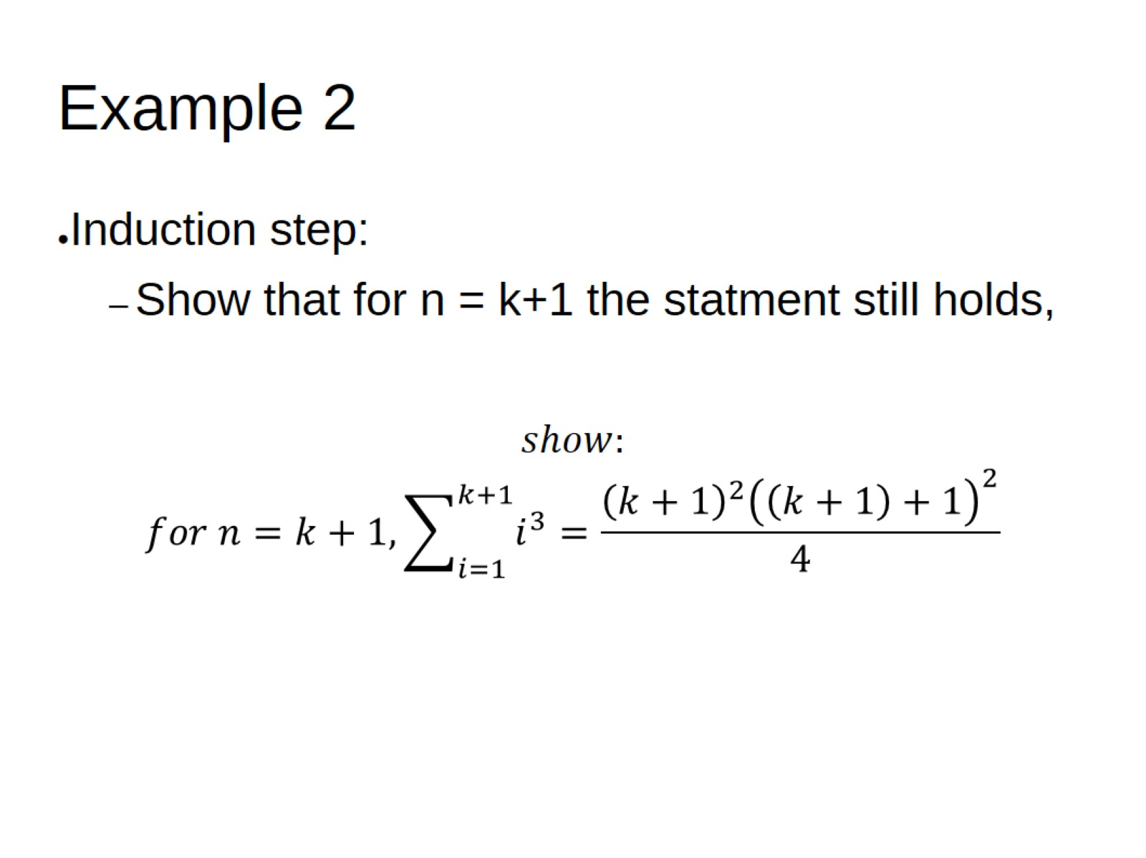
Example 2

Slide 13
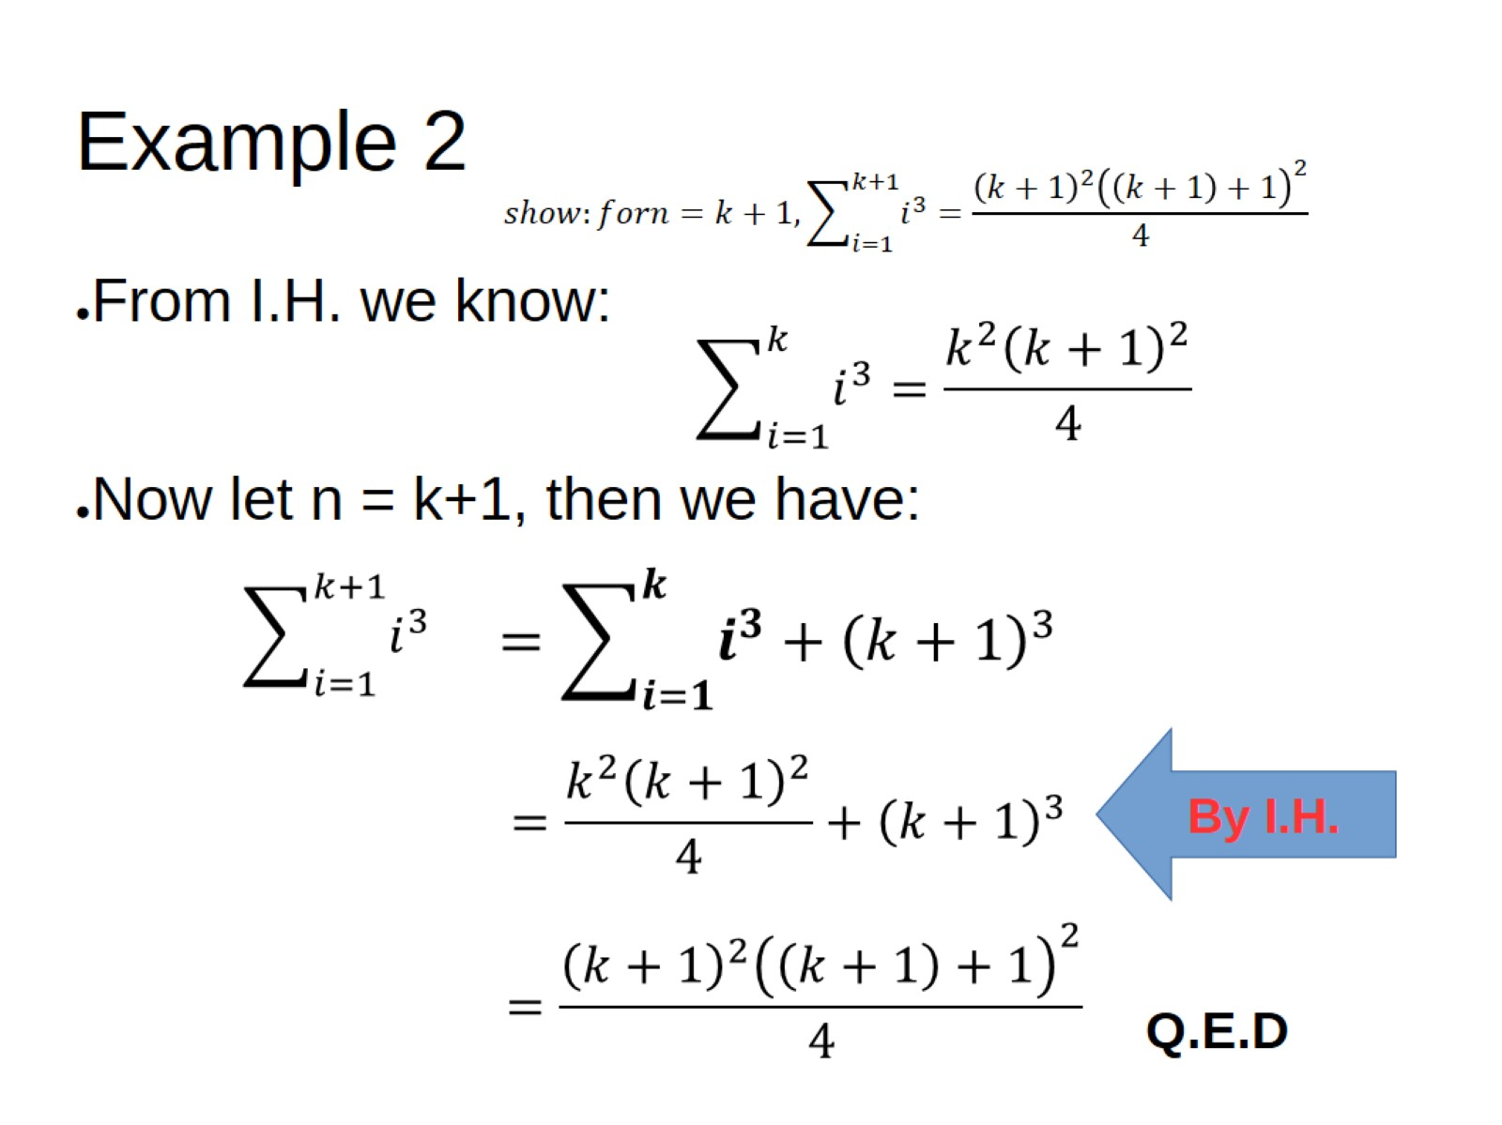
Example 2

Slide 14
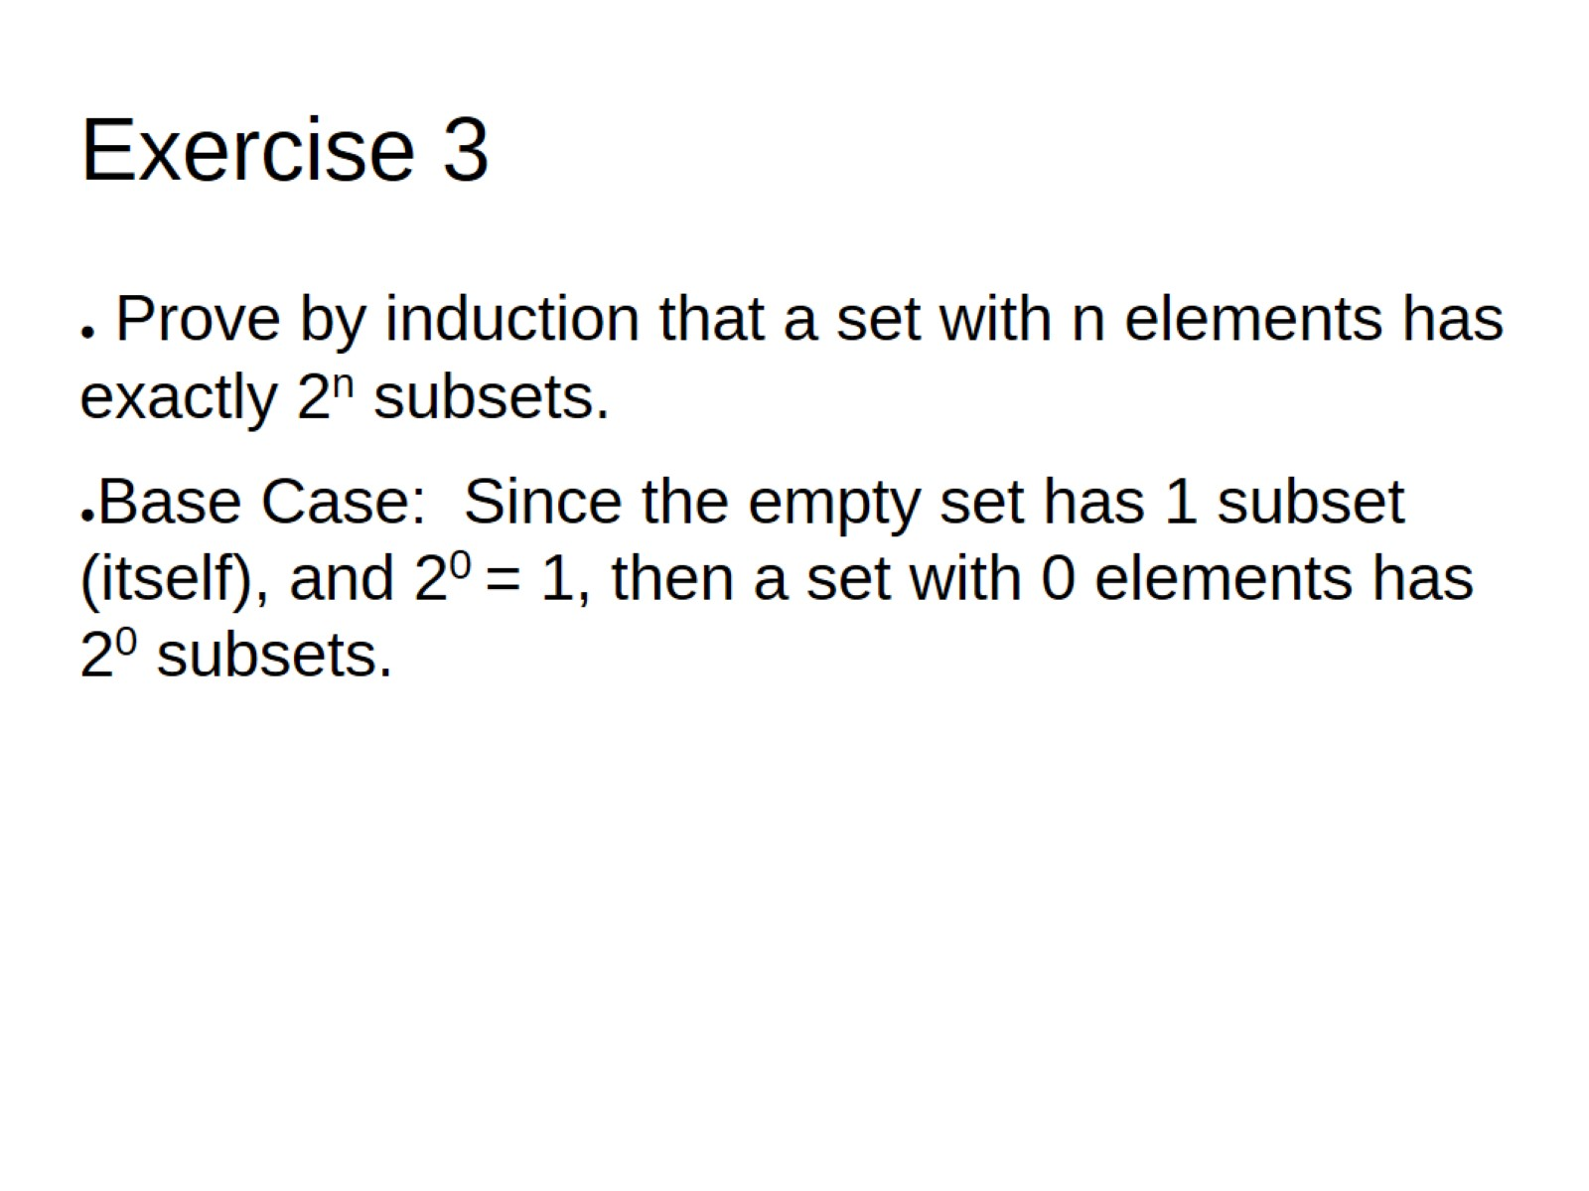
Exercise 3

Slide 15
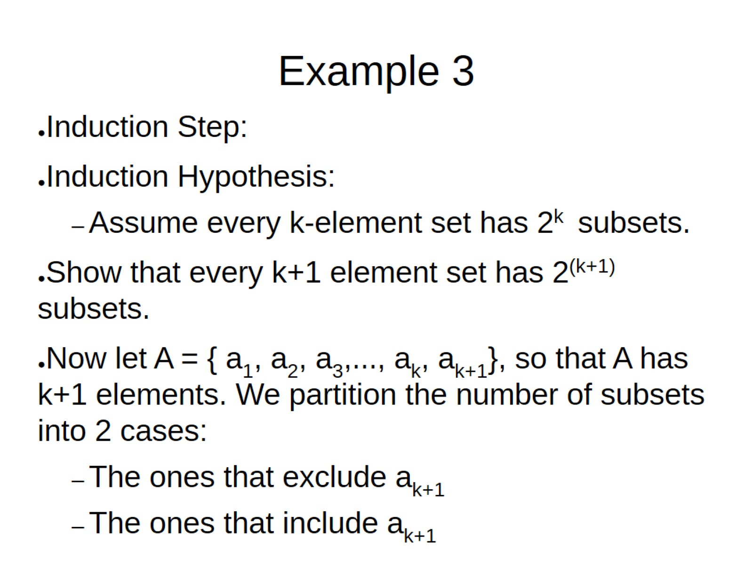
Example 3

Slide 16
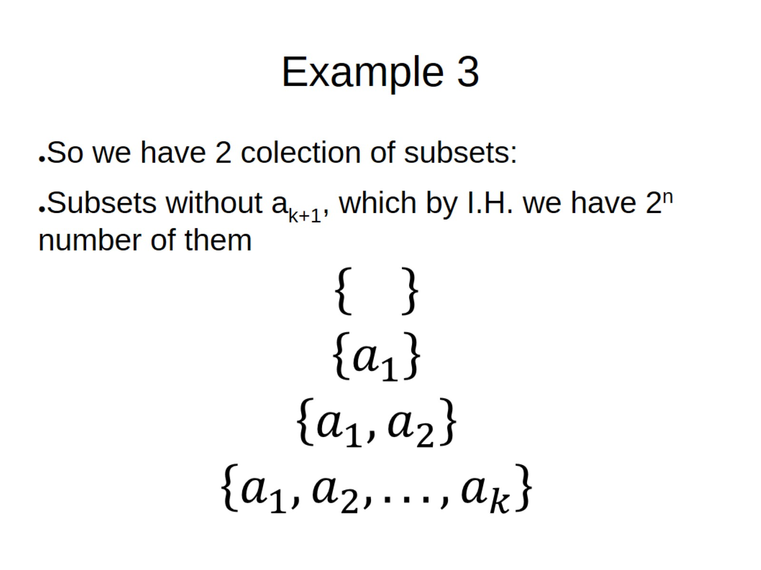
Example 3

Slide 17
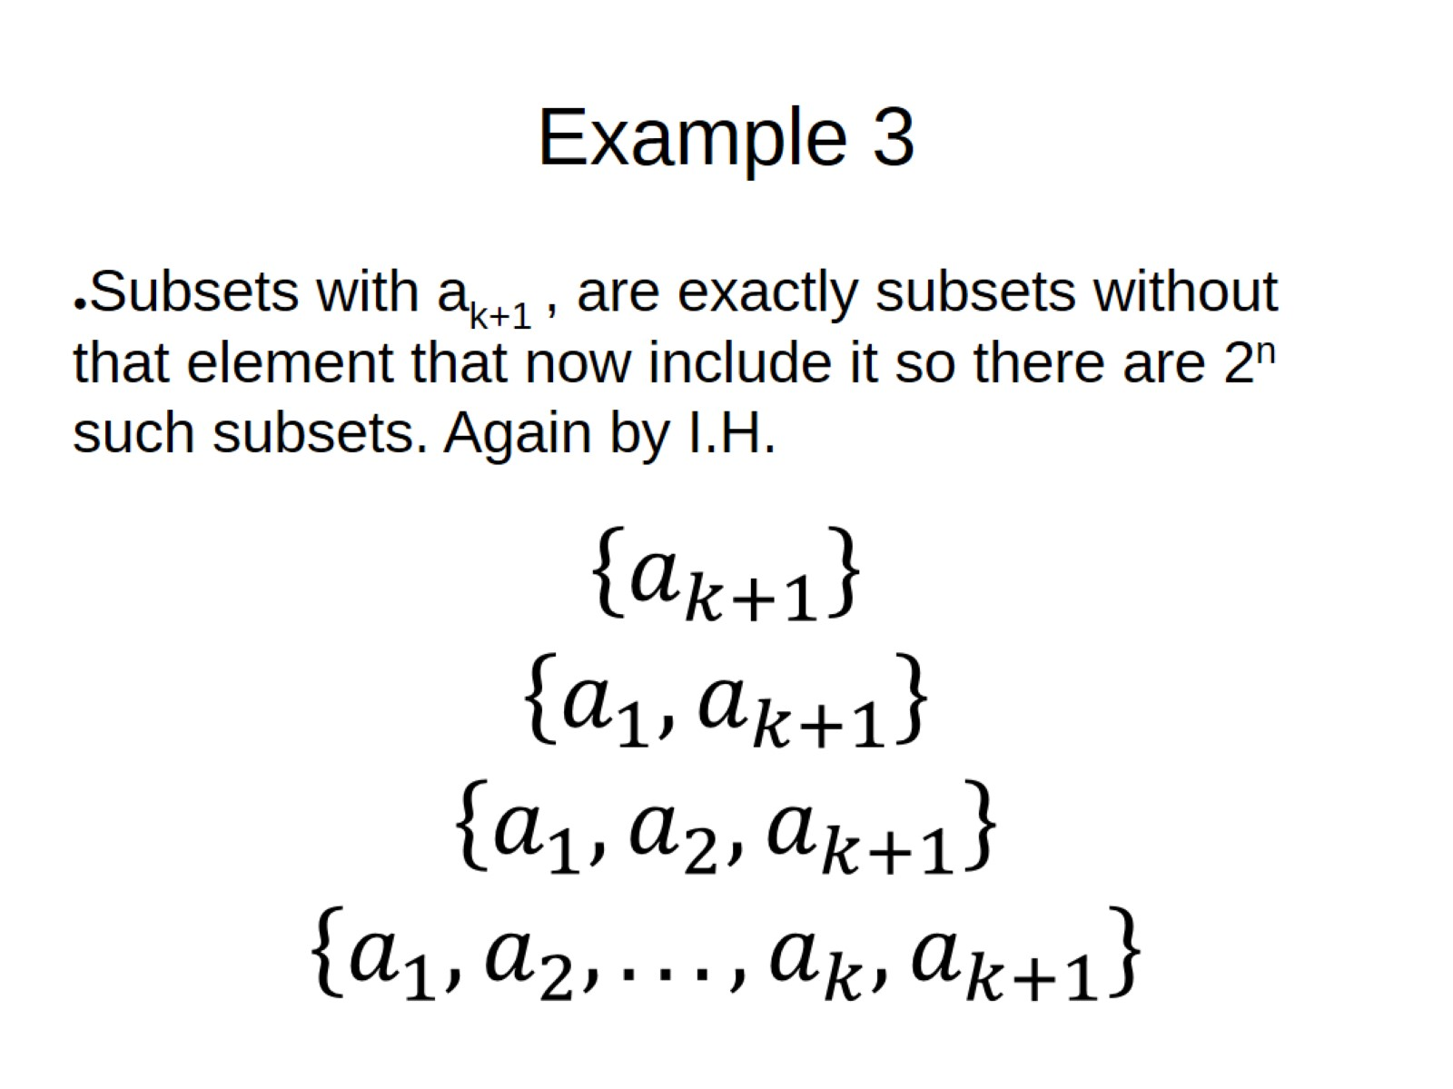
Example 3

Slide 18
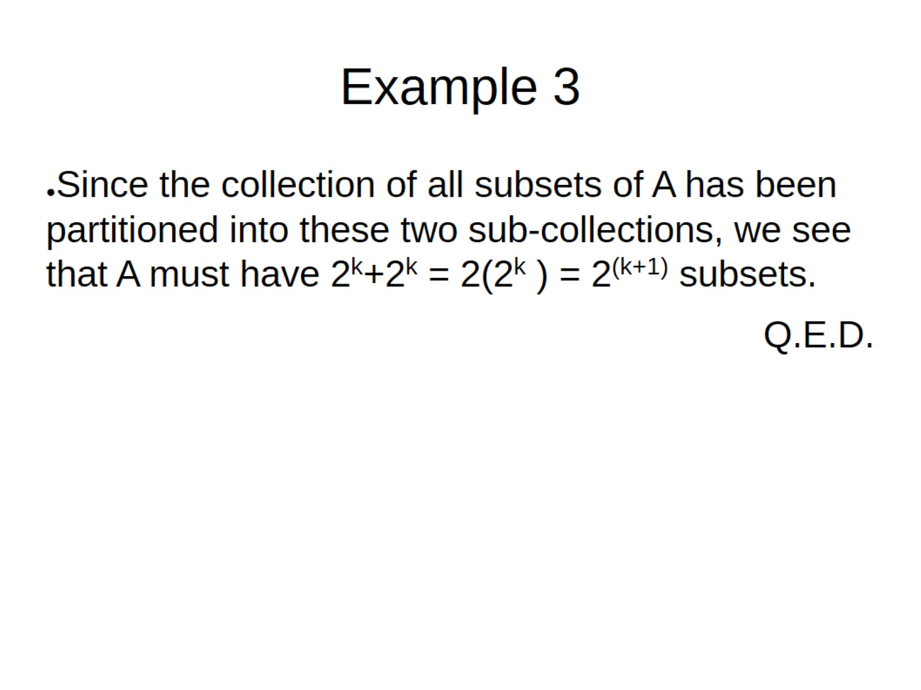
Example 3

Slide 19
Citations:
Book
Mathematical Thinking: Problem-solving and Proofs
D'Angelo, J.P.
West, D.B.
9780130144126
https://books.google.ca/books?id=fL6nQgAACAAJ
2000
Prentice Hall

