Slide 1
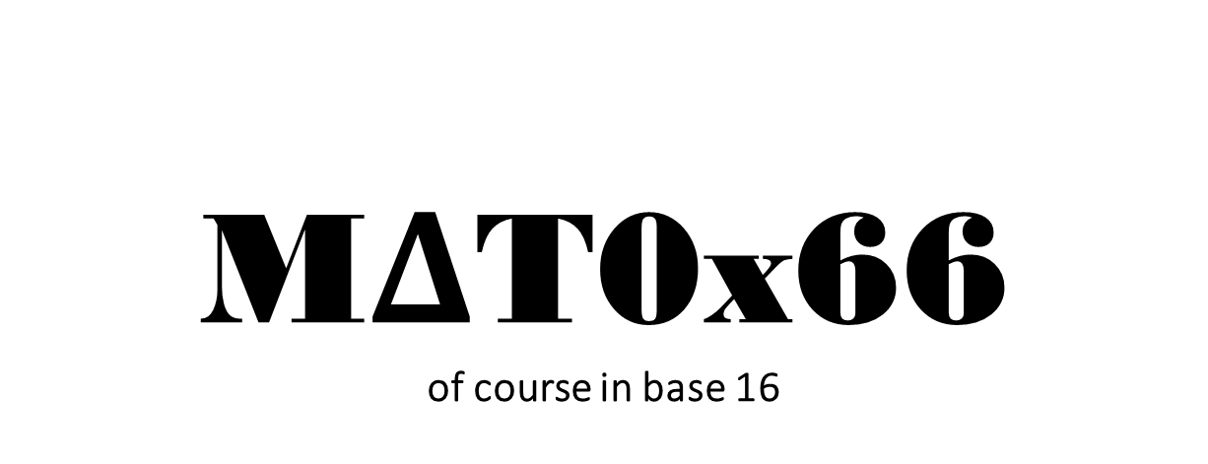
M$Δ$T0x66 of course in base 16
Arash Gholami
Email: arash.gholami@mail.utoronto.ca
Office hour: Mondays 11 am_12 pm
Tutorial 7
Credits to Larry Zhang

Slide 2
Simple and complete induction

Slide 3
Todays topics
Review of simple induction
2 examples of simple induction
Principle of complete induction
1 example for complete induction
Review example for proving by contradiction

Slide 4


Review of Principle of Simple Induction
Let P(n) be the statement for some number n,
If
then

Slide 5
Recipe for writing a proof using simple induction
Step 1: Define the predicate P(n), i.e. the statement you want to prove.
Step 2: Base Case: show that P(b) is True, e.g., b = 0
Step 3: Induction Step: show P(k) => P(k+1),
for k >= b, i.e.,
a. Assume P(k) is True (Inductive Hypothesis)
b. Show that P(k+1) is True
Done.

Slide 6
Example 4
Step 1: Define the Statement you want to prove. (i.e. the predicate P(n))
Step 2: check for the base case: since n is an element of Natural numbers, base case is n = 1;
a₁ = 1
a₁ = 1³-1+1 = 1
Since the formula yields the same result for a₁ compared to what we have defined a₁ to be, Base case holds.

Slide 7

Example 4 cont’d
Step 3: Induction Step: show P(k) => P(k+1),
Assume that for n=k, a_{k} = k³-k+1, Induction Hypothesis
Show that for n=k+1 ; a_{k+1}=(k+1)³-(k+1)+1
By the recursive definition a_{n+1} = a_{n} +3n(n+1)
Then; a_{k+1}=a_{k}+3k(k+1)
=k³-k+1+3k(k+1)
=k³ +3k² +3k+1 -k
=(k+1)³ -k -1 +1
= (k+1)³-(k+1)+1
a_{k} = k³-k+1 by I.H.
Add -1+1 = 0

Slide 8
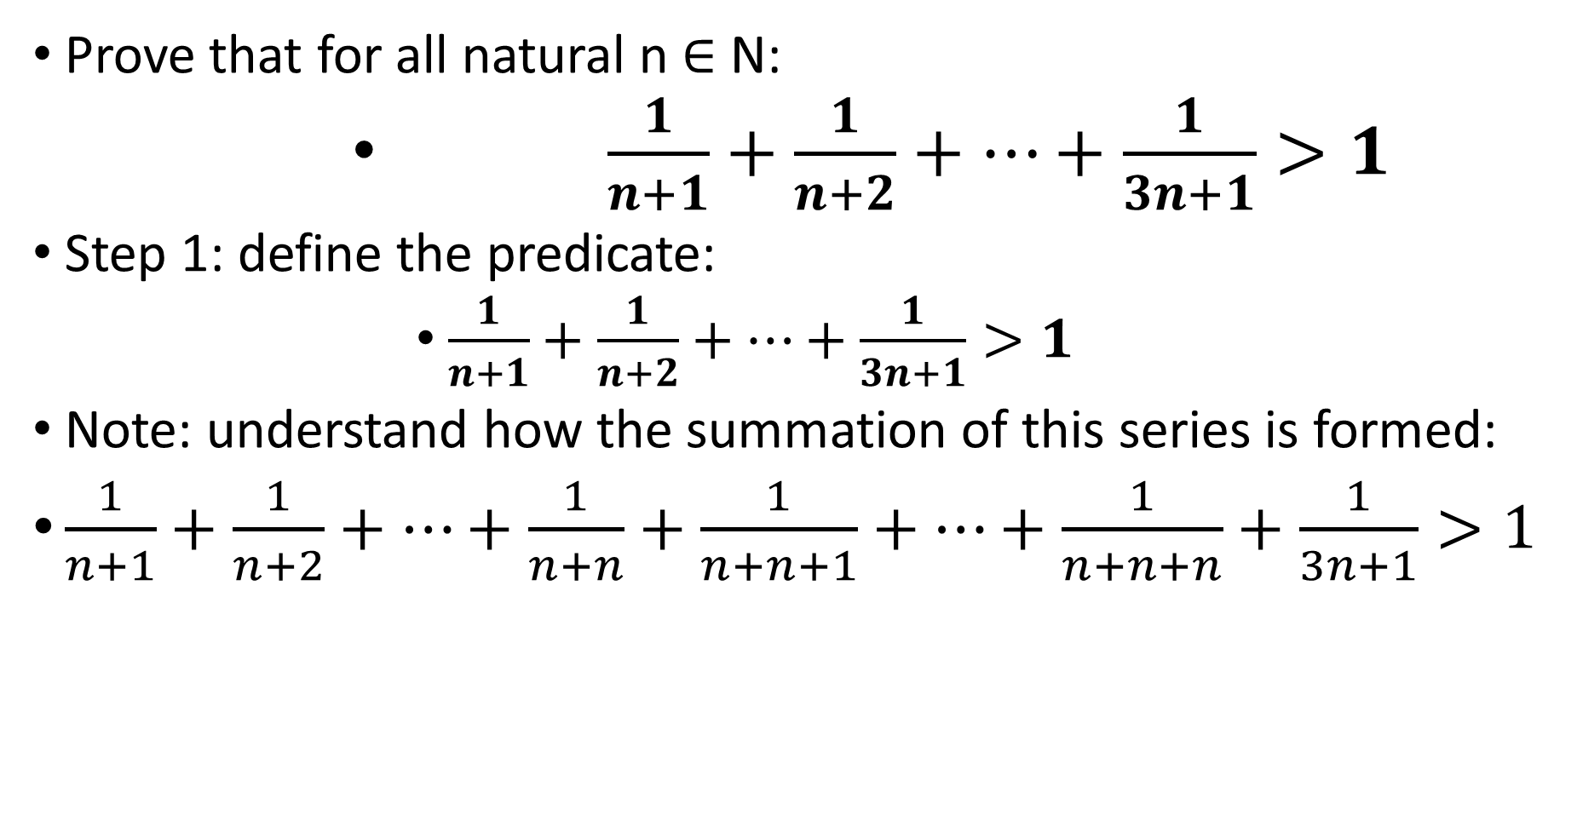
Example 5
Prove that for all natural n ∈ N:
$\frac{1}{n+1}+\frac{1}{n+2}+…+\frac{1}{3n+1}>1$
Step 1: define the predicate:
$\frac{1}{n+1}+\frac{1}{n+2}+…+\frac{1}{3n+1}>1$
Note: understand how the summation of this series is formed:
$\frac{1}{n+1}+\frac{1}{n+2}+…+\frac{1}{n+n}+\frac{1}{n+n+1}+…+\frac{1}{n+n+n}+\frac{1}{3n+1}>1$
+1
+n
+1
+n-1
+1
+2n

Slide 9
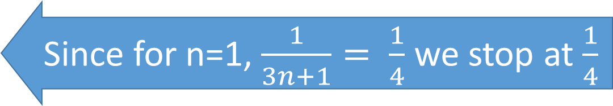

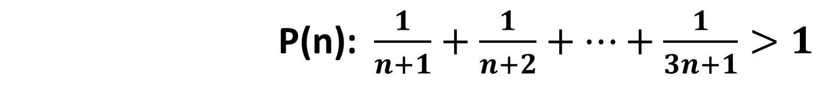
Example 5 cont’d
P(n): $\frac{1}{n+1}+\frac{1}{n+2}+…+\frac{1}{3n+1}>1$
Step 2: check for the base case, n=1:
$\frac{1}{1+1}+\frac{1}{1+2}+\frac{1}{1+3}>1$
$⇒\frac{1}{2}+\frac{1}{3}+\frac{1}{4}>1$
$⇒\frac{6+4+3}{12}>1$
$⇒\frac{13}{12}>1$ True, Therefore it holds for the base case
Since for n=1, $\frac{1}{3n+1}= \frac{1}{4}$ we stop at $\frac{1}{4}$

Slide 10
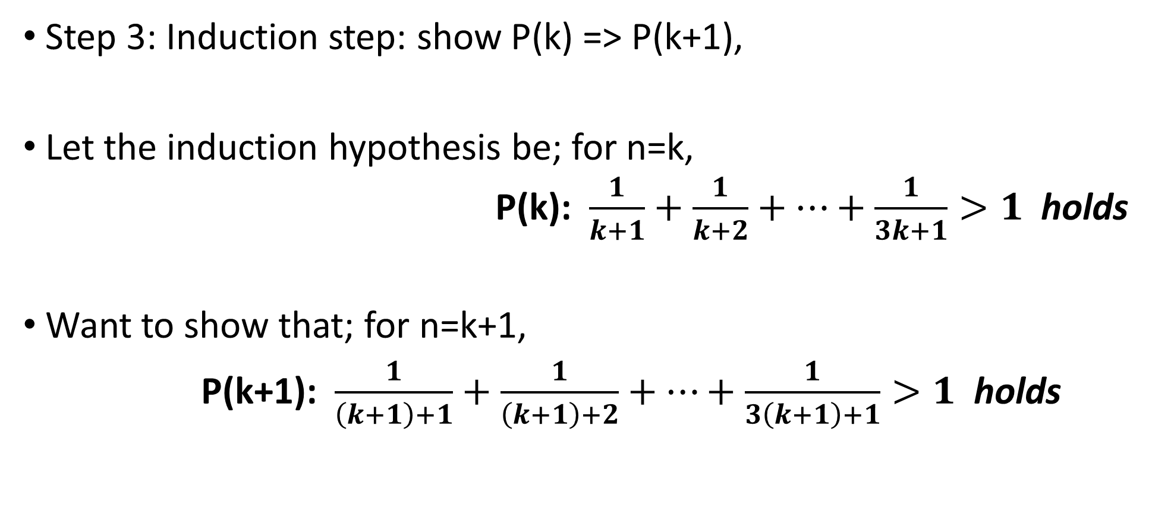
Example 5 cont’d
P(n): $\frac{1}{n+1}+\frac{1}{n+2}+…+\frac{1}{3n+1}>1$
Step 3: Induction step: show P(k) => P(k+1),
Let the induction hypothesis be; for n=k,
P(k): $\frac{1}{k+1}+\frac{1}{k+2}+…+\frac{1}{3k+1}>1$ holds
Want to show that; for n=k+1,
P(k+1): $\frac{1}{\left(k+1\right)+1}+\frac{1}{\left(k+1\right)+2}+…+\frac{1}{3\left(k+1\right)+1}>1$ holds
Induction hypothesis

Slide 11
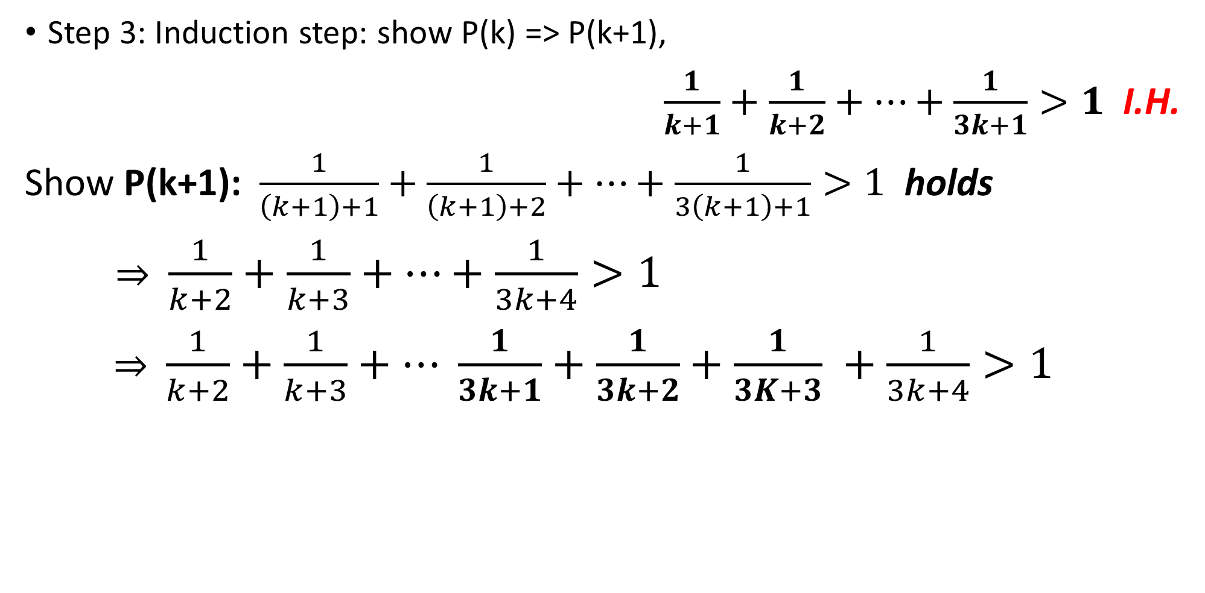
Example 5 cont’d
P(n): $\frac{1}{n+1}+\frac{1}{n+2}+…+\frac{1}{3n+1}>1$
Step 3: Induction step: show P(k) => P(k+1),
$\frac{1}{k+1}+\frac{1}{k+2}+…+\frac{1}{3k+1}>1$ I.H.
Show P(k+1): $\frac{1}{\left(k+1\right)+1}+\frac{1}{\left(k+1\right)+2}+…+\frac{1}{3\left(k+1\right)+1}>1$ holds
$⇒$ $\frac{1}{k+2}+\frac{1}{k+3}+…+\frac{1}{3k+4}>1$
$⇒$ $\frac{1}{k+2}+\frac{1}{k+3}+… \frac{1}{3k+1}+\frac{1}{3k+2}+\frac{1}{3K+3} +\frac{1}{3k+4}>1$
-1
-1
-1

Slide 12

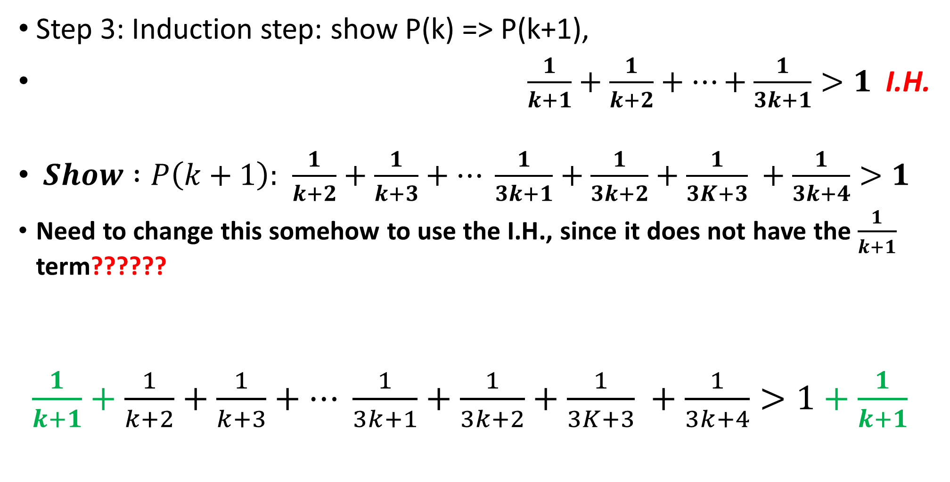
Example 5 cont’d
P(n): $\frac{1}{n+1}+\frac{1}{n+2}+…+\frac{1}{3n+1}>1$
Step 3: Induction step: show P(k) => P(k+1),
$\frac{1}{k+1}+\frac{1}{k+2}+…+\frac{1}{3k+1}>1$ I.H.
$Show :P\left(k+1\right):$ $\frac{1}{k+2}+\frac{1}{k+3}+… \frac{1}{3k+1}+\frac{1}{3k+2}+\frac{1}{3K+3} +\frac{1}{3k+4}>1$
Need to change this somehow to use the I.H., since it does not have the $\frac{1}{k+1}$ term??????
$\frac{1}{k+1}+\frac{1}{k+2}+\frac{1}{k+3}+… \frac{1}{3k+1}+\frac{1}{3k+2}+\frac{1}{3K+3} +\frac{1}{3k+4}>1+\frac{1}{k+1}$
Solution: add $\frac{1}{k+1}$ to both sides

Slide 13
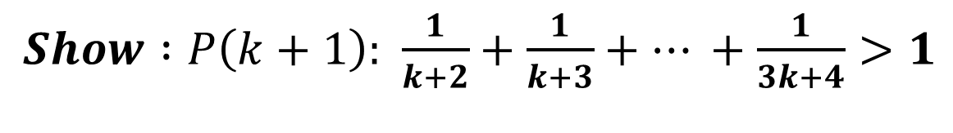
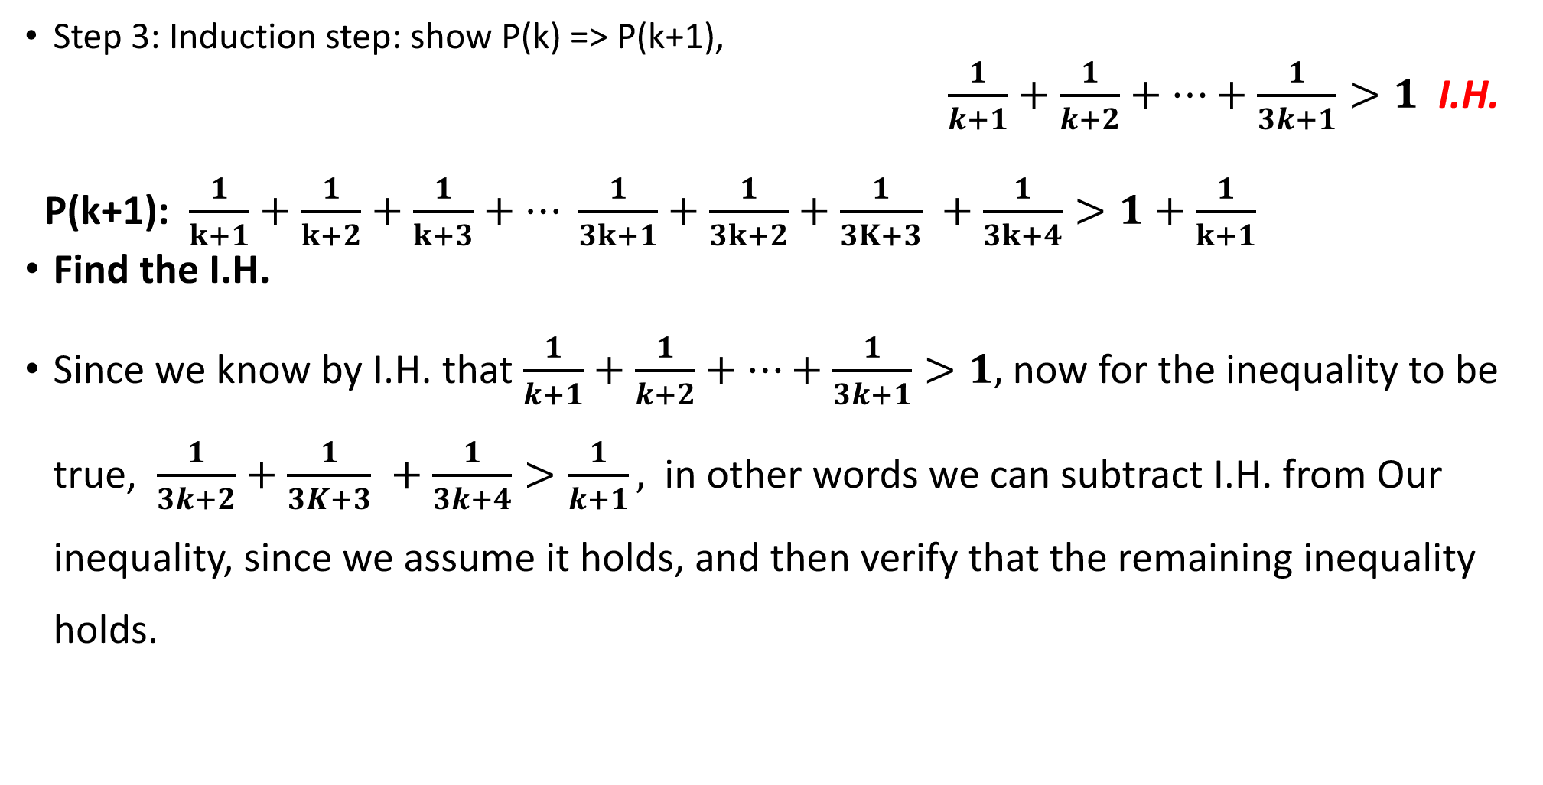
Example 5 cont’d
$Show :P\left(k+1\right):$ $\frac{1}{k+2}+\frac{1}{k+3}+… +\frac{1}{3k+4}>1$
Step 3: Induction step: show P(k) => P(k+1),
$\frac{1}{k+1}+\frac{1}{k+2}+…+\frac{1}{3k+1}>1$ I.H.
P(k+1): $\frac{1}{k+1}+\frac{1}{k+2}+\frac{1}{k+3}+… \frac{1}{3k+1}+\frac{1}{3k+2}+\frac{1}{3K+3} +\frac{1}{3k+4}>1+\frac{1}{k+1}$
Find the I.H.
Since we know by I.H. that $\frac{1}{k+1}+\frac{1}{k+2}+…+\frac{1}{3k+1}>1,$ now for the inequality to be true, $\frac{1}{3k+2}+\frac{1}{3K+3} +\frac{1}{3k+4}>\frac{1}{k+1},$ in other words we can subtract I.H. from Our inequality, since we assume it holds, and then verify that the remaining inequality holds.
I.H.

Slide 14
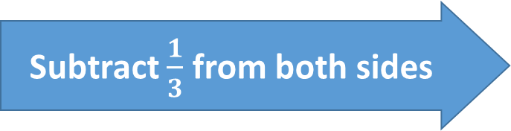
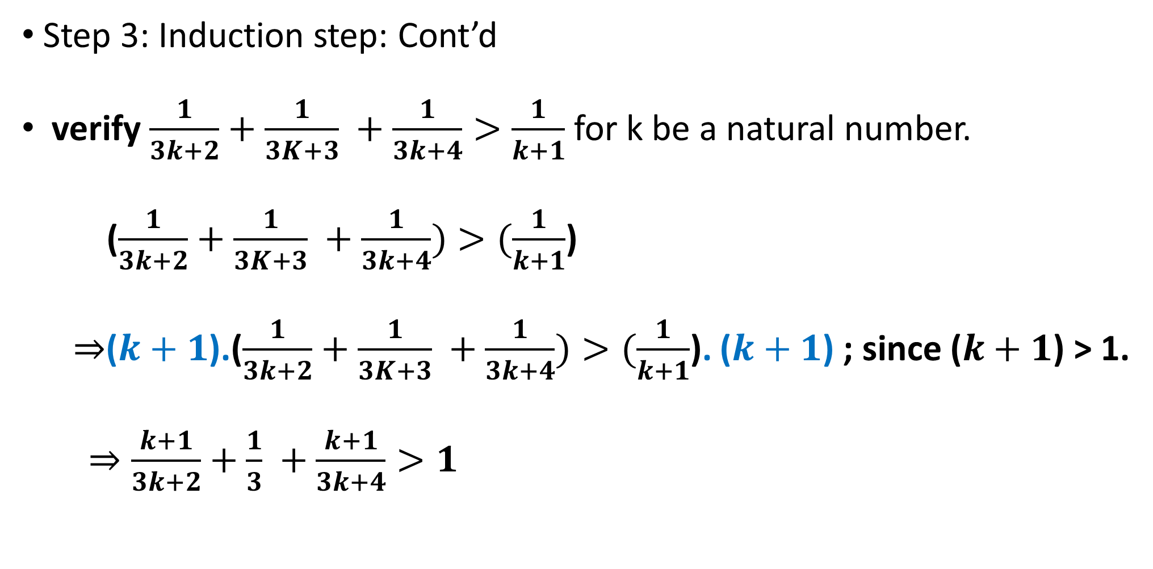
Example 5 cont’d
Step 3: Induction step: Cont’d
verify $\frac{1}{3k+2}+\frac{1}{3K+3} +\frac{1}{3k+4}>\frac{1}{k+1}$ for k be a natural number.
($\frac{1}{3k+2}+\frac{1}{3K+3} +\frac{1}{3k+4})>(\frac{1}{k+1}$)
$⇒$($k+1$).($\frac{1}{3k+2}+\frac{1}{3K+3} +\frac{1}{3k+4})>(\frac{1}{k+1}$). ($k+1$) ; since ($k+1$) > 1.
$⇒\frac{k+1}{3k+2}+\frac{1}{3} +\frac{k+1}{3k+4}>1$
Multiply both sides by (k+1)
Subtract $\frac{1}{3}$ from both sides

Slide 15

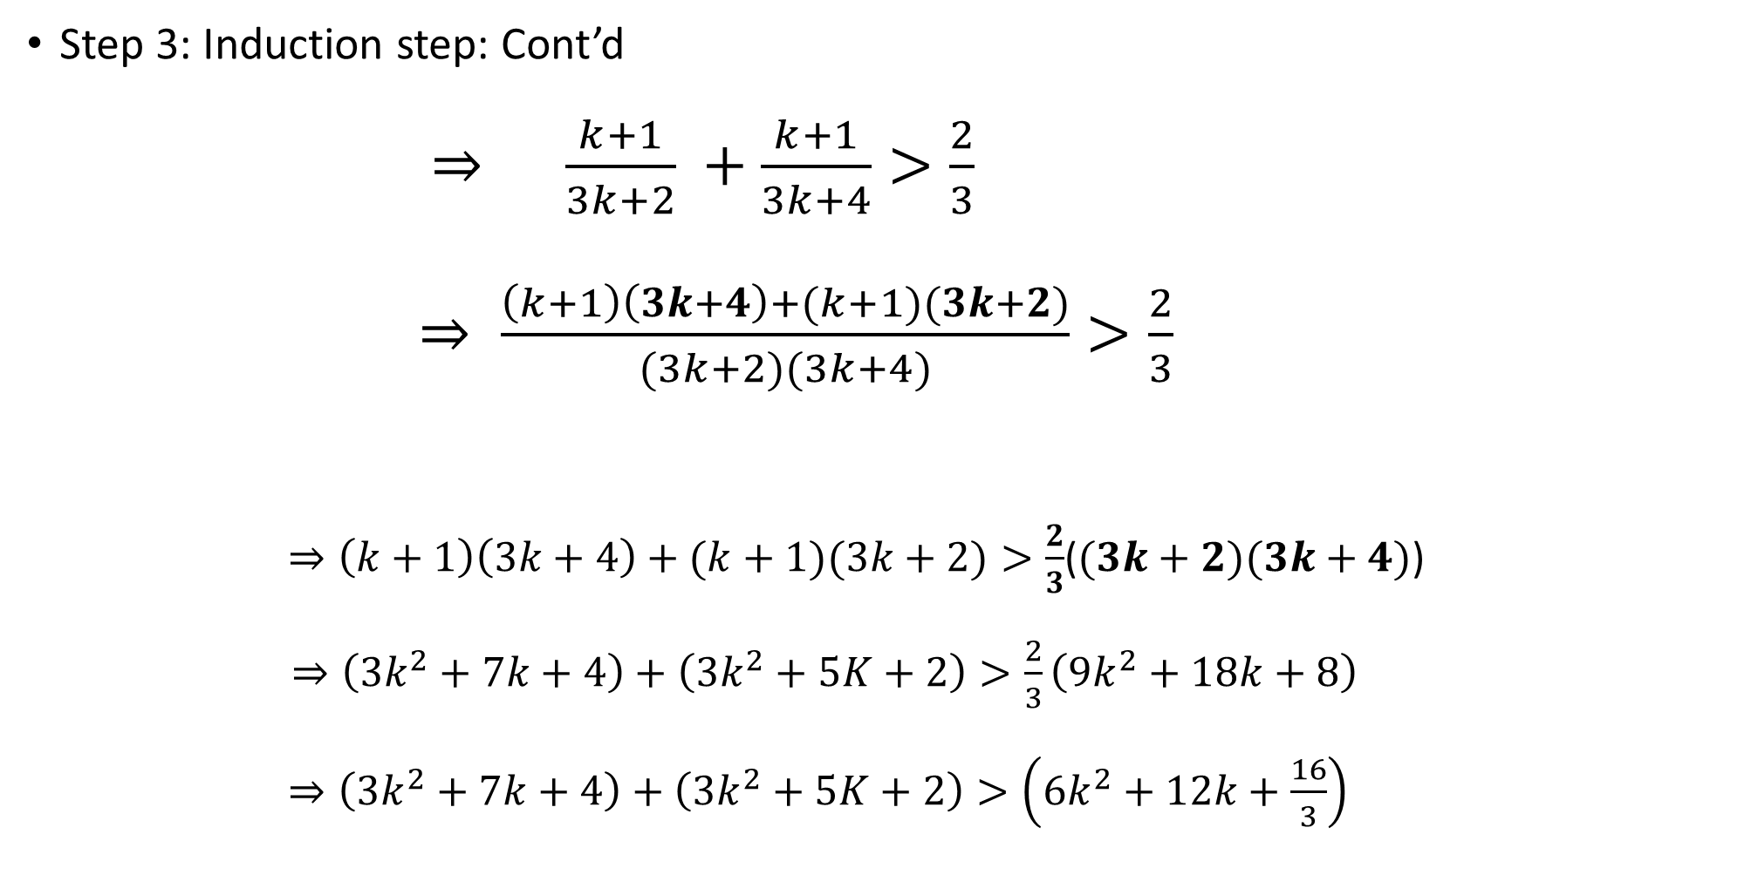
Example 5 cont’d
Step 3: Induction step: Cont’d
$⇒ \frac{k+1}{3k+2} +\frac{k+1}{3k+4}>\frac{2}{3}$
$⇒ \frac{\left(k+1\right)\left(3k+4\right)+(k+1)(3k+2)}{(3k+2)(3k+4)}>\frac{2}{3}$
$⇒\left(k+1\right)\left(3k+4\right)+(k+1)(3k+2)>\frac{2}{3}$($(3k+2)(3k+4)$)
$⇒\left(3k^{2}+7k+4\right)+\left(3k^{2}+5K+2\right)>\frac{2}{3}\left(9k^{2}+18k+8\right)$
$⇒\left(3k^{2}+7k+4\right)+\left(3k^{2}+5K+2\right)>\left(6k^{2}+12k+\frac{16}{3}\right)$
Take the common denominator
Multiply by
$(3k+2)(3k+4)$

Slide 16
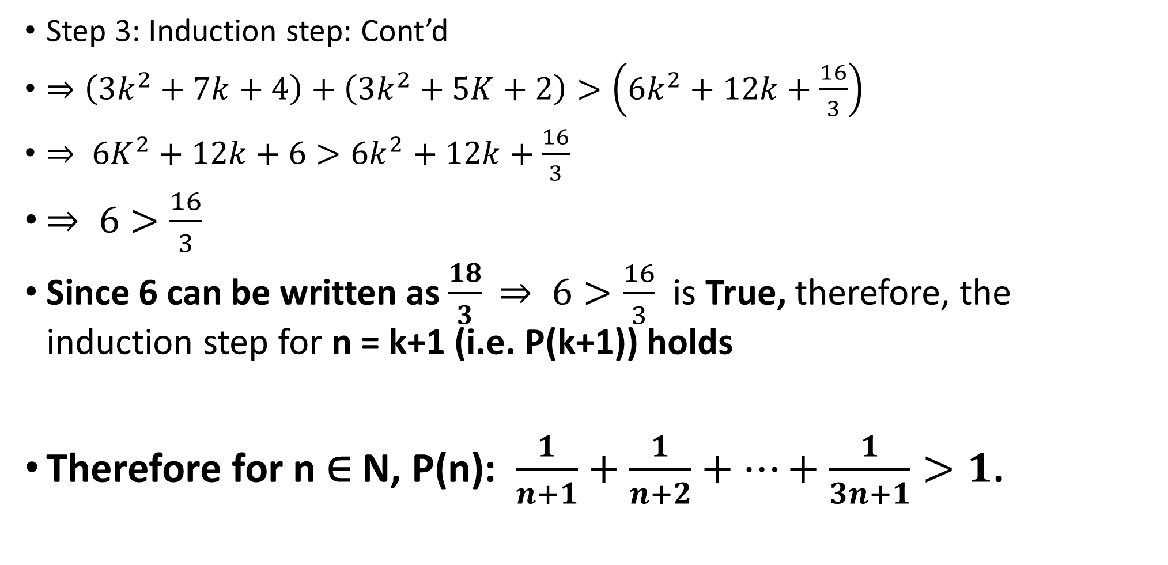
Example 5 cont’d
Step 3: Induction step: Cont’d
$⇒\left(3k^{2}+7k+4\right)+\left(3k^{2}+5K+2\right)>\left(6k^{2}+12k+\frac{16}{3}\right)$
$⇒ 6K^{2}+12k+6>6k^{2}+12k+\frac{16}{3}$
$⇒ 6>\frac{16}{3}$
Since 6 can be written as $\frac{18}{3}$ $⇒ 6>\frac{16}{3}$ is True, therefore, the induction step for n = k+1 (i.e. P(k+1)) holds
Therefore for n ∈ N, P(n): $\frac{1}{n+1}+\frac{1}{n+2}+…+\frac{1}{3n+1}>1$.

Slide 17

New topic: Complete (strong Induction)
Think about the dominoes
What simple induction says is that, to show that d[236] falls, all I need to know is that d[235] falls.
But by knowing d[235] falls, we actually know much more…
We also know d[1] to d[234] all fall ○
We didn’t use this information because knowing that d[235] falls happened to be enough
But sometimes it is NOT enough and we need to use all the information we know.

Slide 18

In other words
What we did in simple induction Suppose P(0) is True Then we use P(0) to prove P(1) is True Then we use P(1) to prove P(2) is true. Then we use P(2) to prove P(3) is true …... | Suppose P(0) is True Then we can use P(0) to prove P(1) is True Then we can use both P(0) and P(1) to prove P(2) is true. Then we can use P(0), P(1) and P(2) to prove P(3) is true …... This is called complete (strong) induction.

Slide 19

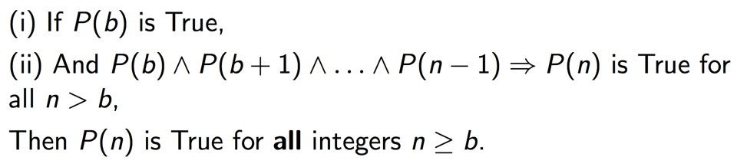
Principle of Complete Induction
Induction
Hypothesis

Slide 20
Example 1 Prime or Product of Primes
Prove that every natural number greater than 1 can be written as a product of primes. Think on it for 1 minute.
For example: 2 = 2
3 = 3
4 = 2 x 2
6 = 2 x 3
28 = 2 x 2 x 7

Slide 21
Example 1 cont’d
Let’s try simple induction ...
Define predicate P(n): n can be decomposed into a product of primes
Base case: n=2
2 is already a product of primes (2 is prime), so we're done.
Induction Step:
Assume n >= 2 and that n can be written as a product of primes. Need to prove that n+1 can be written as a product of primes...
Imagine that we know that 8 can be written as a product of primes. (2x2x2) How does this help us decompose 9 into a product of primes? (3x3) Not obvious!
Problem: There is no obvious relation between the decomposition of k and the decomposition of k+1. Simple induction not working!

Slide 22
Example 1 cont’d
Use Complete Induction
Define predicate P(n): n can be decomposed into a product of primes. (same as before)
Base case: n=2,
2 is already a product of primes (2 is prime), so we're done. (same as before)

Slide 23
Example 1 cont’d
Induction Step:
Assume P(2) ∧ P(3) ∧ P(4) ∧ … ∧ P(n-1), i.e., all numbers from 2 to n-1 can be written as a product of primes. (Induction Hypothesis of Complete Induction)
Now need to show P(n), i.e., n can be written as a product of primes
Case 1: n is prime …
then n is already a product of primes, done
Case 2: n is composite (not prime) …
then n can be written as n = a x b, where a & b satisfies 2 <= a, b <= n-1
According to I.H., each of a and b can be written as a product of primes.
So n = a x b can be written as a product of primes.

Slide 24
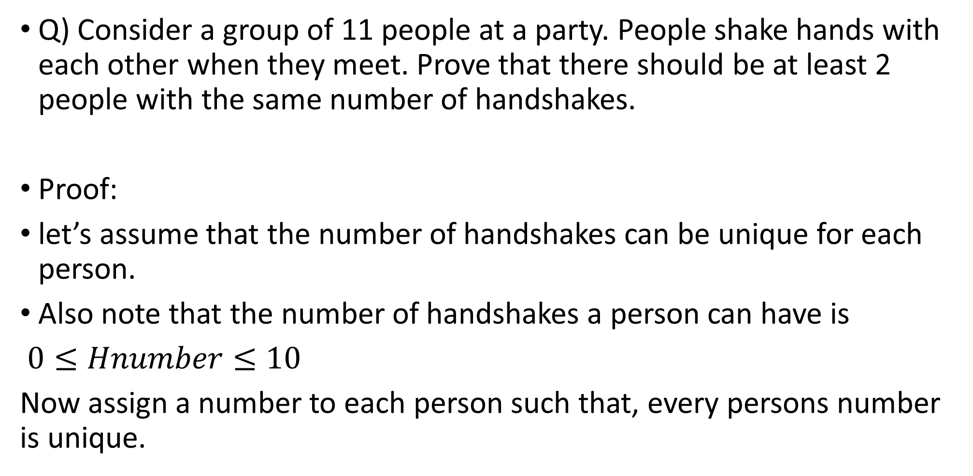
Example 2 review of contradiction proving method
Q) Consider a group of 11 people at a party. People shake hands with each other when they meet. Prove that there should be at least 2 people with the same number of handshakes.
Proof:
let’s assume that the number of handshakes can be unique for each person.
Also note that the number of handshakes a person can have is
$0≤Hnumber≤10$
Now assign a number to each person such that, every persons number is unique.

Slide 25
Example 2 cont’d
Proof cont’d:
Now assign a number to each person such that the number every persons number is unique.
A₁ ->0
A₂ -> 1
…
A₁₁ ->10
Now realize that the person A₁ has shaken hands with nobody, and the A₁₁ person has shaken hands with everyone, and this is a contradiction,
Therefore there must be at least 2 people with the same number of handshakes. Q.E.D.

Slide 26
Citations:
Book
Mathematical Thinking: Problem-solving and Proofs
D'Angelo, J.P.
West, D.B.
9780130144126
https://books.google.ca/books?id=fL6nQgAACAAJ
2000
Prentice Hall

