Slide 1
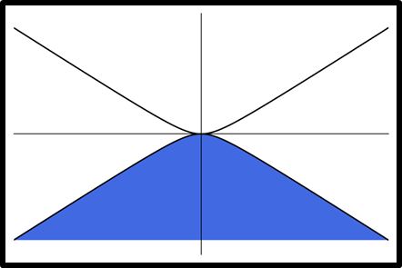
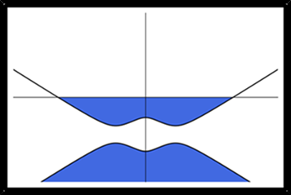




$$V_{T}=0$$
$$V_{T}≠0$$
$$V_{B}=0$$
$$V_{B}≠0$$
BACKGATE
BACKGATE
Notes:
Many common measurements involve placing a layer near a gate that can generate an electric field. We can bias the layer relative to the backgate. If the back gate is turned off, the layers are neutral.

