Slide 1
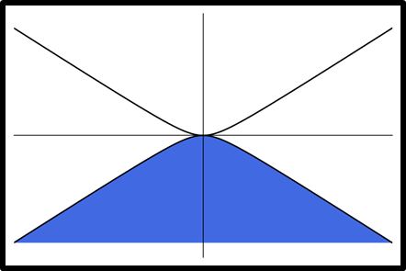
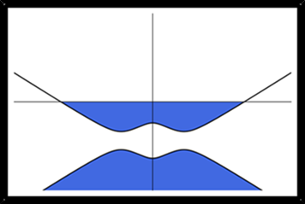




$$V_{T}=0$$
$$V_{T}≠0$$
$$V_{B}=0$$
$$V_{B}≠0$$
BACKGATE
BACKGATE
Notes:
Many common measurements involve placing a layer near a gate that can generate an electric field. We can bias the layer relative to the backgate. If the back gate is turned off, the layers are neutral.

Slide 2
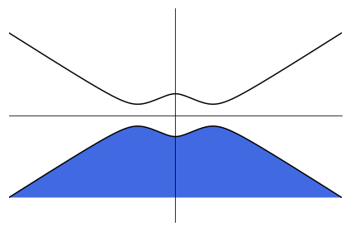
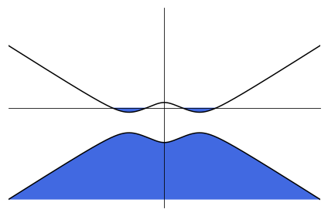
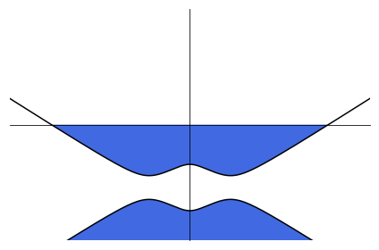


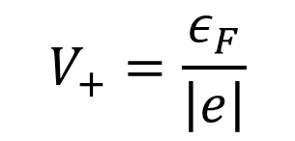
Tip
V_{T}
ε₁
$$V_{+}=\frac{ε_{F}}{\left|e\right|}$$
$$d1$$
V₁
V_{t}
,n_{t}
,n_{b}
V_{b}
ε₂
ε₂
V₂
$$d2$$
V_{B}
Back Gate
Notes:
…this is because of the effect of doping. Under tip, we dope the sample and change band structure. Also graphene under tip at diff electrostatic potential than at the contact. VQ because related to quantum capacitance.

