Slide 1
Sketch demo
Project highlights – rev 01
Gustavo Homem
homem.gustavo@gmail.com
October 2023

Slide 2
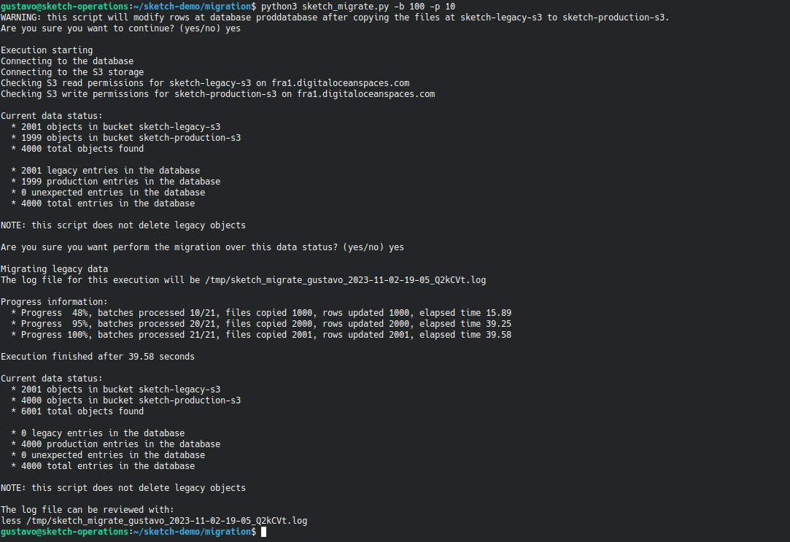
TLDR - migration tool

Slide 3
TLDR - migration tool
Confirm you want to write into prod
Confirm the initial situation makes sense
Check progress
Review the final situation
Be aware of the log file

Slide 4
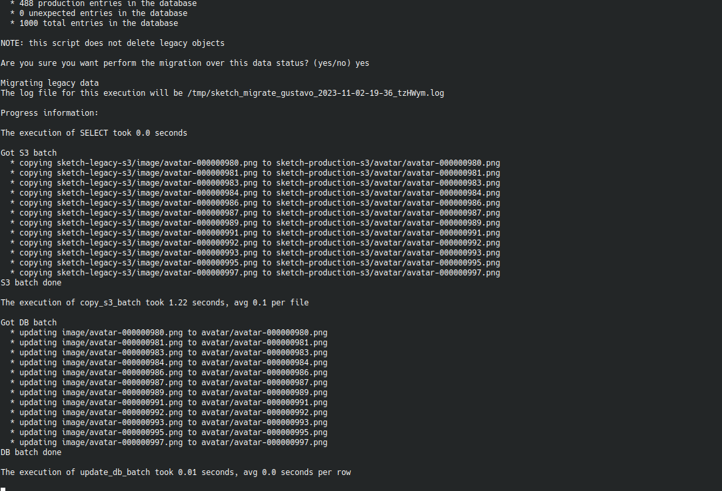
TLDR - migration tool in verbose mode
The verbose information is available both on screen and in the log file.
(but in the log file lines are prefixed with timestamps)

Slide 5
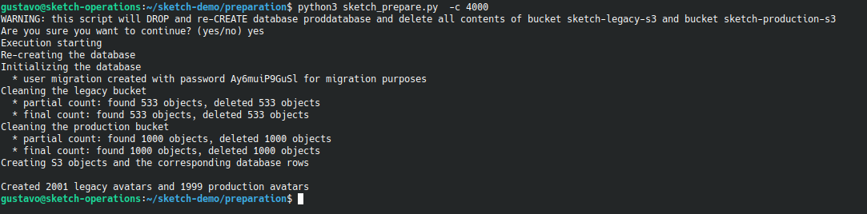
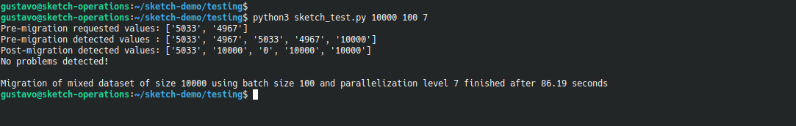
TLDR – simulated environment preparation tool
Confirm you want reset the simulation data
Check progress
Review the final situation
TLDR – integration test
CAREFUL: this is an automated tool
Review correctness and performance

Slide 6
Compliance
Please check the compliance.md document for a one by one review of the requirements.

Slide 7
Agenda
Environment
Deployment
Performance

Slide 8
Environment
The execution environment is a Digital Ocean project comprised of:
An Ubuntu Linux machine
A PostgreSQL database cluster
Two storage Spaces (S3 compatible buckets)

Slide 9
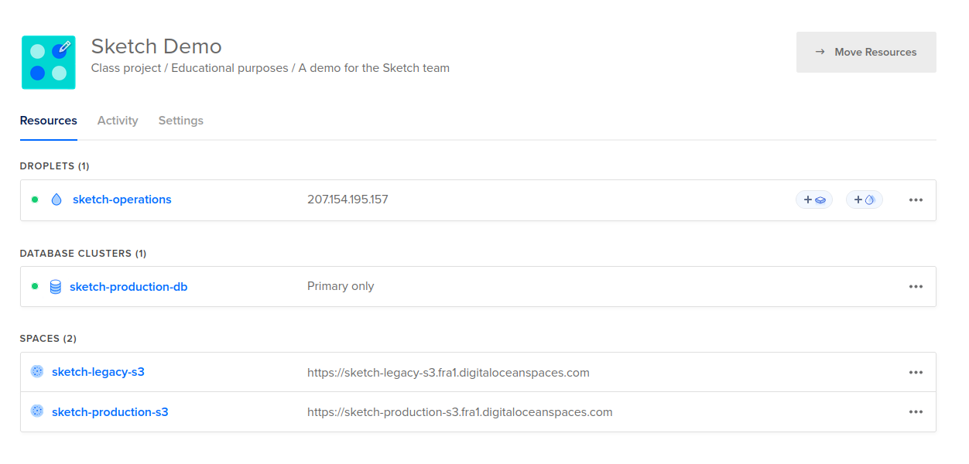
Environment

Slide 10
Environment
I chose Digital Ocean because:
  the monthly Spaces subscription includes 1TB of bandwidth (performance testing generates many requests and AWS charges per request)
  performance results would not be realistic on local S3 emulation environments
Side effect: an opportunity to test the S3 API compatibility of a different provider.

Slide 11
Agenda
Environment
Deployment
Performance

Slide 12
Deployment
The deployment of the migration script is extremely simple because we only need an Ubuntu machine and the guarantee that 3 apt packages from the Ubuntu distribution are present.

Slide 13
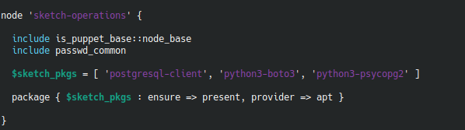
Deployment
The machine

Slide 14
Deployment
The machine
The deployment was tested in the smallest Digital Ocean configuration (1 vCPU, 512M RAM) and nothing bigger than that is necessary.

Slide 15
Deployment
The script could simply be deployed by hand using git clone or it could be deployed via IaC code. I can provide details on IaC deployment, if necessary.

Slide 16
Agenda
Environment
Deployment
Performance

Slide 17
The low hanging fruit for performance
Execute on a Linux instance near the database
Avoid transversing the entire database more than once
Do not overwrite files that are already migrated

Slide 18
The low hanging fruit for performance
Execute on a Linux instance near the database
Avoid transversing the entire database more than once
Do not overwrite files that are already migrated
3x improvement versus “your computer” just from this, for single process executions.

Slide 19
The low hanging fruit for performance
Execute on a Linux instance near the database
Avoid transversing the entire database more than once
Do not overwrite files that are already migrated
3x improvement versus “your computer” just from this, for single process executions.
The problem is very latency-sensitive because we are copying a large number of small files. For large files it would be different.

Slide 20
The low hanging fruit for performance
Execute on a Linux instance near the database
Avoid transversing the entire database more than once
Do not overwrite files that are already migrated
3x improvement versus “your computer” just from this, for single process executions.
The problem is very latency-sensitive because we are copying a large number of small files. For large files it would be different.
It is not only client to API latency that counts. With small files there is also the TCP slow start inside the provider.

Slide 21
The low hanging fruit for performance
Execute on a Linux instance near the database
Avoid transversing the entire database more than once
Do not overwrite files that are already migrated
Theoretically important and adopted in the implementation but it turns out that the SELECTs with the LIKE operator are very fast compared to the S3 copy operations.

Slide 22
The low hanging fruit for performance
Execute on a Linux instance near the database
Avoid transversing the entire database more than once
Do not overwrite files that are already migrated
From ~0.07 seconds per file to less than 0.005 seconds (more than 14x faster).
Note: some files might be already migrated if we are re-executing over a the result of previous partial migration

Slide 23
The low hanging fruit for performance
All the low hanging fruit has been collected before the implementation of more complex performance optimizations. A simple implementation with all the low hanging fruit included delivered a modest migration performance of ~ 14.5 entries per second.

Slide 24
Next steps for performance
With this implementation it was possible to conclude that:
time spent on the single used SELECT is negligible
time spent on UPDATEs is small compared to the total time
time spent on S3 copies dominates the process

Slide 25
Next steps for performance
With this implementation it was possible to conclude that:
time spent on the single used SELECT is negligible
time spent on UPDATEs is small compared to the total time
time spent on S3 copies dominates the process
We already lowered the latency by using a dedicated instance that lives near the database.

Slide 26
Next steps for performance
With this implementation it was possible to conclude that:
time spent on the single used SELECT is negligible
time spent on UPDATEs is small compared to the total time
time spent on S3 copies dominates the process
The S3 API does not implement bulk copies in a simple way ☹

Slide 27
Next steps for performance
With this implementation it was possible to conclude that:
time spent on the single used SELECT is negligible
time spent on UPDATEs is small compared to the total time
time spent on S3 copies dominates the process
I chose to parallelize the copies with the standard python multiprocessing module.

Slide 28
Strategy for multiprocessing
scan the database and pick X batches of Y entries to migrate
  distribute X batches to X processes and wait for completion
  pick the execution results from the processes using a shared queue
  log progress and stats

Slide 29
Strategy for multiprocessing
scan the database and pick X batches of Y entries to migrate
  distribute X batches to X processes and wait for completion
  pick the execution results from the processes using a shared queue
  log progress and stats
The waiting part might seem strange but we need to ensure that we don’t lose control of launched processes and we need to control the logging order of the migration steps. Furthermore, these processes will take roughly the same time to finish, therefore the waiting time of finished processes will be small compared to their execution time.

Slide 30
Strategy for multiprocessing
scan the database and pick X batches of Y entries to migrate
  distribute X batches to X processes and wait for completion
  pick the execution results from the processes using a shared queue
  log progress and stats
implement an integration test that allows for detailed performance testing at low cognitive effort and find optimal values for X and Y
I executed the migration of 5000 entries 64 times on order to collect a modest set of performance data. If the process was not fully automated this would not have been possible within the given timeframe.

Slide 31
Strategy for multiprocessing
scan the database and pick X batches of Y entries to migrate
  distribute X batches to X processes and wait for completion
  pick the execution results from the processes using a shared queue
  log progress and stats
implement an integration test that allows for detailed performance testing at low cognitive effort and find optimal values for X and Y
X and Y are exposed to the user as CLI parameters. See:
python3 sketch_migrate.py -h

Slide 32
Results obtained with multiprocessing

Slide 33
Results obtained with multiprocessing
As usual, real world data is noisy, but the pattern is clear.

Slide 34
Results obtained with multiprocessing
Performance plateau

Slide 35
Results obtained with multiprocessing
4x – 5x performance improvement
the estimated performance is ~ 67 entries per second
optimal batch size found to lie between 100 and 1000
“optimal” parallelization level is between 5 and 10
  there is a dramatic improvement as we increase the parallelization level from small numbers but a plateau is hit between 5 and 10
At 67 entries per second we would expect to migrate 1M entries in 4.15 h.

Slide 36

Tradeoffs
No tradeoffs for the parallelization level: use at least of 10 processes as they fit perfectly even on a very small machine
Small batches are less efficient because processes and network connections are started / stopped more often but large batches amplify the inter-batch waiting time for synchronization
Small batches provide more frequent on screen progress updates than large batches
If in doubt, use a batch size of 100

Slide 37
REVISITING the low hanging fruit for performance
Execute on a Linux instance near the database
Avoid transversing the entire database more than once
Do not overwrite files that are already migrated
“From ~0.07 seconds per file to less than 0.005 seconds (more than 14x faster).”
Let’s measure this rigorously now!

Slide 38
The cost of overwrite prevention
The initial measurement was lighthearted and not accurate.
Copying takes in average 0.115 seconds while listing to look up the file takes in average 0.028 seconds.
(measured on a sample of 5000 points)

Slide 39
The cost of overwrite prevention
By looking up we use only 25% of what would be the copy time if the file is already in the production bucket (75% saved).
But when the file is not there, the lookup adds 25% to the copy process.

Slide 40
An idea for performance improvement
Idea: let’s allow overriding the overwrite prevention via a new -w flag.
The prevention is not useful for the first execution, even though it might be useful for subsequent ones, if they are necessary.

Slide 41
Result

Slide 42
Result
The performance gain is ~ 50% rather than the expected 25%.
This could be because interleaving copy and list operations was causing an extra penalty compared to requesting copy operations only.

Slide 43
REVISITING results obtained with multiprocessing
7x performance improvement
the estimated performance is ~ 100 entries per second
optimal batch size found to lie between 100 and 1000 – needs reconfirmation
“optimal” parallelization level is between 10 and 14
At 100 entries per second we would expect to migrate 1M entries in 2.8 h.

Slide 44
Are we happy, then?

Slide 45
Next Botoneck

Slide 46

Next Botoneck

Slide 47
Next Botoneck
S3.Client.copy()
performance

Slide 48
Next Botoneck
S3.Client.copy()
S3.Client.copy_object()
is twice as fast as
S3.Client.copy()
at least for small files.
performance

Slide 49
Next Botoneck
S3.Client.copy()
S3.Client.copy_object()
is twice as fast as
S3.Client.copy()
at least for small files.
Not entirely obvious detail!
performance

Slide 50
Result

Slide 51
REVISITING results obtained with multiprocessing
14x performance improvement (vs the first implementation)
the estimated performance is ~ 200 entries per second
optimal batch size found to lie between 100 and 1000 – needs reconfirmation
“optimal” parallelization level is between 10 and 15
At 200 entries per second we would expect to migrate 1M entries in 1.4 h.

Slide 52
Hypothetical other steps for performance
If this performance is not good enough we could still consider:
refine the metrics (nr of observations and ranges)
investigating the complex S3 Batch operations, as an alternative
check if individual Linux instances are rate-limited in the S3 API and, if so, split the process across multiple instances
Each additional performance gain will come at the cost of additional R&D time and additional code complexity.

Slide 53

Final note
The performance results are orientative at this point. That is, these results allow us to understand the order of magnitude where we are working.
For the results to be statistically more robust we should perform multiple runs for every combination of batch size and parallelization level and calculate the average and standard deviation. There is intrinsinc variance in the process due to the variable load on the provider API.
The effort to invest in further performance work depends on how many millions of rows have to be migrated and how time sensitive is the process, given that there is no business discountinuity as the database entries are only updated after sucessful copy of the corresponding file to the new bucket.
Photo by Dave Hoefler on Unsplash

Slide 54
Thank you!
Sketch demo
Project highlights – rev 01
Gustavo Homem
homem.gustavo@gmail.com
October 2023

