Slide 1


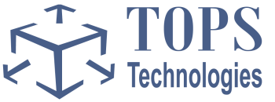
TOPS Technologies Pvt Ltd.
Build Your Career With Python

Slide 2


About TOPS
Dynamic, rapidly growing, IT Software Development Company with headquarters in Chicago and 15 offices in all our India
Delivering Business Value through Service Excellence
Comprehensive, end-to-end technology and process solutions
Flexible delivery model
SLA-based engagements
Commitment to clients’ business performance
Develop and take outsourcing projects in Microsoft, SUN, Open Source, and SEO
Training Division with placements in .Net, PHP, Software Testing, SEO, Java and J2EE
Management team with over 10 years of US Experience working for Banks and Consulting Companies
Always on the look out for talented individuals to join our team. We hire for our development and training centers, our offices in the US and our MNC clients.

Slide 3
IT Industry
IT Industry
Products
Services
Hardware
Software
Hardware
Software

Slide 4
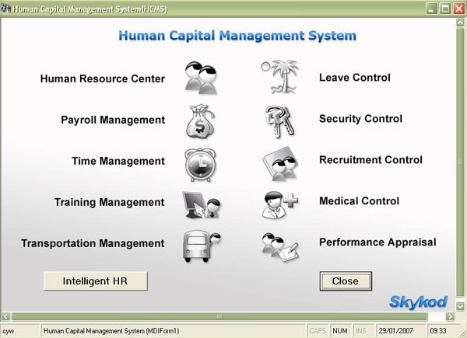
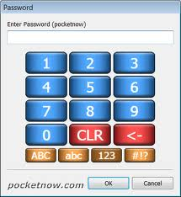
Desktop Application

Slide 5
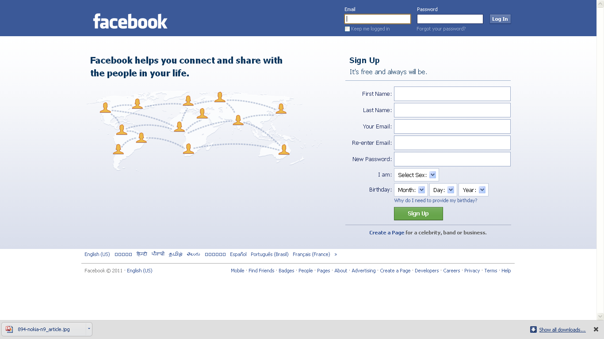
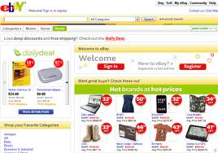
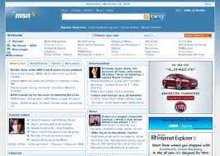
Web Application

Slide 6
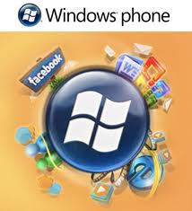
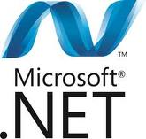
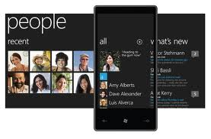
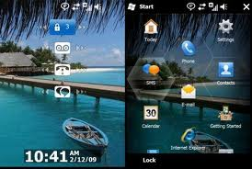
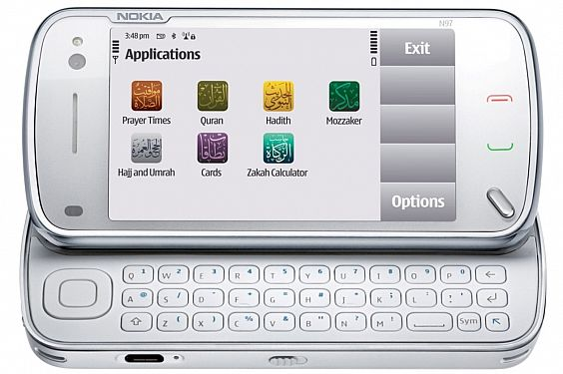
Mobile Application

Slide 7

Python
7
Notes:
7

Slide 8
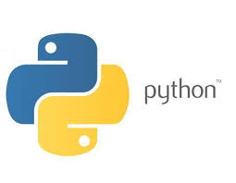
About Python
Created in 1990 by Guido van Rossum
About the origin of Python, Van Rossum wrote in 1996:
I decided to write an interpreter for the new scripting language I had been thinking about lately: a descendant of ABC that would appeal to Unix/C hackers. I chose Python as a working title for the project, being in a slightly irreverent mood (and a big fan of Monty Python's Flying Circus).
8
Notes:
8

Slide 9
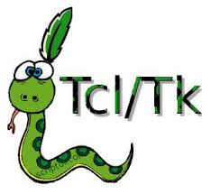
Python as Scripting Language
Usually thought of as one
But this is mainly a marketing issue
People think of scripting languages as being easy to learn, and useful.
But Python is a well worked out coherent dynamic programming language
And there is no reason not to use it for a wide range of applications.
9
Notes:
9

Slide 10
Feature of Python
Batteries Included
Everything is an Object
Interactive Shell
Strong Introspection
Cross Platform
CPython, Jython, IronPython, PyPy
Simple
Easy to Learn
Free and Open Source
Portable
Interpreted
Interactive Shell
Object Oriented
Extensive Libraries
10
Notes:
10

Slide 11
Python Productivity
Reduced development time
code is 2-10x shorter than C, C++, Java
Improved program maintenance
code is extremely readable
Less training
language is very easy to learn
11
Notes:
11

Slide 12
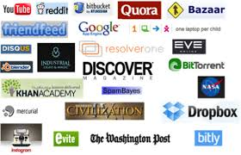
Use of Paython
rapid prototyping
web scripting
throw-away, ad hoc programming
steering scientific applications
extension language
XML processing
database applications
GUI applications
A Glue Language
12
Notes:
12

Slide 13
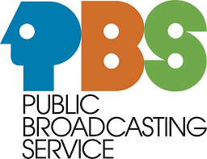




Who Uses Python
Google
PBS
NASA
Library of Congress
the ONION
13
Notes:
13

Slide 14
Python Vs. Other Languages
Python vs. Perl
Easier to learn
important for occasional users
More readable code
improved code maintenance
Fewer “magical” side effects
More “safety” guarantees
Better Java integration
Less Unix bias
14
Notes:
14

Slide 15
Python Vs. Other Languages
Python vs. Tcl
Real datatypes, object-orientation
More differentiated syntax
Much faster (even than Tcl 8.x)
Less need for C extensions
C extensions don’t redefine syntax
hence fewer extension conflicts
Better Java integration
Python uses Tk as de-facto GUI std
15
Notes:
15

Slide 16
Python Vs. Other Languages
Python vs. Java
Code 5-10 times more concise
Dynamic typing
Much quicker development
no compilation phase
less typing
Yes, it runs slower
but development is so much faster!
Use Python with Java: Jython!
16
Notes:
16

Slide 17
Python Programs
Core programming with python.....
For printing in python just use print ‘hello ,world’ will be output as “hello world”.
For printing string variable just write down,
>>> myString = 'Hello World!'
>>> print myString
Hello World!
17
Notes:
17

Slide 18
Python Programs
Program Input and the raw_input() Built-in Function
The easiest way to obtain user input from the command-line is with the raw_input() built-in function. It reads from standard input and assigns the string value to the variable you designate.
>>> user = raw_input('Enter login name: ')
Enter login name: TOPS Technologies
>>> print 'Your login is:', user
Your login is: TOPS Technologies
18
Notes:
18

Slide 19
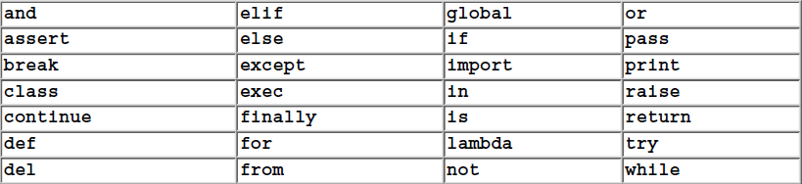
Python Programs
Python Keywords
19
Notes:
19

Slide 20
Python Programs
Declare variable and Assign value
>>> counter = 0
>>> miles = 1000.0
>>> name = 'Bob'
>>> counter = counter + 1
>>> kilometers = 1.609 * miles
>>> print '%f miles is the same as %f km' % (miles, kilometers)
1000.000000 miles is the same as 1609.000000 km
20
Notes:
20

Slide 21
Python Programs
Lists and tuples..
Lists and tuples can be thought of as generic "buckets" with which to hold an arbitrary number of arbitrar Python objects. The items are ordered and accessed via index offsets, similar to arrays, except that lists and tuples can store different types of objects.
The main differences between lists and tuples are: Lists are enclosed in brackets ( [ ] ), and their elements and size can be changed, while tuples are enclosed in parentheses ( ( ) ) and cannot be updated. Tuples can be thought of for now as "read-only" lists. Subsets can be taken with the slice operator ( [] and [ : ] ) in the same manner as strings.
21
Notes:
21

Slide 22
Python Programs
Example..
>>> aList = [1, 2, 3, 4]
>>> aList
[1, 2, 3, 4]
>>> aList[0]
1
>>> aList[2:]
[3, 4]
22
Notes:
22

Slide 23
Python Programs
Dictionaries..
Dictionaries are Python's hash table type. They work like associative arrays or hashes found in Perl and consist of key-value pairs. Keys can be almost any Python type, but are usually numbers or strings. Values, on the other hand, can be any arbitrary Python object. Dictionaries are enclosed by curly braces ( { } ).
23
Notes:
23

Slide 24
Python Programs
Continue..
>>> aDict = {}
>>> aDict['host'] = 'earth'
>>> aDict['port'] = 80
>>> aDict
{'host': 'earth', 'port': 80}
>>> aDict.keys()
['host', 'port']
>>> aDict['host']
'earth'
24
Notes:
24

Slide 25
Python Programs
Functions..
How to create and call functions??
Syntax:-
def add(a,b): //use def to create function..
return a+b
def addFixedValue(a): //second function
y = 5
return y +a
print add(1,2) //call add function
print addFixedValue(1) //call addFixedValue function
25
Notes:
25

Slide 26
Classes in Python
What is class??
A class is merely a container for static data members or function declarations, called a class's attributes. Classes provide something which can be considered a blueprint for creating "real“ objects, called class instances. Functions which are part of classes are called methods. Classes are an object-oriented construct that are not required at this stage in learning Python. However, we will present it here for those who have some background in object-oriented methodology and would like to see how classes are implemented in Python.
26
Notes:
26

Slide 27
Classes in Python
How to declare class?
Syntax:-
Class class_name[(base_classes_if_any)]:
"optional documentation string"
static_member_declarations
method_declarations
27
Notes:
27

Slide 28
Modules
Modules are a logical way to physically organize and distinguish related pieces of Python code into individual files. Modules can contain executable code, functions, classes, or any and all of the above.
When you create a Python source file, the name of the module is the same as the file except without the trailing ".py" extension. Once a module is created, you may "import" that module for use from another module using the import statement.
28
Notes:
28

Slide 29
Modules Examples
How to Call a Module Function or Access a Module Variable
Once imported, a module's attributes (functions and variables) can be accessed using the familiar dotted attribute notation:
module.function()
module.variable
Example:-
>>> import sys
>>> sys.stdout.write('Hello World!\n')
Hello World!
29
Notes:
29

Slide 30
Multithreaded programming in python..
I think you all are already know something about thread.
Thread is light weight process which are run concurrently but they don’t require resources as much process reqired.
It can be pre –empted(intruptted).
It can be tempopary put in hold while the other thread require resources.

Slide 31
Python Approach
Goals
Minimize changes to existing programs
Work with standard interpreter
Zope Object Database (ZODB)
Support Zope application server
Originally targeted for web development
Separate database and storage layers
31
Notes:
31

Slide 32
GUI Programming using Tkinter
Python provides various options for developing graphical user interfaces (GUIs).
Tkinter: Tkinter is the Python interface to the Tk GUI toolkit shipped with Python.
wxPython: This is an open-source Python interface for wxWindows http://wxpython.org.
JPython: JPython is a Python port for Java which gives Python scripts seamless access to Java class libraries on the local machine.

Slide 33
Web client programming
Web client programming is a powerful technique for querying the Web. A web client is any program that retrieves data from a web server using the Hyper Text Transfer Protocol (the http in your URLs). A web browser is a client; so are web crawlers, programs that traverse the Web automatically to gather information. You can also use web clients to take advantage of services offered by others on the Web and add dynamic features to your own web site.

Slide 34
Web Services Python
The Web Services for Python Project provides libraries for developing web services using the python programming language. The libraries implement the various protocols used when writing web services including SOAP, WSDL, and other related protocols.

Slide 35
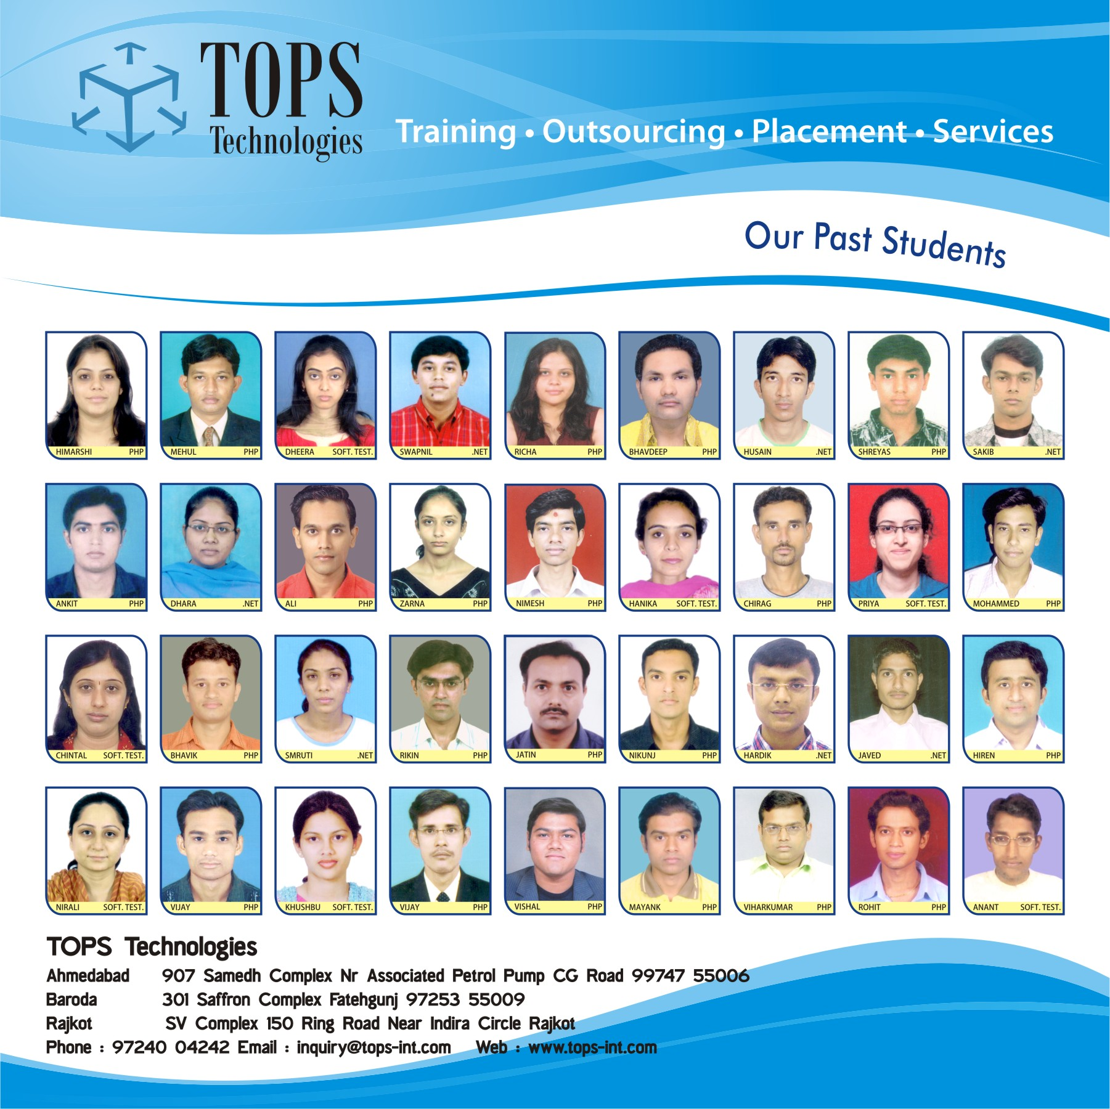
Short List of Our Past Students

Slide 36
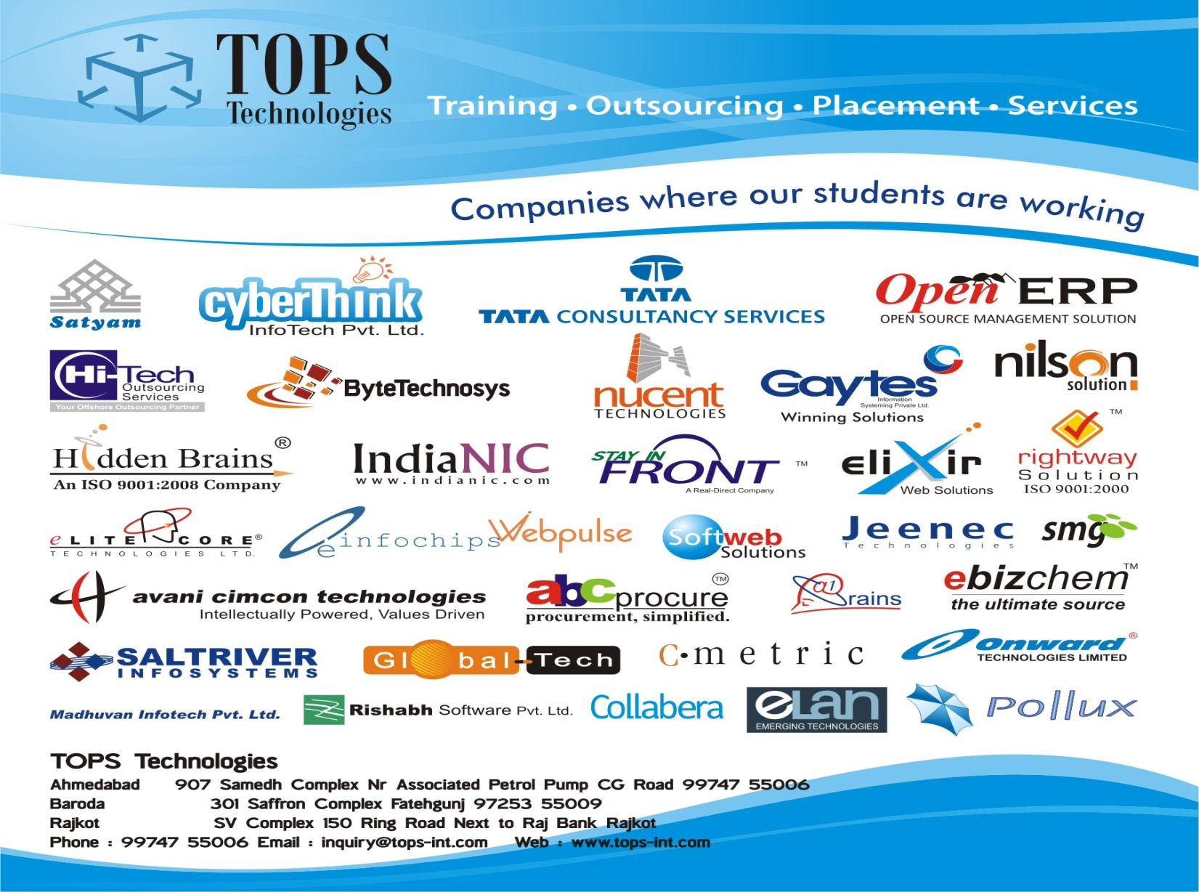
Placement Tie ups (Tentative List)
Placement Tie ups (TentativeList)

Slide 37

Contact us
Gujarat
Palanpur(8140176186)
Ahmadabad ( 9974755006)
Junagadh (7359391159)
Maninagar ( 9974863333 )
Jamnagar ( 91579 76736)
Gandhinagar ( 76240 06888)
Ankur( 7624007666 )
M P
Baroda(9725355009)
Bhopal (8103711555)
Surat (9724033344)
Jabalpur (9039707077)
Mehsana(7600009613)
Rajasthan
Rajkot( 9724004242)
Jaipur (9983337728)
Navsari (9601793193)
Kota (8233022331)
Jodhpur (9587873999)
Notes:
37

Slide 38
Contact us
Question ?
Thank You
Notes:
38

