Slide 1

Secure and Efficient Cloud Storage Using Fog Computing and Regenerating Codes
MSc Research Project
MSC Cyber Security
Pranav Ghorpade
Student ID: X22197044
School of Computing
National College of Ireland Supervisor: Michael Pantridge

Slide 2
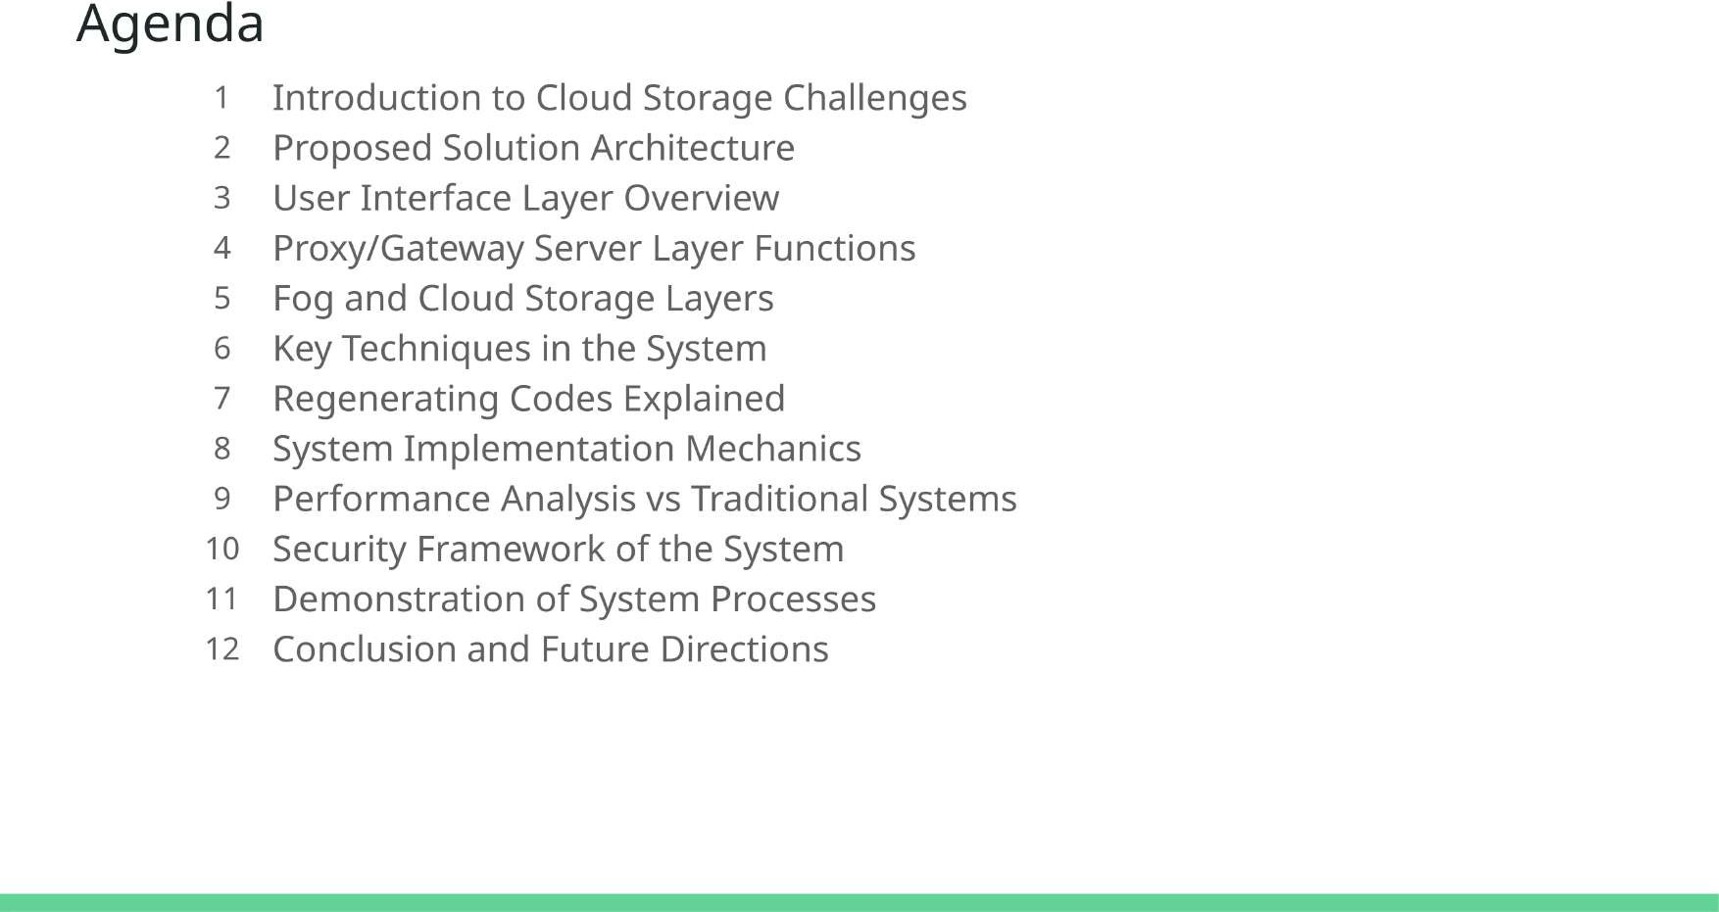

Slide 3
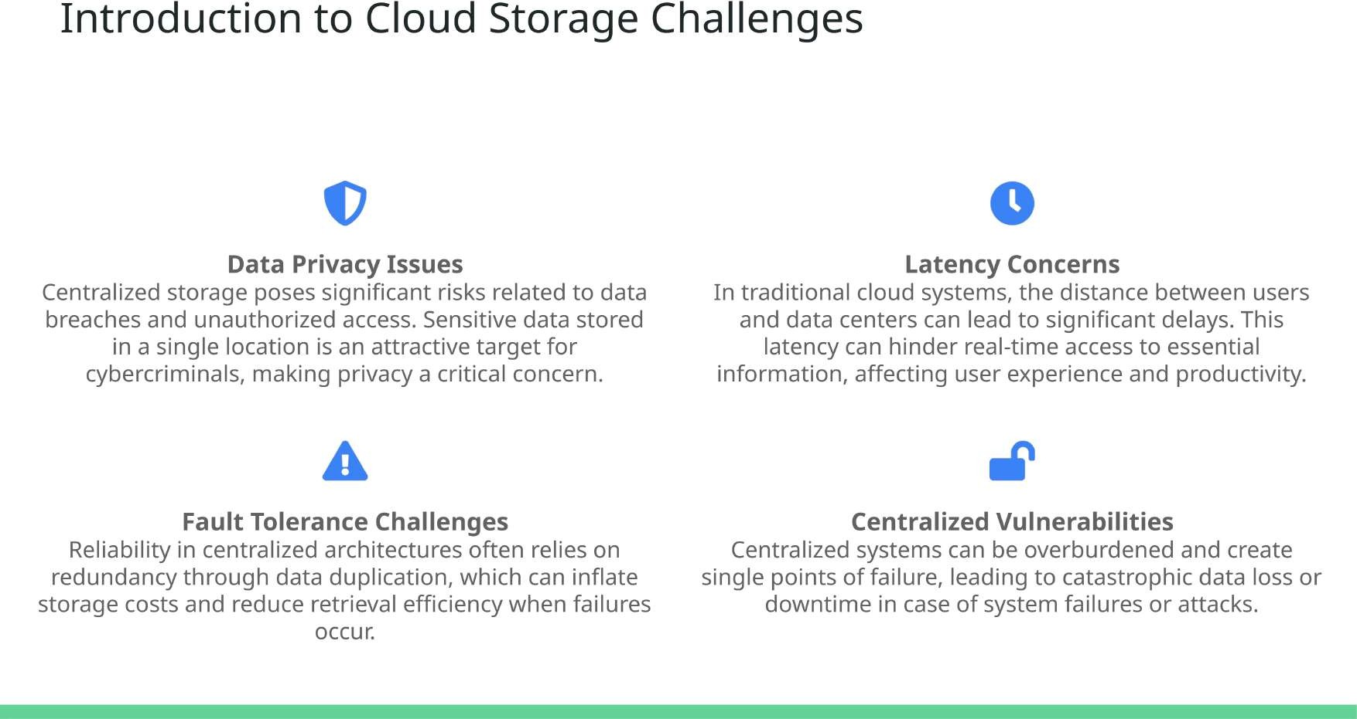

Slide 4
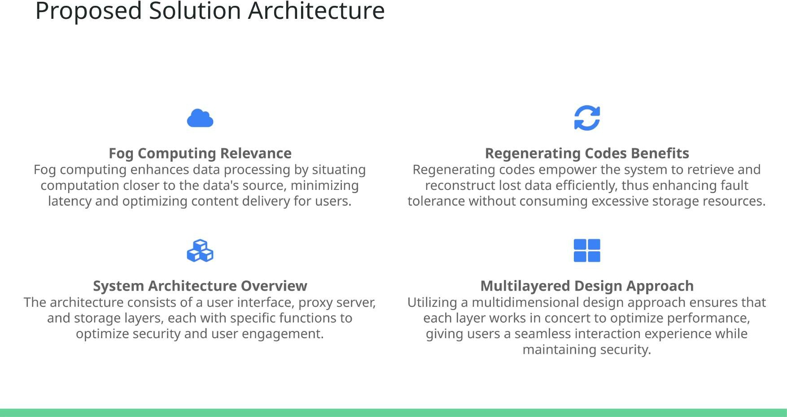

Slide 5
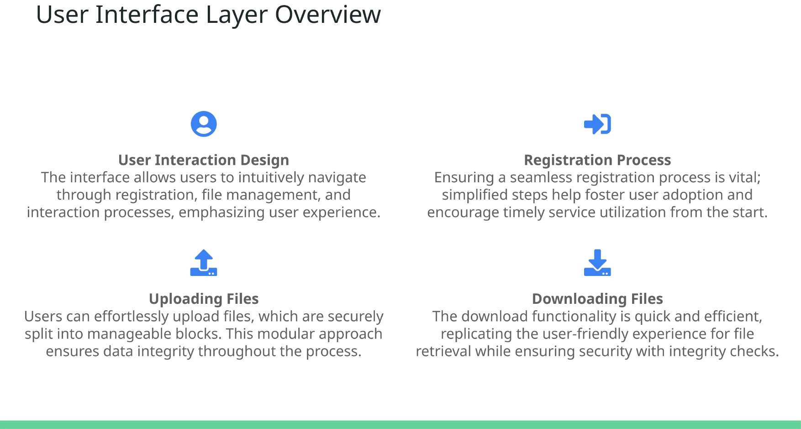

Slide 6
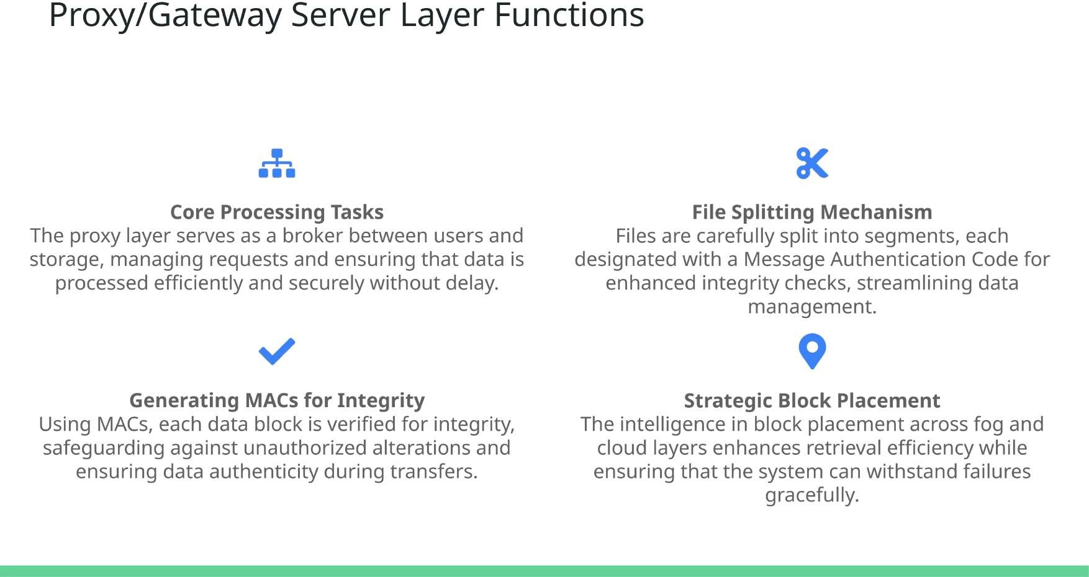

Slide 7
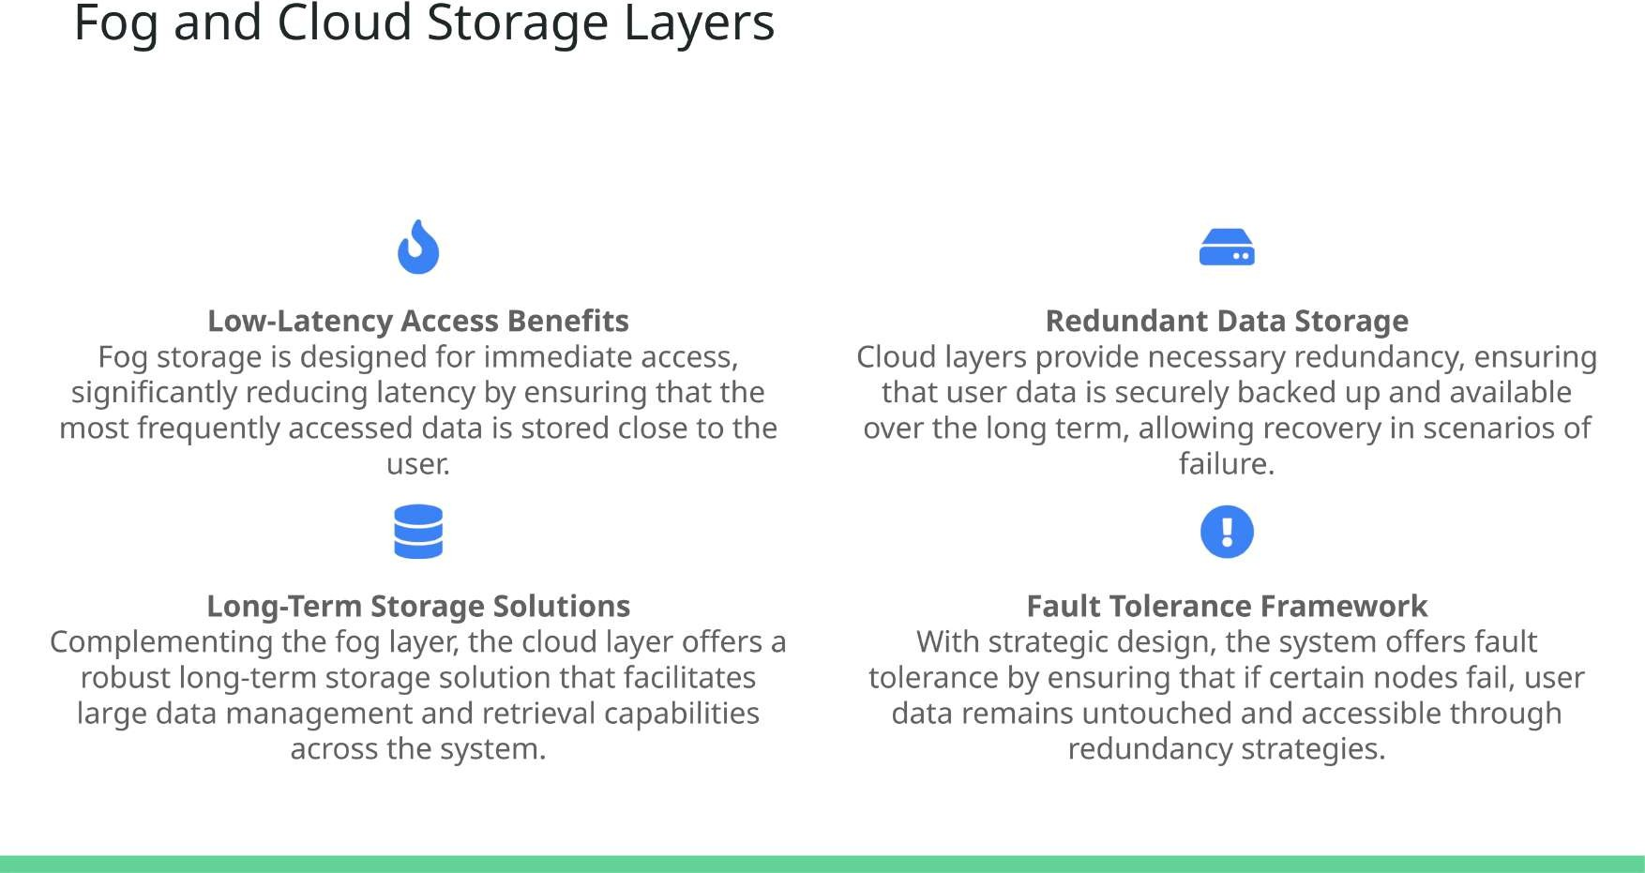

Slide 8
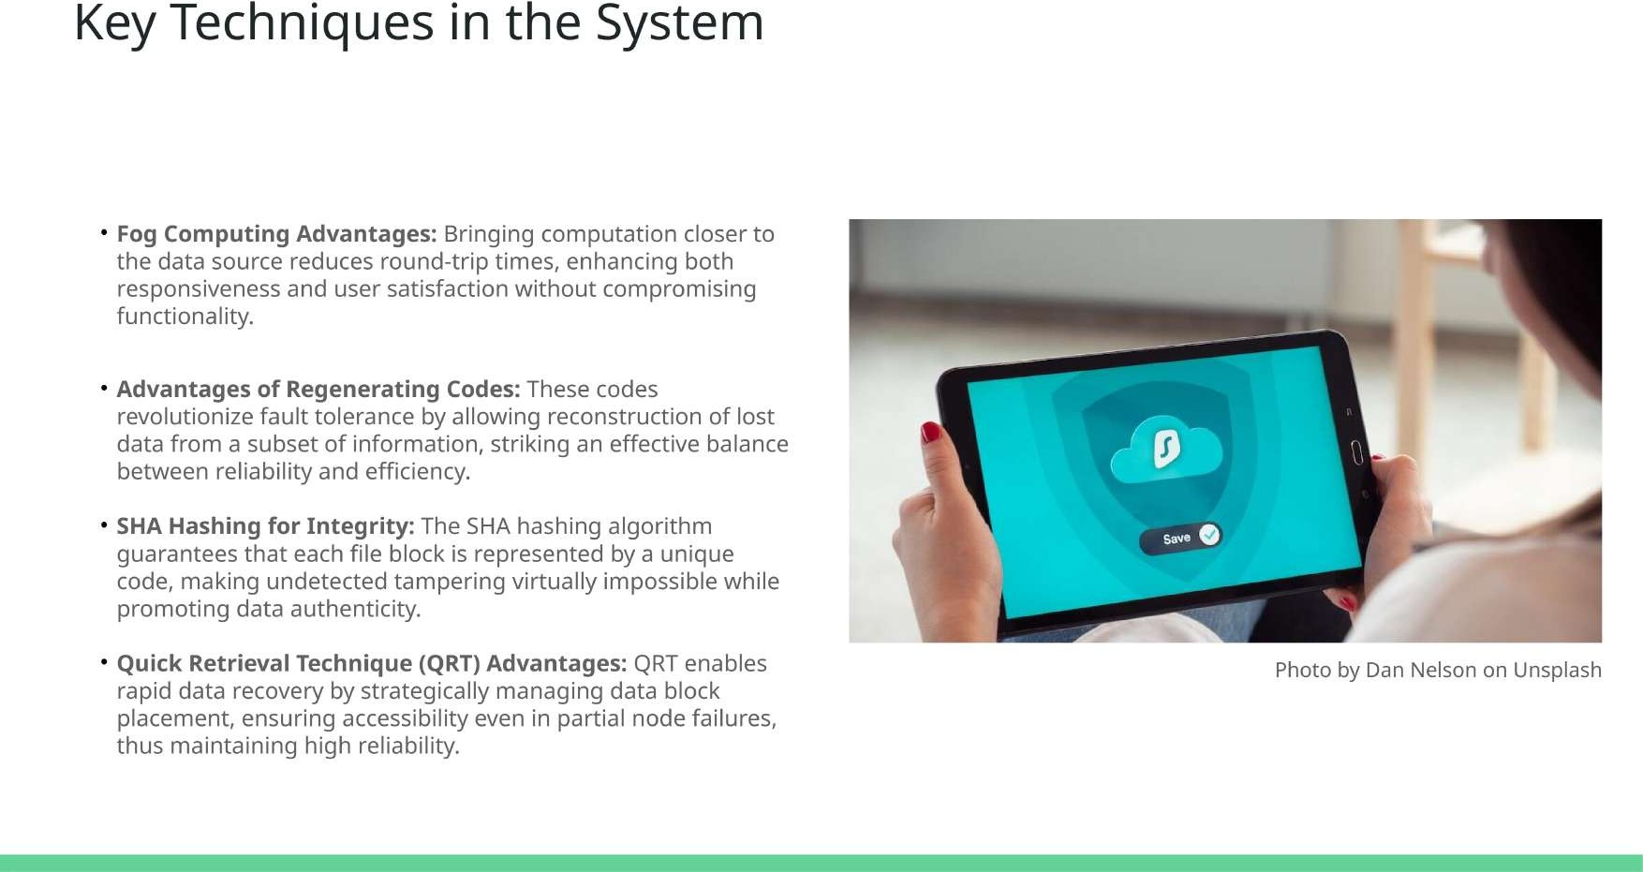

Slide 9
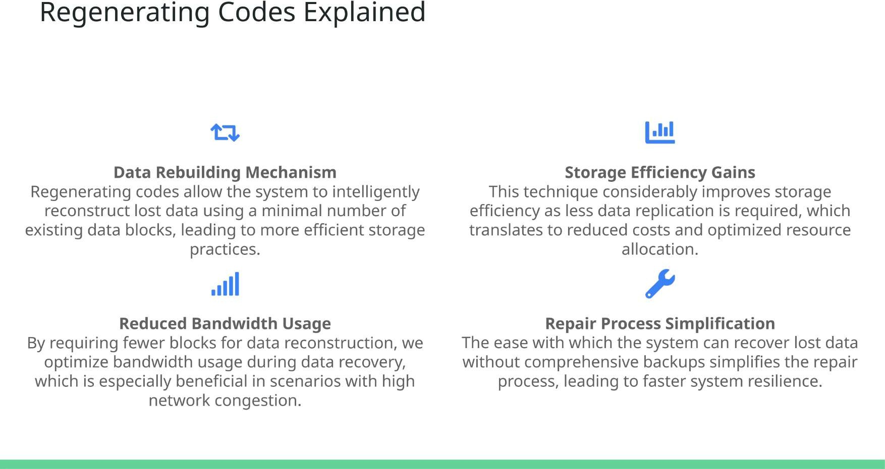

Slide 10
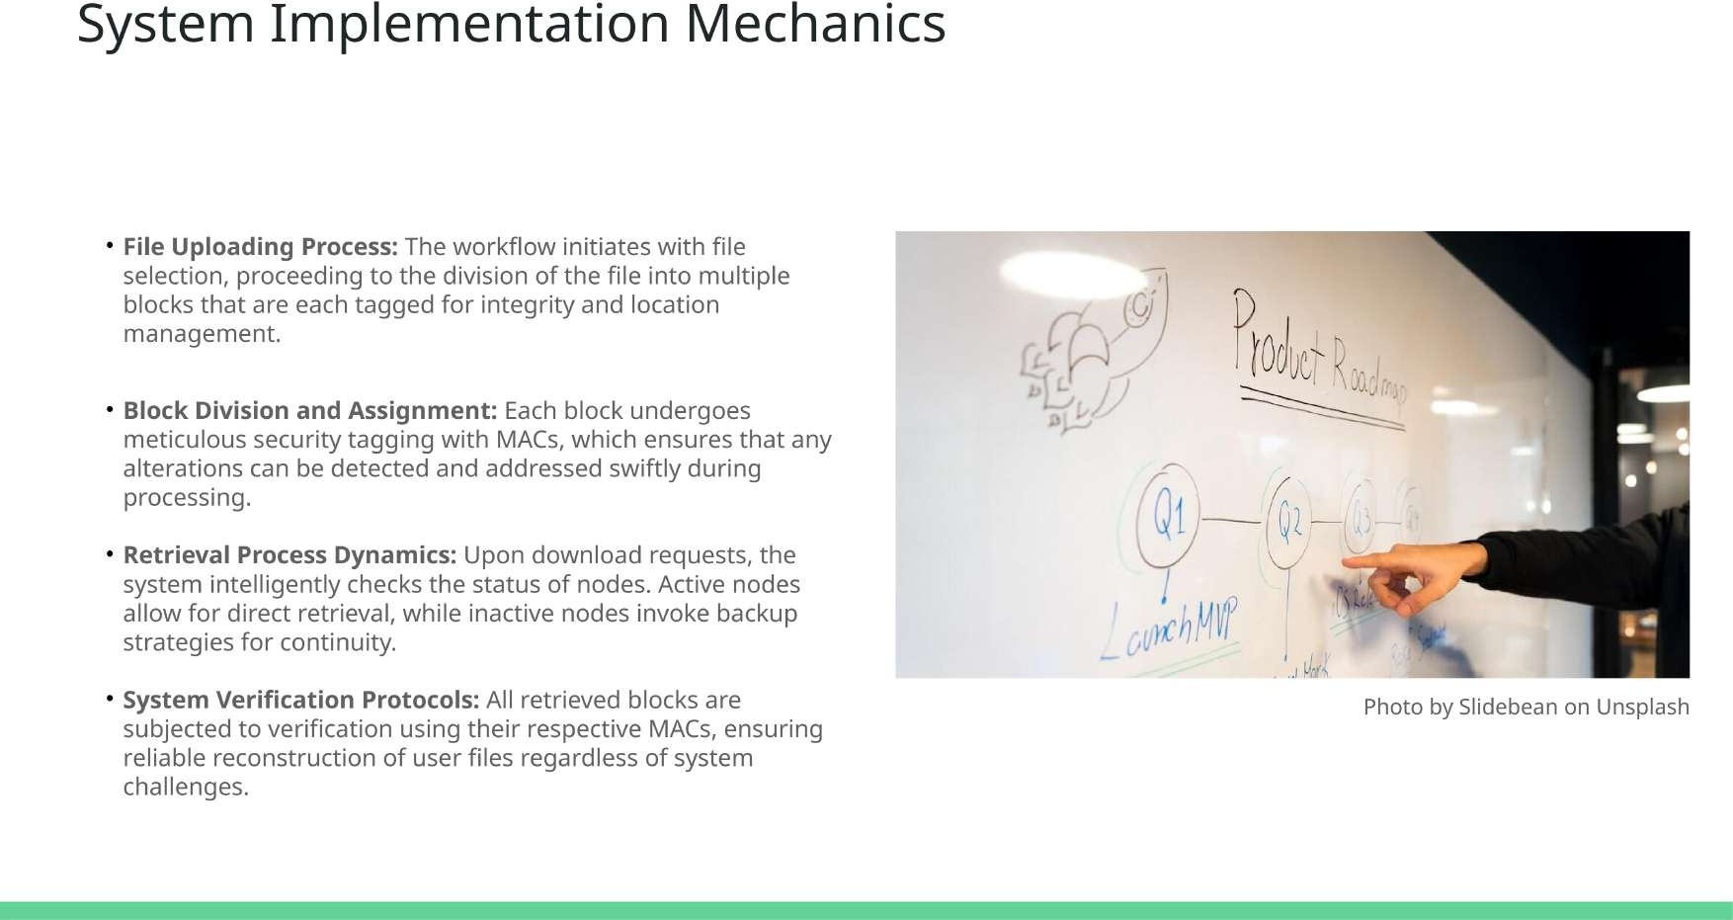

Slide 11
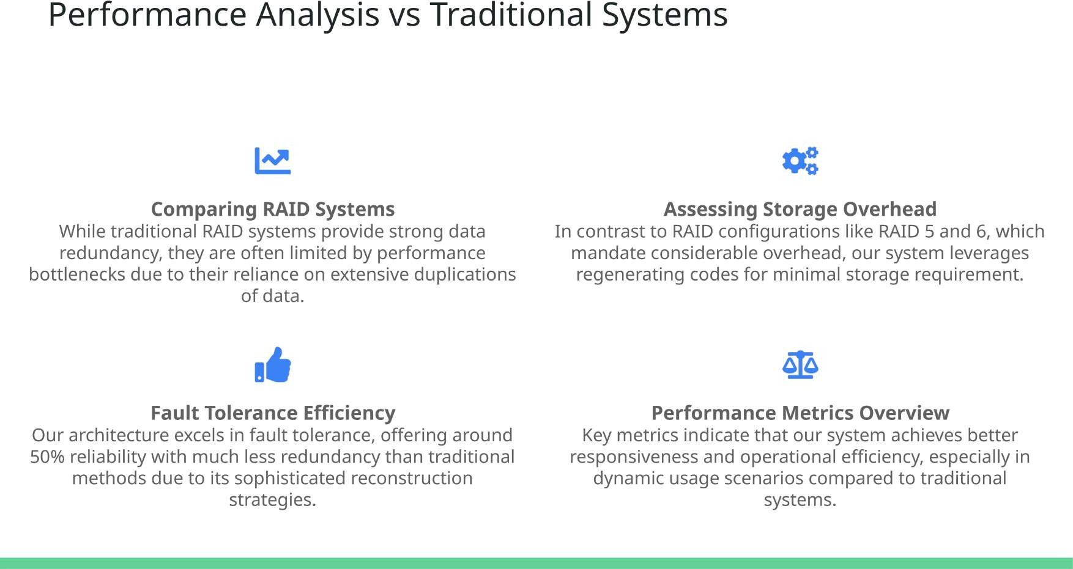

Slide 12
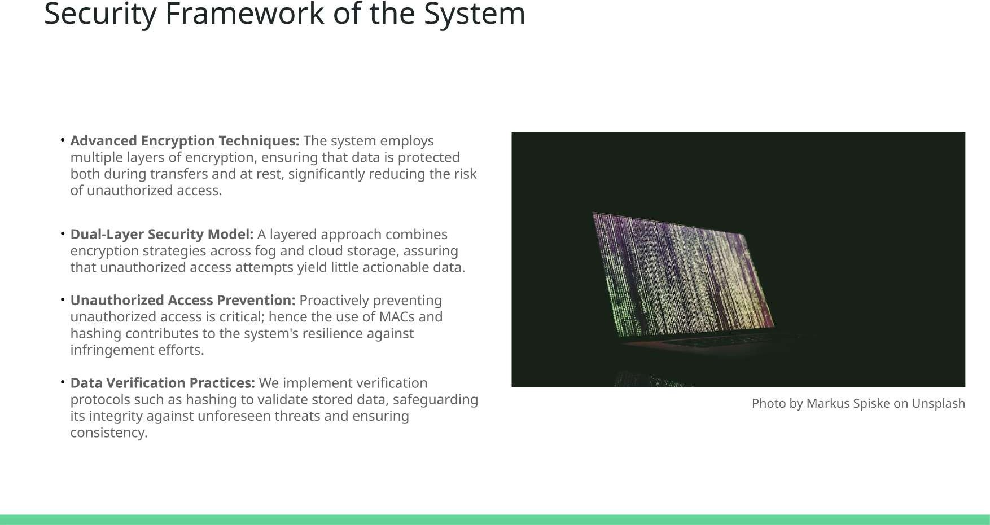

Slide 13
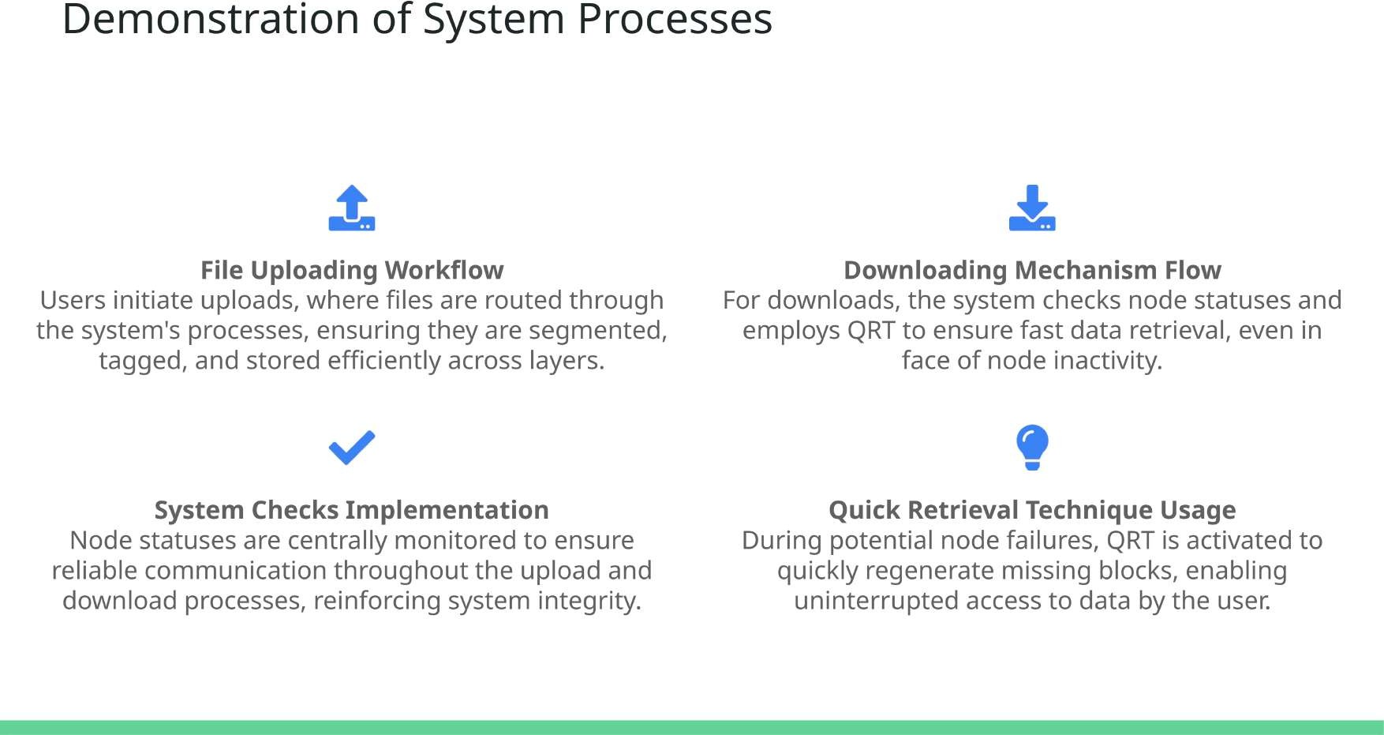

Slide 14
