Slide 1

Plant Leaf
Disease Detection
Using ML
Tashin Mahmud Khan | Md Nabil Hasan | Ahmed Sadman

Slide 2

Unique contribution

Slide 3
Unique Contribution of the Paper
The research introduces Few-Shot Learning (FSL) techniques for deep learning on limited datasets to classify plant leaves.
The study demonstrates an FSL model for plant leaf classification based on Siamese networks and Triplet loss, with an efficient class boundary learning algorithm based on multiclass support vector machines (SVM).
The paper also shows the accuracy and Data efficiency between classical fine-tuning transfer learning techniques, FSL based on siamese networks using Contrastive loss, FSL based on siamese networks using Triplet loss.

Slide 4

DATASET DETAILS
DATASET DETAILS

Slide 5
Dataset Details
The dataset used in this paper is the Plant Village dataset, which consists of 54,303 labeled images of plant leaves and diseases. All the images in the dataset are 256x256 pixels.
All the images in the dataset are 256x256 pixels.
The dataset includes images of 38 different plant leaf and/or disease types (classes), comprising 14 crop species and 26 diseases.
The data was split into a source domain (32 classes) and a target domain (6 classes) for the experiments.
The dataset was further split into a training set (80%) and a test set (20%) for model development and result evaluation.

Slide 6
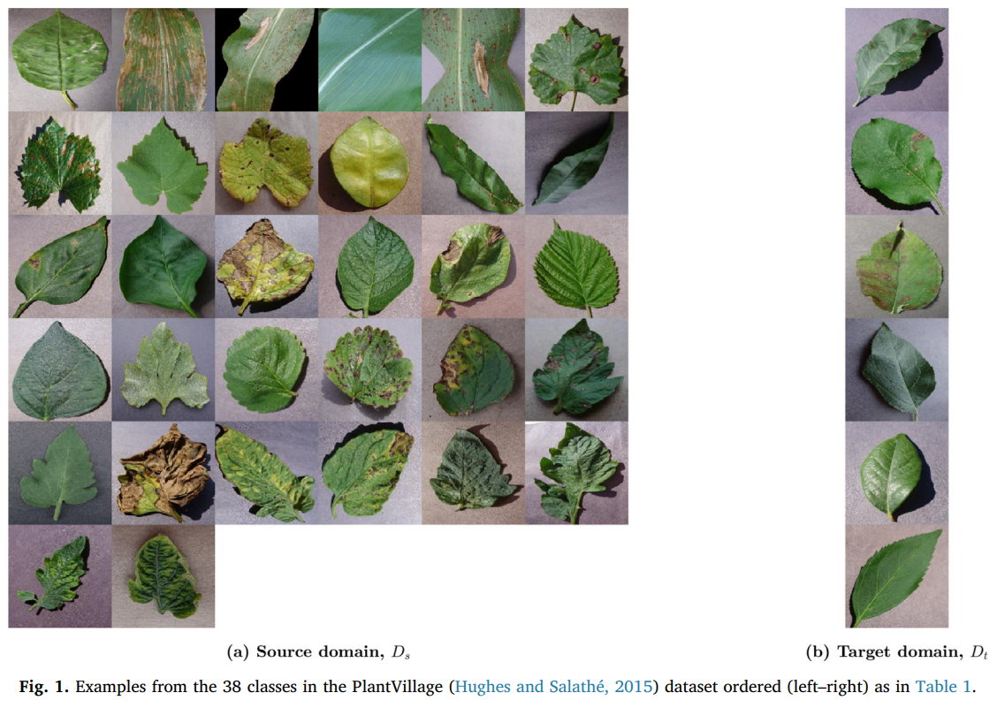
Dataset Sample

Slide 7

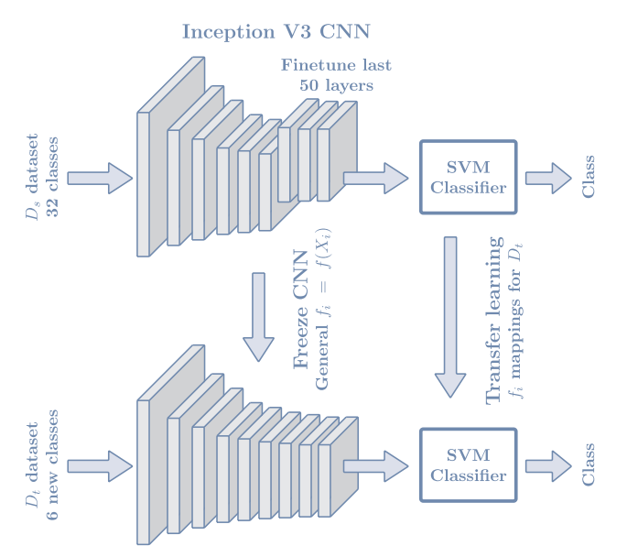
Model Explanation

Slide 8
Model Overview
The architecture of the model consists of two blocks: a general-purpose CNN image classification network and a shallow SVM classifier.
The algorithm was trained with the source domain dataset and tested on the test dataset.
The FSL architecture was used for knowledge transfer, which involved freezing the CNN image mapping network and readjusting the class distance representation of the SVM classifier.
The study hypothesized that the image mappings and distance representations learned by the algorithm in the source dataset would be general enough to transfer knowledge for classifying new plant leaf classes using a few images of those classes.

Slide 9
Model Details
For the baseline CNN, the paper used the Inception V3 network pretrained with the ImageNet database, with 265 frozen layers and 50 trained layers on the source dataset, to extract image embeddings for plant leaf classification, using an embedding dimension of 128.
A Siamese network with three subnets and triplet loss was used to learn image embeddings, where all subnets share the same weights as the baseline fine-tuning model.
In the Siamese network, three images (anchor, positive, and negative) are fed to the network during training. The triplet loss function is used to minimize the distance between the embeddings for the anchor and positive images and maximize the distance between the embeddings for the anchor and the negative class.
The SVM classifier is designed to maximize the margin between different classes in binary and multiclass classification problems.
In the proposed architecture, a one versus all multiclass SVM classifier is used, where K different SVM classifiers are trained, and a winner takes all strategy is followed to decide the class.

Slide 10
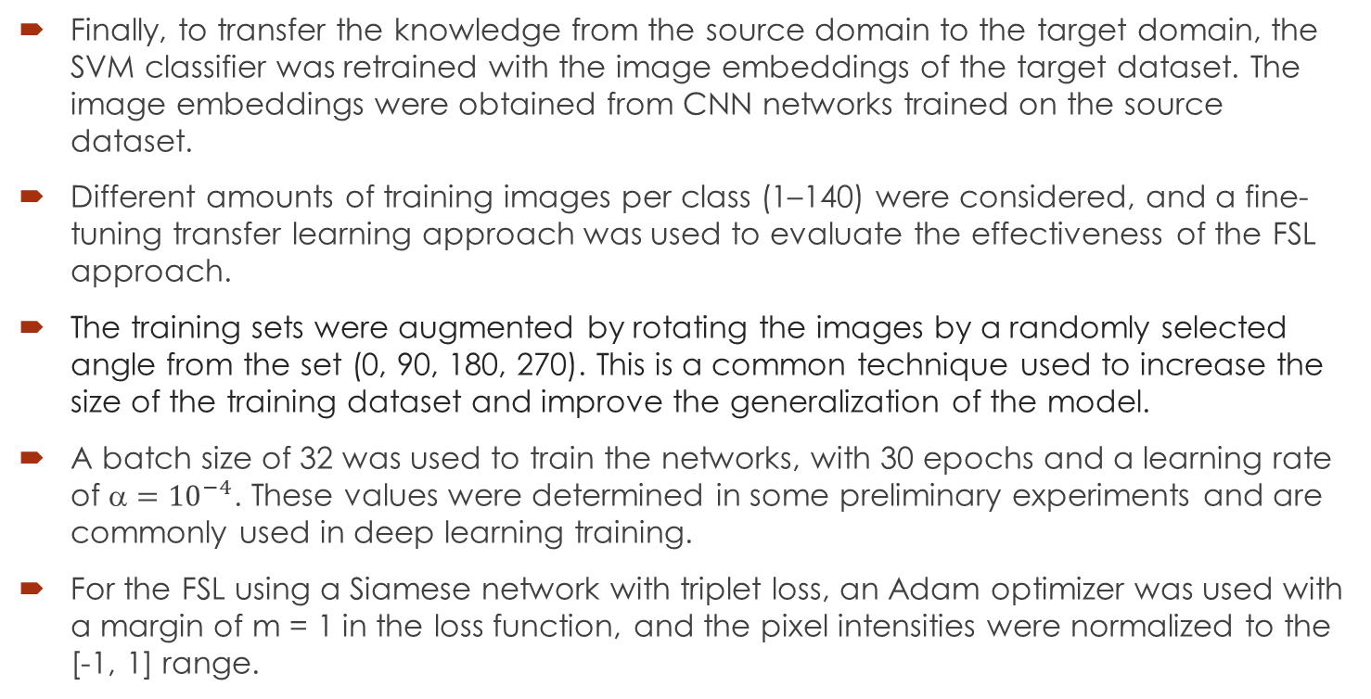
Model Details(Cont.)
Finally, to transfer the knowledge from the source domain to the target domain, the SVM classifier was retrained with the image embeddings of the target dataset. The image embeddings were obtained from CNN networks trained on the source dataset.
Different amounts of training images per class (1–140) were considered, and a fine-tuning transfer learning approach was used to evaluate the effectiveness of the FSL approach.
The training sets were augmented by rotating the images by a randomly selected angle from the set (0, 90, 180, 270). This is a common technique used to increase the size of the training dataset and improve the generalization of the model.
A batch size of 32 was used to train the networks, with 30 epochs and a learning rate of ${\text{}=10}^{−4}$. These values were determined in some preliminary experiments and are commonly used in deep learning training.
For the FSL using a Siamese network with triplet loss, an Adam optimizer was used with a margin of m = 1 in the loss function, and the pixel intensities were normalized to the [-1, 1] range.

Slide 11
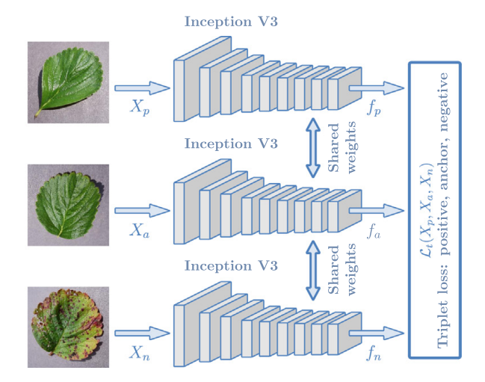
Model Details(Cont.)
Plant leaf image classification is a multiclass classification problem, and the evaluation involves calculating recall, precision, and F-score for each class using a confusion matrix.
The multiclass accuracy or error rate can be calculated as a summary metric for all classes.
The experiments in the dataset show that multiway accuracy is a good overall measure of accuracy, and the metrics are reported as median and 90% confidence interval.

Slide 12
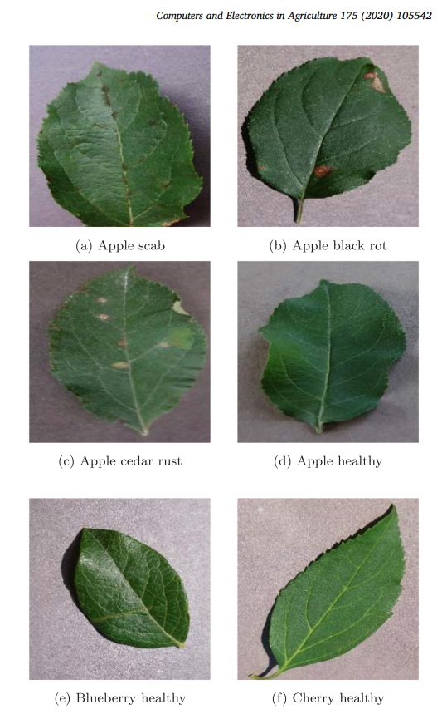
Result Analysis
Examples of leaves in the target domain, with similar morphologies (top four) or different morphologies (lower two).
The network had difficulties differentiating leaves with very similar morphologies such as :
apple scab (class 0)
apple black rot (1)
cedar apple rust (2)
healthy apple leaves (3)
All four leaves correspond to the same crop in different varieties and/or disease conditions.

Slide 13
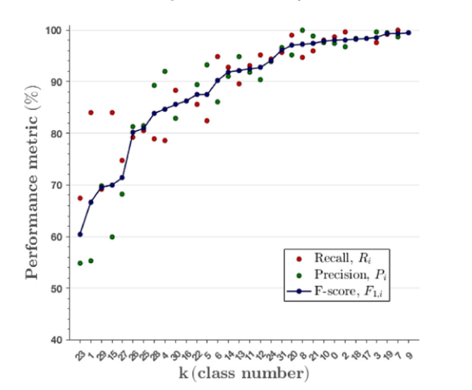
The 32-class models in the test subset of the source domain had accuracies of 91.4% and 90.6% for the Triplet and the Contrastive loss Siamese networks, respectively. Moreover, the median (90% CI) precision, recall and F-score per class were 93.8 (77.4–99.3)%, 92.6 (65.8–99.4)% and 92.3 (69.9–98.8)% for the Triplet loss; and 93.8 (73.8–99.1)%, 93.1 (54.1–99.9)% and 91.2 (64.8–98.8)% for the Contrastive loss. Not only did the Siamese architectures learn how to classify leaf types and disease types, but they did it for a vast majority of the 32 classes. The number of classes with F-scores below 70% was 3 for Triplet loss and 5 for Contrastive loss. All classes had recall, precision and F-score values above 55.0% for the Triplet loss, which is a considerable improvement over the 3.1% accuracy for a random guess in 32 classes

Slide 14
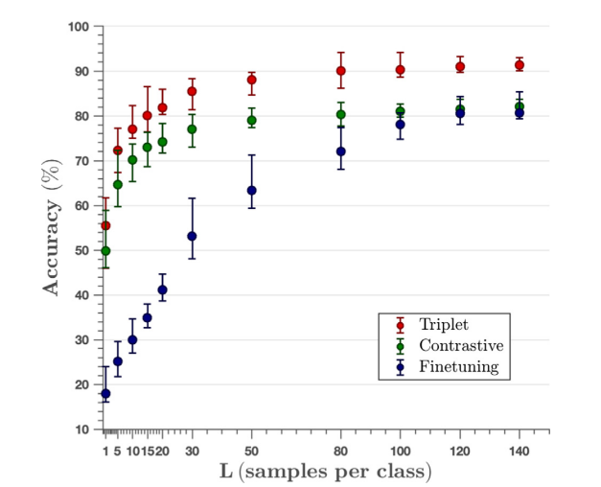
The median (90% CI) accuracy for the FSL approaches as a function of the images per class (L) in the Test Dataset is shown here. All curves increase sharply as L grows until the methods reach a plateau in accuracy. However, the accuracy of the FSL methods was significantly higher (p > 0.05) than that of the fine tuning model, except for Contrastive loss with L > 100. For L > 5 the FSL method based on Triplet loss had significantly higher accuracies (p < 0.05) than that based on Contrastive loss. When all 4421 training samples from Test Dataset were used the accuracy was 94.0%, only 4- points larger than the 90.0 (86.1–94.2)% obtained with Triplet loss and L = 80 (480 images for the 6 classes). This means a reduction of 89.1% in the data set size requirements with a loss of only 4-points in accuracy.

Slide 15
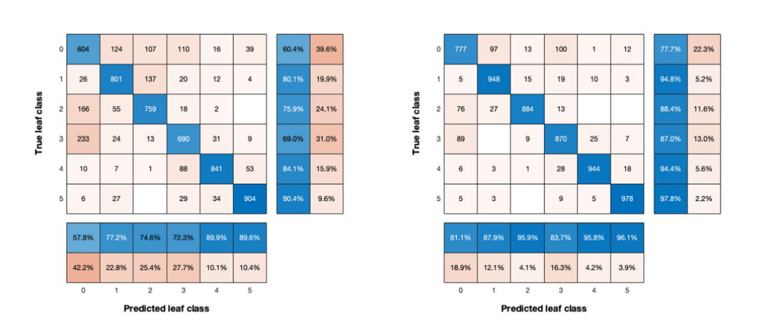
An interesting insight into how the best method performed on the target domain is to analyze the stacked confusion matrices for Test Dataset with Triplet loss for low and moderate values of L. This is shown here. Stacked confusion matrices for the 20 random experiments with the Triplet loss, for L = 10 samples per class (left) and L = 80 (right). The bottom rows show the recall (Ri) per class and the leftmost columns the precision (Pi) per class. The test set contained 50 samples per class or a total of 6000 decisions in the 20 runs.

Slide 16

Thank You

