Slide 1
General max values
 | Station | Year | Month | Day | Value
Daily Rainfall Total (mm) | Changi | 2021 | 1 | 2 | 210.6
Mean Temperature (°C) | Sentosa Island | 2021 | 4 | 1 | 31.1
Maximum Temperature (°C) | Sentosa Island | 2020 | 12 | 2 | 38.0
Minimum Temperature (°C) | Tuas South | 2020 | 5 | 16 | 29.2
Mean Wind Speed (km/h) | Admiralty | 2021 | 1 | 18 | 28.8

Slide 2
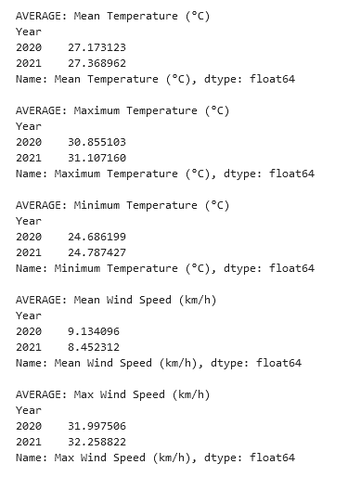
Did Singapore get hotter between 2020 to 2021?
From the results,
There is a general increase in temperature in Maximum Temperature, Minimum Temperature.
Furthermore, the general wind speed has seemed to drop based on Mean Wind Speed, even though Max Wind Speed saw a 1 km/h rise in its average.
It is likely that Singaporeans feel hotter as a result.

Slide 3
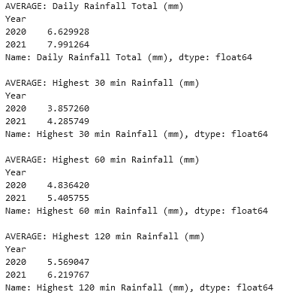
Did it rain more longer from 2020 to 2021?
From the results,
There are increases across the board by 1mm.
We can conclude that not only did it rain longer, it also rained more often.

