Slide 1
Big Data Analytics Big Picture
-Adit Ghosh

Slide 2
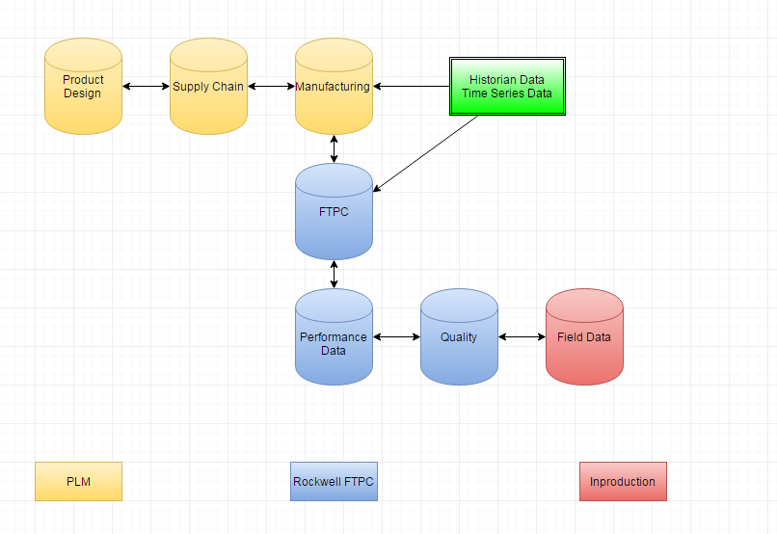
What we have

Slide 3
Why? Need in market?
Rockwell has a huge amount of varied data. Design to market
Product History
Trends
Predictive analysis and maintenance

Slide 4
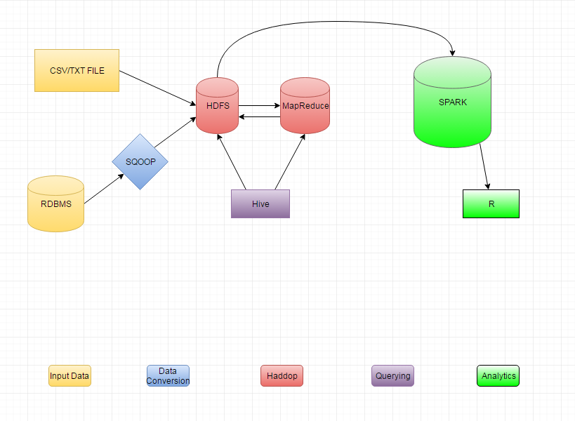
How?

Slide 5
Goals
Short: Ability to better store data. Predict/trends in failure. ➔ Test on one product
Long: Ability to diversify this across platforms. Use R for visualization

Slide 6
Working/Algorithms
Storing this data in a column based storage will dramatically improve speed of access of data.
Clustering ➔ KMeans ➔ divide all products into groups. Eg Good, average bad
From these trained clusters we can predict which cluster a new set of data will fit into. Thus say what the likelihood of future events are- Predict Failure.

