Slide 1
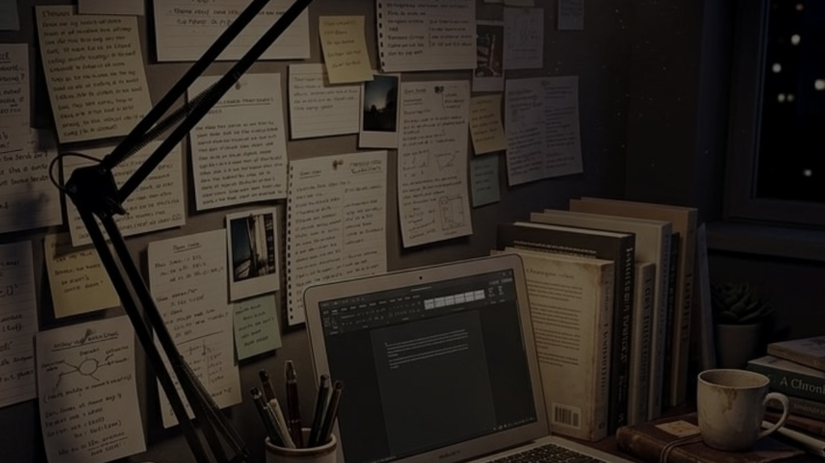
A CALMER WAY TO STUDY
StudyOS
Your syllabus,\nfinally connected.
A personal workspace for the topics,\nmaterials, notes and progress that\nmake up your study life.
LESS SCATTER. MORE CONTEXT.
STUDYOS / A PERSONAL SYLLABUS-TO-STUDY WORKSPACE
01

Slide 2
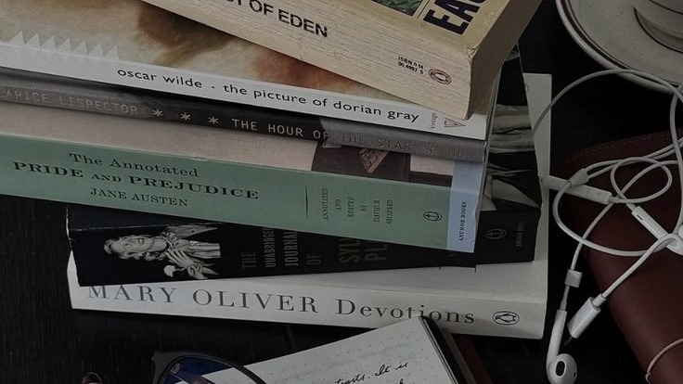
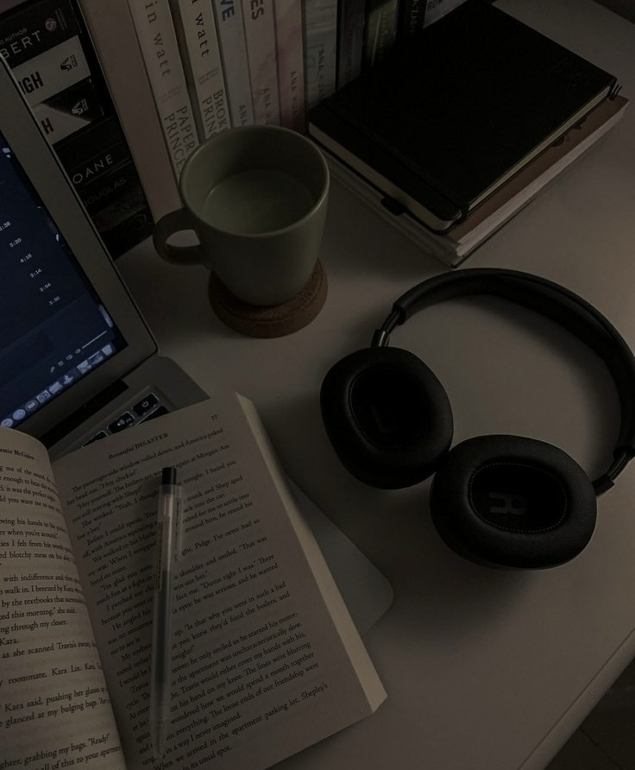
01 / THE EVERYDAY PROBLEM
Studying happens in pieces.
But the connections are left to you.
SYLLABUS
PDFs + SLIDES
The plan
The materials
CHECKLIST
PERSONAL NOTES
The progress
The thinking
AI CONVERSATIONS
A file can be saved.\nA connection can still be lost.
The questions
The extra work is remembering where everything belongs.
STUDYOS / A PERSONAL SYLLABUS-TO-STUDY WORKSPACE
02

Slide 3
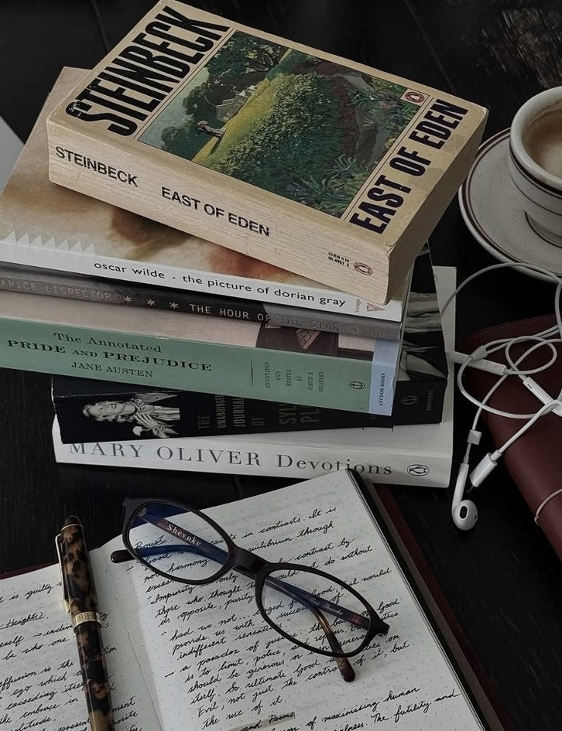
02 / THE STUDYOS IDEA
Start with the syllabus.
Make it the structure everything else can belong to.
BIOLOGY / SUBJECT
EDITABLE BY THE STUDENT
Import a supported syllabus\nor build one manually.\n\nAdd, rename, move and\nrearrange levels as needed.
UNIT 02 / CELLS
Cell membrane
Organelles
THE TREE IS THE HOME BASE.
Diffusion
Resources follow the selected node.
STUDYOS / A PERSONAL SYLLABUS-TO-STUDY WORKSPACE
03

Slide 4
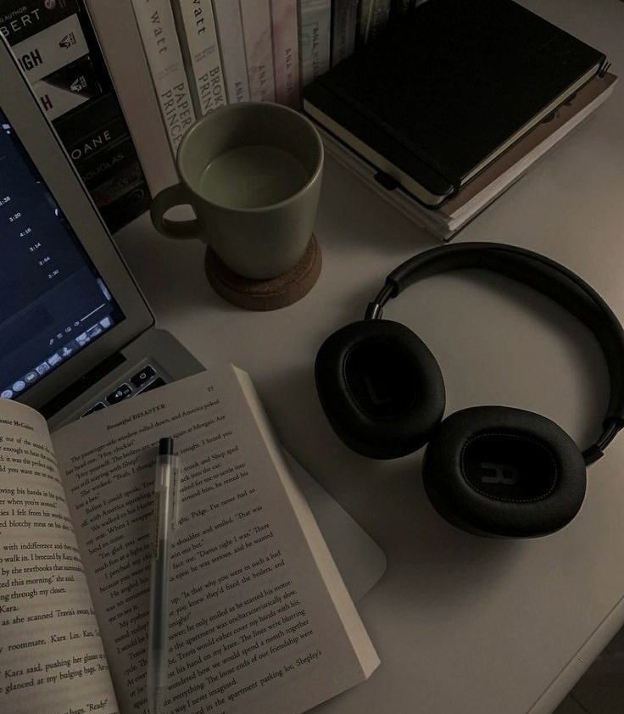
03 / A STUDY SESSION
One topic. A connected workflow.
Choose a node in the tree; the rest of the workspace follows.
01
Create or import
Review and edit the syllabus tree.
02
Select a topic
Keep the current subject in view.
03
Track progress
Check off subtopics; parent progress is derived.
04
Bring in your work
Attach materials and write notes for that node.
05
Ask, if useful
Optional AI: explanations, notes, practice and answer feedback.
AI IS OPTIONAL. CONTEXT IS THE POINT.
STUDYOS / A PERSONAL SYLLABUS-TO-STUDY WORKSPACE
04

Slide 5
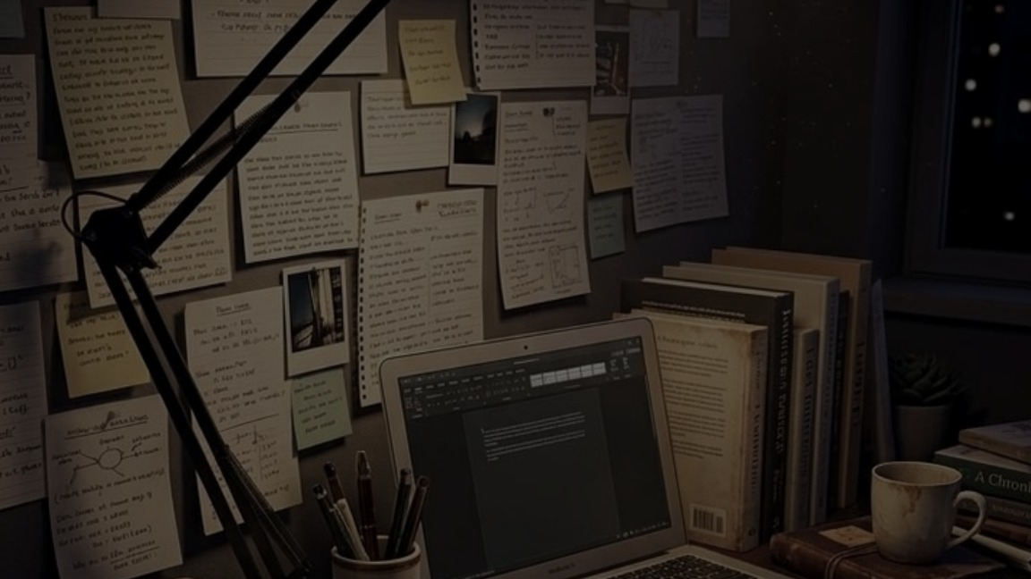
04 / THE VALUE
Keep the whole\nstudy life in context.
01
One editable syllabus structure
02
A clearer view of what is done — and what remains
03
Materials and personal notes beside the relevant topic
04
Optional study assistance when you want it
05
A workspace that persists with supported sign-in
Your syllabus is not just a list.\nIt is the structure of your study life.
Student-controlled. AI-optional. Clear about its limits.
STUDYOS / A PERSONAL SYLLABUS-TO-STUDY WORKSPACE
05

