Slide 1
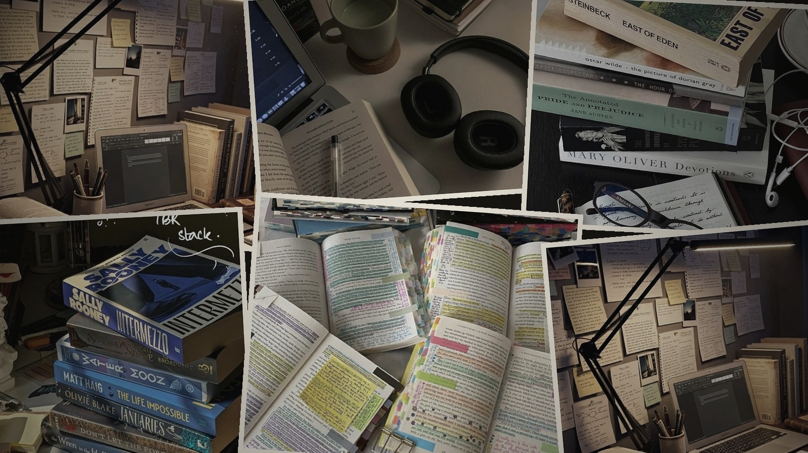
THE PROBLEM
Studying is full of material.
But the material is fragmented.
Syllabus • textbooks • PDFs • screenshots
notes • practice • AI tools
The student has the pieces.
There is rarely one place where those pieces stay connected.

Slide 2

INTRODUCING
StudyOS
A personal syllabus-to-study workspace.
Syllabus → Tree → Topics → Study workspace
Turn a syllabus into an editable structure —
then keep the work around each topic.

Slide 3
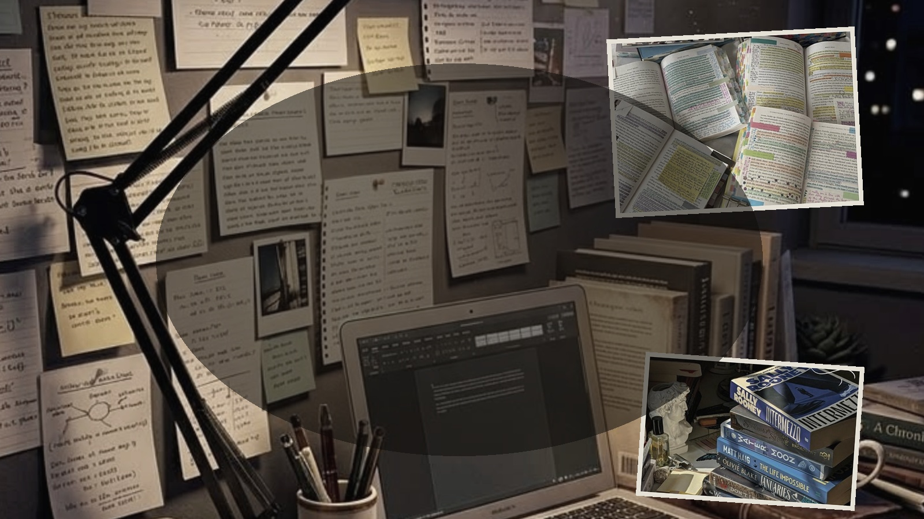
THE CORE IDEA
The tree becomes
the workspace.
Mathematics
Algebra
Quadratic Equations
Materials
Notes
AI
Practice
Select a node → access the context that belongs to it.

Slide 4
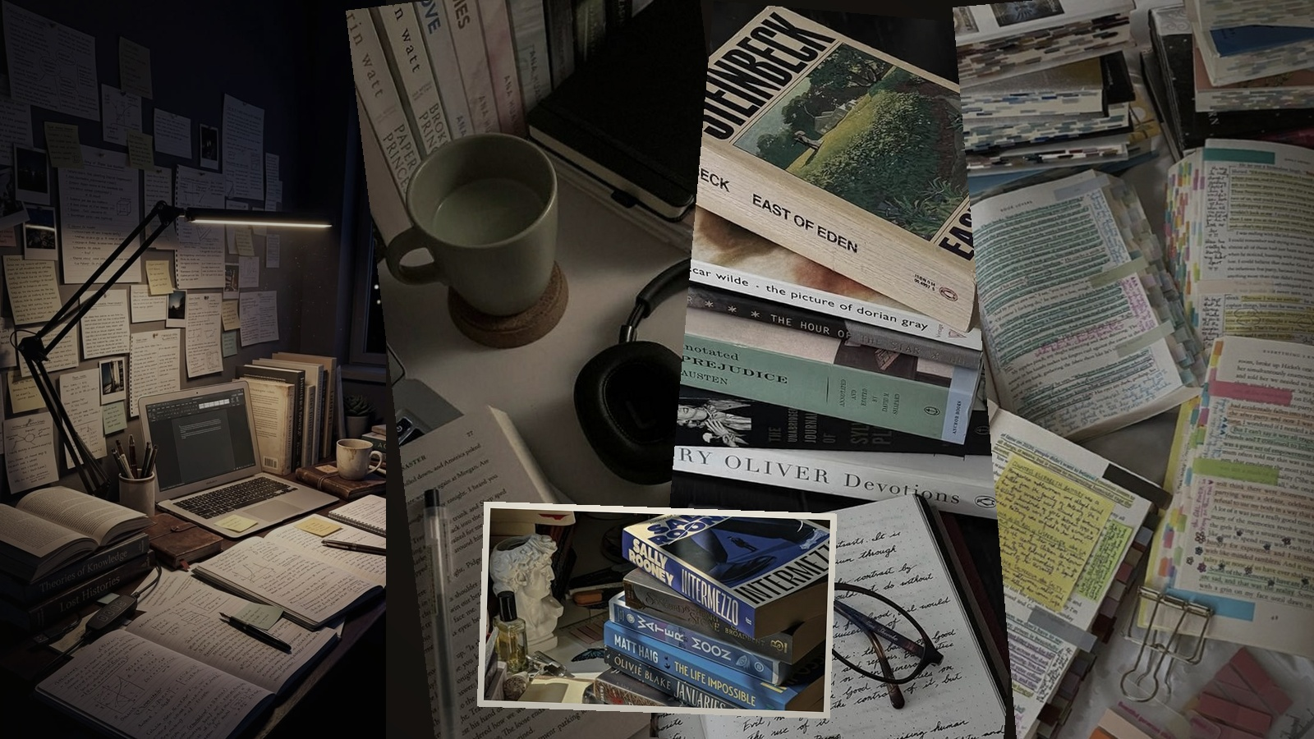
WHAT STUDENTS CAN DO
Build it. Organize it.
Study from it.
TRACK
EDIT
Mark topics complete and see parent progress.
IMPORT
Add, rename, move, reorder and expand topics.
Bring in a syllabus and review its structure.
ASSIST
WRITE
Use optional contextual AI and topic practice.
ATTACH
Store personal notes beside the topic.
Keep files and pasted material with the right node.
The student controls the structure. AI stays contextual and optional.

Slide 5
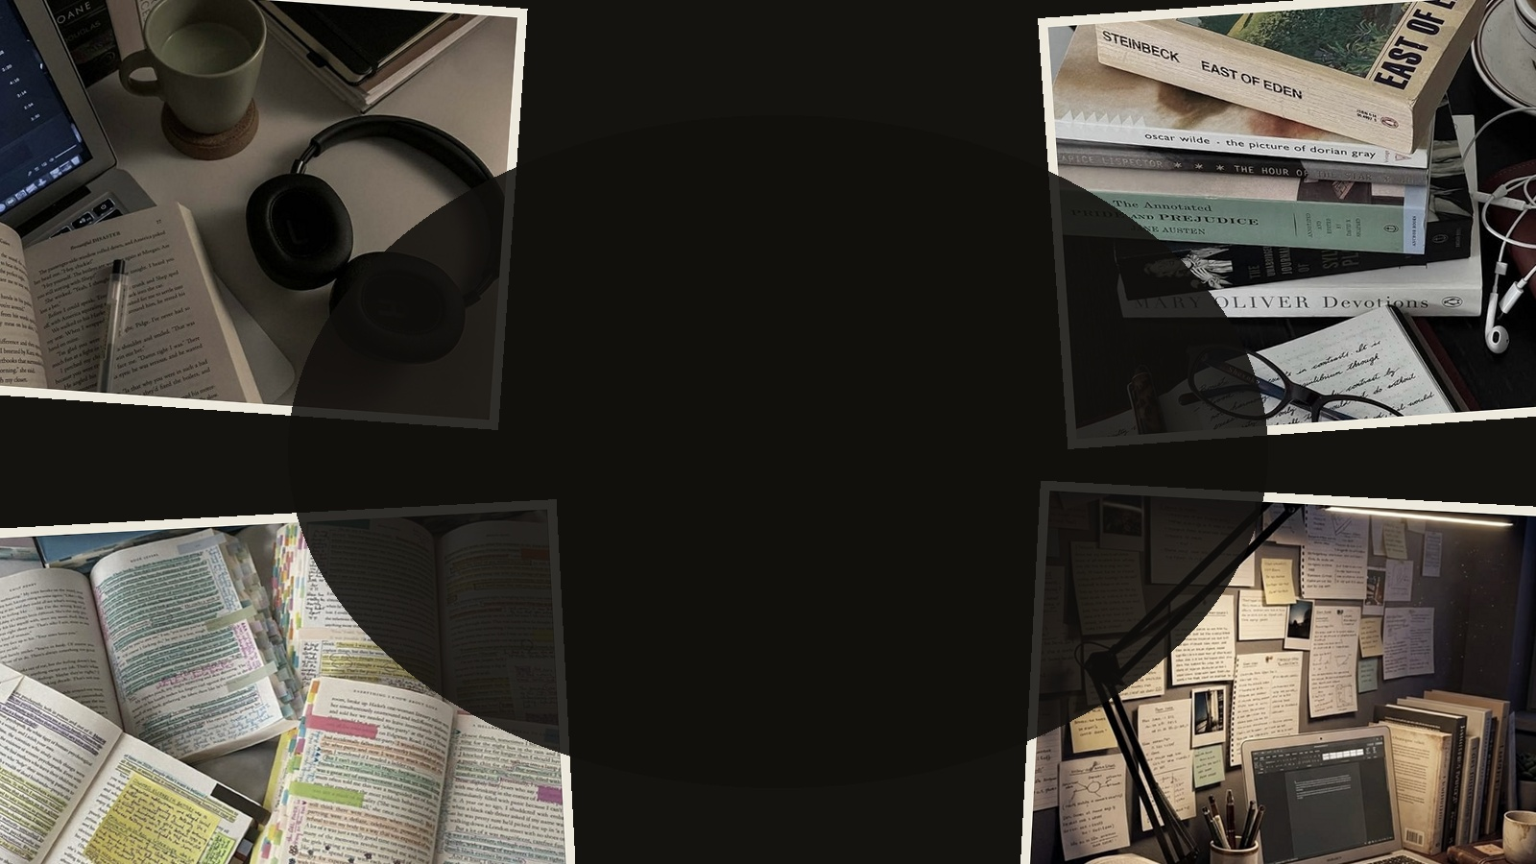
THE STUDYOS EXPERIENCE
From scattered material
to one connected workspace.
SYLLABUS
→
ORGANIZE
→
STUDY
→
TRACK
→
CONTEXTUAL HELP
One editable syllabus. One connected place to keep the work around it.
STUDYOS

