Slide 1
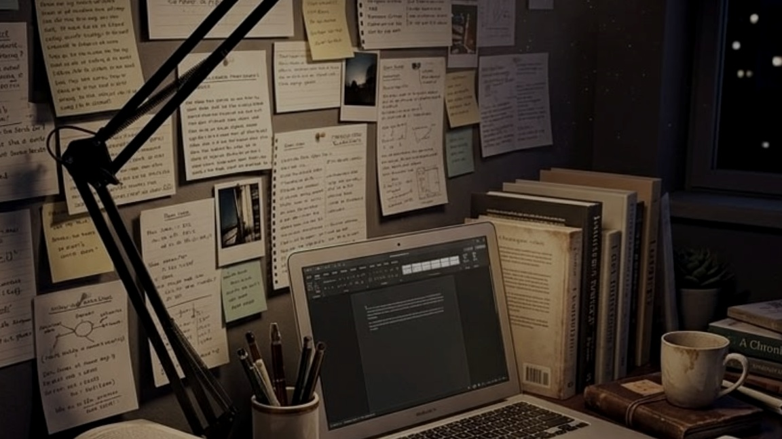
A PERSONAL SYLLABUS-TO-STUDY WORKSPACE
A STUDY SPACE
built around the syllabus
StudyOS
Your syllabus,
finally connected.
Subjects, materials, progress and personal notes—
organised around the topics you study.
Team name : Night City Legends
Team members: Haimontika Roy
Saptarshi Ghosh
Open Innovation
01 / INTRODUCTION
A calmer way to find your next step.

Slide 2
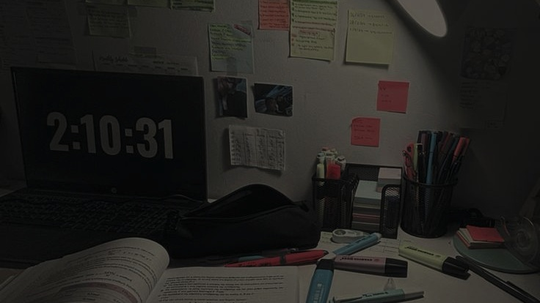
02 / THE EVERYDAY PROBLEM
Everything is somewhere.
Nothing is quite connected.
A student ends up doing the organising by hand.
PDFs + SLIDES
PERSONAL NOTES
SYLLABUS
Files in different places
PROGRESS
Thoughts out of context
A separate document
A checklist on its own
THE WORK BETWEEN
AI CONVERSATIONS
SCREENSHOTS
Reconnect every piece
by hand.
Answers away from the topic
Saved, then hard to find
Individual tools help. The missing piece is the connection to the topic.
STUDYOS / FIELD NOTES 02

Slide 3
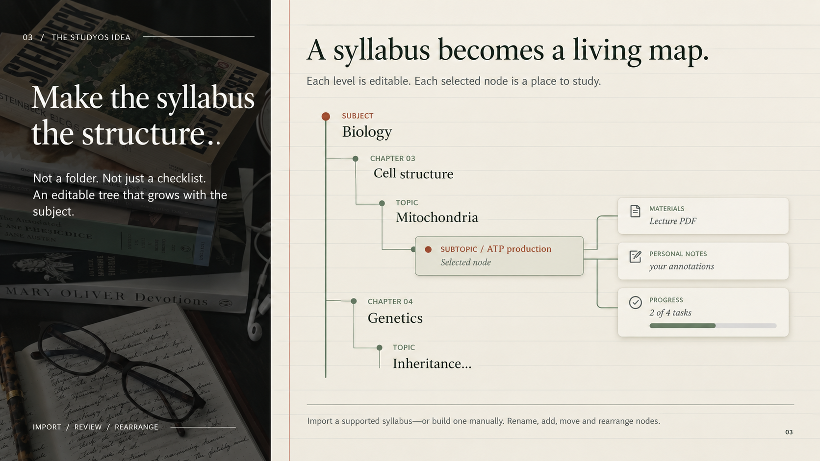

Slide 4
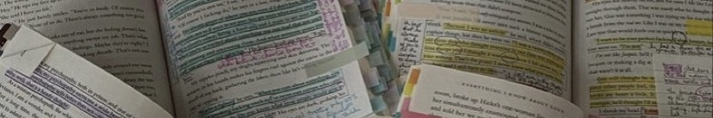
04 / HOW A STUDENT USES STUDYOS
A study session, connected.
The selected node is the thread through every step.
SELECT
COLLECT
Open a subject, chapter
or specific topic.
Attach study materials
and write personal notes.
01
02
03
04
05
CREATE
TRACK
ASK · OPTIONAL
Import a syllabus
or build one manually.
Check off tasks; parent
progress follows along.
Request an explanation,
notes, practice or feedback.
THE PRINCIPLE
AI is an optional tool inside the workflow—not the centre of it.
One topic. The relevant materials, notes, progress and help beside it.
04

Slide 5
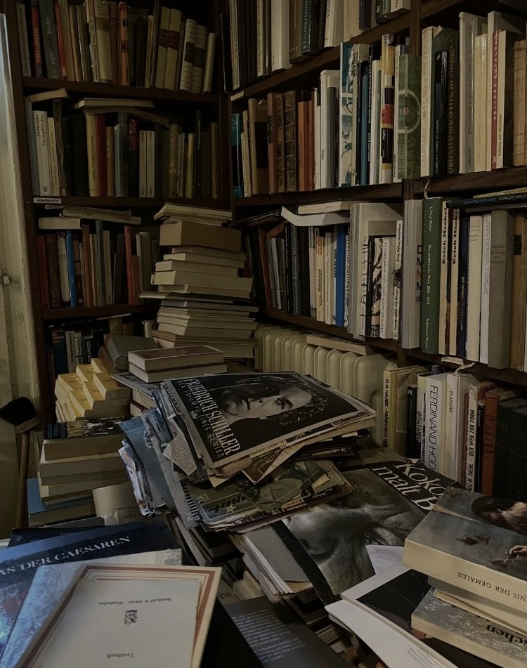
05 / THE VALUE
Your study life,
in one place.
STUDENT-CONTROLLED
AI-OPTIONAL
TRANSPARENT ABOUT LIMITS
Not by replacing every tool—by giving the work a shared structure.
PROGRESS
TOPIC
01
Navigate
One editable syllabus tree.
MATERIALS
02
See progress
Completed and unfinished topics at a glance.
NOTES
03
Keep context
Materials and personal notes stay with relevant topics.
04
Get support
Optional AI help when you need it.
OPTIONAL AI
05
Return to it
A workspace that persists through supported sign-in.
Syllabus. Progress. Materials. Notes.
Connected by the topics you study.
STUDYOS / 05

