Slide 1
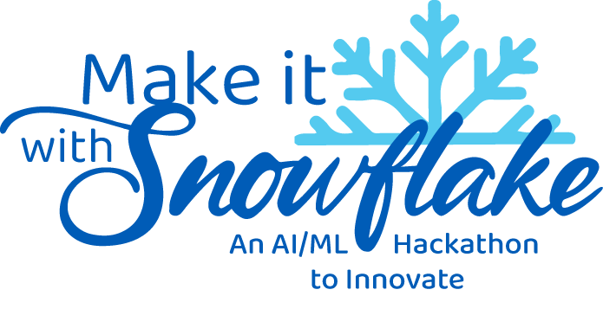
Concept
Submission
Avijit Rana
Aditi
Trisha Ghoshal

Slide 2
Concept Submission Guidelines and Rules
Submission Format: Submit a written solution concept (100 words max). Teams may optionally include one clearly labeled diagram or illustration to support the solution description. Please name your file as: SnowPals_ConceptSubmission.
Submission Deadline: All submissions must be received by 30th May’ 25. Late submissions will not be accepted.
Originality: Solutions must be original and developed specifically for this hackathon. Reusing previous work is prohibited.
Content Accuracy and Integrity: Submissions must accurately reflect the solution without exaggeration or misrepresentation of capabilities.
Judging Criteria: Clarity of Problem Statement & Solution Direction & Relevance
Code of Conduct: All participants must always maintain respectful and professional interactions. Violations may lead to disqualification.

Slide 3
Submission Date
Submitted By
30/05/2025
Trisha Ghoshal

Slide 4


Team Name: SnowPals
Theme Name: Conversational-AI for Sales - Deploy a chatbot for sales insights or chatbot to streamline Sales CRM workflows, making it easier for salespeople to use and update the CRM

Slide 5
PROBLEM STATEMENT
In B2B sales, CRM platforms used to track leads, deals, deal status, follow-ups, reminders etc. but due to mnaual complex steps of CRM data management, Sales Rep often avoid using it, thus leading inaccurate forcasting analysis, poor analysis of customer pain points, no automated recommendation to customer's enquiries, poor solution proposals thus leading missed opportunities.
Significant time / effort / energy of Sales Rep spending on identifying potential high lead and ending up on unqualified leads, without any dynamic standard lead scoring system.
Lack of in-built CRM data management tools (intelligent tools) causes Sales rep's manual effort, time and productivity leading low adoption of CRM tools by sales rep.
Poor sales forecast, business recommendations, possible business proposal plans to Leads based on user interactions.

Slide 6
SOLUTION CONCEPT
AI Driven conversational Interface for Sales team & Custo: Sales Reps/Customers both interacts with CRM data through AI chatbot which is connected via native NLP / ML models for user's enquiry/feedback texts at near realtime sentiment analysis (customer), predicting possible lead conversion (sales), dynamically updates lead scores (sales), fetching dasboards via converting data enquiries into SQL (e.g Snowflake's Cortex NLP to SQL feature) to make the interface an easy self service way, thus enhancing better likelihood of leads conversion into successful deals.
AI – driven CRM CRUD Operations Via ChatBot: As backend system, NLP integrated with Snowflake Snowpark converts ChatBot's sales user's conversations / queries / request to update CRM data into SQL for near real-time CRM data updates and other CRUD operations capabilities at ease, cutting down significantly manual entry efforts to improve productivity and CRM adoption by Sales teams. leveraging Snowflake's native / marketplace CRM data sync connector.
Business Impact: Saving significantly Sales teams time and energy, improves CRM data accuracy, empowers sales teams to focus on the most promising leads, automated Customer Solution/lead follow-up recommendations significantly reducing missing lead opportunities.

Slide 7
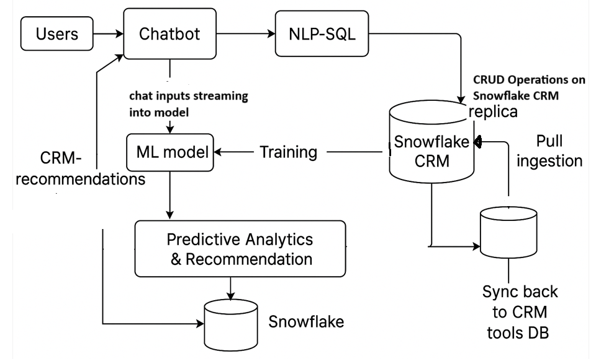
HLD

