Slide 1
🧬 MediNova
Multimodal AI for Rare Disorder Diagnosis
Ankur Ghosh
2nd Year, B. Tech, Chemical Engineering
IIT Kanpur
E-mail: ankurg25@iitk.ac.in, ghoshankur102@gmail.com
Ph:7439735705

Slide 2
The Problem: Diagnostic Odyssey
Rare diseases affect over 300 million people worldwide
The average time to diagnosis is 5-7 years due to fragmented clinical knowledge, complex terminology, and lack of integrated diagnostic tools.
Current AI systems either rely on isolated symptom matching without clinical context or require expensive specialized infrastructure.

Slide 3
Time: The Greatest Enemy
Neurodegenerative and metabolic rare diseases have narrow treatment window: A significant save in time can mean all the difference
75% of rare diseases affect children: Delayed diagnosis hits during critical developmental periods can't be recovered later
Every additional year of misdiagnosis adds unnecessary financial burden on the patient’s family

Slide 4
The Solution: RAGnosis
MediNova: A production-ready, hybrid RAG that accelerates diagnosis of rare disorders.
A hybrid retrieval system that gives importance to colloquial language just as a patient would speak besides clinical terminology
Besides text, also supports image analysis for more precise diagnosis
Contextually aware response

Slide 5
Who MediNova Targets
MediNova is designed as a clinical decision support tool primarily for clinicians and medical researchers, including: geneticists, radiologists, paediatricians, and rare disease specialists
Patients are the ultimate beneficiaries as MediNova strives to bridge the gap between symptoms and diagnosis
Healthcare institutions benefit from reduced diagnostic costs and improved patient outcomes

Slide 6
MediNova: The Pipeline
Symptoms
Image
Medical Context
RAG Engine
Top 5 Conditions

Slide 7
The Hybrid Retrieval
Semantic Understanding + Exact Keyword Matching
The same clinical concept can be expressed in dozens of different ways: Without semantic understanding, systems miss the link
Semantic understanding empowers colloquial terms alongside clinical terminology.
Keyword matching is necessary for looking for HPO codes that ultimately map the condition.
Moreover, certain terms are rare and may not be well embedded. Sparse search finds them immediately.

Slide 8
Image Analysis
Diagnostic reports such as X-rays, MRI, CT scans, etc. are analysed using the Gemini 2.5 Flash toolkit which generates the relevant symptom queries. The multi-modal support improves RAG accuracy.
Medical Report
Visual Abnormality
Relevant symptoms
The RAG then uses these queries to enhance the retrieval quality.

Slide 9
Why Gemini Vision
Gemini 2.5 Flash performs exceptionally well on well-defined, high-contrast structures in modalities.
Dice scores of 0.824 for optic disc segmentation, 0.766 for colorectal polyps, and 0.761 for skin lesions.
However, its performance degraded sharply on low-contrast radiological tasks, with scores dropping to 0.071 for liver mass segmentation on CT and 0.035 for pneumothorax detection on chest X-rays
While Gemini 2.5 Flash is effective for well-defined, high-contrast medical imaging tasks and text processing, it requires careful application and human oversight

Slide 10
The Challenge: Disorders with Similar Symptoms
The greatest challenge was to distinguish between disorders having similar symptoms
To do this, we created a multi-layered retrieval system which annotates each disease with 20+ distinguishing features:
Biochemical markers, typical age of onset, progression rate, gender dominance, inheritance patterns, associated complications and pathognomonic sign
Hence, we built a contextual awareness layer that rewards conditions with similar patterns while penalizes those that differ

Slide 11
The Solution: Context Matters
The RAG studies the patient across relevant parameters such as age of onset, sex, inheritance pattern and distinguishing biochemical markers
Hybrid search helps identify symptoms unique to a particular condition
This prevents the RAG from distinguishing conditions having similar symptoms
Eg: Kayser-Fleischer rings for Wilson disease, pseudohypertrophy for Duchenne MD, salty sweat for cystic fibrosis

Slide 12
Architecture: A Brief Overview
Model | Source | Purpose
MedCPT-Query-Encoder | Hugging Face | Dense embeddings
BM-25 | Rank BM-25 library | Sparse embeddings
Cross Encoder | Sentence transformer | Re-ranking retrieved results
Gemini 2.5 Flash | Google AI | Medical Image Analysis
HPO OBO Ontology | Human Phenotype Ontology | HPO ID to symptom expansion (20,000+ terms)
Orphanet Disease Database | Orphanet | 10,000+ rare diseases with clinical annotations

Slide 13
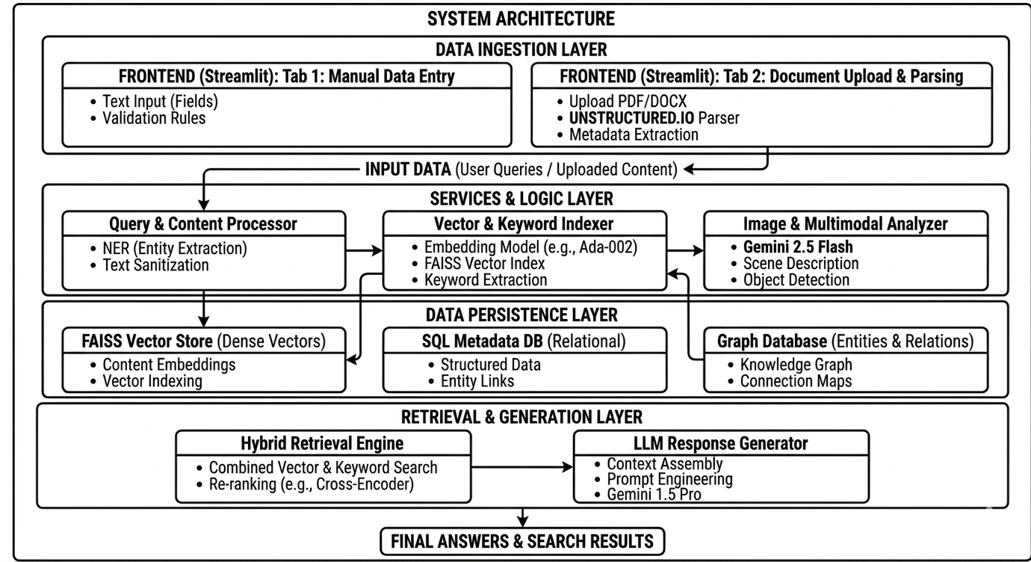
Complete Pipeline in Action

Slide 14
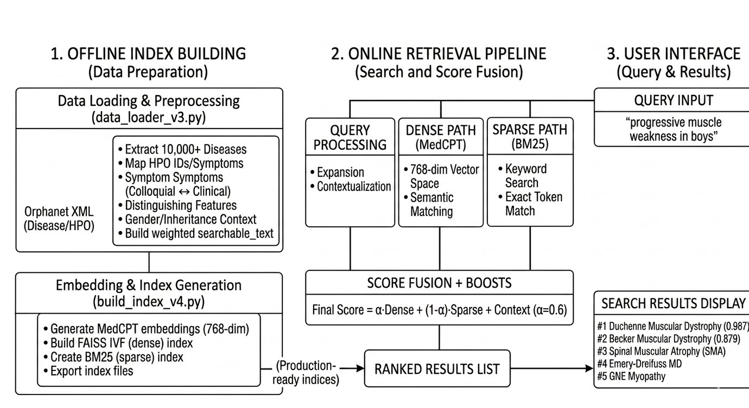
Query Processing Pipeline

Slide 15
MediNova: Unique Features
Hybrid Retrieval: Balances colloquial terms with scientific terminology
Contextual Awareness: Gender, Age, Onset, Family history
Multi-modal: Text + Images
Production Performance: 73.6% accuracy for natural language queries and 91.7% for HPO ids
Latency < 400ms

Slide 16
Retrieval Performance Breakdown
Category | Hit Rate | MRR | Count
Classic Symptoms | 94.4% | 0.9444 | 18
Biochemical Markers | 87.5% | 0.8750 | 16
Name Aliases | 62.5% | 0.5885 | 32
Gender Specific | 68.8% | 0.6875 | 16
Vague Single Symptom | 53.3% | 0.5333 | 15
Inheritance Terms | 100% | 0.8667 | 5
Onset Terms | 100% | 0.8333 | 4
Gender Filtering | 50% | 0.5000 | 4

Slide 17
Evaluation Report: Natural Language Queries
Metric | Value | Note
Hit Rate (k=5) | 73.6% | Expected disease found in top 5
Mean Reciprocal Rank (MRR) | 0.7136 | Average rank of correct result
NDCG | 0.7194 | Ranked relevance score
Average Query Time | 0.39s | Per Query
Throughput | 4.5 queries/sec | Benchmark Performance

Slide 18
HPO ID Evaluation
Category | Hit Rate | MRR | Count
HPO Only | 100% | 1.0000 | 8
HPO + Symptoms | 100% | 1.0000 | 4
HPO Classic | 100% | 1.0000 | 4
HPO Biochemical | 75% | 0.7500 | 4
HPO Rare | 100% | 1.0000 | 4
Overall | 91.7% | 0.9167 | 30

Slide 19
Observation: What Worked Well
The classic symptom queries achieved 94.4% accuracy because the RAG engine successfully differentiated between similar diseases
Vague symptom queries dropped to 53.3% because the lack of contextual signals made differentiation difficult.
OBO successfully maps the HPO ids to searchable text, hence 91.7% accuracy

Slide 20
Observation: What Needs Improvement
Vague symptoms have an accuracy of only 53.3% as lack of contextual input makes differentiation difficult
Gender Filtering was achieved successfully only for 50% cases due to complex gender-inheritance pattern
Name Aliases could be detected only for 62.5% cases as a condition might have multiple names

Slide 21
Scope for Improvement
Vague symptoms: Follow up questions could be added for ambiguous queries
Gender filtering: Enhanced gender-inheritance rules
Name alias: Build a comprehensive alias database, even expand to multiple Indian languages for regional names

Slide 22
References
Do J, et al. "Evaluating Conversational Image Segmentation for Medicine." medRxiv 2025. https://www.medrxiv.org/content/10.1101/2025.11.21.25340008v1
Nakaura T, et al. "Performance of State-of-the-Art Multimodal Large Language Models on an Image-Rich Radiology Board Examination." Academic Radiology 2026. https://www.sciencedirect.com/science/article/pii/S1076633225010372
Truong T, et al. "Towards Selection of Large Multimodal Models as Engines for Burned-in Protected Health Information Detection." arXiv 2025. https://ar5iv.labs.arxiv.org/html/2511.02014
"Large language models for structuring knee ultrasound reports." PubMed 2026. https://pubmed.ncbi.nlm.nih.gov/41772565/
"Evaluation of LLM Performance on Japanese National Examination for Radiological Technologists." J-Stage 2026. https://www.jstage.jst.go.jp/article/jjrt/82/5/82_26-1639/_html/-char/en

Slide 23
Thank you

