Slide 1

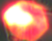
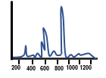
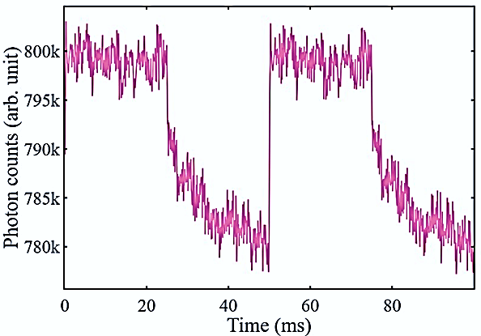
OK
Modulator
START
END
200
1000
400
1200
600
800
DM 2
A
B
C
D
PBS 2
QPD

Slide 2

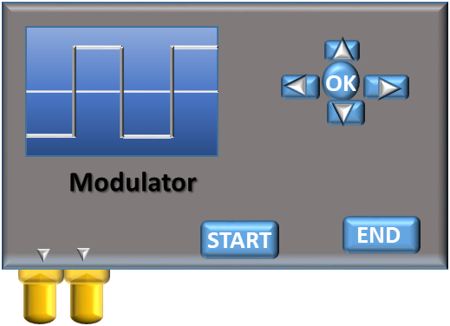
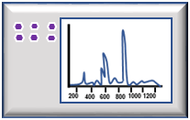
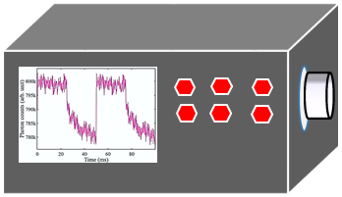
LED
Laser Blocker
DM2
Condenser
(10X, 0.25NA)
Sample Stage
Glass Slide
Cover Slip
NaBiF₄:Yb:Er
particle
Function Generator
Spectrometer
Objective
(100X, 1.3NA)
PBS
HWP 1
DM1
Laser 1
(1064 nm)
90:10 BS
HWP 2
660 nm Filter
Flip Mirror
Laser 2
(975 nm)
Avalanche Photo Diode
CMOS
Camera

Slide 3
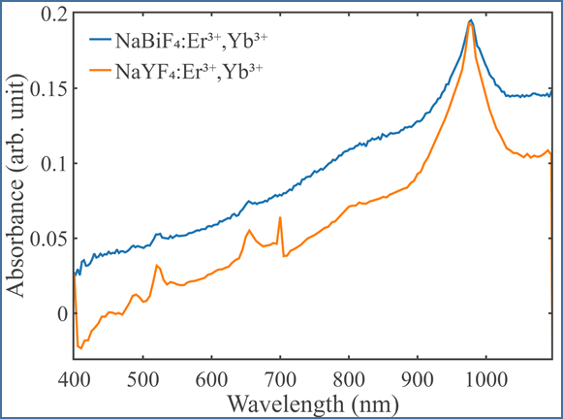
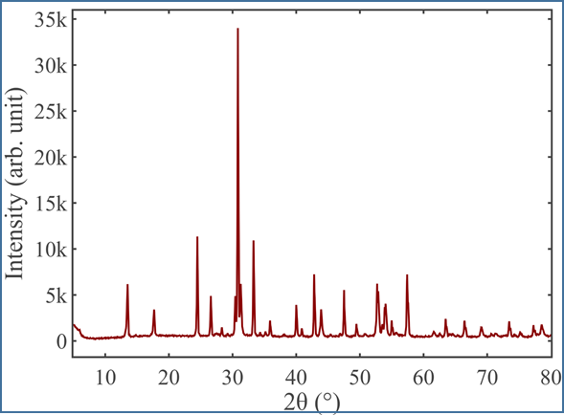
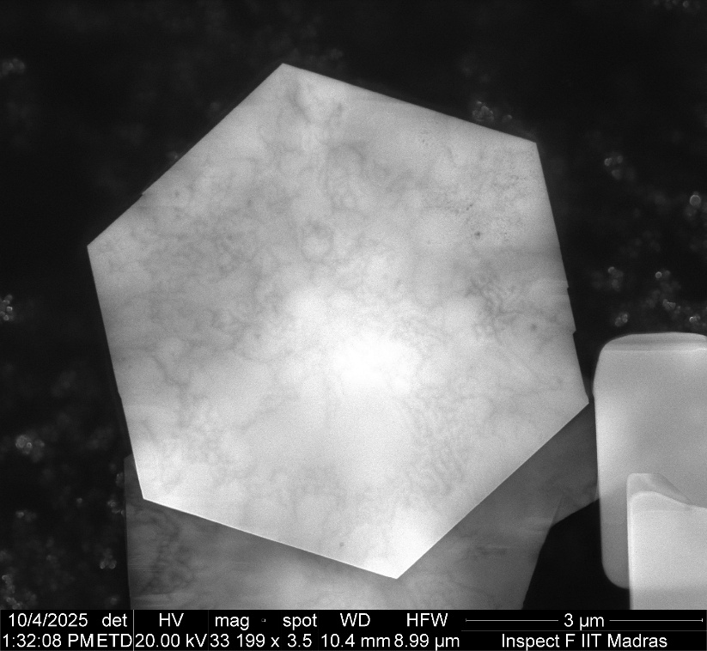
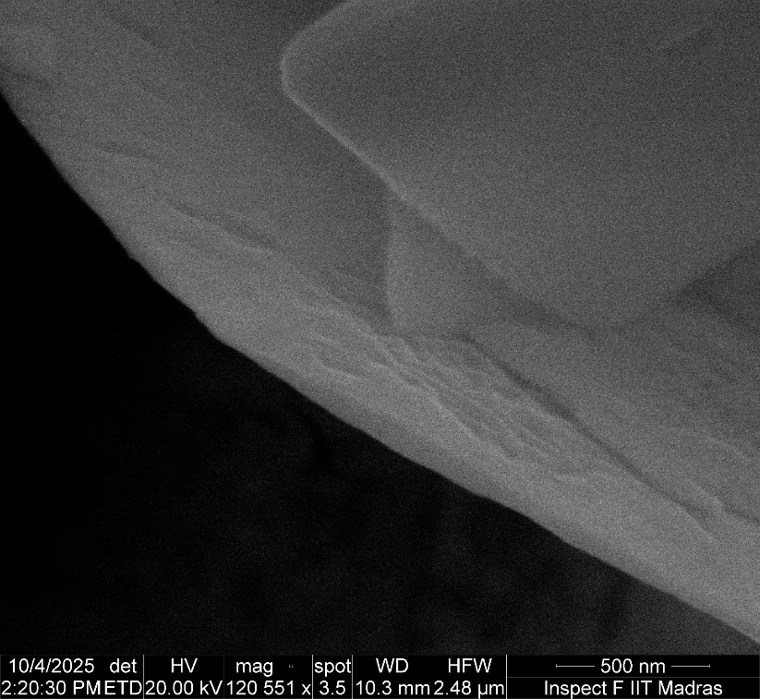
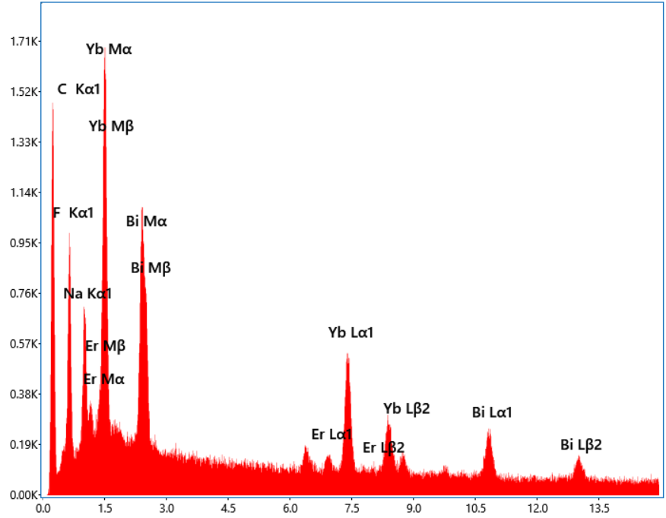
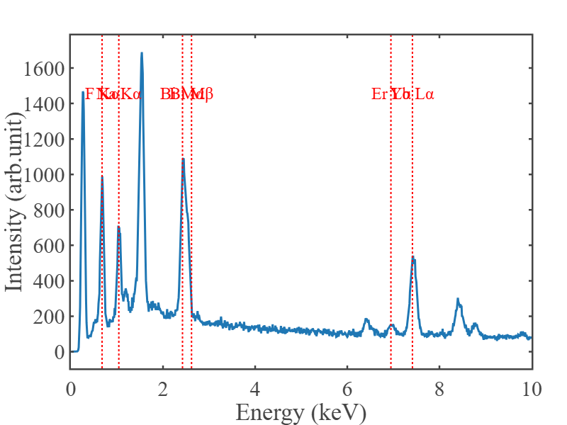
Raman Plot

Slide 4


(a)
(b)
94.98 nm
3 µm
500 nm

Slide 5
Raman Plot

Slide 6
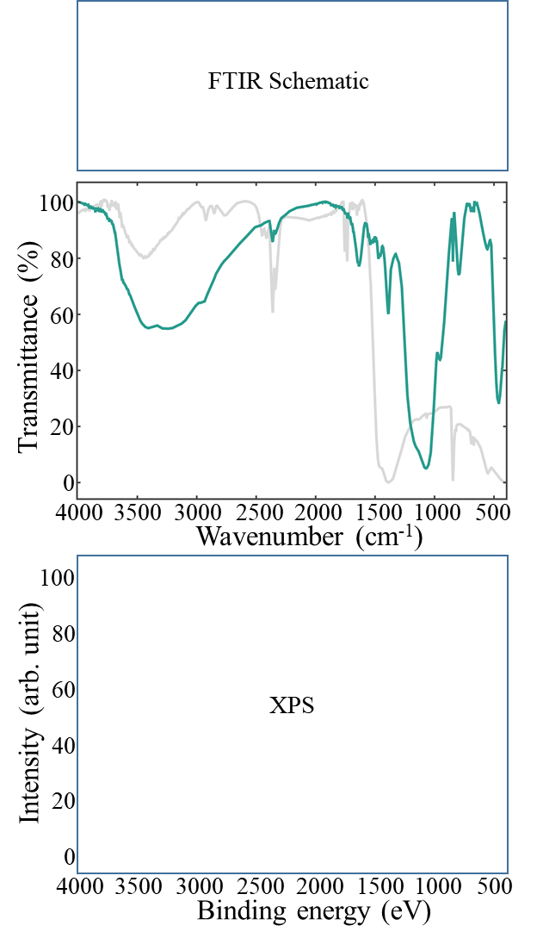
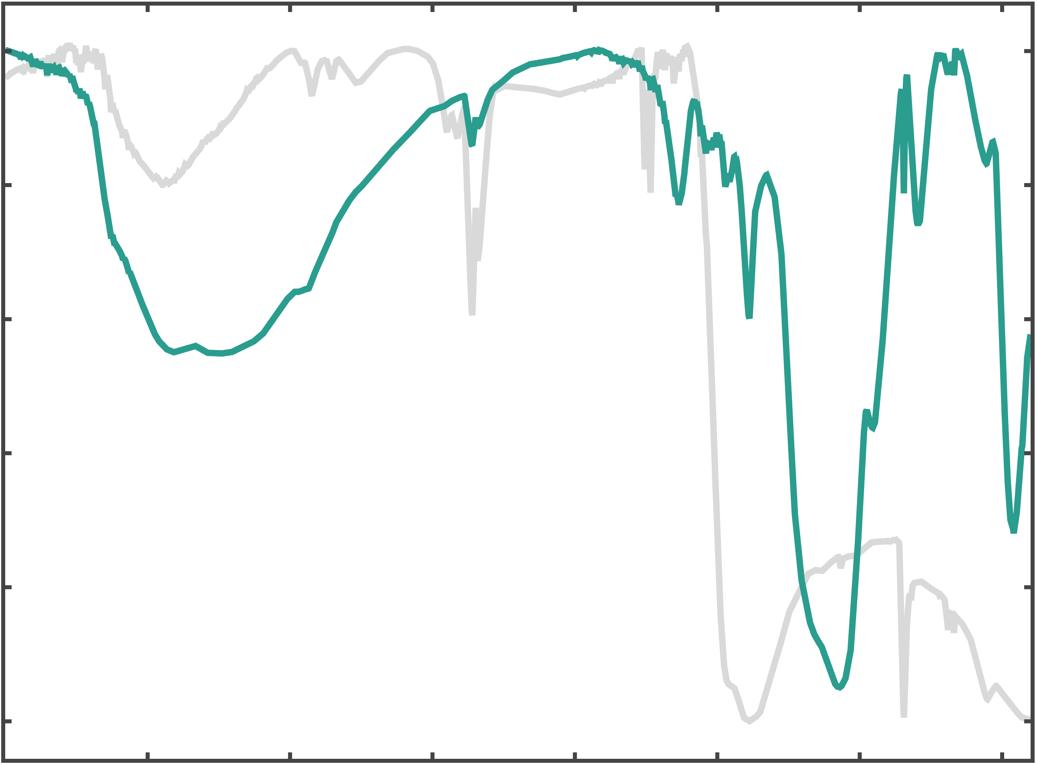
FTIR Schematic
100
80
60
Transmittance (%)
40
20
0
4000
3500
3000
2500
2000
1500
1000
500
Wavenumber (cm⁻¹)
100
80
60
Intensity (arb. unit)
XPS
40
20
0
4000
3500
3000
2500
2000
1500
1000
500
Binding energy (eV)

Slide 7
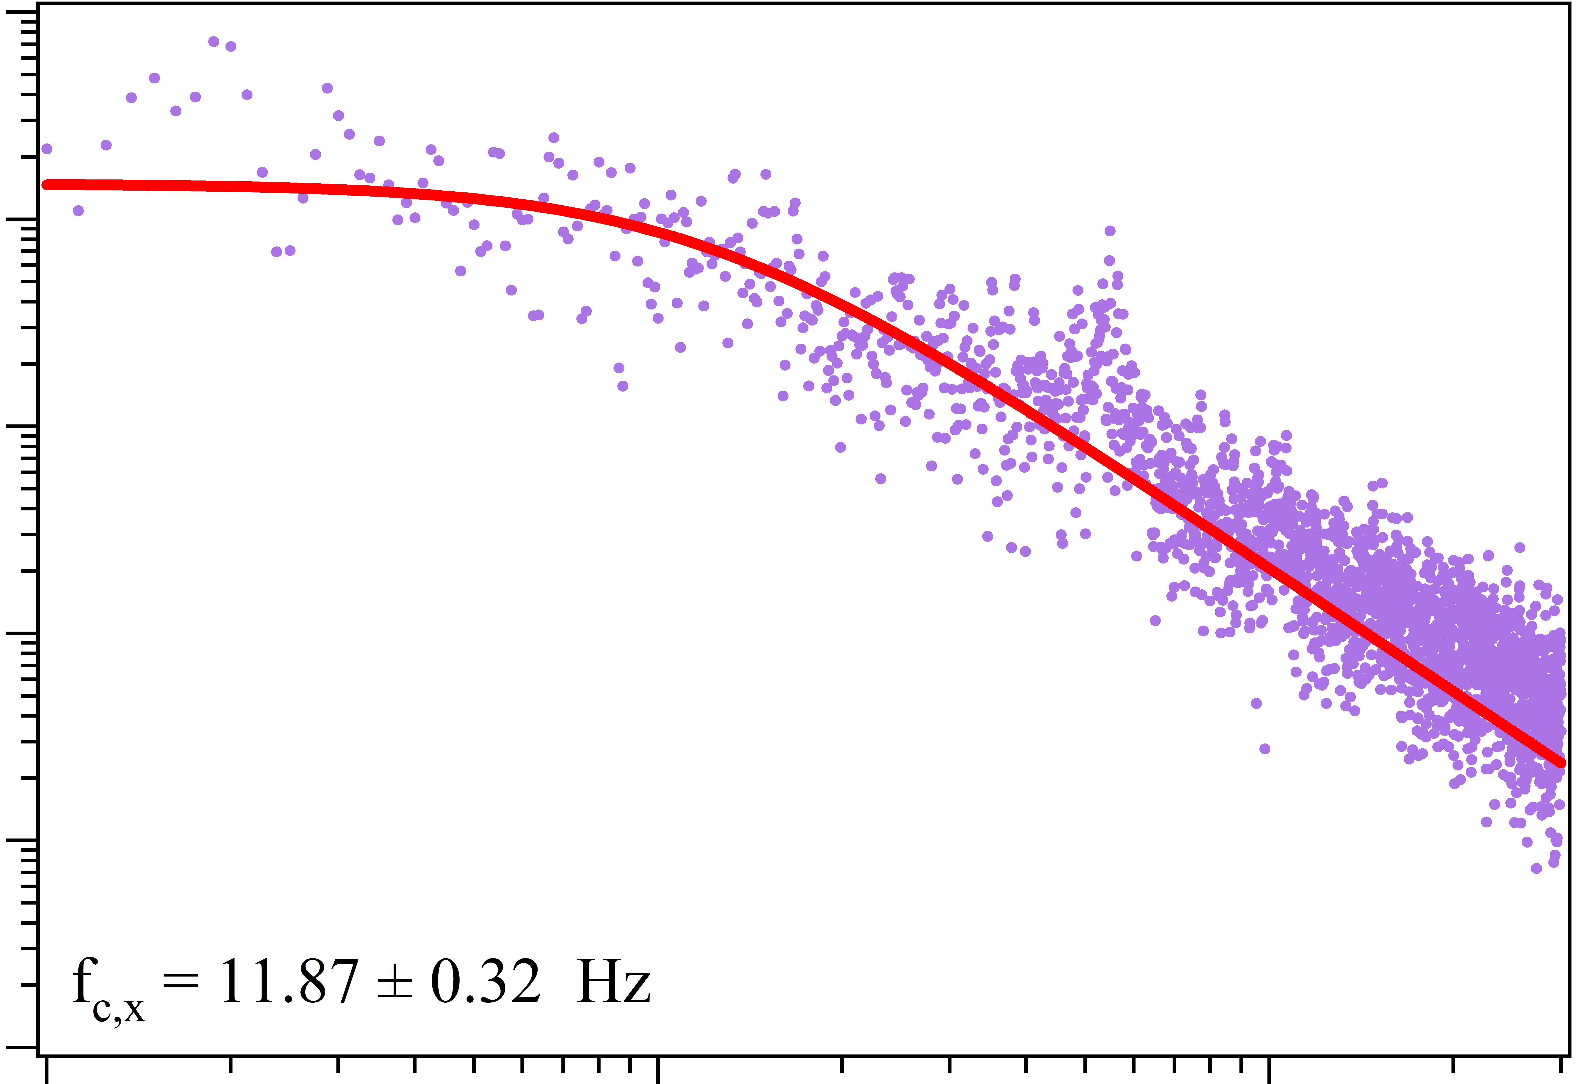
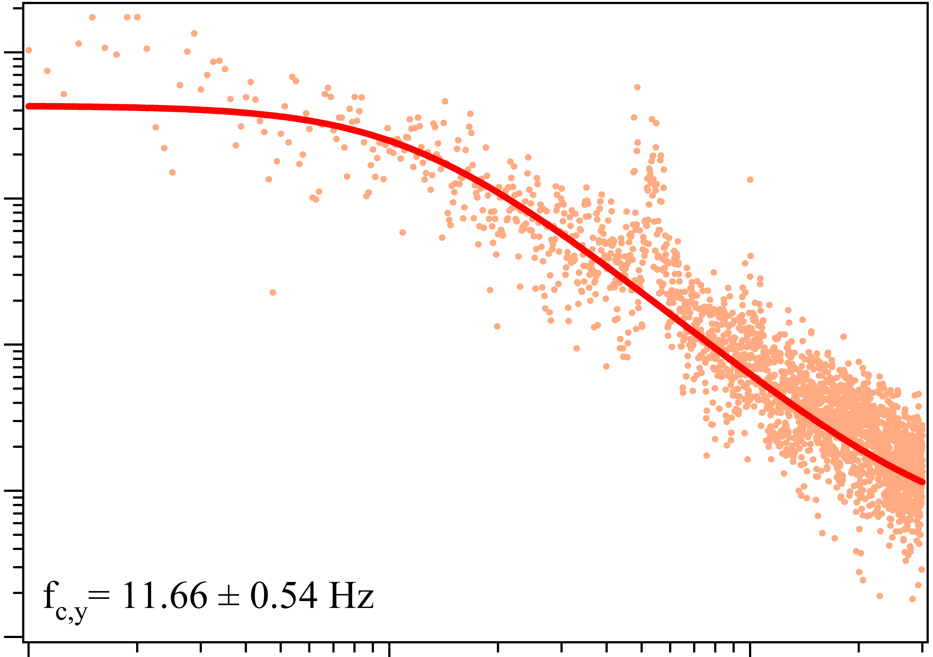
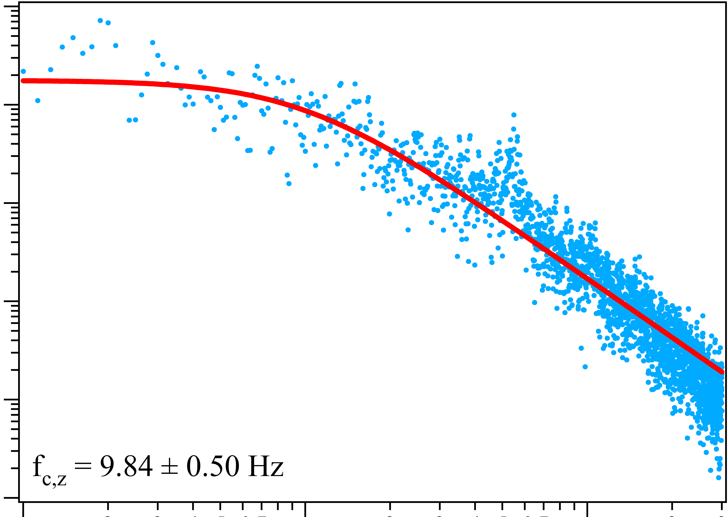
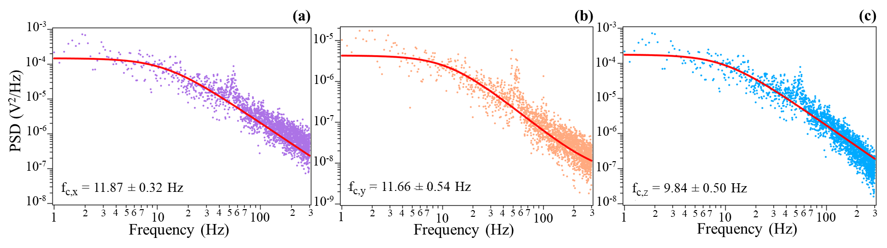
(a)
(b)
(c)
10⁻³
10⁻³
10⁻⁵
10⁻⁴
10⁻⁴
10⁻⁶
10⁻⁵
10⁻⁵
PSD (V²/Hz)
10⁻⁶
10⁻⁷
10⁻⁶
10⁻⁷
10⁻⁸
10⁻⁷
f_{c,x} = 11.87 ± 0.32 Hz
f_{c,y} = 11.66 ± 0.54 Hz
f_{c,z} = 9.84 ± 0.50 Hz
10⁻⁸
10⁻⁹
10⁻⁸
6
3
4
5
7
6
7
4
5
6
7
2
3
3
4
6
3
4
2
3
2
3
2
5
7
5
2
6
3
3
4
6
3
4
7
1
10
100
1
10
2
100
1
2
5
7
10
2
5
100
2
Frequency (Hz)
Frequency (Hz)
Frequency (Hz)

Slide 8
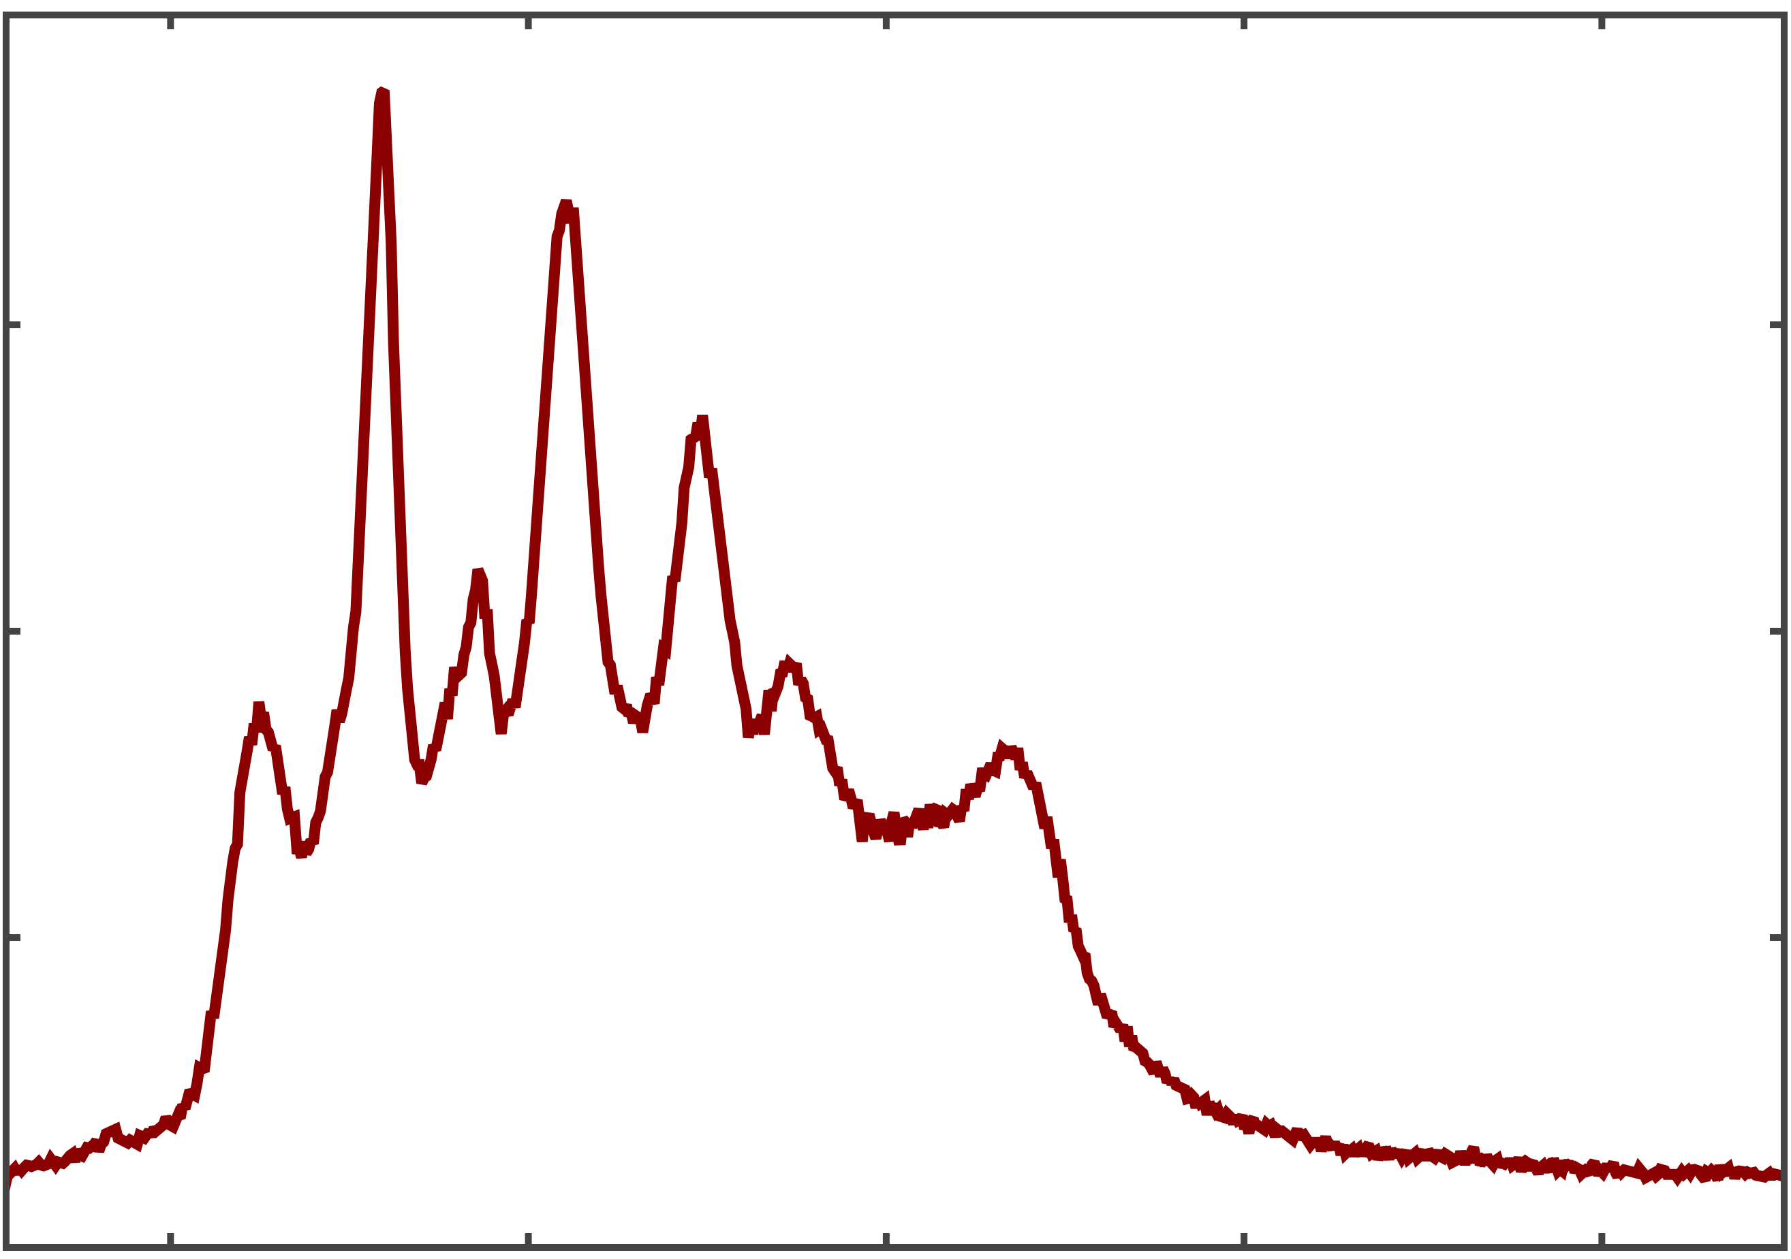
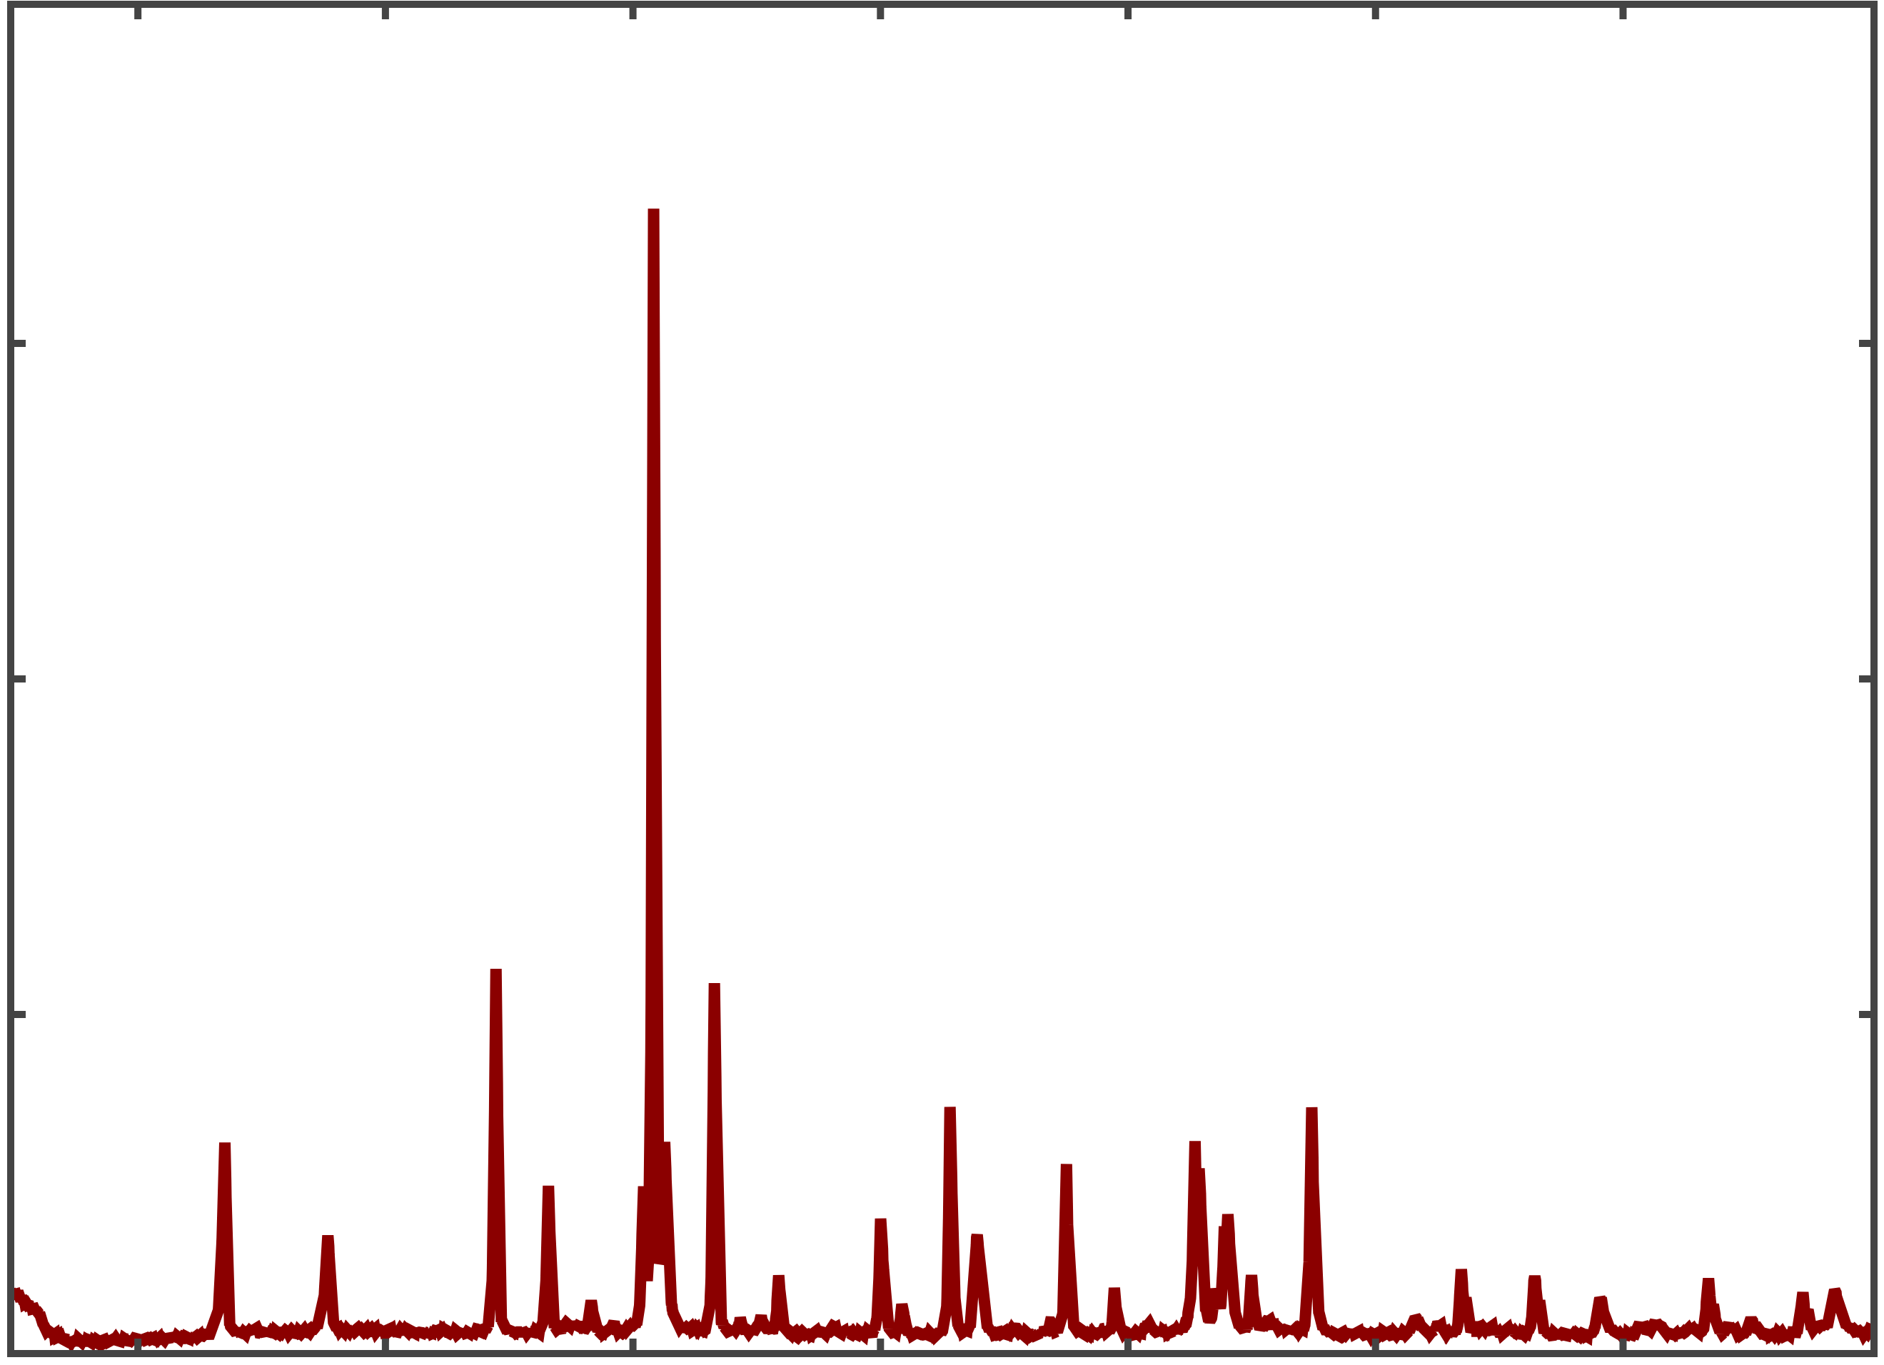
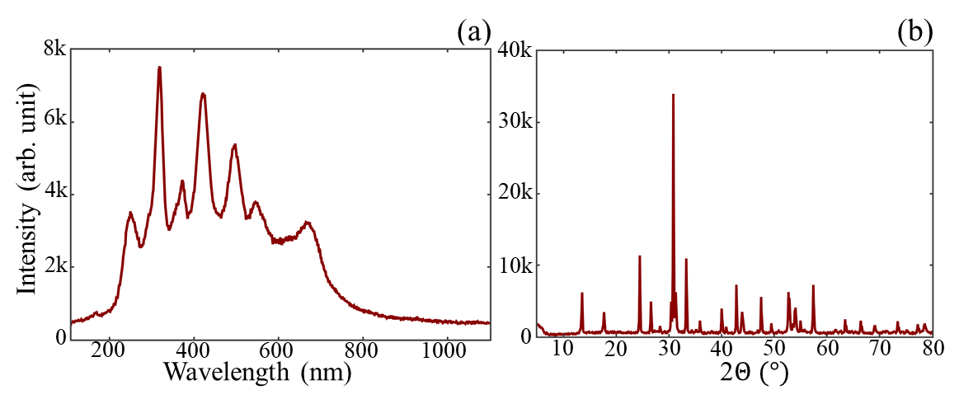

(a)
(b)
8k
40k
6k
30k
Intensity (arb. unit)
4k
20k
2k
10k
0
200
400
600
800
1000
0
10
20
30
40
50
60
70
80
Wavelength (nm)
2$Θ (°)$
Intensity (arb. unit)
Wavelength (nm)

Slide 9
30
⁴G_{11/2}
⁴H_{9/2}
25
⁴F_{3/2}
⁴F_{7/2}
20
ET
²H_{11/2}
⁴S_{3/2}
ESA
Energy (x 10³ cm⁻¹)
CR
⁴F_{9/2}
15
⁴I_{9/2}
10
²F_{5/2}
⁴I_{11/2}
NR
975 nm
⁴I_{13/2}
5
GSA
560 nm
660 nm
412 nm
²F_{7/2}
⁴I_{15/2}
0
Yb³⁺
Er³⁺

Slide 10
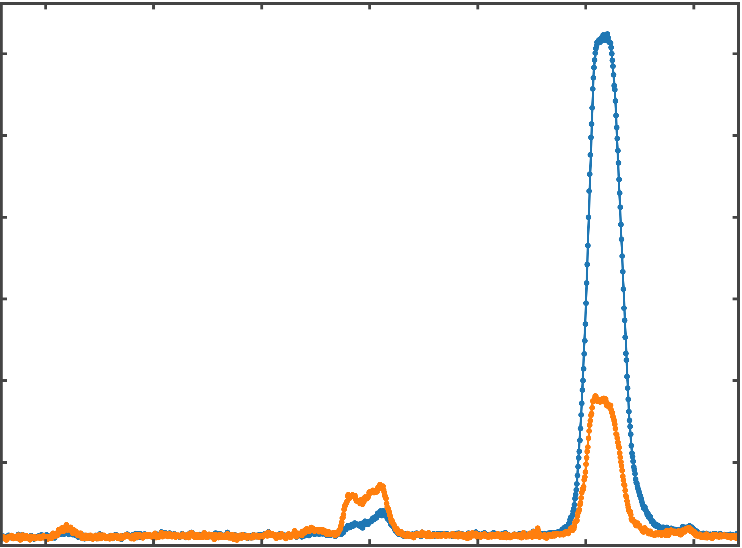
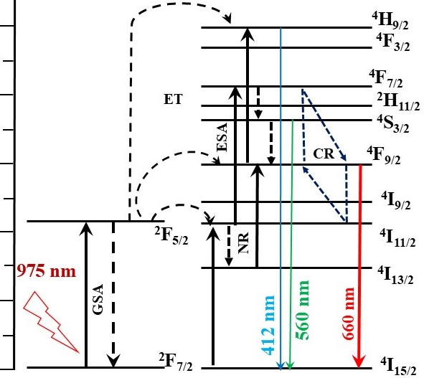
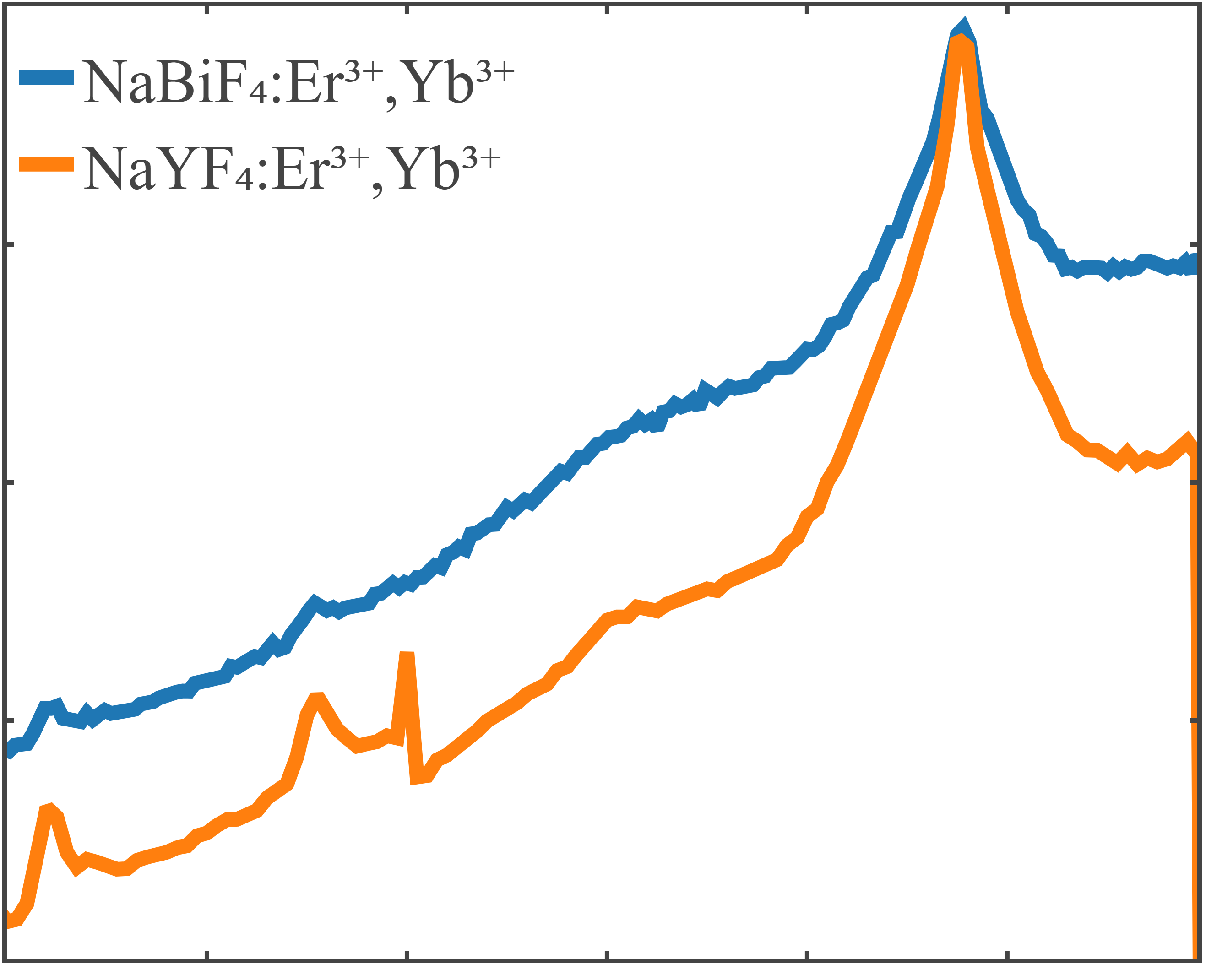

(a)
(b)
30k
NaBiF₄: Er³⁺, Yb³⁺
25
NaYF₄: Er³⁺, Yb³⁺
25k
0.2
20
20k
0.15
Intensity (arb. unit)
15
Absorbance (arb. unit)
Energy (x 10³ cm⁻¹)
15k
0.1
10k
0.05
10
0
600
900
1000
5k
500
700
800
5
Wavelength (nm)
400
450
500
550
600
650
700
0
Wavelength (nm)
Yb³⁺
Er³⁺
(a)
NaBiF₄: Er³⁺, Yb³⁺
NaYF₄: Er³⁺, Yb³⁺
$\frac{I_{Bi}^{norm}}{I_{Y}^{norm}}$= 3.803 ± 0.005

Slide 11
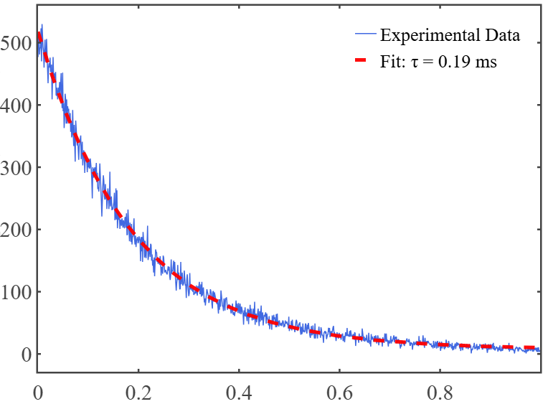
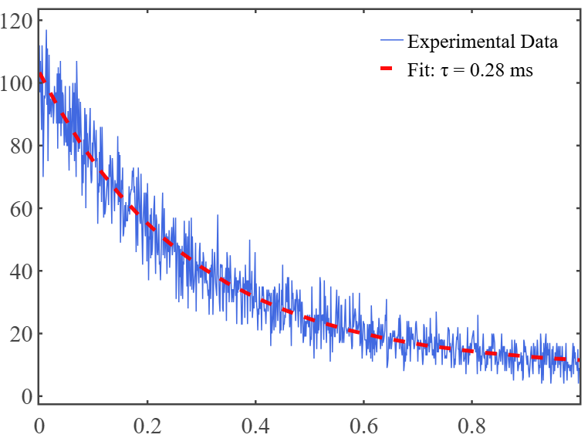
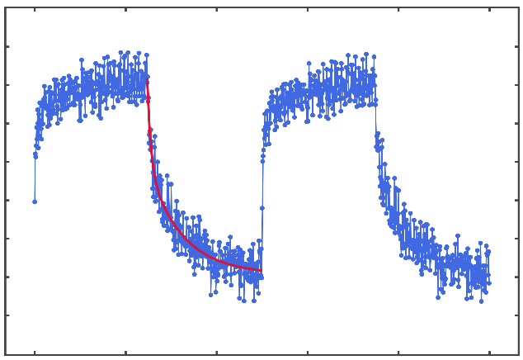




(a)
(c)
500
Experimental data
Fitted curve
ON
400
$τ_{975}$ = 0.19 ± 0.001 ms
OFF
975 nm laser pulse
300
Photon Counts (arb. unit)
ON
200
t = 25 ms
OFF
100
1064 nm laser pulse
0
(b)
0
0.2
0.4
0.6
0.8
1.0
(d)
120
Experimental data
Experimental data
Fitted curve
Fitted curve
506k
100
504k
80
$τ_{1064}$ = 0.28 ± 0.01 ms
502k
500k
Photon Counts (arb. unit)
Photon Counts (arb. unit)
60
498k
40
496k
20
494k
492k
$τ_{1}$ = 0.76 ± 0.43 ms
$τ_{2}$ = 7.47 ± 2.81 ms
0
0.2
0
80
100
0
0.4
0.6
0.8
1.0
20
40
60
Time (ms)
Time (ms)

Slide 12
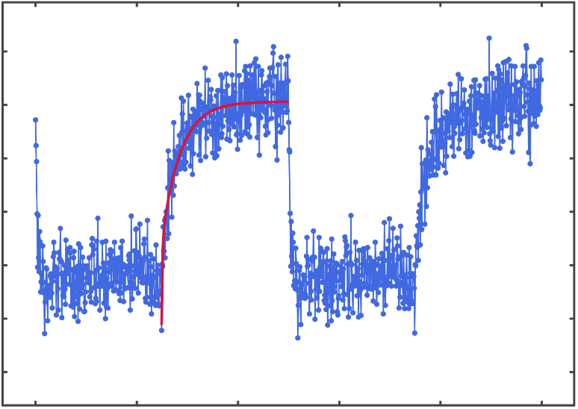




(a)
ON
OFF
975 nm laser pulse
Photon Counts (arb. unit)
ON
t = 25 ms
OFF
1064 nm laser pulse
(b)
(c)
506k
Experimental data
Fitted curve
Experimental data
Fitted curve
21k
504k
20k
502k
19k
500k
498k
18k
496k
17k
494k
16k
492k
$τ_{1}$ = 0.76 ± 0.43 ms
$τ_{2}$ = 7.47 ± 2.81 ms
15k
$τ_{1}$ = 0.15 ± 0.19 ms
$τ_{2}$ = 3.65 ± 0.86 ms
0
20
40
60
80
100
0
20
40
60
80
100
Time (ms)
Time (ms)

Slide 13
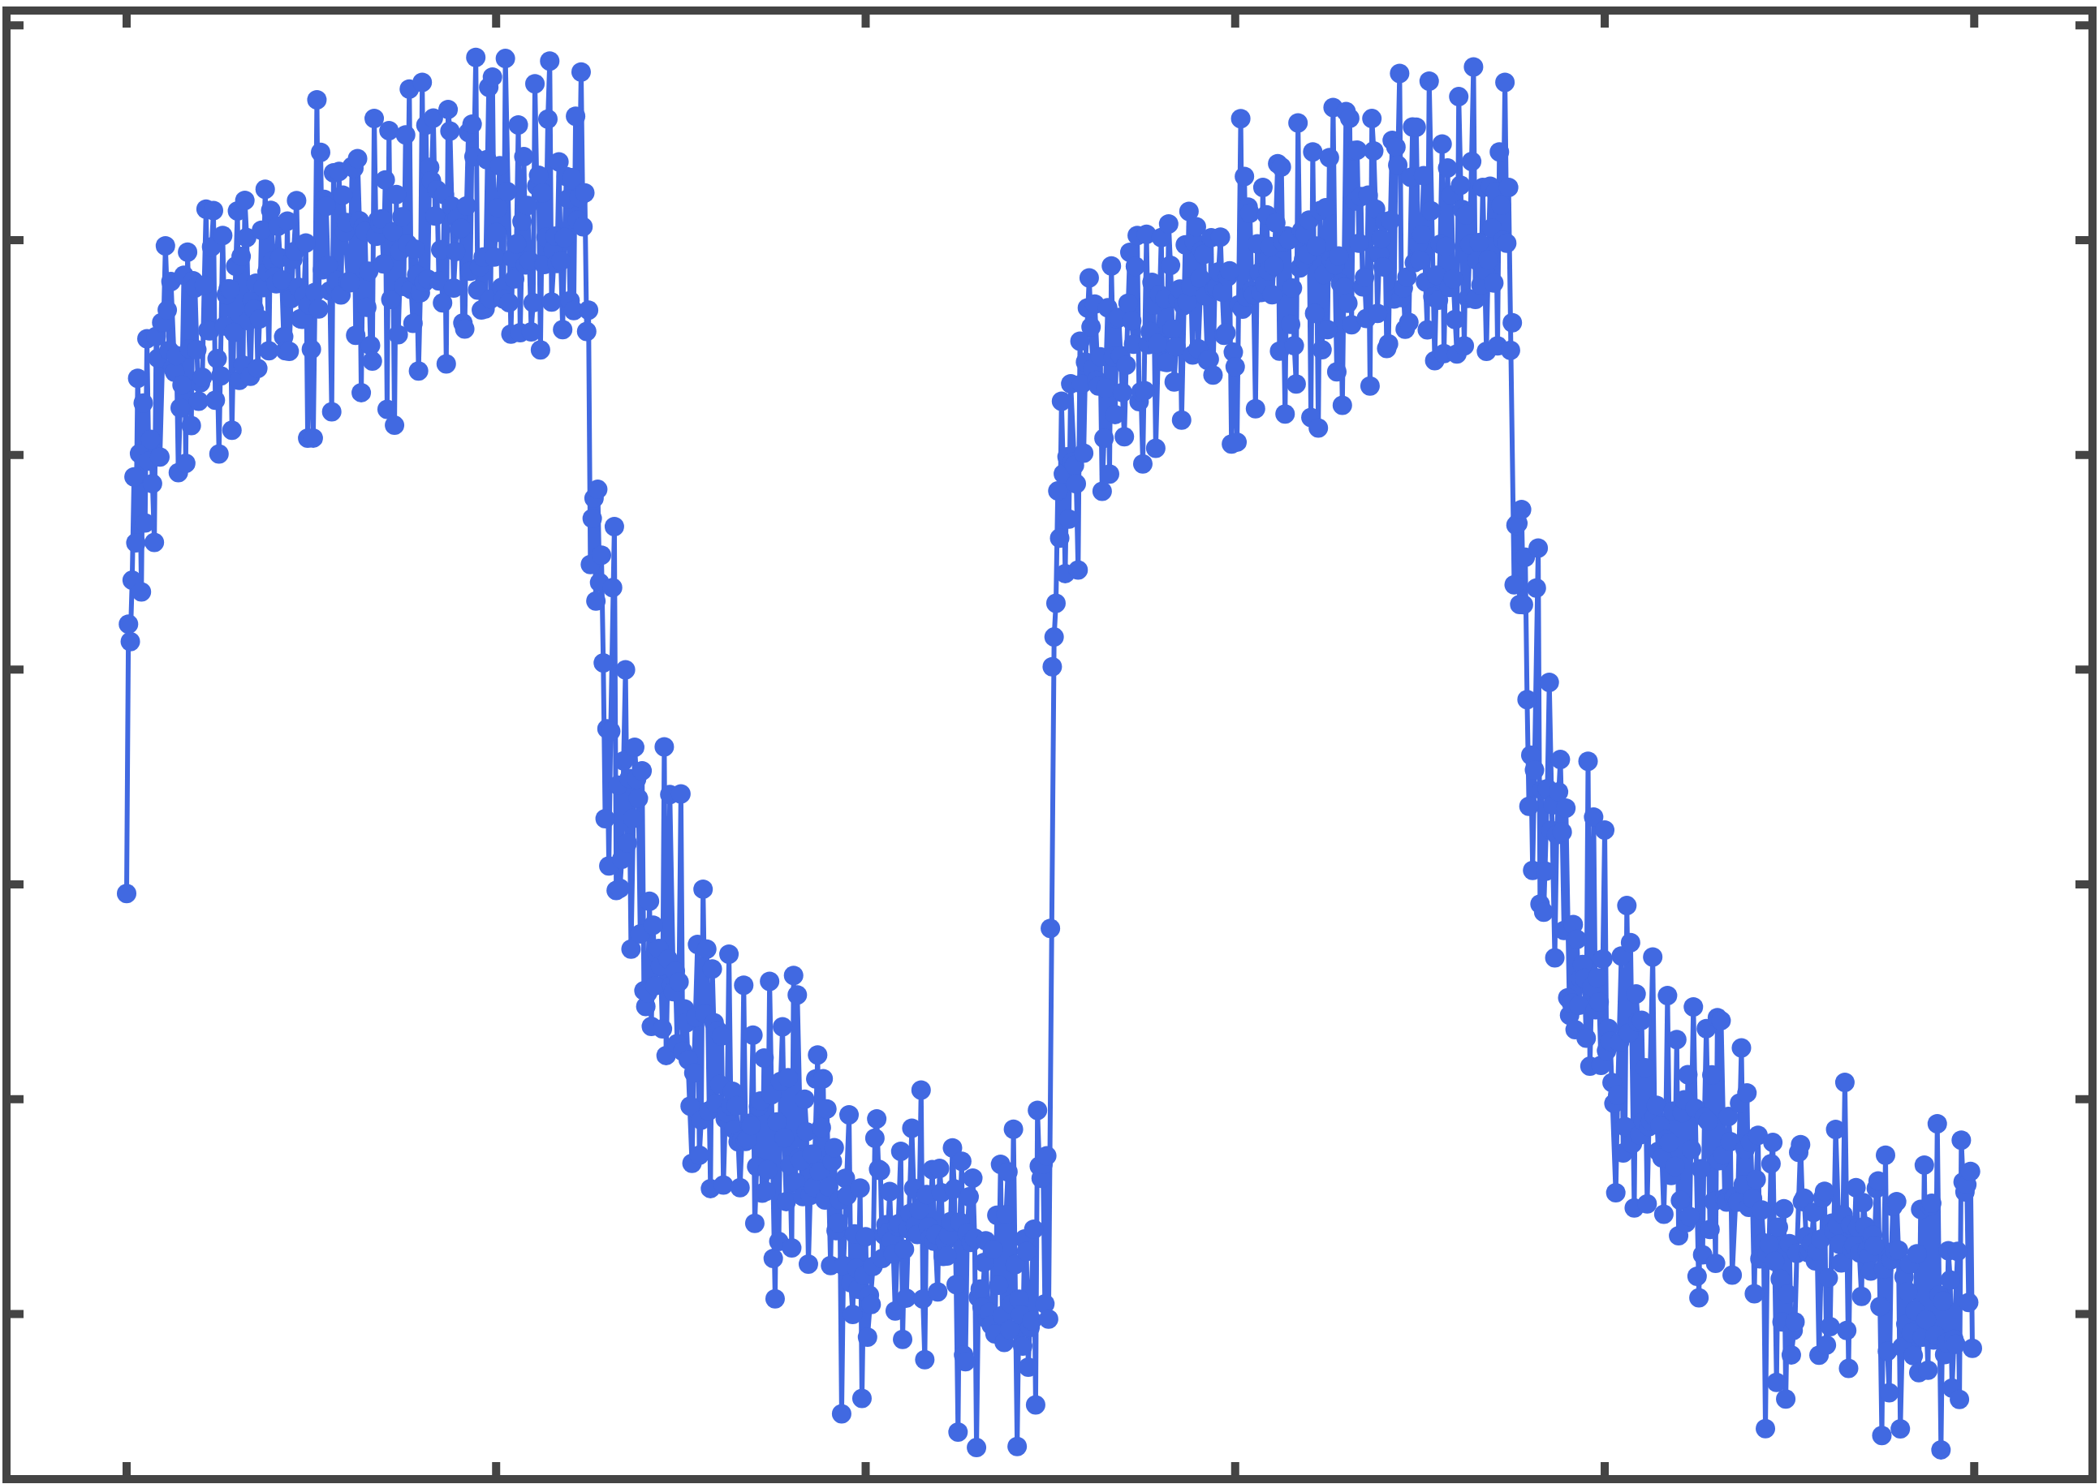
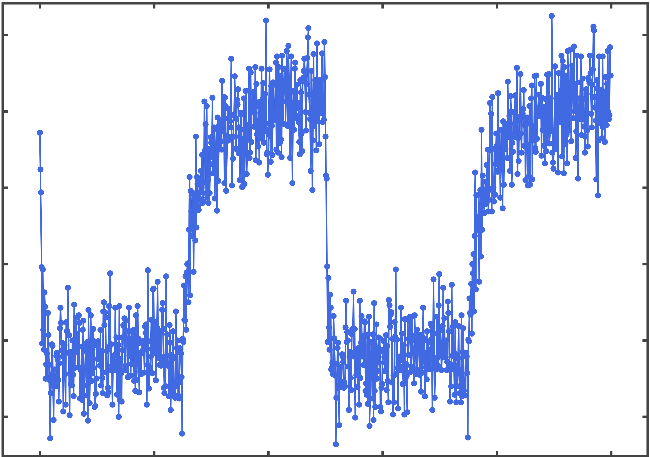
(a)
ON
OFF
975 nm laser pulse
ON
t = 25 ms
OFF
1064 nm laser pulse
( 10³)
(b)
X
506
504
502
Photon Counts (arb. unit)
500
498
496
494
0
20
40
60
80
100
( 10²)
(c)
X
21
20
19
Photon Counts (arb. unit)
18
17
16
0
20
40
60
80
100
Time (ms)

Slide 14








Two-photon process
E₂
$$α_{1}^{′}$$
$$α_{2}^{′}$$
Visible emission
$$β_{2}^{}$$
E₁
$$α_{1}$$
$$γ_{1}^{}$$
$$α_{2}^{}$$
$$γ_{2}^{}$$
$$β_{1}^{}$$
E₀
975 nm
1064 nm

Slide 15
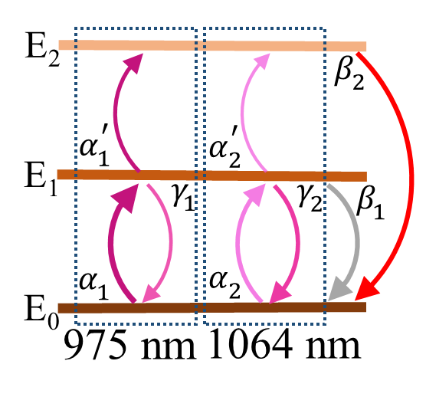
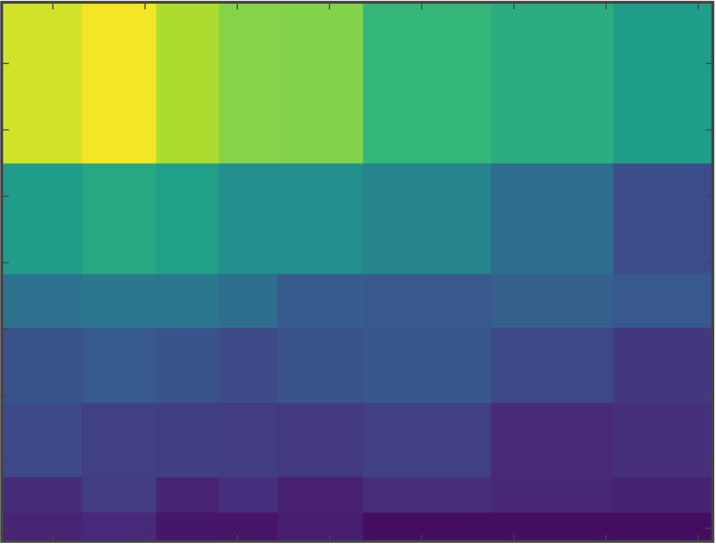
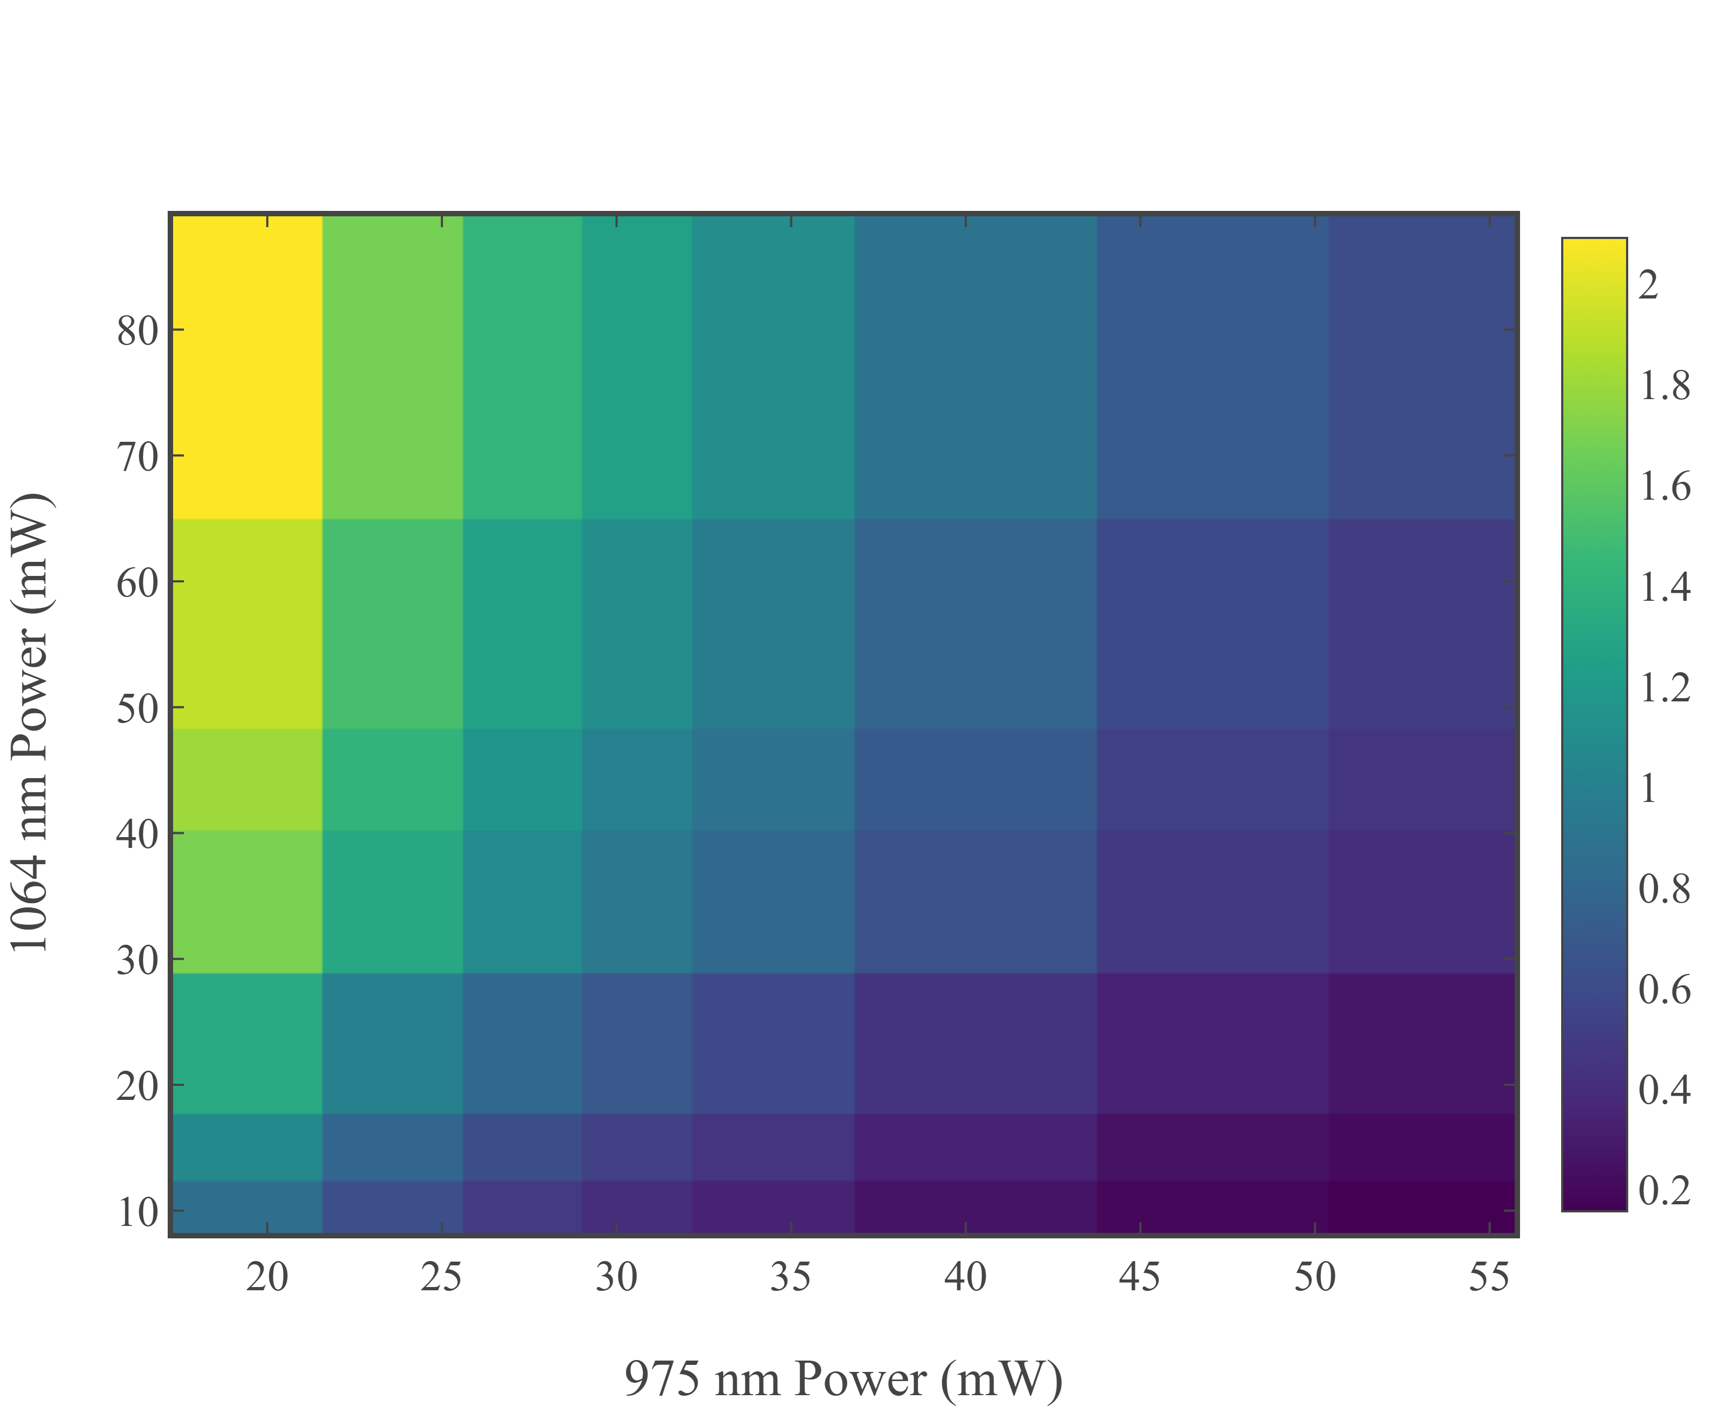
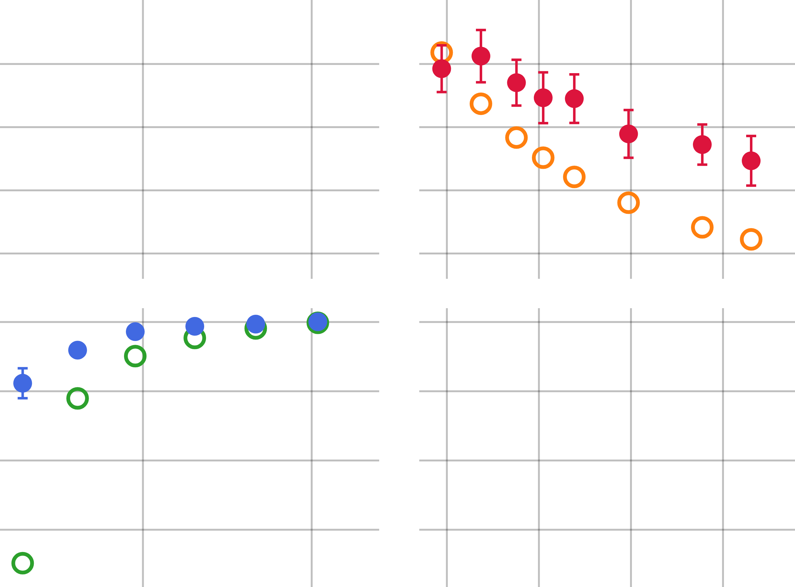
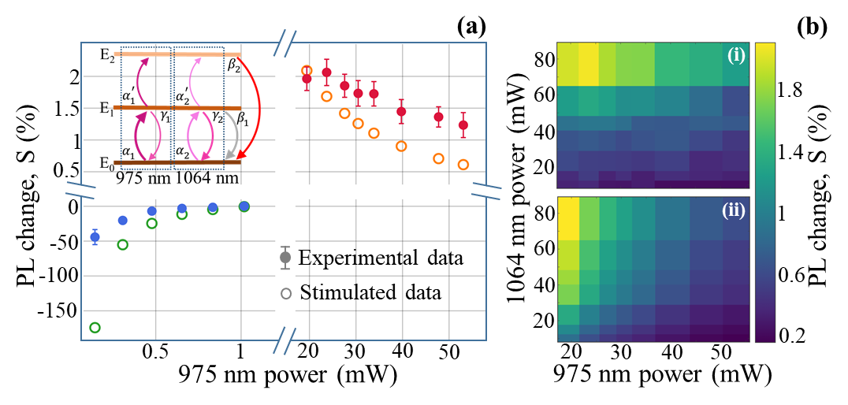









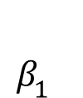



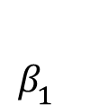


(a)
(b)
80
(i)
E₂
$$β_{2}^{}$$
2
60
1.8
Visible emission
1.5
1
40
$$α_{1}^{′}$$
$$α_{2}^{′}$$
20
1.4
0.5
1064 nm power (mW)
$$γ_{1}^{}$$
$$γ_{2}^{}$$
$$β_{1}^{}$$
PL change, S (%)
PL change, S (%)
E₁
0
80
(ii)
1
-50
Experimental data
60
-100
0.6
$$α_{1}$$
$$α_{2}^{}$$
Stimulated data
40
-150
20
0.5
1
20
30
40
20
50
0.2
E₀
50
30
40
975 nm
1064 nm
975 nm power (mW)
975 nm power (mW)
E₂
$$β_{2}^{}$$
$$α_{1}^{′}$$
$$α_{2}^{′}$$
$$γ_{1}^{}$$
$$γ_{2}^{}$$
$$β_{1}^{}$$
E₁
$$α_{1}$$
$$α_{2}^{}$$
E₀
975 nm
1064 nm

Slide 16
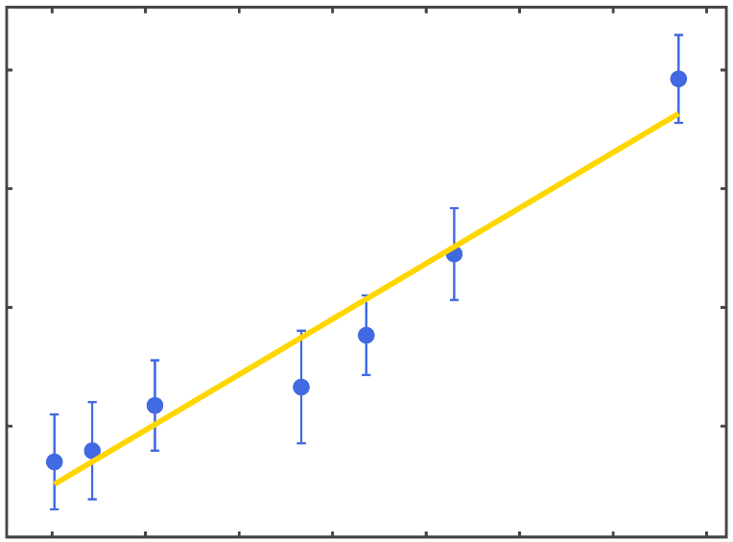
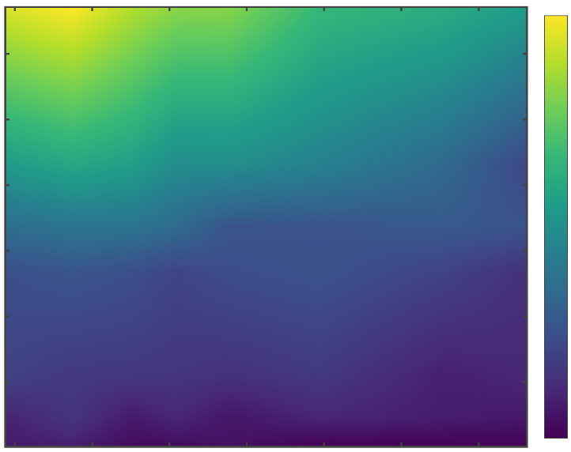
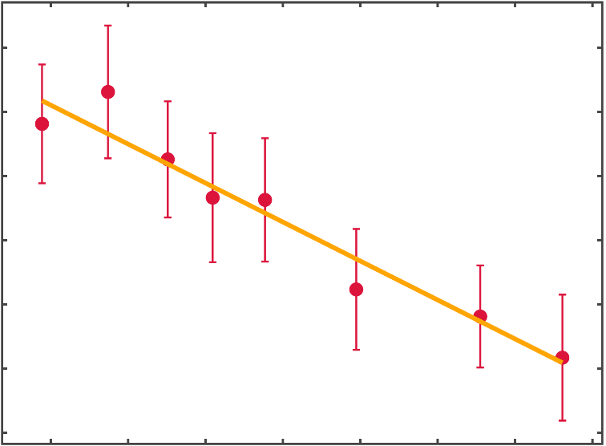
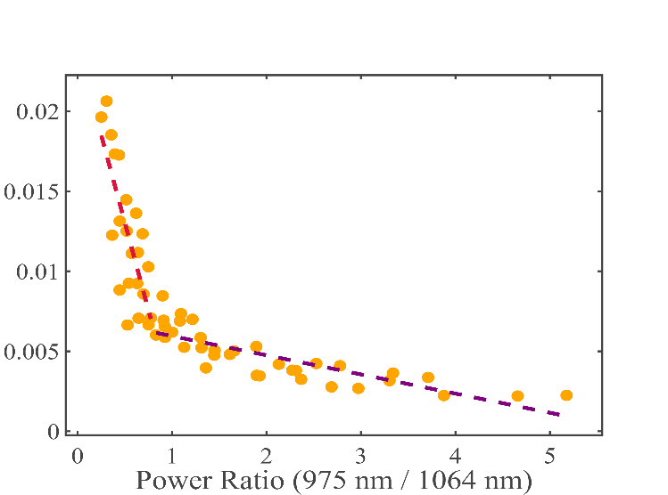


(a)
(c)
70
2
2
60
1.6
1.5
50
PL change, S (%)
PL change, S (%)
1064 nm laser power (mW)
1.2
1
40
30
0.8
0.5
$Δ_{frac}^{abs}$= 0.796
20
0.4
10
20
30
40
50
60
70
80
20
25
30
35
40
45
50
(b)
1064 nm laser power (mW)
(d)
975 nm laser power (mW)
2.2
2
2
Slope₁ = - 0.022
1.5
1.8
PL change, S (%)
PL change, S (%)
1.6
1
1.4
Slope₂ = - 0.012
1.2
0.5
$Δ_{frac}^{abs}$= 0.396
1
20
25
30
35
40
45
50
55
0
1
2
3
4
5
975 nm laser power (mW)
Power₉₇₅ / Power₁₀₆₄

Slide 17

(a)
(b)
(c)
2
2.2
2
2
Slope₁ = - 0.022
1.5
1.5
1.8
PL change, S (%)
1
1.6
1
1.4
Slope₂ = - 0.012
0.5
0.5
$Δ_{frac}^{abs}$= 0.796
1.2
$Δ_{frac}^{abs}$= 0.396
1
0
1
2
3
4
5
10
20
30
40
50
60
70
80
20
25
30
35
40
45
50
55
1064 nm laser power (mW)
975 nm laser power (mW)
Power₉₇₅ / Power₁₀₆₄

Slide 18
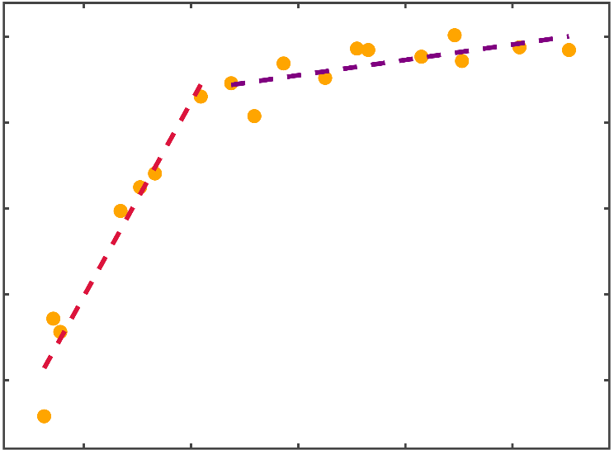


(a)
(b)
Experimental data
Fitted curve
0
2100
2000
-10
Slope₂ = 597.32
1900
-20
Photon Counts (arb. unit)
PL change, S (%)
1800
1700
-30
Slope₁ = 7538.13
1600
$τ_{2}$ = 3.65 ± 0.86 ms
-40
1500
$τ_{1}$ = 0.15 ± 0.19 ms
0
20
40
60
80
100
0.003
0.006
0.009
0.012
0.015
Time (ms)
Power₉₇₅ / Power₁₀₆₄

Slide 19


(a)
(b)
Experimental data
120
Experimental data
500
Fitted curve
Fitted curve
100
400
$τ_{975}$ = 0.19 ± 0.001 ms
$τ_{1064}$ = 0.28 ± 0.01 ms
80
300
Photon Counts (arb. unit)
60
200
40
100
20
0
0
0
0.2
0.4
0.6
0.8
1.0
0
0.2
0.4
0.6
0.8
1.0
Time (ms)
Time (ms)

Slide 20
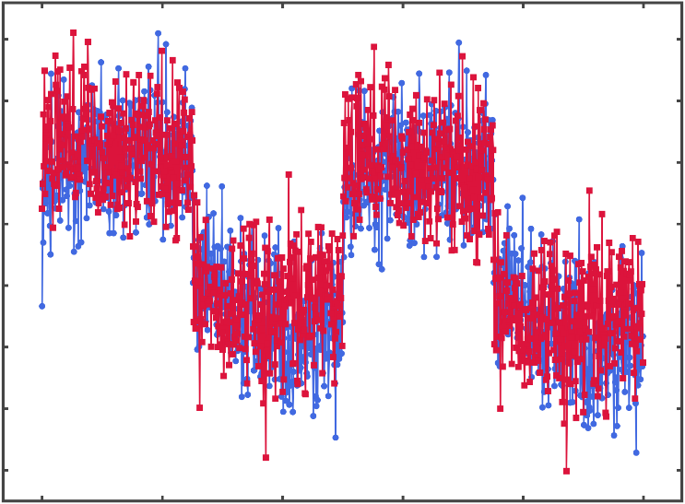
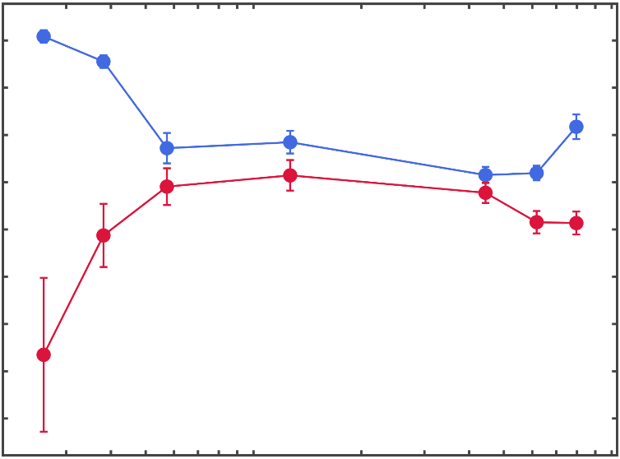
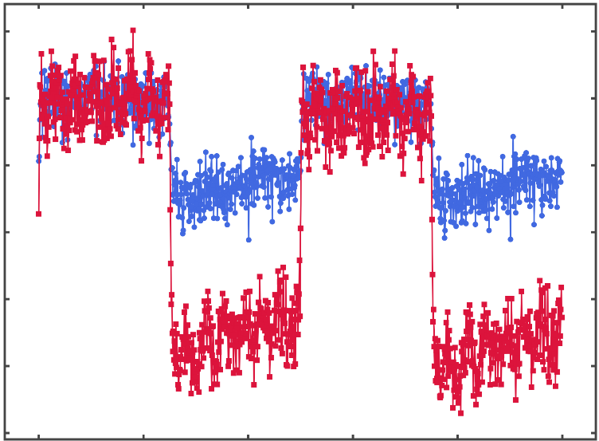
(a)
(b)
504k
Face on
503k
Figurative diagram of face on and side on configuration with its dipoles’ configurations
502k
501k
Photon Counts (arb. unit)
500k
499k
498k
497k
Parallel
Perpendicular
0
20
40
60
80
100
(d)
(c)
Time (ms)
1
Parallel
51k
Side on
0.8
50k
0.6
0.4
49k
S_{symlog}
0.2
Photon Counts (arb. unit)
48k
0
-0.2
47k
-0.4
46k
-0.6
Face on
Side on
45k
Parallel
Perpendicular
3
4
5
6
8
2
3
4
5
6
0
20
40
60
80
100
7
9
9
8
1
7
10
975 nm power (mW)
Time (ms)

Slide 21
(a)
(b)
(c)
1
Parallel
504k
Face on
51k
Side on
0.8
503k
50k
0.6
502k
0.4
49k
501k
S_{symlog}
0.2
Photon Counts (arb. unit)
48k
0
500k
-0.2
499k
47k
-0.4
498k
46k
-0.6
Face on
Side on
497k
Parallel
Perpendicular
Parallel
Perpendicular
3
5
6
2
3
5
6
0
20
40
60
80
100
45k
0
20
40
60
80
100
4
8
4
7
9
9
8
1
7
10
975 nm power (mW)
Time (ms)
Time (ms)

Slide 22
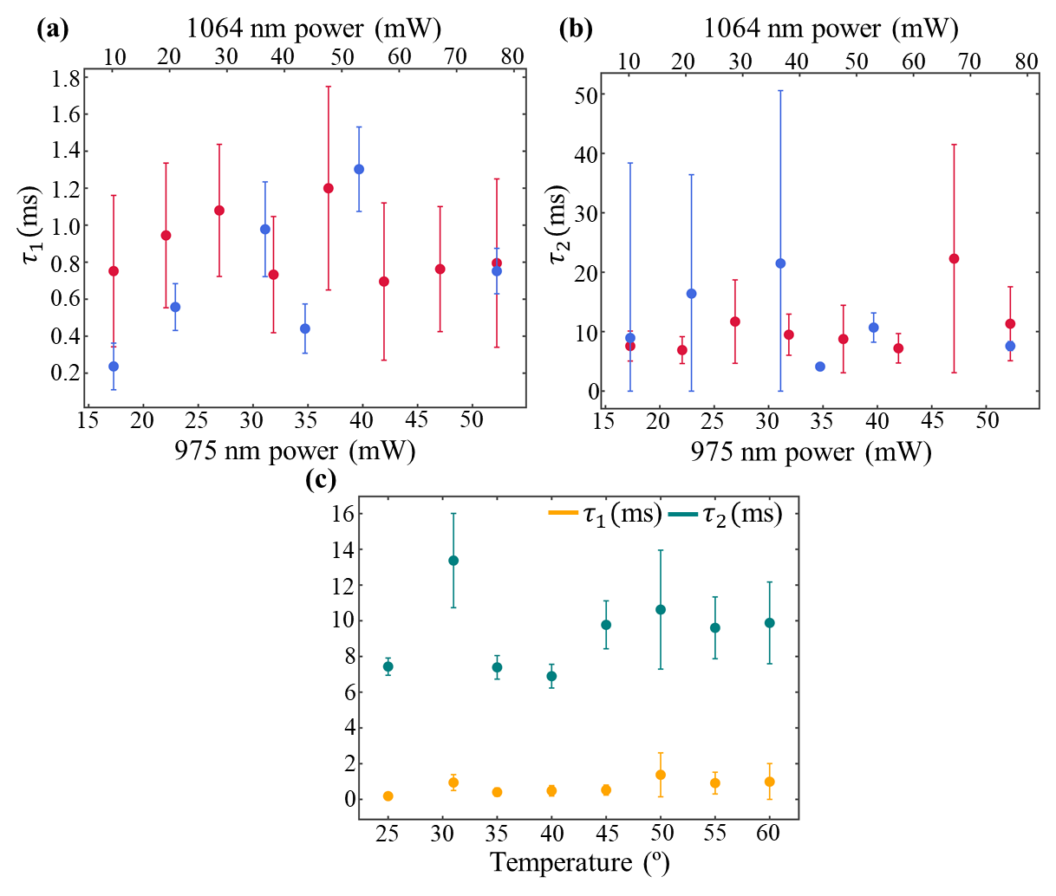
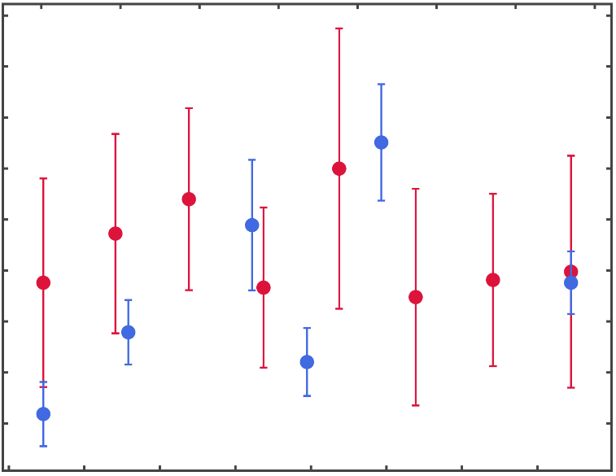
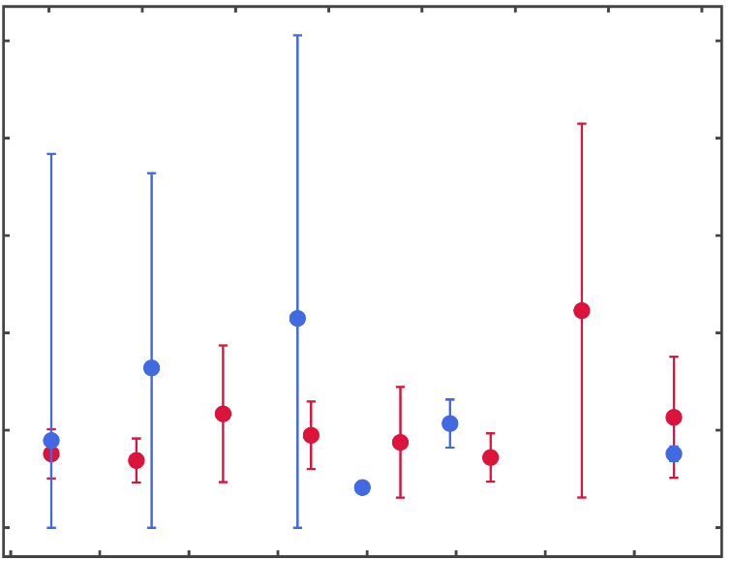
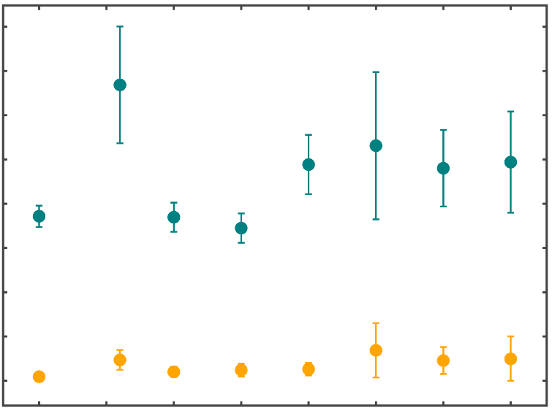




(a)
1064 nm power (mW)
(b)
1064 nm power (mW)
10
20
30
40
50
60
70
80
10
20
30
40
50
60
70
80
1.8
50
1.6
1.4
40
1.2
$τ_{1}($ms)
$τ_{2}($ms)
1.0
30
0.8
20
0.6
0.4
10
0.2
0
15
20
25
30
35
40
45
50
15
20
25
30
35
40
45
50
975 nm power (mW)
975 nm power (mW)
(c)
16
$τ_{1}($ms)
$τ_{2}($ms)
14
12
10
8
6
4
2
0
25
30
35
40
45
50
55
60
Temperature (º)

Slide 23




(a)
506k
504k
502k
Photon Counts (arb. unit)
500k
498k
25º
496k
60º
0
20
40
60
80
100
Time (ms)
(b)
10
0
-10
$$\frac{ΔS}{S_{ref}} [\%]$$
-20
-30
-40
$η_{frac}$= 1.46 $°C/√Hz$
-50
25
30
35
40
45
50
55
60
Temperature (º)

