Slide 1

Lending
Club
Case
Study

Slide 2
Objective
The objective is this case study is to analyze a financial institution’s data on lending to borrowers. The goal is to analyze the various attributes from the historical dataset using EDA and arrive at a recommendation as to if the loan application should be approved or rejected basis the risk.

Slide 3
The approach taken is as below –
Analysis and understanding the data
Check for nulls/missing data
Remove irrelevant rows/columns
Convert Datatype as appropriate
Perform EDA (Univariate, Segmented and Bivariate analysis) on appropriate columns
Analyze the pattern, relationship between variables to make inference
Conclude
Importing the Data
Removing null columns
Removing Duplicates
Removing irrelevant columns
Fixing Null values
Datatype correction and addition
Remove Outliers

Slide 4
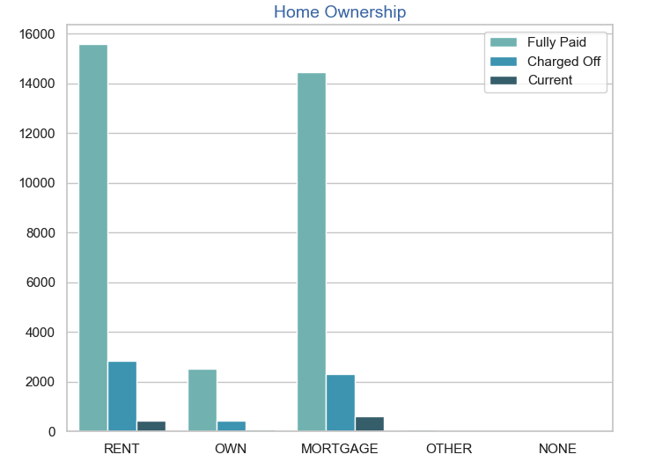
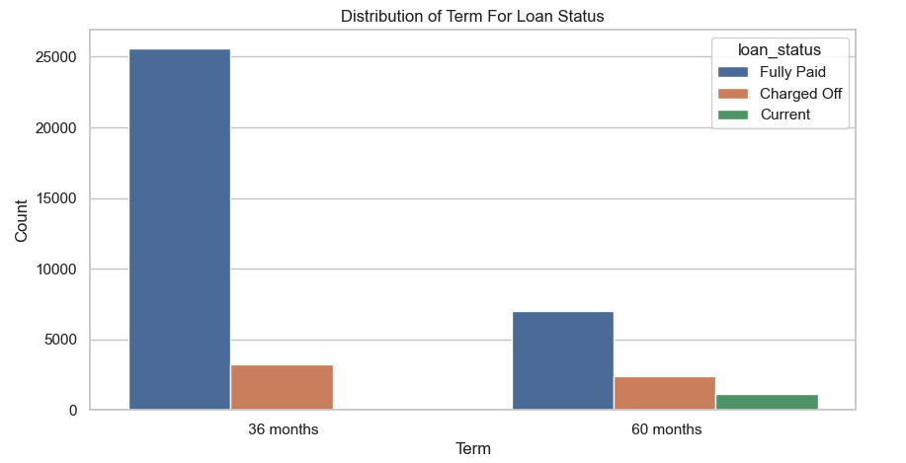
Home Ownership & Loan Tenure
Majority of the borrowers don’t own a home
Borrowers having own properly don’t default
Majority of the defaulters
Majority of the loans taken are for 36 months
Loan taken for 36 months have lesser defaults
More defaulting possibility on loan taken for 60 months

Slide 5
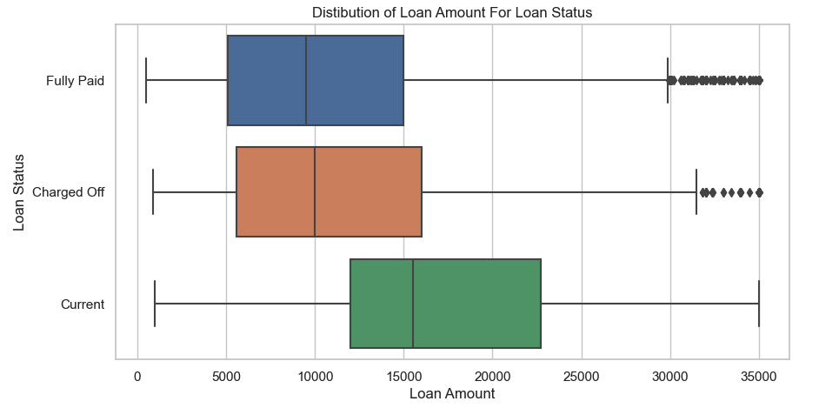
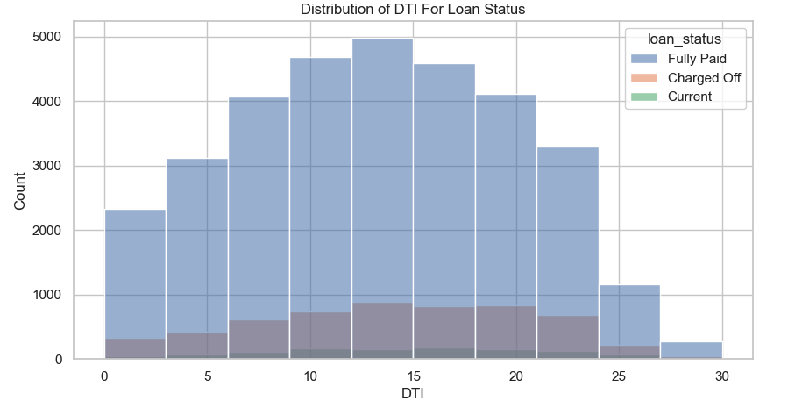
Loan Amount and DTI Over Loan Status
Majority of the loan amount hovers between 5 -15K with a median of 10K
This implies majority of the loan amount is small
Higher the loan amount the chance of defaulting increases
DTI ratio is higher between 10 - 15
Majority of defaulters between 12-15 DTI ratio

Slide 6
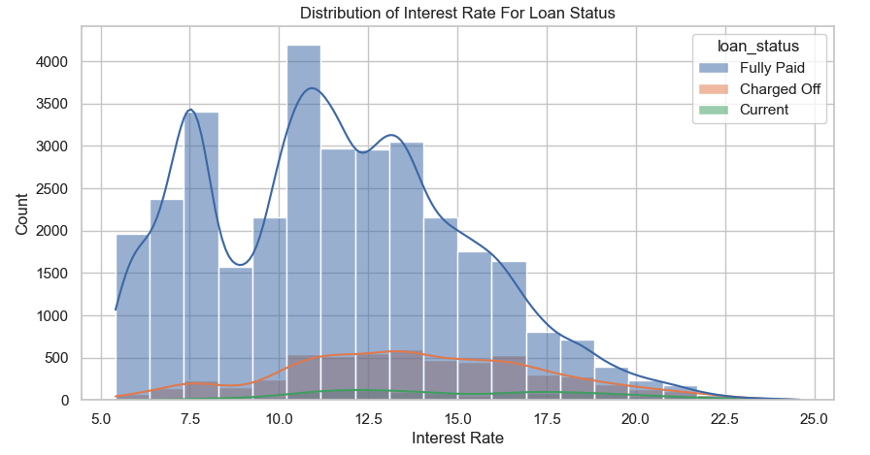
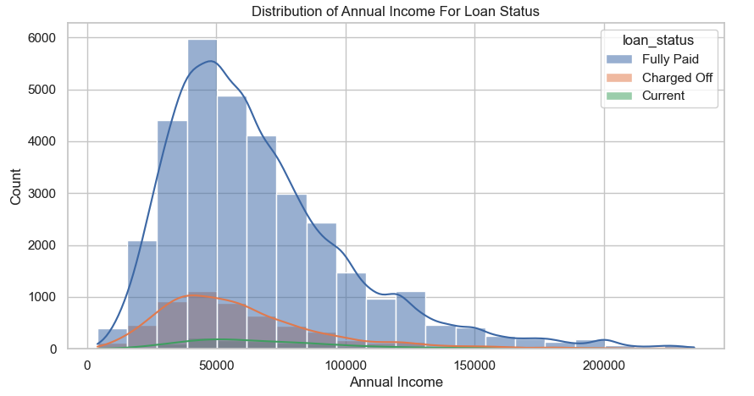
Interest Rate and Annual Income
Count of loan is peak for interest rate between 10 – 15
Max defaulters also lie within this rate of interest
Interest rate decreases steeply beyond 17.5
Majority of income group is below 50K
Majority of defaulters are also below 50K which tells that lower income group tends to default more

Slide 7
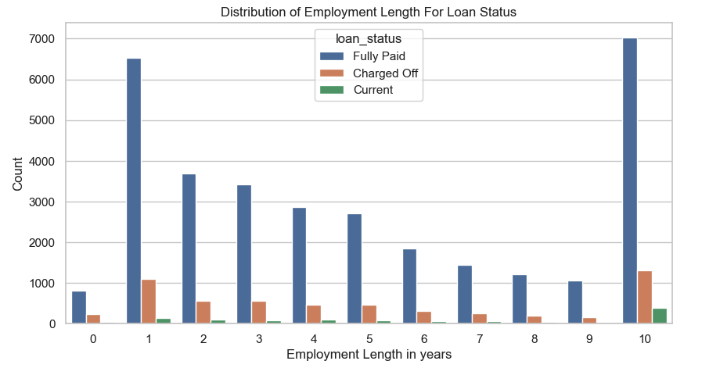
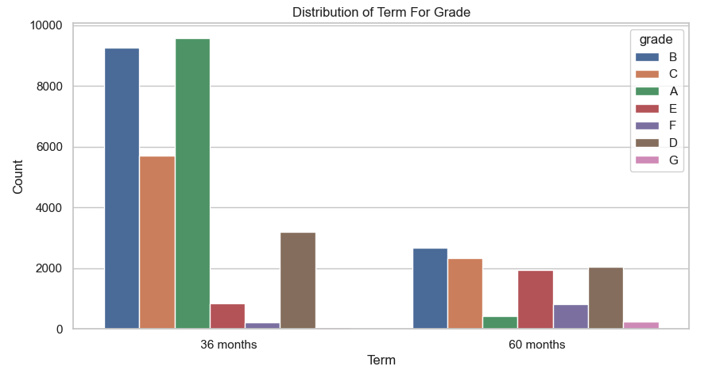
Grades and Employee Tenure
Majority of the defaulters belong to either lower (1) or higher (10+) tenure
Majority of the loans are given to higher grade because they are less risky

Slide 8
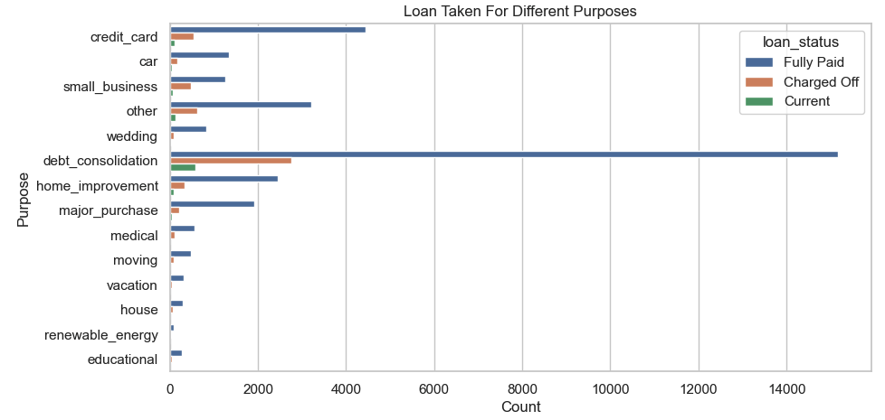
Loan Purpose
The number of loans for debt consolidation is far to high compared to any other categories – this means this is a popular loan
The number of defaulters are also significantly large – directly proportional

Slide 9
Conclusion
Major drivers for avoiding Credit Loss:
DTI
Grades
Annual Income
Home Ownership
Employee/Loan Tenure

