Slide 1

Multilingual Opinion Mining on Social Media Comments Using Unsupervised Neural Clustering Methods
Master‘s Thesis - Final Presentation
Research Group Social Computing
Department of Informatics
Technical University of Munich
Presented By | : Mainak Ghosh
Supervisor | : PD Dr. Georg Groh
Advisor | : Gerhard Hagerar, M.Sc
Date | : 14.11.2019

Slide 2
Overview
Motivation
Problem Statement & Proposed Solution
Model Architecture & MUSE
Evaluation Methods
Data Exploration & Preprocessing
Experiments & Results
Aspect Distribution
Conclusion
Future Work
Mainak Ghosh (TUM) | Master’s Thesis | Research Group Social Computing

Slide 3
Motivation
Common Sense Advisory surveyed 2,430 web consumers in eight countries and observed
„72.1% of consumers spend most or all of their time on websites in their own language.“
Companies need to study customers in their native languages.
Insights over multilingual reviews benefits business stakeholders.
Multilingual opinion mining
Source: https://hbr.org/2012/08/speak-to-global-customers-in-t

Slide 4
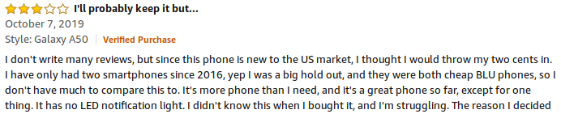
Problem Statement
Overall Opinion: Satisfactory
Learning fine-grained opinion
Aspect Extraction
Multilingual resource is limited
Difficulty in optimizing deep neural model on multilingual resource

Slide 5
Proposed Solution
Attention-based neural clustering model to cluster sematically coherent aspect terms to extract aspects.
  Shift from traditional (Latent Dirichlet Allocation) LDA model – LDA uses Bag of Words, so aspect terms not semantically coherent to a large extent (he et al., 2017).
Mainak Ghosh (TUM) | Master’s Thesis | Research Group Social Computing

Slide 6
Proposed Solution: Multilingual Setting
Model - English
English
Embedding
English
+
German
Optimal
Embedding
Apply
Model
Word2vec,
GloVe,
FastText
MUSE
Optimal
Embedding
German
Embedding
Model - German
Mainak Ghosh (TUM) | Master’s Thesis | Research Group Social Computing

Slide 7
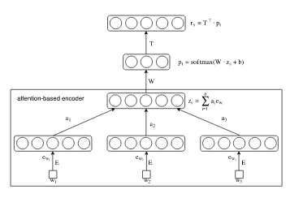
Model Architecture
Attention-based Aspect Extraction (ABAE) model (he et al., 2017)
  Improve quality of semantic clustering of aspect terms
  Employed attention-mechanism and auto-encoder model.
Mainak Ghosh (TUM) | Master’s Thesis | Research Group Social Computing

Slide 8
Model Architecture: ABAE
ABAE
Mainak Ghosh (TUM) | Master’s Thesis | Research Group Social Computing

Slide 9
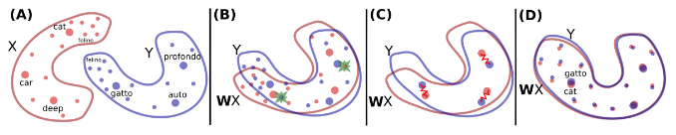
MUSE
Multilingual Unsupervised and Supervised Embeddings
  Aligns source embedding space to target embedding space.
  No need of cross-lingual annotated data.
  Continuous learning by applying Procrustes method and discriminator until either:
    Alignment is achieved
    Maximum threshold of iterations is achieved.
Source: Conneau et al., 2017
Mainak Ghosh (TUM) | Master’s Thesis | Research Group Social Computing

Slide 10


Evaluation Methods
{"beef", "chicken", "pork", "potatoes"} Good quality of aspect terms ?
UMass Coherence Score (Mimno et al., 2011):
{"beef", "chicken", "pork", "potatoes"}
How to measure coherence score of the model ?
  Average coherence score of all the aspects
Mainak Ghosh (TUM) | Master’s Thesis | Research Group Social Computing

Slide 11
Evaluation Methods
Word Vector Similarity-based Coherence Score
Measure cosine distance of word vectors
{"beef", "chicken", "pork", "potatoes"}
More the coherence score is, better the model is.
Mainak Ghosh (TUM) | Master’s Thesis | Research Group Social Computing

Slide 12
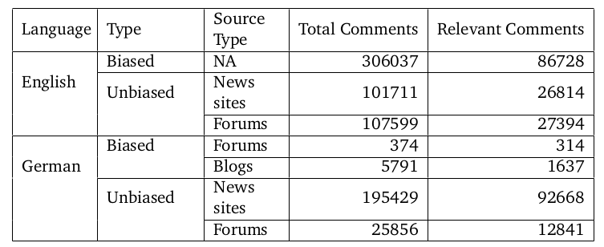
Data Exploration
Mainak Ghosh (TUM) | Master’s Thesis | Research Group Social Computing

Slide 13
Data Preprocessing
Converted upper case to lower case, not applicable for German language
Contraction expansion, such as “I’m” to “I am” and spelling correction
Abbreviation replacement, such as “btw” to “by the way”
Filtered the data with words:
  {"organic", "food", "conventional","gm", "genetically modified"} for English
  {"Bio", "bio", "Öko", "öko"} for German
  English and German dataset after this contains 69342 sentences and 40620 sentences respectively.
Removed URLs, punctuation and stop words and lemmatized the data
Mainak Ghosh (TUM) | Master’s Thesis | Research Group Social Computing

Slide 14
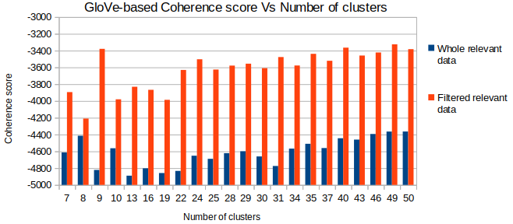
Experiments and Results
Why did we conclude of filtering the data ?
Mainak Ghosh (TUM) | Master’s Thesis | Research Group Social Computing

Slide 15
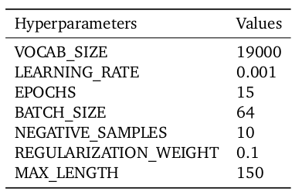
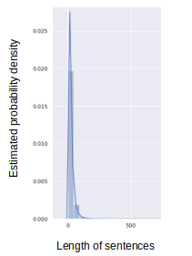
Experiments and Results
ABAE Hyperparameters and Optimization – English Data
Vocab size 19000 reduced OOV significantly.
Batch size 64 produced better coherence score.
Mainak Ghosh (TUM) | Master’s Thesis | Research Group Social Computing

Slide 16
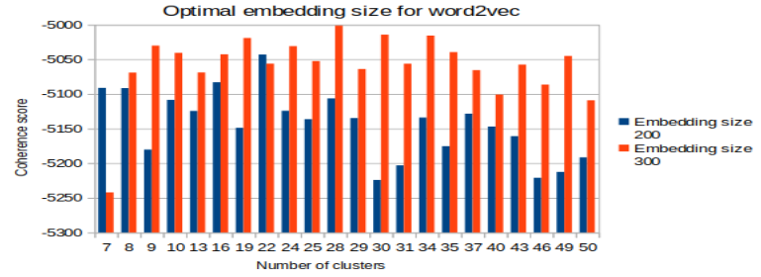
Experiments and Results
Optimization of Word vector size:
  The authors of ABAE model experimented with size 200.
  But, Our experiments used 300 as size.
Mainak Ghosh (TUM) | Master’s Thesis | Research Group Social Computing

Slide 17
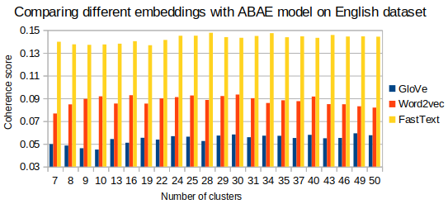
Experiments and Results
Performed experiment with ABAE with embedding models word2vec, GloVe, and fastText.
These embedding models were trained on our English data.
Corresponding pre-trained embedding models was used in word vector-based similarity coherence score.
Mainak Ghosh (TUM) | Master’s Thesis | Research Group Social Computing

Slide 18
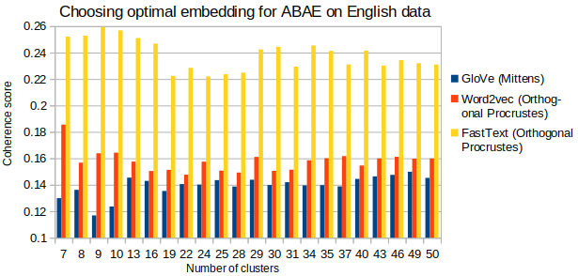
Experiments and Results
Our dataset is small to train properly word2vec, GloVe, and fastText
Solution – access pre-trained word2vec, GloVe, and fastText
Need to fine-tune or align pre-trained embedding space to our data. Orthogonal Procrustes and Canonical correlation analysis.
Post that, performed experiment with ABAE
Mainak Ghosh (TUM) | Master’s Thesis | Research Group Social Computing

Slide 19
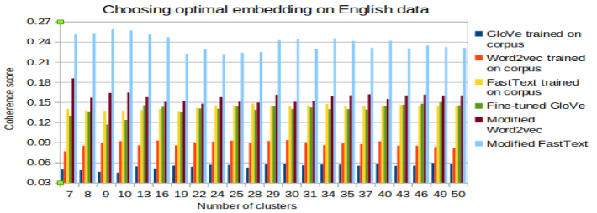
Experiments and Results
Which is the best embedding on English data based on ABAE ?
Mainak Ghosh (TUM) | Master’s Thesis | Research Group Social Computing

Slide 20
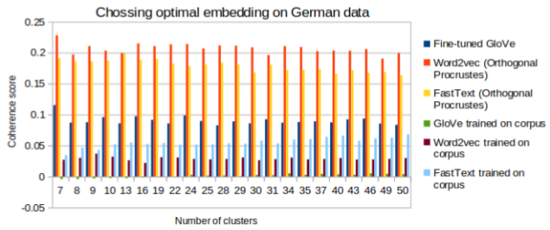
Experiments and Results
Finding optimal embedding on German data using ABAE
Mainak Ghosh (TUM) | Master’s Thesis | Research Group Social Computing

Slide 21
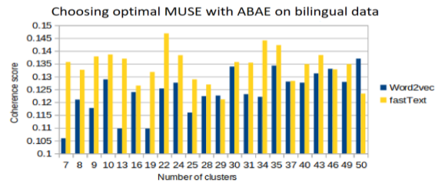
Experiments and Results
MUSE with ABAE on bilingual data
  MUSE was applied with source and target as English and German word embedding space respectively.
Mainak Ghosh (TUM) | Master’s Thesis | Research Group Social Computing

Slide 22
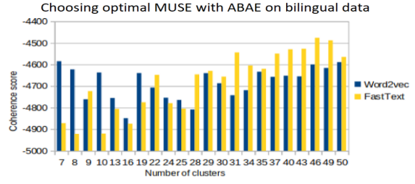
Experiments and Results
Optimal ABAE with MUSE in terms of capturing bilingual data
Mainak Ghosh (TUM) | Master’s Thesis | Research Group Social Computing

Slide 23
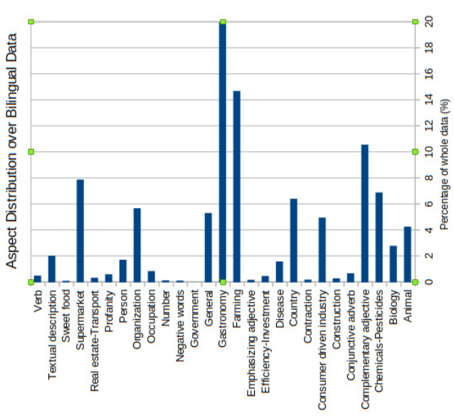
Aspect Distribution
Mainak Ghosh (TUM) | Master’s Thesis | Research Group Social Computing

Slide 24
Distribution of Words over Aspects
Aspect Label | Aspect Terms
Gastronomy | lecker, salad, essen, pizza, gourmet, Schokolade, eating, dessert, isst, Käse
Farming | farming, monocrop, Gemüseanbau, farmer, Bioanbau, farm, Maisanbau, agronomist
Supermarket | Bio, Rewe, Edeka, Bioladen, Tegut, Super- market, Discounter, Biosupermarkt, Lidl
Chemicals-Pesticides | herbicide, pesticide, glyphosate, sulphites, pyrethrin, atrazine, dicamba, bisphenol
Country | america, europe, usa, india, britain, mex- ico, germany, australia, russia, england
Mainak Ghosh (TUM) | Master’s Thesis | Research Group Social Computing

Slide 25
Conclusion & Future Work
ABAE with fastText performs better over multilingual data.
Optimal cluster size is not fixed, varies with respect to embedding model.
Increasing cluster sizes, more coherent and fine-grained aspects are generated.
Future Work
No unique evaluation metric – try other metric as well with own perception.
Can add coherence score function in loss function to evaluate optimal cluster automatically.
Tune more hyperparamters
More preprocessing is required – can apply spelling correction model too.
Mainak Ghosh (TUM) | Master’s Thesis | Research Group Social Computing

Slide 26
Reference
he, Ruidan, Wee Sun Lee, Hwee Tou Ng, and Daniel Dahlmeier (Jan. 2017). „An Unsupervised Neural Attention Model for Aspect Extraction“. In: pp. 388–397
Mimno, David, Hanna M. Wallach, Edmund Talley, Miriam Leenders, and Andrew McCallum (2011). „Optimizing Semantic Coherence in Topic Models“. In: Proceedings of the Conference on Empirical Methods in Natural Language Processing. EMNLP ’11. Edinburgh, United Kingdom: Association for Computational Linguistics, pp. 262–272
Conneau, Alexis, Guillaume Lample, Marc’Aurelio Ranzato, Ludovic Denoyer, and Hervé Jégou (2017). „Word Translation Without Parallel Data“. In: arXiv preprint arXiv:1710.04087
Mainak Ghosh (TUM) | Master’s Thesis | Research Group Social Computing

Slide 27
THANK YOU
QUESTIONS ?
Mainak Ghosh (TUM) | Master’s Thesis | Research Group Social Computing

