Slide 1

Mastering Spotify Data Cleaning in Pandas
A comprehensive guide to exploring, cleaning, and analyzing messy CSV datasets with practical examples from a real Spotify tracks dataset.

Slide 2
Understanding Your Dataset: First Look
Before cleaning any dataset, it's crucial to understand its structure and contents. The Spotify tracks dataset contains 15,828 songs with 22 features including metadata like track names, artists, and release years, plus audio characteristics like danceability, energy, and tempo.
15,828
Total Tracks
Use df.head() and df.tail() to inspect the first and last rows. This reveals data formatting issues immediately - notice the truncated URLs and inconsistent spacing in the sample data. The df.info() method provides a comprehensive overview of column types and missing values.
Songs in dataset
22
Features
Data columns
10,819
Unique Tracks
Distinct song titles

Slide 3
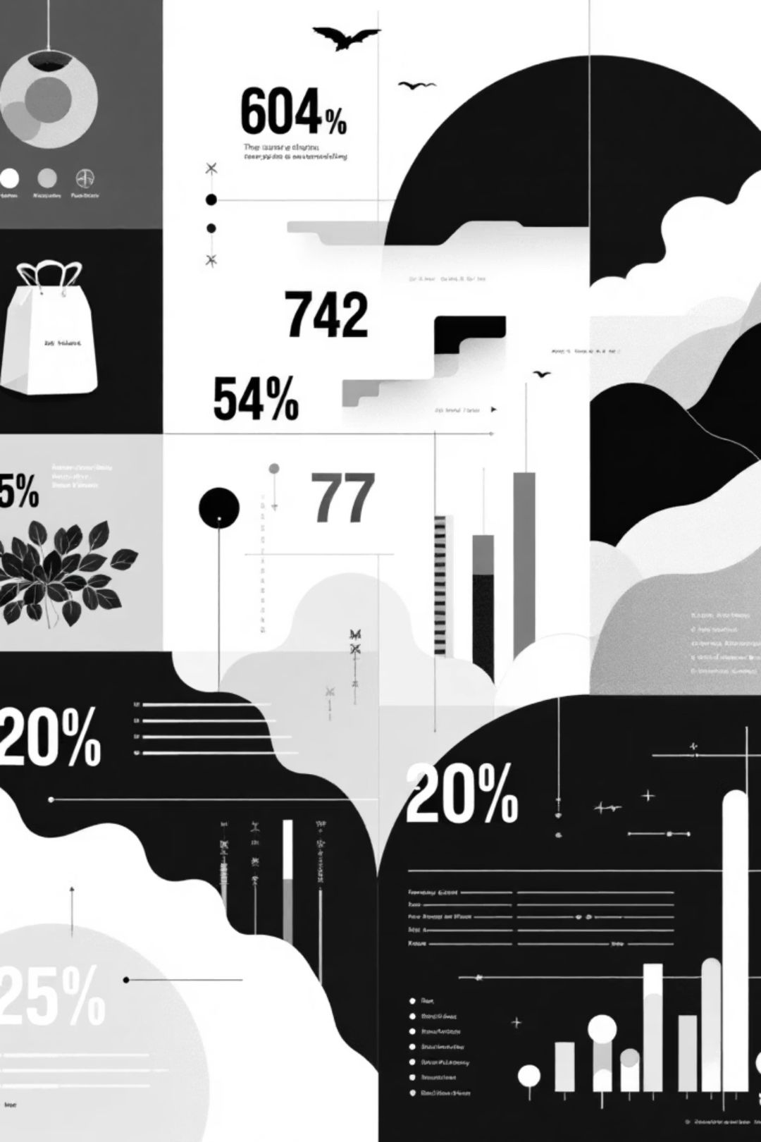



Data Type Discovery: The Foundation of Cleaning
Object Types (7 columns)
Integer Types (2 columns)
String data including track_id, track_name, artist_name, artwork_url, album_name, track_url, and language. These require text cleaning and standardization.
Year and popularity are stored as integers. Check for unrealistic values like future years or negative popularity scores.
Float Types (13 columns)
Audio features like danceability, energy, and tempo use floats. Verify these fall within expected ranges (typically 0-1 for normalized features).
Understanding data types helps you choose appropriate cleaning methods. For instance, string columns need trimming and encoding checks, while numeric columns require range validation and outlier detection.

Slide 4
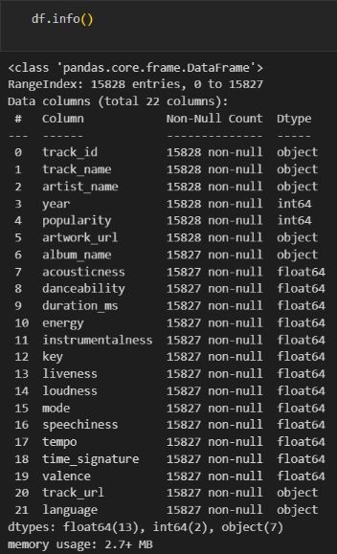

Spotting Missing Data Patterns
Key Findings from df.info()
The df.info() output reveals subtle but important missing data patterns. While most columns show 15,828 non-null entries, three columns have exactly 15,827 non-null values:
album_name: 1 missing value
All audio features: 1 missing value each (acousticness through valence)
track_url and language: 1 missing value each
This pattern suggests a single problematic row where Spotify's API failed to return complete data. The consistent count indicates a systematic issue rather than random data loss.
Pro tip: When you see the same number of missing values across multiple columns, investigate whether they're from the same rows using df[df.isnull().any(axis=1)]

Slide 5

Identifying Duplicate Records
The dataset contains 10,819 unique track names out of 15,828 total records - a significant difference that indicates substantial duplication. The value_counts() analysis reveals interesting patterns:
1
2
3
Most Duplicated Track
Common Duplicates
Cleaning Strategy
"Intezaar" appears 23 times in the dataset - likely representing different versions, remixes, or live recordings of the same song.
"Moongil Thottam" (18 occurrences) and "Kya Khabar" (17 occurrences) show similar duplication patterns, suggesting multiple album releases or compilation appearances.
Decide whether to keep all versions (for comprehensive analysis) or deduplicate based on track_id (for unique song analysis). Consider using df.drop_duplicates() with strategic column selection.

Slide 6
Memory Optimization Strategies
The df.memory_usage() output shows each column consuming 126,624 bytes. With 22 columns, the total memory footprint is approximately 2.7 MB - manageable for this dataset but important to optimize for larger files.
# Example optimization codedf['language'] = df['language'].astype('category')df['year'] = df['year'].astype('int16')df['popularity'] = df['popularity'].astype('int8')# Downcast float columnsfloat_cols = df.select_dtypes(include=['float64']).columnsfor col in float_cols: df[col] = df[col].astype('float32')
Key Optimization Techniques
Convert object types to categorical for repetitive text data
Downcast integers from int64 to smaller types when possible
Use float32 instead of float64 for audio features
Remove unnecessary columns early in your pipeline

Slide 7



Visualizing Popularity Distribution
The popularity histogram reveals crucial insights about your dataset's characteristics. Most tracks cluster in the lower popularity ranges, with a right-skewed distribution - this is typical for music streaming data where a small number of hits dominate.
0-20
20-50
50-100
Low Popularity
Moderate Popularity
High Popularity
Majority of tracks fall here - niche or older content
Steady listener base but not trending
Chart-toppers and viral hits - small percentage
When cleaning, watch for outliers: tracks with impossibly high popularity scores or negative values indicate data quality issues. The KDE (kernel density estimation) overlay helps identify multimodal distributions that might suggest distinct track categories.

Slide 8

Duration Analysis: Catching Data Anomalies
Song duration is measured in milliseconds, making this field prone to data entry errors and outliers. A typical song ranges from 120,000ms (2 minutes) to 360,000ms (6 minutes).
Common Issues to Check
Suspiciously short tracks: Values under 30,000ms might be snippets or data errors
Unrealistically long tracks: Values over 900,000ms (15 minutes) could indicate live recordings, DJ sets, or corrupted data
Zero or null values: Missing duration data that needs imputation or removal
Use percentile analysis (df['duration_ms'].quantile([0.01, 0.99])) to identify reasonable bounds for filtering.

Slide 9




Musical Key Distribution Patterns
The key distribution visualization shows which musical keys are most common in the dataset. In standard music theory, keys are represented numerically (0 = C, 1 = C#, 2 = D, etc.). Understanding this distribution helps identify data quality issues and reveals interesting musical trends.
Validate Key Range
Keys should only range from 0-11. Any values outside this range indicate data corruption or API errors.
Check for Imbalances
Extreme clustering in certain keys might suggest genre bias in your dataset or processing errors.
Handle Missing Values
Consider whether to impute missing keys (using mode) or exclude tracks without key information.

Slide 10
Your Data Cleaning Checklist
01
02
Load and Inspect
Handle Missing Data
Use df.head(), df.info(), and df.describe() to understand structure and identify immediate issues
Decide on imputation, deletion, or flagging strategies based on the pattern and importance of missing values
03
04
Remove Duplicates
Validate Ranges
Use df.drop_duplicates() strategically, considering whether to keep first, last, or all occurrences
Check that numeric fields fall within expected ranges using boolean indexing and percentile analysis
05
06
Optimize Data Types
Visualize Distributions
Convert to appropriate types (category, int16, float32) to reduce memory usage and improve performance
Create histograms and count plots to spot outliers, skewness, and unexpected patterns
Remember: data cleaning is iterative. As you analyze and model your data, you'll discover new issues that require additional cleaning steps. Document your decisions and create reusable cleaning functions for efficiency.

Slide 11




Key Audio Features Under Investigation
Danceability
Energy
Measures how suitable a track is for dancing based on tempo, rhythm stability, beat strength, and overall regularity.
Represents perceptual intensity and activity, from calm meditation music to aggressive heavy metal.
Loudness
Acousticness
Overall amplitude measured in decibels, reflecting the track's dynamic range and mixing approach.
Confidence measure of whether the track uses acoustic versus electronic instrumentation.

Slide 12



Additional Musical Dimensions
Valence
Instrumentalness
Liveness
Quantifies the musical positiveness conveyed by a track. High valence sounds cheerful and euphoric, while low valence sounds sad, depressed, or angry. This emotional dimension helps categorize mood-based listening experiences.
Predicts whether a track contains no vocals. Values above 0.5 typically indicate instrumental content, though rap tracks may also score highly. This feature distinguishes between vocal-driven and purely instrumental compositions.
Detects the presence of an audience in the recording. Higher values represent increased probability of live performance, capturing the energy and spontaneity of concert recordings versus studio productions.

Slide 13
Key Findings and Patterns
1
Production Quality Dominates
2
Vocals Matter
3
Emotional Diversity
The near-universal presence of vocals in popular music underscores the human connection listeners seek. Instrumental tracks face significant barriers to mainstream success, regardless of other audio feature strengths.
The uniform valence distribution challenges assumptions about listener preferences, revealing that audiences embrace music across the full emotional spectrum when other production and marketing factors align favorably.
Low acousticness and liveness values in popular tracks indicate that modern audiences gravitate toward polished studio productions with electronic elements. The "loudness wars" continue to influence mixing decisions, with optimal loudness around -7dB.

Slide 14

Research Overview and Methodology
Dataset Characteristics
Analytical Approach
Our analysis leverages a comprehensive music dataset containing popularity metrics and audio feature measurements. Each track includes normalized values for seven distinct audio characteristics, enabling systematic comparison across the full spectrum of musical styles and genres.
Using seaborn's scatterplot functionality, we visualized bivariate relationships between popularity scores and individual audio features. The alpha transparency parameter (0.6) allows us to identify density patterns and potential clustering within the data distribution.

Slide 15

Debugging Python Audio Visualizations
A practical guide to identifying and fixing common errors in music dataset analysis. We'll walk through real code examples with typos and syntax issues, showing you how to spot problems and implement proper visualization techniques for audio features like acousticness, loudness, and popularity metrics.

Slide 16
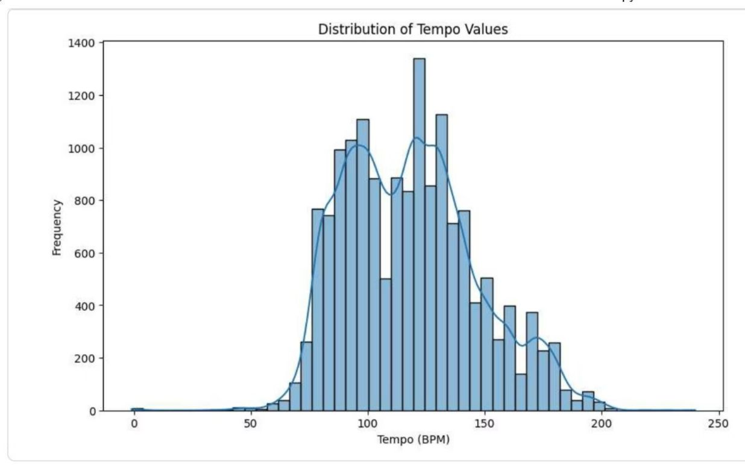
Visualizing Acousticness Distribution
Clean Code Pattern
This histogram with KDE overlay effectively shows the distribution of acousticness scores across your dataset. The code uses proper matplotlib and seaborn syntax to create a publication-ready visualization.
plt.figure(figsize=(10, 6))sns.histplot(df['acousticness'], bins=30, kde=True)plt.title('Distribution of Acousticness')plt.xlabel('Acousticness')plt.ylabel('Frequency')plt.show()
Note the consistent use of plt prefix and proper string formatting throughout.

Slide 17
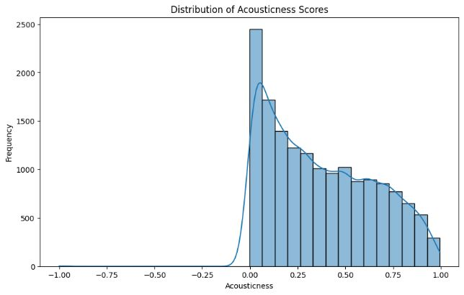
Critical Typos in Loudness Analysis
Error #1: vitle() Method
plt.vitle() should be plt.title() - a simple typo that will cause AttributeError
Error #2: vilabel() Method
plt.vilabel() appears twice and should be plt.xlabel() and plt.ylabel() respectively
Error #3: Variable Name Inconsistency
loudness_t defined but loudness_std used in calculations - will raise NameError
Error #4: Invalid F-string Syntax
{loudness_mean +/- std) contains invalid operators - should use separate calculations for range boundaries

Slide 18

Corrected Loudness Visualization Code
Fixed Implementation
plt.figure(figsize=(10, 6))sns.histplot(df['loudness'], bins=30, kde=True)plt.title('Distribution of Loudness Levels (dB)')plt.xlabel('Loudness (dB)')plt.ylabel('Frequency')plt.show()loudness_mean = df['loudness'].mean()loudness_min = df['loudness'].min()loudness_max = df['loudness'].max()loudness_std = df['loudness'].std()print(f"Average loudness: {loudness_mean:.2f} dB")print(f"Range (mean ± std): {loudness_mean - loudness_std:.2f} dB to {loudness_mean + loudness_std:.2f} dB")print(f"Minimum loudness: {loudness_min:.2f} dB")print(f"Maximum loudness: {loudness_max:.2f} dB")
Key fixes: corrected all method names, fixed variable naming (loudness_std), and properly formatted the range calculation with separate expressions.

Slide 19
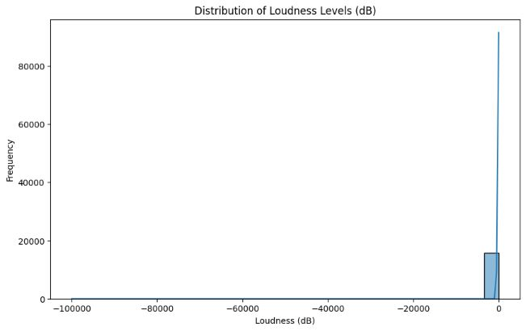
Mode Distribution Analysis
Major vs. Minor Keys
This countplot reveals the distribution between major (1) and minor (0) modes in your dataset. The visualization uses proper parameter ordering and includes rotation settings for readability.
The code correctly uses value_counts() to get frequency data before plotting, ensuring the bars are ordered by count.

Slide 20
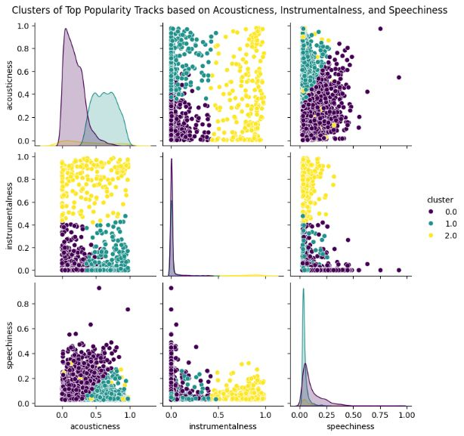
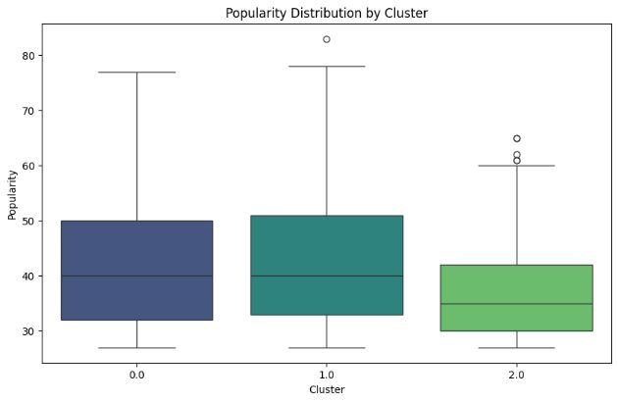
Clustering Popular Tracks by Sound Profile
This K-means clustering analysis identifies subgenres within highly popular tracks using three audio features: acousticness, instrumentalness, and speechiness. The pairplot visualization shows relationships between features across three distinct clusters.
01
Feature Selection
Choose relevant audio characteristics that define sound profiles
02
Data Scaling
Standardize features using StandardScaler for equal weighting
03
Cluster Assignment
Apply K-means with n_clusters=3 and random_state for reproducibility
04
Visual Analysis
Generate pairplot with hue='cluster' to examine group separation

Slide 21
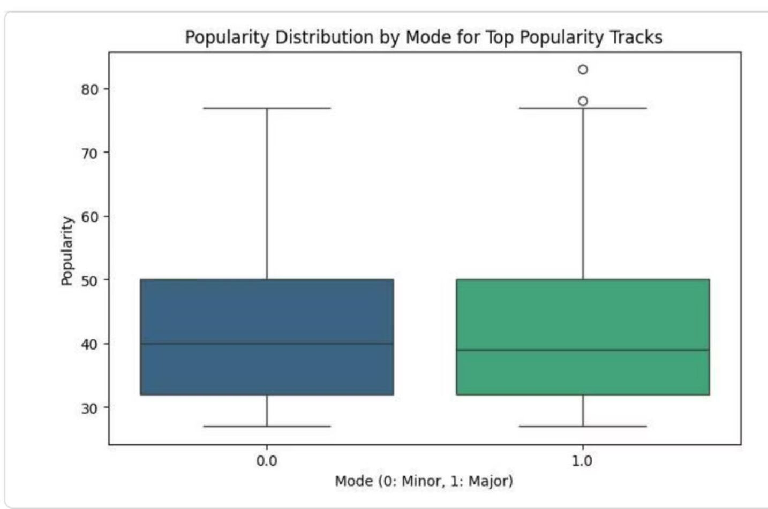

Popularity Patterns Across Musical Keys
Key and Mode Relationships
Box plots reveal how popularity varies across different musical keys (0-11 representing C through B) and modes (major/minor) for top-quartile tracks.
The visualization shows relatively consistent popularity across keys, with some variation. Mode analysis indicates whether major or minor tonality correlates with higher popularity scores.

Slide 22
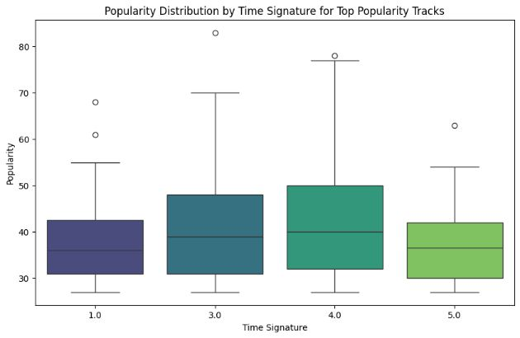

Time Signature Analysis
Popularity by Rhythmic Structure
This boxplot examines how time signatures (beats per measure) relate to track popularity in the top quartile. Most popular music uses 4/4 time, but this analysis reveals whether alternative time signatures like 3/4 or 5/4 show different popularity distributions.
Important Note: The code example contains a typo in one ylabel() call, which should read plt.xlabel('Time Signature') instead of plt.ylabel('Time Signature') to properly label the x-axis.

Slide 23
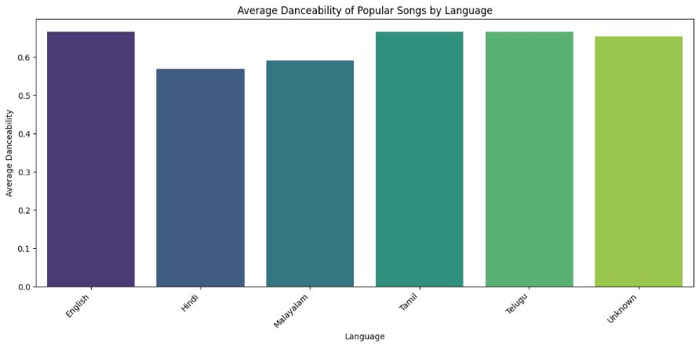
Danceability Across Language Categories
Cross-Cultural Audio Features
Analyzing average danceability, energy, and valence across different language categories reveals cultural patterns in popular music. English tracks show the highest energy (0.86) and valence (0.70), while Hindi tracks exhibit lower values.
The grouped data calculation uses proper pandas syntax with groupby() and mean() methods to aggregate features by language.
0.67
0.57
0.67
English Danceability
Hindi Danceability
Tamil/Telugu Average
Highest average danceability score
Lower danceability in South Asian music
Consistent across regional languages

Slide 24
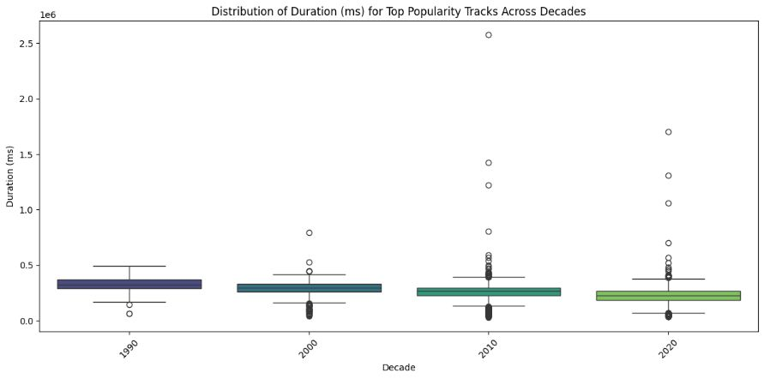
Duration Trends Across Decades
Temporal Patterns in Popular Music
This temporal analysis examines how song duration and liveness have evolved over decades for top-popularity tracks. The boxplot effectively shows median values, quartiles, and outliers across time periods.
Key Takeaway #1
Key Takeaway #2
Always verify method names - vitle() and vilabel() are common typos that break code
Maintain variable naming consistency throughout your analysis workflow
Key Takeaway #3
Key Takeaway #4
Use proper f-string syntax - separate calculations for complex expressions
Test visualizations incrementally to catch errors before they compound

Slide 25

Decoding Musical Popularity Through Data Analytics
A comprehensive Python-based analysis exploring the audio features and temporal patterns that define popular music. Using advanced data visualization techniques and statistical analysis, we uncover the quantitative characteristics that drive track popularity across different musical dimensions.

Slide 26
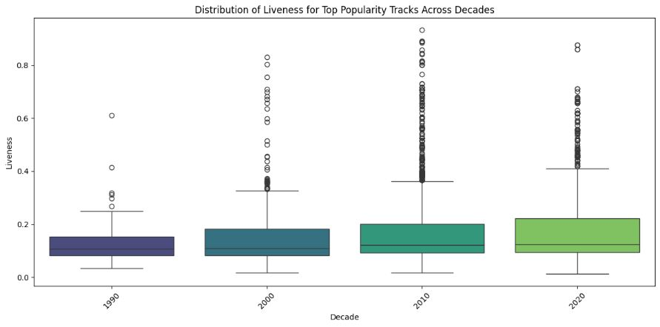
Danceability Distribution in Popular Tracks
Analysis Overview
The distribution of danceability reveals critical insights into what makes tracks popular. Using a histogram with kernel density estimation (KDE), we visualize the frequency distribution across the danceability spectrum.
This seaborn visualization employs 30 bins to capture granular patterns in the data. The KDE overlay smooths the distribution, revealing underlying trends that discrete bins alone might obscure.
sns.histplot( top_popularity_df['danceability'], bins=30, kde=True)

Slide 27

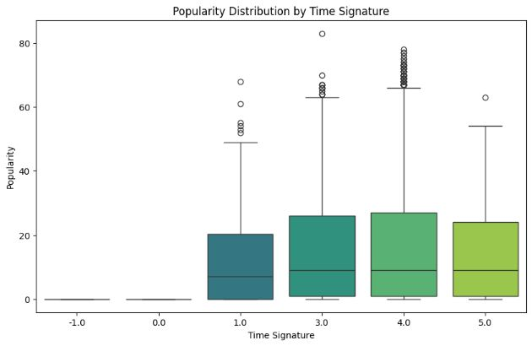
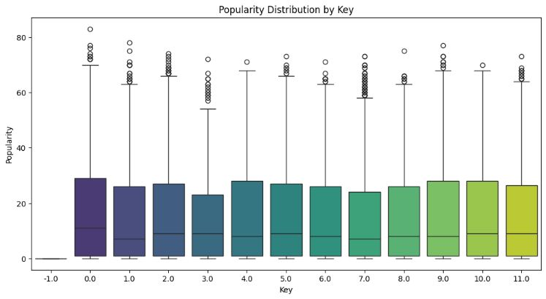
Musical Key and Mode Analysis
Key Distribution
Major vs Minor Mode
Analysis across 12 musical keys reveals popularity patterns. Certain keys may dominate popular music due to instrumental comfort zones, vocal ranges, or cultural preferences.
The mode comparison (0: Minor, 1: Major) shows fascinating emotional preferences. Major keys typically convey brightness and optimism, while minor keys express melancholy or tension.

Slide 28
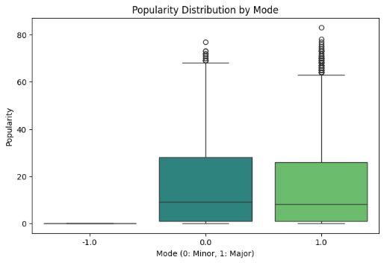
Temporal Evolution: Danceability vs Energy Relationship
This scatterplot tracks the evolving relationship between danceability and energy across years, with each point representing a popular track. The viridis color gradient maps temporal progression, revealing how musical preferences shift over time.
Analytical Approach
Key Insights
Using hue encoding for year values allows us to visualize temporal patterns within the feature space. The alpha transparency prevents overplotting while maintaining density visibility.
Clusters and trajectories in this visualization reveal whether popular music is becoming more energetic, more danceable, or maintaining balance between these characteristics over the decades.

Slide 29
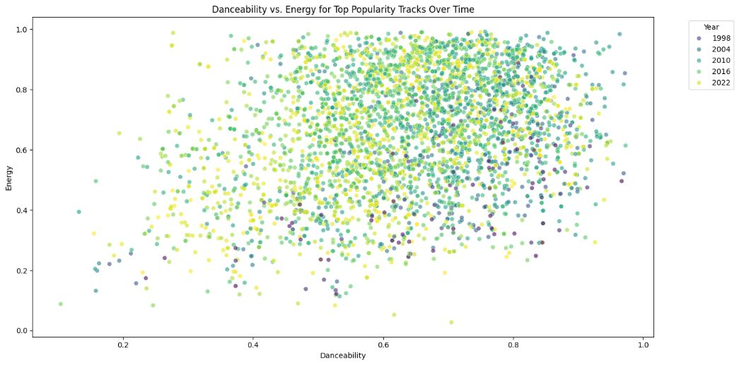
The Rise of Speechiness in Popular Music
01
02
Data Aggregation
Temporal Visualization
Calculate average speechiness values by year using pandas groupby operations on the top popularity dataset.
Generate a line plot to track speechiness trends, revealing whether rap, spoken word, and vocal-heavy tracks are gaining prominence.
03
Trend Interpretation
Analyze the trajectory to understand shifts in musical content, from melodic to speech-like delivery patterns.

Slide 30
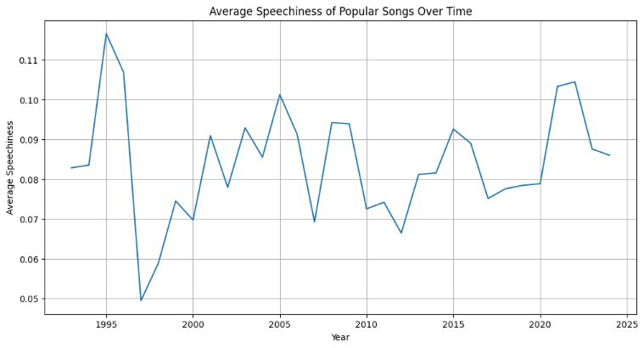



Language Distribution Trends in Popular Music
Examining how language categories in popular music have evolved reveals fascinating patterns about globalization, cultural exchange, and the democratization of music distribution platforms.
Language Detection
Categorize tracks by linguistic content to understand market diversity.
Temporal Analysis
Track language prevalence year-over-year using count plots with hue encoding.
Pattern Recognition
Identify whether English dominance persists or if multilingual content is rising.

Slide 31
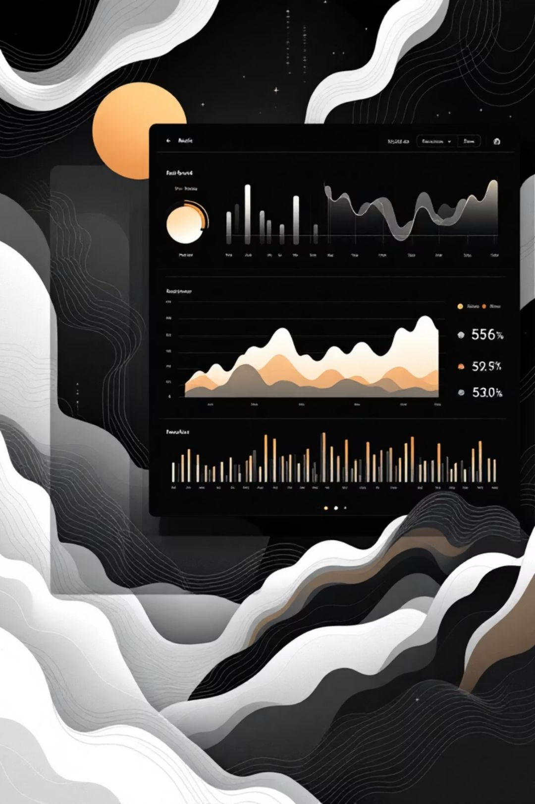
Key Takeaways for Music Analytics
Python + Seaborn = Powerful Insights
Audio Features Tell Stories
Danceability, energy, valence, speechiness, and structural elements like key and time signature create quantifiable signatures of popular music.
Combining matplotlib and seaborn enables sophisticated visual analysis of complex audio feature relationships across temporal and categorical dimensions.
Evolution Over Time
Temporal analysis reveals that musical preferences aren't static—they evolve with cultural shifts, technological advances, and global connectivity.
This analytical framework can be extended to predict popularity, recommend similar tracks, or inform production decisions. The intersection of data science and music analytics continues to unlock new understanding of what makes songs resonate with audiences worldwide.

Slide 32

Analyzing Music Feature Distributions in Popular Tracks
This analysis explores the audio features that define popular music tracks, examining how characteristics like danceability, energy, and valence shape listener preferences. Using Python's powerful data visualization libraries—matplotlib and seaborn—we'll uncover patterns in what makes songs resonate with audiences.

Slide 33
Danceability Distribution Analysis
Understanding Danceability Metrics
Danceability measures how suitable a track is for dancing based on tempo, rhythm stability, beat strength, and overall regularity. Values range from 0.0 to 1.0, with higher values indicating greater danceability.
The histogram visualization with kernel density estimation (KDE) reveals the concentration of danceability scores among top popularity tracks, helping identify the sweet spot that resonates with audiences.
plt.figure(figsize=(10, 6))sns.histplot(top_popularity_df['danceability'], bins=30, kde=True)plt.title('Distribution of Danceability for Top Popularity Tracks')plt.xlabel('Danceability')plt.ylabel('Frequency')plt.show()

Slide 34
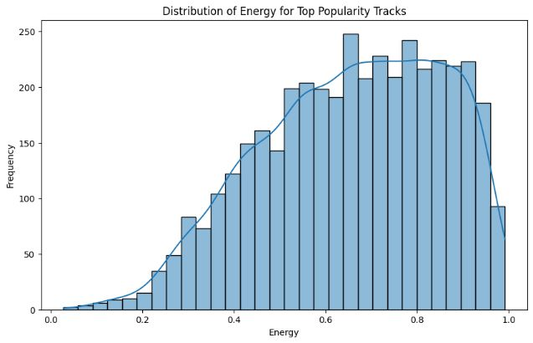
Energy Patterns in Popular Music
Energy represents the perceptual measure of intensity and activity in a track. Energetic tracks feel fast, loud, and noisy, with high energy values typically ranging from 0.0 to 1.0. This metric captures elements like dynamic range, perceived loudness, timbre, onset rate, and general entropy.
The distribution plot helps us understand whether popular tracks tend toward high-energy intensity or if there's a broader spectrum of energy levels that audiences find appealing. The KDE overlay smooths the histogram to reveal underlying trends in energy preferences.
plt.figure(figsize=(10, 6))sns.histplot(top_popularity_df['energy'], bins=30, kde=True)plt.title('Distribution of Energy for Top Popularity Tracks')plt.xlabel('Energy')plt.ylabel('Frequency')plt.show()

Slide 35

Valence: The Musical Positivity Measure
Emotional Spectrum Analysis
Decoding Listener Preferences
Valence describes the musical positiveness conveyed by a track. High valence indicates happy, cheerful, euphoric sounds, while low valence suggests sad, depressed, or angry emotions. This 0.0-1.0 scale provides insight into the emotional landscape of popular music.
By analyzing valence distribution, we can determine whether audiences gravitate toward uplifting content or appreciate a broader emotional range. The histogram with KDE curve reveals clustering patterns that indicate dominant emotional tones in successful tracks.
plt.figure(figsize=(10, 6))sns.histplot(top_popularity_df['valence'], bins=30, kde=True)plt.title('Distribution of Valence for Top Popularity Tracks')plt.xlabel('Valence')plt.ylabel('Frequency')plt.show()

Slide 36
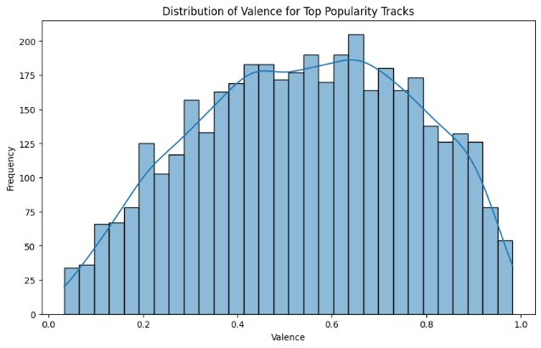
Time Signature Impact on Popularity
Rhythmic Structure Analysis
Time signature indicates how many beats are in each bar, with common values including 3/4 (waltz time), 4/4 (common time), and 5/4 (complex time). This fundamental musical element shapes how listeners perceive and engage with rhythm.
The boxplot visualization reveals the distribution of popularity scores across different time signatures, highlighting whether conventional or unconventional rhythmic structures find greater success with audiences.
plt.figure(figsize=(10, 5))sns.boxplot(data=df, x='time_signature', y='popularity', palette='viridis')plt.title('Popularity Distribution by Time Signature')plt.xlabel('Time Signature')plt.ylabel('Popularity')plt.show()

Slide 37

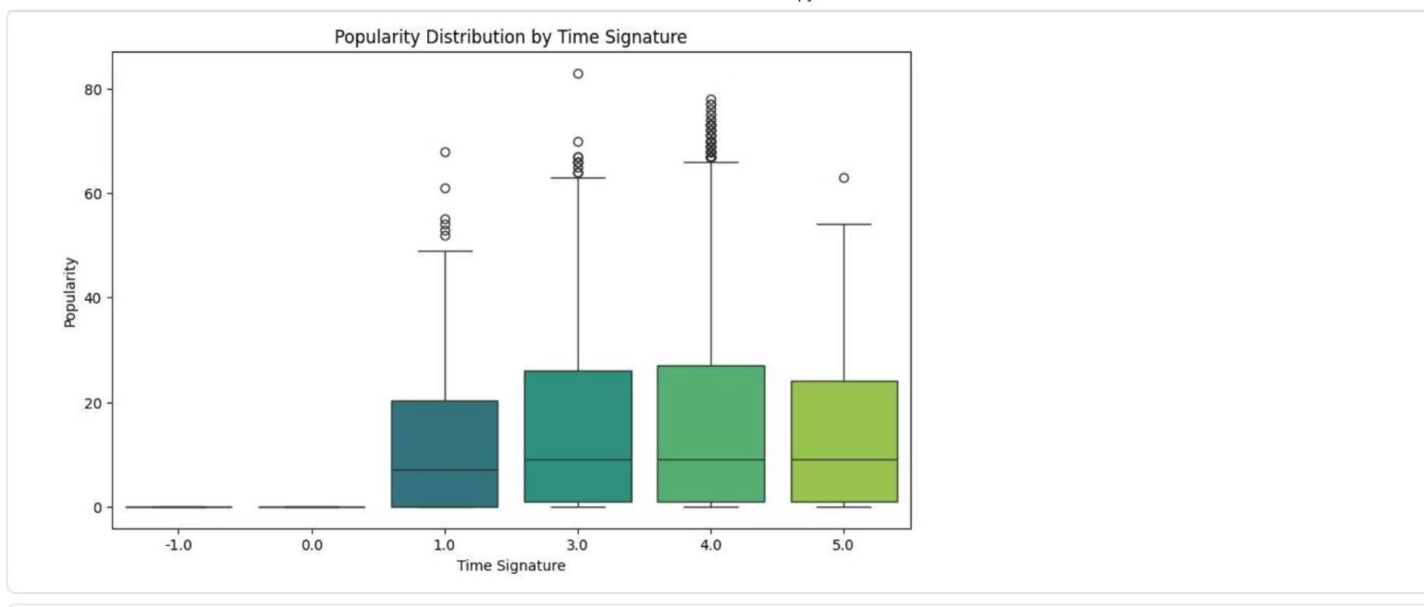
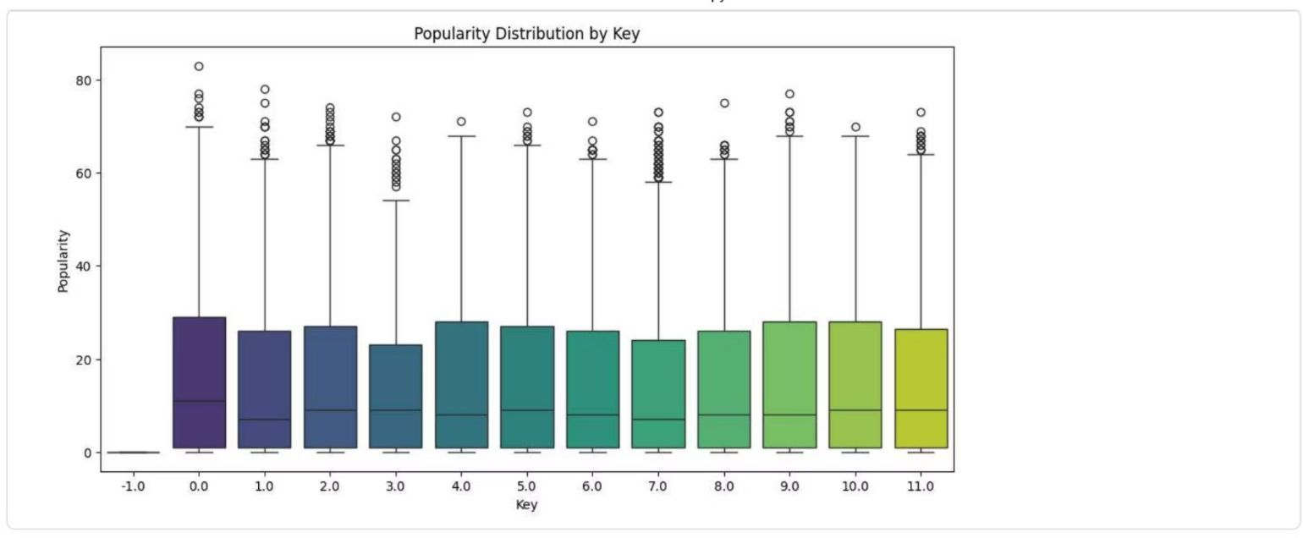
Musical Key and Mode Analysis
1
Key Distribution Insights
Musical keys (C, C#, D, etc.) form the tonal foundation of tracks. The boxplot analysis reveals whether certain keys correlate with higher popularity, potentially indicating listener preferences for specific tonal centers.
2
Major vs. Minor Mode Comparison
Mode distinguishes between major (1) and minor (0) scales. Major keys typically sound brighter and happier, while minor keys convey darker, more somber emotions. This analysis examines if mode influences track popularity.

Slide 38
Feature Relationships Evolving Over Time
Analyze the evolution of the relationship between features over time
Subtask:
Analyze how the relationship between two features, such as danceability and energy, has evolved over time for popular songs.
.

Slide 39
Speechiness Trends in Popular Music
Vocal Content Evolution
Speechiness detects the presence of spoken words in a track. Values above 0.66 indicate tracks made entirely of spoken words (podcasts, audiobooks). Values between 0.33-0.66 suggest tracks containing both music and speech (rap music), while values below 0.33 represent instrumental or singing-focused tracks.
The line plot tracks average speechiness over time, revealing whether popular music has incorporated more spoken-word elements or maintained traditional singing-focused approaches. This metric is particularly relevant for understanding the rise of rap and hip-hop influences in mainstream music.
average_speechiness_by_year = top_popularity_df.groupby('year')['speechiness'].mean()average_speechiness_by_year.plot(kind='line')plt.title('Average Speechiness of Popular Songs Over Time')plt.grid(True)

Slide 40
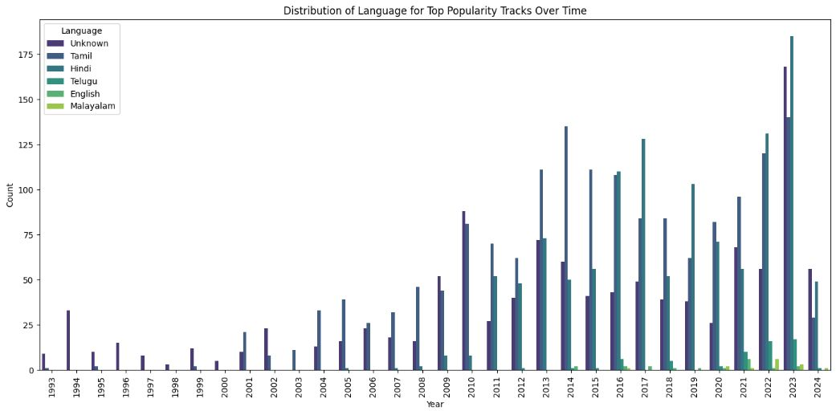
Language Diversity in Popular Music
This temporal analysis examines the linguistic diversity of popular tracks over time. The stacked count plot reveals how different languages have gained or lost prominence in mainstream music, reflecting globalization trends, cultural exchange, and the international music market's evolution.
By tracking language distribution across years, we can identify periods of linguistic homogeneity versus diversity, observe the rise of non-English language tracks in global charts, and understand how music consumption has become increasingly cross-cultural. Each colored segment represents a different language, with height indicating the number of popular tracks in that language for each year.
sns.countplot(data=top_popularity_df, x='year', hue='language', palette='viridis')plt.title('Distribution of Language for Top Popularity Tracks Over Time')plt.xticks(rotation=90)plt.legend(title='Language')

Slide 41
Key Takeaways and Analytical Approaches
1
Multi-Dimensional Feature Analysis
2
Structural Elements Matter
3
Temporal Evolution Patterns
Time signature, musical key, and mode influence popularity patterns. Boxplot analysis exposes relationships between these fundamental musical structures and commercial success.
Feature relationships and linguistic diversity shift over time. Scatter plots and time-series visualizations reveal how popular music characteristics have evolved, reflecting changing production trends and global cultural exchange.
Popular music success correlates with specific ranges across danceability, energy, and valence metrics. Histogram distributions with KDE reveal optimal feature values that resonate with audiences.
These Python visualization techniques using matplotlib and seaborn provide data scientists with powerful tools to decode the complex factors driving music popularity, enabling data-driven insights for artists, producers, and music industry professionals.

Slide 42

Visualizing Music Trends: Audio Feature Analysis
A comprehensive exploration of how popular songs have evolved over time through the lens of audio features. This analysis investigates key musical characteristics—from loudness and valence to acousticness and tempo—to uncover patterns in the "loudness war," shifting production styles, and the evolution of musical positivity across decades.

Slide 43
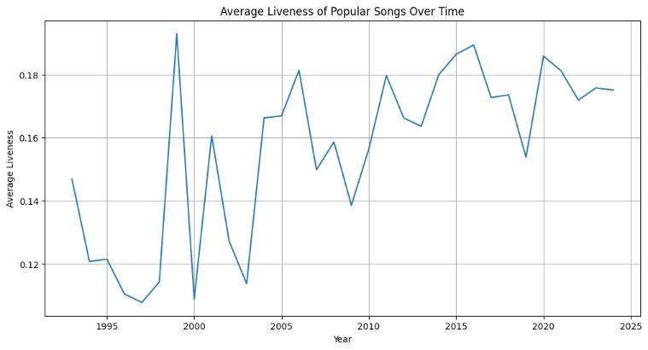
Understanding the Dataset
Our analysis focuses on popular songs ranked in the top quartile by popularity score. This strategic filtering ensures we're examining tracks that resonated most strongly with audiences, providing meaningful insights into mainstream music trends rather than obscure outliers.
Data Scope
Key Features
Top quartile popularity tracks across multiple decades
Loudness, valence, acousticness, instrumentalness, duration, tempo, and key
Methodology
Year-over-year aggregation and visualization using Python libraries

Slide 44
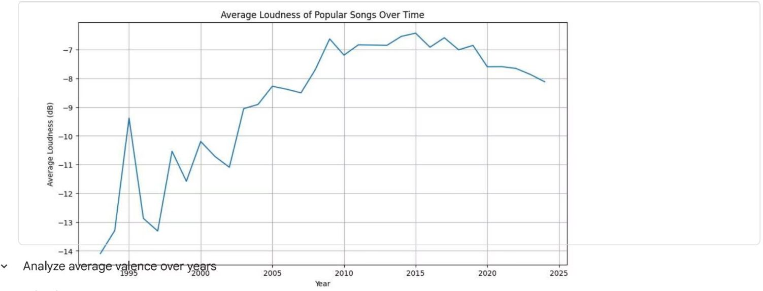
The "Loudness War" Revealed
Tracking Audio Intensity
The line plot reveals a clear upward trend in average loudness (measured in decibels) over time. This visualization provides empirical evidence of the so-called "loudness war"—a phenomenon where music producers progressively increased track loudness to compete for listener attention.
The steady climb from lower dB levels to higher values demonstrates how production techniques evolved to create more compressed, louder masters, particularly accelerating in the late 1990s and 2000s.

Slide 45
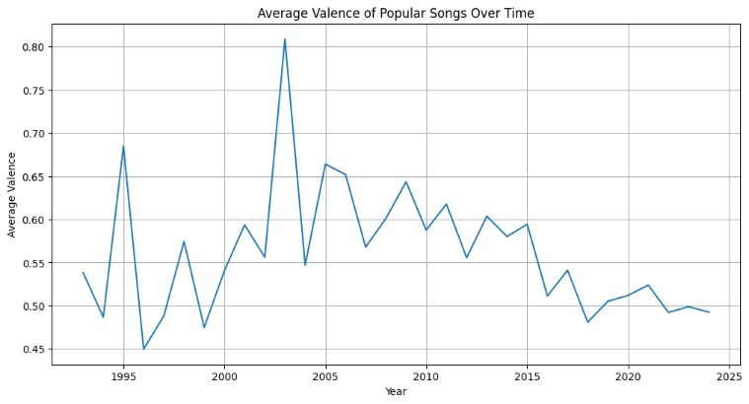
Musical Positivity: The Valence Journey
Valence measures the musical positivity conveyed by a track, with higher values indicating more cheerful, euphoric sounds and lower values suggesting sadness or anger. This time-series analysis tracks how the emotional tone of popular music has shifted across generations.
1
Early Trends
Baseline valence levels establish the emotional starting point
2
Mid-Period Shifts
Notable fluctuations reflect cultural and social influences
3
Recent Evolution
Contemporary patterns reveal current emotional preferences

Slide 46
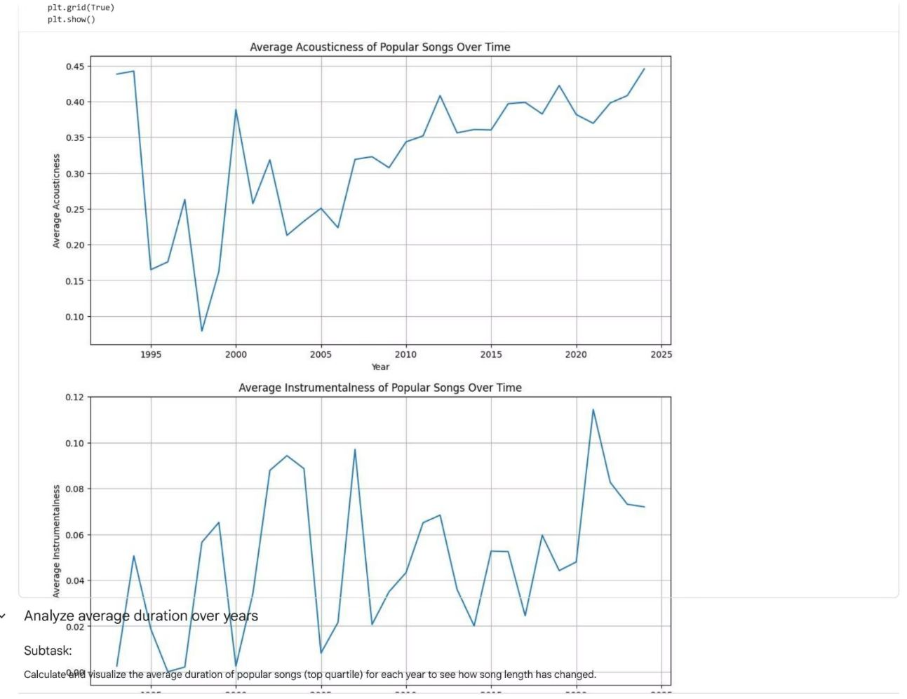

Production Style Evolution: Acousticness & Instrumentalness
Acousticness Trajectory
The declining trend in acousticness reveals a dramatic shift toward electronic and synthesized production. As digital audio workstations became ubiquitous, fewer hit songs featured predominantly acoustic instruments.
Instrumentalness Patterns
The instrumentalness metric tracks vocal versus instrumental content. The data shows most popular music maintains strong vocal presence, with purely instrumental tracks becoming increasingly rare in mainstream charts.

Slide 47
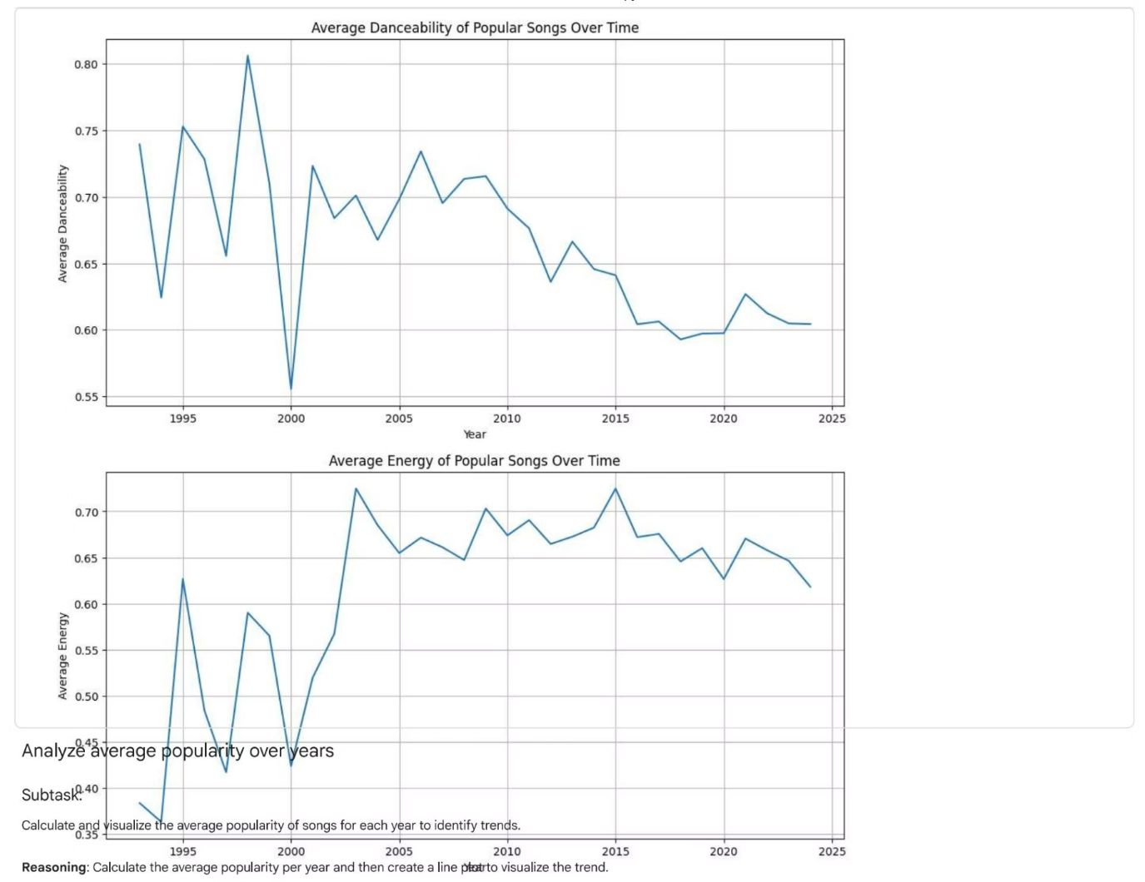
Tempo Trends: The Rhythm of Popularity
Tempo Range Analysis
We categorized songs into five distinct tempo ranges to understand rhythmic preferences:
<80 BPM: Slow ballads and downtempo tracks
80-120 BPM: Moderate tempo, comfortable groove
120-160 BPM: Upbeat pop and dance music
160-200 BPM: Fast-paced, high energy
>200 BPM: Extreme tempo, specialized genres
The visualization shows how tempo preferences have evolved, potentially reflecting shifts in dominant genres—from disco's steady beats to hip-hop's varied rhythms to EDM's driving energy.

Slide 48
Research Overview and Methodology
Dataset Characteristics
Analytical Approach
Our analysis leverages a comprehensive music dataset containing popularity metrics and audio feature measurements. Each track includes normalized values for seven distinct audio characteristics, enabling systematic comparison across the full spectrum of musical styles and genres.
Using seaborn's scatterplot functionality, we visualized bivariate relationships between popularity scores and individual audio features. The alpha transparency parameter (0.6) allows us to identify density patterns and potential clustering within the data distribution.

Slide 49
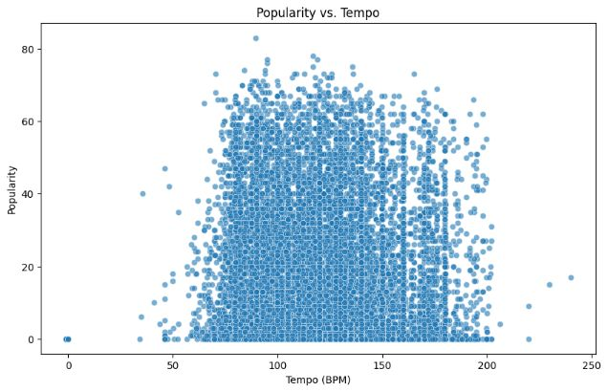
Analyzing Music Popularity Through Audio Features
A comprehensive exploration of how musical attributes correlate with track popularity using Python's seaborn visualization library. This analysis examines seven key audio features to uncover patterns in what makes music resonate with audiences.

Slide 50
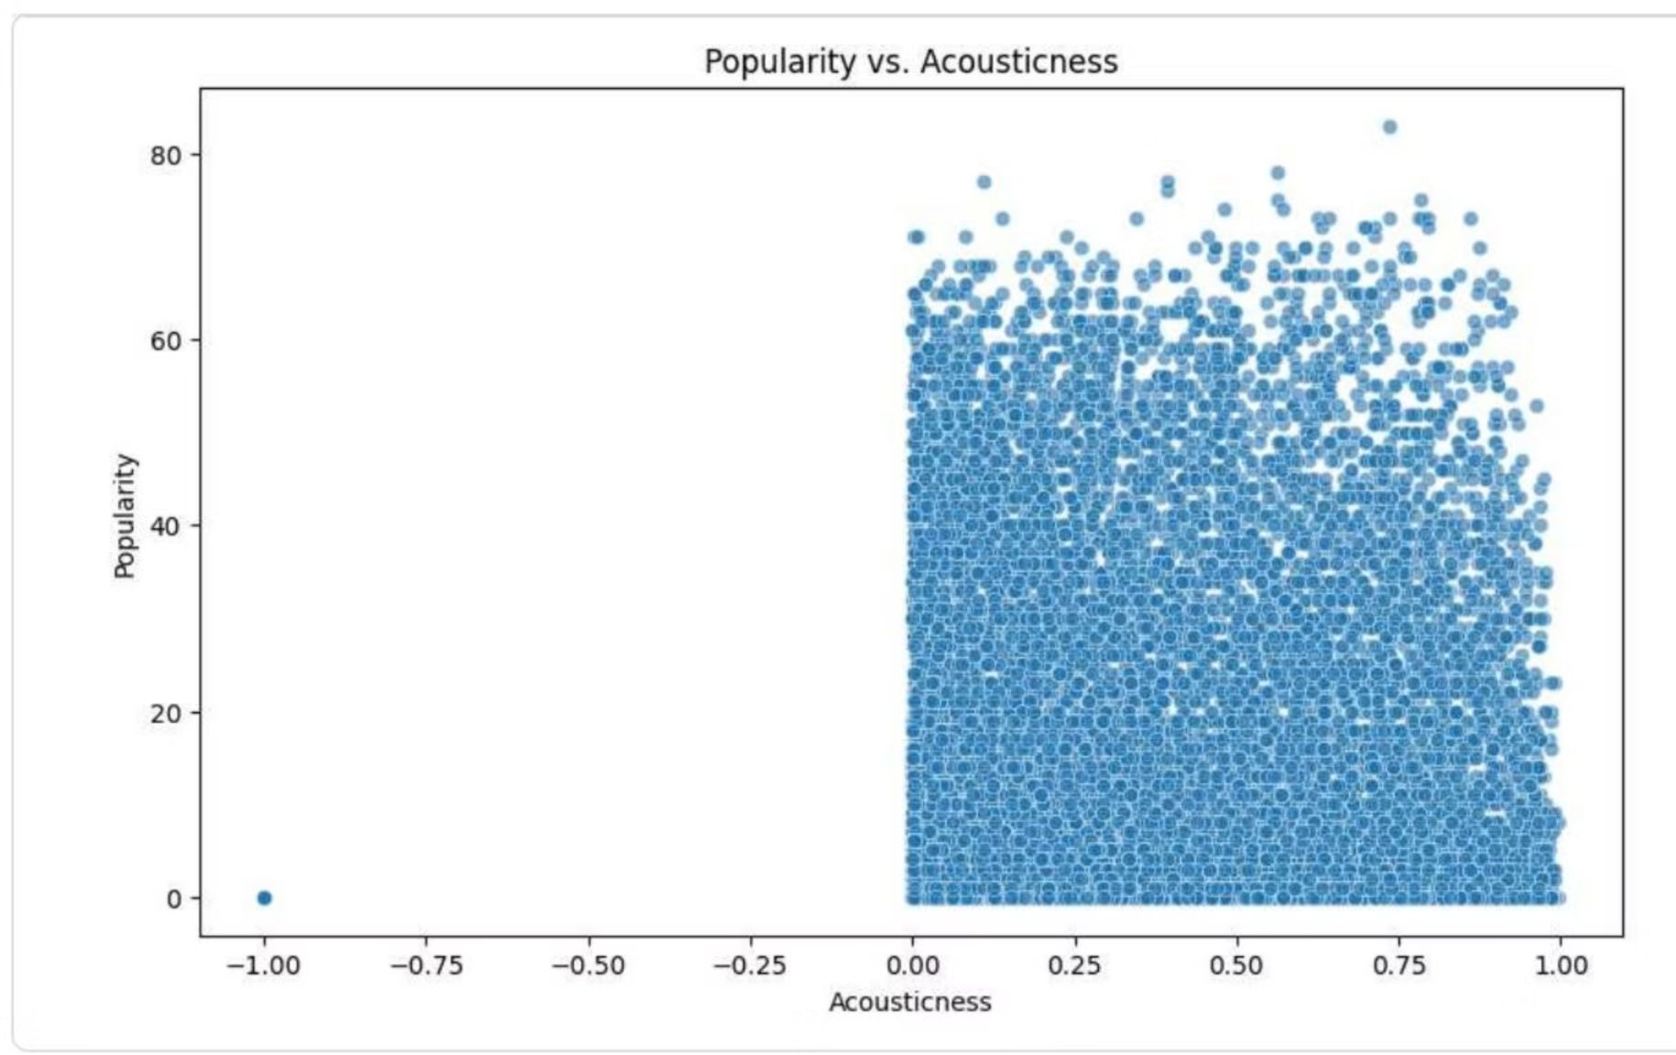
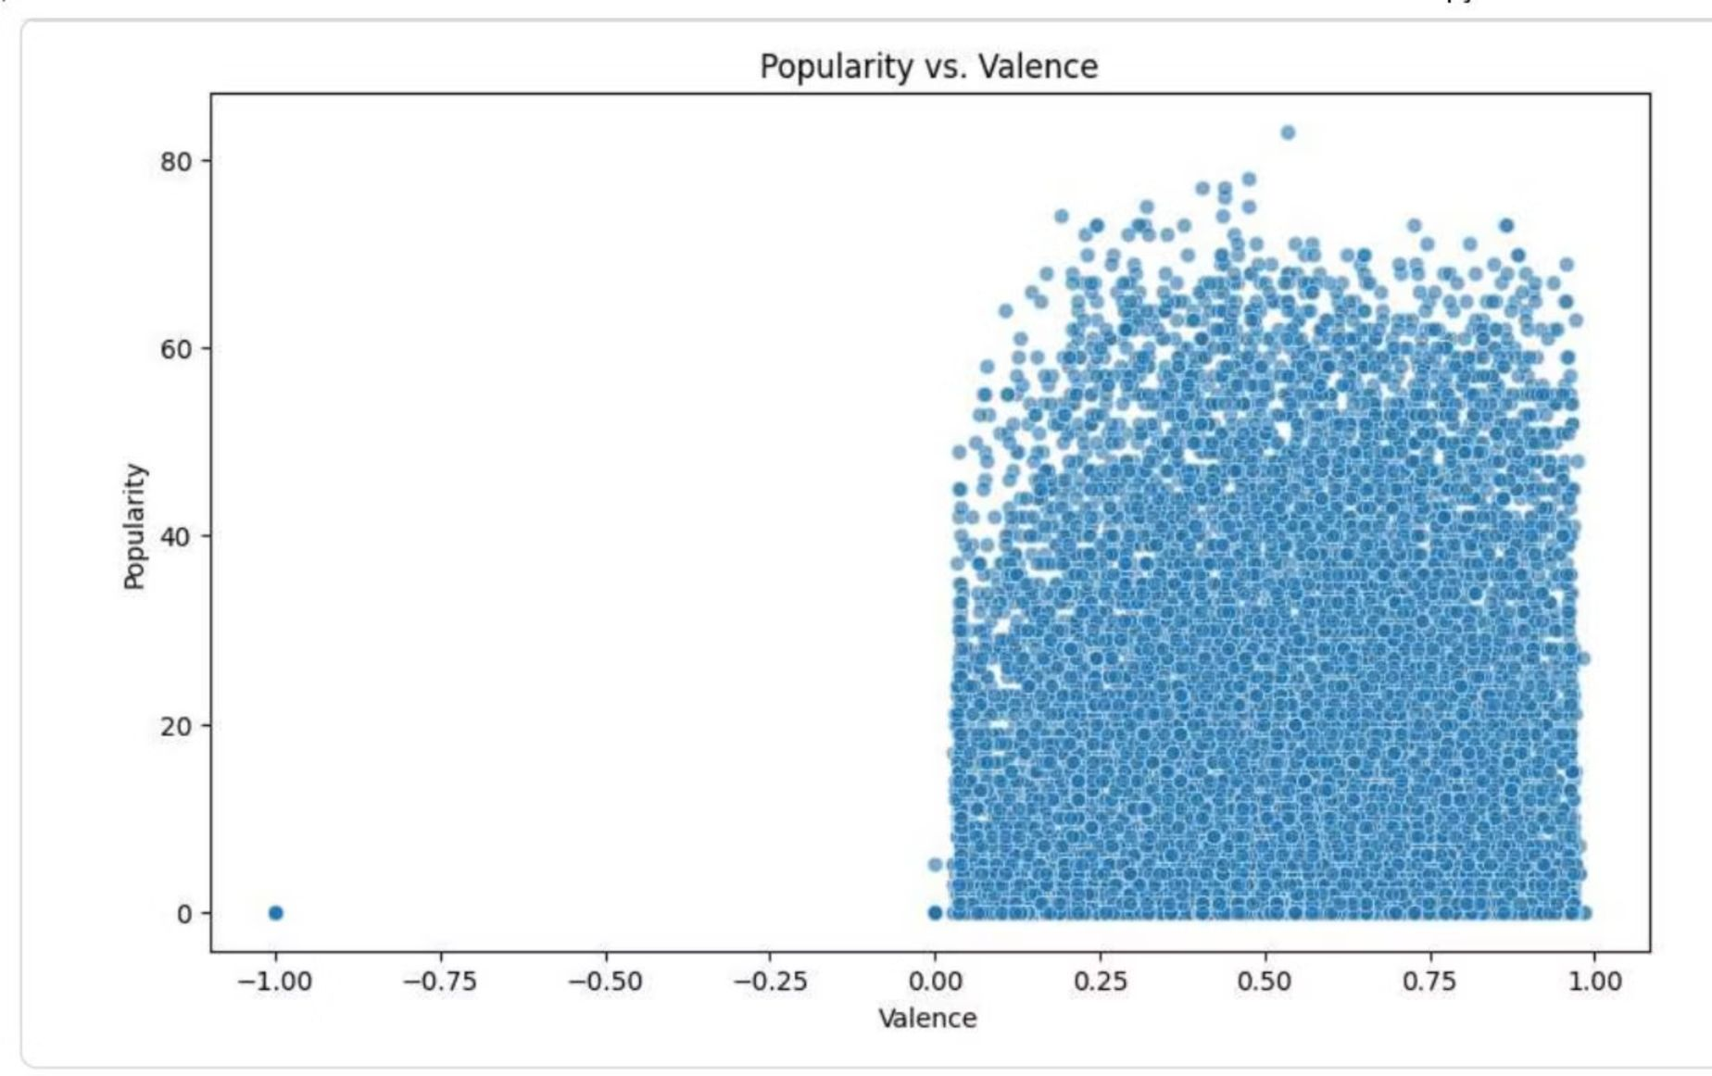
Loudness and Acoustic Properties
Loudness Trends
The loudness analysis shows most popular tracks cluster between -10dB and -5dB, reflecting modern mastering practices. Extremely quiet tracks (below -15dB) rarely achieve high popularity, potentially due to perceived production quality or streaming platform normalization standards.
Acousticness Insights
Acousticness exhibits an inverse relationship with popularity. Most high-performing tracks score low on acousticness (<0.2), suggesting contemporary audiences favor electronic production and synthesized sounds over purely acoustic arrangements.

Slide 51
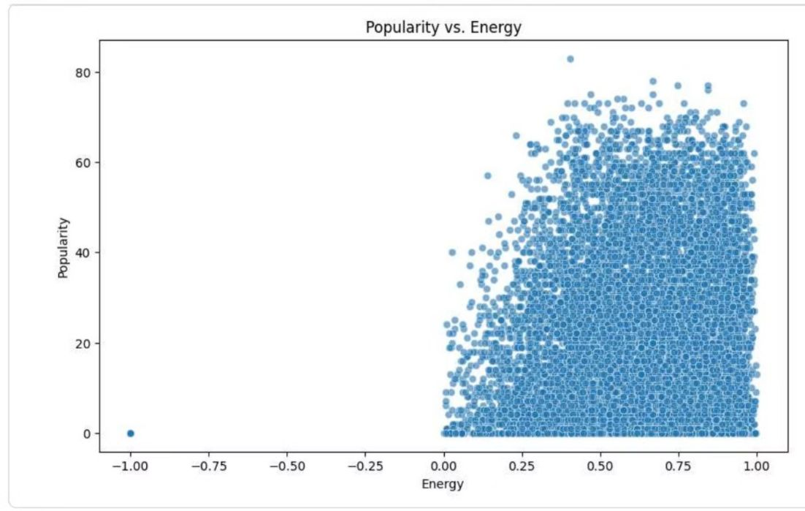
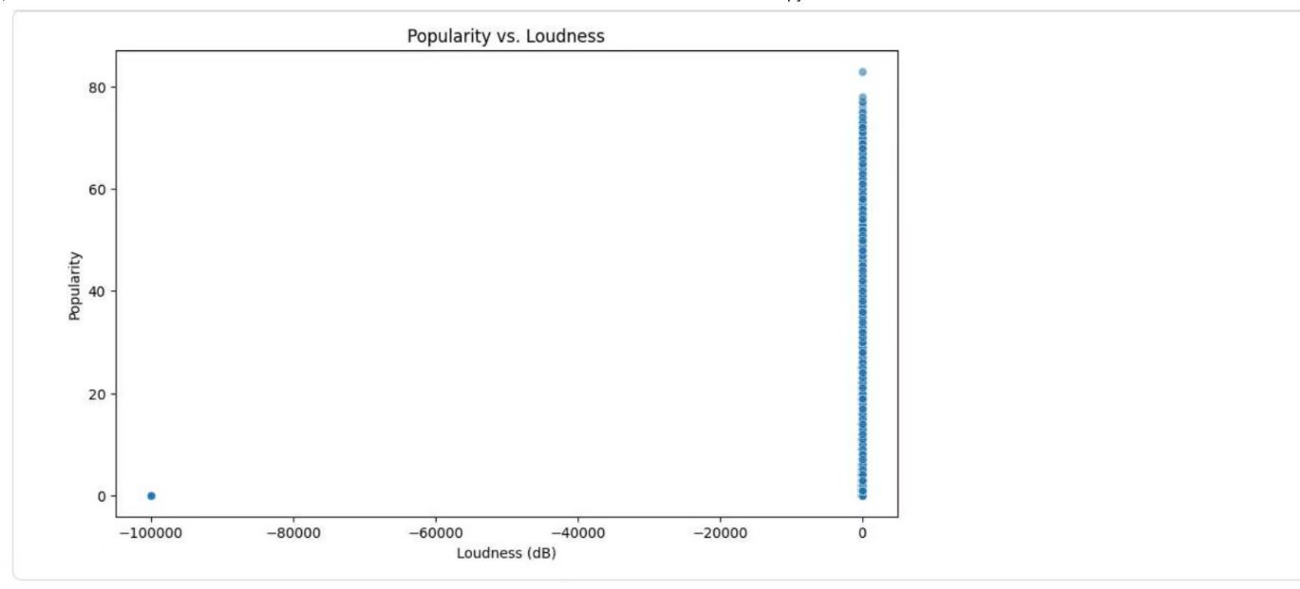
Danceability and Energy Analysis
Danceability Correlation
Energy Patterns
Energy displays a broader distribution across the popularity spectrum. High-energy tracks (>0.7) show significant popularity variation, indicating that intensity alone doesn't guarantee commercial success. The data suggests listeners appreciate both energetic and mellow content.
The danceability scatterplot reveals a concentrated cluster of popular tracks in the mid-to-high danceability range (0.5-0.8), suggesting that rhythmic accessibility contributes to mainstream appeal.

Slide 52
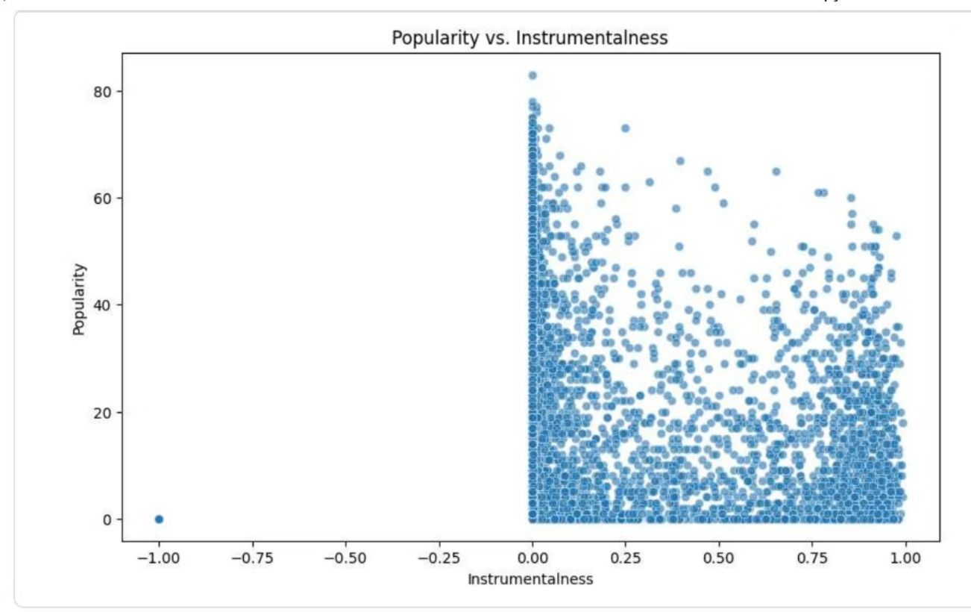

Emotional and Tonal Characteristics
Valence Distribution
The valence scatterplot displays remarkable uniformity, with popular tracks spanning the entire emotional spectrum from melancholic to euphoric. This suggests that emotional tone is highly subjective and audience-dependent, with successful music catering to diverse mood preferences across genres and demographics.
Interpretation
The lack of clear valence correlation indicates that listeners don't universally prefer happy or sad music. Instead, popularity depends on authenticity, production quality, and contextual factors like marketing and cultural relevance rather than inherent emotional positivity.

Slide 53



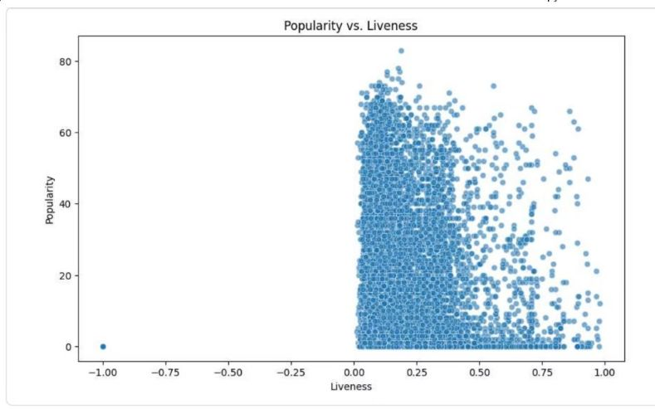
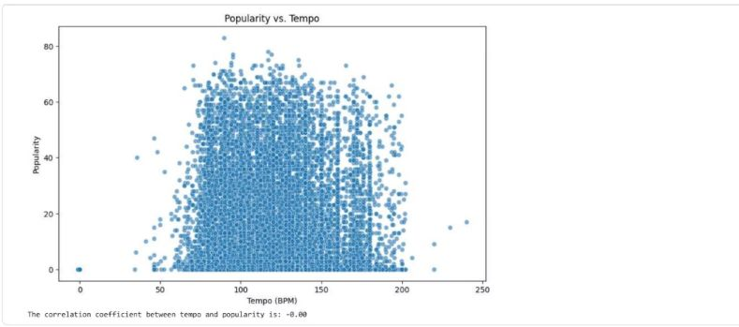
Instrumental and Live Performance Metrics
Instrumentalness
Liveness
The liveness distribution heavily favors studio recordings, with most popular tracks showing liveness scores below 0.3. This reflects listener preferences for polished, controlled production over the raw energy of live performances in streaming contexts.
Nearly all popular tracks cluster at instrumentalness values near zero, confirming the dominance of vocal-driven music in mainstream markets. Pure instrumental tracks rarely achieve mass popularity outside specialized genres like classical or film scores.

Slide 54
Conclusions and Analytical Implications
No Single Formula for Success
This multivariate analysis demonstrates that music popularity emerges from complex interactions between audio features rather than any single dominant characteristic. While certain trends appear—preference for moderate danceability, electronic production, and vocal content—substantial variance exists within these patterns.
Recommendations for Further Research
Incorporate temporal analysis to track how feature preferences evolve across decades and musical eras
Examine genre-specific patterns, as aggregated data may obscure important stylistic distinctions
Integrate external variables like marketing spend, artist reputation, and playlist placement
Apply machine learning clustering algorithms to identify distinct audience segments with unique feature preferences
These visualizations provide a foundation for deeper investigation into the quantifiable dimensions of musical appeal and commercial success.

Slide 55
Presented by Manobendra Ghosh
"Together, We Achieve More"
This presentation was crafted with care, attention to detail, and a commitment to excellence. Every element—from concept to execution—reflects the dedication and expertise of Manobendra Ghosh.
100%
∞
1
Dedication
Gratitude
Vision
Full commitment to quality and impact
Endless appreciation for your time
United purpose driving excellence
Thank you once again for your attention, engagement, and support. Here's to continued collaboration, growth, and shared success.

Slide 56

Thank You!
We appreciate your time, attention, and engagement throughout this presentation. Your presence has made this moment meaningful.

