Slide 1

Customer Life Cycle Management & Contact Strategy
The Idea
March 2015

Slide 2


CEM Analytics owns a suite of Predictive Models
Cater well to a specific need, but not tie things holistically – hence, not very optimal
Multiple messages being sent to same Customer/s, expressing different themes
Who are my maximum Revenue generating Customers?
Confusion for end Customers when they are bombarded with multiple messages
Who will respond to my Campaigns?
Who is likely to Attrite ?
Confused Customer => Lower RoI from Marketing Budget
What Product/s should a Customer be Targeted with?
What Products will help me do more Cross Sell ?
Are there specific Customer Behavior Segments?

Slide 3

Customer Life Cycle Management – Strategic Approach
Coming from Competition
ACQUISITION
Relationship Development Phase
ACTIVE
Continue to be Active
Lost forever to Competition
New Shoppers
ATTRITE
Dead Consumer
Cannibalized from Sister-brand
Returning Consumer
Transitioned to Sister-brand
ACQUISITION
ACTIVE
ATTRITE
Grow the Relationship
Stop them from Attrition
Cross Sell
Free benefits for limited days
Keep them happy and engaged
Up Sell – especially to lower LTV
Customized messaging
Needs a Proactive approach
Issues to be addressed
Hold Attrition with Unusual Offers
Addressing Customer grievances

Slide 4
Analytics Support to Marketing Activities – Hierarchal Architecture
CONTACT STRATEGY
Customer-wise snapshot of Targeting (When, What Message?, What mode?, How frequently?)
Created at the beginning of each quarter
Updated –Customer Activity/Response acts as a trigger
CAMPAIGN DESIGN
Compiling Lead Gen list to achieve specific Business Objectives
Suggested Messages can also be compiled
The list will mostly be generated from EVERGEEN ATTRIBUTES
The list size can be determined from Budget or Optimal Response Zone
EVERGREEN ATTRIBUTES
Inferred(Statistically or based on Business Rules) Customer Attributes
Updated on agreed cadence
Likelihood to Respond to Mail/Email, Likelihood to Attrite, Life Cycle Labels (Recent or Retained), CLTV, Customer Segment, Discount Sensitivity, Probable Product Purchase, Optimal Number of Touch Points, preferred mode of communication, etc.
Models put into Production/in pilot phase
DATABASE
The raw data as we see it – ods_orderheader_t, ods_orderline_t…

Slide 5
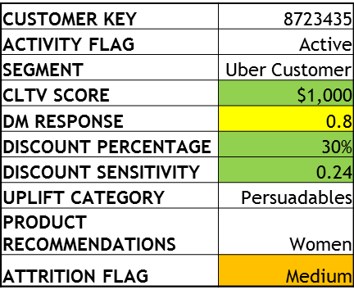
Contact Strategy
Bottom line – Don’t target a Customer more than ‘x’ number of times in a Quarter –No Targeting immediately after a Purchase Event
x can be a statistically determined Optimal Number of Touch Points for a Customer – an EVERGREEN ATTRIBUTE
Unique for every Customer
Touch Dates planned in the beginning of the Quarter
Updated daily – to look for any Purchase Events
Mostly playing around with Timing and Opportunity to Contact
Q2 FY 2015 Contact Strategy for Customer Key xxxxxx
Email
Email
DM
Email
CUSTOMER PROFILE
Quarter Beginning
M01 Starts
M02 Starts
M03 Starts
Quarter Ends
Updated Q2 FY 2015 Contact Strategy for Customer Key xxxxxx
Purchase Event
Email
Email
DM
V.High
Quarter Beginning
M01 Starts
M02 Starts
M03 Starts
Quarter Ends
High
Med
Low

Slide 6
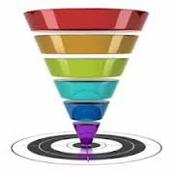
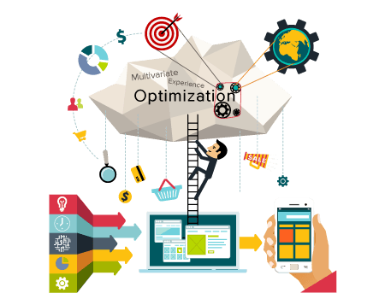
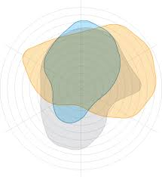
Campaign Design
Example of a Business Objective – Reach out to maximum number of Active BR Customers to keep them engaged
Use EVERGREEN ATTRIBUTES to get optimal business value (like more responses or more revenue) while doing list selection
Also take Real time ‘Contact Strategy’ inputs/attributes – they will filter out a lot of leads
Pure Filter/Overlay Approach VS Multivariate Experience Optimization
Customer list Optimized for the given Creative / Message
Maximize Customer Response or generate Maximum Revenue
Last Touch Point also incorporated in the Lead Gen Process

Slide 7
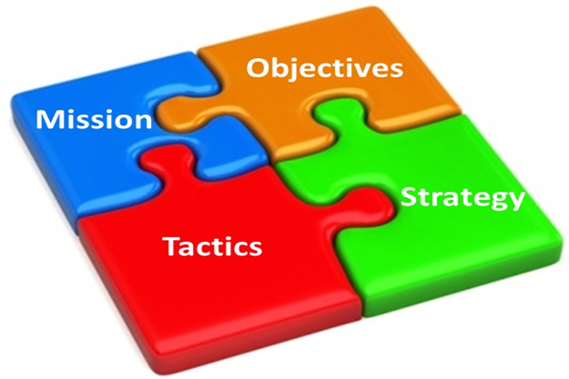
Integration at all levels
Marketing is about CUSTOMER EXPERIENCE
Customers have a natural cadence/cycle to purchase if the products are not a necessity
No Over-saturation of Emails
More Intelligent Emails – personalized, relevant, and specific

Slide 8
APPENDIX

Slide 9
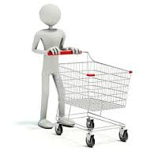
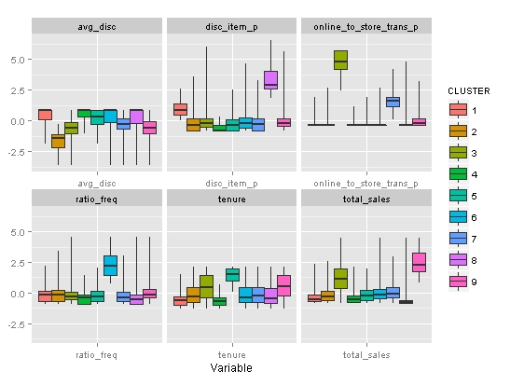
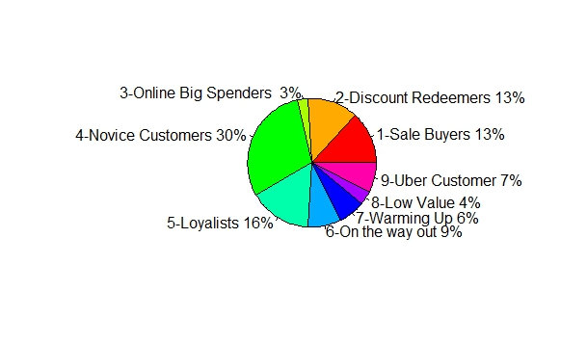
Active Customer Segments
50%
3.4
1.3
22%
# of Customers =13,865,046
15%
18.9%
7.4%
30%
SALE BUYERS
DISCOUNT REDEEMERS
ONLINE BIG SPENDERS
NOVICE CUSTOMERS
$1437.4
LOYALISTS
4
10.8Y
$896.3
$373
ON THE WAY OUT
6.9Y
7.18Y
$278
0.67
0.5
4Y
2.7Y
$170.6
$148
$328
$67.9
WARMING UP
LOW VALUE
UBER CUSTOMER
RESET
Highest discount, medium spend, consistent, longish tenure
Very high value, long-term, online buyers, heavy discount and sale
Longest-term customer, mostly retail
Online buyers increasing their frequency, engaging with discount, good spend
Highest value, long-term customer. Engaged with discount
Higher discount but low on sale
Recent Customers, further split on Product Proportion
Mid-tier spenders who are attriting from ON
Lowest value but reactivating through onsale items

