Slide 1
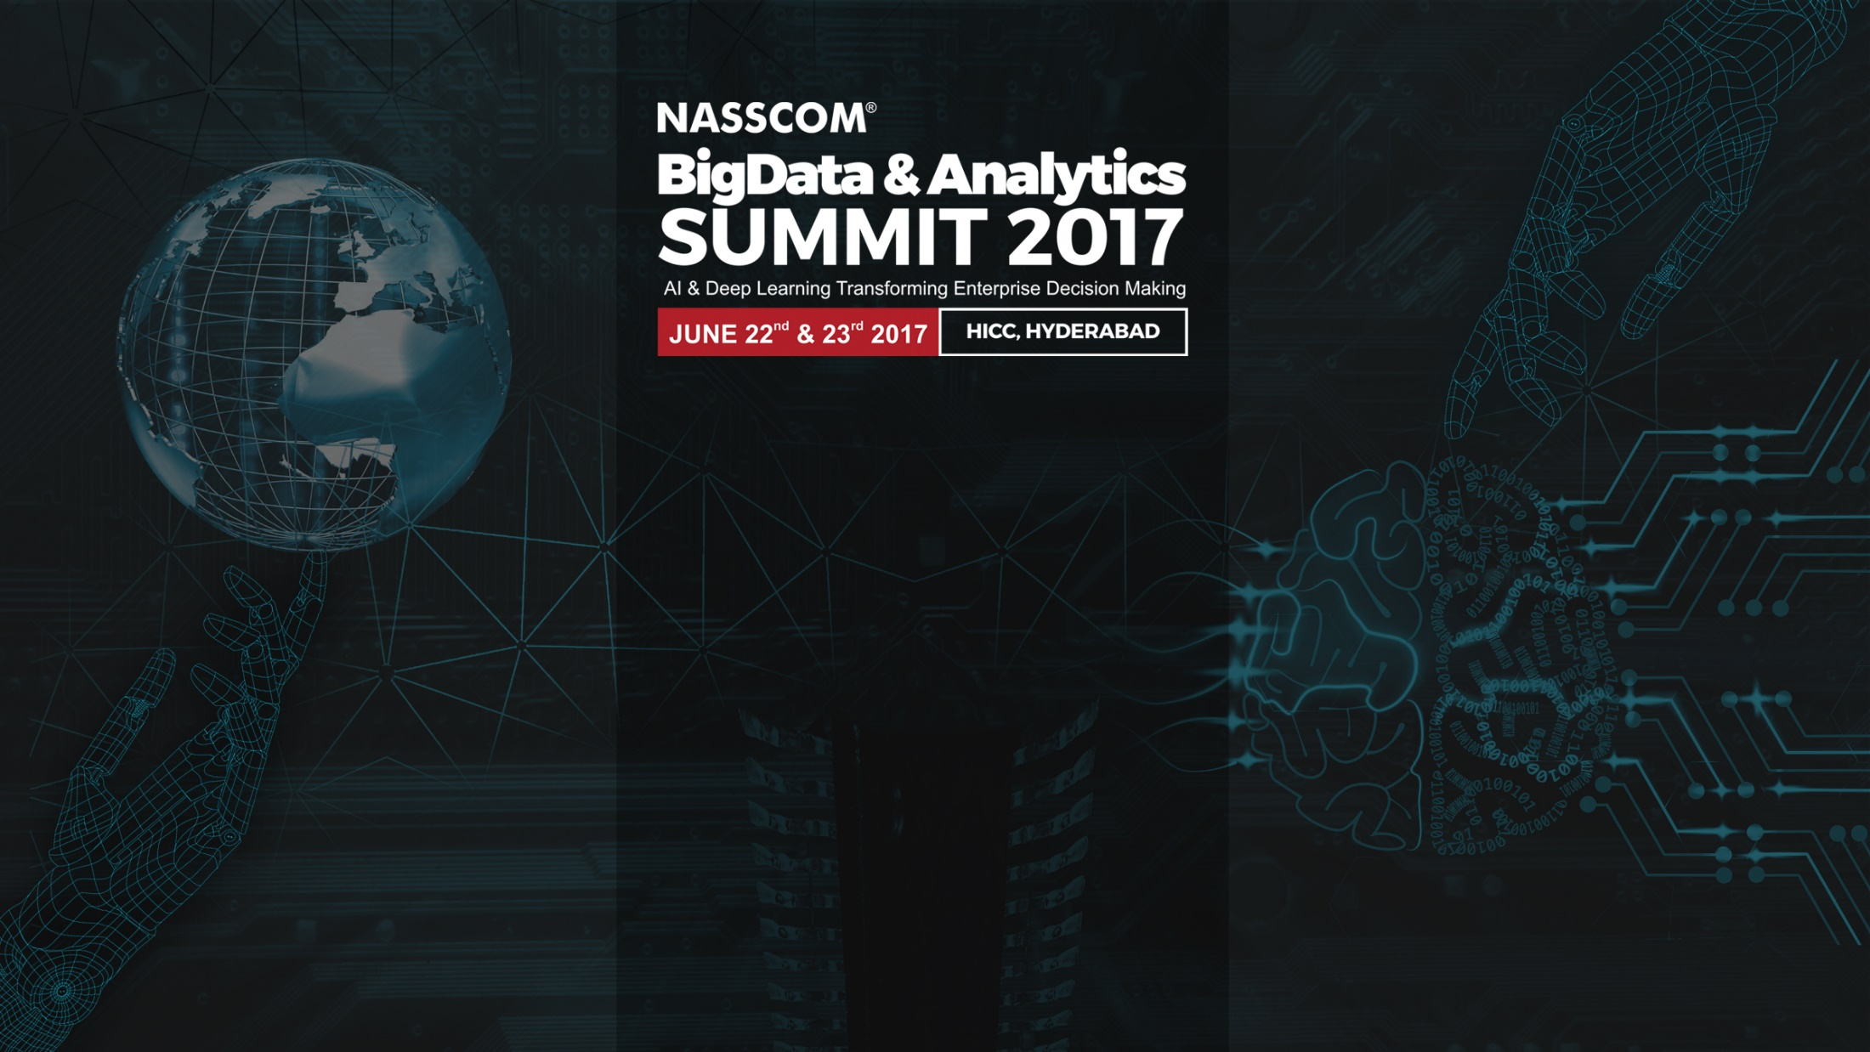
Analytics Strategy and Information Catalogue

Slide 2

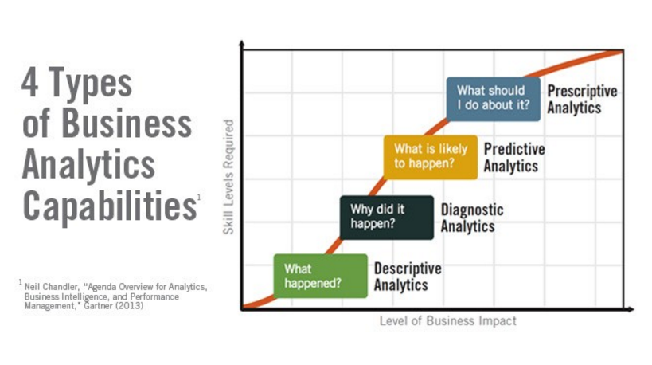
What is Analytics?
Sachin Pendse
Global Data Modeling / Architect Lead
Mondelez International

Slide 3

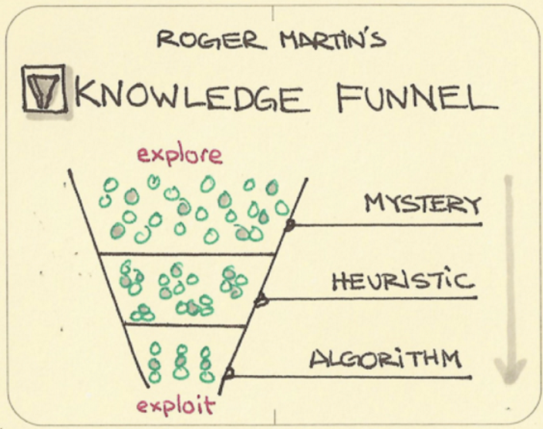
Analytics Strategy - How we are going to do it
GOAL
Liquid data to empower bottom and top-line growth
STRATEGY
Deliver insights today AND build solid data foundations for tomorrow
OPERATING MODEL
4 engagement types to address different use cases (Knowledge Funnel)
Advanced Analytics
Ad-hoc Solutions
Scalable Solutions
Self-service BI
Analytics Projects will be on the Analytics CoE Portfolio only if they fit
with the Strategy
Analytics Lab
Reporting Hub
Delivery Hub
Global Data Marketplace

Slide 4
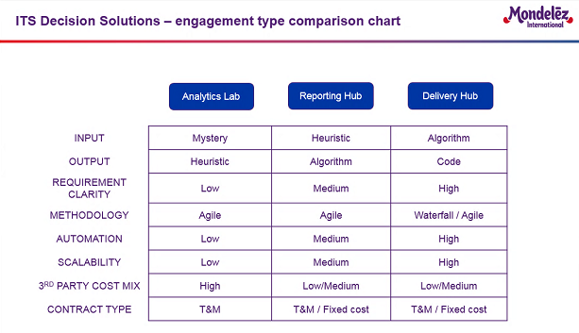
Analytics Strategy

Slide 5
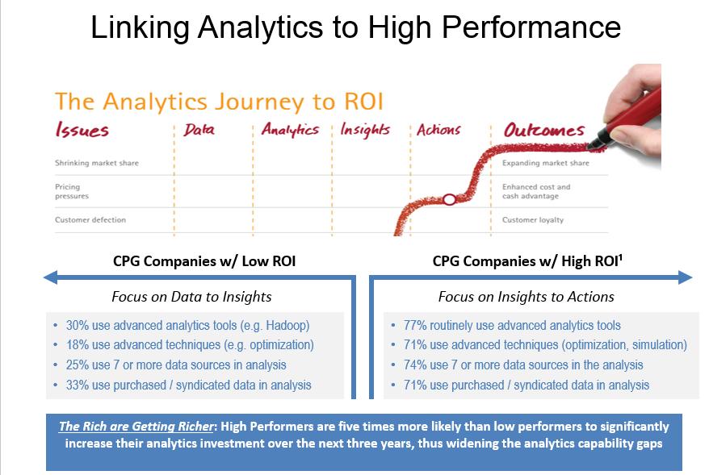

Slide 6
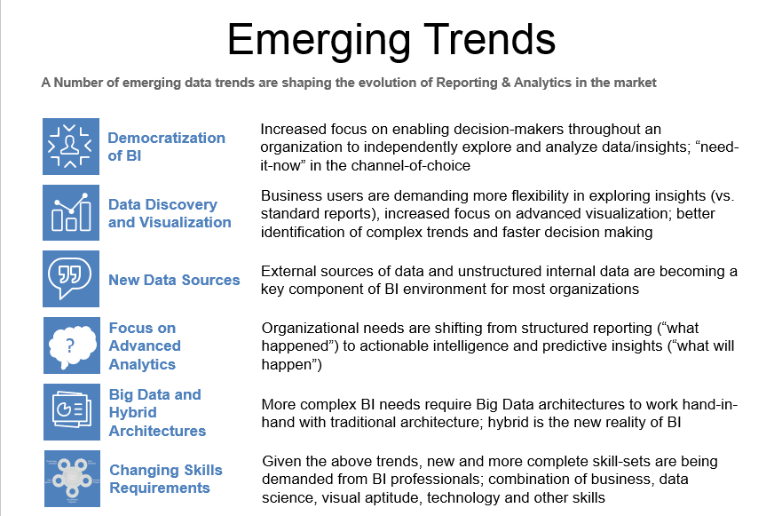

Slide 7
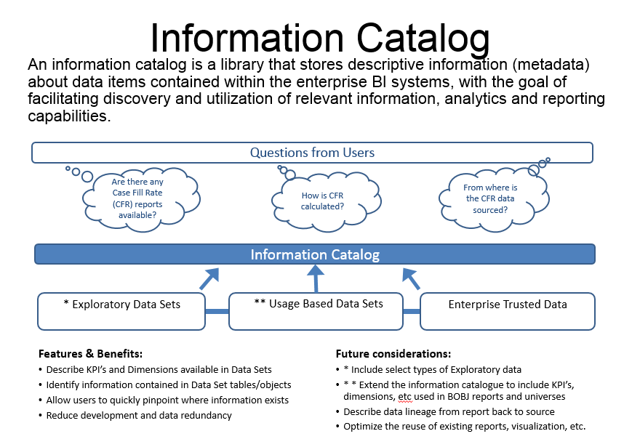

Slide 8
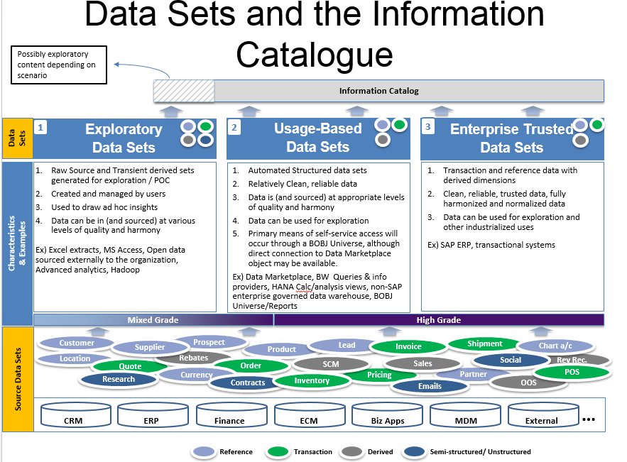

Slide 9
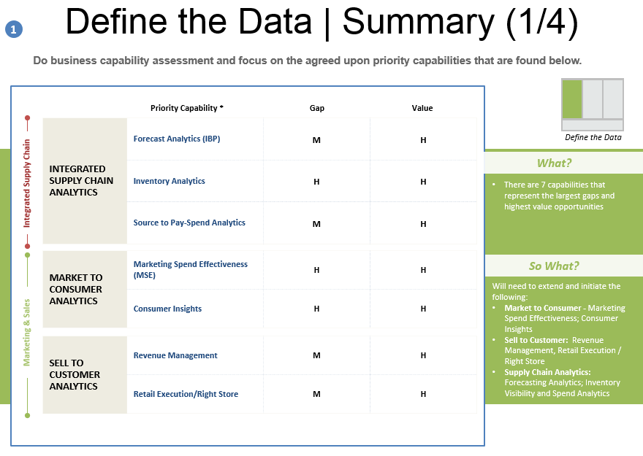

Slide 10
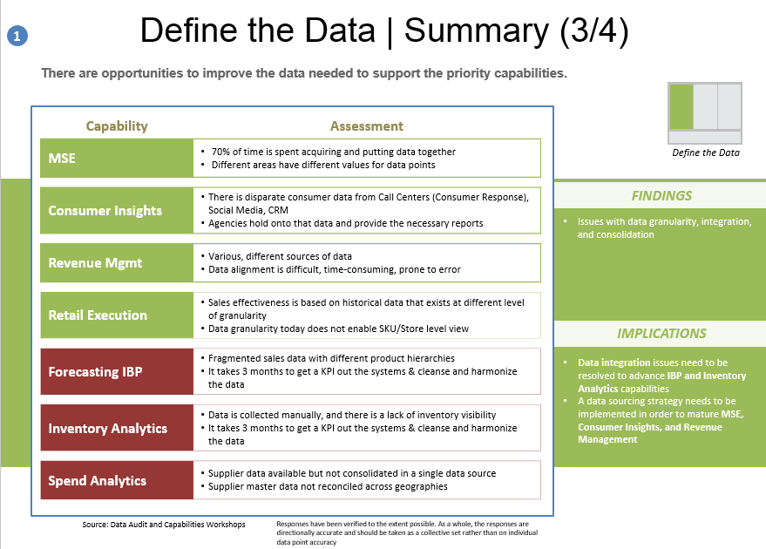

Slide 11
Thank You

