Slide 1
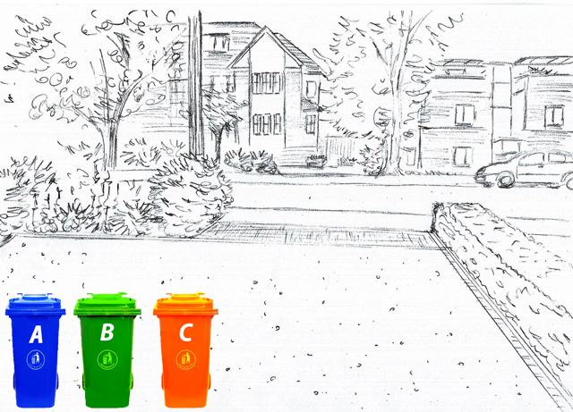
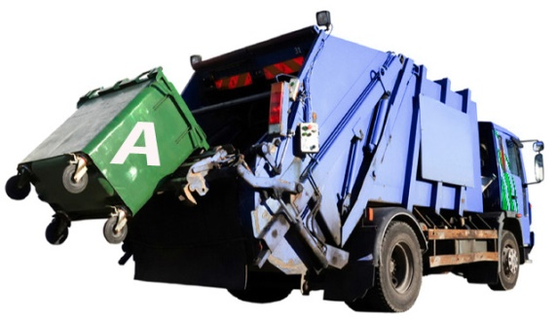
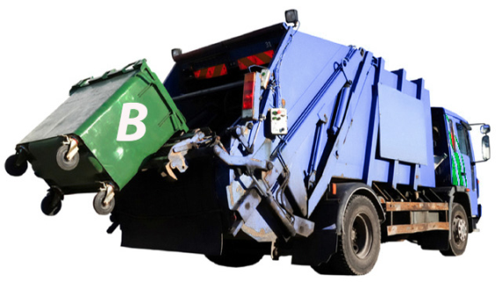
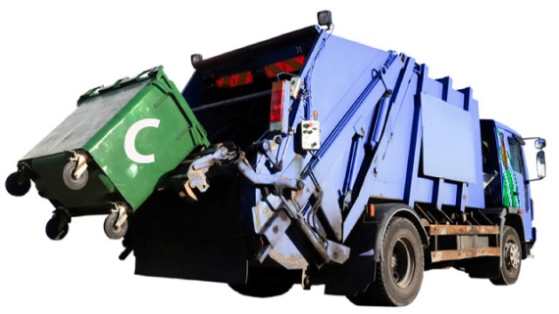
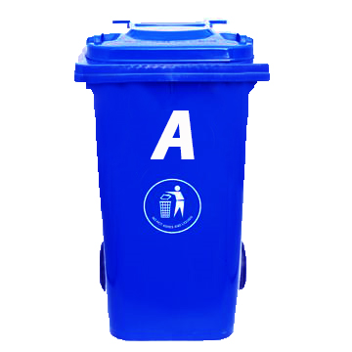
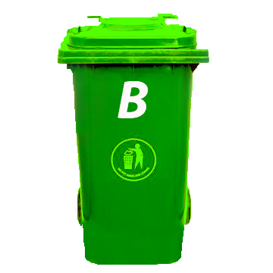
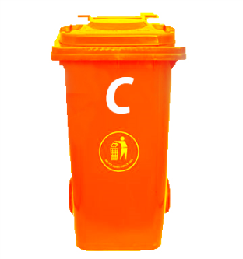
3 -SMARTBIN SYSTEM
A SMALL EFFORT IN OUR PART TOWARDS A CLEAN CITY
PRESENTED BY:
PREETAM GHOSH
RAJDEEP DEBNATH
T. JITENDRA KUMAR

Slide 2
THE PROBLEM:
With the ever increasing population and urbanization, the waste management has emerged as a huge challenge in our country. Not only the waste has increased in quantity, but the characteristics of waste have also changed tremendously over a period, with the introduction of so many new gadgets and equipment. It is estimated that about 62 million tonnes of waste is generated annually in our country, out of which 5.6 million is plastic waste, 0.17 million is biomedical waste. In addition, hazardous waste generation is 7.90 million TPA and 15 lakh tonne is e-waste. The per capita waste generation in Indian cities range from 200 grams to 600 grams per day as of 2011. 43 million TPA is collected, 11.9 million is treated and 31 million is dumped in landfill sites.
One of the main problems in INDIA is garbage mixing. Different types of waste are dumped without separating them which reduces the possibility of recycling. Another major problem is overfilling of garbage collecting bins , which hampers the garbage collection process and pollutes the environment.

Slide 3


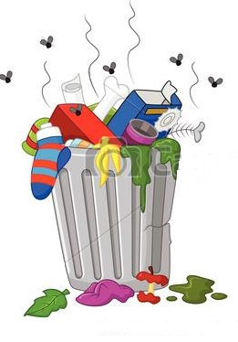




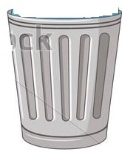

Slide 4
THE PROPOSED SOLUTION : 3- SMARTBIN SYSTEM
To tackle the problem we propose a 3-smartbin system which would minimize the problem and help us to reduce the amount of waste. The waste generated can mainly be divided into three categories:
Bio-degradable
Non bio-degradable
Electronic waste or e-waste
3-SMARTBIN SYSTEM:According to the classification of waste into three main types, they need to be disposed in three different types. Hence, 3 smartbin system can be useful in solving the present problem. The waste would be separated into three different types of smartbins which will be processed in three different methods to manage the garbage. In the first dustbin, bio degradable waste would dumped. In second dustbin, non bio-degradable waste(except e-waste) would be dumped. In third dustbin, electronic waste would be dumped. These would be carried by three different types of trucks and dumped in three different dump yards which would prevent the mixing of garbage.

Slide 5
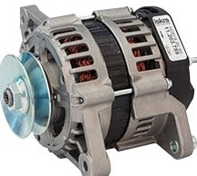
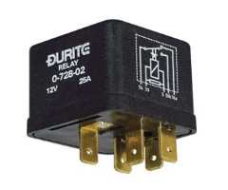
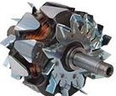



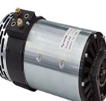




A
B
C

Slide 6
Smartbin A: (Green colour signifying ecofriendlyness)
Smartbin A would collect the bio degradable waste. Around 50% of the waste generated is bio-degradable.
Bio-degradable waste: Bio-degradable waste is a type of waste which can be broken down into base compounds by micro-organisms and other living things in a matter of weeks or few months.
Common examples are fruit and vegetable peels, kitchen wastes, left over food materials, slaughter house waste, etc.
These are used for landfilling, biogas generation and fertilizer producing.
How Bio-degradable waste cause problems: The bio-degradable decompose easily and give out foul smell. When kept in open, flies and other insects swarm over it and it is also spilled by dogs and cats which is unhygienic and spreads diseases. Due to spread out by animals and also during rainy season, it goes into sewage drains and clog them. It also produces methane, a greenhouse gas
Collection and processing of waste through smartbin A: In smartbin A, the bio-degradable waste would be collected. Then this waste would be collected by truck A and carried to dump yard A. There the waste would be used for generation of energy by incineration process and biogas plant and also in fertilizer making.

Slide 7
Smartbin B:(Red colour signifying hazardous)
Smartbin B would collect the non bio-degradable waste. Around 30% of the waste generated is non bio-degradable.
Non-Biodegradable waste: Non bio-degradable waste is composed of substances that do not break down to a natural, environmentally safe condition over time by biological processes.
Common examples are plastic products, metal products, bottles, tin cans, plastic bags, tires, pvc pipes, used papers, old newspaper, broken glass wares, etc.
As they cannot be broken down, they are recycled and reused.
How Non Bio-degradable waste cause problems: The plastic and synthetic materials does not decompose easily and get into drains and causes water clogging. It also get mixed in water bodies and causes death of aquatic animals.
It emits toxic pollutants coming in contact with air and water harmful for living organisms. When mixed with soil, it reacts and pollutes the soil. As these materials require a long time to decompose so occupies a large area in dumping sites.

Slide 8
Collection and processing of waste through smartbin B: In smartbin B, non-biodegradable waste would be collected. It will then be collected by dumping truck B and sent to dumping site B. There the waste would be separated by rag pickers and the articles which can be reused would be separated by them. The remaining materials which cannot be recycled would be incinerated. The materials collected by the rag pickers would be accumulated and would be sold to scrap dealers and factories as raw materials. For example the broken glassware would be sold to glass factories who would melt it and reuse it again.

Slide 9
Smartbin C:( Blue colour signifying recycling)
Smartbin C would collect the electronic waste. With the increase in use of technology a lot of electronic waste is being generated.
Electronic waste: Electronic waste or e-waste is a special category of non biodegradable waste. It describes discarded electrical or electronic devices. Used electronics which are destined for reuse , resale, recycling or disposal are also considered e-waste.
Common examples are discarded computers, mobiles, television sets, refrigerators, CRTs, used batteries, etc.
They are recycled and used as raw materials for new electronics devices and precious metals like gold, copper, beryllium, etc. are extracted.
How e-waste cause problems: Informal processing of e-waste may cause serious health and pollution problems due to limited regulatory oversight of e-waste processing. Electronic components contain contaminants such as lead, cadmium, Beryllium, brominated flame retardants which causes significant risk to the living organisms. It emits radiation harmful for living cells.

Slide 10
Collection and processing of waste through smartbin C: In smartbin C, the electronic waste materials would be collected. Then truck C would collect the waste and dump it into dump yard C. There trained persons, employed by the municipality, having the proper
knowledge about disposal of e-waste would separate the waste. Microchips can be reused in electronic circuits. The metals like gold, copper, etc. can be extracted. The plastic used can also be recycled.

Slide 11
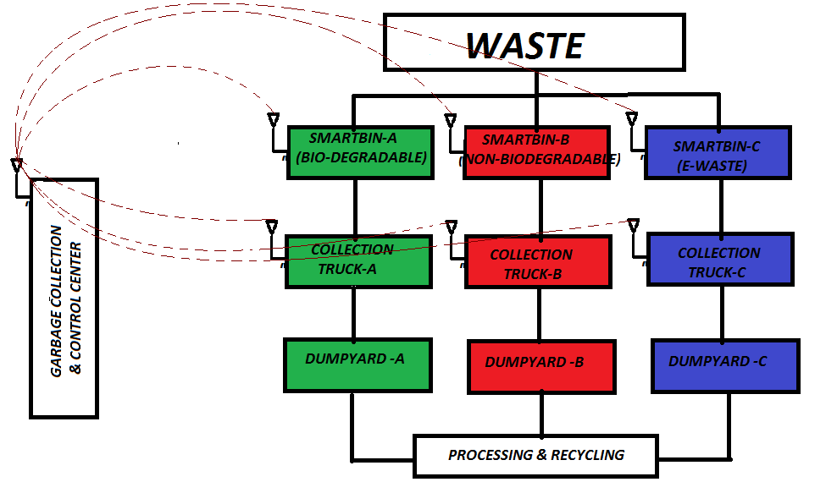

Slide 12
SMARTBIN = SMART + DUSTBIN
we are using the word ‘smartbin’ to refer to smart dustbins that would inform the municipal garbage collection center when bins are full for their collection and proper disposal. Also, if wrong type of waste is disposed in any of the bins( for example if bio-degradable waste is disposed in non-biodegradable) that would be informed to the collection center. These bins especially the bio-degradable ones equipped with gas sensors would nullify the possibility of development of methane and other gases by informing the collection center. The bins would also ensure that they are not over-filled by triggering an alarm and informing the collection center. When the bin is filled, or there is a need to dispose the wastes of a bin due to any special condition like forming of methane, ammonia, the collection center would inform a nearby truck. Other provisions like taking photograph of the waste thrown recently can also be installed for stopping malpractice and raising awareness. This project will help in stopping garbage mixing and facilitate better recycling and reusing practices. It will also help in better garbage collection and monitoring system.

Slide 13
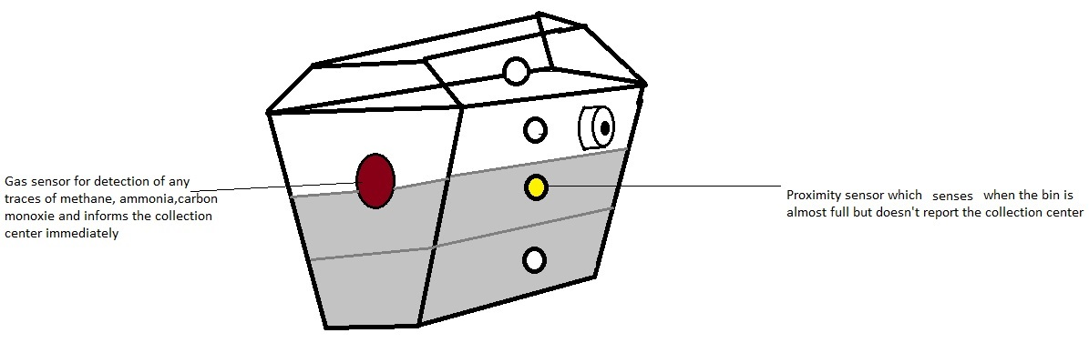
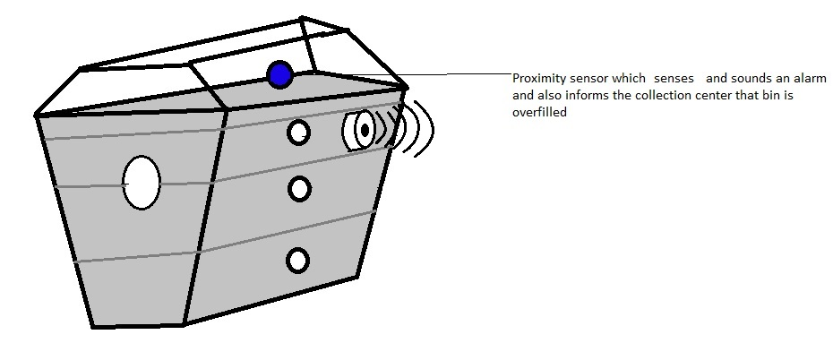
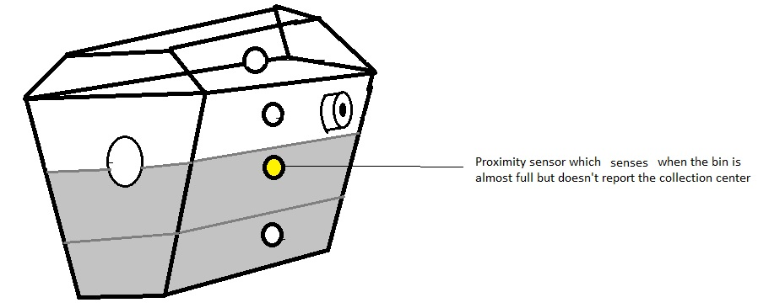
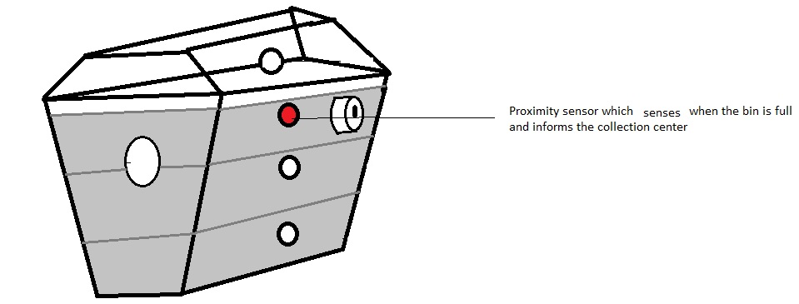
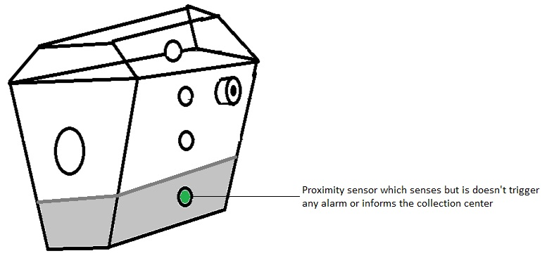
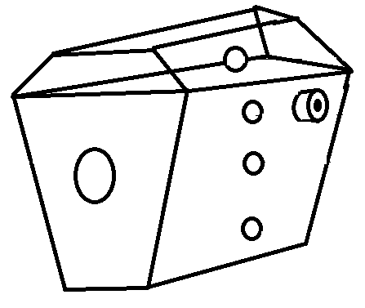

Slide 14
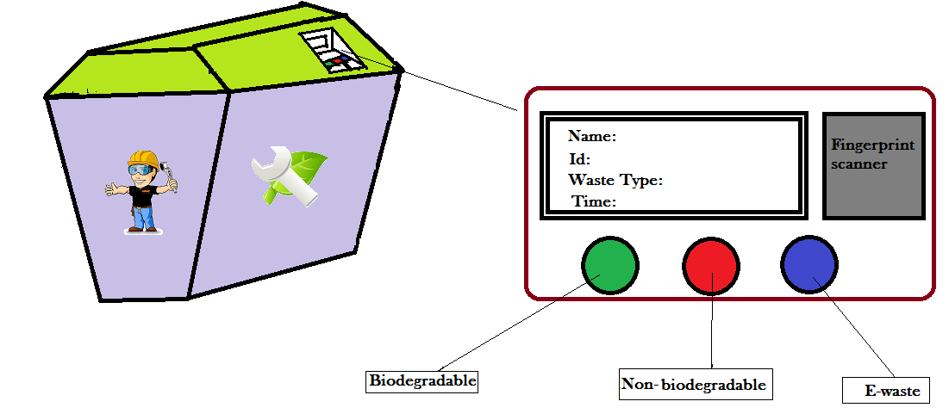

Slide 15
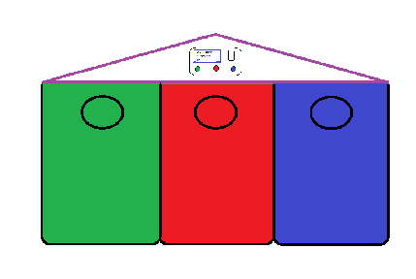
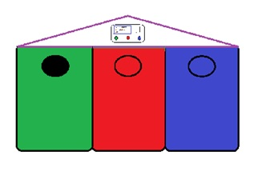
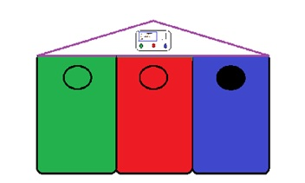
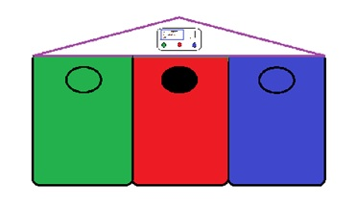
OPENING FOR
GARBAGE DISPOSAL

Slide 16
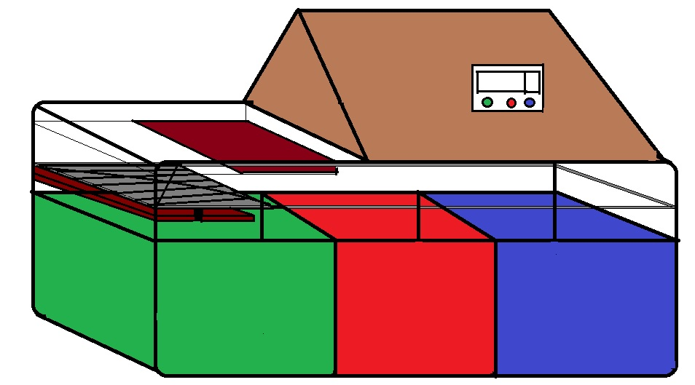
OPENING FOR
GARBAGE DISPOSAL

Slide 17
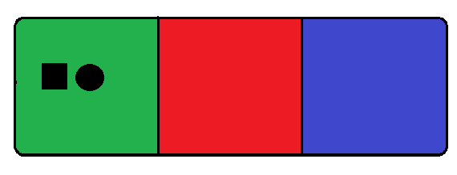
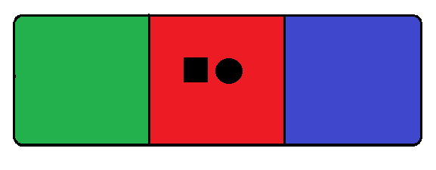
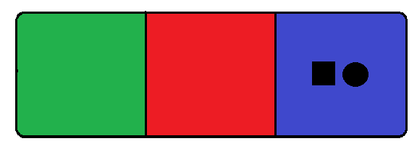
SENSOR SYSTEM
CAMERA

Slide 18
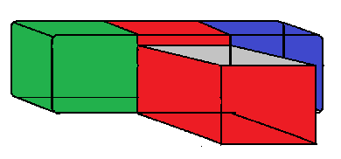
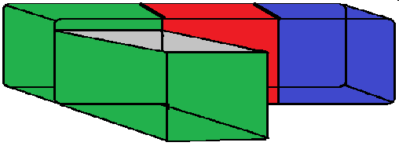
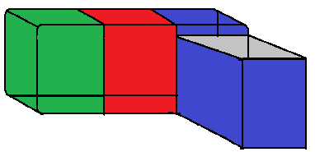

Slide 19
PROS:
The advantages of this project are;
Segregation of different types of waste and their proper disposal.
Reduces the overfilling problems of dustbins.
Human friendly.
Better monitoring and collection of waste.
This may provide a livelihood for rag pickers and would also help the municipal corporation from the shortage of staff.
As trained technicians are working in the process of recycling of e-waste , so no harm will happen to workers.

Slide 20
CONS:
The disadvantages of this project are;
Lack of Social awareness and sense of responsibility may disturb the system.
Poor connectivity may be an issue in case of data transferring and monitoring.
Permanent shortage of staff and transportation vehicles in many municipal corporations and lack of infrastructure.

Slide 21
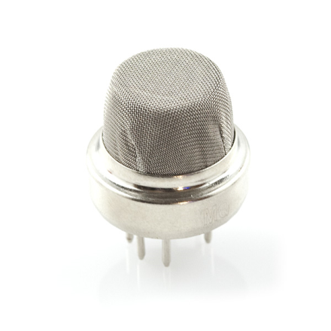
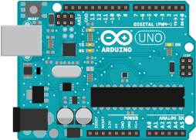
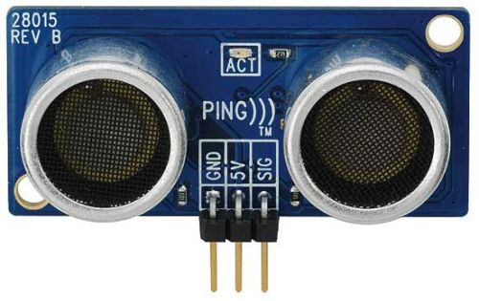
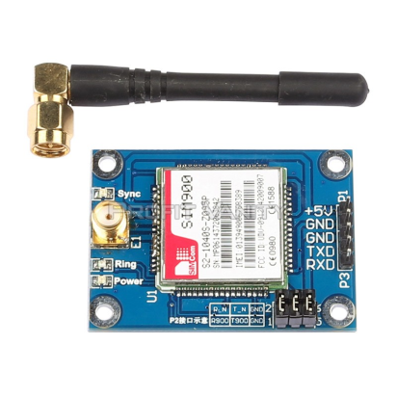
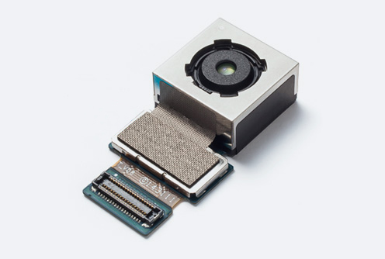
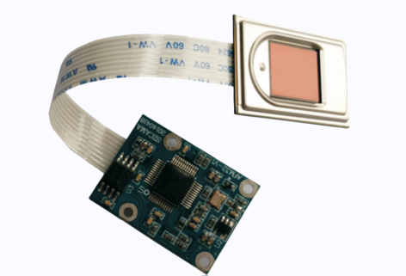
Gas sensor
Microcontroller
Proximity sensor
Camera
Fingerprint sensor
GPRS/GSM module

Slide 22
ACKNOWLEDGEMENT:
http://envfor.nic.in/sites/default/files/Waste%20Management%20Rules,%202016.pdf
https://www.shutterstock.com/image-vector/big-containers-recycling-waste-sorting-plastic-49656070
http://weclipart.com/plastic+bottle+recycle+clip+art
https://create.arduino.cc/projecthub/Aritro/smoke-detection-using-mq-2-gas-sensor-79c54a
http://www.makeuseof.com/tag/8-creative-ideas-recycle-mobile-phone-throwing/
http://zeenews.india.com/news/space/indian-regional-navigation-satellite-system-irnss-10-things-you-must-know_1880352.html
http://factordaily.com/seelampur-indias-digital-underbelly/

Slide 23
THANK YOU

