Slide 1
Application of Neural Networks
Dr. Gahangir Hossain
Texas A&M University—Kingsville, TX
Some Slides from: Peter Andras, peter.andras@ncl.ac.uk
www.staff.ncl.ac.uk/peter.andras/lectures

Slide 2
Overview
What are Neural Networks?
Application Principles
Neural Network Solutions
Course Outlines

Slide 3
Introduction
What are Neural Networks?
Neural networks are a new method of programming computers.
They are exceptionally good at performing pattern recognition and other tasks that are very difficult to program using conventional techniques.
Programs that employ neural nets are also capable of learning on their own and adapting to changing conditions.

Slide 4
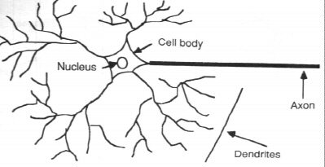
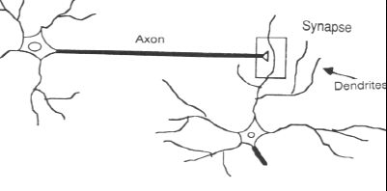
How the Human Brain learns
In the human brain, a typical neuron collects signals from others through a host of fine structures called dendrites.
The neuron sends out spikes of electrical activity through a long, thin stand known as an axon, which splits into thousands of branches.
At the end of each branch, a structure called a synapse converts the activity from the axon into electrical effects that inhibit or excite activity in the connected neurons.

Slide 5
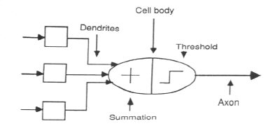
A Neuron Model
When a neuron receives excitatory input that is sufficiently large compared with its inhibitory input, it sends a spike of electrical activity down its axon. Learning occurs by changing the effectiveness of the synapses so that the influence of one neuron on another changes.
We conduct these neural networks by first trying to deduce the essential features of neurons and their interconnections.
We then typically program a computer to simulate these features.

Slide 6
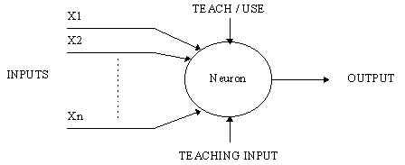
A Simple Neuron
An artificial neuron is a device with many inputs and one output.
The neuron has two modes of operation;
the training mode and
the using mode.

Slide 7
A Simple Neuron (Cont.)
In the training mode, the neuron can be trained to fire (or not), for particular input patterns.
In the using mode, when a taught input pattern is detected at the input, its associated output becomes the current output. If the input pattern does not belong in the taught list of input patterns, the firing rule is used to determine whether to fire or not.
The firing rule is an important concept in neural networks and accounts for their high flexibility. A firing rule determines how one calculates whether a neuron should fire for any input pattern. It relates to all the input patterns, not only the ones on which the node was trained on previously.

Slide 8

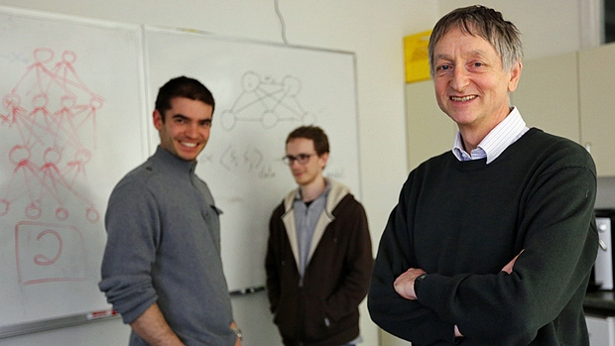


Why is everyone talking about Deep Learning?
Motivation
Because a lot of money is invested in it…
DeepMind: Acquired by Google for $400 million
DNNResearch: Three person startup (including Geoff Hinton) acquired by Google for unknown price tag
Enlitic, Ersatz, MetaMind, Nervana, Skylab: Deep Learning startups commanding millions of VC dollars
Because it made the front page of the New York Times

Slide 9
Why is everyone talking about Deep Learning?
Motivation
1960s
Deep learning:
Has won numerous pattern recognition competitions
Does so with minimal feature engineering
1980s
1990s
This wasn’t always the case!
Since 1980s: Form of models hasn’t changed much, but lots of new tricks…
More hidden units
Better (online) optimization
New nonlinear functions (ReLUs)
Faster computers (CPUs and GPUs)
2006
2016
Notes:
TODO: Cut this.

Slide 10
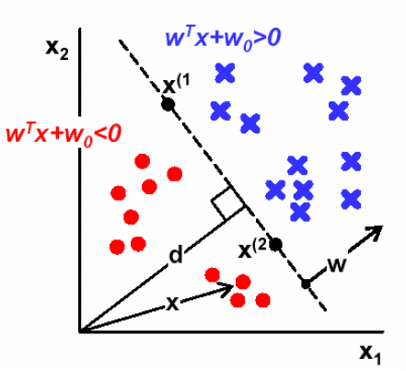
Perceptron and Neural Nets
From biological neuron to artificial neuron (perceptron)
Activation function
Artificial neuron networks
supervised learning
gradient descent

Slide 11
Connectionist Models
Consider humans:
Neuron switching time
~ 0.001 second
Number of neurons
~ 10¹⁰
Connections per neuron
~ 10⁴⁻⁵
Scene recognition time
~ 0.1 second
100 inference steps doesn't seem like enough
→ much parallel computation
Properties of artificial neural nets (ANN)
Many neuron-like threshold switching units
Many weighted interconnections among units
Highly parallel, distributed processes
Slide from: Matt Gormley, CMU

Slide 12
Application principles
The solution of a problem must be the simple.
Complicated solutions waste time and resources.
If a problem can be solved with a small look-up table that can be easily calculated that is a more preferred solution than a complex neural network with many layers that learns with back-propagation.

Slide 13
Application principles
The speed is crucial for computer game applications.
If it is possible on-line neural network solutions should be avoided, because they are big time consumers. Preferably, neural networks should be applied in an off-line fashion, when the learning phase doesn’t happen during the game playing time.

Slide 14
Application principles
On-line neural network solutions should be very simple.
Using many layer neural networks should be avoided, if possible. Complex learning algorithms should be avoided. If possible a priori knowledge should be used to set the initial parameters such that very short training is needed for optimal performance.

Slide 15
Application principles
All the available data should be collected about the problem.
Having redundant data is usually a smaller problem than not having the necessary data.
The data should be partitioned in training, validation and testing data.

Slide 16
Application principles
The neural network solution of a problem should be selected from a large enough pool of potential solutions.
Because of the nature of the neural networks, it is likely that if a single solution is build than that will not be the optimal one.
If a pool of potential solutions is generated and trained, it is more likely that one which is close to the optimal one is found.

Slide 17
Problem
Control:
The objective is to maintain some variable in a given range (possibly around a fixed value), by changing the value of other, directly modifiable (controllable) variables.
Example: keeping a stick vertically on a finger, by moving your arm, such that the stick doesn’t fall.

Slide 18
Problem
Movement control:
How to move the parts (e.g., legs, arms, head) of an animated figure that moves on some terrain, using various types of movements (e.g., walks, runs, jumps) ?

Slide 19
Problem
Problem analysis:
variables
modularisation into sub-problems
objectives
data collection

Slide 20
Problem
Simple problems need simple solutions.
If the animated figure has only a few components, moves on simple terrains, and is intended to do a few simple moves (e.g., two types of leg and arm movements, no head movement), the movement control can be described by a few rules.

Slide 21
Problem
Example rules for a simple problem:
IF (left_leg IS forward) AND (right_leg IS backward) THEN
right_leg CHANGES TO forward
left_leg CHANGES TO backward

Slide 22
Problem
Controlling complex movements needs complex rules.
Complex rules by simple solutions:
 | A1 | A2 | A3 | A4
B1 | M1 | M4 | M1a | M3
B2 | M3 | M2 | M2 | M4
B3 | M1a | M1 | M3 | M4
Simple solutions get very complex structure.

Slide 23
Problem
Complex solutions by complex methods:
Variable B
Variable A
Approximation of functional relationship by a neural network.

Slide 24
Neural network solution
Problem specification:
input and output variables
other specifications (e.g., smoothness)
Example: desired movement parameters for given input values

Slide 25
Neural network solution
Problem modularisation:
separating sub-problems that are solved separately
Example:
the movements should be separated on the basis of causal independence and connectedness
separate solution for y1 and y2 if they are causally independent, joint solution if they are interdependent, connected solution if one is causally dependent on the other

Slide 26
Neural network solution
Data collection and organization:
training, validation and testing data sets
Example:
Training set: ~ 75% of the data
Validation set: ~ 10% of the data
Testing set: ~ 5% of the data

Slide 27
Neural network solution
Solution design:
neural network model selection
Example:
x1x2x3
y_{out}
Gaussian neurons

Slide 28
Neural network solution
Generation of a pool of candidate models.
Example:
W1, W2
W3, W4
…
W19, W20

Slide 29
Neural network solution
Learning the task from the data: we apply the learning algorithm to each network from the solution pool we use the training data set
Example:

Slide 30
Neural network solution
Learning the task from the data:
Before learning After learning

Slide 31
Neural network solution
Neural network solution selection
each candidate solution is tested with the validation data and the best performing network is selected
Network 11 Network 4 Network 7

Slide 32
Neural network solution
Choosing a solution representation:
the solution can be represented directly as a neural network specifying the parameters of the neurons
alternatively the solution can be represented as a multi-dimensional look-up table
the representation should allow fast use of the solution within the application

Slide 33
Summary
Neural network solutions should be kept as simple as possible.
For the sake of the gaming speed neural networks should be applied preferably off-line.
A large data set should be collected and it should be divided into training, validation, and testing data.
Neural networks fit as solutions of complex problems.
A pool of candidate solutions should be generated, and the best candidate solution should be selected using the validation data.
The solution should be represented to allow fast application.

Slide 34
Navy Projects
Project and homework assignments are aligned with the concepts from the Navy Center for Applied Research in Artificial Intelligence (NCARAI).
Some active research projects are in Adaptive Systems, Intelligent Systems, Interactive Systems, and Perceptual Systems.
3D Audio-Cued Operator Performance Modeling
Adaptive Testing of Autonomous Systems
Chat Attention Management for Enhanced Situational Awareness
Cognitive Robotics and Human Robot Interaction
Human Mimetic Active Sonar Classification
Machine Classification of Spoken Language
Predicting and Preventing Errors
Unifying Inference through Attention
This course will encourage homework, assignments, and projects related to these topics – in terms of clustering (through self organizing maps), classification (single layer or multilayer perceptron, backpropagation, deep learning), and prediction (regression, RBF, Kernel methods).

Slide 35
Course Outlines
Week 1: Anatomy of a single neuron Model and Network Architectures, Transfer functions, Topology of neural network architectures Recurrent neural network | Lecture#1 – 3 Reading Paper#1
Week 2: Perceptron, Learning rules, Convergence and Applications | Lecture#4 – 6 Reading Paper#2
Week 3: Activation functions and Regressions | Lecture#7 - 9 Reading Paper#3
Week 4: Hebbian Learning Linear associator The Hebb rule Variations of Hebbian learning | Lecture#10 - 12 Reading Paper#4
Week 5-6: Multi-Layer Networks; Backpropagation Configuration Training algorithms and variations Stability Recurrent Self-Organizing map Counter propagation network Group Method of Data Handling (GMDH) | Lecture#13 – 15 Reading Paper#5 Lecture#16 - 18 Reading Paper#6
Week 7: Self-Organizing Maps | Lecture#19 - 21 Reading Paper#7
Week 9: Convolutional Networks | Lecture#22 - 24 Reading Paper#8
Week 10: Recurrent Networks | Lecture#25 – 27 Reading Paper#9
Week 11: Generative Adversarial Networks Week 14: - Deep Belief Nets | Lecture#28 - 30 Lecture#30 Reading Paper# 10

Slide 36
Questions
Are the immune cells part of the nervous system ?
Can an artificial neuron receive inhibitory and excitatory inputs ?
Do the Gaussian neurons use sigmoidal activation function ?
Can we use general optimisation methods to calculate the weights of neural networks with a single nonlinear layer ?
Does the application of neural networks increase the speed of simple games ?
Should we have a validation data set when we train neural networks ?

