Slide 1
Neural Networks with Activation Function
Dr. Gahangir Hossain
Texas A&M University-Kingsville
Slides from: Rafie Tarabay, IBM

Slide 2
How to use Neural Network Models in Keras
Five steps
Define Network.
Compile Network.
Fit Network.
Evaluate Network.
Make Predictions.

Slide 3
Step 1. Define Network
Neural networks are defined in Keras as a sequence of layers.
The first layer in the network must define the number of inputs to expect. for a Multilayer Perceptron model this is specified by the input_dim attribute.
Example of small Multilayer Perceptron model (2 inputs, 5 hidden layers, 1 output)
Re-write after add activation function
 | model = Sequential() model.add(Dense(5, input_dim=2)) model.add(Dense(1))
model = Sequential()
model.add(Dense(5, input_dim=2, activation='relu'))
model.add(Dense(1, activation='sigmoid'))

Slide 4
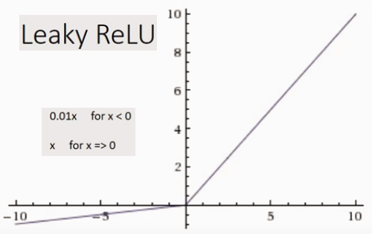
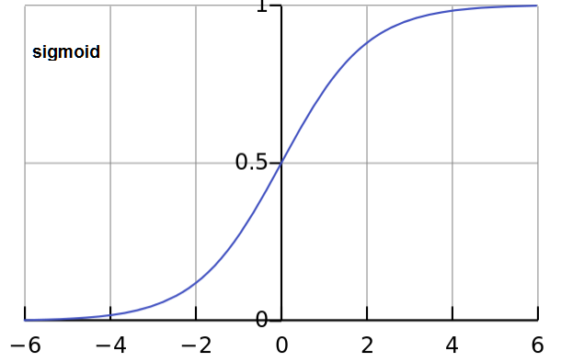
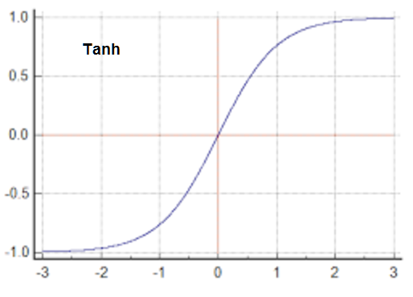
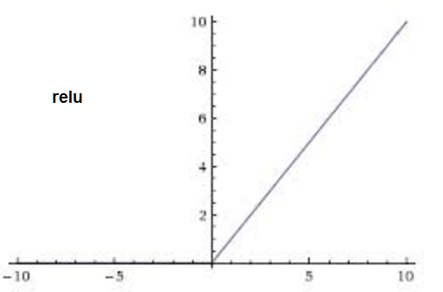
Available Activation Functions
Optional, it is like a filter, used to solve some common predictive modeling problem, to get significant boost in performance.
Sigmoid: used for Binary Classification (2 class) one neuron the output layer. What ever the input it will map to zero or one.
Softmax: used for Multiclass Classification (>2 class), one output neuron per class value.
Linear: used for Regression, the number of neurons matching the number of outputs.
Tanh: what ever the input it will convert to number between -1 and 1
Relu: either 0 for a<0 or a for a>0. so, it just remove the negative values and pass the positive as it is.
LeakyReLU: minimize the value of negative values and pass as it is if positive
elu
selu
softplus
softsign
hard_sigmoid
PReLU
ELU
ThresholdedReLU

Slide 5
Step 2. Compile Network
Specifically the optimization algorithm to use to train the network and the loss function used to evaluate the network that is minimized by the optimization algorithm.
Optimizers tool to minimize loss between prediction and real value. Commonly used optimization algorithms:
‘sgd‘ (Stochastic Gradient Descent) requires the tuning of a learning rate and momentum.
ADAM requires the tuning of learning rate.
RMSprop requires the tuning of learning rate.
Loss functions:
Regression: Mean Squared Error or ‘mse‘.
Binary Classification (2 class): ‘binary_crossentropy‘.
Multiclass Classification (>2 class): ‘categorical_crossentropy‘.
Finally, you can also specify metrics to collect while fitting the model in addition to the loss function. Generally, the most useful additional metric to collect is accuracy.
model.compile(optimizer='sgd', loss='mse’)
model.compile(optimizer='sgd', loss='mse', metrics=['accuracy'])

Slide 6
Optimizers

Slide 7
Step 3. Fit Network
history = model.fit(X, y, batch_size=10, epochs=100)
The network is trained using the backpropagation algorithm
Batch size is the number of samples that going to be propagated through the network.
epochs is the number of training times (for ALL the training examples)
Example: if you have 1000 training examples, and your batch size is 500, then it will take 2 iterations to complete 1 epoch.

Slide 8
Step 4. Evaluate Network
The model evaluates the loss across all of the test patterns, as well as any other metrics specified when the model was compiled.
For example, for a model compiled with the accuracy metric, we could evaluate it on a new dataset as follows:
loss, accuracy = model.evaluate(X, Y)
print("Loss: %.2f, Accuracy: %.2f% %" % (loss, accuracy*100))

Slide 9
Step 5. Make Predictions
probabilities = model.predict(X)
predictions = [float(round(x)) for x in probabilities]
accuracy = numpy.mean(predictions == Y) #count the number of True and divide by the total size
print("Prediction Accuracy: %.2f% %" % (accuracy*100))

Slide 10
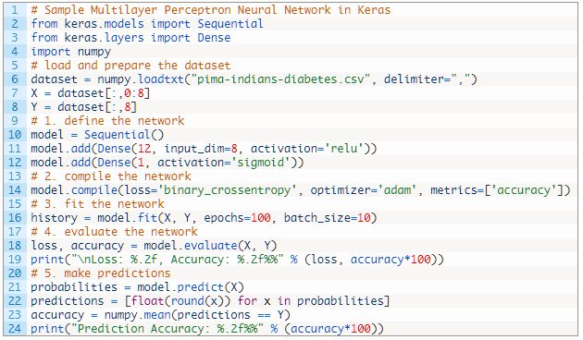
Binary classification using Neural Network in Keras
Diabetes Data Set
Detect Diabetes Disease based on analysis
Dataset Attributes:
1. Number of times pregnant
2. Plasma
3. Diastolic blood pressure (mm Hg)
4. Triceps skin fold thickness (mm)
5. 2-Hour serum insulin (mu U/ml)
6. Body mass index
7. Diabetes pedigree function
8. Age (years)
9. Class variable (0 or 1)

Slide 11
Save prediction model
After train our model, ie, model.fit(X_train, Y_train), we can save this traning to use later.
This task can done by Pickle package(Python Object Serialization Library), using dump and load methods. Pickle can save any object not just the prediction model.
import pickle
…………….
model.fit(X_train, Y_train)
# save the model to disk
pickle.dump(model, open("c:/data.dump", 'wb’)) #wb= write bytes
# some time later... load the model from disk
model = pickle.load(open("c:/data.dump", 'rb’)) #rb= read bytes

