Slide 1
LMS Algorithm, Data and Learning
Dr. Gahangir Hossain
Texas A&M University-Kingsville
Slides from: Dr. C. Lee Giles, Penn State University

Slide 2
Many online software packages & datasets
Data sets
UC Irvine
http://www.kdnuggets.com/datasets/index.html
Software (much related to data mining)
JMIR Open Source
Weka
Shogun
RapidMiner
ODM
Orange
CMU
Several researchers put their software online

Slide 3
Defining the Learning Task
Improve on task, T, with respect to
performance metric, P, based on experience, E.
T: Playing checkers
P: Percentage of games won against an arbitrary opponent
E: Playing practice games against itself
T: Recognizing hand-written words
P: Percentage of words correctly classified
E: Database of human-labeled images of handwritten words
T: Driving on four-lane highways using vision sensors
P: Average distance traveled before a human-judged error
E: A sequence of images and steering commands recorded while
observing a human driver.
T: Categorize email messages as spam or legitimate.
P: Percentage of email messages correctly classified.
E: Database of emails, some with human-given labels

Slide 4
Designing a Learning System
Choose the training experience
Choose exactly what is too be learned, i.e. the target function.
Choose how to represent the target function.
Choose a learning algorithm to infer the target function from the experience.
Learner
Environment/
Experience
Knowledge
Performance
Element

Slide 5
Sample Learning Problem
Learn to play checkers from self-play
Develop an approach analogous to that used in the first machine learning system developed by Arthur Samuels at IBM in 1959.

Slide 6
Training Experience
Direct experience: Given sample input and output pairs for a useful target function.
Checker boards labeled with the correct move, e.g. extracted from record of expert play
Indirect experience: Given feedback which is not direct I/O pairs for a useful target function.
Potentially arbitrary sequences of game moves and their final game results.
Credit/Blame Assignment Problem: How to assign credit blame to individual moves given only indirect feedback?

Slide 7
Source of Training Data
Provided random examples outside of the learner’s control.
Negative examples available or only positive?
Good training examples selected by a “benevolent teacher.”
“Near miss” examples
Learner can query an oracle about class of an unlabeled example in the environment.
Learner can construct an arbitrary example and query an oracle for its label.
Learner can design and run experiments directly in the environment without any human guidance.

Slide 8
Training vs. Test Distribution
Generally assume that the training and test examples are independently drawn from the same overall distribution of data.
IID: Independently and identically distributed
If examples are not independent, requires collective classification.
If test distribution is different, requires transfer learning.

Slide 9
Choosing a Target Function
What function is to be learned and how will it be used by the performance system?
For checkers, assume we are given a function for generating the legal moves for a given board position and want to decide the best move.
Could learn a function:
ChooseMove(board, legal-moves) → best-move
Or could learn an evaluation function, V(board) → R, that gives each board position a score for how favorable it is. V can be used to pick a move by applying each legal move, scoring the resulting board position, and choosing the move that results in the highest scoring board position.

Slide 10
Ideal Definition of V(b)
If b is a final winning board, then V(b) = 100
If b is a final losing board, then V(b) = –100
If b is a final draw board, then V(b) = 0
Otherwise, then V(b) = V(b´), where b´ is the highest scoring final board position that is achieved starting from b and playing optimally until the end of the game (assuming the opponent plays optimally as well).
Can be computed using complete mini-max search of the finite game tree.

Slide 11
Approximating V(b)
Computing V(b) is intractable since it involves searching the complete exponential game tree.
Therefore, this definition is said to be non-operational.
An operational definition can be computed in reasonable (polynomial) time.
Need to learn an operational approximation to the ideal evaluation function.

Slide 12
Representing the Target Function
Target function can be represented in many ways: lookup table, symbolic rules, numerical function, neural network.
There is a trade-off between the expressiveness of a representation and the ease of learning.
The more expressive a representation, the better it will be at approximating an arbitrary function; however, the more examples will be needed to learn an accurate function.

Slide 13
Linear Function for Representing V(b)
In checkers, use a linear approximation of the evaluation function.
bp(b): number of black pieces on board b
rp(b): number of red pieces on board b
bk(b): number of black kings on board b
rk(b): number of red kings on board b
bt(b): number of black pieces threatened (i.e. which can be immediately taken by red on its next turn)
rt(b): number of red pieces threatened

Slide 14
Obtaining Training Values
Direct supervision may be available for the target function.
< <bp=3,rp=0,bk=1,rk=0,bt=0,rt=0>, 100> (win for black)
With indirect feedback, training values can be estimated using temporal difference learning (used in reinforcement learning where supervision is delayed reward).

Slide 15
Temporal Difference Learning
Estimate training values for intermediate (non-terminal) board positions by the estimated value of their successor in an actual game trace.
where successor(b) is the next board position where it is the program’s move in actual play.
Values towards the end of the game are initially more accurate and continued training slowly “backs up” accurate values to earlier board positions.

Slide 16
Learning Algorithm
Uses training values for the target function to induce a hypothesized definition that fits these examples and hopefully generalizes to unseen examples.
In statistics, learning to approximate a continuous function is called regression.
Attempts to minimize some measure of error (loss function) such as mean squared error:

Slide 17
Least Mean Squares (LMS) Algorithm
A gradient descent algorithm that incrementally updates the weights of a linear function in an attempt to minimize the mean squared error
Until weights converge :
For each training example b do :
1) Compute the absolute error :
2) For each board feature, f_{i}, update its weight, w_{i} :
for some small constant (learning rate) c

Slide 18
LMS Discussion
Intuitively, LMS executes the following rules:
If the output for an example is correct, make no change.
If the output is too high, lower the weights proportional to the values of their corresponding features, so the overall output decreases
If the output is too low, increase the weights proportional to the values of their corresponding features, so the overall output increases.
Under the proper weak assumptions, LMS can be proven to eventetually converge to a set of weights that minimizes the mean squared error.

Slide 19
Lessons Learned about Learning
Learning can be viewed as using direct or indirect experience to approximate a chosen target function.
Function approximation can be viewed as a search through a space of hypotheses (representations of functions) for one that best fits a set of training data.
Different learning methods assume different hypothesis spaces (representation languages) and/or employ different search techniques.

Slide 20
Evaluation of Learning Systems
Experimental
Conduct controlled cross-validation experiments to compare various methods on a variety of benchmark datasets.
Gather data on their performance, e.g. test accuracy, training-time, testing-time.
Analyze differences for statistical significance.
Theoretical
Analyze algorithms mathematically and prove theorems about their:
Computational complexity
Ability to fit training data
Sample complexity (number of training examples needed to learn an accurate function)

Slide 21
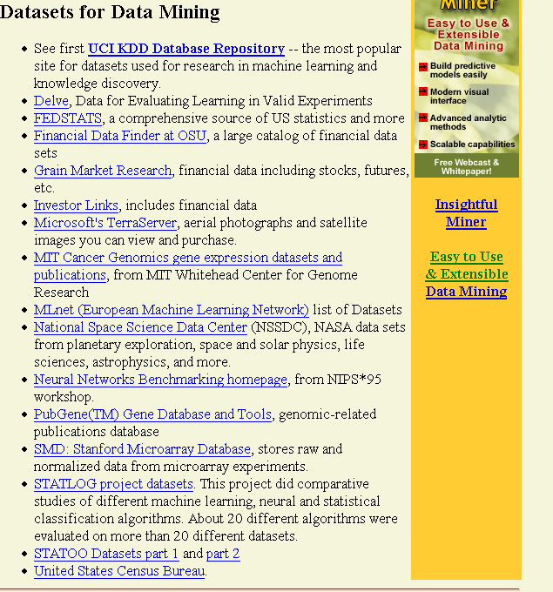
http://www.kdnuggets.com/datasets/index.html

Slide 22
Supervised Learning Classification
Example: Cancer diagnosis
Training Set
Use this training set to learn how to classify patients where diagnosis is not known:
Test Set
Input Data
Classification
The input data is often easily obtained, whereas the classification is not.

Slide 23
Classification Problem
Goal: Use training set + some learning method to produce a predictive model.
Use this predictive model to classify new data.
Sample applications:

Slide 24
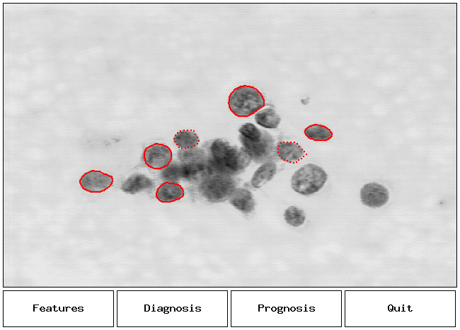
Application: Breast Cancer Diagnosis
Research by Mangasarian,Street, Wolberg

Slide 25
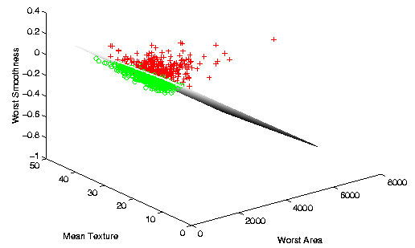
Breast Cancer Diagnosis Separation
Research by Mangasarian,Street, Wolberg

