Slide 1
Perceptron and Hidden Layers
Dr. Gahangir Hossin
Texas A&M University-Kingsville
Slides from: Ming Li, University of Waterloo

Slide 2
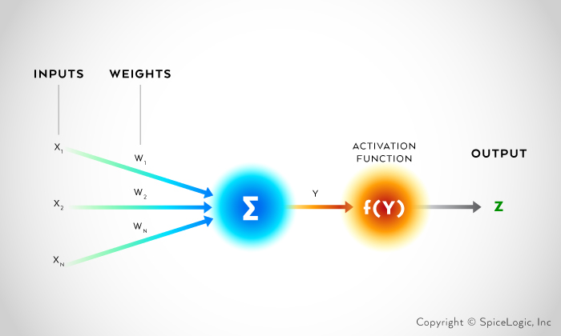
Perceptron Architecture
features
Inputs
x₁
x₂
x₃
f₁
f₂
f₃
Binary Threshold Neuron
Learning
By hand!
As long as you pick right features, this can learn almost anything.

Slide 3
This actually gives a powerful machine learning paradigm:
Pick right features by clustering
Linearly separate the features.
This is essentially what Rosenblatt initially claimed for perceptron. Chomsky & Papert actually attacked a different target.
−1
+1
+1
−1
W
F

Slide 4
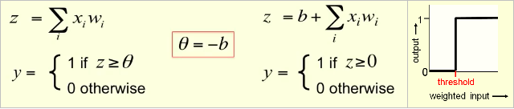
Binary threshold neuron
McCulloch-Pitts (1943)
There are two ways of describing the binary threshold neuron:
Threshold = 0
Threshold ≠ 0

Slide 5
Avoiding learning biases separately
By a trick of adding 1 to input.
We now can learn a bias as if it were a weight.
Hence we get rid of the threshold.
b
w₂
w₁
1
x₁
x₂

Slide 6
A converging perceptron learning alg.
If the output unit is correct, leave its weights unchanged.
If the output unit incorrectly outputs a zero, add the input vector to the weight vector.
If the output unit incorrectly outputs a 1, subtract the input vector from the weight vector.
This is guaranteed to find a set of weights that is correct for all training cases if such “solution” exists.

Slide 7
Weight space
The dimension k is number of the weights w=(w₁, … , w_{k}).
A point in the space represents a weight vector (w₁, … , w_{k}) as its coordinates .
Each training case is represented as a hyper-plane through the origin (assuming we move the threshold to the bias weight)
The weights must lie on one side of this hyper-plane to get answer correct.

Slide 8
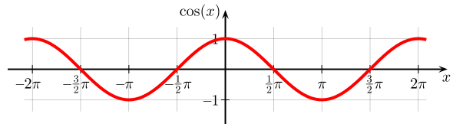
Remember dot product facts: a • b = ||a||||b||cos(θ_{ab}) = a₁b₁+a₂b₂+ … +a_{n}b_{n}
Thus, a • b ≥ 0, if –π/2 ≤ θ_{ab} ≤ π/2
a • b ≤ 0, if –π ≤ θ_{ab} ≤ −π/2 or π/2 ≤ θ_{ab} ≤ π

Slide 9
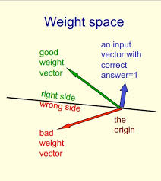
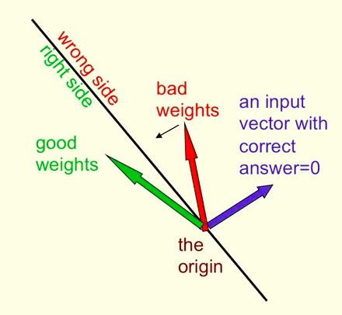
Weight space
A point in the space represents a weight vector
Training case is a hyper-plane through the origin,
assuming threshold represented by bias.

Slide 10
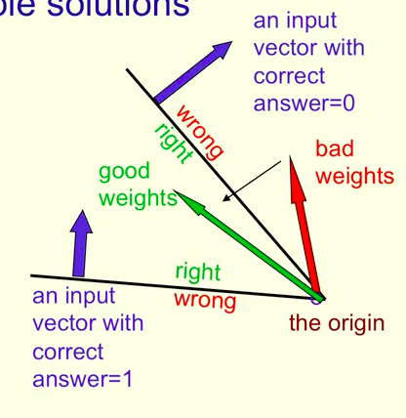
The cone of feasible solutions
A negative example
This is convex
To get all training cases right, we need
to find a point on the “right side” of all
planes (representing training cases).
The solution region, if exists, is a cone
and is convex.
A positive example

Slide 11
A converging perceptron learning alg.
If the output unit is correct, leave its weights unchanged.
If the output unit incorrectly outputs a zero, add the input vector to the weight vector.
If the output unit incorrectly outputs a 1, subtract the input vector from the weight vector.
This is guaranteed to find a set of weights that is correct for all training cases if such solution exists.

Slide 12
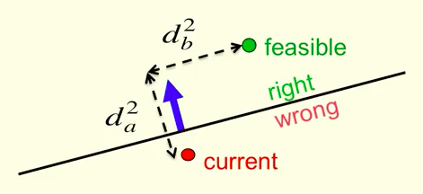
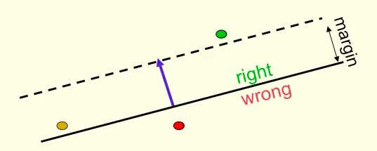
Proof of convergence by picture
But what about this point?
We might move farther.
Generously
feasible vector
Proof: If there is a generously
feasible vector, then each
step we move closer to the
feasible region. After finitely
many steps, the weight vector
is in the feasible region.
Note: this is assuming generously feasible vector exists.

Slide 13
The limitations of Perceptrons
If we are allowed to choose features by hand, then we can do anything. But this is not learning.
If we do not hand-pick features, then Minsky and Papert showed that perceptrons cannot do much. We will look at these proofs.

Slide 14
XOR cannot be learnt by a perceptron
We prove that binary threshold output unit cannot do exclusive-or:
Positive examples: (1,1) → 1; (0,0) →1
Negative examples: (1,0)→0; (0,1) → 0
The 4 input-output pairs give 4 inequalities, T being threshold:
w₁ + w₂ ≥ T, 0 ≥ T ➔ w₁ + w₂ ≥ 2T
w₁ < T, w₂ <T ➔ w₁ + w₂ < 2T
Contradiction. QED

Slide 15
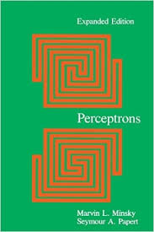
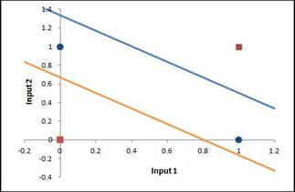
Geometric view
Chapter 0
of this book
Data-space view
Each input is point
A weight vector defines a hyperplane
The weight plane is perpendicular to the weight vector and misses the origin by a distance equal to the threshold
Blue dots and red dots
are not linearly separable.

Slide 16
But this can be easily solved:
Just pick right features (clusters)
Then linearly separate the features, solves all.
This is essentially what Rosenblatt initially claimed for perceptron. Chomsky & Papert actually attacked a different target.
−1
+1
+1
−1
W
F

Slide 17
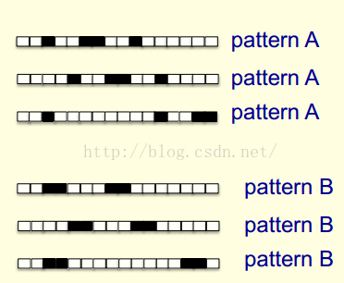
Group Invariance Theorem (Minsky-Papert): Perceptron cannot distinguish following two patterns under translation.
Proof.
Each pixel is activated by 4 different
translations of both Pattern A and B.
Hence the total input received by the
decision unit over all these patterns is
four times the sum of all weights for
both patterns A and B.
No threshold can always accept A & reject B. QED.
In general Perceptrons cannot do
groups. Image translation forms
a group. This was sometimes
mis-interpreted as NN’s are no good.
Hidden units can learn such features. But deeper NN are hard to train.
Positive Examples:
Negative Examples:
Translation with wrap-around of two patterns

