Slide 1
Perceptron Basic Neuron Implementation
Dr. Gahangir Hossain
Texas A&M University-Kingsville
Slides From : Ming Li, University of Waterloo

Slide 2
Basic Neurons
To model neurons we have to idealize them:
Idealization removes complicated details that are not essential for understanding the main principles.
It allows us to apply mathematics and to make analogies to other familiar systems
Once we understand the basic principles, its easy to add complexity to make the model more faithful.

Slide 3
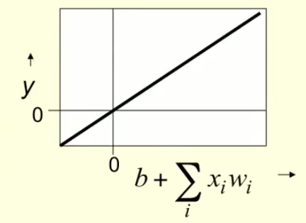
Linear neurons
These are the basic building parts for all other neuron networks.
bias
i-th input
y = b + Σ_{i} x_{i} w_{i}
output
Weight on
i-th input

Slide 4
Binary threshold neuron
McCulloch-Pitts (1943)
First compute a weighted sum of inputs
Then send out a fixed size spike of activity if the weighted sum exceeds a threshold.
McCulloch and Pitts thought that each spike is like the truth value of a proposition and each neuron combines truth values to compute the truth value of another proposition.
This has influenced Von Neumann.

Slide 5
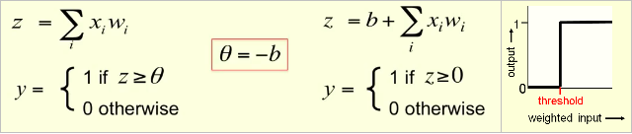
There are two equivalent ways to describe a binary threshold neuron
θ

Slide 6
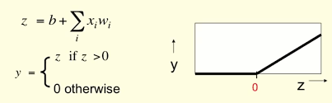
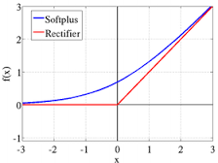
Rectified Linear Unit (ReLU)
They compute a linear weighted sum of their inputs.
The output is a non-linear function of the total input.
This is the most popularly used neuron.
Or written as: f(x) = max {0,x}
A smooth approximation of the ReLU is “softplus” function
f(x) = ln (1+e^{x})

Slide 7
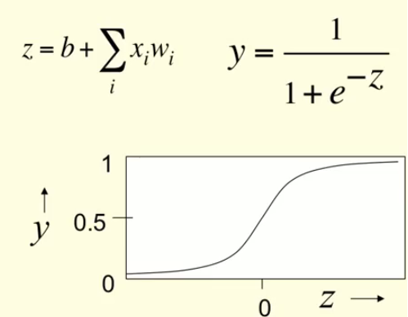
Sigmoid neurons
Typically they use the
logistic function
They have nice
derivatives which
makes learning easy.
But they cause
vanishing gradients
during
backpropogation.

Slide 8
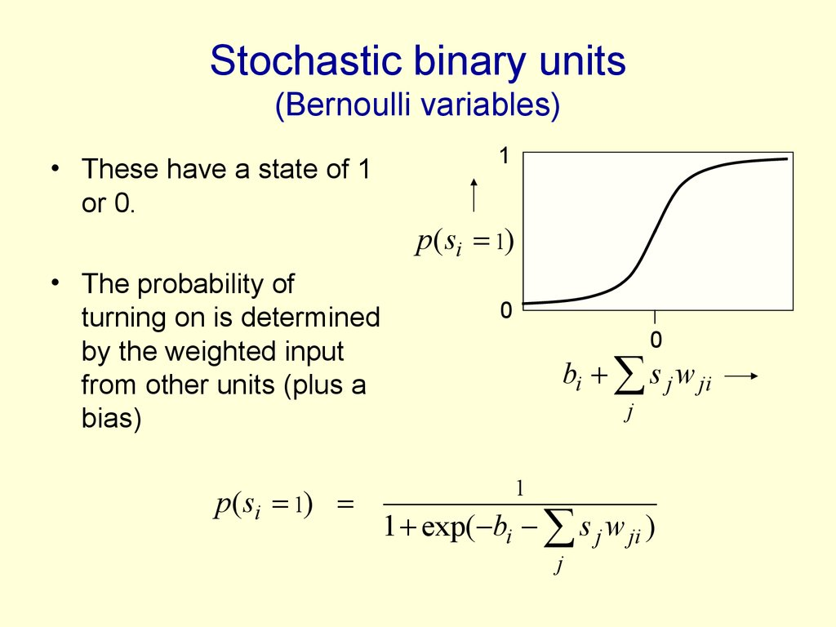
Stochastic binary neurons

Slide 9
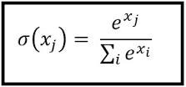
Softmax function (Normalized exponential function)
If we take an input of [1,2,3,4,1,2,3], the softmax of that is
[0.024, 0.064, 0.175, 0.475, 0.024, 0.064, 0.175].
The softmax function highlights the largest values and
suppress other values.
Comparing to “max” function, softmax is differentiable.

Slide 10
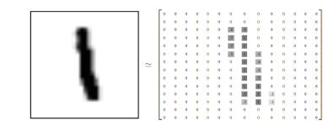
Lecture 3. Fully Connected NN & Hello World of Deep Learning
0–9 handwritten digit recognition:
Neural
Network
“1”
28 x 28
MNIST Data maintained by Yann LeCun: http://yann.lecun.com/exdb/mnist/
Keras provides data sets loading function at http://keras.io/datasets

Slide 11
Keras & Tensorflow
Interface of Tensorflow and Theano.
Francois Chollet, author of Keras is at Google, Keras will become Tensorflow API.
Documentation: http://keras.io.
Examples: https://github.com/fchollet/keras/tree/master/examples
Simple course on Tensorflow: https://docs.google.com/presentation/d/1zkmVGobdPfQgsjIw6gUqJsjB8wvv9uBdT7ZHdaCjZ7Q/edit#slide=id.p

Slide 12
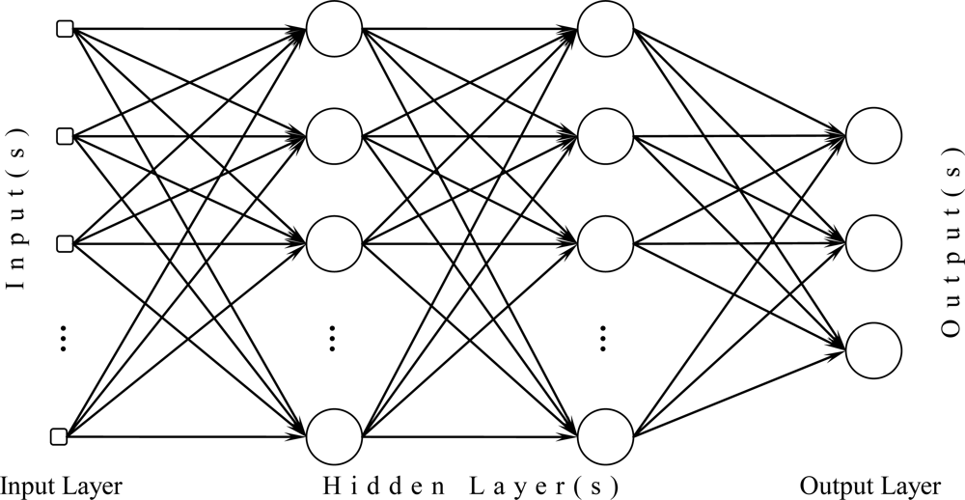
Implementing in Keras
500
500
softmax
y₀
y₁
y₉
28x28
…
Fully connected NN
model = sequential() # layers are sequentially added
model.add( Dense(input_dim=28*28, output_dim=500))
model.add(Activation(‘sigmoid’)) #: softplus, softsign,relu,tanh, hard_sigmoid
model.add(Dense( output_dim = 500))
model.add (Activation(‘sigmoid’))
Model.add(Dense(output_dim=10))
Model.add(Activation(‘softmax’))
model.compile(loss=‘categorical_crossentropy’, optimizer=‘adam’, metrics=[‘accuracy’])
model.fit(x_train, y_train, batch_size=100, nb_epoch=20)

Slide 13
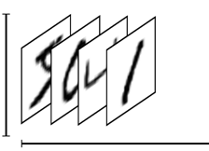
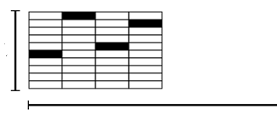
Training
model.fit(x_train, y_train, batch_size=100, nb_epoch=20)
numpy array
28 x 28
=784
10
Number of training examples
Number of training examples

Slide 14




Batch: parallel processing
We do not really minimize total loss!
model.fit(x_train, y_train, batch_size=100, nb_epoch=20)
Randomly initialize network parameters
NN
Pick the 1st batch
x₁
y₁
y’₁
l₁
L’ = l₁ + l₉+ …
Update parameters
First batch
NN
x₉
y₉
y’₉
Pick the 2nd batch
……
l₉
L” = l₂ + l₁₆+ …
Update parameters
NN
…
x₂
y₂
y‘₂
l₂
Until all batches have been picked
2nd batch
x₁₆
NN
y₁₆
y’₁₆
one epoch
……
l₁₆
Repeat the above process

Slide 15
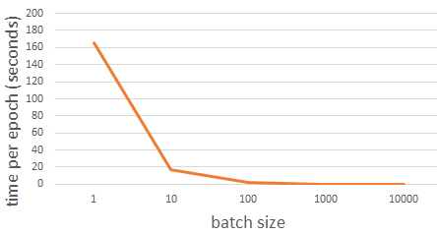
Speed
Very large batch size can yield worse performance
Smaller batch size means more updates in one epoch
E.g. 50000 examples
batch size = 1, 50000 updates in one epoch
batch size = 10, 5000 updates in one epoch
166s
1 epoch
17s
10 epochs
166s
Batch size = 1 and 10, update the same amount of times in the same period.
Batch size = 10 is more stable, converge faster
17s
GTX 980 on MNIST with 50000 training examples

Slide 16



Speed - Matrix Operation
Why is batching faster?
One at a time:
=
=
Batch by GPU, 2 at a time, 1/2 time cost
=
Matrix operation

