Slide 1
Kohonen Self-Organizing Maps (SOM) Learning Unsupervised Environment
Dr. Gahangir Hossain
Texas A&M University-Kingsville
Some Slides from: Dr. Abdul Basit Siddiqui, FURC

Slide 2
Unsupervised Learning
We can include additional structure in the network so that the net is forced to make a decision as to which one unit will respond.
The mechanism by which it is achieved is called competition.
It can be used in unsupervised learning.
A common use for unsupervised learning is clustering based neural networks.

Slide 3
Unsupervised Learning
In a clustering net, there are as many units as the input vector has components.
Every output unit represents a cluster and the number of output units limit the number of clusters.
During the training, the network finds the best matching output unit to the input vector.
The weight vector of the winner is then updated according to learning algorithm.

Slide 4

Kohonen Learning
A variety of nets use Kohonen Learning
New weight vector is the linear combination of old weight vector and the current input vector.
The weight update for cluster unit (output unit) j can be calculated as:
the learning rate alpha decreases as the learning process proceeds.

Slide 5
Kohonen SOM (Self Organizing Maps)
Since it is unsupervised environment, so the name is Self Organizing Maps.
Self Organizing NNs are also called Topology Preserving Maps which leads to the idea of neighborhood of the clustering unit.
During the self-organizing process, the weight vectors of winning unit and its neighbors are updated.

Slide 6
Kohonen SOM (Self Organizing Maps)
Normally, Euclidean distance measure is used to find the cluster unit whose weight vector matches most closely to the input vector.
For a linear array of cluster units, the neighborhood of radius R around cluster unit J consists of all units j such that:

Slide 7
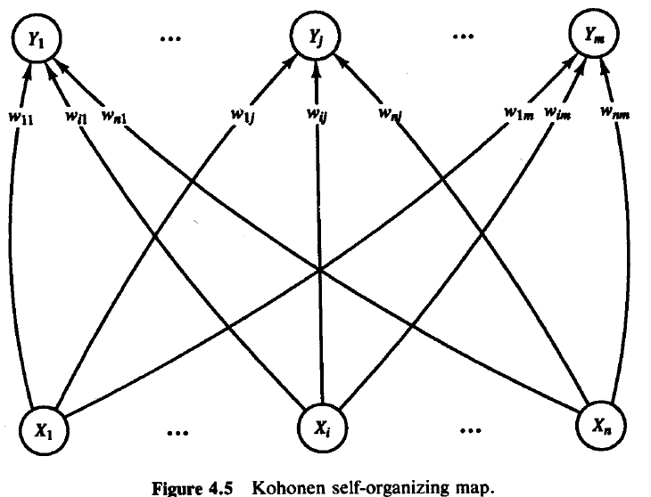
Kohonen SOM (Self Organizing Maps)
Architecture of SOM

Slide 8
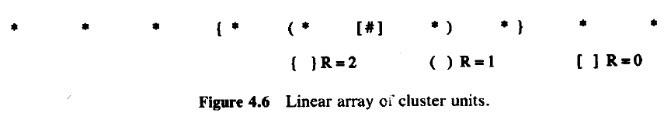
Kohonen SOM (Self Organizing Maps)
Structure of Neighborhoods

Slide 9
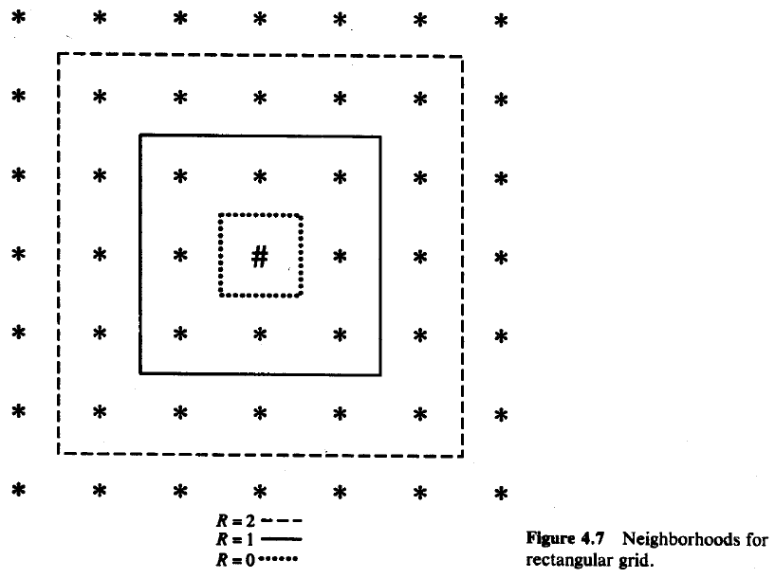
Kohonen SOM (Self Organizing Maps)
Structure of Neighborhoods

Slide 10
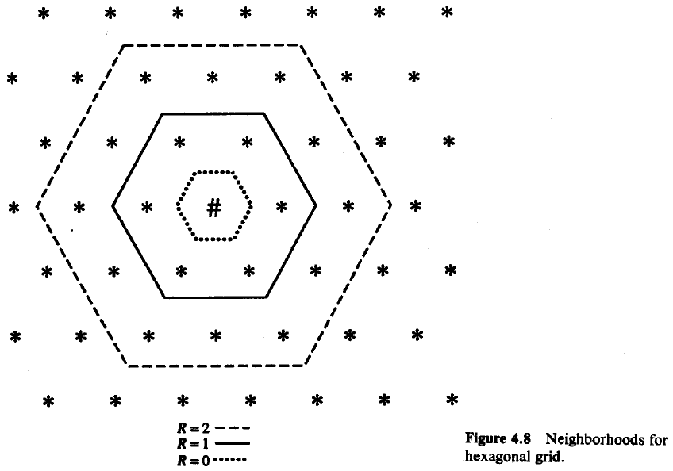
Kohonen SOM (Self Organizing Maps)
Structure of Neighborhoods

Slide 11
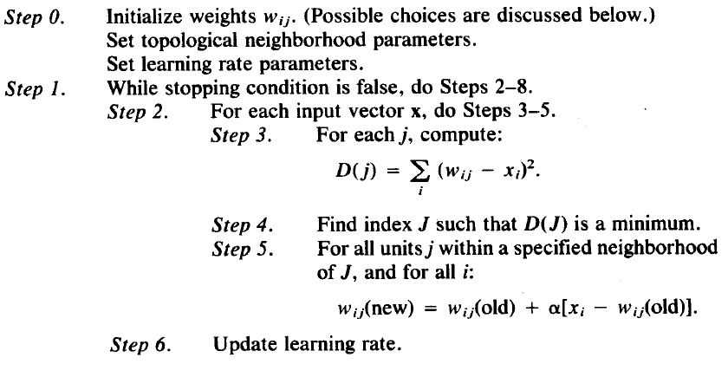
Kohonen SOM (Self Organizing Maps)
Neighborhoods do not wrap around from one side of the grid to other side which means missing units are simply ignored.
Algorithm:

Slide 12
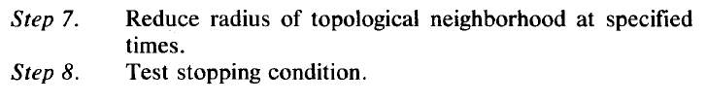
Kohonen SOM (Self Organizing Maps)
Algorithm:
Radius and learning rates may be decreased after each epoch.
Learning rate decrease may be either linear or geometric.

Slide 13
KOHONEN SELF ORGANIZING MAPS
Architecture
neuron i
Kohonen layer
w_{i}
Winning neuron
Input vector X
X=[x₁,x₂,…x_{n}] ∈ R^{n}
w_{i}=[w_{i1},w_{i2},…,w_{in}] ∈ R^{n}

Slide 14
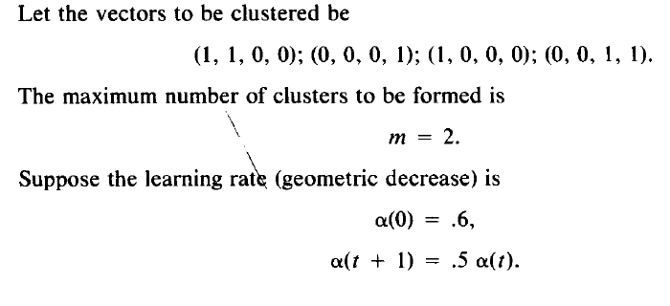
Kohonen SOM (Self Organizing Maps)
Example

Slide 15
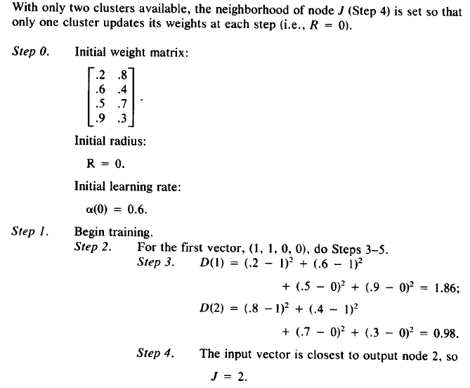
Kohonen SOM (Self Organizing Maps)

Slide 16
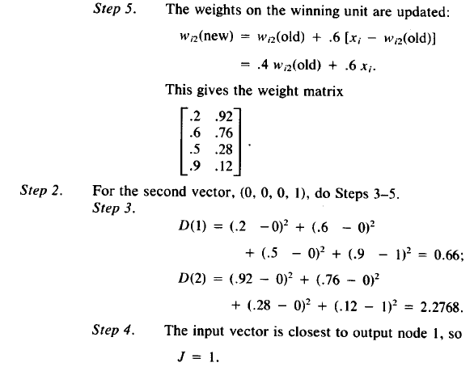
Kohonen SOM (Self Organizing Maps)

