Slide 1
Self-Organizing Maps
Dr. Gahangir Hossain
Texas A&M University-Kingsville
Slides from: https://www.cs.umb.edu/~marc/cs271/cog11-24.ppt

Slide 2
Self-Organizing Maps (Kohonen Maps)
In the BPN, we used supervised learning.
This is not biologically plausible: In a biological system, there is no external “teacher” who manipulates the network’s weights from outside the network.
Biologically more adequate: unsupervised learning.
We will study Self-Organizing Maps (SOMs) as examples for unsupervised learning (Kohonen, 1980).

Slide 3
Self-Organizing Maps (Kohonen Maps)
In the human cortex, multi-dimensional sensory input spaces (e.g., visual input, tactile input) are represented by two-dimensional maps.
The projection from sensory inputs onto such maps is topology conserving.
This means that neighboring areas in these maps represent neighboring areas in the sensory input space.
For example, neighboring areas in the sensory cortex are responsible for the arm and hand regions.

Slide 4
Self-Organizing Maps (Kohonen Maps)
Such topology-conserving mapping can be achieved by SOMs:
Two layers: input layer and output (map) layer
Input and output layers are completely connected.
Output neurons are interconnected within a defined neighborhood.
A topology (neighborhood relation) is defined on the output layer.

Slide 5
Self-Organizing Maps (Kohonen Maps)
BPN structure:
output vector o
O₁
O₂
O₃
…
O_{m}
I₁
I₂
…
I_{n}
input vector x

Slide 6
Self-Organizing Maps (Kohonen Maps)
Common output-layer structures:
One-dimensional (completely interconnected for determining “winner” unit)
i
Two-dimensional (connections omitted, only neighborhood relations shown [green])
i
Neighborhood of neuron i

Slide 7
Self-Organizing Maps (Kohonen Maps)
A neighborhood function (i, k) indicates how closely neurons i and k in the output layer are connected to each other.
Usually, a Gaussian function on the distance between the two neurons in the layer is used:

position of k
position of i

Slide 8
Unsupervised Learning in SOMs
For n-dimensional input space and m output neurons:
(1) Choose random weight vector w_{i} for neuron i, i = 1, ..., m
(2) Choose random input x
(3) Determine winner neuron k:
||w_{k} – x|| = min_{i} ||w_{i} – x|| (Euclidean distance)
(4) Update all weight vectors of all neurons i in the neighborhood of neuron k: w_{i} := w_{i} + ·(i, k)·(x – w_{i})
(w_{i} is shifted towards x)
(5) If convergence criterion met, STOP. Otherwise, narrow neighborhood function  and learning parameter  and go to (2).

Slide 9
Unsupervised Learning in SOMs
Example I: Learning a one-dimensional representation of a two-dimensional (triangular) input space:
0
20
100
1000
10000
25000

Slide 10
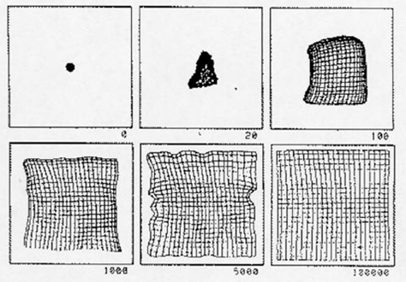
Unsupervised Learning in SOMs
Example II: Learning a two-dimensional representation of a two-dimensional (square) input space:

Slide 11
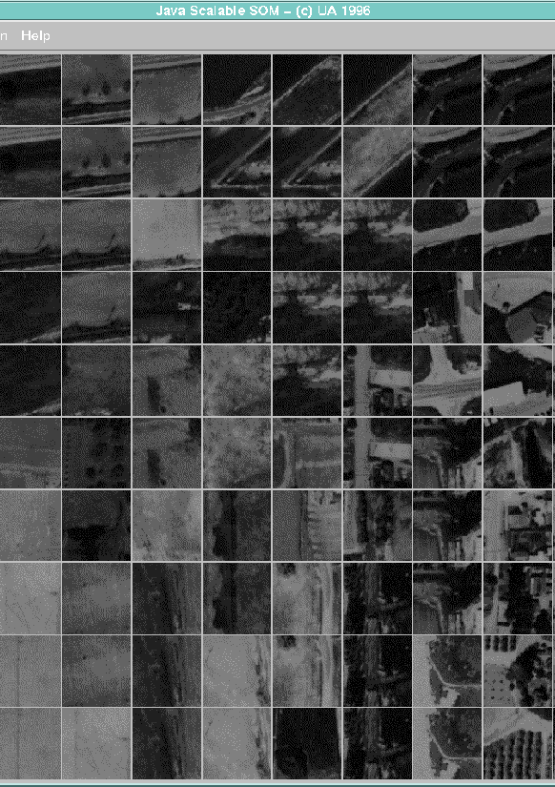
Unsupervised Learning in SOMs
Example III: Learning a two-dimensional mapping of texture images

Slide 12
The Hopfield Network
The Hopfield model is a single-layered recurrent network.
It is usually initialized with appropriate weights instead of being trained.
The network structure looks as follows:
X₁
X₂
…
X_{N}

Slide 13
The Hopfield Network
We will focus on the discrete Hopfield model, because its mathematical description is more straightforward.
In the discrete model, the output of each neuron is either 1 or –1.
In its simplest form, the output function is the sign function, which yields 1 for arguments ≥ 0 and –1 otherwise.

Slide 14
The Hopfield Network
We can set the weights in such a way that the network learns a set of different inputs, for example, images.
The network associates input patterns with themselves, which means that in each iteration, the activation pattern will be drawn towards one of those patterns.
After converging, the network will most likely present one of the patterns that it was initialized with.
Therefore, Hopfield networks can be used to restore incomplete or noisy input patterns.

Slide 15
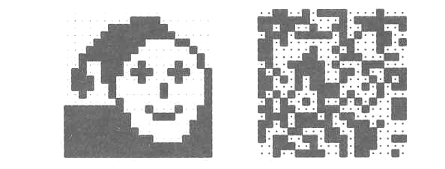
The Hopfield Network
Example: Image reconstruction (Ritter, Schulten, Martinetz 1990)
A 20×20 discrete Hopfield network was trained with 20 input patterns, including the one shown in the left figure and 19 random patterns as the one on the right.

Slide 16
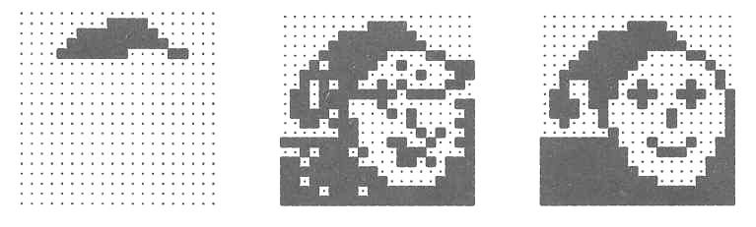
The Hopfield Network
After providing only one fourth of the “face” image as initial input, the network is able to perfectly reconstruct that image within only two iterations.

Slide 17
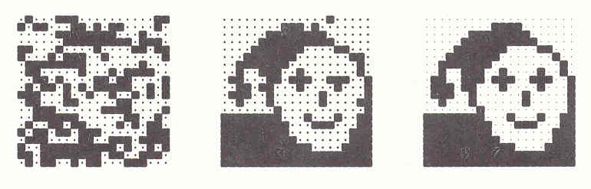
The Hopfield Network
Adding noise by changing each pixel with a probability p = 0.3 does not impair the network’s performance.
After two steps the image is perfectly reconstructed.

Slide 18
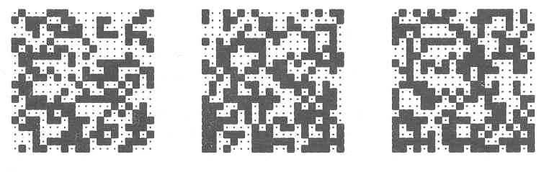
The Hopfield Network
However, for noise created by p = 0.4, the network is unable the original image.
Instead, it converges against one of the 19 random patterns.

Slide 19
The Hopfield Network
The Hopfield model constitutes an interesting neural approach to identifying partially occluded objects and objects in noisy images.
These are among the toughest problems in computer vision.
Notice, however, that Hopfield networks require the input patterns to always be in exactly the same position, otherwise they will fail to recognize them.

