Slide 1
Information Visualization with Self-Organizing Maps
Dr.Gahangir Hossain
Texas A&M University-Kingsville
Slides from: Jing Li, Mail: jing.li@lijing.de

Slide 2
Agenda
Motivation
Self-Organizing Maps
Origins
Algorithm
Example
Scalable Vector Graphics
Information Visualization with Self-Organizing Maps in an Information Portal
Conclusion

Slide 3
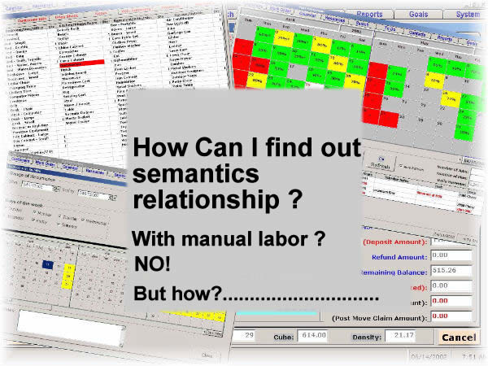
Motivation: The Problem Statement
The problem is how to find out semantics relationship among lots of information without manual labor
How do I know, where to put my new data in, if I know nothing about information‘s topology?
When I have a topic, how can I get all the information about it, if I don‘t know the place to search them?

Slide 4



Motivation: The Idea
Computer know automatically information classification and put them together
Input Pattern 1
Input Pattern 2
Input Pattern 3

Slide 5
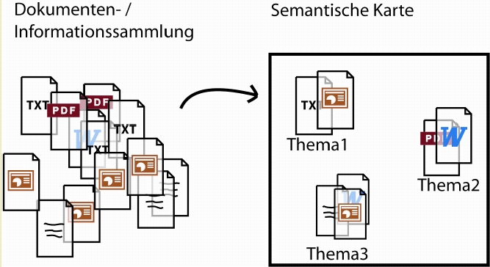
Motivation: The Idea
Text objects must be automatically produced with semantics relationships
Semantics Map
Topic1
Topic2
Topic3

Slide 6
Agenda
Motivation
Self-Organizing Maps
Origins
Algorithm
Example
Scalable Vector Graphics
Information Visualization with Self-Organizing Maps in an Information Portal
Conclusion

Slide 7
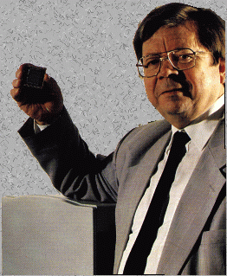
Self-Organizing Maps : Origins
Self-Organizing Maps
Ideas first introduced by C. von der Malsburg (1973), developed and refined by T. Kohonen (1982)
Neural network algorithm using unsupervised competitive learning
Primarily used for organization and visualization of complex data
Biological basis: ‘brain maps’
Teuvo Kohonen

Slide 8
Self-Organizing Maps
SOM - Architecture
Lattice of neurons (‘nodes’) accepts and responds to set of input signals
Responses compared; ‘winning’ neuron selected from lattice
Selected neuron activated together with ‘neighbourhood’ neurons
Adaptive process changes weights to more closely resemble inputs
j
2d array of neurons
w_{j1}
w_{j2}
w_{j3}
w_{jn}
Weighted synapses
x₁
x₂
x₃
...
x_{n}
Set of input signals
(connected to all neurons in lattice)

Slide 9
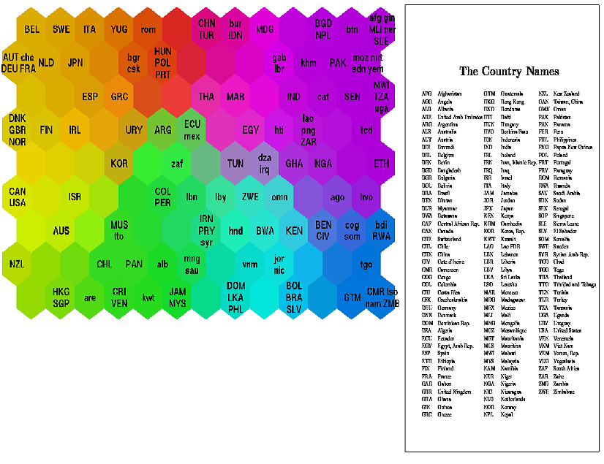
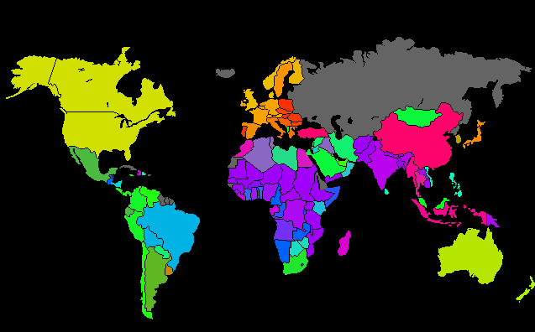
Self-Organizing Maps
SOM – Result Example
Helsinki University of Technology
Classifying World Poverty
‘Poverty map’ based on 39 indicators from World Bank statistics (1992)

Slide 10
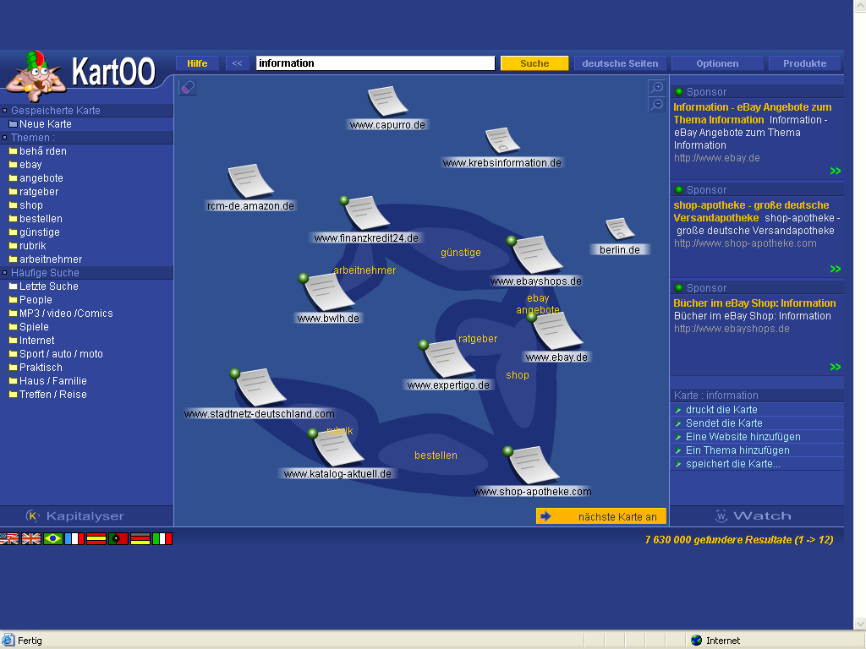
SOM – Result Example

Slide 11
Self-Organizing Maps
SOM – Result Example
Helsinki University of Technology
Classifying World Poverty
‘Poverty map’ based on 39 indicators from World Bank statistics (1992)

Slide 12
Self-Organizing Maps
SOM – Algorithm Overview
Randomly initialise all weights
Select input vector x = [x₁, x₂, x₃, … , x_{n}]
Compare x with weights w_{j} for each neuron j to determine winner
Update winner so that it becomes more like x, together with the winner’s neighbours
Adjust parameters: learning rate & ‘neighbourhood function’
Repeat from (2) until the map has converged (i.e. no noticeable changes in the weights) or pre-defined no. of training cycles have passed

Slide 13
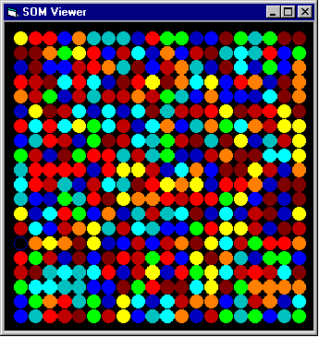
Initialisation
(i)Randomly initialise the weight vectors w_{j} for all nodes j

Slide 14
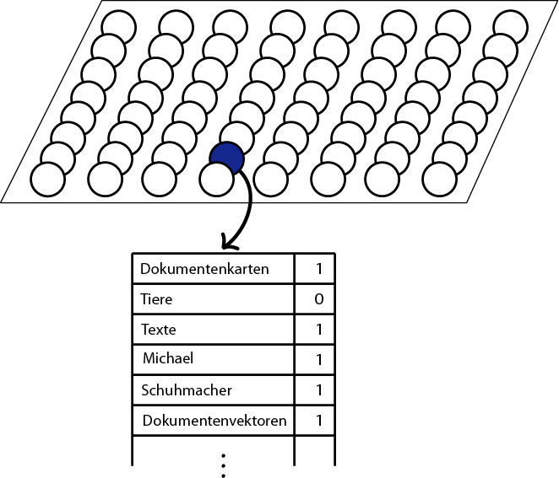
Input vector
In computer texts are shown as a frequency distribution of one word.
A Text Example:
Self-organizing maps (SOMs) are a data visualization technique invented by Professor Teuvo Kohonen which reduce the dimensions of data through the use of self-organizing neural networks. The problem that data visualization attempts to solve is that humans simply cannot visualize high dimensional data as is so technique are created to help us understand this high dimensional data.
Region
(ii) Choose an input vector x from the training set
Self-organizing
2
maps
1
data
4
visualization
2
technique
2
Professor
1
invented
1
Teuvo Kohonen
1
dimensions
1
...
Zebra
0

Slide 15

Finding a Winner
(iii) Find the best-matching neuron ω(x), usually the neuron whose weight vector has smallest Euclidean distance from the input vector x
The winning node is that which is in some sense ‘closest’ to the input vector
‘Euclidean distance’ is the straight line distance between the data points, if they were plotted on a (multi-dimensional) graph
Euclidean distance between two vectors a and b, a = (a₁,a₂,…,a_{n}), b = (b₁,b₂,…b_{n}), is calculated as:
Euclidean distance

Slide 16
Weight Update
SOM Weight Update Equation
w_{j}(t +1) = w_{j}(t) + μ(t) λ_{ω(x)}(j,t) [x - w_{j}(t)]
“The weights of every node are updated at each cycle by adding
Current learning rate × Degree of neighbourhood with respect to winner × Difference between current weights and input vector
to the current weights”
Example of μ(t) Example of λ_{ω(x)}(j,t)
L. rate
No. of cycles
x-axis shows distance from winning node
y-axis shows ‘degree of neighbourhood’ (max. 1)

Slide 17
Example: Self-Organizing Maps
The animals should be ordered by a neural networks.
And the animals will be described with their attributes(size, living space).
e.g. Mouse = (0/0)
Size: Living space: small=0 medium=1 big=2 Land=0 Water=1 Air=2
Mouse
Lion
Horse
Shark
Dove
Size
small
medium
big
big
small
Living space
Land
Land
Land
Water
Air
(0/0)
(1/0)
(2/0)
(2/1)
(0/2)

Slide 18
Example: Self-Organizing Maps
After the fields of map will be initialized with random values, animals will be ordered in the most similar fields. If the mapping is ambiguous, anyone of fields will be seleced.
(0/0)
Mouse (0/0), Lion (1/0)
(0/2)
Dove (0/2)
(2/2)
(2/1)
Shark (2/1)
(0/0)
(2/0)
Horse (2/0)
(1/1)
(1/1)
(0/0)

Slide 19
Example: Self-Organizing Maps
Auxiliary calculation for the field of left above:
Old value in the field: (0/0)
Direct ascendancies:
Difference Mouse (0/0): (0/0)
Difference Lion (1/0): (1/0)
Sum of the difference: (1/0)
Thereof 50%: (0.5/0)
Influence of the allocations of the neighbour fields:
Difference Dove (0/2): (0/2)
Difference Shark (2/1): (2/1)
Sum of the difference: (2/3)
Thereof 25%: (0.5/0.75)
New value in the field: (0/0) + (0.5/0) + (0.5/0.75)= (1/0.75)
(0/0)
Lion (1/0)
Training
(1/0.75)
Lion (1/0)

Slide 20
Example: Self-Organizing Maps
This training will be done in every field. After the network had been trained, animals will be ordered in the similarest field again.
(1/0.75)
Lion
(0.25/1)
Dove
(1.5/1.5)
(1.25/0.5)
(1/0.75)
(2/0)
Horse
(1.25/1)
Shark
(1/1)
(0.5/0)
Mouse

Slide 21
Example: Self-Organizing Maps
This training will be very often repeated. In the best case the animals should be at close quarters ordered by similarest attribute.
(0.75/0.6875)
(0.1875/1.25)
Dove
(1.125/1.625)
(1.375/0.5)
(1/0.875)
(1.5/0)
Hourse
(1.625/1)
Shark
(1/0.75)
Lion
(0.75/0)
Mouse
Land animals

Slide 22


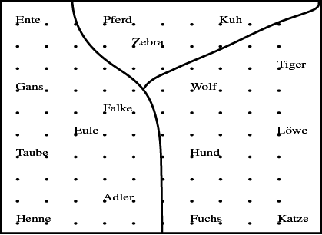

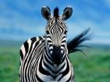


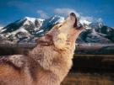







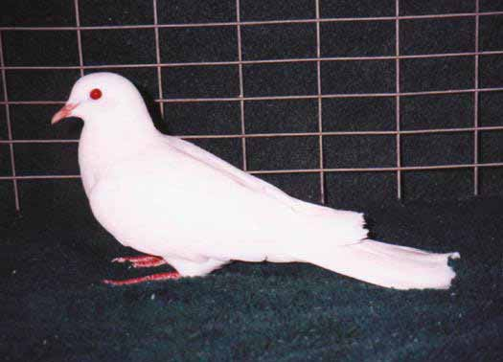

Example: Self-Organizing Maps
Animal names and their attributes
is
A grouping according to similarity has
emerged
has
peaceful
likes
to
birds
hunters
[Teuvo Kohonen 2001] Self-Organizing Maps; Springer;

Slide 23
Agenda
Motivation
Self-Organizing Maps
Origins
Algorithm
Example
Scalable Vector Graphics
Information Visualization with Self-Organizing Maps in an Information Portal
Conclusion

Slide 24
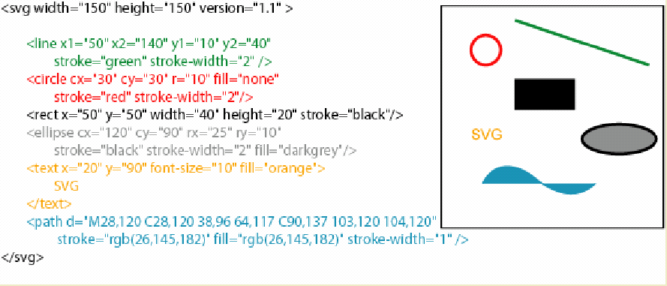
Technologie: Scalable Vector Graphics (SVG)
Scalable Vector Graphics (SVG) is an XML markup language for describing two-dimensional vector graphics, both static and animated. It is an open standard created by the World Wide Web Consortium, which is also responsible for standards like HTML and XHTML.

Slide 25
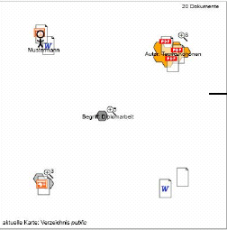
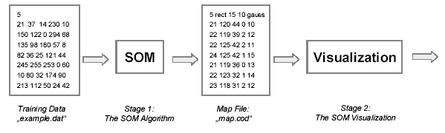
Scalable Vector Graphics (SVG)
It is desirable to distinguish the algorithm from the visualization as clearly as possible. The anticipated System Structure is shown below.
SVG

Slide 26
Agenda
Motivation
Self-Organizing Maps
Origins
Algorithm
Example
Scalable Vector Graphics
Information Visualization with Self-Organizing Maps in an Information Portal
Conclusion

Slide 27
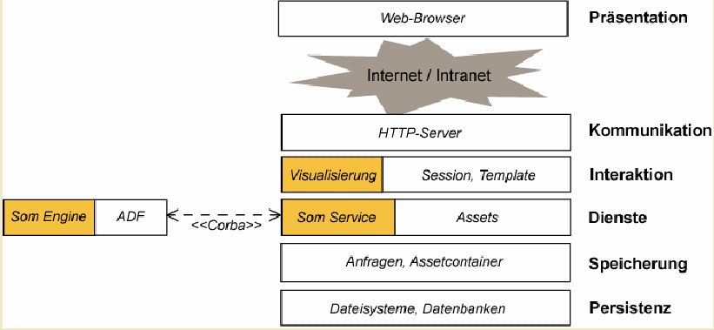
Software model for Information Visualization of SOM
Over-all architecture
Presentation
Communication
Interaction
Other Services
Services
Request, Container
Storage
Data Base
Persistence

Slide 28
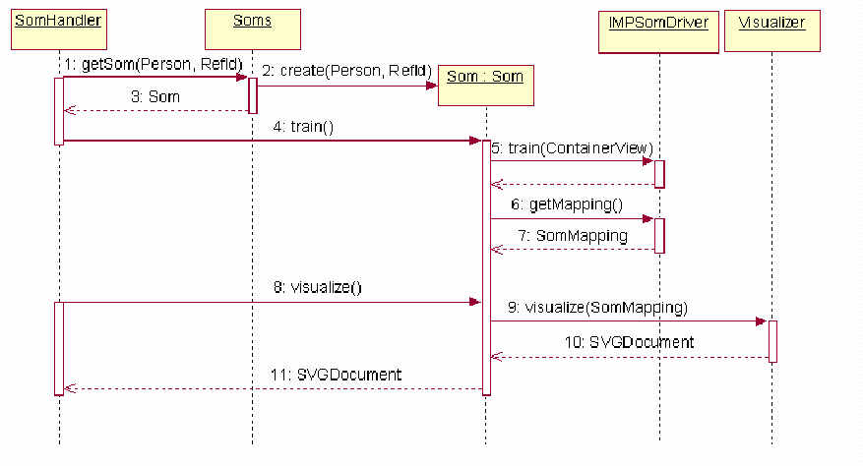
Software model for Information Visualization of SOM
Sequence diagram of sample document map call

Slide 29
Agenda
Motivation
Self-Organizing Maps
Origins
Algorithm
Example
Scalable Vector Graphics
Information Visualization with Self-Organizing Maps in an Information Portal
Conclusion

Slide 30
Conclusion
Advantages
SOM is Algorithm that projects high-dimensional data onto a two-dimensional map.
The projection preserves the topology of the data so that similar data items will be mapped to nearby locations on the map.
SOM still have many practical applications in pattern recognition, speech analysis, industrial and medical diagnostics, data mining
Disadvantages
Large quantity of good quality representative training data required
No generally accepted measure of ‘quality’ of a SOM
e.g. Average quantization error (how well the data is classified)

Slide 31
Thank you for listening

Slide 32
Discussion topics
What is the main purpose of the SOM?
Do you know any example systems with SOM Algorithm?

Slide 33
References
[Witten and Frank (1999)] Witten, I.H. and Frank, Eibe. Data Mining: Practical Machine Learning Tools and Techniques with Java Implementations. Morgan Kaufmann Publishers, San Francisco, CA, USA. 1999
[Kohonen (1982)] Teuvo Kohonen. Self-organized formation of topologically correct feature maps. Biol. Cybernetics, volume 43, 59-62
[Kohonen (1995)] Teuvo Kohonen. Self-Organizing Maps. Springer, Berlin, Germany
[Vesanto (1999)] SOM-Based Data Visualization Methods, Intelligent Data
Analysis, 3:111-26
[Kohonen et al (1996)] T. Kohonen, J. Hynninen, J. Kangas, and J. Laaksonen, "SOM
PAK: The Self-Organizing Map program package, " Report
A31, Helsinki University of Technology, Laboratory of
Computer and Information Science, Jan. 1996
[Vesanto et al (1999)] J. Vesanto, J. Himberg, E. Alhoniemi, J Parhankangas. Self-
Organizing Map in Matlab: the SOM Toolbox. In Proceedings
of the Matlab DSP Conference 1999, Espoo, Finland, pp. 35-40, 1999.
[Wong and Bergeron (1997)] Pak Chung Wong and R. Daniel Bergeron. 30 Years of Multidimensional Multivariate Visualization. In Gregory M.
Nielson, Hans Hagan, and Heinrich Muller, editors, Scientific
Visualization - Overviews, Methodologies and Techniques, pages 3-33, Los Alamitos, CA, 1997. IEEE Computer Society Press.
[Honkela (1997)] T. Honkela, Self-Organizing Maps in Natural Language
Processing, PhD Thesis, Helsinki, University of Technology,
Espoo, Finland
[SVG wiki] http://en.wikipedia.org/wiki/Scalable_Vector_Graphics
[Jost Schatzmann (2003)] Final Year Individual Project Report Using Self-Organizing Maps to Visualize Clusters and Trends in Multidimensional Datasets
Imperial college London 19 June 2003

