Slide 1
Convolutional Neural Network

Slide 2
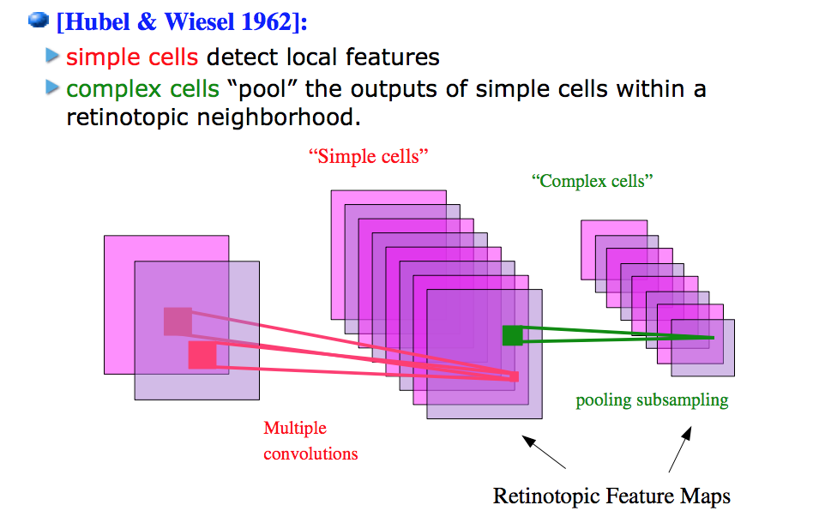
Model of vision in animals

Slide 3
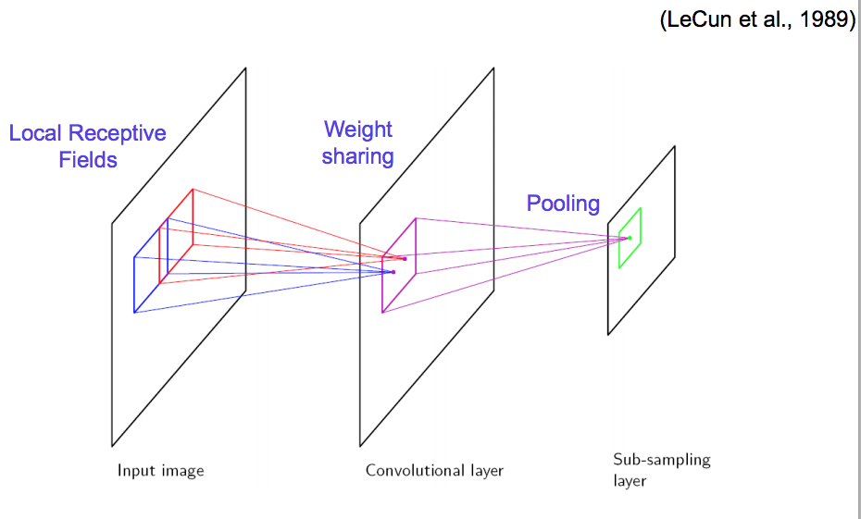
Vision with ANNs

Slide 4
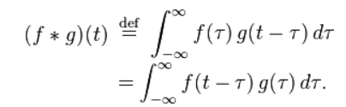
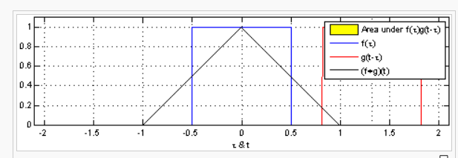
What’s a convolution?
https://en.wikipedia.org/wiki/Convolution
1-D

Slide 5
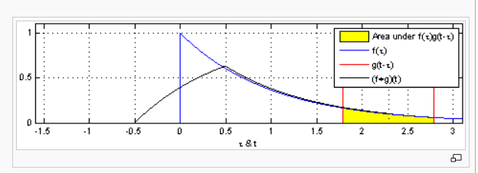
What’s a convolution?
https://en.wikipedia.org/wiki/Convolution
1-D

Slide 6
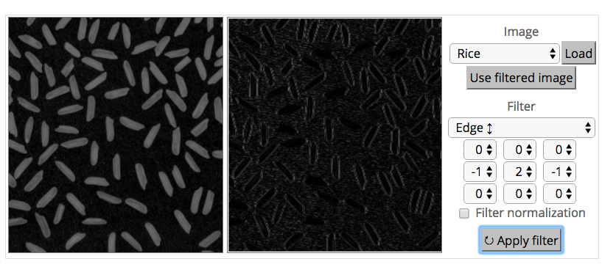
What’s a convolution?
http://matlabtricks.com/post-5/3x3-convolution-kernels-with-online-demo

Slide 7
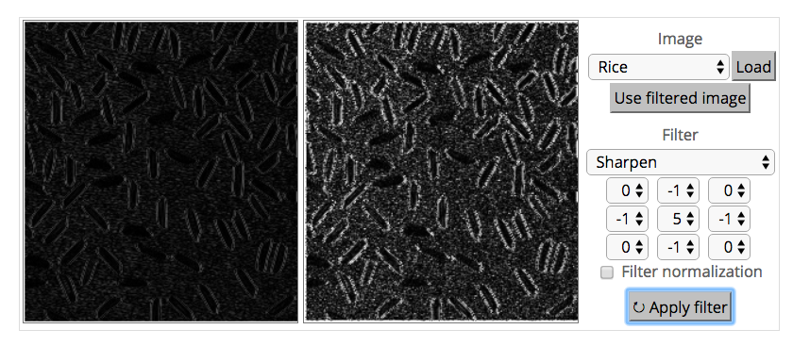
What’s a convolution?
http://matlabtricks.com/post-5/3x3-convolution-kernels-with-online-demo

Slide 8
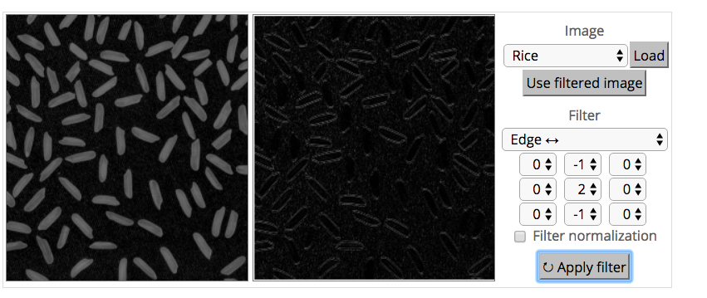
What’s a convolution?
http://matlabtricks.com/post-5/3x3-convolution-kernels-with-online-demo

Slide 9
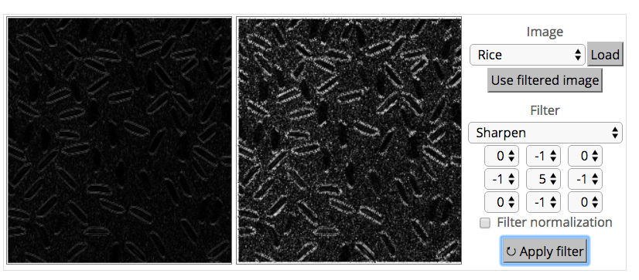
What’s a convolution?
http://matlabtricks.com/post-5/3x3-convolution-kernels-with-online-demo

Slide 10
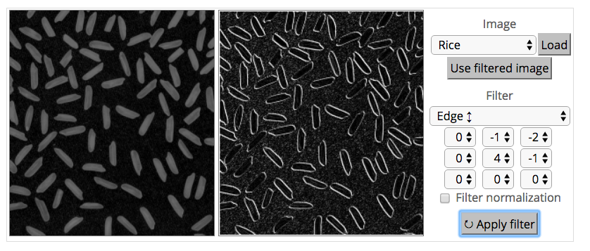
What’s a convolution?
http://matlabtricks.com/post-5/3x3-convolution-kernels-with-online-demo

Slide 11
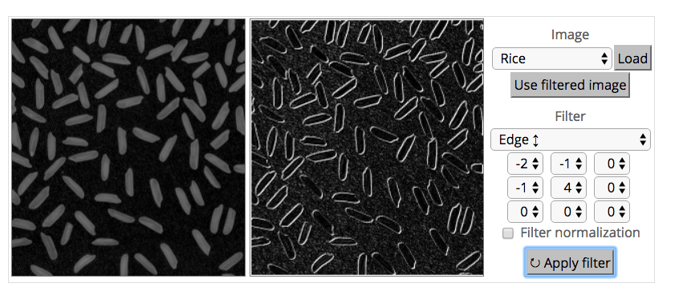
What’s a convolution?
http://matlabtricks.com/post-5/3x3-convolution-kernels-with-online-demo

Slide 12
What’s a convolution?
Basic idea:
Pick a 3x3 matrix F of weights
Slide this over an image and compute the “inner product” (similarity) of F and the corresponding field of the image, and replace the pixel in the center of the field with the output of the inner product operation
Key point:
Different convolutions extract different types of low-level “features” from an image
All that we need to vary to generate these different features is the weights of F

Slide 13
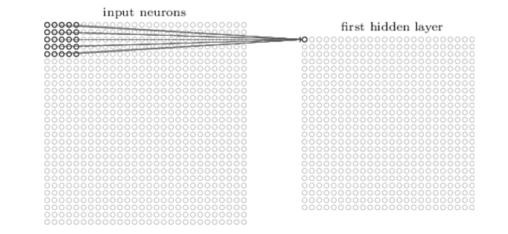
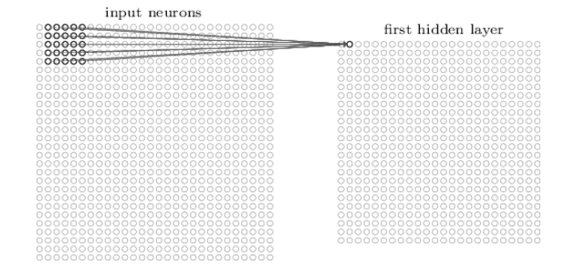
How do we convolve an image with an ANN?
Note that the parameters in the matrix defining the convolution are tied across all places that it is used

Slide 14
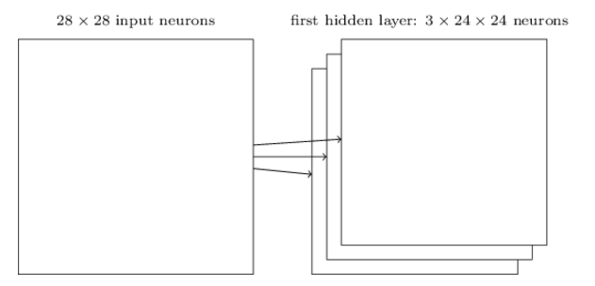
How do we do many convolutions of an image with an ANN?

Slide 15
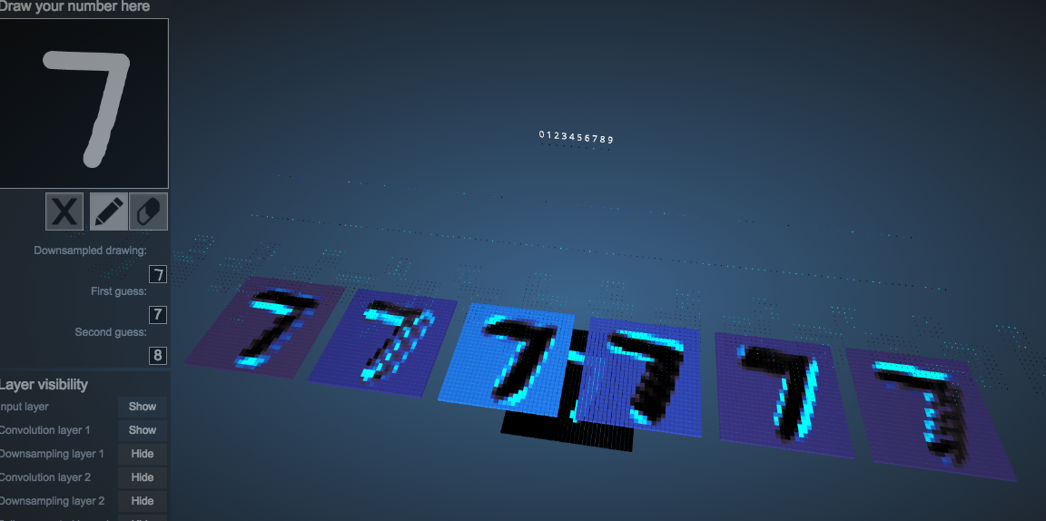

Example: 6 convolutions of a digit
http://scs.ryerson.ca/~aharley/vis/conv/

Slide 16
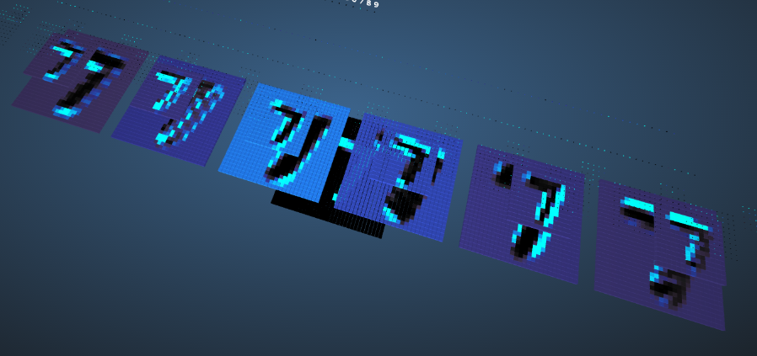

CNNs typically alternate convolutions, non-linearity, and then downsampling
Downsampling is usually averaging or (more common in recent CNNs) max-pooling

Slide 17
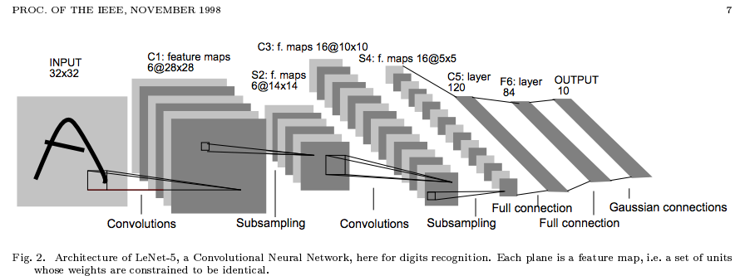
Why do max-pooling?
Saves space
Reduces overfitting?
Because I’m going to add more convolutions after it!
Allows the short-range convolutions to extend over larger subfields of the images
So we can spot larger objects
Eg, a long horizontal line, or a corner, or …

