Slide 1
Recurrent Neural Networks
Dr. Gahangir Hossain
Texas A&M University-Kingsville
Slides From : Ming Li

Slide 2
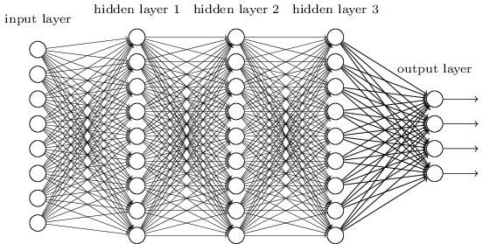
Motivation: what about sequence prediction?
What can I do when input size and output size vary?

Slide 3
Motivation: what about sequence prediction?
h
A
x

Slide 4
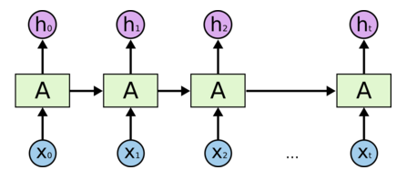
Architecture for an RNN
Some information is passed from one subunit to the next
Sequence of outputs
Sequence of inputs
Start of sequence marker
End of sequence marker
http://colah.github.io/posts/2015-08-Understanding-LSTMs/

Slide 5
Architecture for an 1980’s RNN
…
Problem with this: it’s extremely deep and very hard to train

Slide 6
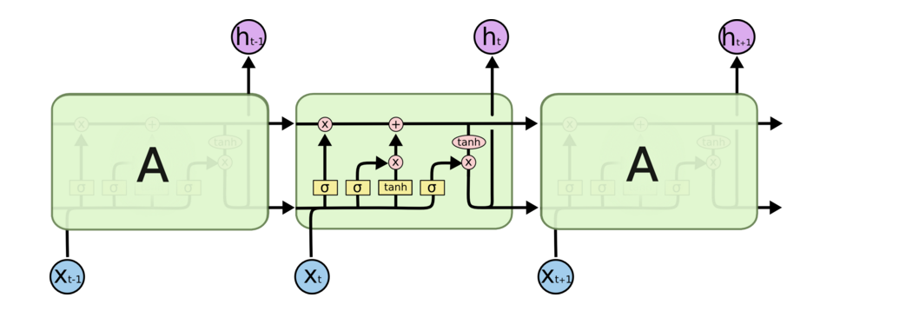
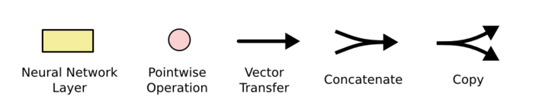
Architecture for an LSTM
“Bits of memory”
Decide what to forget
Decide what to insert
Longterm-short term model
Combine with transformed x_{t}
σ: output in [0,1]
tanh: output in [-1,+1]
http://colah.github.io/posts/2015-08-Understanding-LSTMs/
Notes:
Info is transferred down the chain, not just propagated
Decide when to insert imformation from input into the “backbone”

Slide 7
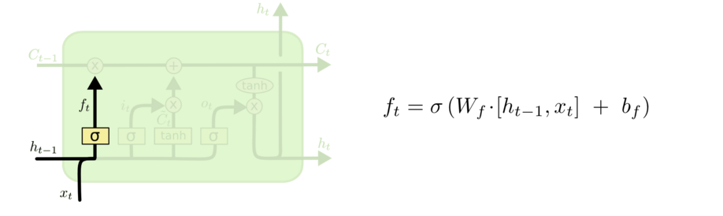
Walkthrough
What part of memory to “forget” – zero means forget this bit

Slide 8
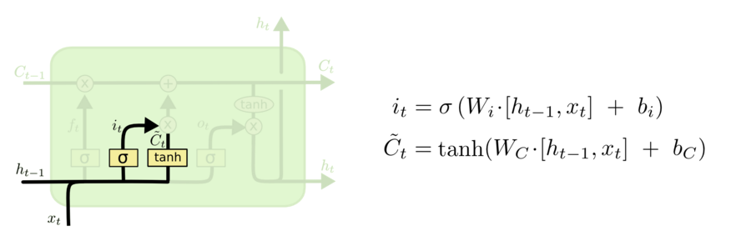
Walkthrough
What bits to insert into the next states
What content to store into the next state
http://colah.github.io/posts/2015-08-Understanding-LSTMs/

Slide 9
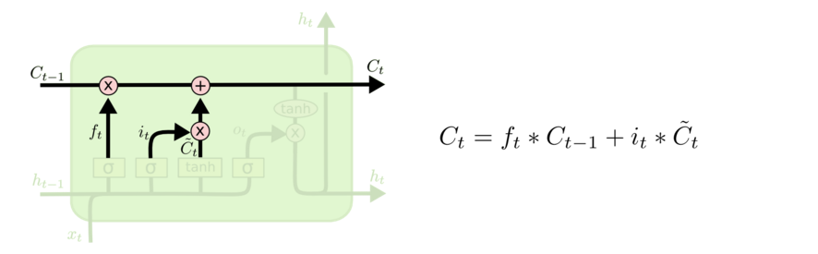
Walkthrough
Next memory cell content – mixture of not-forgotten part of previous cell and insertion
http://colah.github.io/posts/2015-08-Understanding-LSTMs/

Slide 10
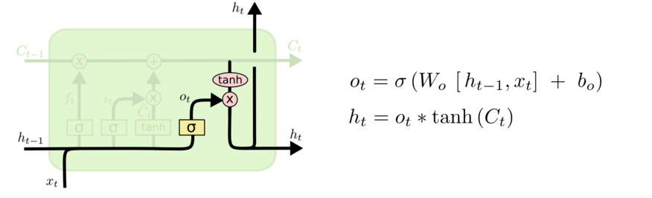
Walkthrough
What part of cell to output
tanh maps bits to [-1,+1] range
http://colah.github.io/posts/2015-08-Understanding-LSTMs/

Slide 11
Architecture for an LSTM
(1)
(2)
C_{t-1}
(3)
i_{t}
o_{t}
f_{t}
http://colah.github.io/posts/2015-08-Understanding-LSTMs/
Notes:
Info is transferred down the chain, not just propagated
Decide when to insert imformation from input into the “backbone”

Slide 12
Implementing an LSTM
For t = 1,…,T:
(1)
(2)
(3)
http://colah.github.io/posts/2015-08-Understanding-LSTMs/
Notes:
Info is transferred down the chain, not just propagated
Decide when to insert imformation from input into the “backbone”

Slide 13
Some Fun LSTM Examples
http://karpathy.github.io/2015/05/21/rnn-effectiveness/

Slide 14
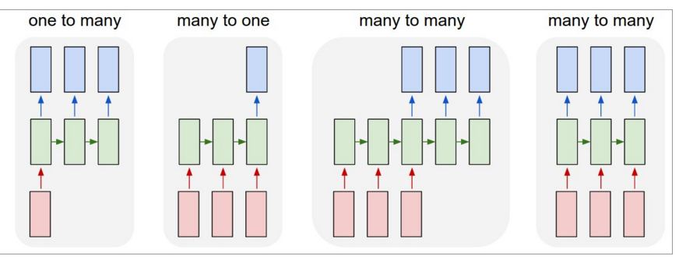
LSTMs can be used for other sequence tasks
image captioning
sequence classification
named entity recognition
translation
http://karpathy.github.io/2015/05/21/rnn-effectiveness/

Slide 15
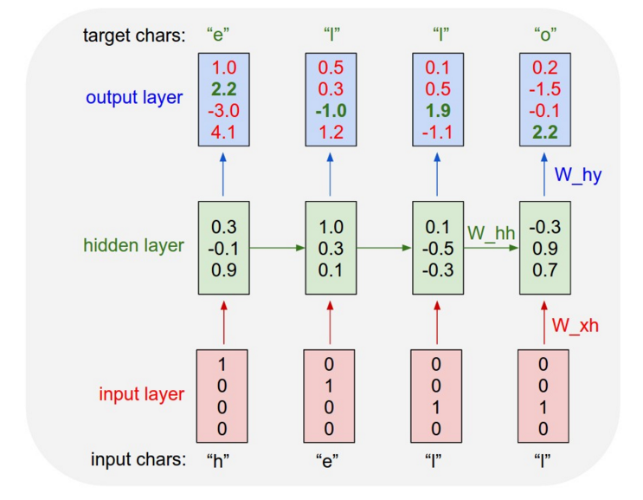
Character-level language model
Test time:
pick a seed character sequence
generate the next character
then the next
then the next …
http://karpathy.github.io/2015/05/21/rnn-effectiveness/

Slide 16
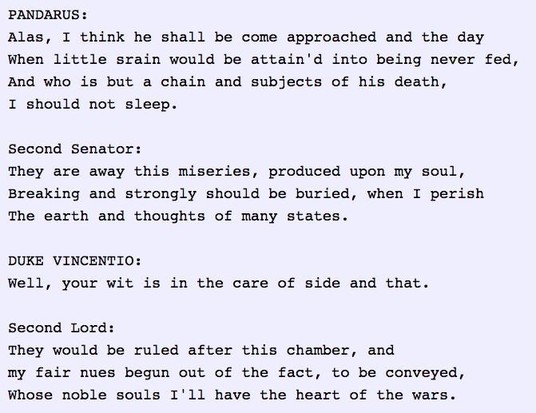
Character-level language model
http://karpathy.github.io/2015/05/21/rnn-effectiveness/

Slide 17
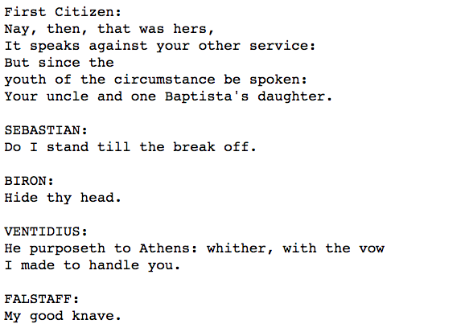
Character-level language model
Yoav Goldberg:
order-10 unsmoothed character n-grams
http://karpathy.github.io/2015/05/21/rnn-effectiveness/

Slide 18
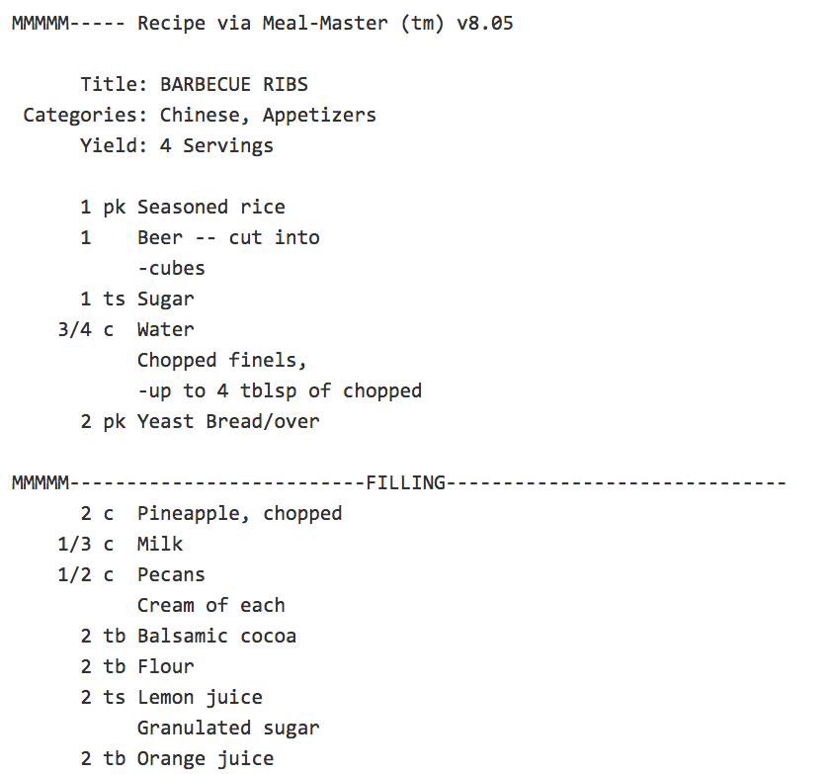
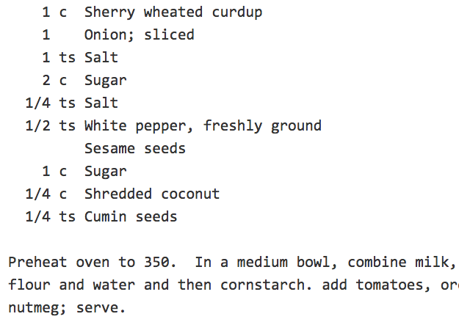
Character-level language model
http://karpathy.github.io/2015/05/21/rnn-effectiveness/

Slide 19
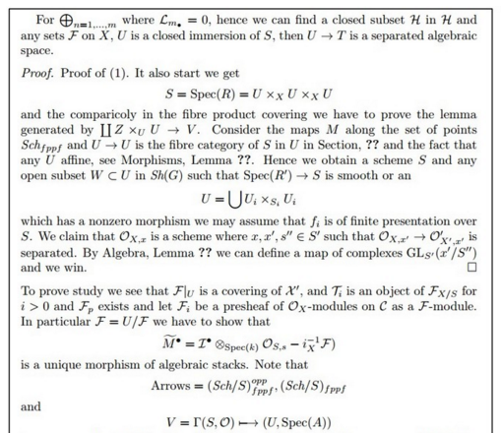
Character-level language model
LaTeX “almost compiles”
http://karpathy.github.io/2015/05/21/rnn-effectiveness/

Slide 20
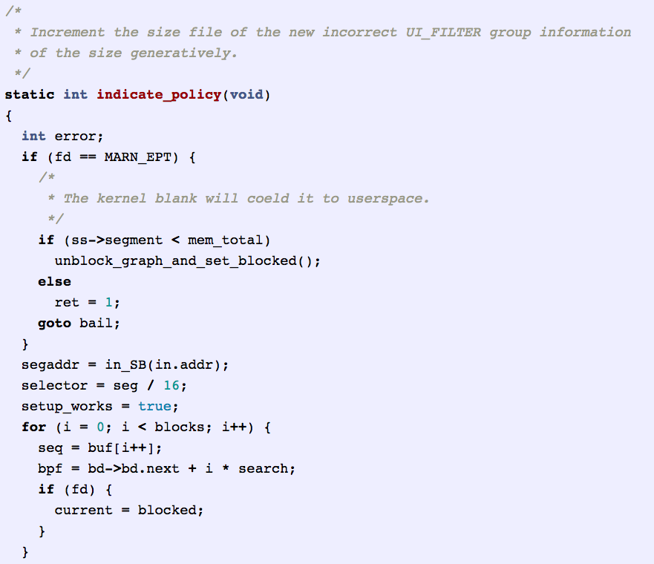
Character-level language model
http://karpathy.github.io/2015/05/21/rnn-effectiveness/

Slide 21
Outline
What’s new in ANNs in the last 5-10 years?
Deeper networks, more data, and faster training
Scalability and use of GPUs ✔
Symbolic differentiation ✔
Some subtle changes to cost function, architectures, optimization methods ✔
What types of ANNs are most successful and why?
Convolutional networks (CNNs) ✔
Long term/short term memory networks (LSTM)
Word2vec and embeddings
What are the hot research topics for deep learning?

Slide 22
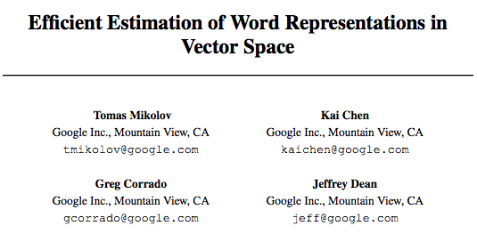
Word2Vec and Word embeddings

Slide 23
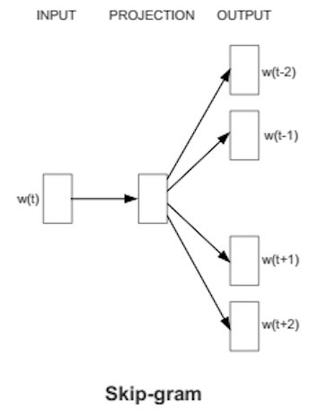
Basic idea behind skip-gram embeddings
construct hidden layer that “encodes” that word
So that the hidden layer will predict likely nearby words w(t-K), …, w(t+K)
from an input word w(t) in a document
final step of this prediction is a softmax over lots of outputs

Slide 24
Basic idea behind skip-gram embeddings
Training data:
positive examples are pairs of words w(t), w(t+j) that co-occur
You want to train over a very large corpus (100M words+) and hundreds+ dimensions
Training data:
negative examples are samples of pairs of words w(t), w(t+j) that don’t co-occur

Slide 25
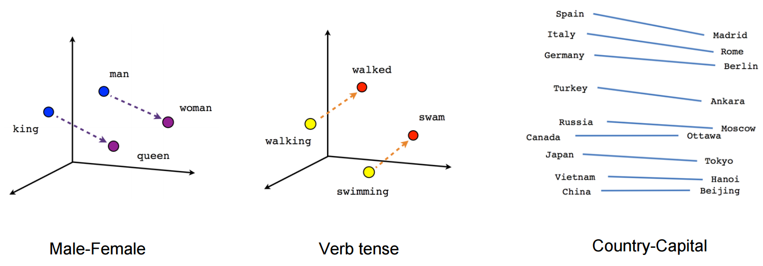
Results from word2vec
https://www.tensorflow.org/versions/r0.7/tutorials/word2vec/index.html

Slide 26
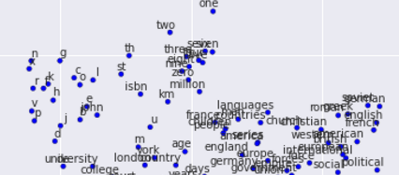
Results from word2vec
https://www.tensorflow.org/versions/r0.7/tutorials/word2vec/index.html

Slide 27
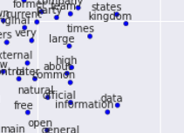
Results from word2vec
https://www.tensorflow.org/versions/r0.7/tutorials/word2vec/index.html

Slide 28
Outline
What’s new in ANNs in the last 5-10 years?
Deeper networks, more data, and faster training
Scalability and use of GPUs ✔
Symbolic differentiation ✔
Some subtle changes to cost function, architectures, optimization methods ✔
What types of ANNs are most successful and why?
Convolutional networks (CNNs) ✔
Long term/short term memory networks (LSTM)
Word2vec and embeddings
What are the hot research topics for deep learning?

Slide 29
Some current hot topics
Multi-task learning
Does it help to learn to predict many things at once? e.g., POS tags and NER tags in a word sequence?
Similar to word2vec learning to produce all context words
Extensions of LSTMs that model memory more generally
e.g. for question answering about a story

Slide 30
Some current hot topics
Optimization methods (>> SGD)
Neural models that include “attention”
Ability to “explain” a decision

Slide 31
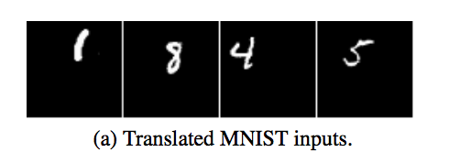
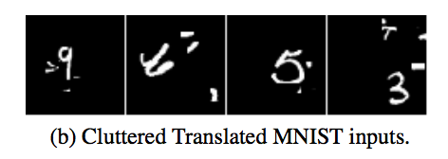
Examples of attention
https://papers.nips.cc/paper/5542-recurrent-models-of-visual-attention.pdf

Slide 32
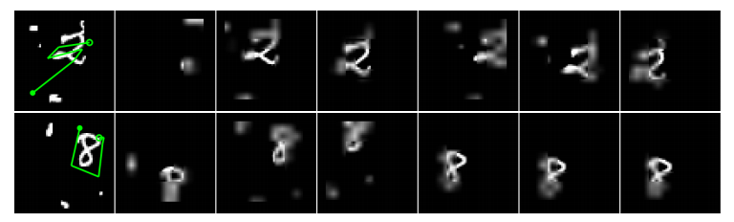
Examples of attention
Basic idea: similarly to the way an LSTM chooses what to “forget” and “insert” into memory, allow a network to choose a path to focus on in the visual field
https://papers.nips.cc/paper/5542-recurrent-models-of-visual-attention.pdf

Slide 33
Some current hot topics
Knowledge-base embedding: extending word2vec to embed large databases of facts about the world into a low-dimensional space.
TransE, TransR, …
“NLP from scratch”: sequence-labeling and other NLP tasks with minimal amount of feature engineering, only networks and character- or word-level embeddings

Slide 34
Some current hot topics
Computer vision: complex tasks like generating a natural language caption from an image or understanding a video clip
Machine translation
English to Spanish, …
Using neural networks to perform tasks
Driving a car
Playing games (like Go or …)

