Slide 1
Generative Adversarial Network (GAN)
Dr. Gahangir Hossain
Texas A&M University-Kingsville
Some slides from: Ian Byod

Slide 2
Deriving GAN
During the rest of this lecture, we will go thru the original ideas and derive GAN.
I will avoid the continuous case and stick to simple explanations.

Slide 3
Maximum Likelihood Estimation
Give a data distribution P_{data}(x)
We use a distribution P_{G}(x;θ) parameterized by θ to approximate it
E.g. P_{G}(x;θ) is a Gaussian Mixture Model, where θ contains means and variances of the Gaussians.
We wish to find θ s.t. P_{G}(x;θ) is close to P_{data}(x)
In order to do this, we can sample
{x¹,x², … x^{m}} from P_{data}(x)
The likelihood of generating these
x^{i}’s under P_{G} is
L= Π_{i=1…m} P_{G}(x^{i}; θ)
Then we can find θ* maximizing the L.

Slide 4
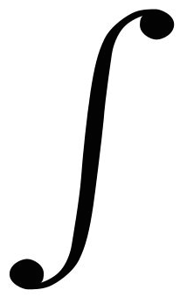
KL (Kullback-Leibler) divergence
Discrete:
D_{KL}(P||Q) = Σ_{i}P(i)log[P(i)/Q(i)]
Continuous:
D_{KL}(P||Q) = p(x)log [p(x)/q(x)]
Explanations:
Entropy: - Σ_{i}P(i)logP(i) - expected code length (also optimal)
Cross Entropy: - Σ_{i}P(i)log Q(i) – expected coding
length using optimal code for Q
D_{KL}= Σ_{i}P(i)log[P(i)/Q(i)] = Σ_{i}P(i)[logP(i) – logQ(i)], extra bits
JSD(P||Q) = ½ D_{KL}(P||M)+ ½ D_{KL}(Q||M), M= ½ (P+Q), symmetric KL
* JSD = Jensen-Shannon Divergency
∞
−∞

Slide 5
Maximum Likelihood Estimation
θ* = arg max_{θ} Π_{i=1..m}P_{G}(x^{i}; θ) →
arg max_{θ} log Π_{i=1..m}P_{G}(x^{i}; θ)
= arg max_{θ} Σ_{i=1..m} log P_{G}(x^{i}; θ), {x¹,..., x^{m}} sampled from P_{data}(x)
= arg max_{θ} Σ_{i=1..m} P_{data}(x^{i}) log P_{G}(x^{i}; θ) --- this is cross entropy
≅ arg max_{θ} Σ_{i=1..m} P_{data}(x^{i}) log P_{G}(x^{i}; θ) - Σ_{i=1..m} P_{data}(x^{i} )logP_{data}(x ^{i})
= arg min_{θ} KL (P_{data}(x) || P_{G}(x; θ)) --- this is KL divergence
Note: P_{G} is Gaussian mixture model, finding best θ will still be Gaussians, this only can generate a few blubs. Thus this above maximum likelihood approach does not work well.
Next we will introduce GAN that will change P_{G}, not just estimating P_{G is} parameters We will find best P_{G} , which is more complicated and structured, to approximate P_{data}.

Slide 6

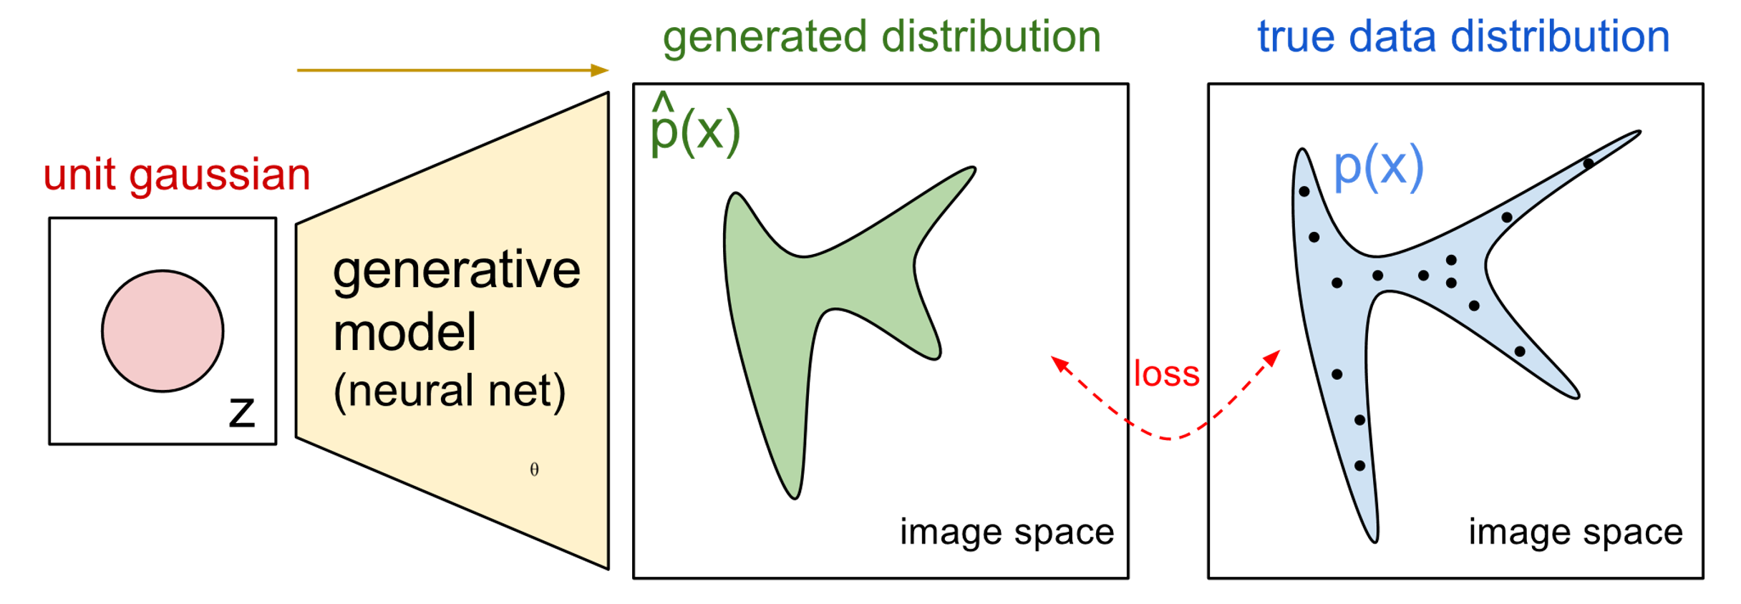

Thus let’s use an NN as P_{G}(x; θ)
P_{G}(x,θ)
P_{data}(x)
G
θ
Prior
distribution
of z
Smaller
dimension
Larger
dimension
How to compute the likelihood?
P_{G}(x) = Integration_{z} P_{prior}(z) I_{[G(z)=x]}dz
https://blog.openai.com/generative-models/

Slide 7
Basic Idea of GAN
Generator G
G is a function, input z, output x
Given a prior distribution P_{prior}(z), a probability distribution P_{G}(x) is defined by function G
Discriminator D
D is a function, input x, output scalar
Evaluate the “difference” between P_{G}(x) and P_{data}(x)
In order for D to find difference between P_{data} from P_{G}, we need a cost function V(G,D):
G*=arg min_{G}max_{D}V(G,D)
Note, we are changing distribution G, not just update
its parameters (as in the max likelihood case).
Hard to learn P_{G} by maximum likelihood

Slide 8


Basic Idea
G* = arg min_{G}max_{D} V(G,D)
Pick JSD function: V = E_{x~P_data} [log D(x)] + E_{x~P_G}[log(1-D(x))]
Given a generator G, max_{D}V(G,D) evaluates the
“difference” between P_{G} and P_{data}
Pick the G s.t. P_{G} is most similar to P_{data}
V(G₁,D)
V(G₂,D)
V(G₃,D)
G₁
G₂
G₃

Slide 9
Max_{D}V(G,D), G*=arg min_{G}max_{D}V(G,D)
Given G, what is the optimal D* maximizing
Given x, the optimal D* maximizing is:
f(D) = alogD + blog(1-D) ➔ D*=a/(a+b)
V = E_{x~P_data} [log D(x)] + E_{x~P_G}[log(1-D(x))]
= Σ [ P_{data}(x) log D(x) + P_{G}(x) log(1-D(x) ]
Thus: D*(x) = P_{data}(x) / (P_{data}(x)+P_{G}(x))
Assuming D(x) can have any value here

Slide 10


max_{D}V(G,D), G* = arg min_{G}max_{D} V(G,D)
D₁*(x) = P_{data}(x) / (P_{data}(x)+P_{G_1}(x))
D₂*(x) = P_{data}(x) / (P_{data}(x)+P_{G_2}(x))
“difference” between P_{G1} and P_{data}
V(G₁,D*₁)
V(G₁,D)
V(G₂,D)
V(G₃,D)

Slide 11
max_{D}V(G,D)
V = E_{x~P_data} [log D(x)]
+ E_{x~P_G}[log(1-D(x))]
max_{D} V(G,D)
= V(G,D*), where D*(x) = P_{data} / (P_{data} + P_{G}), and
1-D*(x) = P_{G} / (P_{data} + P_{G})
= E_{x~P_data} log D*(x) + E_{x~P_G} log (1-D*(x))
≈ Σ [ P_{data} (x) log D*(x) + P_{G}(x) log (1-D*(x)) ]
= -2log2 + 2 JSD(P_{data} || P_{G} ),
JSD(P||Q) = Jensen-Shannon divergence
= ½ D_{KL}(P||M)+ ½ D_{KL}(Q||M)
where M= ½ (P+Q).
D_{KL}(P||Q) = Σ P(x) log P(x) /Q(x)
Notes:
Converge

Slide 12
Summary:
V = E_{x~P_data} [log D(x)]
+ E_{x~P_G}[log(1-D(x))]
Generator G, Discriminator D
Looking for G* such that
Given G, max_{D} V(G,D)
= -2log2 + 2JSD(P_{data}(x) || P_{G}(x))
What is the optimal G? It is G that makes JSD smallest = 0:
P_{G}(x) = P_{data} (x)
G* = arg min_{G}max_{D} V(G,D)

Slide 13

Algorithm
G* = arg min_{G}max_{D} V(G,D)
L(G), this is the
loss function
To find the best G minimizing the loss function L(G):
θ_{G} ← θ_{G} =−η L(G)/ θ_{G ,} θ_{G} defines G
Solved by gradient descent. Having max ok. Consider simple case:
f(x) = max {D₁(x), D₂（x), D₃(x)}
If D_{i}(x) is the
Max in that region,
then do dD_{i}(x)/dx
D₁(x)
D₃(x)
D₂(x)
dD₁(x)/dx
dD₂(x)/dx
dD₃(x)/dx

Slide 14
Algorithm
G* = arg min_{G}max_{D} V(G,D)
L(G)
Given G₀
Find D*₀ maximizing V(G₀,D)
V(G₀,D₀*) is the JS divergence between P_{data}(x) and P_{G0}(x)
θ_{G} ← θ_{G} −η ΔV(G,D₀*) / θ_{G} ➔ Obtaining G₁ (decrease JSD)
Find D₁* maximizing V(G₁,D)
V(G₁,D₁*) is the JS divergence between P_{data}(x) and P_{G1}(x)
θ_{G} ← θ_{G} −η ΔV(G,D₁*) / θ_{G} ➔ Obtaining G₂ (decrease JSD)
And so on …

Slide 15
In practice …
V = E_{x~P_data} [log D(x)]
+ E_{x~P_G}[log(1-D(x))]
Given G, how to compute max_{D}V(G,D)?
Sample {x¹, … ,x^{m}} from P_{data}
Sample {x*¹, … ,x*^{m}} from generator P_{G}
Maximize:
V’ = 1/m Σ_{i=1..m} logD(x^{i}) + 1/m Σ_{i=1..m} log(1-D(x*^{i}))
Positive example
D must accept
Negative example
D must reject
This is what a Binary Classifier do
Output is D(x)
Minimize Cross-entropy
If x is a positive example
Minimize –log D(x)
If x is a negative example
Minimize –log(1-D(x))

Slide 16
Binary Classifier
Output is f(x)
Minimize Cross-entropy
If x is a positive example
Minimize –log f(x)
If x is a negative example
Minimize –log(1-f(x))
D is a binary classifier (can be deep) with parameters θ_{d}
{x¹,x², … x^{m}} from P_{data} (x)
Positive examples
{x*¹,x*², … x*^{m}} from P_{G}(x)
Negative examples
Minimize
L = - V’
or
Maximize
V’ = Σ_{i=1..m} logD(x^{i}) + 1/m Σ_{i=1..m} log(1-D(x*^{i}))

Slide 17
Algorithm
Initialize θ_{d} for D and θ_{g} for G
Can only find lower bound of JSD or max_{D}V(G,D)
In each training iteration
Sample m examples {x¹,x², … x^{m}} from data distribution P_{data}(x)
Sample m noise samples {z¹, … , z^{m}} from a simple prior P_{prior}(z)
Obtain generated data {x*¹, … , x*^{m}}, x*^{i}=G(z^{i})
Update discriminator parameters θ_{d} to maximize
V’ ≈ 1/m Σ_{i=1..m} logD(x^{i}) + 1/m Σ_{i=1..m} log(1-D(x*^{i}))
θ_{d} ← θ_{d} + ηΔV’(θ_{d}) (gradient ascent)
Simple another m noise samples {z¹,z², … z^{m}} from the prior P_{prior}(z)，G(z^{i})=x*^{i}
Update generator parameters θ_{g} to minimize
V’= 1/mΣ_{i=1..m} logD(x^{i}) + 1/m Σ_{i=1..m} log(1-D(x*^{i}))
θ_{g} ← θ_{g} − ηΔV’(θ_{g}) (gradient descent)
Ian Goodfellow
comment: this
is also done once
Learning D
Repeat k times
Learning G
Only Once
Notes:
位什麼要 1- 啊

Slide 18
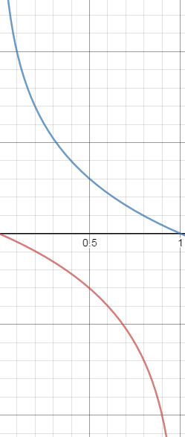



Objective Function for Generator in Real Implementation
V = E_{x~P_data} [log D(x)
+ E_{x~P_G}[log(1-D(x))]
Training slow at the beginning
V = E_{x~P_G} [ − log (D(x)) ]
Real implementation:
label x from P_{G} as positive

Slide 19
Some issues in training GAN
M. Arjovsky, L. Bottou, Towards principled methods for training generative adversarial networks, 2017.

Slide 20
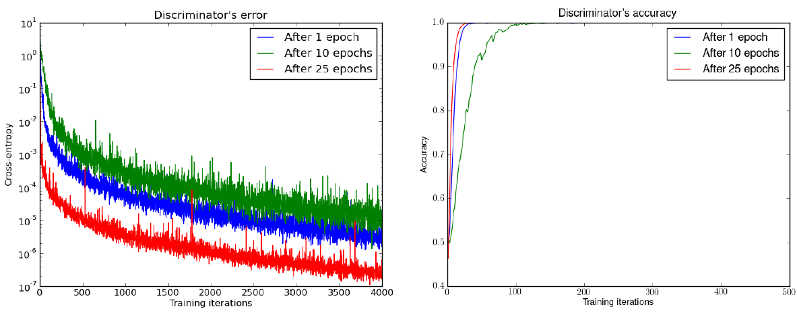
Evaluating JS divergence
Discriminator is too strong: for all three
Generators, JSD = 0
Martin Arjovsky, Léon Bottou, Towards Principled Methods for Training Generative Adversarial Networks, 2017, arXiv preprint

Slide 21
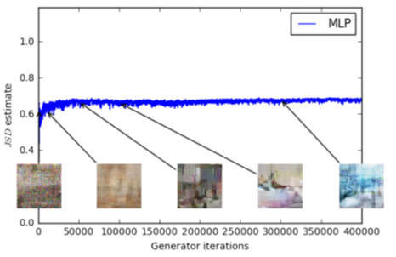
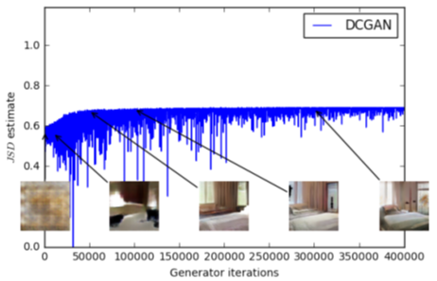
Evaluating JS divergence
https://arxiv.org/abs/1701.07875
JS divergence estimated by discriminator telling little information
Weak Generator
Strong Generator

Slide 22
Discriminator
1 for all positive examples
0 for all negative examples
V = E_{x~P_data} [log D(x)] + E_{x~P_G}[log(1-D(x))]
= 1/m Σ_{i=1..m} logD(x^{i}) + 1/m Σ_{i=1..m} log(1-D(x*^{i}))
max_{D}V(G,D) = -2log2 + 2 JSD(P_{data} || P_{G} )
= 0
log 2 when P_{data} and P_{G} differ completely
Reason 1. Approximate by sampling
Weaken your discriminator?
Can weak discriminator compute JS divergence?

Slide 23
Discriminator
1
0
GAN implementation
estimation
V = E_{x~P_data} [log D(x)] + E_{x~P_G}[log(1-D(x))]
= 1/m Σ_{i=1..m} logD(x^{i}) + 1/m Σ_{i=1..m} log(1-D(x*^{i}))
≈ 0
max_{D}V(G,D) = -2log2 + 2 JSD(P_{data} || P_{G} )
= 0
log2
Theoretical estimation
Reason 2. the nature of data
P_{data}(x) and P_{G}(x) have very little
overlap in high dimensional space

Slide 24
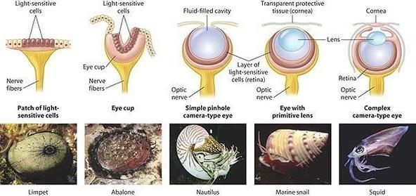
Evolution
http://www.guokr.com/post/773890/
Better

Slide 25
Evolution needs to be smooth:
P_{G_0}(x)
JSD(P_{G_0} || P_{data}) = log2
P_{data}(x)
……
Better
P_{G_50}(x)
P_{data}(x)
JSD(P_{G_50} || P_{data}) = log2
Not really better ……
……
P_{G_100}(x)
P_{data}(x)
JSD(P_{G_100} || P_{data}) = 0

Slide 26
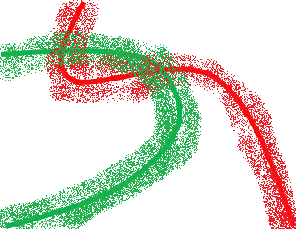
One simple solution: add noise
Add some artificial noise to the inputs of discriminator
Make the labels noisy for the discriminator
Discriminator cannot perfectly separate real and generated data
P_{data}(x) and P_{G}(x) have some overlap
Noises need to decay over time

Slide 27
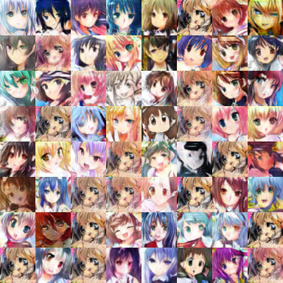
Mode Collapse
Converge to same faces
Generated Distribution
Data Distribution
Sometimes, this is hard to tell since
one sees only what’s generated, but not what’s missed.

Slide 28
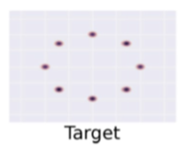
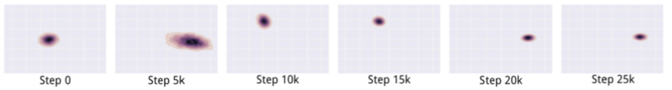
Mode Collapse Example 8 Gaussian distributions:
P_{data}
What we want …
In reality …

Slide 29
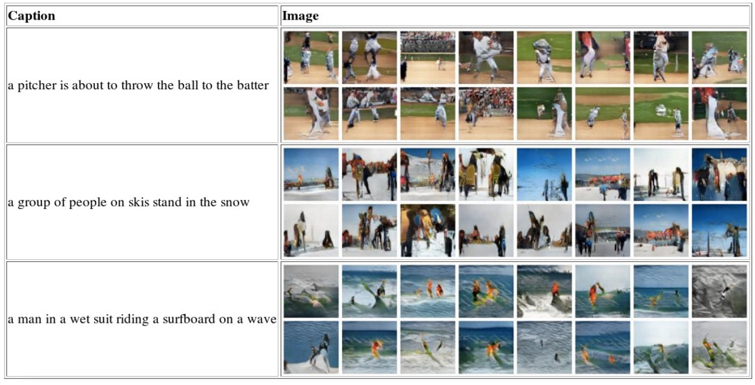
Text to Image, by conditional GAN

Slide 30

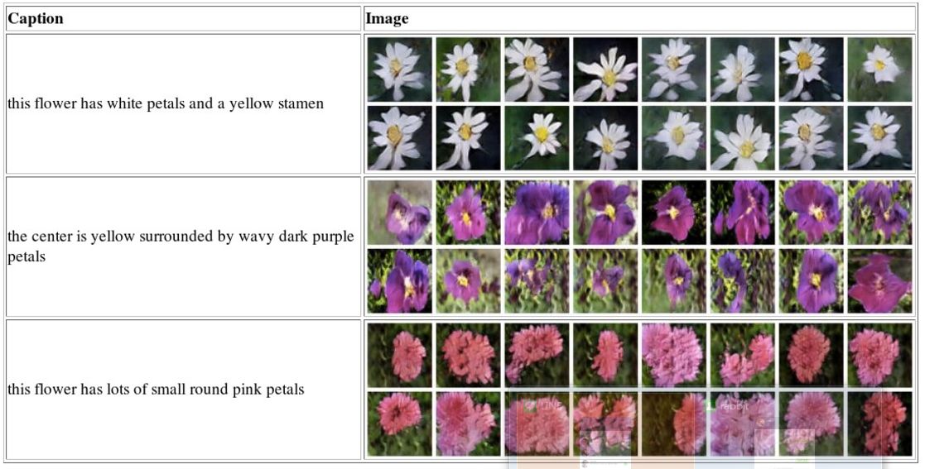
Text to Image - Results
"red flower with black center"
From CY Lee lecture
Project topic: Code and data are all on web, many possibilities!

Slide 31
Algorithm
WGAN
In each training iteration
Sample m examples {x¹,x², … x^{m}} from data distribution P_{data}(x)
Sample m noise samples {z¹, … , z^{m}} from a simple prior P_{prior}(z)
Obtain generated data {x*¹, … , x*^{m}}, x*^{i}=G(z^{i})
Update discriminator parameters θ_{d} to maximize
V’ ≈ Σ_{i=1..m} logD(x^{i}) + 1/m Σ_{i=1..m} log(1-D(x*^{i}))
θ_{d} ← θ_{d} + ηΔV’(θ_{d}) (gradient ascent plus weight clipping)
Simple another m noise samples {z¹,z², … z^{m}} from the prior P_{prior}(z)，G(z^{i})=x*^{i}
Update generator parameters θ_{g} to minimize
V’= 1/mΣ_{i=1..m} logD(x^{i}) + 1/m Σ_{i=1..m} log(1-D(x*^{i}))
θ_{g} ← θ_{g} − ηΔV’(θ_{g}) (gradient descent)
Ian Goodfellow
comment: this
is also done once
Learning D
Repeat k times
Learning G
Only Once

Slide 32
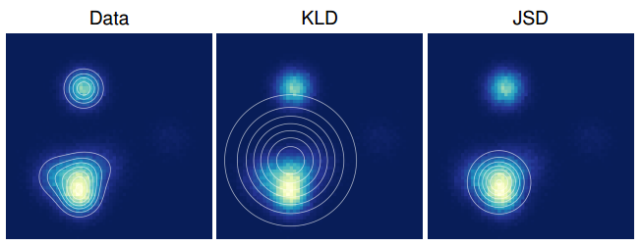
Experimental Results
Approximate a mixture of Gaussians by single mixture

Slide 33
WGAN Background
We have seen that JSD does not give GAN a smooth and continuous improvement curve.
We would like to find another distance which gives that.
This is the Wasserstein Distance or earth mover’s distance.

Slide 34




Earth Mover’s Distance
Considering one distribution P as a pile of earth (total amount of earth is 1), and another distribution Q (another pile of earth) as the target
The “earth mover’s distance” or “Wasserstein Distance” is the average distance the earth mover has to move the earth in an optimal plan.
d
Notes:
http://www.wxlhcc.com/product/328294.html

Slide 35
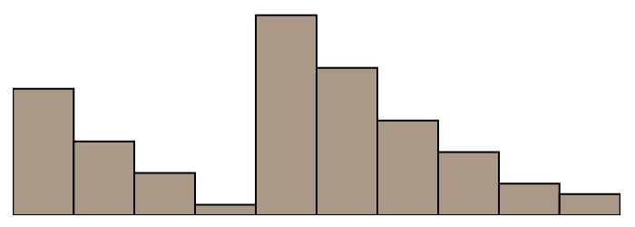
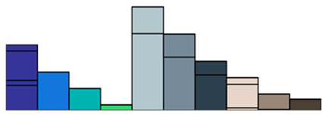
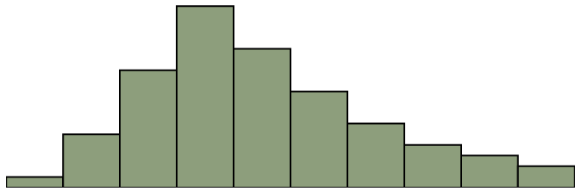
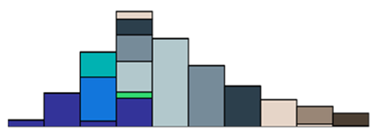
Earth Mover’s Distance: best plan to move
P
Q

Slide 36
JS vs Earth Mover’s Distance
d₀
d₅₀
d₁₀₀
P_{G_0}
P_{data}
……
P_{G_50}
P_{data}
……
P_{G_100}
P_{data}
JS(P_{G_0}, P_{data}) = log2
JS(P_{G_50}, P_{data}) = log2
JS(P_{G_100}, P_{data}) = 0
W(P_{G_0}, P_{data})=d₀
W(P_{G_50}, P_{data})=d₅₀
W(P_{G_100}, P_{data})=0

Slide 37
Explaining WGAN
Let W be the Wasserstein distance.
W(P_{data}, P_{G}) = max_{D} _{is 1-Lipschitz}[E_{x~P_data} D(x) – E_{x~P_G} D(x)]
Where a function f is a
k-Lipschitz function if
||f(x₁) – f(x₂) ≤ k||x₁ – x₂ ||
How to guarantee this?
Weight clipping: for all
parameter updates, if w>c
Then w=c, if w<-c, then w=-c.
Blue: D(x) for original GAN
Green: D(x) for WGAN
WGAN will provide gradient to push P_{G} towards P_{data}

Slide 38
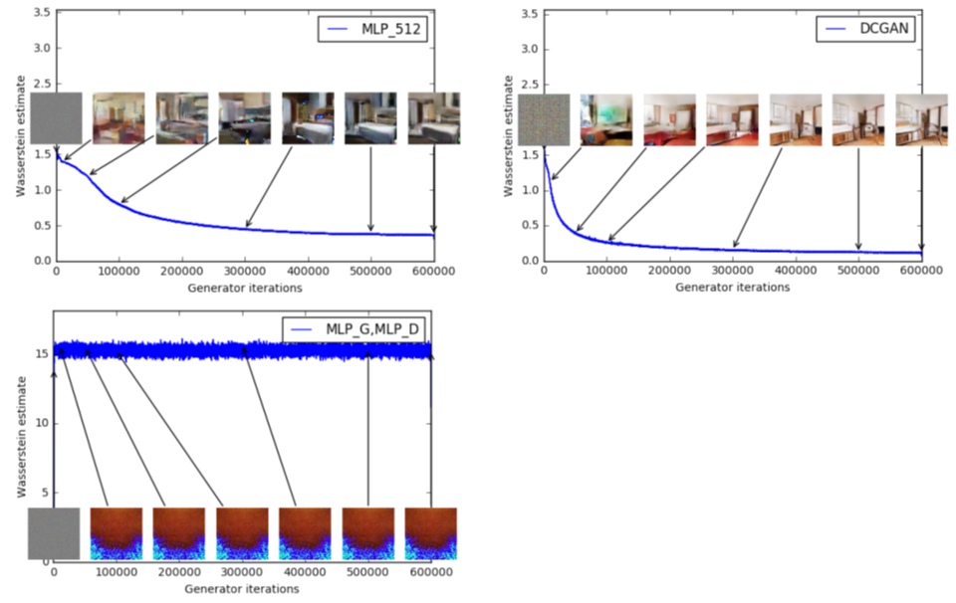
Earth Mover Distance Examples:
Multi-layer perceptron

