Slide 1
Python for Machine Learning : Neural Networks
Dr. Gahangir Hossain
Slides from: Katia Oleinik (koleinik@bu.edu), Rafie Tarabay and
Ali Ghodsi and Ion Stoica, UC Berkeley

Slide 2
Why Python?
A large community
tons of machine learning specific libraries
easy to learn
TensorFlow make Python the leading language in the data science community.
About Python
It is case sensitive
Text indentation is important in logic flow!
Use # symbol to add a code comment
Use ‘’’ ‘’’ to comment a block of code

Slide 3
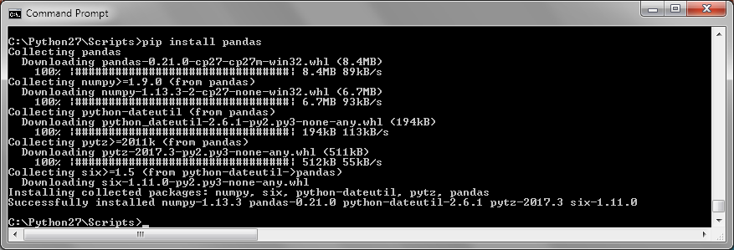
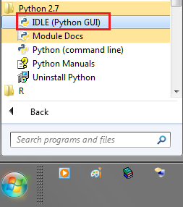
Prepare your machine
Install Python 2.7.xx
Pip install pandas
Pip install matplotlib Sklearn Statistics scipy seaborn Ipython pip install --no-cache-dir pystan #to force redownload exist package in case of error
Get Data set for training through http://archive.ics.uci.edu/ml/datasets.html

Slide 4
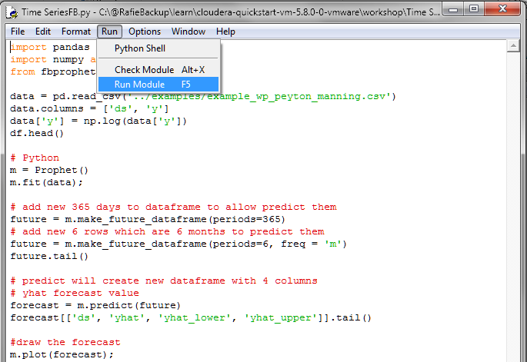
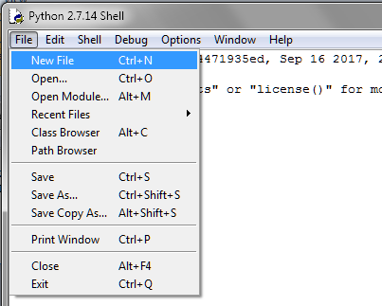
How to Run Python ML application
Open “IDLE (Python GUI)” → File → New File
Write your code on the new window then → Run → Run Module
Alt+3 ➔ Comment lines
Alt+4 ➔ Remove lines comments

Slide 5
Anaconda
Anaconda is Python distribution for data scientists .
It has around 270 packages including the most important ones for most scientific applications, data analysis, and machine learning such as NumPy, SciPy, Pandas, IPython, matplotlib, and scikit-learn.
Download it for free from https://www.continuum.io/downloads

Slide 6
Import Statistical libraries
import time
import random
import datetime
import pandas as pd
import matplotlib.pyplot as plt
import statistics
from scipy import stats
import sklearn
import seaborn
from IPython.display import Image
import numpy as np

Slide 7
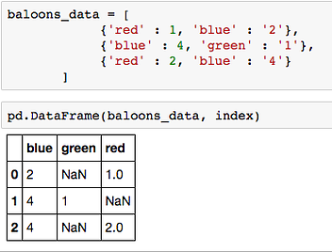
import pandas as pd
Pandas DataFrame similar to Python lists but it has extra column (index) and Any operation to perform on a DataFrame , get’s performed on every single element inside it.
Example of convert python list to DataFrame →
Common Operations
1) Set dataset columns names → data.columns = [‘blue’,’green’,’red’]
2) Get value of any cell use cell index and column index/name like this : data.ix[2,’red’]
3) replace NaN with zero using : data = data.replace(np.nan,0)
4) Select a subset of columns in new dataFrame : NewDF= data [ [ ‘blue’ , ’red’ ] ]
5) Count of rows that has data on a column: data[‘red'].value_counts().sum()
6) Select count of distinct value on a column: data[‘blue’].nunique()
7) Drop duplicates rows: data = data.drop_duplicates()
The missing values are dennoted by NaN __

Slide 8
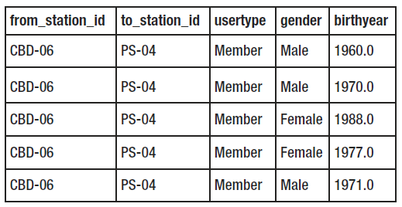
Basic commands
Reading the Data from disk into Memory
data = pd.read_csv('examples/trip.csv’)
Reading the Data from HDFS into Memory
with hd.open("/home/file.csv") as f:
data = pd.read_csv(f)
Printing Size of the Dataset and Printing First/last Few Rows
print len(data)
data.head()
data.tail()
data.describe() #get data summary count, mean, the min and max values
Order Dataset and get first and last element of a column
data = data.sort_values(by= 'birthyear')
data.reset_index()
print data.ix[1, 'birthyear’ ] #first element
print data.ix[len(data)-1, 'birthyear’ ] #last element

Slide 9
DataFrame cleaning
If need to convert column with negative values data['AwaitingTime'] = data['AwaitingTime'].apply(lambda x: abs(x))
Convert string values to integer values (DayOfTheWeek to Integers) Day_mapping = {'Monday' : 0, 'Tuesday' : 1, 'Wednesday' : 2, 'Thursday' : 3, 'Saturday' : 5, 'Sunday' : 6} data['DayOfTheWeek'] = data['DayOfTheWeek'].map(Day_mapping)
Remove rows that has age column less than zero data = data[data['Age'] >= 0]
Delete column from Dataset del data[‘from_station_id']

Slide 10
Filter data to remove rows that has NA/0
> df = pd.DataFrame({'a':[0,0,1,1], 'b':[0,1,0,1]})
df = df[(df.T != 0).any()] #keep row if any feature contain values
> print df
> df = df[(df.T != 0).all()] #keep row if all features contain values
> print df
Original DataFrame
Keep raw if ANY contains a value
Keep raw if ALL contains values
b | a
0 | 0 | 1
0 | 1 | 2
1 | 0 | 3
1 | 1 | 4
b | a
0 | 1 | 2
1 | 0 | 3
1 | 1 | 4
b | a
1 | 1 | 4
df[(df.T != 0).all()]
df[(df.T != 0).any()]

Slide 11
Drop the columns where Any/All elements are NaN
data.dropna(how='any’)
how : {‘any’, ‘all’}
any : if any NA values are present, drop that label
all : if all values are NA, drop that label

Slide 12
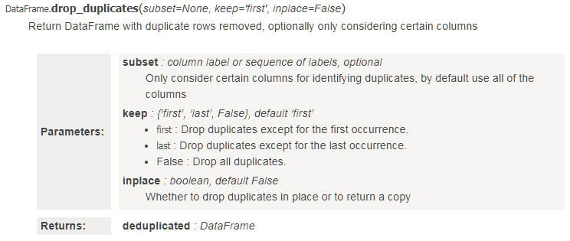
Drop duplicate rows
Consider duplicate if all the row are the same, return result in new dataframe
dataframe1 = df.drop_duplicates(subset=None, inplace=False)
Consider duplicate if Column1, Column3 are the same, drop duplicate except last row, return result in the same dataframe
df.drop_duplicates(subset=[‘Column1', ‘Column3'], keep=‘last’)
Save unique data
df.to_csv(file_name_output)

Slide 13
Split Dataset, Create training, and test dataset
How to split dataset by 70-30? [70% of the observations fall into training and 30% of observations fall into the test dataset.]
x_train,x_test, y_train, y_test = train_test_split(data[‘x’],data[‘y'], test_size=0.3, random_state=1)

Slide 14
import matplotlib.pyplot as plt
plt.bar – creates a bar chart
plt.scatter – makes a scatter plot
plt.boxplot – makes a box and whisker plot
plt.hist – makes a histogram
plt.plot – creates a line plot

Slide 15
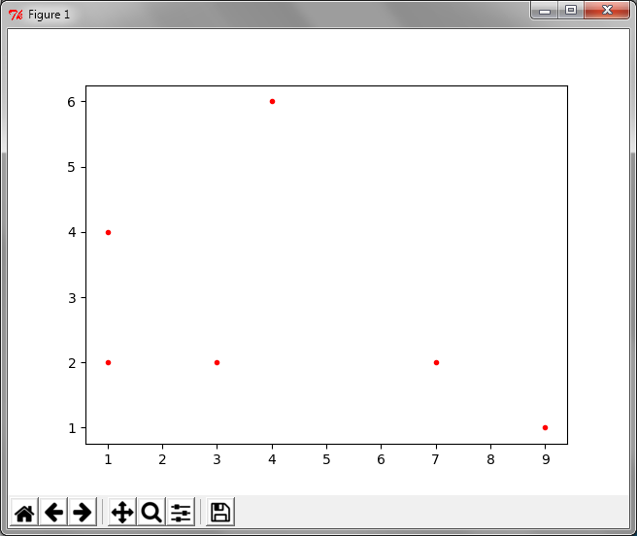
Plot for Data array
import numpy as np
import matplotlib.pyplot as plt
Data=np.array([ [1,2], [3,2], [4,6], [7,2], [1,4], [9,1] ])
Column1=0
Column2=1
for i in range( len(Data) ):
plt.plot( Data[ i ] [Column1] , Data[ i ] [Column2] ,'r.’) #r. :red
plt.show()

Slide 16
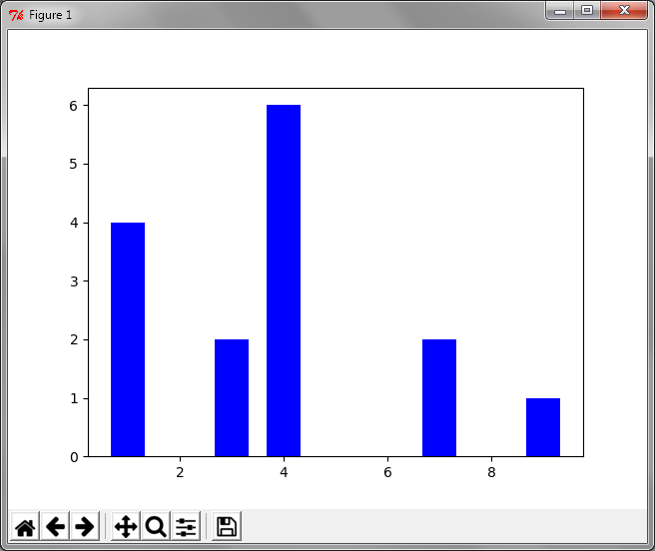
Bar plot for Data array
import numpy as np
import matplotlib.pyplot as plt
Data=np.array([ [1,2], [3,2], [4,6], [7,2], [1,4], [9,1] ])
Column1=0
Column2=1
BarWidth=1/1.5
for i in range( len(Data) ):
plt.bar( Data[ i ] [Column1] , Data[ i ] [Column2] , BarWidth , color="blue")
plt.show()

Slide 17
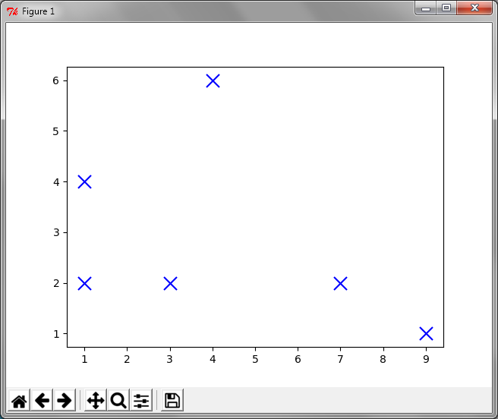
Scatter plot for Data
import numpy as np
import matplotlib.pyplot as plt
Data=np.array([ [1,2], [3,2], [4,6], [7,2], [1,4], [9,1] ])
Column1=0
Column2=1
plt.scatter( Data[:, Column1] , Data[:, Column2] , marker = "x“ , s=150 , linewidths = 5 , zorder = 1)
plt.show()
#Where s is the size of the marker

Slide 18
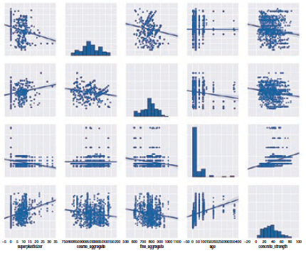
Calculating Pair Plot Between All Features
import numpy as np
import matplotlib.pyplot as plt
data=np.array([ [1,2], [3,2], [4,6], [7,2], [1,4], [9,1] ])
import pandas
df = pandas.DataFrame(Data)
#Calculating Pair Plot Between All Features
seaborn.pairplot(df)
plt.show()

Slide 19
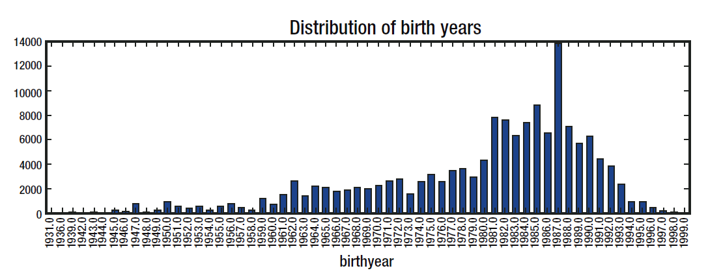
Basic commands
Sort, Filter, group, and Plotting the Data
data = data.sort_values(by='birthyear’)
data = data[(data['birthyear'] >= 1931) & (data['birthyear']<=1999)]
groupby_birthyear = data.groupby('birthyear').size()
groupby_birthyear.plot.bar(title = 'Distribution of birth years’, figsize = (15,4))
plt.show()

Slide 20
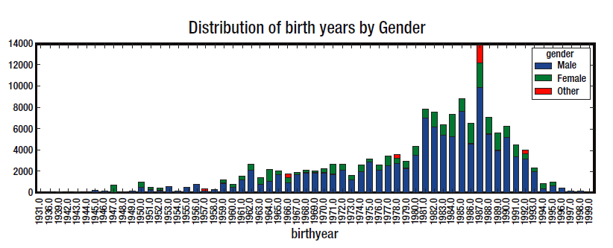
Stacked column chart
data1 = data.groupby(['birthyear', 'gender']).size().unstack('gender').fillna(0)
data1.plot.bar(title ='Distribution of birth years by Gender', stacked=True, figsize = (15,4))

Slide 21
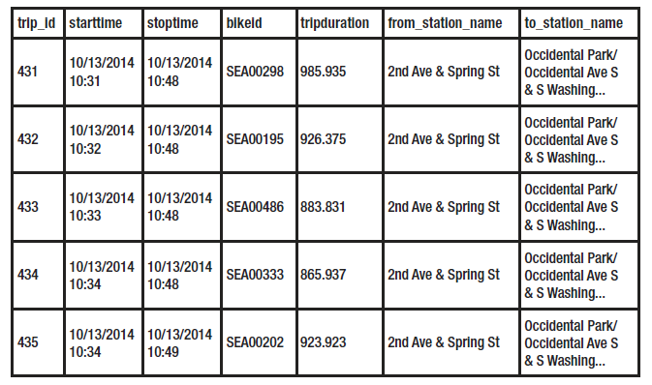
Convert string to DateTime
Create new column as date/time
data['StartTime1'] = data['starttime'].apply(lambda x: datetime.datetime.strptime(x, "%m/%d/%Y %H:%M") )
Extract Year, Month, Day, and Hour
data['year'] = data['StartTime1'].apply(lambda x: x.year )
data['month'] = data['StartTime1'].apply(lambda x: x.month )
data['day'] = data['StartTime1'].apply(lambda x: x.day )
data['hour'] = data['StartTime1'].apply(lambda x: x.hour )

Slide 22
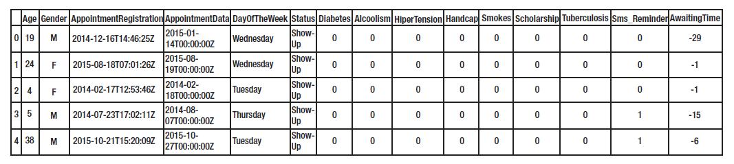
Split String column to create new columns for Year-Month-Day
for index, component in enumerate(['year', 'month', 'day']):
data[component] = data[‘AppointmentRegistration’].apply(lambda x: int(x.split('T')[0].split('-')[index]))
OR
data[‘year’] = data[‘AppointmentRegistration’].apply(lambda x: int(x.split('T')[0].split('-’)[0]))
data[‘month’] = data[‘AppointmentRegistration’].apply(lambda x: int(x.split('T')[0].split('-’)[1]))
data[‘day’] = data[‘AppointmentRegistration’].apply(lambda x: int(x.split('T')[0].split('-’)[2]))
Notes
‘abcde’[0:2] → ‘ab’
‘abcde’[:2] → ‘ab’
‘abcde’[:-1] → ‘abcd’

Slide 23
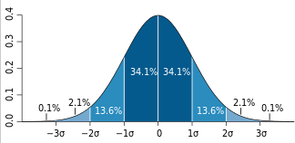
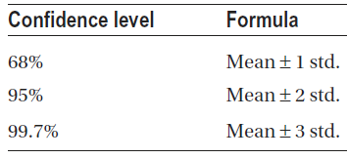
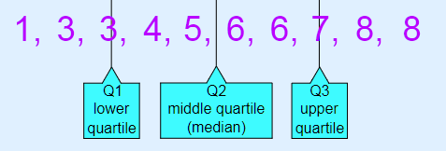
Concepts
Mean : Average
Median: When the frequency of observations in the data is odd, the middle data point is returned as the median.
Mode: returns the observation in the dataset with the highest frequency.
Variance: represents variability of data points about the mean.
Standard deviation: just like variance, also captures the spread of data along the mean. The only difference is that it is a square root of the variance.
Normal distribution (Gaussian distribution): the mean lies at the center of this distribution with a spread (i.e., standard deviation) around it. Some 68% of the observations lie within 1 standard deviation from the mean; 95% of the observations lie within 2 standard deviations from the mean, whereas 99.7% of the observations lie within 3 standard deviations from the mean.
Outliers: refer to the values distinct from majority of the observations. These occur either naturally, due to equipment failure, or because of entry mistakes.

Slide 24
Plot mean
Draw mean of ‘TripDuration’ group by ‘StartTime_date’
data.groupby('starttime_date')['tripduration'].mean() .plot.bar(title = 'Distribution of Trip duration by date', figsize = (15,4))
Calculate Mean, Standard deviation, Median
print data['tripduration_mean'].mean()
print data['tripduration_mean'].std()
print data['tripduration_mean'].median()

Slide 25
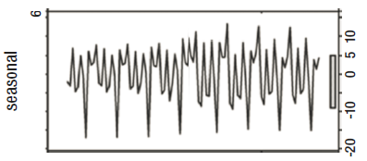
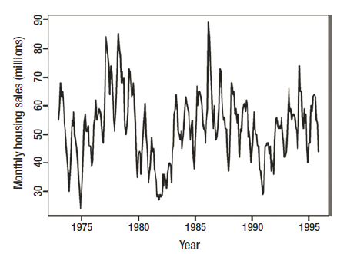
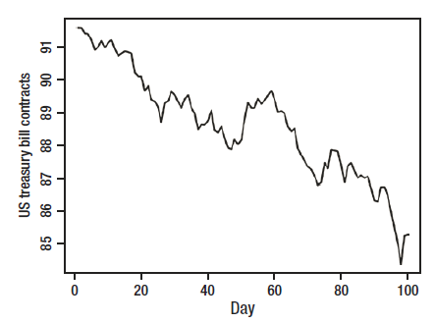
Seasonal pattern vs Cyclic Pattern vs Trend
Seasonal: pattern over fixed period, like monthly pattern
Cycle: pattern overall without worry about periods, to check if patterns repeat over non-periodic time cycles.
Trend: In long-term does the continuous variable increase/decrease
Seasonal pattern Cycle pattern Trend

Slide 26
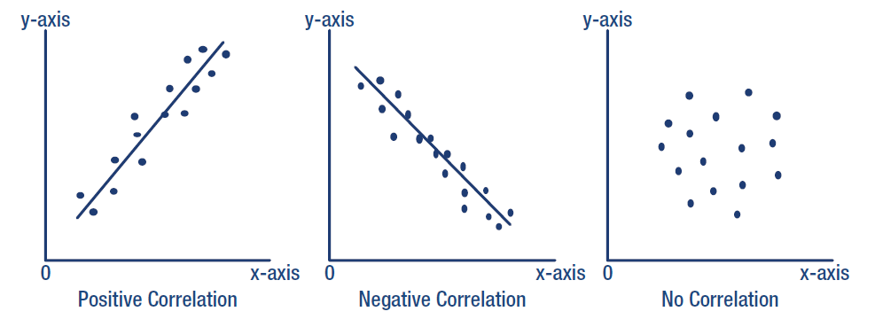
Correlation directions

Slide 27
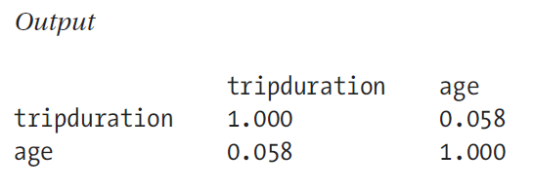
Calculate the correlation
pd.set_option('precision', 3)
correlations = data[['tripduration','age']].corr()
print(correlations)
.corr(method='pearson')
method : {‘pearson’, ‘kendall’, ‘spearman’}
pearson : standard correlation coefficient
kendall : Kendall Tau correlation coefficient
spearman : Spearman rank correlation
For more information http://www.statisticssolutions.com/correlation-pearson-kendall-spearman/

Slide 28
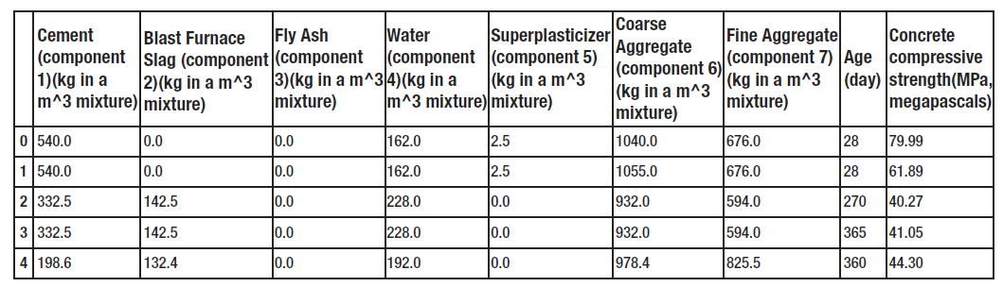
Rename Dataset columns' names
Get data from the next URL and save as “concrete_data.csv” http://archive.ics.uci.edu/ml/datasets/Concrete+Compressive+Strength
data = pd.read_csv('examples/concrete_data.csv’)
print len(data)
data.head()
Renaming the Columns
data.columns = ['cement_component', 'furnace_slag', 'flay_ash’,\
'water_component’, 'superplasticizer', 'coarse_aggregate’, \
'fine_aggregate', 'age', 'concrete_strength']

Slide 29
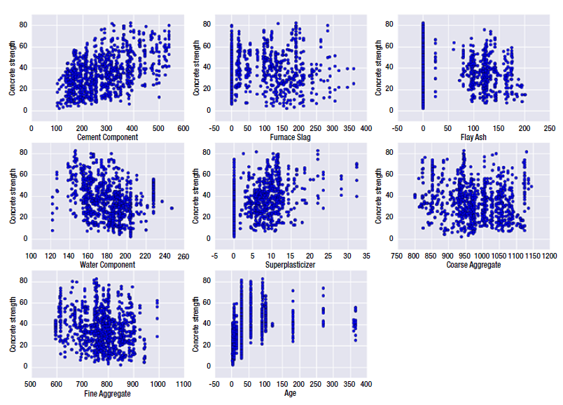
Loop through dataset Draw relation between each feature and concrete_strength
plt.figure(figsize=(15,10.5))
plot_count = 1
for feature in list(data.columns)[:-1]:
plt.subplot(3,3,plot_count)
plt.scatter(data[feature], data['concrete_strength'])
plt.xlabel(feature.replace('_',' ').title())
plt.ylabel('Concrete strength')
plot_count+=1
plt.show()
#//Get the correlation between data
pd.set_option('display.width', 100)
pd.set_option('precision', 3)
correlations = data.corr(method='pearson')
print(correlations)

Slide 30
Python Libraries for Machine Learning
Many popular Python toolboxes/libraries:
NumPy
SciPy
Pandas
SciKit-Learn
Visualization libraries
matplotlib
Seaborn
and many more …

Slide 31

Python Libraries for Data Science
NumPy:
introduces objects for multidimensional arrays and matrices, as well as functions that allow to easily perform advanced mathematical and statistical operations on those objects
provides vectorization of mathematical operations on arrays and matrices which significantly improves the performance
many other python libraries are built on NumPy
Link: http://www.numpy.org/

Slide 32

Python Libraries for Data Science
SciPy:
collection of algorithms for linear algebra, differential equations, numerical integration, optimization, statistics and more
part of SciPy Stack
built on NumPy
Link: https://www.scipy.org/scipylib/

Slide 33

Python Libraries for Data Science
Pandas:
adds data structures and tools designed to work with table-like data (similar to Series and Data Frames in R)
provides tools for data manipulation: reshaping, merging, sorting, slicing, aggregation etc.
allows handling missing data
Link: http://pandas.pydata.org/

Slide 34

Python Libraries for Data Science
SciKit-Learn:
provides machine learning algorithms: classification, regression, clustering, model validation etc.
built on NumPy, SciPy and matplotlib
Link: http://scikit-learn.org/

Slide 35

Python Libraries for Data Science
matplotlib:
python 2D plotting library which produces publication quality figures in a variety of hardcopy formats
a set of functionalities similar to those of MATLAB
line plots, scatter plots, barcharts, histograms, pie charts etc.
relatively low-level; some effort needed to create advanced visualization
Link: https://matplotlib.org/

Slide 36
Python Libraries for Data Science
Seaborn:
based on matplotlib
provides high level interface for drawing attractive statistical graphics
Similar (in style) to the popular ggplot2 library in R
Link: https://seaborn.pydata.org/

Slide 37
Login to the Shared Computing Cluster
Use your SCC login information if you have SCC account
If you are using tutorial accounts see info on the blackboard
Note: Your password will not be displayed while you enter it.

Slide 38
Selecting Python Version on the SCC
# view available python versions on the SCC
[scc1 ~] module avail python
# load python 3 version
[scc1 ~] module load python/3.6.2

Slide 39
Download tutorial notebook
# On the Shared Computing Cluster
[scc1 ~] cp /project/scv/examples/python/data_analysis/dataScience.ipynb .
# On a local computer save the link:
http://rcs.bu.edu/examples/python/data_analysis/dataScience.ipynb

Slide 40
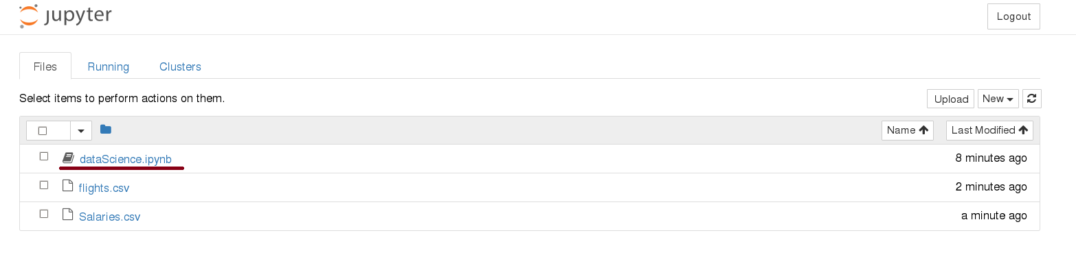
Start Jupyter nootebook
# On the Shared Computing Cluster
[scc1 ~] jupyter notebook

Slide 41
Loading Python Libraries
In [ ]:
#Import Python Libraries
import numpy as np
import scipy as sp
import pandas as pd
import matplotlib as mpl
import seaborn as sns
Press Shift+Enter to execute the jupyter cell

Slide 42
Reading data using pandas
In [ ]:
#Read csv file
df = pd.read_csv("http://rcs.bu.edu/examples/python/data_analysis/Salaries.csv")
Note: The above command has many optional arguments to fine-tune the data import process.
There is a number of pandas commands to read other data formats:
pd.read_excel('myfile.xlsx',sheet_name='Sheet1', index_col=None, na_values=['NA'])
pd.read_stata('myfile.dta')
pd.read_sas('myfile.sas7bdat')
pd.read_hdf('myfile.h5','df')

Slide 43
TensorFlow
Abadi et al., “TensorFlow: A System for Large-Scale Machine Learning”, OSDI 2016
(https://www.usenix.org/system/files/conference/osdi16/osdi16-abadi.pdf)

Slide 44
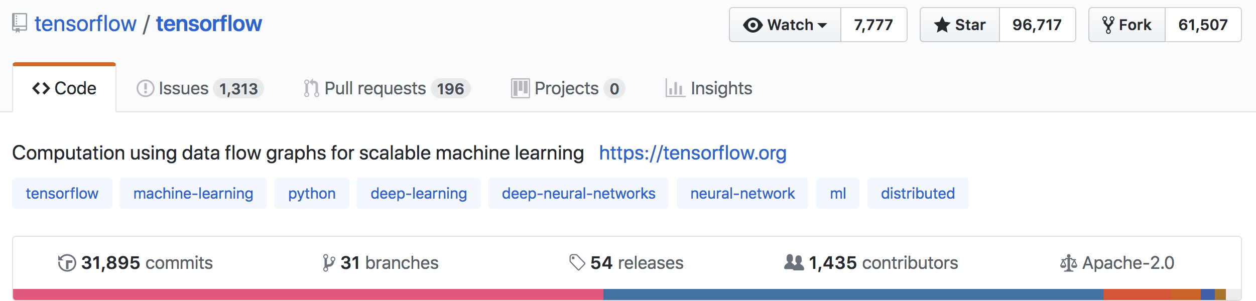
What is TensorFlow?
Open source library for numerical computation using data flow graphs
Developed by Google Brain Team to conduct machine learning research
Based on DisBelief used internally at Google since 2011
“TensorFlow is an interface for expressing machine learning algorithms, and an implementation for executing such algorithms”

Slide 45
What is TensorFlow
Key idea: express a numeric computation as a graph
Graph nodes are operations with any number of inputs and outputs
Graph edges are tensors which flow between nodes

Slide 46
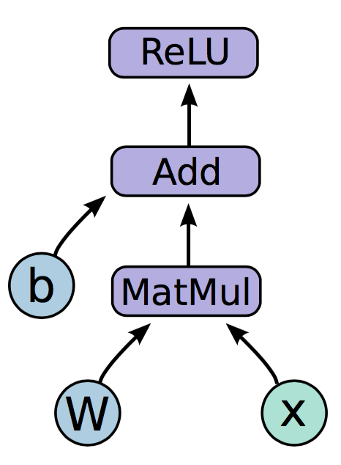
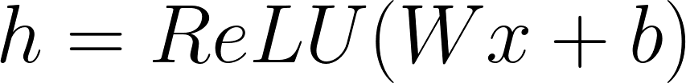
Programming model
Notes:
Neural network with one hidden layer
The function we are computing is on the left. Relu is an activation function that takes the max of 0 and your input, applies a nonlinearity to your network.
The graph on the right is how this function would look like in a tensorflow graph.
Let us break down the nodes in the graph into three types

Slide 47
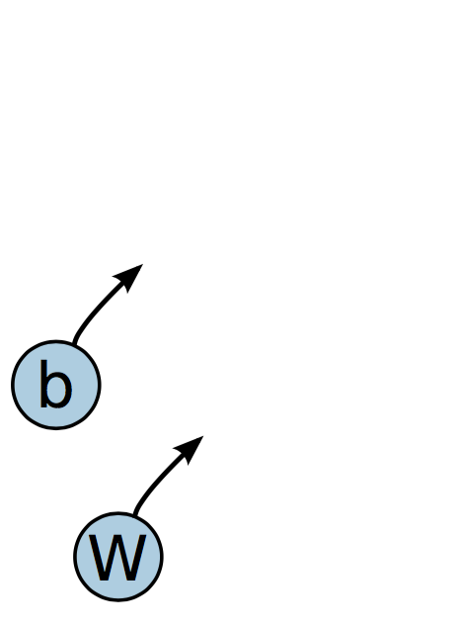
Programming model
Variables are stateful nodes which output their current value. State is retained across multiple executions of a graph
(mostly parameters)
Notes:
We have two variables in this graph, the bias and W matrix.
What we mean by saying that variables are stateful is that they retain their current value over multiple executions, and it’s easy to restore saved values to variables.
Variables have a number of other useful features. They can be saved to disk during and after training, and gradient updates will by default apply over all the variables in your graph
Variables are still operations (nodes = operations!). When you run a variable you get the value of its state.
The variables in your graph are going to be your parameters

Slide 48
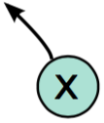
Programming model
Placeholders are nodes whose value is fed in at execution time
(inputs, labels, …)
Notes:
The second important node type is placeholders. If you have inputs into your network that depend on some external data, you want to be able to build your graph without depending on any real values yet, as those are passed in at run time.
Placeholders, unlike variables that have initial assignment, expect as arguments a data type and a shape of a tensor.
Inputs, labels

Slide 49
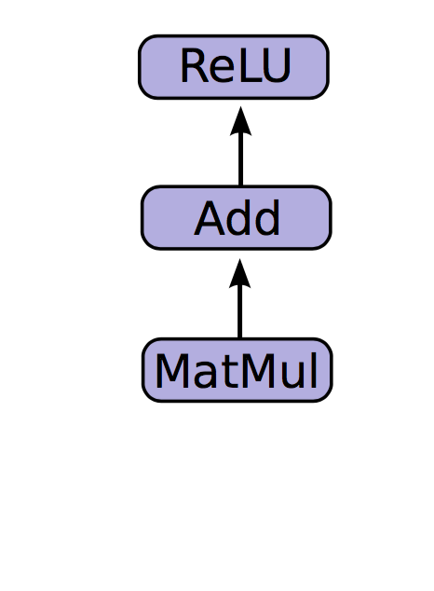
Programming model
Mathematical operations:
MatMul: Multiply two matrices
Add: Add elementwise
ReLU: Activate with elementwise rectified linear function
0, x <= 0
ReLu(x) =
x, x > 0
Notes:
The other nodes are mathematical operations that you are familiar with. Matmul, addition, and relu are all operations in your graph that combine your inputs and parameters to produce new nodes.

Slide 50
Code
import tensorflow as tf b = tf.Variable(tf.zeros((100,))) W = tf.Variable(tf.random_uniform((784, 100), -1, 1)) x = tf.placeholder(tf.float32, (1, 784))
h = tf.nn.relu(tf.matmul(x, W) + b)

Slide 51
Running the graph
Deploy graph with a session: a binding to a particular execution context (e.g. CPU, GPU)
CPU
GPU

Slide 52
End-to-end
So far:
Built a graph using variables and placeholders
Deploy the graph onto a session, i.e., execution environment
Next: train model
Define loss function
Compute gradients

Slide 53
Defining loss
Use placeholder for labels
Build loss node using labels and prediction
prediction = tf.nn.softmax(...) #Output of neural network
label = tf.placeholder(tf.float32, [100, 10])
cross_entropy = -tf.reduce_sum(label * tf.log(prediction), axis=1)

