Slide 1
Deep Belief Nets
Dr. Gahangir Hossain
Texas A&M University-Kingsville
Slides from: Swadhin Pradhan, UT Austin

Slide 2
So, 1. what exactly is deep learning ?
And, 2. why is it generally better than other methods on image, speech and certain other types of data?

Slide 3
So, 1. what exactly is deep learning ?
And, 2. why is it generally better than other methods on image, speech and certain other types of data?
The short answers
1. ‘Deep Learning’ means using a neural network
with several layers of nodes between input and output
2. the series of layers between input & output do
feature identification and processing in a series of stages,
just as our brains seem to.

Slide 4
hmmm… OK, but:
3. multilayer neural networks have been around for
25 years. What’s actually new?

Slide 5
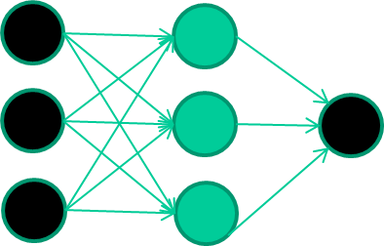
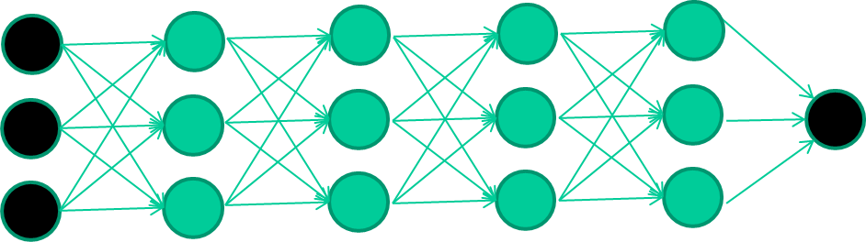
hmmm… OK, but:
3. multilayer neural networks have been around for
25 years. What’s actually new?
we have always had good algorithms for learning the
weights in networks with 1 hidden layer
but these algorithms are not good at learning the weights for
networks with more hidden layers
what’s new is: algorithms for training many-later networks

Slide 6
longer answers
reminder/quick-explanation of how neural network weights are learned;
the idea of unsupervised feature learning (why ‘intermediate features’ are important for difficult classification tasks, and how NNs seem to naturally learn them)
The ‘breakthrough’ – the simple trick for training Deep neural networks

Slide 7
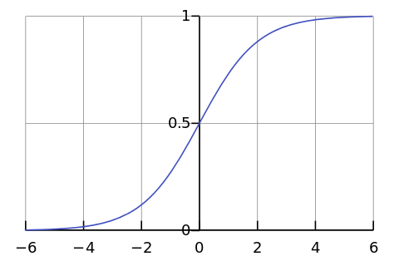

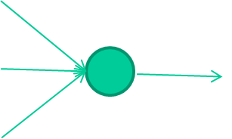
-0.06
W1
W2
f(x)
-2.5
W3
1.4

Slide 8
-0.06
2.7
-8.6
f(x)
-2.5
0.002
x = -0.06×2.7 + 2.5×8.6 + 1.4×0.002 = 21.34
1.4

Slide 9
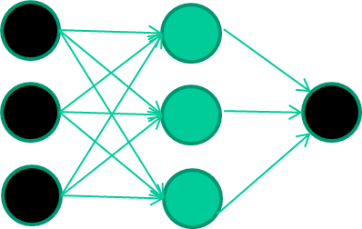
A dataset
Fields class
1.4 2.7 1.9 0
3.8 3.4 3.2 0
6.4 2.8 1.7 1
4.1 0.1 0.2 0
etc …

Slide 10
Training the neural network
Fields class
1.4 2.7 1.9 0
3.8 3.4 3.2 0
6.4 2.8 1.7 1
4.1 0.1 0.2 0
etc …

Slide 11
Training data
Fields class
1.4 2.7 1.9 0
3.8 3.4 3.2 0
6.4 2.8 1.7 1
4.1 0.1 0.2 0
etc …
Initialise with random weights

Slide 12
Training data
Fields class
1.4 2.7 1.9 0
3.8 3.4 3.2 0
6.4 2.8 1.7 1
4.1 0.1 0.2 0
etc …
Present a training pattern
1.4
2.7
1.9

Slide 13
Training data
Fields class
1.4 2.7 1.9 0
3.8 3.4 3.2 0
6.4 2.8 1.7 1
4.1 0.1 0.2 0
etc …
Feed it through to get output
1.4
2.7 0.8
1.9

Slide 14
Training data
Fields class
1.4 2.7 1.9 0
3.8 3.4 3.2 0
6.4 2.8 1.7 1
4.1 0.1 0.2 0
etc …
Compare with target output
1.4
2.7 0.8
0
1.9 error 0.8

Slide 15


Training data
Fields class
1.4 2.7 1.9 0
3.8 3.4 3.2 0
6.4 2.8 1.7 1
4.1 0.1 0.2 0
etc …
Adjust weights based on error
1.4
2.7 0.8
0
1.9 error 0.8

Slide 16
Training data
Fields class
1.4 2.7 1.9 0
3.8 3.4 3.2 0
6.4 2.8 1.7 1
4.1 0.1 0.2 0
etc …
Present a training pattern
6.4
2.8
1.7

Slide 17
Training data
Fields class
1.4 2.7 1.9 0
3.8 3.4 3.2 0
6.4 2.8 1.7 1
4.1 0.1 0.2 0
etc …
Feed it through to get output
6.4
2.8 0.9
1.7

Slide 18
Training data
Fields class
1.4 2.7 1.9 0
3.8 3.4 3.2 0
6.4 2.8 1.7 1
4.1 0.1 0.2 0
etc …
Compare with target output
6.4
2.8 0.9
1
1.7 error -0.1

Slide 19
Training data
Fields class
1.4 2.7 1.9 0
3.8 3.4 3.2 0
6.4 2.8 1.7 1
4.1 0.1 0.2 0
etc …
Adjust weights based on error
6.4
2.8 0.9
1
1.7 error -0.1

Slide 20
Training data
Fields class
1.4 2.7 1.9 0
3.8 3.4 3.2 0
6.4 2.8 1.7 1
4.1 0.1 0.2 0
etc …
And so on ….
6.4
2.8 0.9
1
1.7 error -0.1
Repeat this thousands, maybe millions of times – each time
taking a random training instance, and making slight
weight adjustments
Algorithms for weight adjustment are designed to make
changes that will reduce the error

Slide 21
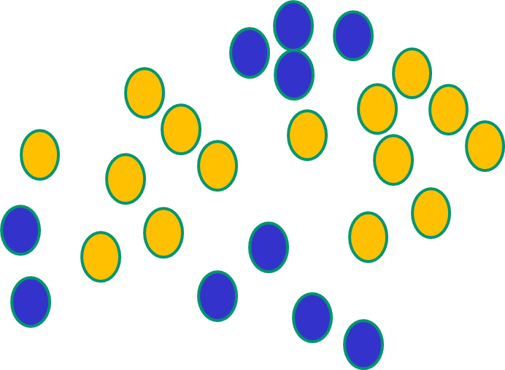
Why non-linear function ?
NNs use nonlinear f(x) so they SVMs only draw straight lines,
can draw complex boundaries, but they transform the data first
but keep the data unchanged in a way that makes that OK

Slide 22
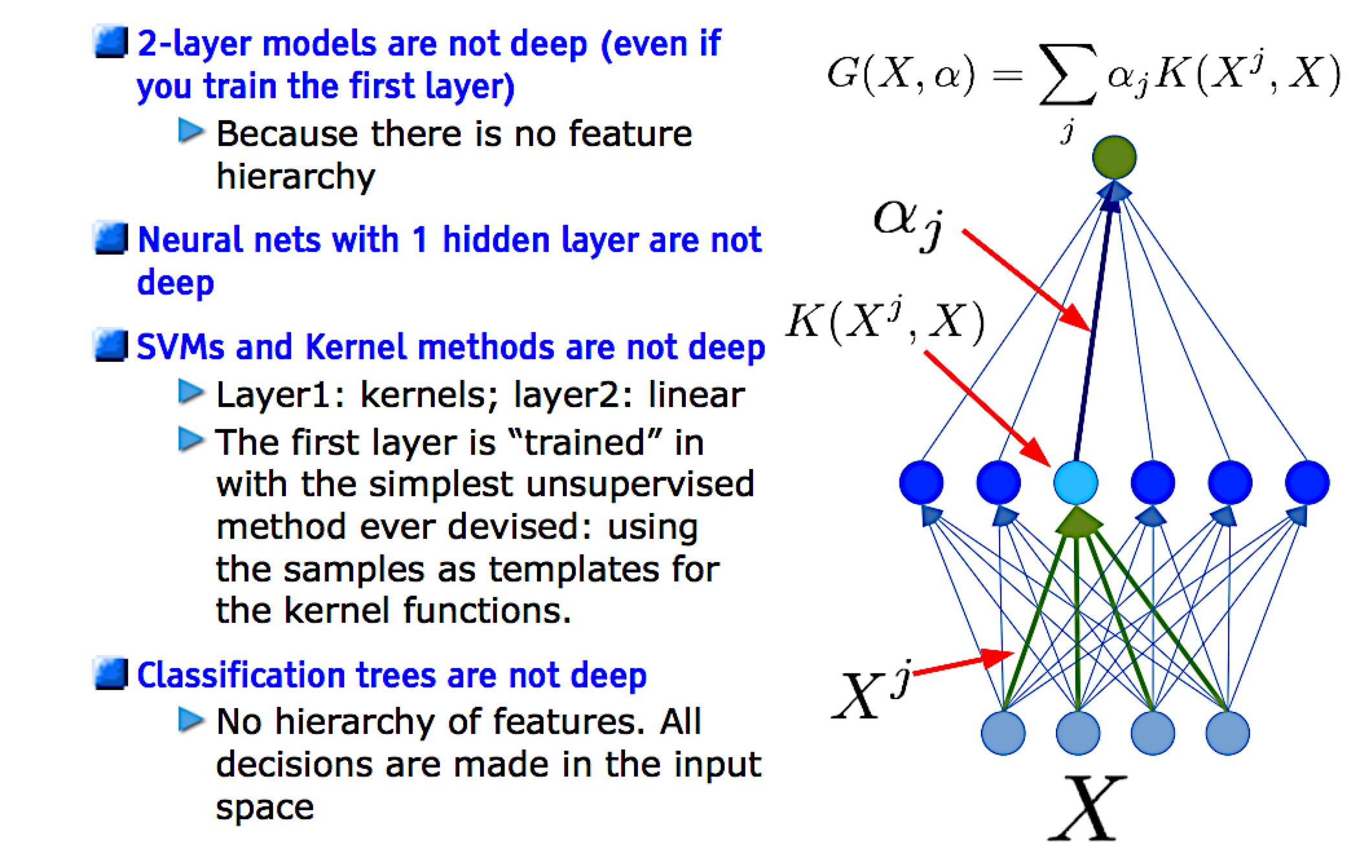
Which models are deep ?

Slide 23
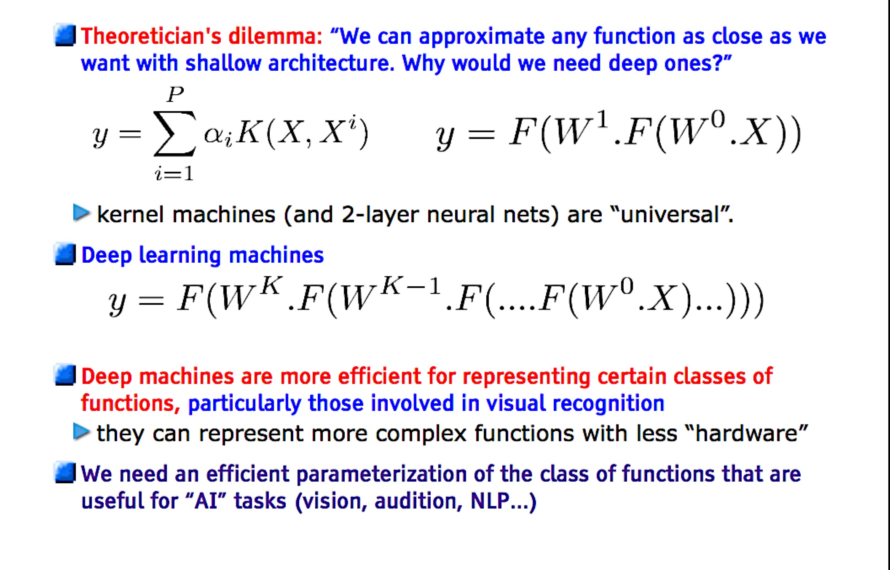
Do we really need deep architectures ?

Slide 24
Multi Layer Perceptron
Multiple Layers
Feed Forward
Connected Weights
1-of-N Output
[ Y₁ , Y₂ ]
k
output
w_{jk}
hidden
j
1
v_{ij}
0
i
input
0
[ X₁ , X₂ , X₃ ]

Slide 25



Backpropagation
Minimize error of calculated output
Adjust weights
Gradient Descent
Procedure
Forward Phase
Backpropagation of errors
For each sample, multiple epochs
k
w_{jk}
j
v_{ij}
i

Slide 26
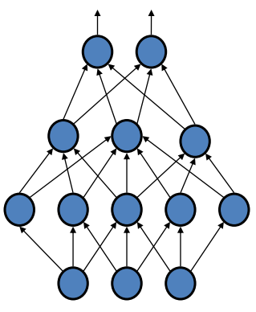
Problems with Backpropagation
Multiple hidden Layers
Get stuck in local optima
start weights from random positions
Slow convergence to optimum
large training set needed
Only use labeled data
most data is unlabeled
Generative Approach

Slide 27
Outline
Deep learning
Greedy layer-wise training (for supervised learning)
Deep belief nets
Stacked denoising auto-encoders
Stacked predictive sparse coding
Deep Boltzmann machines
Convolutional Neural Net

Slide 28
Deep Network Training (that actually works)
Use unsupervised learning (greedy layer-wise
training)
Allows abstraction to develop naturally from one layer to another
Help the network initialize with good parameters
Perform supervised top-down training as final step
Refine the features (intermediate layers) so that they become more relevant for the task

Slide 29
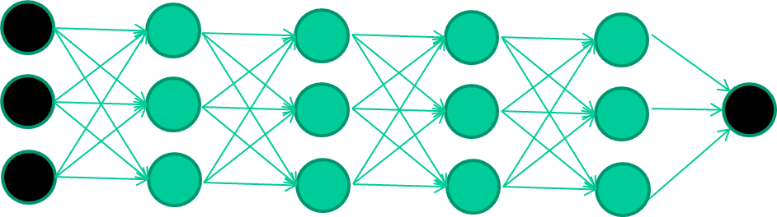
The new way to train multi-layer NNs…
Train this layer first

Slide 30
The new way to train multi-layer NNs…
Train this layer first
then this layer

Slide 31
The new way to train multi-layer NNs…
Train this layer first
then this layer
then this layer

Slide 32
The new way to train multi-layer NNs…
Train this layer first
then this layer
then this layer
then this layer

Slide 33
The new way to train multi-layer NNs…
Train this layer first
then this layer
then this layer
then this layer
finally this layer

Slide 34
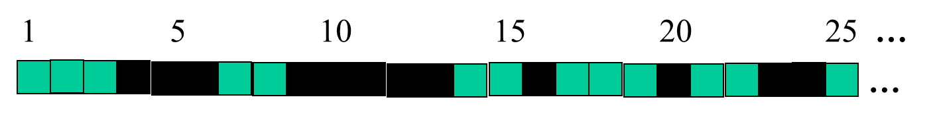
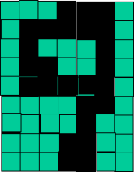
successive layers can learn higher-level features …
detect lines in
Specific positions
etc …
Higher level detetors
( horizontal line,
“RHS vertical lune”
“upper loop”, etc…
etc …
v

Slide 35
Outline
Deep learning
Greedy layer-wise training (for supervised learning)
Deep belief nets
Stacked denoising auto-encoders
Stacked predictive sparse coding
Deep Boltzmann machines
Convolutional Neural Net

Slide 36
Restricted Boltzmann Machines
Unsupervised
Find complex regularities in training data
Bipartite Graph
visible, hidden layer
Binary stochastic units
On/Off with probability
1 Iteration
Update Hidden Units
Reconstruct Visible Units
Maximum Likelihood of training data
j
hidden
w_{ij}
i
visible

Slide 37
Restricted Boltzmann Machines
Training Goal: Best probable reproduction
unsupervised data
find latent factors of data set
Adjust weights to get maximum probability of input data
j
hidden
w_{ij}
i
visible

Slide 38
Deep Belief Networks(DBNs)
Hinton et al., 2006
Probabilistic generative model
Deep architecture – multiple layers
Unsupervised pre-learning provides a good initialization of the network
maximizing the lower-bound of the log-likelihood
of the data
Supervised fine-tuning
Generative: Up-down algorithm
Discriminative: backpropagation

Slide 39
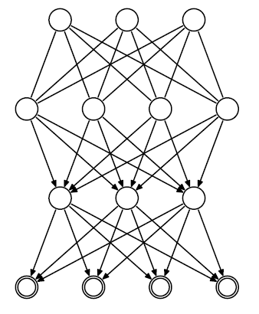






DBN structure
_{h}3
Hinton et al., 2006
RBM
Hidden
layers
_{h}2
_{h}1
Directed belief nets
Visible layer
v
P(v, h¹, h² ,..., h^{l} ) = P(v | h¹ )P(h¹ | h² )...P(h^{l−2} | h^{l−1})P(h^{l−1}, h^{l} )

Slide 40
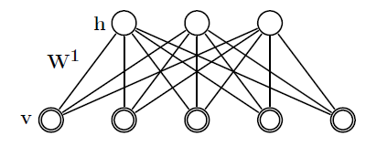
DBN Greedy training
Hinton et al., 2006
First step:
Construct an RBM with an input layer v and a hidden layer h
Train the RBM

Slide 41
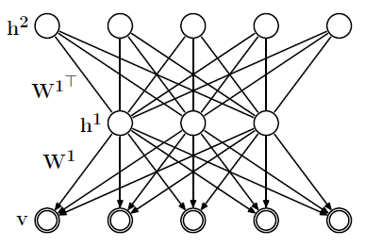

DBN Greedy training
Hinton et al., 2006
Second step:
– Stack another hidden
layer on top of the RBM
to form a new RBM
– Fix W¹, sample h¹ from
Q(h¹ | v) as input. Train
_{W}2
W
2
as RBM.
_{W}1
Q(h¹ | v)

Slide 42
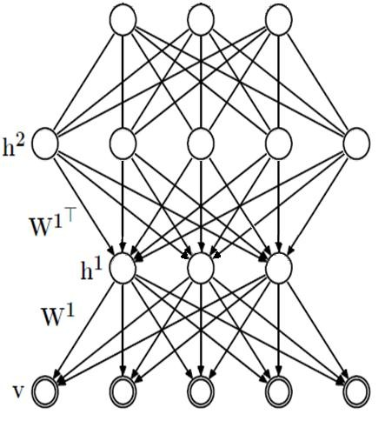
DBN Greedy training
Hinton et al., 2006
Third step:
_{h}3
_{W}3
– Continue to stack layers
on top of the network,
train it as previous step,
with sample sampled
from Q(h² | h¹)
And so on…
Q(h² | h¹)
W
2
_{W}1
Q(h¹ | v)

Slide 43
Why greedy training works?
Hinton et al., 2006
RBM specifies P(v,h) from
P(v|h) and P(h|v)
Implicitly defines P(v) and P(h)
Key idea of stacking
Keep P(v|h) from 1st RBM
Replace P(h) by the distribution generated by 2nd level RBM

Slide 44
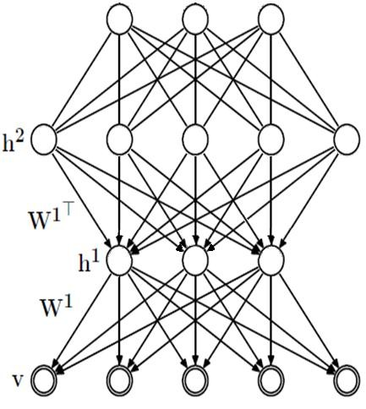

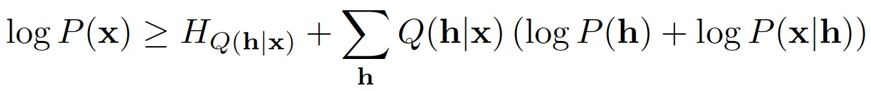
Why greedy training works?
Hinton et al., 2006
Easy approximate inference
_{h}3
P(h_{k+1}|h_{k}) approximated from the
associated RBM
Approximation because P(h_{k+1})
differs between RBM and DBN
Training:
– Variational bound justifies greedy
layerwise training of RBMs
_{W}3
Q(h² | h¹)
W
2
_{W}1
Q(h¹ | v)
Trained by the second layer RBM

