Slide 1
Perceptron Algorithms and Implementation
Dr. Gahangir Hossain

Slide 2
Perceptron Learning Algorithm
First neural network learning model in the 1960’s
Simple and limited (single layer models)
Basic concepts are similar for multi-layer models so this is a good learning tool
Still used in many current applications (modems, etc.)

Slide 3

Perceptron Node – Threshold Logic Unit
x₁
w₁
x₂
w₂
$$θ$$
z
x_{n}
w_{n}
Learn weights such that an objective function is maximized.
What objective function should we use?
What learning algorithm should we use?
Notes:
What parameters and objective function

Slide 4
Perceptron Learning Algorithm
x₁
.4
.1
z
x₂
-.2
x₁
x₂
t
.8
.3
1
.4
.1
0

Slide 5
First Training Instance
.8
.4
.1
z
=1
.3
-.2
net = .8*.4 + .3*-.2 = .26
x₁
x₂
t
.8
.3
1
.4
.1
0

Slide 6
Second Training Instance
.4
.4
.1
z
=1
.1
-.2
net = .4*.4 + .1*-.2 = .14
x₁
x₂
t
.8
.3
1
Δw_{i} =
(t - z)
∗ c
∗ x_{i}
.4
.1
0

Slide 7
Perceptron Rule Learning
Δw_{i} = c(t – z) x_{i}
Where w_{i} is the weight from input i to perceptron node, c is the learning rate, t is the target for the current instance, z is the current output, and x_{i} is i^{th} input
Least perturbation principle
Only change weights if there is an error
small c rather than changing weights sufficient to make current pattern correct
Scale by x_{i}
Create a perceptron node with n inputs
Iteratively apply a pattern from the training set and apply the perceptron rule
Each iteration through the training set is an epoch
Continue training until total training set error ceases to improve
Perceptron Convergence Theorem: Guaranteed to find a solution in finite time if a solution exists
Notes:
Author uses y-t and thus negates the delta w

Slide 8
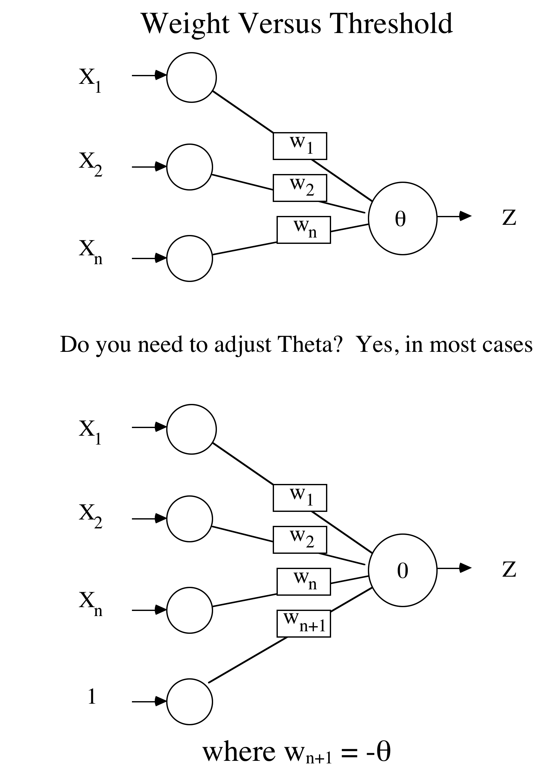

Slide 9
Augmented Pattern Vectors
1 0 1 -> 0
1 0 0 -> 1
Augmented Version
1 0 1 1 -> 0
1 0 0 1 -> 1
Treat threshold like any other weight. No special case. Call it a bias since it biases the output up or down.
Since we start with random weights anyways, can ignore the -θ notion, and just think of the bias as an extra available weight. (note the author uses a -1 input)
Always use a bias weight
Notes:
Author uses -1 into bias, any real difference (back to being a threshold weight), but since starts random anyway, will make no difference, though the final weight will be negated by comparison

Slide 10
Perceptron Rule Example
Assume a 3 input perceptron plus bias (it outputs 1 if net > 0, else 0)
Assume a learning rate c of 1 and initial weights all 0: Δw_{i} = c(t – z) x_{i}
Training set 0 0 1 -> 0
1 1 1 -> 1
1 0 1 -> 1
0 1 1 -> 0
Pattern Target Weight Vector Net Output ΔW
0 0 1 1 0 0 0 0 0

Slide 11
Example
Assume a 3 input perceptron plus bias (it outputs 1 if net > 0, else 0)
Assume a learning rate c of 1 and initial weights all 0: Δw_{i} = c(t – z) x_{i}
Training set 0 0 1 -> 0
1 1 1 -> 1
1 0 1 -> 1
0 1 1 -> 0
Pattern Target Weight Vector Net Output ΔW
0 0 1 1 0 0 0 0 0 0 0 0 0 0 0
1 1 1 1 1 0 0 0 0

Slide 12
Example
Assume a 3 input perceptron plus bias (it outputs 1 if net > 0, else 0)
Assume a learning rate c of 1 and initial weights all 0: Δw_{i} = c(t – z) x_{i}
Training set 0 0 1 -> 0
1 1 1 -> 1
1 0 1 -> 1
0 1 1 -> 0
Pattern Target Weight Vector Net Output ΔW
0 0 1 1 0 0 0 0 0 0 0 0 0 0 0
1 1 1 1 1 0 0 0 0 0 0 1 1 1 1
1 0 1 1 1 1 1 1 1

Slide 13
**Challenge Question** - Perceptron
Assume a 3 input perceptron plus bias (it outputs 1 if net > 0, else 0)
Assume a learning rate c of 1 and initial weights all 0: Δw_{i} = c(t – z) x_{i}
Training set 0 0 1 -> 0
1 1 1 -> 1
1 0 1 -> 1
0 1 1 -> 0
Pattern Target Weight Vector Net Output ΔW
0 0 1 1 0 0 0 0 0 0 0 0 0 0 0
1 1 1 1 1 0 0 0 0 0 0 1 1 1 1
1 0 1 1 1 1 1 1 1
Once this converges the final weight vector will be
1 1 1 1
-1 0 1 0
0 0 0 0
1 0 0 0
None of the above

Slide 14
Example
Assume a 3 input perceptron plus bias (it outputs 1 if net > 0, else 0)
Assume a learning rate c of 1 and initial weights all 0: Δw_{i} = c(t – z) x_{i}
Training set 0 0 1 -> 0
1 1 1 -> 1
1 0 1 -> 1
0 1 1 -> 0
Pattern Target Weight Vector Net Output ΔW
0 0 1 1 0 0 0 0 0 0 0 0 0 0 0
1 1 1 1 1 0 0 0 0 0 0 1 1 1 1
1 0 1 1 1 1 1 1 1 3 1 0 0 0 0
0 1 1 1 0 1 1 1 1

Slide 15
Example
Assume a 3 input perceptron plus bias (it outputs 1 if net > 0, else 0)
Assume a learning rate c of 1 and initial weights all 0: Δw_{i} = c(t – z) x_{i}
Training set 0 0 1 -> 0
1 1 1 -> 1
1 0 1 -> 1
0 1 1 -> 0
Pattern Target Weight Vector Net Output ΔW
0 0 1 1 0 0 0 0 0 0 0 0 0 0 0
1 1 1 1 1 0 0 0 0 0 0 1 1 1 1
1 0 1 1 1 1 1 1 1 3 1 0 0 0 0
0 1 1 1 0 1 1 1 1 3 1 0 -1 -1 -1
0 0 1 1 0 1 0 0 0

Slide 16
Example
Assume a 3 input perceptron plus bias (it outputs 1 if net > 0, else 0)
Assume a learning rate c of 1 and initial weights all 0: Δw_{i} = c(t – z) x_{i}
Training set 0 0 1 -> 0
1 1 1 -> 1
1 0 1 -> 1
0 1 1 -> 0
Pattern Target Weight Vector Net Output ΔW
0 0 1 1 0 0 0 0 0 0 0 0 0 0 0
1 1 1 1 1 0 0 0 0 0 0 1 1 1 1
1 0 1 1 1 1 1 1 1 3 1 0 0 0 0
0 1 1 1 0 1 1 1 1 3 1 0 -1 -1 -1
0 0 1 1 0 1 0 0 0 0 0 0 0 0 0
1 1 1 1 1 1 0 0 0 1 1 0 0 0 0
1 0 1 1 1 1 0 0 0 1 1 0 0 0 0
0 1 1 1 0 1 0 0 0 0 0 0 0 0 0
Notes:
Note it is the relative weight values which make the difference. If we multiply all final weights by a constant ( e.g. ,1) we still get the same results. For perceptron same as if the initial learning rate had been .1,
How would it generalize to novel. Show examples

Slide 17
Perceptron Homework
Assume a 3 input perceptron plus bias (it outputs 1 if net > 0, else 0)
Assume a learning rate c of 1 and initial weights all 1: Δw_{i} = c(t – z) x_{i}
Show weights after each pattern for just one epoch
Training set 1 0 1 -> 0
1 1 0 -> 0
1 0 1 -> 1
0 1 1 -> 1
Pattern Target Weight Vector Net Output ΔW
1 1 1 1

Slide 18
Perceptron Convergence Theorem
The algorithm converges to the correct classification
if the training data is linearly separable
and learning rate is sufficiently small
(Rosenblatt 1962).
The final weights in the solution w is not unique: there are many possible lines to separate the two classes.
Slides modified from Dr. Lei Chen, Jiawei Han, Micheline Kamber, and Jian Pei

Slide 19
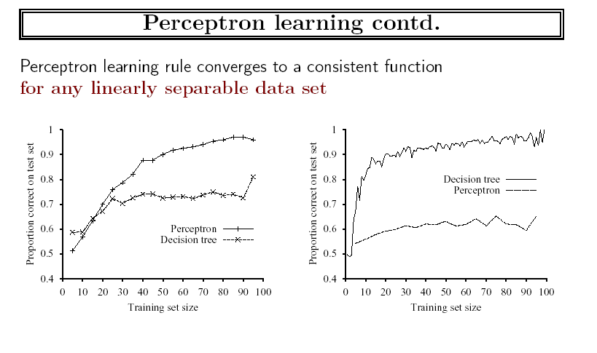
Experiments
Slides modified from Dr. Lei Chen, Jiawei Han, Micheline Kamber, and Jian Pei

Slide 20
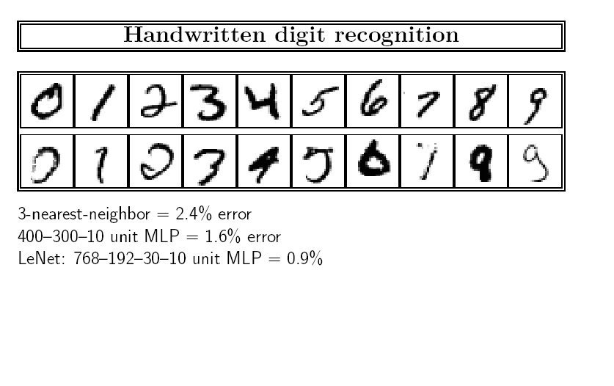
Handwritten Recognition Example
Slides modified from Dr. Lei Chen, Jiawei Han, Micheline Kamber, and Jian Pei

