Slide 1
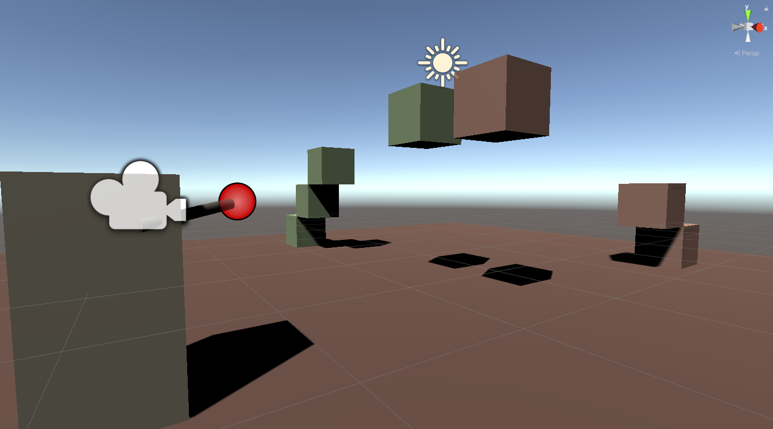

GAME2005 – Game Physics Final Exam 3d Collision Detection and Response
Ian Chapman
Student ID: 101248866
Github: https://github.com/ghostbearshark/GAME2005_Final
Assignment Presentation:
https://drive.google.com/file/d/1EpZZcyDb-FJtu03AxkeNz4N6NGDc8CQb/view?usp=sharing

