Slide 1
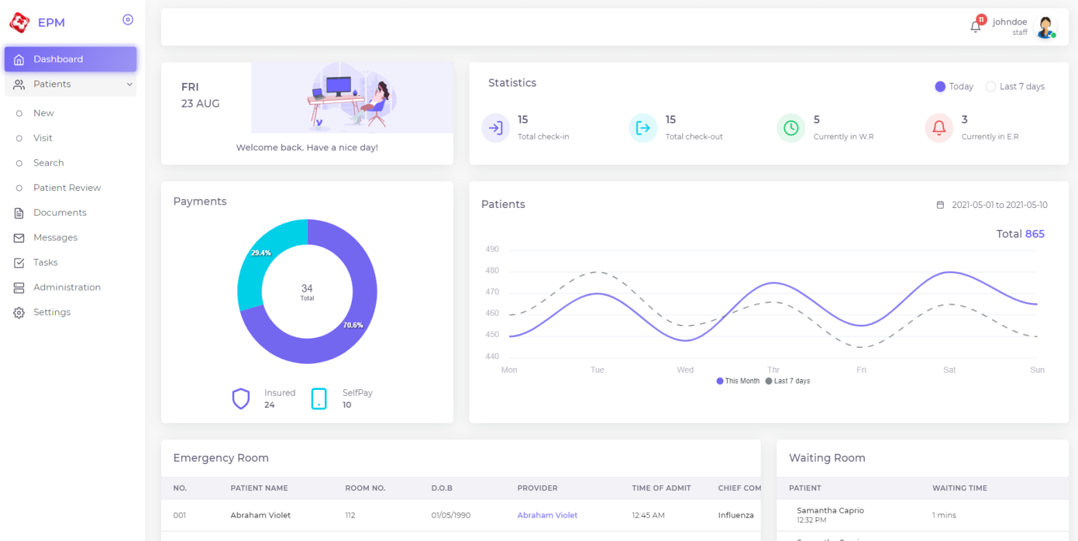
Electrical Patient Management System(Hospital)
2 kinds of User Roles:
Staff
Patient

Slide 2
Required features for first milestone
1: patient login and patient consent-form registration page
- The patient logs in to the EMP server with limited role
- Fills out the consent form data and sends the request
- The requested data is stored on temporary DB, until the staff review this form.
2. - Staff login with his user-role.
- Once the staff login, he can see the notification about new requests.
- Staff can see the notifications with all requests on the web app. (patient review page)
- Staff review the form and submit(adding staff's signature).
- The form data which finished reviewing, is moved from temporary DB to real DB.
- When moving data, the document (pdf) version is generated from form fields.
3. (document search page) - Staff can review the approved patients and their form data.
- he can download the document of registered patient.

Slide 3
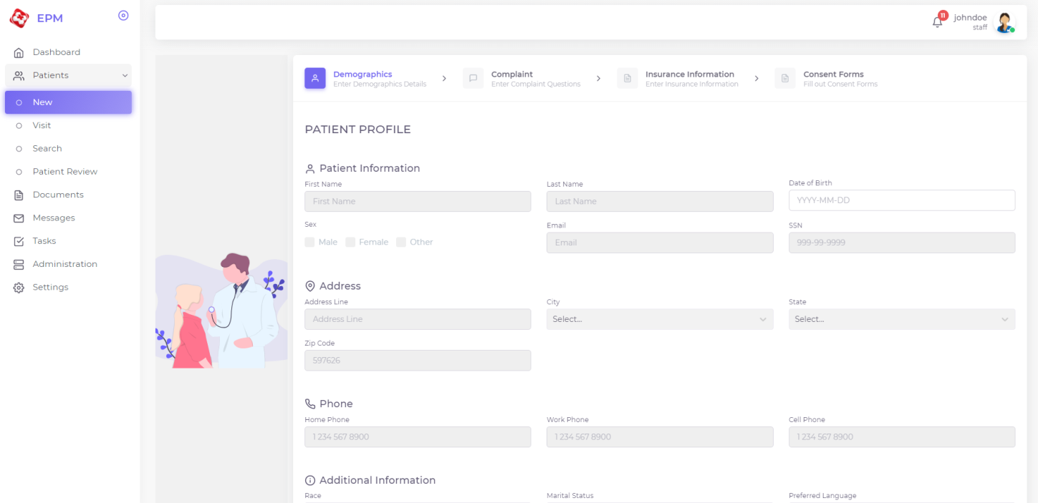
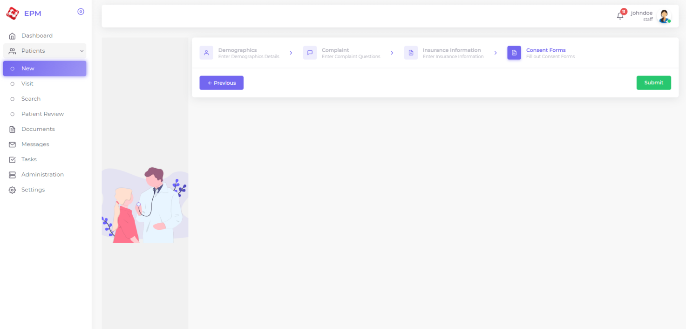
Patient login with his role
He can access only one page “consent-form registration”
He will fillout the information and send the request

Slide 4
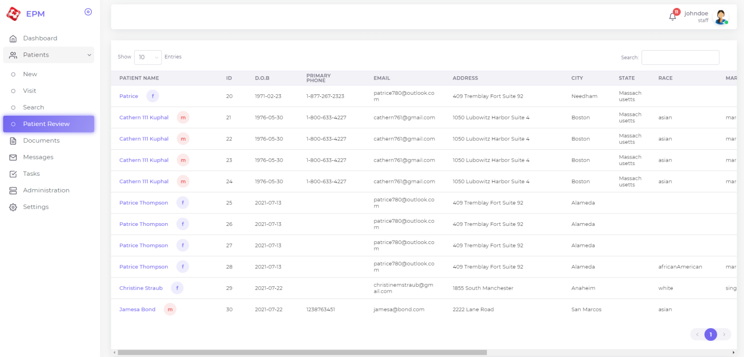
Staff login
He will see the notification about new requests
The staff and search and filter the new requests (on patient review page)
While reviewing, patient will add his sign to the form (not possible to edit the reviewing form data)
Once reviewing is done, the form data will be saved to the DB (mysql)
The saved data will be managed on document search page

